Slide 1
CHAP.17
Oscillation

Slide 2
Oscillation
motion
Simple Harmonic Motion

Slide 3
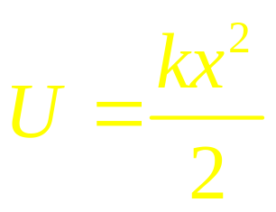
Oscillations
Simple Harmonic Oscillation

Slide 4
Simple Harmonic Oscillations
x

Slide 5
How to solve the equation of motion:
zwma@zju.edu.cn

Slide 6
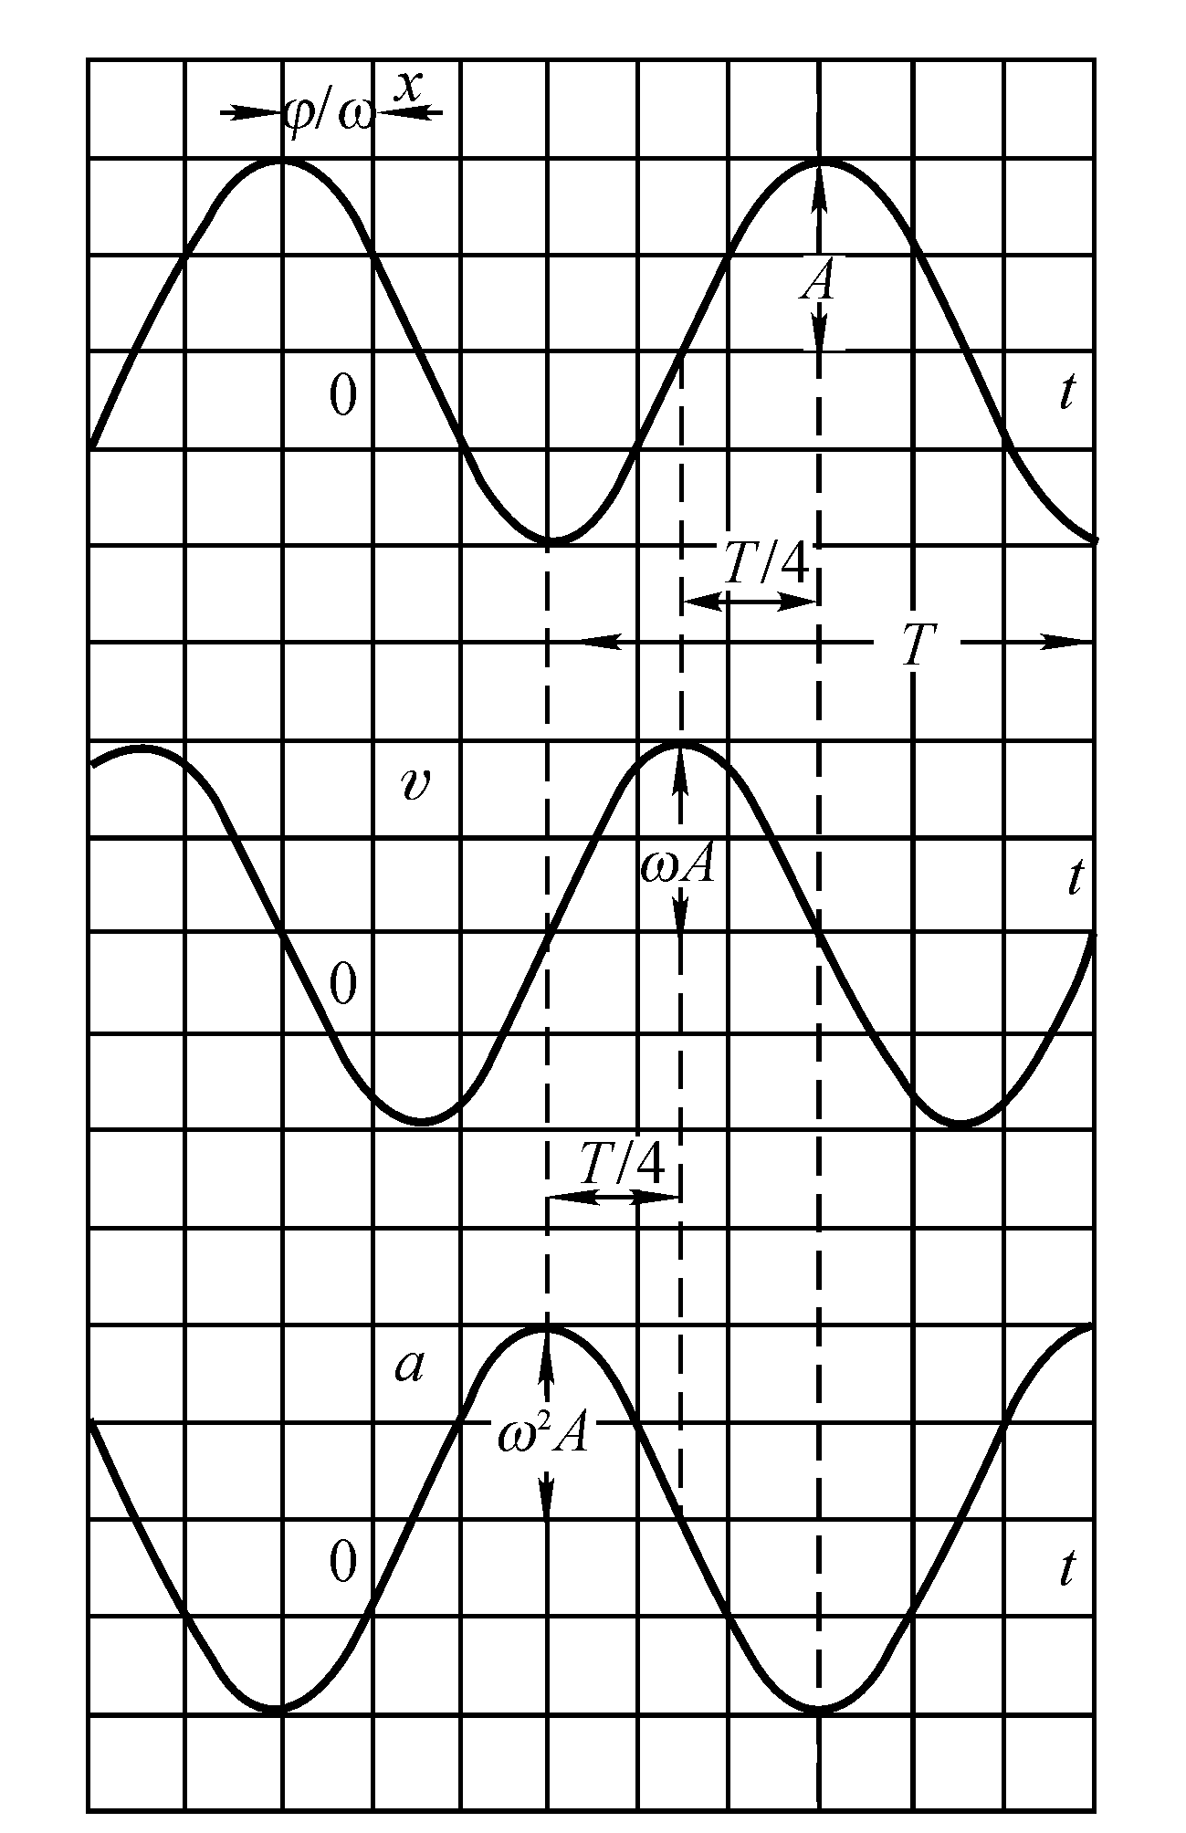
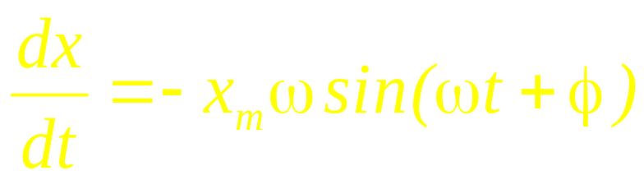


Simple Harmonic Oscillations
Simple Harmonic Oscillation
x

Slide 7
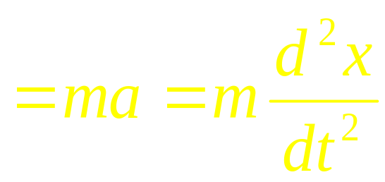
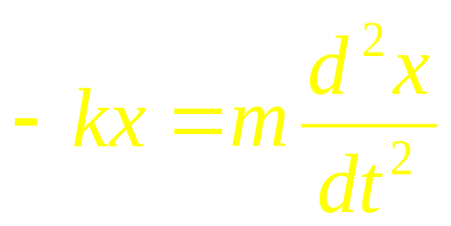
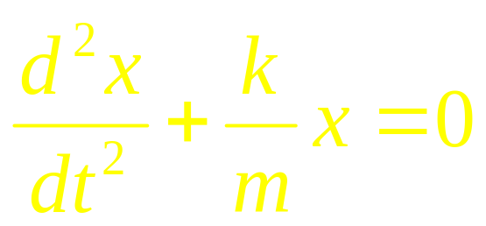
Simple Harmonic Oscillation
depends on the system
depend on the initial condition

Slide 8
x
0

Slide 9
x

Slide 10
x
Potential Energy
Kinetic Energy

Slide 11
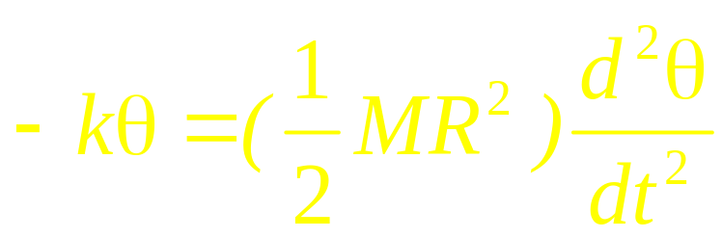
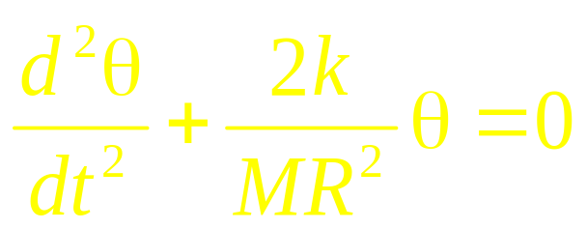

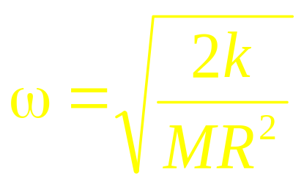
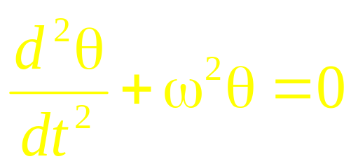
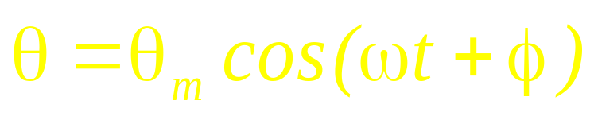
τ = - kθ

Slide 12
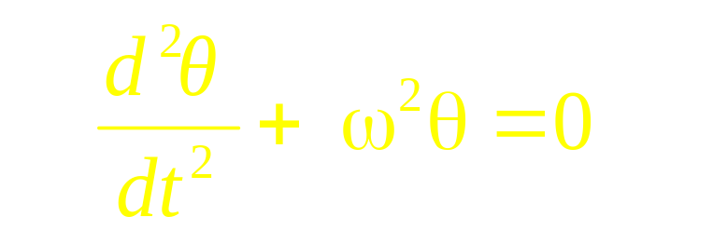
τ = - mglsinθ
θ
l
mg

Slide 13
θ
m, l
mg

Slide 14
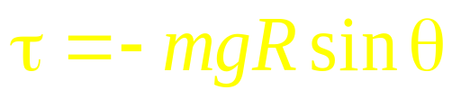
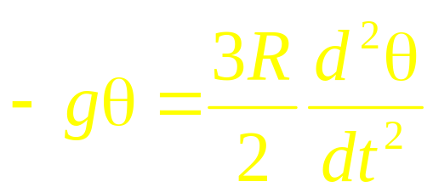
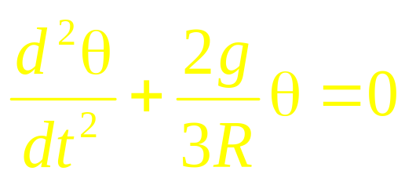

θ
mg
mg

Slide 15
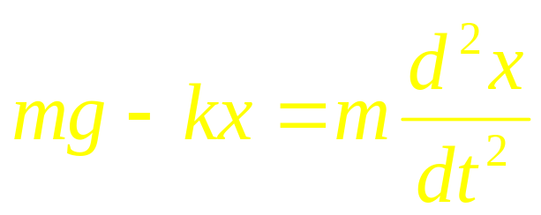



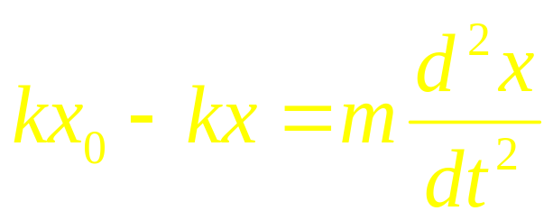

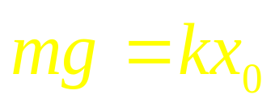

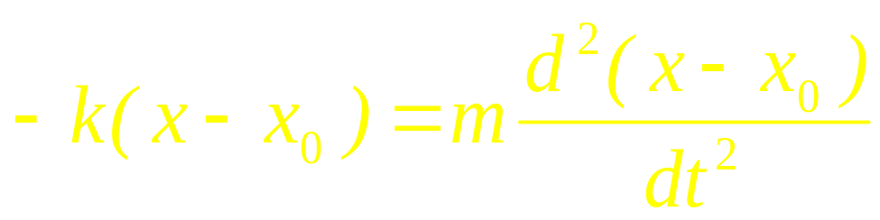

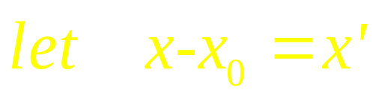
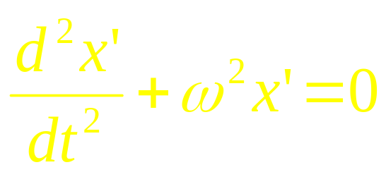
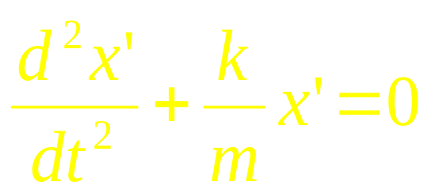

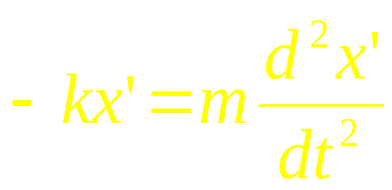
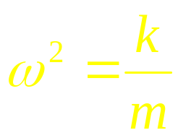
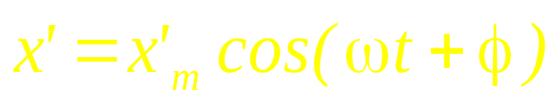

Slide 16






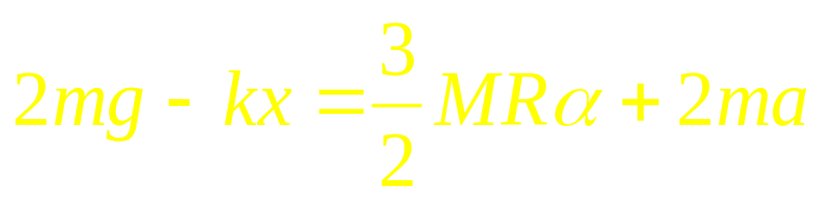

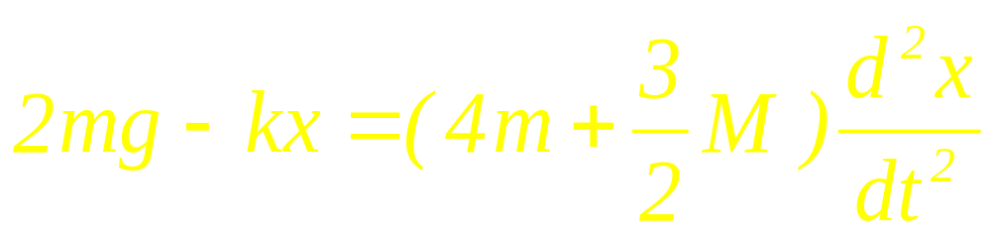
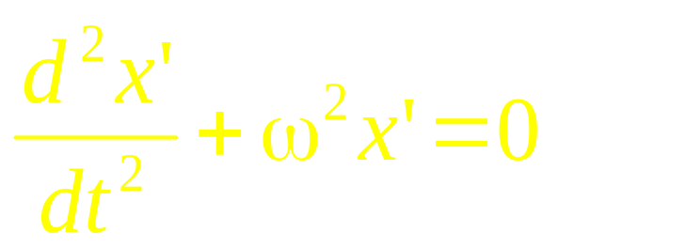
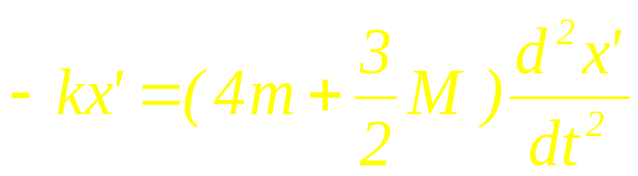
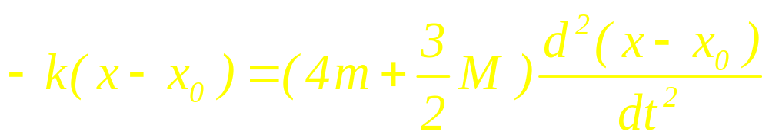
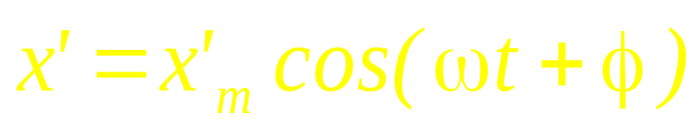

Slide 17
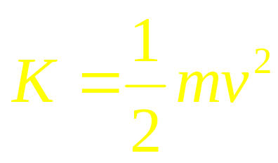
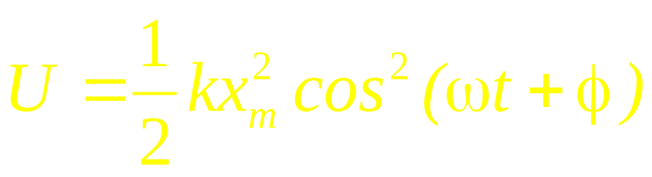
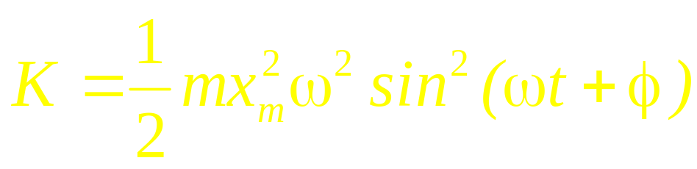
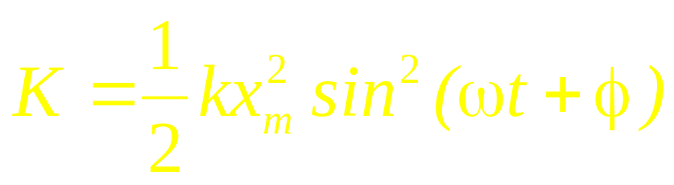
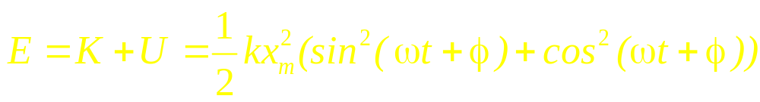

Energy of Simple Harmonic Oscillations
x

Slide 18
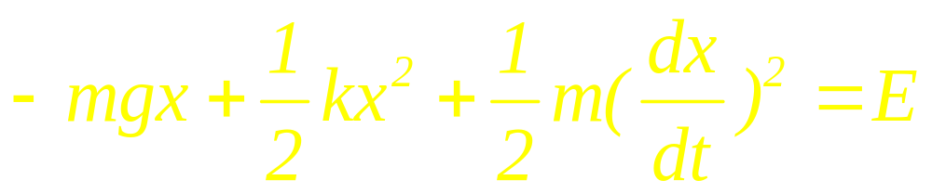
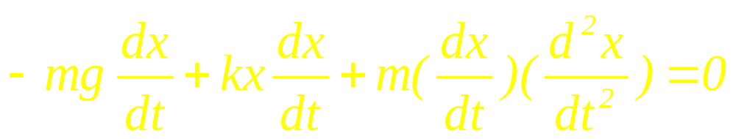
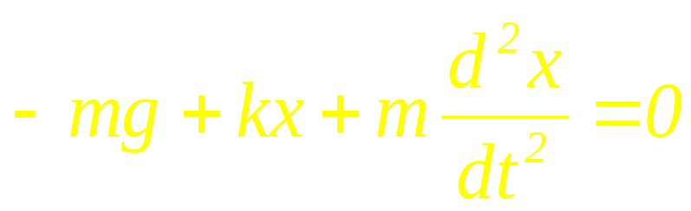
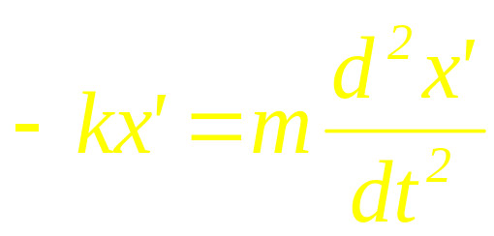
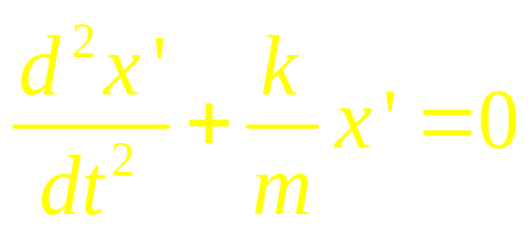

Slide 19
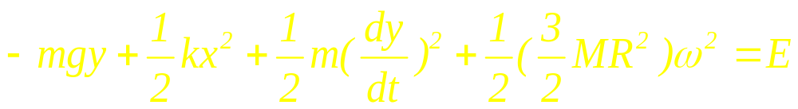

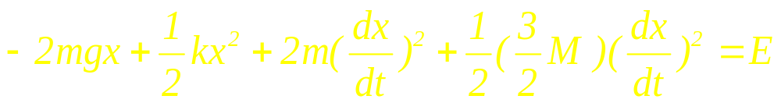

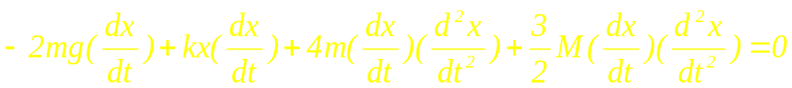
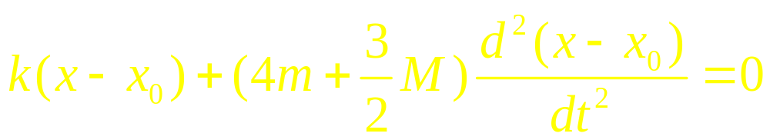
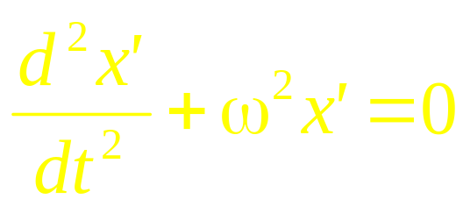


Slide 20
Rolls without slipping
r<<R
Force analyse
Energy analyse
T =?
R
θ
m, r
mg

Slide 21
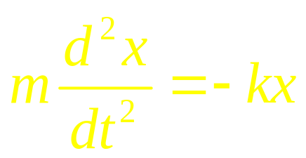
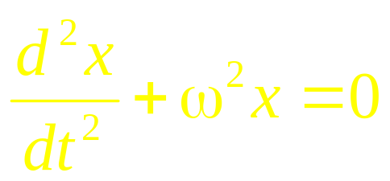

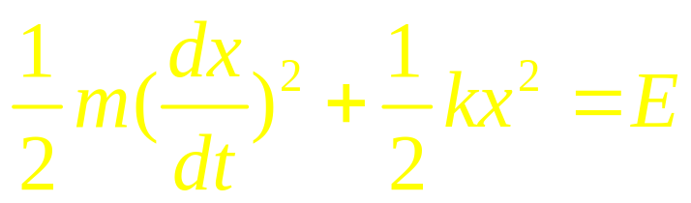
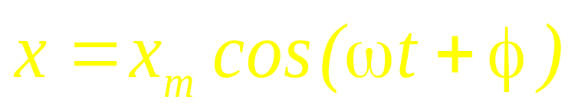




Simple Harmonic Oscillation
x
0
ω depends on the system
x_{m} and φ depend on the initial condition

Slide 22








ω =?
M, R
T₁
T₂
m
k
x
x
mg

Slide 23







M, R
m
k
x
x

Slide 24




F
0
Mg
z

Slide 26

x

Slide 27







x

Slide 28









x

Slide 29





x

Slide 30









λ
dl
ω =?
l
x
L

Slide 31








Slide 32



Simple Harmonic Oscillations
and Uniform Circular Motion
x

Slide 33




Simple Harmonic Oscillations
and Uniform Circular Motion
x

Slide 34




Begin at D point

Slide 35


Damped Harmonic Motion

Slide 36


Damped Harmonic Motion.
The general solution of this equation of motion is
If we substitute this solution in the equation of motion we find
In order to satisfy the equation of motion, the angular frequency must satisfy the following condition:
zwma@zju.edu.cn

Slide 37


Damped Harmonic Motion.
We can solve this equation and determine the two possible values of the angular velocity:
The solution to the equation of motion is thus given by
Damping Term
SHM Term
zwma@zju.edu.cn

Slide 38

Damped Harmonic Motion

Slide 39



Forced Oscillations

Slide 40


Driven Harmonic Motion.
Consider the general solution
The parameters in this solution must be chosen such that the equation of motion is satisfied. This requires that
This equation can be rewritten as
zwma@zju.edu.cn

Slide 41


Driven Harmonic Motion.
Our general solution must thus satisfy the following condition:
Since this equation must be satisfied at all time, we must require that the coefficients of cos(ωt) and sin(ωt) are 0. This requires that
and
zwma@zju.edu.cn

Slide 42


Driven Harmonic Motion.
The interesting solutions are solutions where A ≠ 0 and ω ≠ ω₀. In this case, our general solution can only satisfy the equation of motion if
and
The amplitude of the motion is thus equal to
zwma@zju.edu.cn

Slide 43




Forced Oscillations

Slide 44



















Two-Body Oscillations

Slide 45
CHAP. 17
Exercises
P395:25, 31, 36, 37, 38,
42, 43, 44
Problems
P397: 11, 16

