Slide 1
Chapter 19
SOUND WAVES

Slide 2
To display sound wave
Speed of sound wave
Interference of sound wave
Resonance of sound wave
Doppler effect

Slide 3
SOUND WAVES
Longitudinal waves
Frequency range 20Hz to 20000Hz
y
x
Wave function y = y_{m}sinω(t –x/u)
y = y_{m}sin(kx-ωt )
k=ω/u
SOUND WAVES
Δp(x,t) = Δp_{m}sin(kx- ωt )
change pressure
zwma@zju.edu.cn

Slide 4
SOUND WAVES
Longitudinal waves
Frequency range 20Hz to 20000Hz
y
x
ΔP = -B ΔV/V, (B bulk modulus)
Δp(x,t) = Δp_{m}sin(kx- ωt )
Change in pressure
ρ= m/V
= Δp ( ρ /B)
Δρ = - (m/V²)ΔV = - ρ (ΔV/V)
Δρ(x,t) = Δρ_{m}sin(kx- ωt )
Change in density
zwma@zju.edu.cn

Slide 5
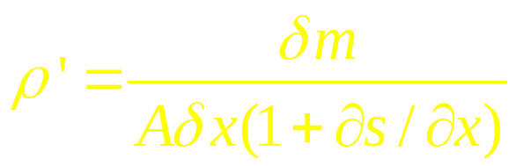
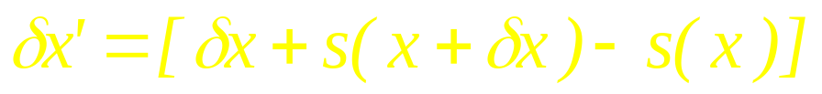
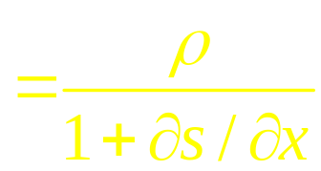
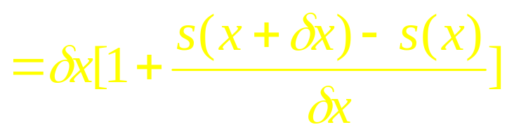




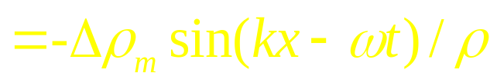

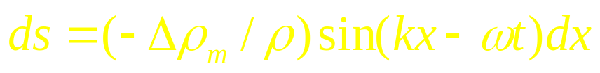

δx
δx’
A
x
s(x+δx)
s(x)
zwma@zju.edu.cn

Slide 6
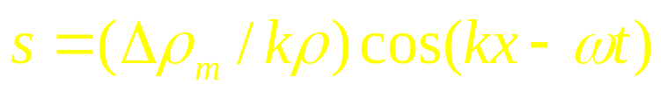
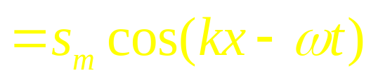
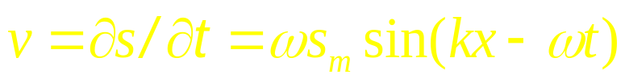

δx
δx’
A
x
s(x+δx)
s(x)
Displacement
Velocity
zwma@zju.edu.cn

Slide 7


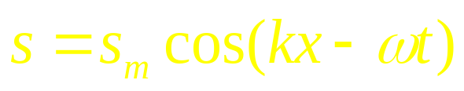
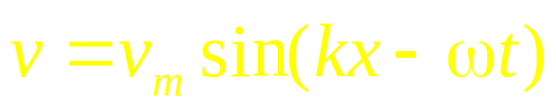
Pressure
Δp
x
density
Δρ
x
s
Displacement
x
v
velocity
x
zwma@zju.edu.cn

Slide 8
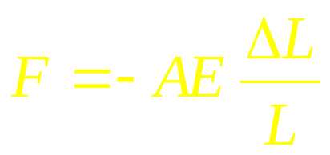
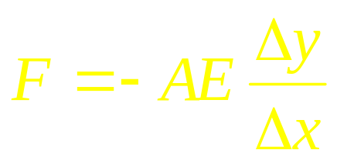
Δy
Wave Speed
Δx
A
x
x+ Δx
zwma@zju.edu.cn
Notes:
E:elastic modulus

Slide 9
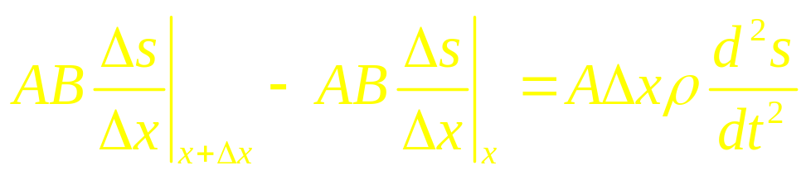
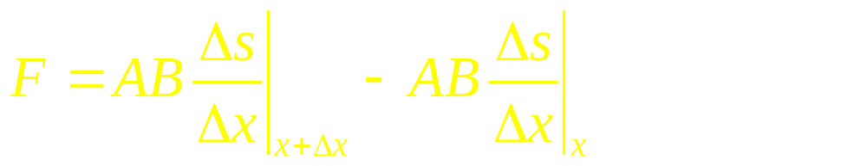
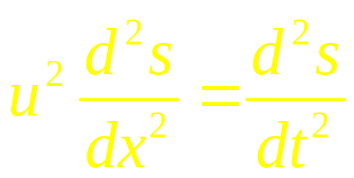
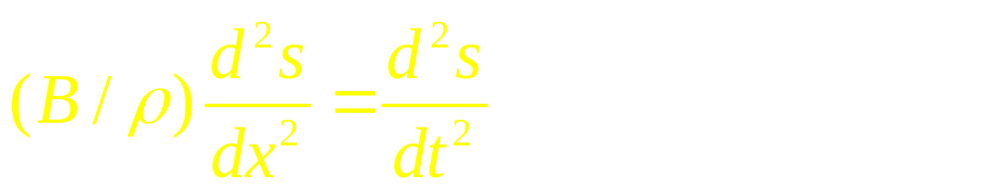
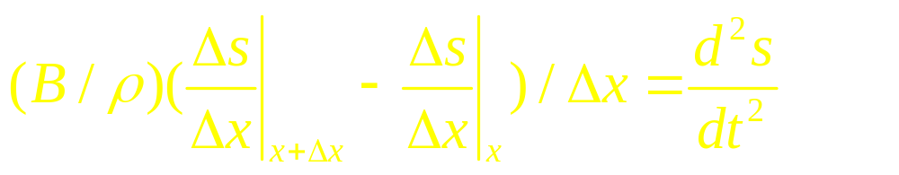
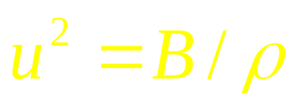
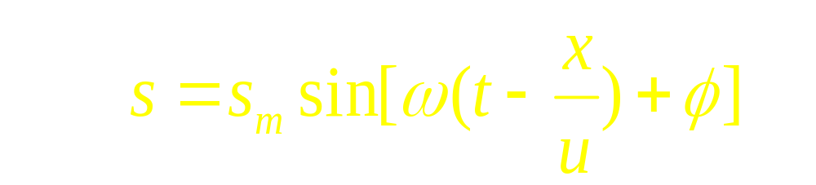
Δs
Wave Speed
Δx
A
x
x+ Δx
The speed of sound
zwma@zju.edu.cn

Slide 10
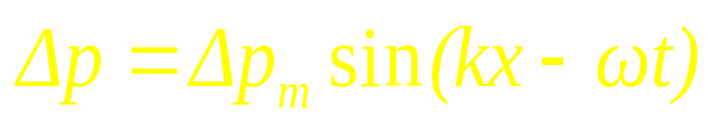
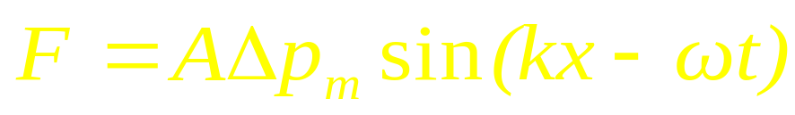
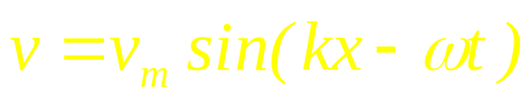

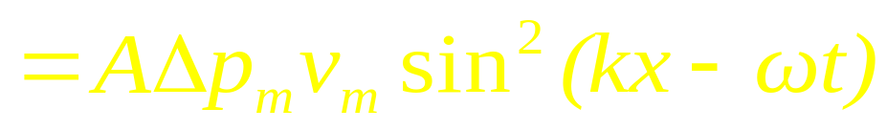
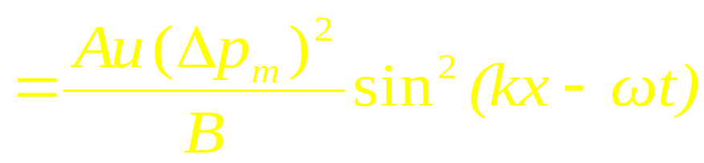
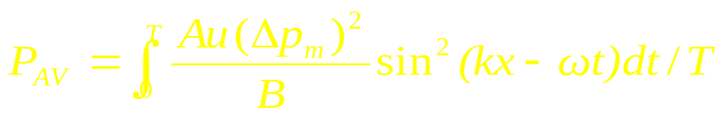
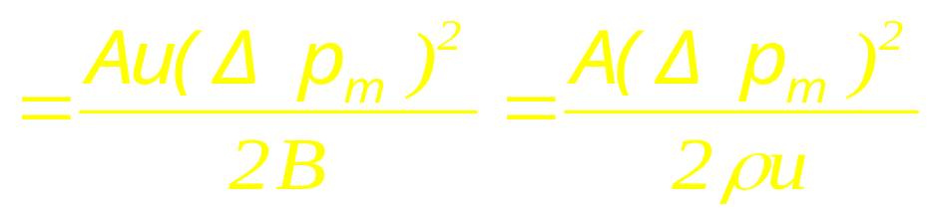
The power of sound
The Average of power
zwma@zju.edu.cn

Slide 11
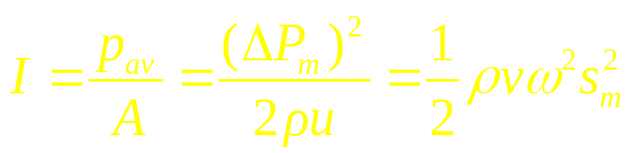
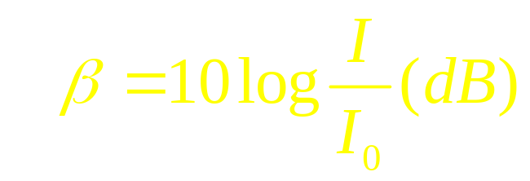
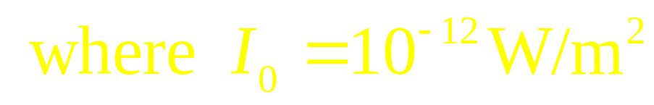

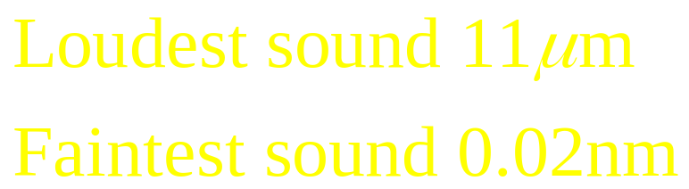
The Intensity
The sound level (SL)
zwma@zju.edu.cn

Slide 12
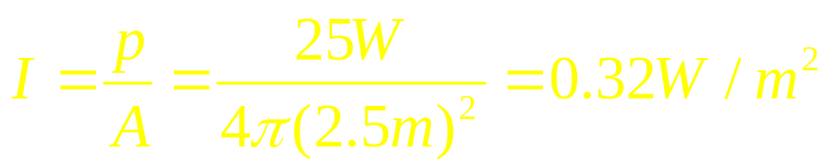
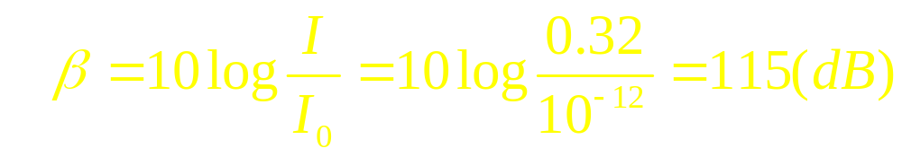
Spherical sound waves are emitted
uniformly in all directions from a point source, the
radiated power P being 25 W. What are the intensity
and the sound level of the sound wave at the distance r=2.5m from the source.
Expample:
zwma@zju.edu.cn

Slide 13
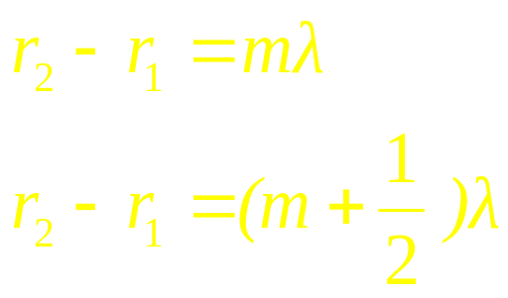
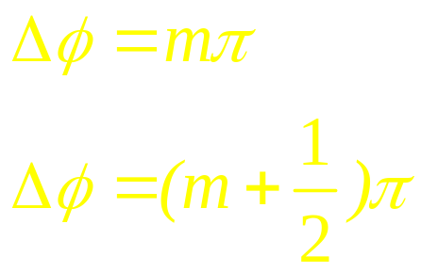
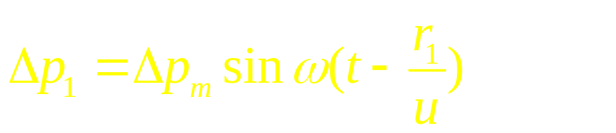
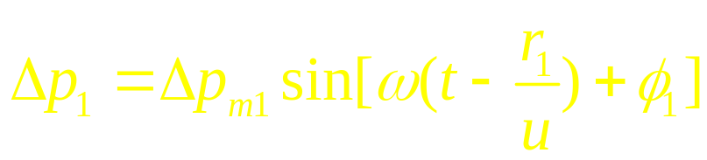
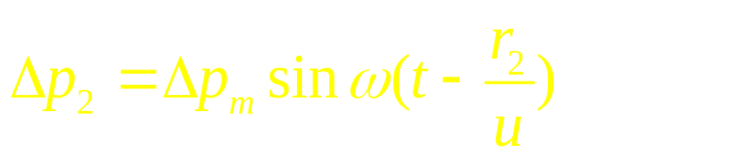
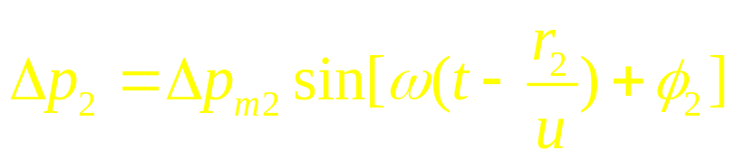
interference
s₁
r₁
p
Max
Min
r₂
s₂
Sound Wave
zwma@zju.edu.cn

Slide 14
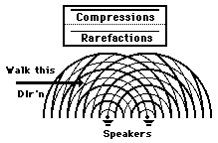
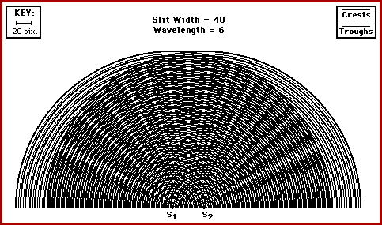
Interference of waves
Two sound waves interfere each other
destructive
constructive
zwma@zju.edu.cn

Slide 15
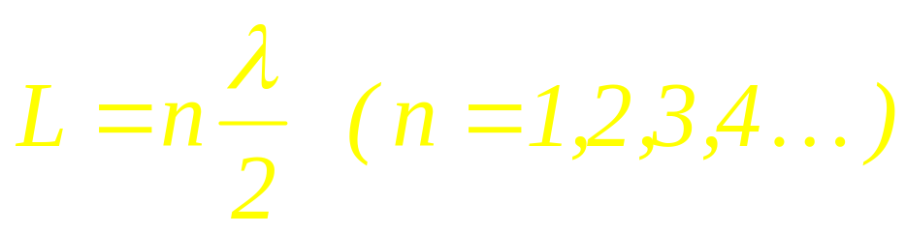
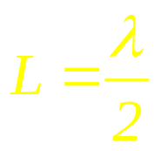

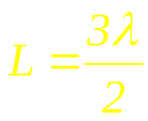

Resonance
zwma@zju.edu.cn

Slide 16
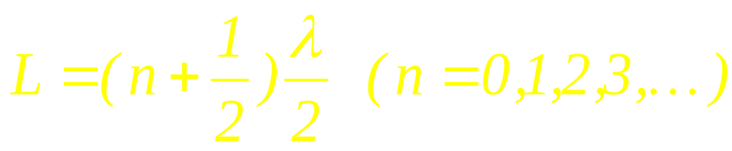
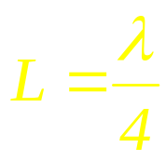
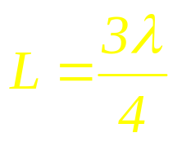
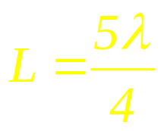
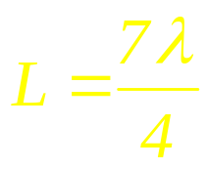
Resonance
zwma@zju.edu.cn

Slide 17
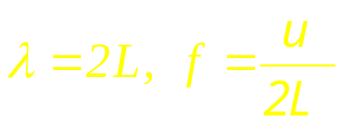




Standing Sound Wave
Resonance
zwma@zju.edu.cn

Slide 18





Standing Sound Wave
Resonance
zwma@zju.edu.cn

Slide 19

Standing sound waves
Sound wave in a pipe with two open ends
zwma@zju.edu.cn

Slide 20

Standing sound waves
Standing sound wave in a pipe with two closed ends
zwma@zju.edu.cn

Slide 21



Resonance

Slide 22

Beats
Two interfering sound waves can make beat
Δp₁
t
Δp₂
t
Δp
t
Two waves with different frequency create a beat because of interference between them. The beat frequency is the difference of the two frequencies.
zwma@zju.edu.cn

Slide 23









Beats (cont’d)
Two interfering sound waves can make beat (cont’d)
Suppose the two waves have frequencies
and
For simplicity, consider two sinusoidal waves of equal intensity:
Then the resulting combined wave will be:
As human ears does not distinguish negative and positive amplitude,
they hear two max. or min. intensity per cycle, so
is the beat frequency .
zwma@zju.edu.cn

Slide 24

Doppler effect
Moving listener
Source at rest
Listener moving right
Source at rest
Listener moving left
zwma@zju.edu.cn

Slide 25





Doppler effect (cont’d)
Moving listener (cont’d)
The wavelength of the sound wave does not change whether
the listener is moving or not.
The time that two subsequent wave crests pass the listener
changes when the listener is moving, which effectively changes
the velocity of sound.
freq. listener hears
freq. source generates
velocity of sound at source
velocity of listener
- for a listener moving away from
+ for a listener moving towards
the source.
zwma@zju.edu.cn

Slide 26


Doppler effect (cont’d)
Moving source
When the source moves
zwma@zju.edu.cn

Slide 27



Doppler effect (cont’d)
Moving source (cont’d)
The wave velocity relative to the wave medium does not
change even when the source is moving.
The wavelength, however, changes when the source is moving.
This is because, when the source generates the next crest, the
the distance between the previous and next crest i.e. the wave-
length changed by the speed of the source.
The source at rest When the source is moving
+ for a receding source
- for a approaching source
zwma@zju.edu.cn

Slide 28

Doppler effect (cont’d)
Moving source and listener
- for a listener moving away from
+ for a listener moving towards
the source.
+ for a receding source
- for a approaching source
The signs of v_{L} and v_{S} are measured
in the direction from the listener L to the
source S.
zwma@zju.edu.cn

Slide 29
Doppler effect (cont’d)
Example 1
A police siren emits a sinusoidal wave with frequency f_{s}=300 Hz.
The speed of sound is 340 m/s. a) Find the wavelength of the waves
if the siren is at rest in the air, b) if the siren is moving at 30 m/s, find
the wavelengths of the waves ahead of and behind the source.
a)
b) In front of the siren:
Behind the siren:
zwma@zju.edu.cn

Slide 30





Summary
Moving Listener
Moving Source
Moving both
zwma@zju.edu.cn

Slide 31






Example
zwma@zju.edu.cn

Slide 32


Example
zwma@zju.edu.cn

Slide 33






Example
zwma@zju.edu.cn

Slide 34









Example
zwma@zju.edu.cn

Slide 35



Example
Frame must be fixed with
material medium
Sound in material medium
zwma@zju.edu.cn

Slide 36





Example
zwma@zju.edu.cn

Slide 37



Effect at High Speed
u_{s}<u
supersonic
u
v
u_{s}
s
x
u_{s}>u
zwma@zju.edu.cn

Slide 38

zwma@zju.edu.cn

Slide 39


zwma@zju.edu.cn

Slide 40

zwma@zju.edu.cn

Slide 41
CHAP. 19 Problems
P449 6, 10
P450 18, 19, 20

