Slide 1
Chapter 21
Temperature

Slide 2
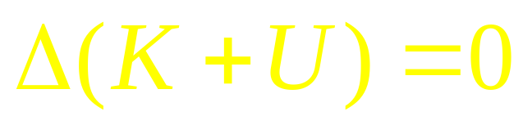

Without external forces
System K, U

Slide 3




Work done on a system by external forces
Thermal Physics
System K, U
Mechanical Energy

Slide 4



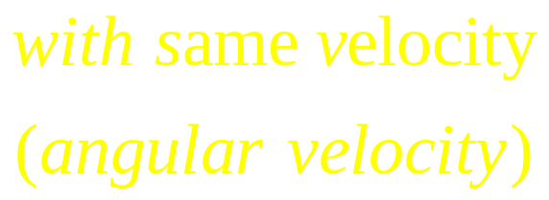
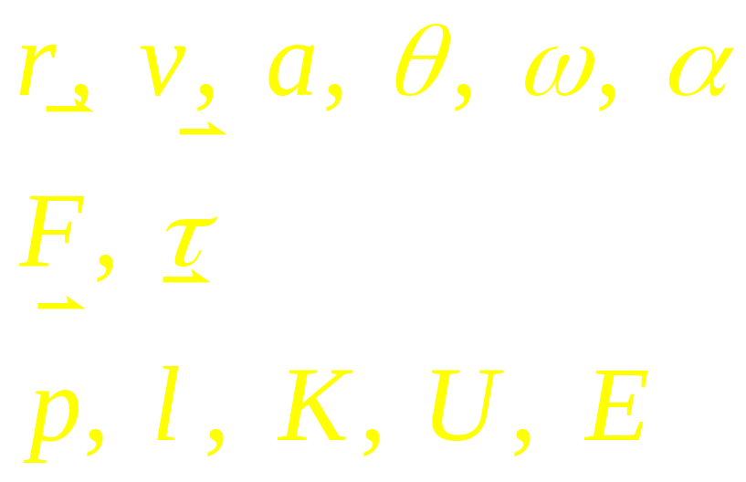


Thermal Physics
Mechanical Physics
?

Slide 5



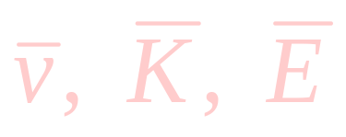


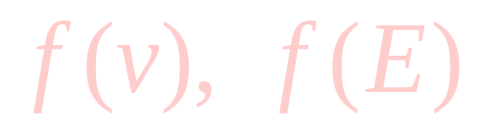
Macroscopic
Thermal Physics
Microscopic

Slide 6
Concept of Temperature
System of Temperature
Measuring of Temperature

Slide 7
Temperature systems:
— Kelvin temperature
— Celsius temperature
— Fahrenheit temperature

Slide 8
— Kelvin temperature
Absolute zero as zero
Water
Triple-point
Ice
Vapor
Triple-point as 273.16K
The kelvin, symbol K, is the SI unit of thermodynamic temperature. It is defined by taking the fixed numerical value of the Boltzmann constant k to be 1.380649×10^{–23} when expressed in the unit J K^{–1},which is equal to kg m²s^{–2}K^{–1}, where the kilogram, meter and second are defined in terms of h, c and Δν_{Cs}. One second equals 9192631770 vibrations of radiation emitted by atom caesium 133.

Slide 9
— Celsius temperature
T_{c}=T-273.15
— Fahrenheit temperature
T_{F}=(9/5)T_{c}+32

Slide 10
Some interesting facts
T (K)
10⁸
Hydrogen bomb
In 1724, Gabriel Fahrenheit made thermometers using mercury. The zero point of his scale is attained by mixing equal parts of water, ice, and salt. A second point was obtained when pure water froze (originally set at 30ºF), and a third (set at 96ºF) “when placing the thermometer in the mouth of a healthy man”.
  On that scale, water boiled at 212.
  Later, Fahrenheit moved the freezing point of water to 32 (so that the scale had 180 increments).
In 1745, Carolus Linnaeus of Upsula, Sweden, described a scale in which the freezing point of water was zero, and the boiling point 100, making it a centigrade (one hundred steps) scale. Anders Celsius (1701-1744) used the reverse scale in which 100 represented the freezing point and zero the boiling point of water, still, of course, with 100 degrees between the two defining points.
10⁷
Sun’s interior
10⁶
Solar corona
10⁵
10⁴
Sun’s surface
10³
Copper melts
100
Water freezes
Liquid nitrogen
10
Liquid hydrogen
1
Liquid helium
0.1
Lowest T
~ 10⁻⁹K

Slide 11
Boiling of Water
Freezing of Water
Boiling of Liquid Nitrogen
Absolute zero
Kelvin
Celsius
Fahrenheit
T_{F}=(9/5)T_{c}+32

Slide 12
Measuring temperature with physical quantity proportional to T:
thermoresistance
R
G

Slide 13
Measuring temperature with physical quantity proportional to T:
thermocouple
NiAl
V
NiCrAl

Slide 14
Measuring temperature with physical quantity proportional to T:
Constant Volume Gas Thermometer:
Constant Pressure Solid Thermometer:

Slide 15
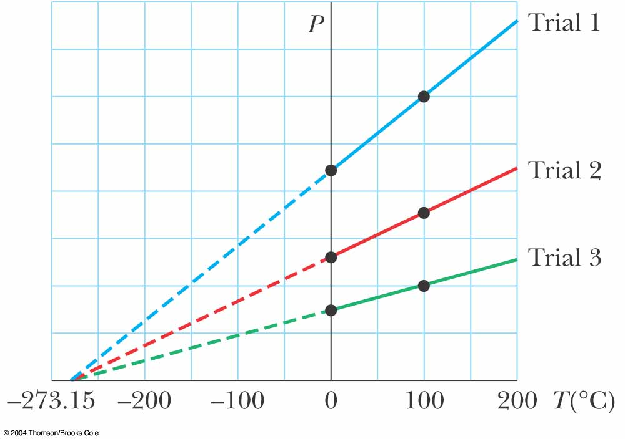
Absolute Zero
The thermometer readings are virtually independent of the gas used
If the lines for various gases are extended, the pressure is always zero when the temperature is –273.15º C
This temperature is called
absolute zero
Absolute zero is used as the basis of the absolute temperature scale
The size of the degree on the absolute scale is the same as the size of the degree on the Celsius scale
To convert: T_{C} = T – 273.15

Slide 16
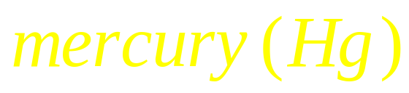
Constant Volume Gas Thermometer:

Slide 17
Thermal Equilibrium
Thermal Contact:
Thermal insulating
Thermal Conducting
T_{A}
A
T_{B}
B
T_{A}
A
T
A
Q
T_{B}
B
T
B
T_{A}=T T_{B} =T
T_{A}< T_{B}
The zeroth law of thermal dynamics

Slide 18
Thermal expansion
amount of expansion depends on…
  change in temperature
  original length
  coefficient of thermal expansion

Slide 19
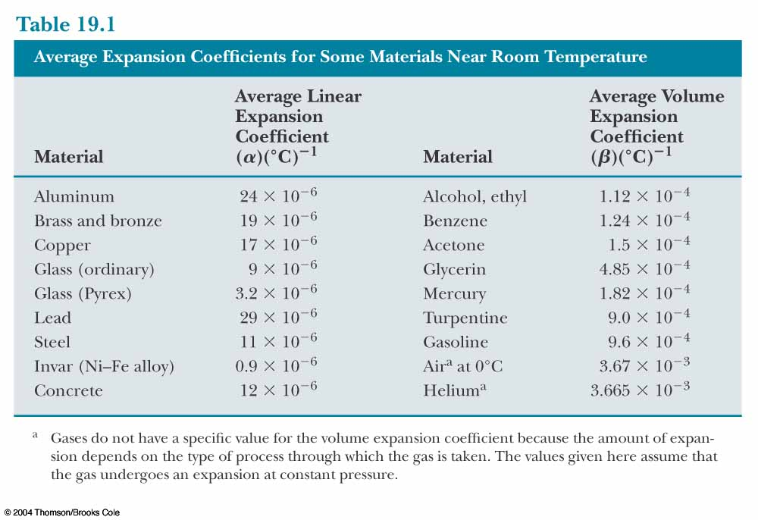
Thermal expansion

Slide 20
Temp: T
L₀

Slide 21
Temp: T
L₀
Temp: T+ΔT
ΔL
    ΔL = α L₀ ΔT (linear expansion)
    ΔA = γ A₀ ΔT (area expansion)
    ΔV = β V₀ ΔT (volume expansion)

Slide 22
    ΔA = γ A₀ ΔT (area expansion)
    L=L₀+ΔL =L₀ + α L₀ ΔT
    L²=(L₀+ΔL) ² =(L₀ + α L₀ ΔT) ²
    =L₀ ² + 2α L₀ ² ΔT+(α L₀ ΔT) ²
    =L₀ ² + 2α L₀ ² ΔT
    A=A₀+ΔA =A₀ + γ A₀ ΔT
    γ =2α
    ΔV = β V₀ ΔT (Volume expansion)
    L ³ =L₀ ³ + 3α L₀ ³ ΔT
    β =3α

Slide 23
Microscopic of Thermal Expansion
When temperature rises
  molecules have more kinetic energy
    they are moving faster, on the average
  consequently, things tend to expand

Slide 25
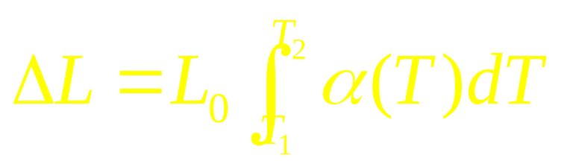
Temp: T
L₀
Temp: T+ΔT
ΔL
    ΔL = α L₀ ΔT (linear expansion)
    α = α (T)

Slide 26
Thermal Expansion
T = 0 C
T = 100 C
Most objects DO expansion with T

Slide 27
Thermal Expansion
T = 0 C
T = 100 C
Most objects DO expansion with T
Water has a maximum density at 4⁰C

Slide 28
Bimetallic Strip

Slide 29
Bimetallic Strip

Slide 30
Bimetallic Strip

Slide 31
220V

Slide 32
220V

Slide 33
Example:
The mass of a hot-air balloon and its cargo (not including the air inside) is 200 kg. The air outside is at 10.0°C and 101 kPa. The volume of the balloon is 400 m³. To what temperature must the air in the balloon be heated for the balloon lifting off ?
(Air density at 10.0°C is 1.25 kg/m³.)
V, T
M

Slide 34

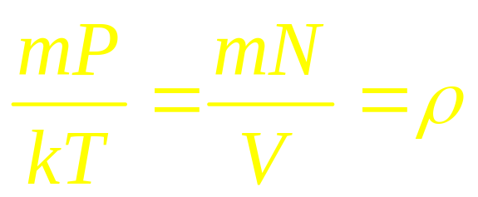
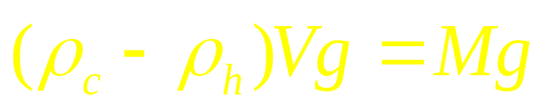
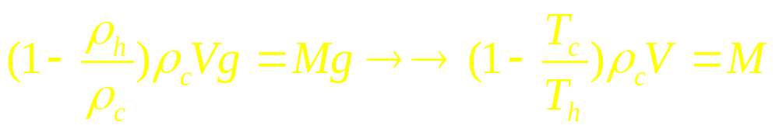
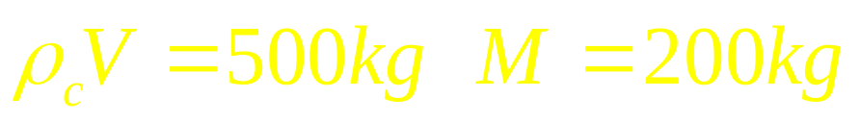
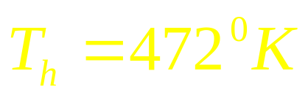
F_{b}
Answer:
For ideal gas,
From force balance,
V, T
M
Mg

Slide 35
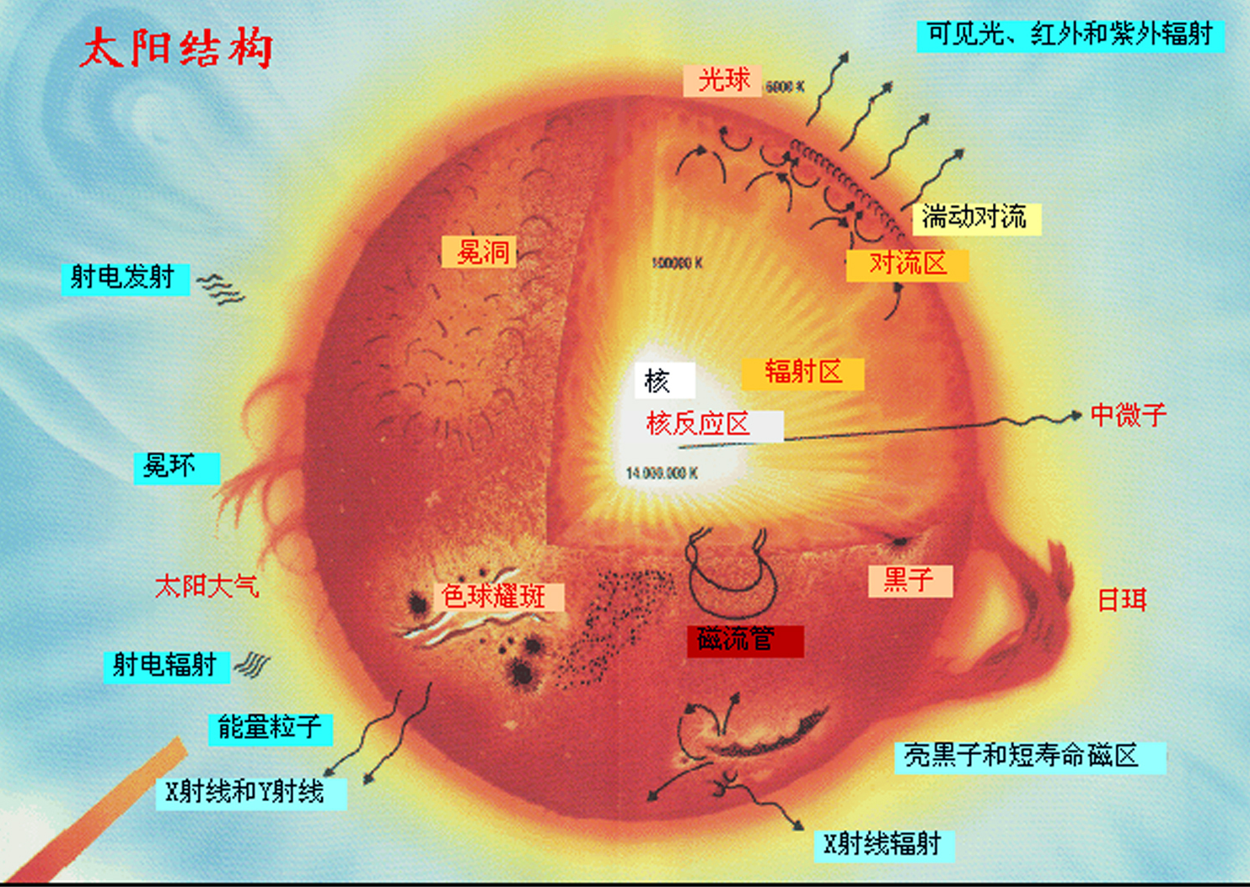
Convection and radiation

Slide 36

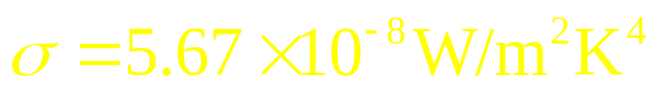


The radiation power from an object with the temperature,
where is called Stefan-Boltzmann constant, is emissivity of the object’s surface.
for blackbody radiator.

Slide 37
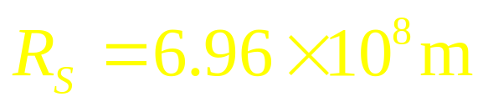
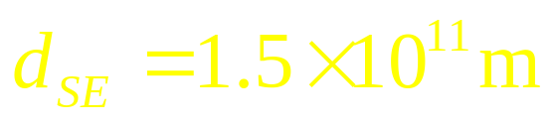
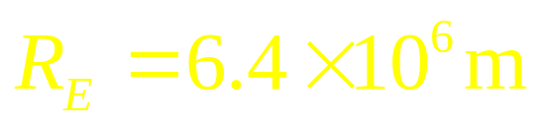

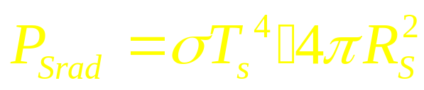
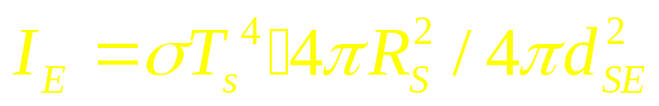
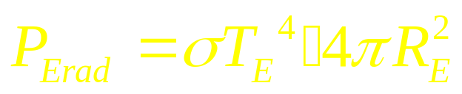
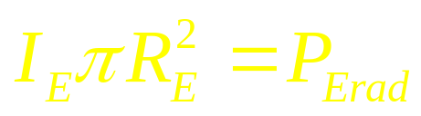
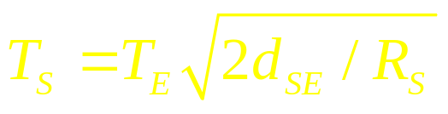
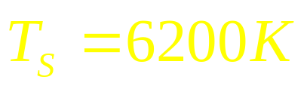
Approximate surface temperature of the Sun
Total radiated power from Sun:
Intensity on the Earth:
Total radiated power from Earth:
Power balance:
The temperature of the Sun is about

Slide 38
CHAP. 21
Problems
P493: 1, 4, 8, 10, 11

