Slide 1
Chapter 22
Molecular Properties
of Gas

Slide 2
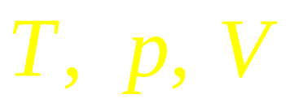
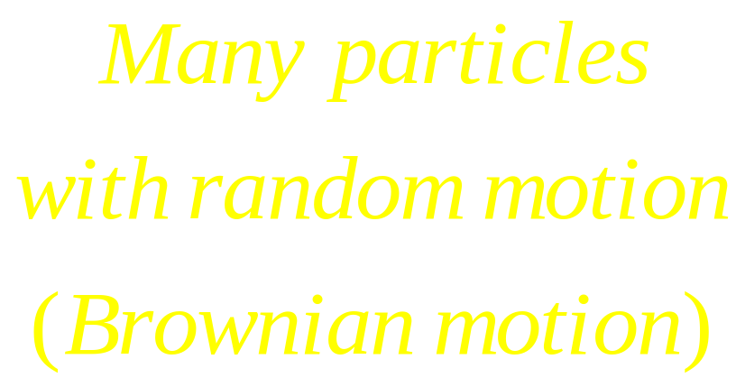

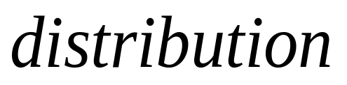
Macroscopic
Thermal Physics
Microscopic
The Ideal Gas
zwma@zju.edu.cn

Slide 3
The Ideal Gas
The number of particles is “large” enough
All particles are in random motion
The particle sizes are small enough
Long range interaction force can be neglected
Bi-collision is perfectly elastic
zwma@zju.edu.cn

Slide 4
The Ideal Gas
The Ideal Gas
The real Gas
The number of particles is “large”
All particles are in random motion
The volume of the particles is small
The particle sizes are not small enough
Long range interaction force should be considered.
There is no interaction between them
The collision is perfectly elastic
zwma@zju.edu.cn

Slide 5
The Ideal Gas
V=const.
p=const.
T=const.
zwma@zju.edu.cn

Slide 6
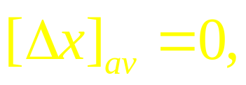
The Brownian motion
zwma@zju.edu.cn

Slide 7
Langevin Equation
In 1908 Paul Langevin developed a more direct derivation based on a stochastic (differential) equation of motion. We start with Newton’s 2nd Law (Langevin Equation):
η = viscosity of a gas or a liquid
F_{ext} is a “random” force on the particle
zwma@zju.edu.cn

Slide 8
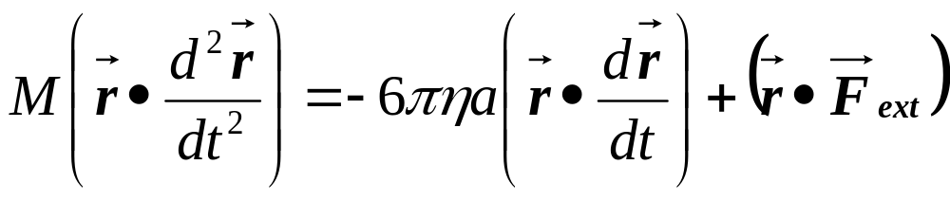
Scalar product by r
We now take the dot (scalar product) of the equation of motion by r :
Next we re-express the above equation in terms of r² instead.
zwma@zju.edu.cn

Slide 9
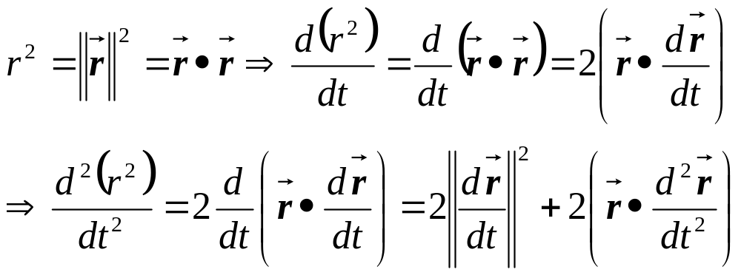
Change of Variable to r²
zwma@zju.edu.cn

Slide 10
Ensemble Average
The equation of motion now becomes:
Rearranging the equation and denoting ||dr/dt||²=V²
Next we take the average over a large number of particles (“ensemble average” denoted by ⟨ ⟩ ) and using u ≡ ⟨r²⟩
zwma@zju.edu.cn

Slide 11
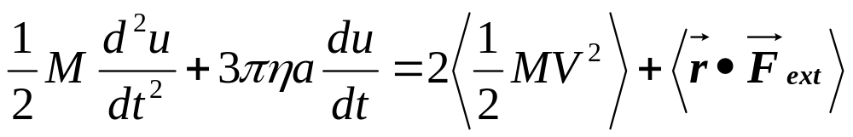
The Physics!!!
0
The last term on the right vanishes because F_{ext} is a “random” force not correlated with the position of the particle.
Equipartition Theorem:
we have ⟨½MV²⟩ = nkT/2 (a constant!)
where n is the number of free spatial dimensions involved and k is again the Boltzmann Constant.
PHYSICS!!!
zwma@zju.edu.cn

Slide 12
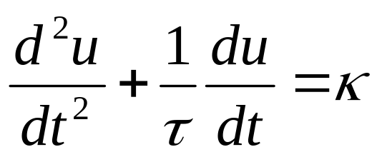
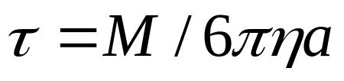
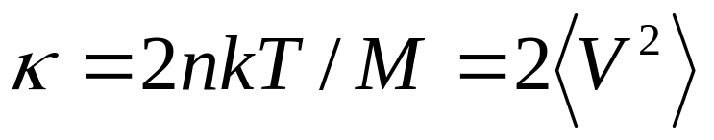
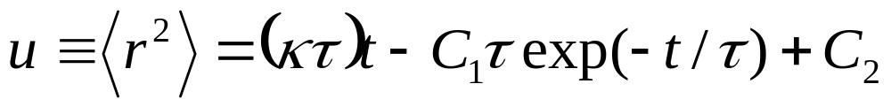
Solving the Differential Equation
⇒ A 2nd order linear inhomogenous ODE:
where
and
The general solution is:
zwma@zju.edu.cn

Slide 13
Initial Conditions
⟨r²⟩ = 0 at t = 0
  Assuming initial position of each particle to be its origin.
d⟨r²⟩/dt = 0 at t = 0
  At very small t (i.e. before any subsequent collisions) we have r_{i}² = (V_{i}t)² where V_{i} is the velocity of the i^{th} particle inherited from a previous collision.
  ⇒ ⟨r²⟩ = ⟨V²⟩ t² ⇒ d⟨r²⟩/dt |_{t=0} = 0
zwma@zju.edu.cn

Slide 14
Applying Initial Conditions
We arrive at the solution
zwma@zju.edu.cn

Slide 15
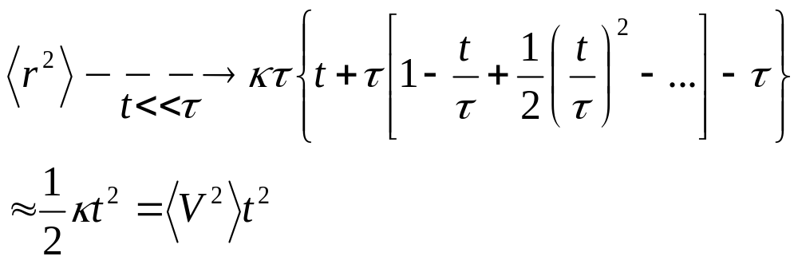
Langevin: t << τ case
Expanding the exponential in Taylor series to 2nd order in t. Note 0th and 1st order terms cancel with the two other terms.
zwma@zju.edu.cn

Slide 16
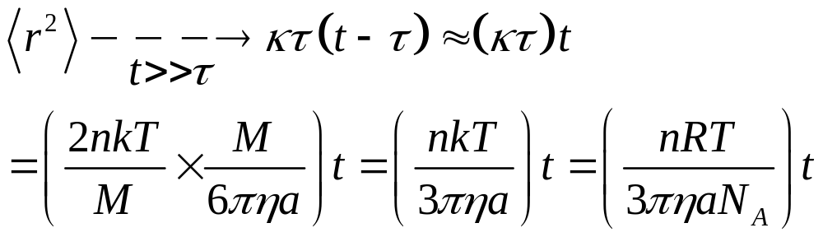
Langevin: t >> τ case
For water τ=3.1x10⁻⁸s
Taking the other extreme case which we are usually interested in
Which is the same as Einstein’s result but with an extra factor of n (Note Einstein’s derivations were for a one dimensional problem)
zwma@zju.edu.cn

Slide 17
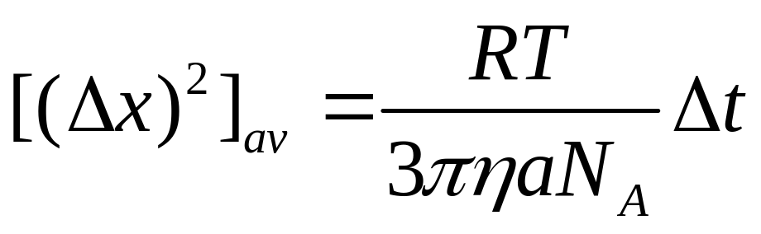

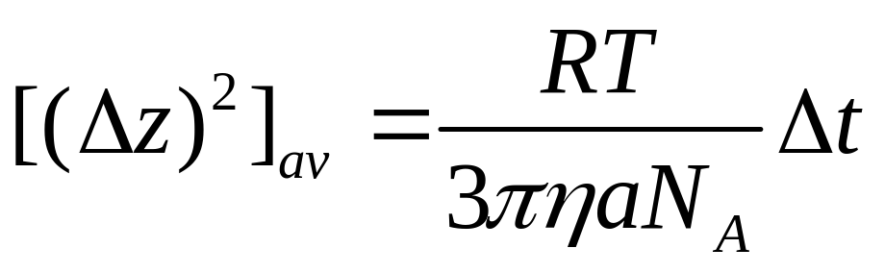
zwma@zju.edu.cn

Slide 18

Microscopic
Macroscopic
A molecular view the pressure
The Mean Free Path
The Distribution of Molecular Speed
The Average of Molecular Speed
zwma@zju.edu.cn

Slide 19
A molecular view the pressure
zwma@zju.edu.cn

Slide 20
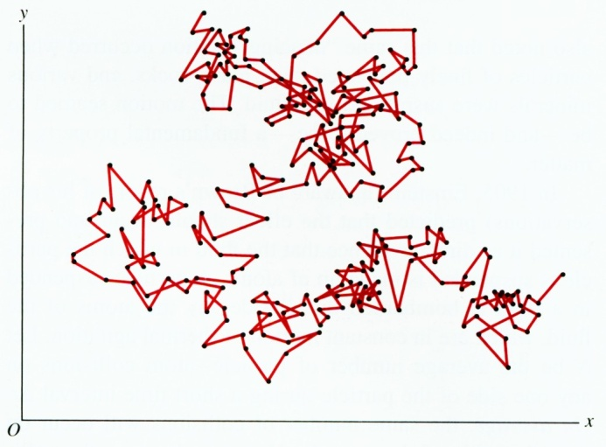
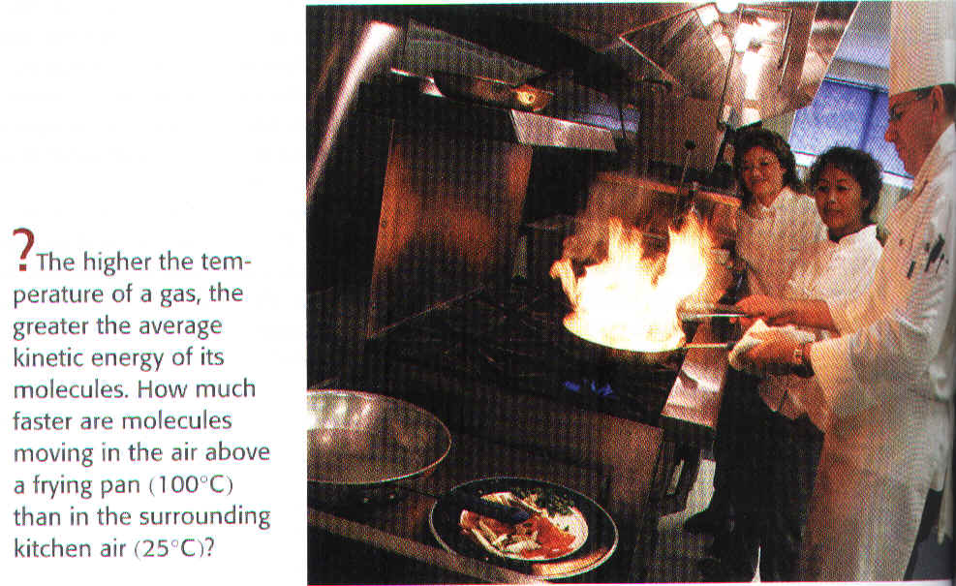
The Mean Free Path
zwma@zju.edu.cn

Slide 21
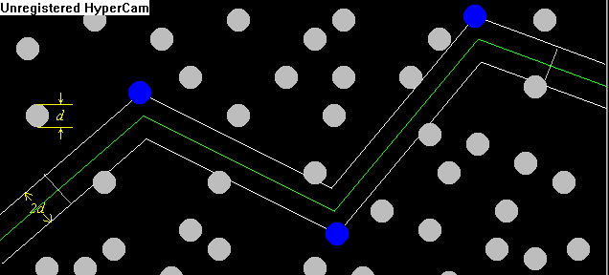
The Mean Free Path
—Average distance between two collisions
zwma@zju.edu.cn

Slide 22
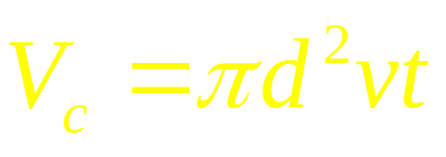
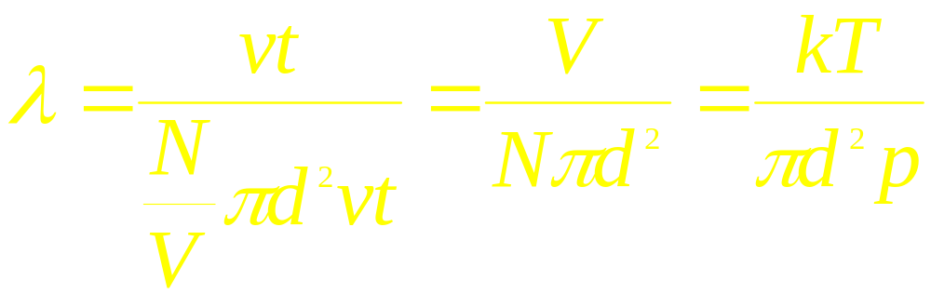
The Mean Free Path
—Average distance between two collisions
Chosen a cylinder of diameter 2d and length L=vt,
Number of collision in t
Volume of the cylinder
The Mean Free Path
zwma@zju.edu.cn

Slide 23
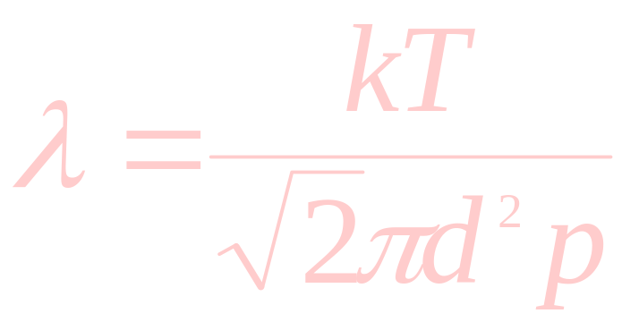
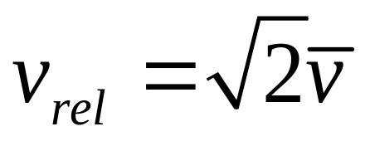
The Mean Free Path
zwma@zju.edu.cn

Slide 24
The Mean Free Path
v_{av}
θ
v_{rel}
v_{av}
zwma@zju.edu.cn

Slide 25
A chamber with N₂ gas at 300K, the d of the molecule is , the pressure in the chamber is . There is a zero-size particle with high speed enters the chamber, what is the mean free path of the particle?
zwma@zju.edu.cn

Slide 26

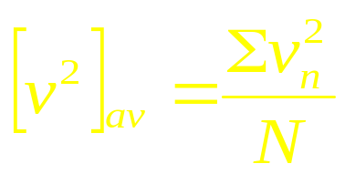
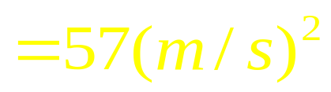
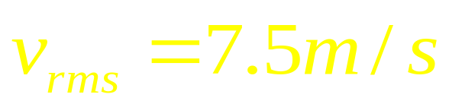
The Distribution of Molecular Speed
The speeds of 10 particles are 0.0, 1.0, 2.0, 3.0, 4.0, 5.0, 6.0, 7.0, 8,0 9.0 m/s
zwma@zju.edu.cn

Slide 27
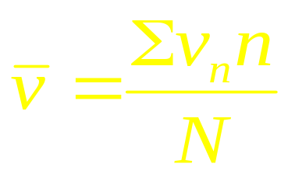
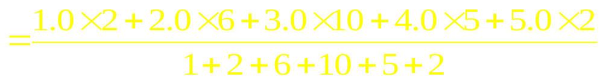
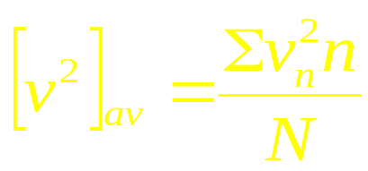
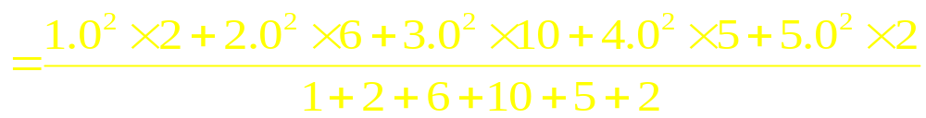
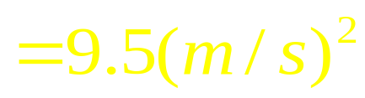
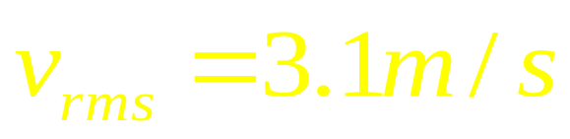
The Distribution of Molecular Speed
Speed of particle (m/s) 0.0, 1.0, 2.0, 3.0, 4.0, 5.0
Number of particle 1, 2, 6, 10, 5, 2
zwma@zju.edu.cn

Slide 28
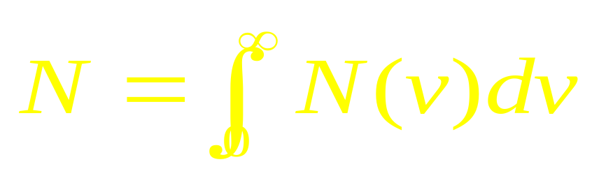
The Maxwell Distribution of Speed
Number of molecules
zwma@zju.edu.cn

Slide 29
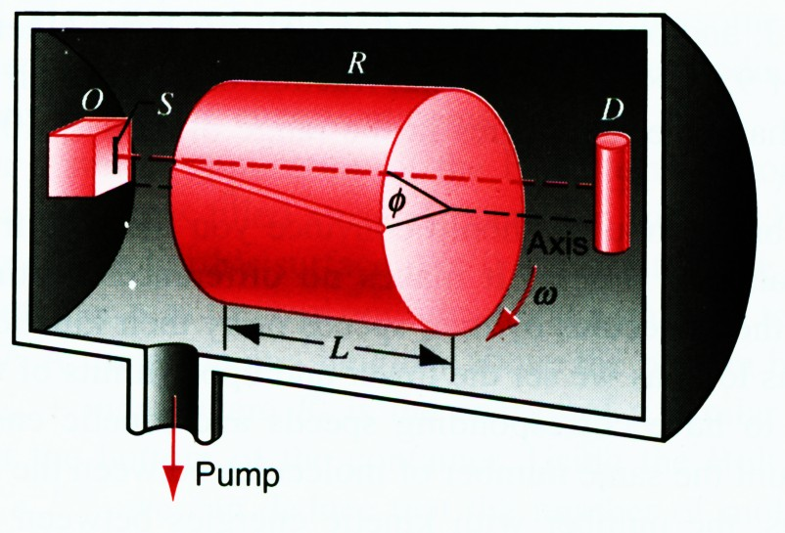
 Experimental verification of the Maxwell speed distribution
velocity selector
zwma@zju.edu.cn

Slide 30
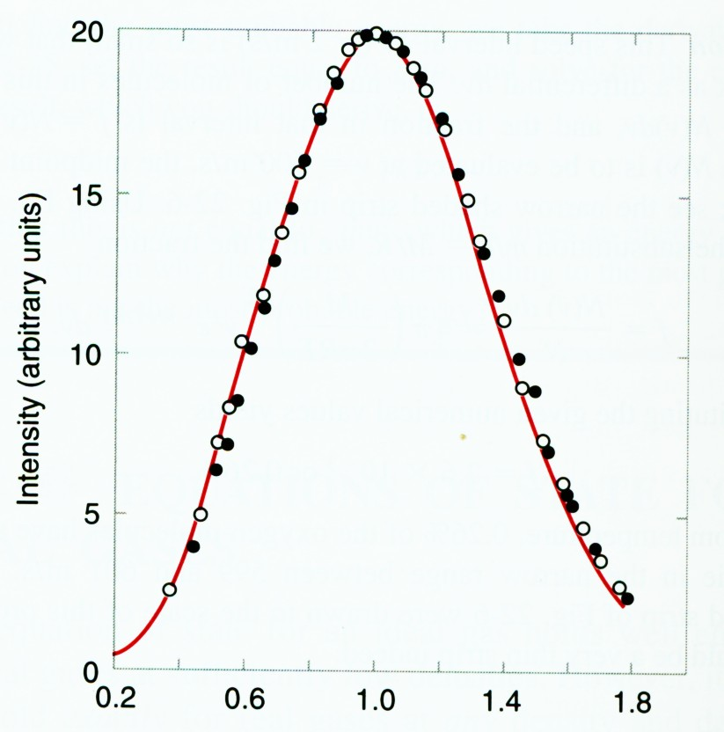
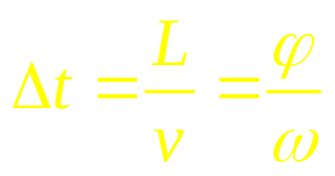
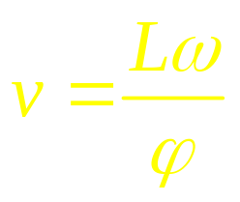
The experiment agrees remarkably with the Maxwell theory
zwma@zju.edu.cn

Slide 31

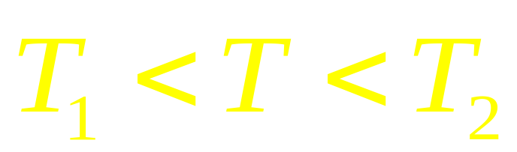

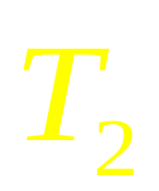
zwma@zju.edu.cn

Slide 32
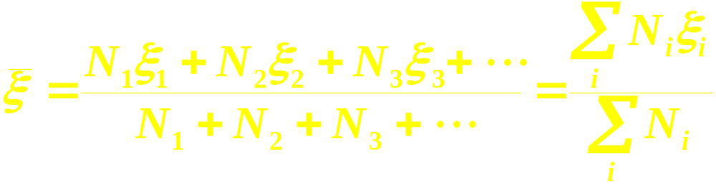
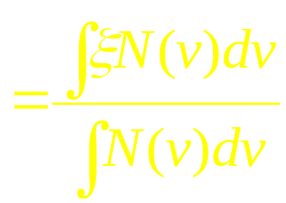
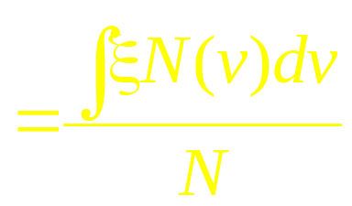
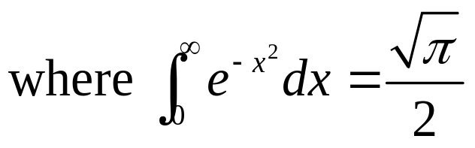
The average
zwma@zju.edu.cn

Slide 33
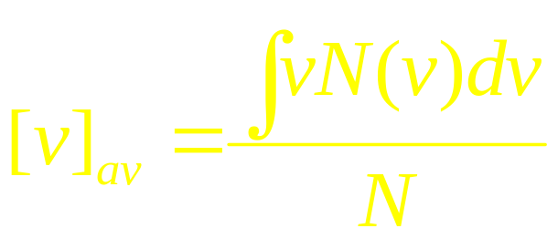
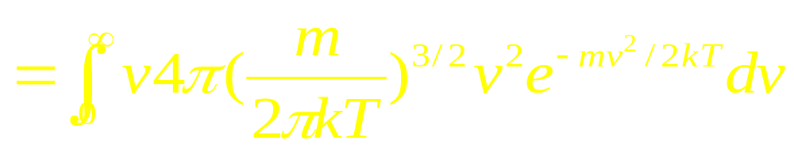
The average
zwma@zju.edu.cn

Slide 34
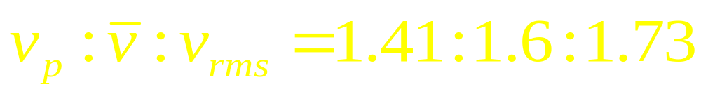
zwma@zju.edu.cn

Slide 35
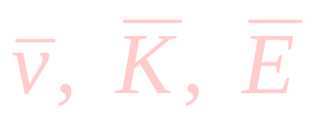

Macroscopic
Thermal Physics
Microscopic
zwma@zju.edu.cn

Slide 36
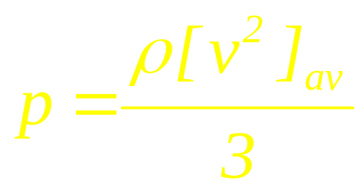
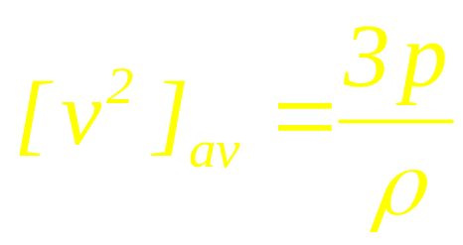
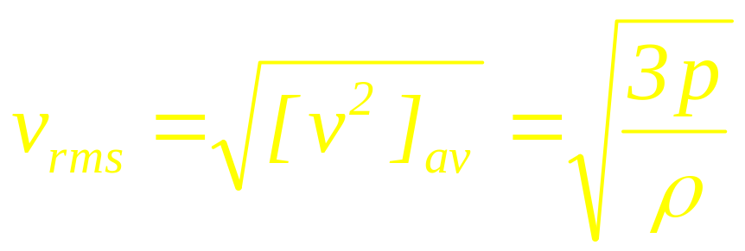
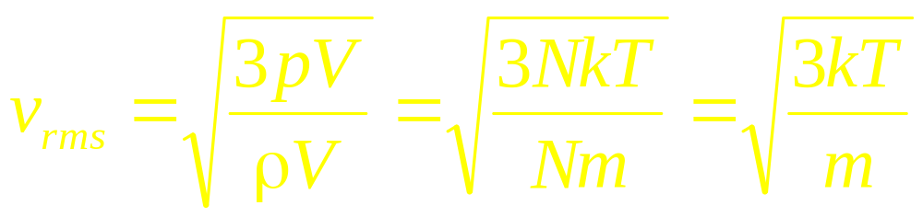

Microscopic
Macroscopic
zwma@zju.edu.cn

Slide 37

The Maxwell Distribution of Speed
Number of molecules in a unit speed region
Number of molecules
zwma@zju.edu.cn

Slide 38




The average
Example
zwma@zju.edu.cn

Slide 39






Example
Ideal gas in a chamber with the temperature T₀ , average velocity v₀, number of collision Z₀ and average mean free path λ₀. When the temperature increases to T₀+4K, what is the average velocity v, number of collision Z and average mean free path λ
zwma@zju.edu.cn

Slide 40











Example
Number of molecules
N
zwma@zju.edu.cn

Slide 41





Example
Number of molecules
N₁
zwma@zju.edu.cn

Slide 42


The Maxwell Distribution of Speed
Probability
Number of molecules
Number of molecules in a unit speed region
Probability
Probability in a unit speed region
zwma@zju.edu.cn

Slide 43
The Maxwell Distribution of Speed
Probability
Probability in a unit speed region
zwma@zju.edu.cn

Slide 44


The Distribution of Energy
The Distribution of Energy
Number of molecules
zwma@zju.edu.cn

Slide 45
The Distribution of Energy
zwma@zju.edu.cn

Slide 46





Derivation of Maxwell Distribution
zwma@zju.edu.cn

Slide 47




Derivation of Maxwell Distribution
0
zwma@zju.edu.cn

Slide 48

zwma@zju.edu.cn

Slide 49
Boltzmann distribution
For the equilibrium system under conservative force field，in the domain
and
The distribution is
After integration for the velocity

Slide 50

The Distribution of Height
zwma@zju.edu.cn

Slide 51

Figure shows a hypothetical speed distribution of N molecules in an ideal gas, with
for
and
for
Find an expression for C in terms of N and
The average speed of the particles
The energy distribution
The average of the energy of the particles?
zwma@zju.edu.cn

Slide 52


Figure shows a hypothetical speed distribution of N molecules in an ideal gas, with
for
and
for
Find an expression for C in terms of N and
The average speed of the particles
The energy distribution
The average of the energy of the particles?
zwma@zju.edu.cn

Slide 53
Figure shows a hypothetical speed distribution of N molecules in an ideal gas, with
for
and
for
Find an expression for C in terms of N and
The average speed of the particles
The energy distribution
The average of the energy of the particles?
zwma@zju.edu.cn

Slide 54
The real Gas
Differences Between Ideal and Real Gases
Ideal Gas
Real Gas
Obey PV=nRT | Always | Only at very low P and high T
Molecular volume | Zero | Small but nonzero
Molecular attractions | Zero | Small
Molecular repulsions | Zero | Small
zwma@zju.edu.cn

Slide 55
Real Gases
Real molecules do take up space and do interact with each other (especially polar molecules).
Need to add correction factors to the ideal gas law to account for these.
zwma@zju.edu.cn

Slide 56
Ideally, the VOLUME of the molecules was neglected:
at 1 Atmosphere Pressure
at 10 Atmospheres Pressure
at 30 Atmospheres Pressure
Ar gas, ~to scale, in a box 3nm x 3nm x3nm
zwma@zju.edu.cn

Slide 57
But since real gases do have volume, we need:
Volume Correction
The actual volume free to move is less because of particle size.
More molecules will have more effect.
Corrected volume V’ = V – nb
“b” is a constant that differs for each gas.
zwma@zju.edu.cn

Slide 58


Pressure Correction
Because the molecules are attracted to each other, the pressure on the container will be less than ideal.
Pressure depends on the number of molecules per unit volume.
Since two molecules interact, the effect must be squared.
zwma@zju.edu.cn

Slide 59


Van der Waal’s equation
Corrected Pressure
Corrected Volume
“a” and “b” are
determined by experiment
“a” and “b” are
different for each gas
bigger molecules have larger “b”
“a” depends on both
size and polarity
Johannes Diderik van der Waals
Mathematician & Physicist
Leyden, The Netherlands
November 23, 1837 – March 8, 1923
zwma@zju.edu.cn

Slide 60

Compressibility Factor The most useful way of displaying this new law for real molecules is to plot the compressibility factor, Z :
For n = 1
Z = PV / RT
Ideal Gases have Z = 1
zwma@zju.edu.cn

Slide 61

The Intermolecular Force
Repelled Force
Attracted Force
Net Force
zwma@zju.edu.cn

Slide 62


The Intermolecular Force
Ideal gas
real gas
340K
340K
260K
260K
300K
300K
V
b
zwma@zju.edu.cn

Slide 63





Macroscopic
Thermal Physics
Microscopic
The Ideal Gas

Slide 64
CHAP. 22
Exercises
P513 6, 12, 23
Problems
P514 9, 10

