Slide 1
Proof Strategies for proving p → q
Choose a method.
First try a direct method of proof.
If this does not work, try an indirect method (e.g., try to prove the contrapositive).
For whichever method you are trying, choose a strategy.
First try forward reasoning. Start with the axioms and known theorems and construct a sequence of steps that end in the conclusion. Start with p and prove q, or start with ¬q and prove ¬p.
If this doesn’t work, try backward reasoning. When trying to prove q, find a statement p that we can prove with the property p → q.

Slide 2
Backward Reasoning
Example: Suppose that two people play a game taking turns removing, 1, 2, or 3 stones at a time from a pile that begins with 15 stones. The person who removes the last stone wins the game. Show that the first player can win the game no matter what the second player does.
Proof: Let n be the last step of the game.
Step n: Player₁ can win if the pile contains 1,2, or 3 stones.
Step n-1: Player₂ will have to leave such a pile if the pile that he/she is faced with has 4 stones.
Step n-2: Player₁ can leave 4 stones when there are 5,6, or 7 stones left at the beginning of his/her turn.
Step n-3: Player₂ must leave such a pile, if there are 8 stones .
Step n-4: Player₁ has to have a pile with 9,10, or 11 stones to ensure that there are 8 left.
Step n-5: Player₂ needs to be faced with 12 stones to be forced to leave 9,10, or 11.
Step n-6: Player₁ can leave 12 stones by removing 3 stones.
Now reasoning forward, the first player can ensure a win by removing 3 stones and leaving 12.

Slide 3
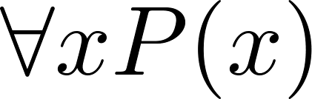

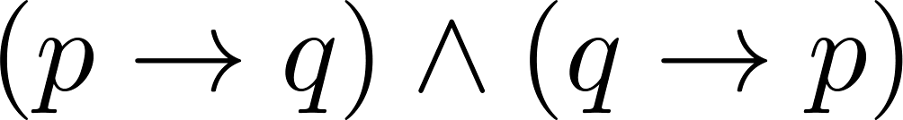
Universally Quantified Assertions
To prove theorems of the form ,assume x is an arbitrary member of the domain and show that P(x) must be true. Using UG it follows that .
Example: An integer x is even if and only if x² is even.
Solution: The quantified assertion is
∀x [x is even ↔ x² is even]
We assume x is arbitrary.
Recall that is equivalent to
So, we have two cases to consider. These are considered in turn.
Continued on next slide →

Slide 4
Universally Quantified Assertions
Case 1. We show that if x is even then x² is even using a direct proof (the only if part or necessity).
If x is even then x = 2k for some integer k.
Hence x² = 4k² = 2(2k² ) which is even since it is an integer divisible by 2.
This completes the proof of case 1.
Case 2 on next slide →

Slide 5
Universally Quantified Assertions
Case 2. We show that if x² is even then x must be even (the if part or sufficiency). We use a proof by contraposition.
Assume x is not even and then show that x² is not even.
If x is not even then it must be odd. So, x = 2k + 1 for some k. Then x² = (2k + 1)² = 4k² + 4k + 1 = 2(2k² + 2k) + 1
which is odd and hence not even. This completes the proof of case 2.
Since x was arbitrary, the result follows by UG.
Therefore we have shown that x is even if and only if x² is even.

Slide 6

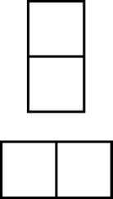
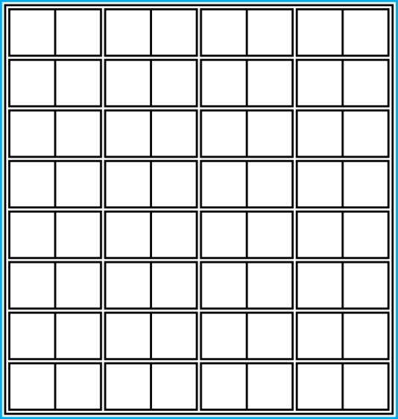
Proof and Disproof: Tilings
Example 1: Can we tile the standard checkerboard using dominos?
Solution: Yes! One example provides a constructive existence proof.
Two Dominoes
The Standard Checkerboard
One Possible Solution

Slide 7
Tilings
Example 2: Can we tile a checkerboard obtained by removing one of the four corner squares of a standard checkerboard?
Solution:
Our checkerboard has 64 − 1 = 63 squares.
Since each domino has two squares, a board with a tiling must have an even number of squares.
The number 63 is not even.
We have a contradiction.

Slide 8

Tilings
Example 3: Can we tile a board obtained by removing both the upper left and the lower right squares of a standard checkerboard?
Nonstandard Checkerboard
Dominoes
Continued on next slide →

Slide 9
Tilings
Solution:
There are 62 squares in this board.
To tile it we need 31 dominos.
Key fact: Each domino covers one black and one white square.
Therefore the tiling covers 31 black squares and 31 white squares.
Our board has either 30 black squares and 32 white squares or 32 black squares and 30 white squares.
Contradiction!

Slide 10
The Role of Open Problems
Unsolved problems have motivated much work in mathematics. Fermat’s Last Theorem was conjectured more than 300 years ago. It has only recently been finally solved.
Fermat’s Last Theorem: The equation x^{n} + y^{n} = z^{n}
has no solutions in integers x, y, and z, with xyz≠0 whenever n is an integer with n > 2.
A proof was found by Andrew Wiles in the 1990s.

Slide 11
An Open Problem
The 3x + 1 Conjecture: Let T be the transformation that sends an even integer x to x/2 and an odd integer x to 3x + 1. For all positive integers x, when we repeatedly apply the transformation T, we will eventually reach the integer 1.
For example, starting with x = 13:
T(13) = 3∙13 + 1 = 40, T(40) = 40/2 = 20, T(20) = 20/2 = 10,
T(10) = 10/2 = 5, T(5) = 3∙5 + 1 = 16,T(16) = 16/2 = 8,
T(8) = 8/2 = 4, T(4) = 4/2 = 2, T(2) = 2/2 = 1
The conjecture has been verified using computers up to 112589990684262400.

Slide 12
Additional Proof Methods
Later we will see many other proof methods:
Mathematical induction（数学归纳法）, which is a useful method for proving statements of the form ∀n P(n), where the domain consists of all positive integers.
Structural induction （结构归纳法）, which can be used to prove such results about recursively defined sets.
Cantor diagonalization（康托尔对角线方法） is used to prove results about the size of infinite sets.
Combinatorial proofs（组合证明） use counting arguments.

Slide 13
Exercise (partB)
第8版： Sec. 1.8 26

Slide 14
Basic Structures: Sets, Functions, Sequences, Sums, and Matrices
Chapter 2

Slide 15
Chapter Summary
Sets（集合）
The Language of Sets
Set Operations
Set Identities
Functions（函数）
Types of Functions
Operations on Functions
Computability
Sequences（序列） and Summations（求和）
Types of Sequences
Summation Formulae
Set Cardinality（基数）
Countable Sets
Matrices
Matrix Arithmetic

Slide 16
Sets
Section 2.1

Slide 17
Section Summary
Definition of sets
Describing Sets
Roster Method
Set-Builder Notation
Some Important Sets in Mathematics
Empty Set and Universal Set
Subsets and Set Equality
Cardinality of Sets
Tuples
Cartesian Product

Slide 18
Introduction
Sets are one of the basic building blocks for the types of objects considered in discrete mathematics.
Important for counting.
Programming languages have set operations.
Set theory is an important branch of mathematics.
Many different systems of axioms have been used to develop set theory.
Here we are not concerned with a formal set of axioms for set theory. Instead, we will use what is called naïve set theory.

Slide 19
Sets
A set is an unordered collection of objects.
the students in this class
the chairs in this room
The objects in a set are called the elements, or members of the set. A set is said to contain its elements.
The notation a ∈ A denotes that a is an element of the set A.
If a is not a member of A, write a ∉ A

Slide 20
Describing a Set: Roster Method
S = {a,b,c,d}
Order not important
S = {a,b,c,d} = {b,c,a,d}
Each distinct object is either a member or not; listing more than once does not change the set.
S = {a,b,c,d} = {a,b,c,b,c,d}
Elipses (…) may be used to describe a set without listing all of the members when the pattern is clear.
S = {a,b,c,d, ……,z }

Slide 21
Roster Method
Set of all vowels in the English alphabet:
V = {a,e,i,o,u}
Set of all odd positive integers less than 10:
O = {1,3,5,7,9}
Set of all positive integers less than 100:
S = {1,2,3,……..,99}
Set of all integers less than 0:
S = {…., -3,-2,-1}

Slide 22
Some Important Sets
N = natural numbers = {0,1,2,3….}
Z = integers = {…,-3,-2,-1,0,1,2,3,…}
Z⁺ = positive integers = {1,2,3,…..}
R = set of real numbers
R⁺ = set of positive real numbers
C = set of complex numbers.
Q = set of rational numbers

Slide 23
Set-Builder Notation
Specify the property or properties that all members must satisfy:
S = {x | x is a positive integer less than 100}
O = {x | x is an odd positive integer less than 10}
O = {x ∈ Z⁺ | x is odd and x < 10}
A predicate may be used:
S = {x | P(x)}
Example: S = {x | Prime(x)}
Positive rational numbers:
Q⁺ = {x ∈ R | x = p/q, for some positive integers p,q}

Slide 24
Interval Notation
[a,b] = {x | a ≤ x ≤ b}
[a,b) = {x | a ≤ x < b}
(a,b] = {x | a < x ≤ b}
(a,b) = {x | a < x < b}
closed interval [a,b]
open interval (a,b)

Slide 25
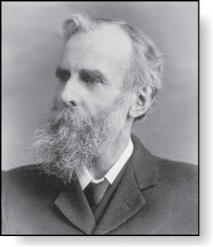
Universal Set and Empty Set
The universal set（全集） U is the set containing everything currently under consideration.
Sometimes implicit
Sometimes explicitly stated.
Contents depend on the context.
The empty set is the set with no
elements. Symbolized ∅, but
{} also used.
Venn Diagram（文氏图）
U
V
a e i
o u
John Venn (1834-1923)
Cambridge, UK

Slide 26
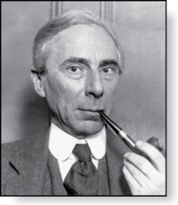
Russell’s Paradox（罗素悖论）
Let S be the set of all sets which are not members of themselves. A paradox results from trying to answer the question “Is S a member of itself?”
Related Paradox:
Henry is a barber who shaves all people who do not shave themselves. A paradox results from trying to answer the question “Does Henry shave himself?”
Bertrand Russell (1872-1970)
Cambridge, UK
Nobel Prize Winner

Slide 27
Some things to remember
Sets can be elements of sets.
{{1,2,3},a, {b,c}}
{N,Z,Q,R}
The empty set is different from a set containing the empty set.
∅ ≠ { ∅ }

Slide 28
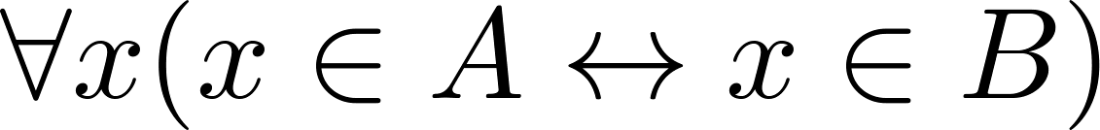
Set Equality
Definition: Two sets are equal if and only if they have the same elements.
Therefore if A and B are sets, then A and B are equal if and only if .
We write A = B if A and B are equal sets.
{1,3,5} = {3, 5, 1}
{1,5,5,5,3,3,1} = {1,3,5}

Slide 29
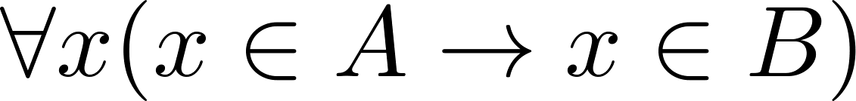
Subsets
Definition: The set A is a subset（子集） of B, if and only if every element of A is also an element of B.
The notation A ⊆ B is used to indicate that A is a subset of the set B.
A ⊆ B holds if and only if is true.
Because a ∈ ∅ is always false, ∅ ⊆ S ,for every set S.
Because a ∈ S → a ∈ S, S ⊆ S, for every set S.

Slide 30
Showing a Set is or is not a Subset of Another Set
Showing that A is a Subset of B: To show that A ⊆ B, show that if x belongs to A, then x also belongs to B.
Showing that A is not a Subset of B: To show that A is not a subset of B, A ⊈ B, find an element x ∈ A with x ∉ B. (Such an x is a counterexample to the claim that x ∈ A implies x ∈ B.)
Examples:
The set of all computer science majors at your school is a subset of all students at your school.
The set of integers with squares less than 100 is not a subset of the set of nonnegative integers.

Slide 31
Another look at Equality of Sets
Recall that two sets A and B are equal, denoted by A = B, iff
Using logical equivalences we have that A = B iff
This is equivalent to
A ⊆ B and B ⊆ A

Slide 32
Proper Subsets
Definition: If A ⊆ B, but A ≠B, then we say A is a proper subset（真子集） of B, denoted by A ⊂ B. If A ⊂ B, then
is true.
Venn Diagram
U
B
A

Slide 33
Set Cardinality
Definition: If there are exactly n distinct elements in S where n is a nonnegative integer, we say that S is finite. Otherwise it is infinite.
Definition: The cardinality of a finite set A, denoted by |A|, is the number of (distinct) elements of A.
Examples:
|ø| = 0
Let S be the letters of the English alphabet. Then |S| = 26
|{1,2,3}| = 3
|{ø}| = 1
The set of integers is infinite.

Slide 34
Power Sets
Definition: The set of all subsets of a set A, denoted P(A), is called the power set（幂集） of A.
Example: If A = {a,b} then
P(A) = {ø, {a},{b},{a,b}}
If a set has n elements, then the cardinality of the power set is 2ⁿ. (In Chapters 5 and 6, we will discuss different ways to show this.)

Slide 35
Tuples
The ordered n-tuple (a₁,a₂,…..,a_{n}) is the ordered collection that has a₁ as its first element and a₂ as its second element and so on until a_{n} as its last element.
Two n-tuples are equal if and only if their corresponding elements are equal.
2-tuples are called ordered pairs（序偶）.
The ordered pairs (a,b) and (c,d) are equal if and only if a = c and b = d.

Slide 36
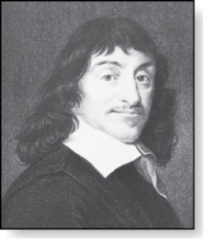
Cartesian Product
René Descartes (1596-1650)
Definition: The Cartesian Product of two sets A and B, denoted by A × B is the set of ordered pairs (a,b) where a ∈ A and b ∈ B .
Example:
A = {a,b} B = {1,2,3}
A × B = {(a,1),(a,2),(a,3), (b,1),(b,2),(b,3)}
Definition: A subset R of the Cartesian product A × B is called a relation（关系） from the set A to the set B. (Relations will be covered in depth in Chapter 9. )

Slide 37
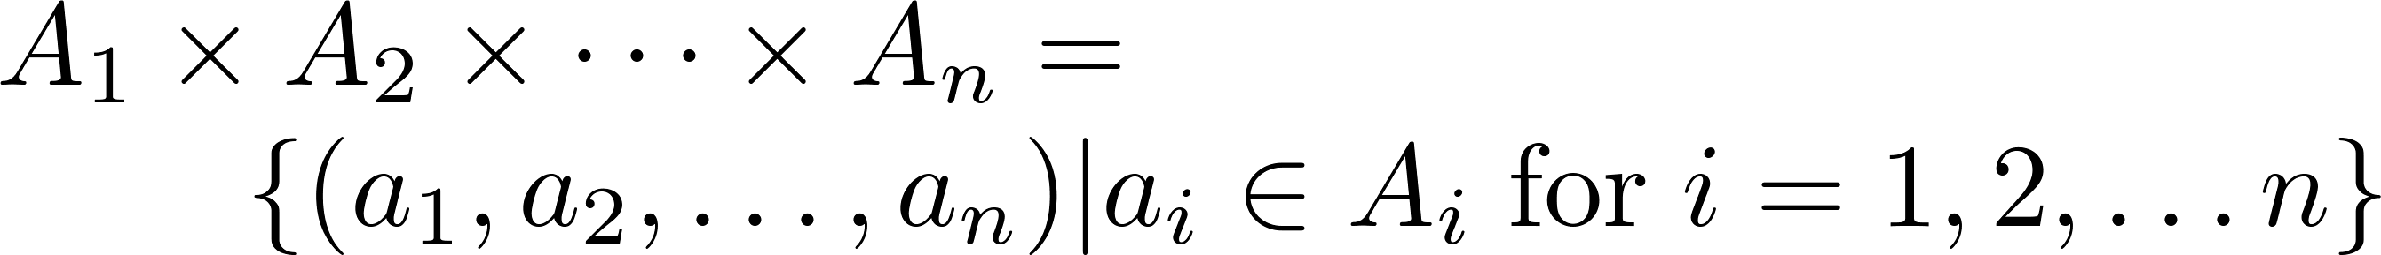
Cartesian Product
Definition: The cartesian products of the sets A₁,A₂,……,A_{n}, denoted by A₁ × A₂ × …… × A_{n} , is the set of ordered n-tuples (a₁,a₂,……,a_{n}) where a_{i} belongs to A_{i} for i = 1, … n.
Example: What is A × B × C where A = {0,1}, B = {1,2} and C = {0,1,2}
Solution: A × B × C = {(0,1,0), (0,1,1), (0,1,2),(0,2,0), (0,2,1), (0,2,2),(1,1,0), (1,1,1), (1,1,2), (1,2,0), (1,2,1), (1,1,2)}

Slide 38
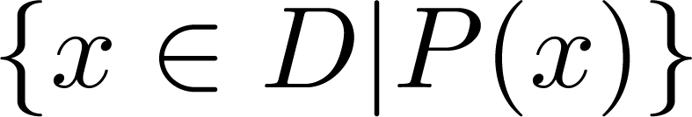
Truth Sets of Quantifiers
Given a predicate P and a domain D, we define the truth set（真值集） of P to be the set of elements in D for which P(x) is true. The truth set of P(x) is denoted by
Example: The truth set of P(x) where the domain is the integers and P(x) is “|x| = 1” is the set {-1,1}

Slide 39
Homework
第8版： Sec. 2.1 13, 20, 24, 26, 34(a),(c)

Slide 40
Set Operations
Section 2.2

Slide 41
Section Summary
Set Operations
Union
Intersection
Complementation
Difference
More on Set Cardinality
Set Identities
Proving Identities
Membership Tables

Slide 42
Boolean Algebra
Propositional calculus and set theory are both instances of an algebraic system called a Boolean Algebra. This is discussed in Chapter 12.
The operators in set theory are analogous to the corresponding operator in propositional calculus.
As always there must be a universal set U. All sets are assumed to be subsets of U.

Slide 43
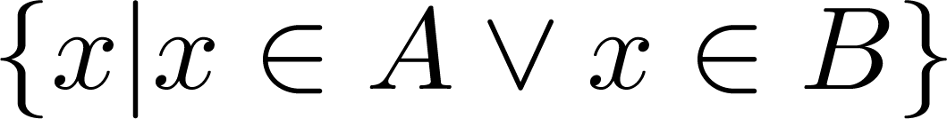
Union
Definition: Let A and B be sets. The union of the sets A and B, denoted by A ∪ B, is the set:
Example: What is {1,2,3} ∪ {3, 4, 5}?
Solution: {1,2,3,4,5}
Venn Diagram for A ∪ B
U
A
B

Slide 44
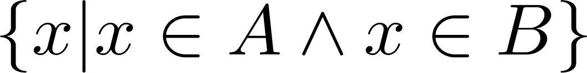
Intersection
Definition: The intersection of sets A and B, denoted by A ∩ B, is
Note if the intersection is empty, then A and B are said to be disjoint.
Example: What is? {1,2,3} ∩ {3,4,5} ?
Solution: {3}
Example:What is?
{1,2,3} ∩ {4,5,6} ?
Solution: ∅
Venn Diagram for A ∩B
U
A
B

Slide 45
Complement
Definition: If A is a set, then the complement of the A (with respect to U), denoted by Ā is the set U - A
Ā = {x ∈ U | x ∉ A}
(The complement of A is sometimes denoted by A^{c} .)
Example: If U is the positive integers less than 100, what is the complement of {x | x > 70}
Solution: {x | x ≤ 70}
Venn Diagram for Complement
U
Ā
A

Slide 46
Difference
Definition: Let A and B be sets. The difference of A and B, denoted by A – B, is the set containing the elements of A that are not in B. The difference of A and B is also called the complement of B with respect to A.
A – B = {x | x ∈ A ∧ x ∉ B} = A ∩‾B
U
Venn Diagram for A − B
A
B

Slide 47
The Cardinality of the Union of Two Sets
Inclusion-Exclusion（容斥原理）
|A ∪ B| = |A| + | B| - |A ∩ B|
Example: Let A be the math majors in your class and B be the CS majors. To count the number of students who are either math majors or CS majors, add the number of math majors and the number of CS majors, and subtract the number of joint CS/math majors.
We will return to this principle in Chapter 6 and Chapter 8 where we will derive a formula for the cardinality of the union of n sets, where n is a positive integer.
U
A
B
Venn Diagram for A, B, A ∩ B, A ∪ B

Slide 48
Review Questions
Example: U = {0,1,2,3,4,5,6,7,8,9,10} A = {1,2,3,4,5}, B ={4,5,6,7,8}
A ∪ B
Solution: {1,2,3,4,5,6,7,8}
A ∩ B
Solution: {4,5}
Ā
Solution: {0,6,7,8,9,10}
Solution: {0,1,2,3,9,10}
A – B
Solution: {1,2,3}
B – A
Solution: {6,7,8}

Slide 49

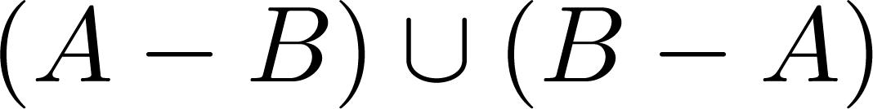
Symmetric Difference (optional)
Definition: The symmetric difference（对称差） of A and B, denoted by is the set
Example:
U = {0,1,2,3,4,5,6,7,8,9,10}
A = {1,2,3,4,5} B ={4,5,6,7,8}
What is:
Solution: {1,2,3,6,7,8}
U
A
B
Venn Diagram

Slide 50
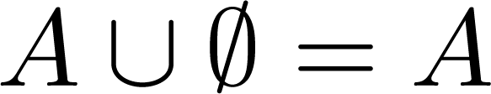


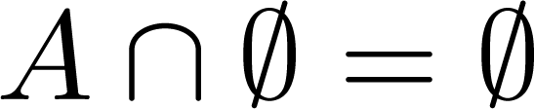


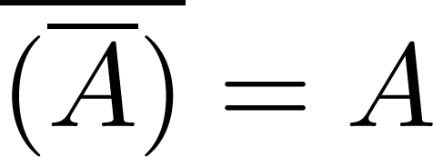
Set Identities
Identity laws（恒等律）
Domination laws（支配律）
Idempotent laws（幂等律）
Complementation law（补律）
Continued on next slide →

Slide 51


Set Identities
Commutative laws（交换律）
Associative laws（结合律）
Distributive laws（分配律）
Continued on next slide →

Slide 52


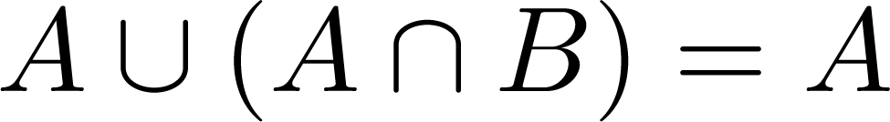
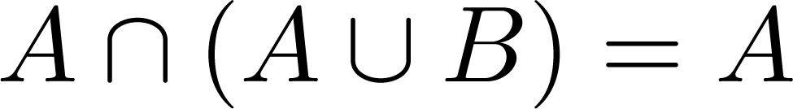
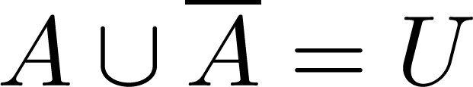
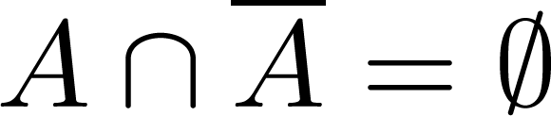
Set Identities
De Morgan’s laws（德摩根律）
Absorption laws（吸收律）
Complement laws（互补律）

Slide 53
Proving Set Identities
Different ways to prove set identities:
Prove that each set (side of the identity) is a subset of the other.
Use set builder notation and propositional logic.
Membership Tables: Verify that elements in the same combination of sets always either belong or do not belong to the same side of the identity. Use 1 to indicate it is in the set and a 0 to indicate that it is not.

Slide 54
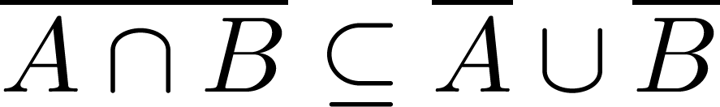

Proof of Second De Morgan Law
Example: Prove that
Solution: We prove this identity by showing that:
1) and
2)
Continued on next slide →

Slide 55
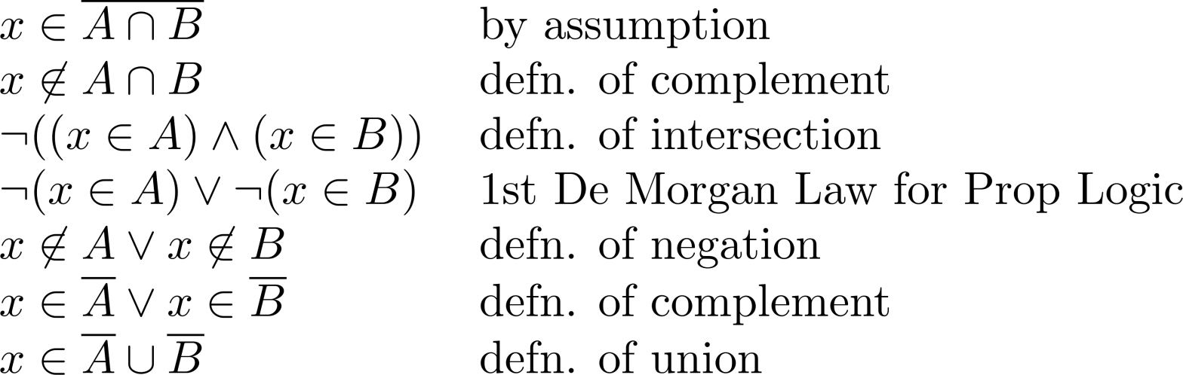
Proof of Second De Morgan Law
These steps show that:
Continued on next slide →

Slide 56
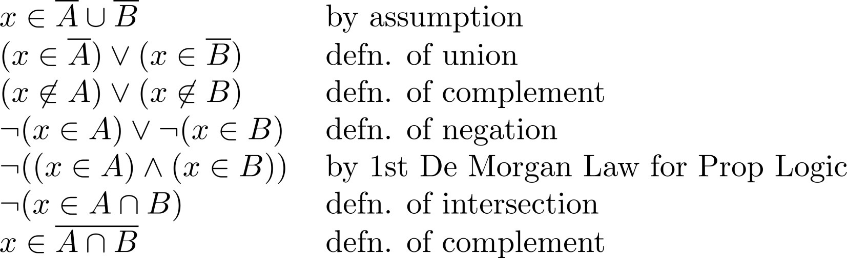
Proof of Second De Morgan Law
These steps show that:

Slide 57
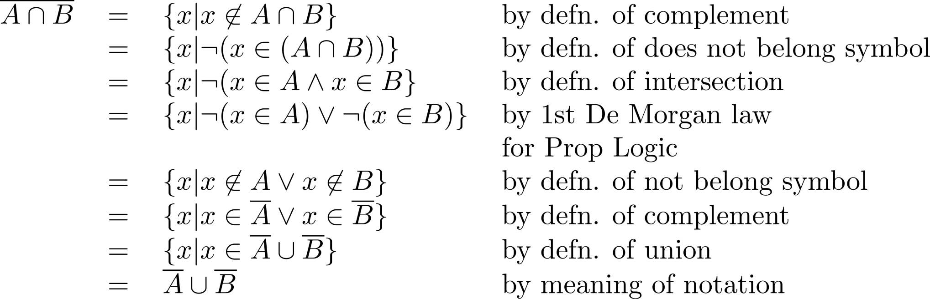
Set-Builder Notation: Second De Morgan Law

Slide 58





Membership Table
Example:
Construct a membership table to show that the distributive law holds.
Solution:
A | B | C
1 | 1 | 1 | 1 | 1 | 1 | 1 | 1
1 | 1 | 0 | 0 | 1 | 1 | 1 | 1
1 | 0 | 1 | 0 | 1 | 1 | 1 | 1
1 | 0 | 0 | 0 | 1 | 1 | 1 | 1
0 | 1 | 1 | 1 | 1 | 1 | 1 | 1
0 | 1 | 0 | 0 | 0 | 1 | 0 | 0
0 | 0 | 1 | 0 | 0 | 0 | 1 | 0
0 | 0 | 0 | 0 | 0 | 0 | 0 | 0

Slide 59
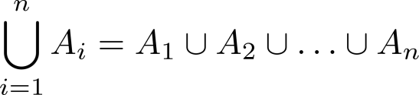
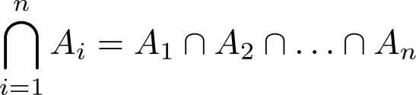
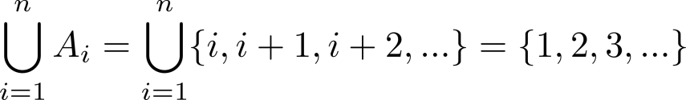
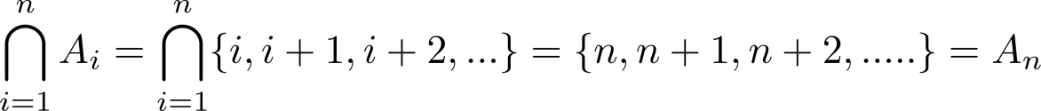
Generalized Unions and Intersections
Let A₁, A₂ ,…, A_{n} be an indexed collection of sets.
We define:
These are well defined, since union and intersection are associative.
For i = 1,2,…, let A_{i} = {i, i + 1, i + 2, ….}. Then,

Slide 60
Computer Representation of Set
Using bit strings to represent sets.
Specify an arbitrary ordering of the elements of U,
for instance
(2) Represent a subset A of U with the bit string of length n, where the ith bit is 1 if belongs to A and is 0 if does not belong to A.
Union: bitwise OR
Intersection: bitwise AND

Slide 61
〖Example 〗 Let U ={1, 2, 3, 4, 5,6,7,8,9}, A={1, 2, 3, 4, 5}, B= (1, 3, 5, 7, 9). Use bit strings to find the difference of A and B.
solution:
The bit string for the set A: 11 1110 000
The bit string for the set B: 10 1010 101
A - B = A ∩‾B

Slide 62
Homework
第8版： Sec. 2.2 19, 54, 63(c)

Slide 63
Functions
Section 2.3

Slide 64
Section Summary
Definition of a Function.
Domain（定义域）, Codomain（陪域）
Image（像）, Preimage （原像）
Injection（单射）, Surjection（满射）, Bijection（双射）
Inverse Function（反函数）
Function Composition（函数组合）
Graphing Functions
Floor, Ceiling, Factorial
Partial Functions (optional)

Slide 65
Functions
Definition: Let A and B be nonempty sets. A function f from A to B, denoted f: A → B is an assignment of each element of A to exactly one element of B. We write f(a) = b if b is the unique element of B assigned by the function f to the element a of A.
∀a(a ∈A → ∃!b (b ∈B ∧ f (a)=b))
Functions are sometimes
called mappings or
transformations.
Students
Grades
A
Carlota Rodriguez
B
Sandeep Patel
C
Jalen Williams
D
F
Kathy Scott

Slide 66
Functions
A function f: A → B can also be defined as a subset of A×B (a relation). This subset is restricted to be a relation where no two elements of the relation have the same first element.
Specifically, a function f from A to B contains one, and only one ordered pair (a, b) for every element a∈ A.
and

Slide 67
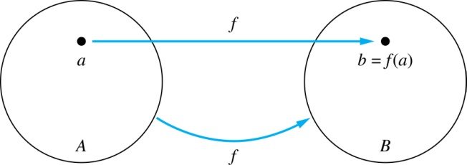
Functions
Given a function f: A → B:
We say f maps A to B or
f is a mapping from A to B.
A is called the domain of f.
B is called the codomain of f.
If f(a) = b,
then b is called the image of a under f.
a is called the preimage of b.
The range（值域） of f is the set of all images of points in A under f. We denote it by f(A).
Two functions are equal when they have the same domain, the same codomain and map each element of the domain to the same element of the codomain.

Slide 68
Representing Functions
Functions may be specified in different ways:
An explicit statement of the assignment.
Students and grades example.
A formula.
f(x) = x + 1
A computer program.
A Java program that when given an integer n, produces the nth Fibonacci Number (covered in the next section and also inChapter 5).

Slide 69
Questions
z
A
B
f(a) = ?
The image of d is ?
z
a
x
The domain of f is ?
A
b
y
The codomain of f is ?
B
c
d
z
The preimage of y is ?
b
f(A) = ?
{y,z}
The preimage(s) of z is (are) ?
{a,c,d}

Slide 70
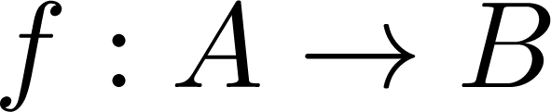
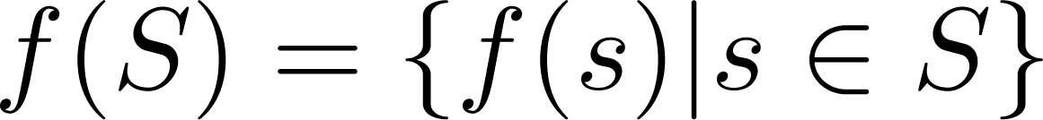
Question on Functions and Sets
If and S is a subset of A, then
A
B
f {a,b,c,} is ?
{y,z}
a
x
f {c,d} is ?
b
{z}
y
c
d
z

Slide 71
Injections
Definition: A function f is said to be one-to-one , or injective, if and only if f(a) = f(b) implies that a = b for all a and b in the domain of f. A function is said to be an injection if it is one-to-one.
A
B
a
x
v
b
y
c
z
d
w

Slide 72

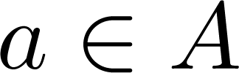
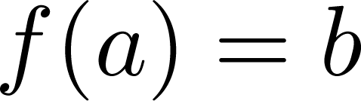
Surjections
Definition: A function f from A to B is called onto or surjective, if and only if for every element there is an element with . A function f is called a surjection if it is onto.
A
B
a
x
b
y
c
z
d

Slide 73
Bijections
Definition: A function f is a one-to-one correspondence, or a bijection, if it is both one-to-one and onto (surjective and injective).
A
B
a
x
b
y
c
d
z
w

Slide 74
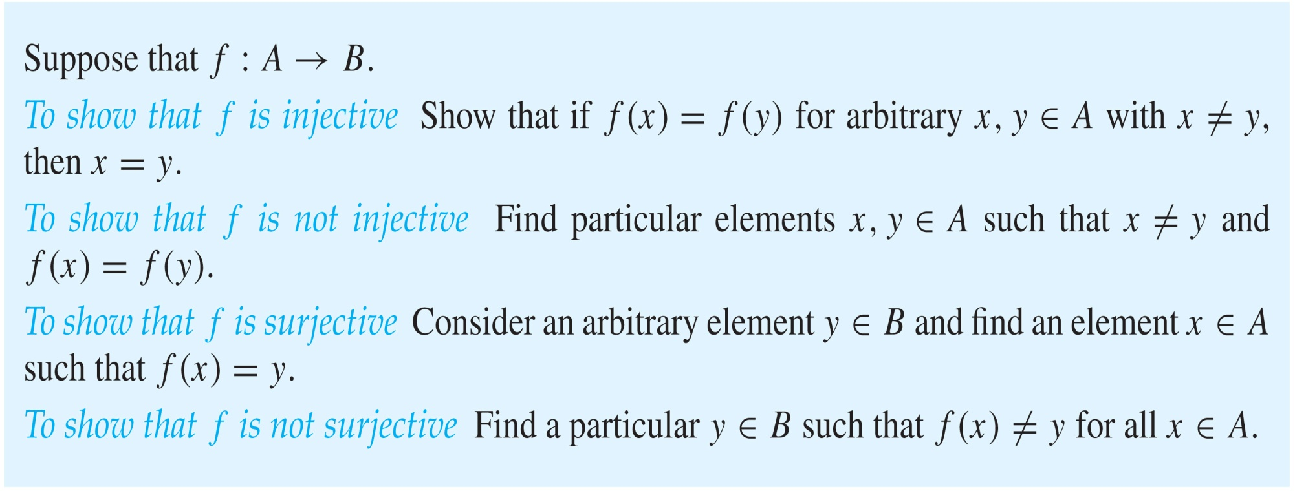
Showing that f is one-to-one or onto

Slide 75
Showing that f is one-to-one or onto
Example 1: Let f be the function from {a,b,c,d} to {1,2,3} defined by f(a) = 3, f(b) = 2, f(c) = 1, and f(d) = 3. Is f an onto function?
Solution: Yes, f is onto since all three elements of the codomain are images of elements in the domain. If the codomain were changed to {1,2,3,4}, f would not be onto.
Example 2: Is the function f(x) = x² from the set of integers onto?
Solution: No, f is not onto because there is no integer x with x² = −1, for example.

Slide 76
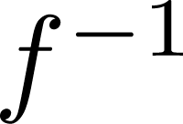
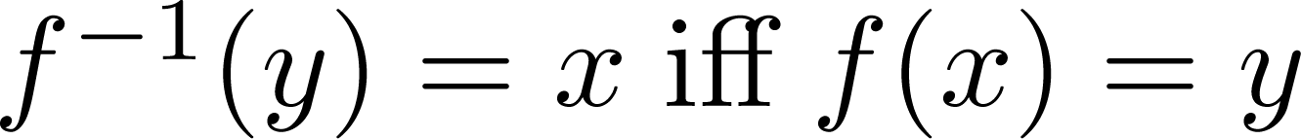
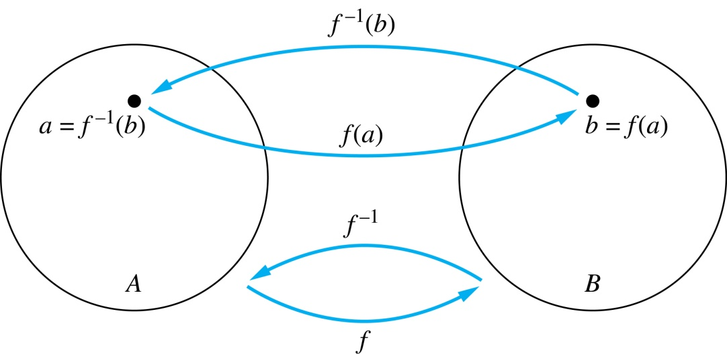
Inverse Functions
Definition: Let f be a bijection from A to B. Then the inverse of f, denoted , is the function from B to A defined as
No inverse exists unless f is a bijection. Why?

Slide 77
Inverse Functions
A
B
A
B
f
a
V
V
a
b
b
W
W
c
c
d
X
X
d
Y
Y

Slide 78
Questions
Example 1: Let f be the function from {a,b,c} to {1,2,3} such that f(a) = 2, f(b) = 3, and f(c) = 1. Is f invertible and if so what is its inverse?
Solution: The function f is invertible because it is a one-to-one correspondence. The inverse function f⁻¹ reverses the correspondence given by f, so f⁻¹ (1) = c, f⁻¹ (2) = a, and f⁻¹ (3) = b.

Slide 79
Questions
Example 2: Let f: Z → Z be such that f(x) = x + 1. Is f invertible, and if so, what is its inverse?
Solution: The function f is invertible because it is a one-to-one correspondence. The inverse function f⁻¹ reverses the correspondence so f⁻¹ (y) = y – 1.

Slide 80
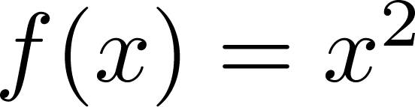
Questions
Example 3: Let f: R → R be such that . Is f invertible, and if so, what is its inverse?
Solution: The function f is not invertible because it is not one-to-one .

Slide 81
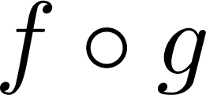
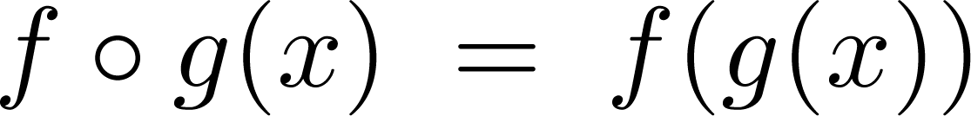
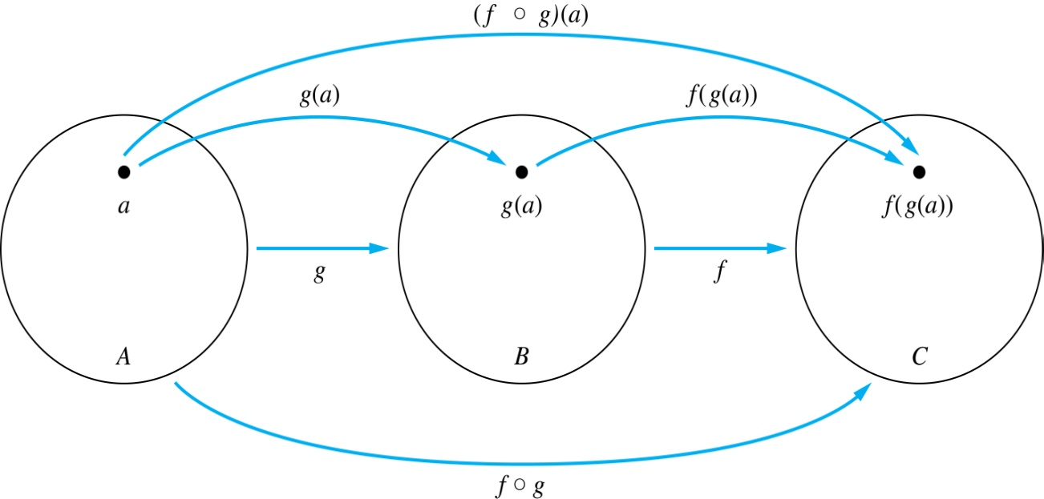
Composition
Definition: Let f: B → C, g: A → B. The composition of f with g, denoted is the function from A to C defined by

Slide 82
Composition
A
g
B
f
C
A
C
V
a
a
h
h
b
i
b
W
i
c
c
X
j
d
d
j
Y

Slide 83
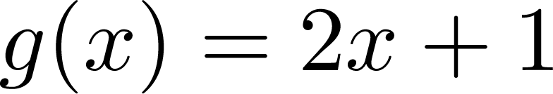
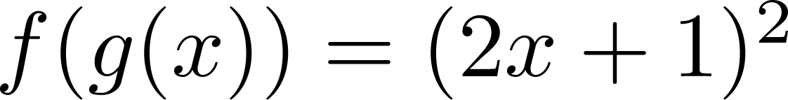
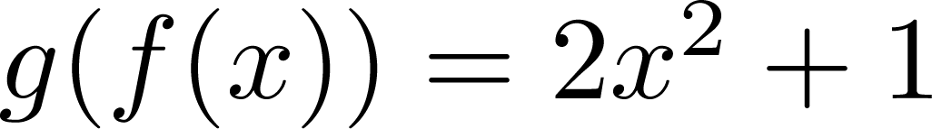
Composition
Example 1: If and , then
and

Slide 84
Composition Questions
Example 2: Let g be the function from the set {a,b,c} to itself such that g(a) = b, g(b) = c, and g(c) = a. Let f be the function from the set {a,b,c} to the set {1,2,3} such that f(a) = 3, f(b) = 2, and f(c) = 1.
What is the composition of f and g, and what is the composition of g and f.
Solution: The composition f∘g is defined by
f∘g (a)= f(g(a)) = f(b) = 2.
f∘g (b)= f(g(b)) = f(c) = 1.
f∘g (c)= f(g(c)) = f(a) = 3.
Note that g∘f is not defined, because the range of f is not a subset of the domain of g.

Slide 85
Composition Questions
Example 2: Let f and g be functions from the set of integers to the set of integers defined by f(x) = 2x + 3 and g(x) = 3x + 2.
What is the composition of f and g, and also the composition of g and f ?
Solution:
f∘g (x)= f(g(x)) = f(3x + 2) = 2(3x + 2) + 3 = 6x + 7
g∘f (x)= g(f(x)) = g(2x + 3) = 3(2x + 3) + 2 = 6x + 11

Slide 86
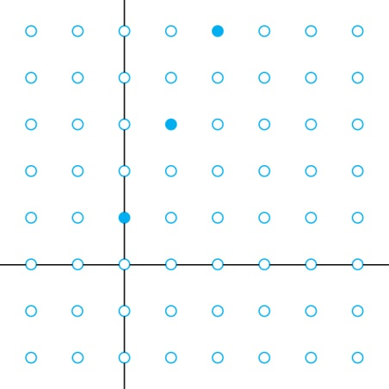
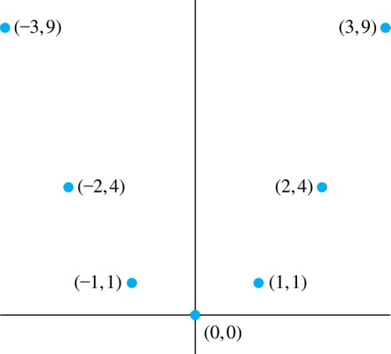
Graphs of Functions
Let f be a function from the set A to the set B. The graph of the function f is the set of ordered pairs {(a,b) | a ∈A and f(a) = b}.
Graph of f(n) = 2n + 1
from Z to Z
Graph of f(x) = x²
from Z to Z

Slide 87
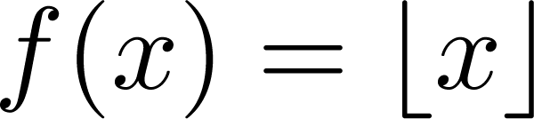
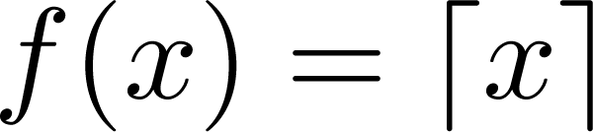
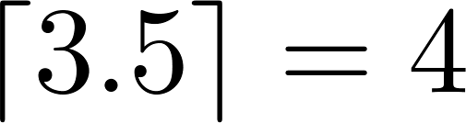



Some Important Functions
The floor function, denoted
is the largest integer less than or equal to x.
The ceiling function, denoted
is the smallest integer greater than or equal to x
Example:

Slide 88

Floor and Ceiling Functions
Graph of (a) Floor and (b) Ceiling Functions

Slide 89

Floor and Ceiling Functions

Slide 90
Proving Properties of Functions
Example: Prove that x is a real number, then
⌊2x⌋= ⌊x⌋ + ⌊x + 1/2⌋
Solution: Let x = n + ε, where n is an integer and 0 ≤ ε< 1.
Case 1: ε < ½
2x = 2n + 2ε and ⌊2x⌋ = 2n, since 0 ≤ 2ε< 1.
⌊x + 1/2⌋ = n, since x + ½ = n + (1/2 + ε ) and 0 ≤ ½ +ε < 1.
Hence, ⌊2x⌋ = 2n and ⌊x⌋ + ⌊x + 1/2⌋ = n + n = 2n.
Case 2: ε ≥ ½
2x = 2n + 2ε = (2n + 1) +(2ε − 1) and ⌊2x⌋ =2n + 1, since 0 ≤ 2 ε - 1< 1.
⌊x + 1/2⌋ = ⌊ n + (1/2 + ε)⌋ = ⌊ n + 1 + (ε – 1/2)⌋ = n + 1 since 0 ≤ ε – 1/2< 1.
Hence, ⌊2x⌋ = 2n + 1 and ⌊x⌋ + ⌊x + 1/2⌋ = n + (n + 1) = 2n + 1.

Slide 91

Factorial（阶乘） Function
Definition: f: N → Z⁺ , denoted by f(n) = n! is the product of the first n positive integers when n is a nonnegative integer.
f(n) = 1 ∙ 2 ∙∙∙ (n – 1) ∙ n, f(0) = 0! = 1
Examples:
^{f(1) = 1! = 1}
^{f(2) = 2! = 1 ∙ 2 = 2}
^{f(6) = 6! = 1 ∙ 2 ∙ 3∙ 4∙ 5} ^{∙ 6 = 720}
f(20) = 2,432,902,008,176,640,000.
Stirling’s Formula:

Slide 92
Partial Functions (optional)
Definition: A partial function f from a set A to a set B is an assignment to each element a in a subset of A, called the domain of definition of f, of a unique element b in B.
The sets A and B are called the domain and codomain of f, respectively.
We day that f is undefined for elements in A that are not in the domain of definition of f.
When the domain of definition of f equals A, we say that f is a total function(全函数).
Example: f: Z → R where f(n) = √n is a partial function from Z to R where the domain of definition is the set of nonnegative integers. Note that f is undefined for negative integers.

Slide 93
Homework
第八版 Sec. 2.3 22(c), 36, 42(a), 74, 76(c,d)

