Slide 1
ML Project: Defending Adversarial Attacks
Xuan Wu, Gary Yang, Heidi Zhang, Jinhan Zhang
Track: Methods, Robust Machine Learning

Slide 2
Problem Definition
Model Robustness
(Robust Prediction) Want model perform well when test data is perturbed
(Robust Training) Want model be able to do reasonably well, when training data is perturbed,
Attack
Adversarial Attack: introduce data perturbations such that the prediction will not be the true label
white box, black box: whether the attacker has access to the model
Defense
Our goal: Develop methods that make training/testing robust against adversarial attacks.
Data & Model
Classification problem on high-dimensional (64 dimensions) image data
Greyscale handwritten digits
All experiments are done with SVM
Notes:
We’ve considered using CNN in our proposal since it does well on image data and there are a lot of literature on robustness of deep networks. But ultimately we decided to stick with SVM to limit the scope of this project.

Slide 3
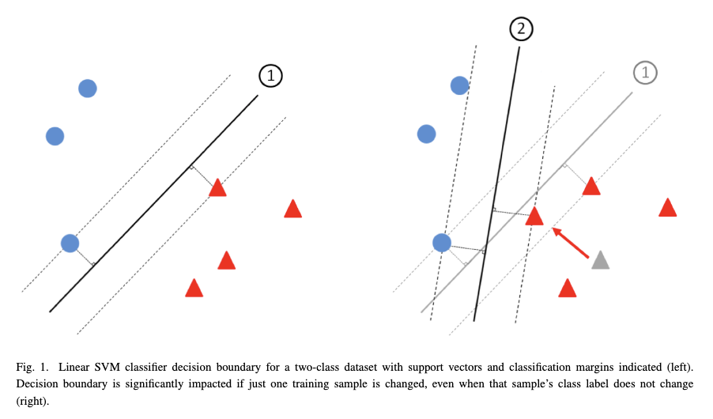
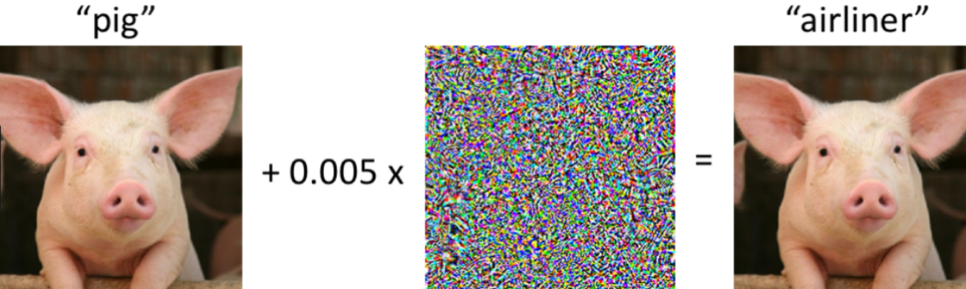
Why is this an interesting problem?
Real-world data are noisy and less representative than expected
Machine learning system is being used in high-stake applications
Autonomous vehicles, computer integrated surgeries, medical image analysis
Robustness isn’t specific to any particular model or field
Misleading information; representativeness
From NIST Taxonomy of Adversarial ML

Slide 4

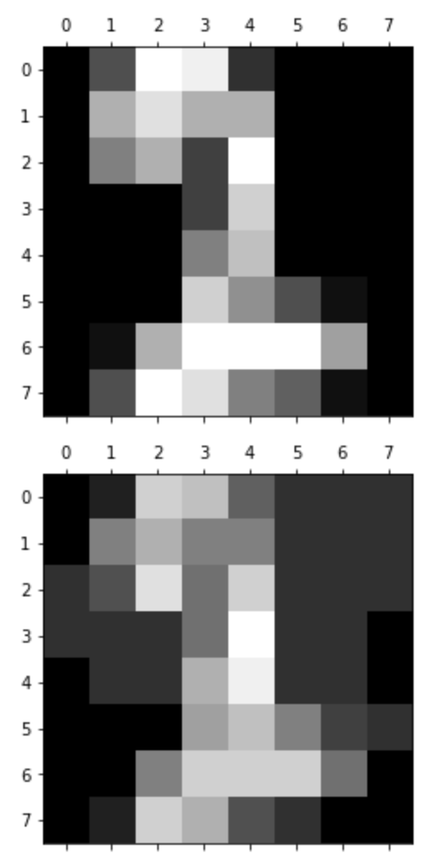


Dataset
Handwritten digits dataset
1797 examples in total
64 pixels, valued between [0,16]
10 labels
train / test: 8 / 2
Adversarial Attack
Evasion
Fast Gradient Method
Jacobian Saliency Method
Poisoning
Backdoor (blackbox)
Fast gradient attack, before (top) and after (bottom)
Ref: ART [1], Dataset [2,3]
Notes:
Digits dataset adapted from the test set of Optical Recognition of Handwritten Digits Data.
Preprocessing: PCA

Slide 5
Baselines
SVM model with RBF kernel model = SVC(C=1.0, kernel="rbf")
1. trained and tested on unperturbed data
2. trained with unperturbed data, tested on perturbed data
3. trained with perturbed data, tested on unperturbed data
(1) is the desired upper baseline
(2), (3) are the lower baselines serving two different experiment goals
Adverse train/test examples:
Fast Gradient with epsilon=3

Slide 6
PCA
Apply dimensionality reduction help protect against adversarial attacks
Unperturbed training & testing set ~98%
PCA on unperturbed training & testing set (20 components) ~98%
Perturb training set & maintain testing set
W/o PCA, the accuracy is ~63%
W/ PCA (20 components), the accuracy is ~77%
Perturb testing set & maintain training set
W/o PCA, the accuracy is ~56%
W/ PCA (20 components), the accuracy is ~62%
Notes:
PCA is a form of feature selection. Reduce dimensions

Slide 7
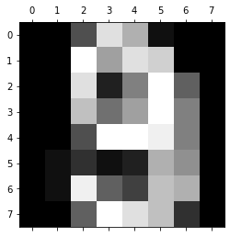
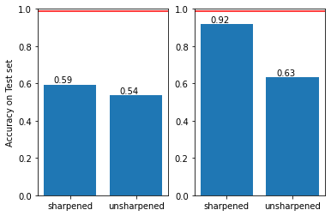
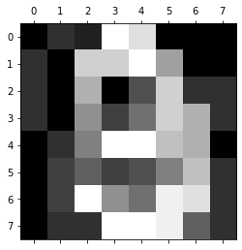
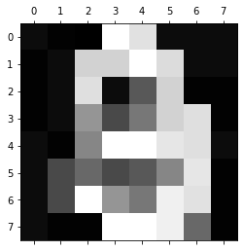
Sharpening (Recover Data)
Original Image
Just recover it!
Mid-dark -> darker
Mid-bright -> bright
Δ depends on pixel’s distance from mean
Robust Prediction
Robust Training
All intact
0.986
Perturbed Image
Sharpened Image
Train intact; Test perturbed
Train perturbed; Test intact
Notes:
Peek at the attacking result: edge blurred → just need to recover the

Slide 8
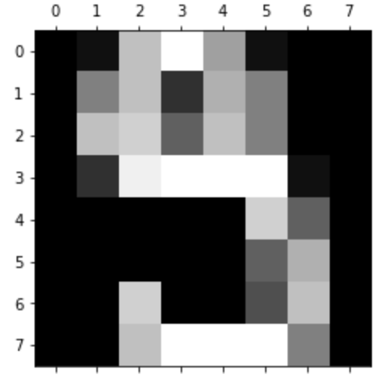
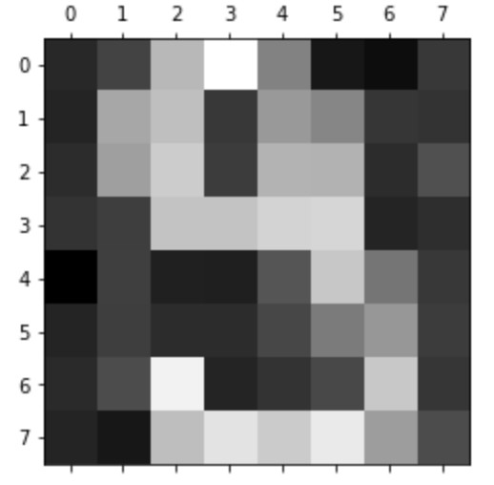
Method: Adversarial Training & Data Augmentation
Train with additional perturbed examples so that the model is more robust
For each original data point x, add:
1. Perturbed example drawn from a Multivariate Gaussian distribution centered at x, with random covariance matrix
2. (JS) Adversarial example crafted with Jacobian Saliency Method (only 100, concatenated)
3. (FG) Adversarial example crafted with Fast Gradient Method, epsilon=1
example Gaussian perturbation (right)

Slide 9
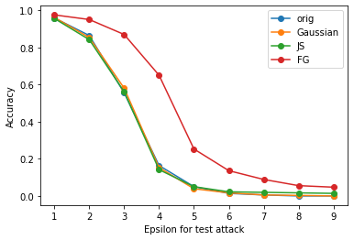
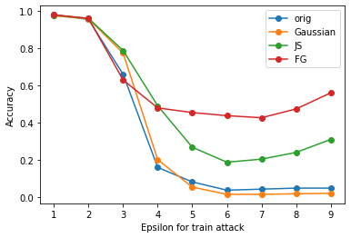
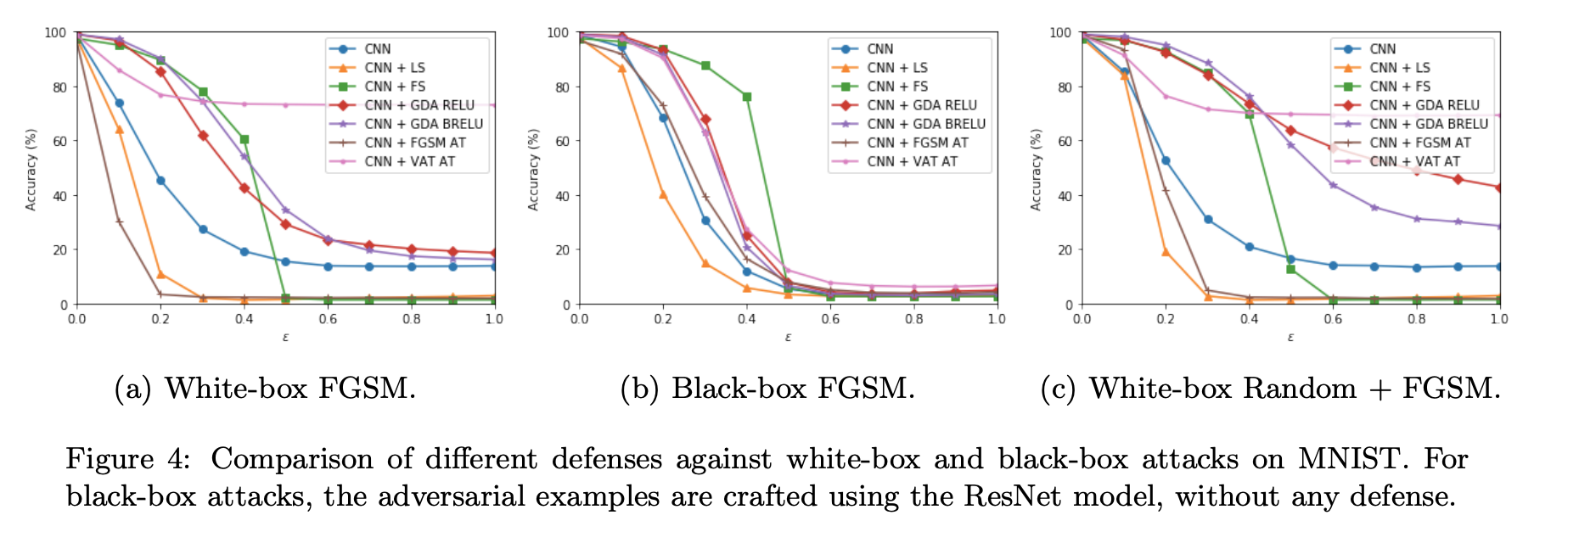
Test data perturbed, training data intact
Training data perturbed, test data intact
Baseline
Baseline
epsilon: strength of attack
Gaussian augmentation does well when epsilon is small; FG does better for larger epsilon
FG augmentation does the best on perturbed test data
[5] Efficient Defenses Against Adversarial Attacks,
Zantedeschi, et al, 2017
Notes:
The original paper used CNN on MNIST dataset

Slide 10
Method: Iterative Learning
Guess the set of attacked samples.
Remove the guessed set, train SVM on the remaining.
Repeat the above for multiple iterations.
Intuition: Strengthen the performance by picking a subset of data.

Slide 11
Method: Iterative Learning (cont.)
How to guess?
1. Remove “the mispredicted sample” with probability p. Remove the “correctly labelled sample” with probability q<p. Set p,q properly.
p=0.5,q=0.2: Accuracy: 60%-->65%
(baseline: SVM with RBF kernel with training data perturbed)
2. Weight every sample and use adaptive sampling to choose a subset.
TBD.

Slide 12

Deliverables
Expect to accomplish (Main method)
1. Go through the same process as above with Neural Network (in particular, CNN).
Focus on one model instead
2. Develop a robust training algorithm adapted from the idea of feedback learning
3. Evaluate the performance of the models against baseline.
Would like to accomplish (Other papers’ results)
1. SVM kernel methods to handle adversaries
2. Experiment with other stability training algorithms
3. Experiment with the denoising and verification ensembles approach for CNN
Must accomplish (Setup)
1. Obtain the digits dataset; detect and eliminate outliers.
Well-studied
2. PCA on training data
3. Attack data using ART. Check accuracy.
Spent a lot of time to explore the attackers
Sharpening and Data Augmentation methods
(Almost)
Notes:
Difficult: come up with a new algorithm

Slide 13
What we’ve learned
Relevant course topics
Practical ML, adversarial training
SVM
PCA
HW3 Lab Assignment (feature selection and noise reduction); real-world noisy data

Slide 14
What we’ve learned (cont.)
Surprising Aspects
ML algorithms are prone to the effect of adverse examples
Simple approaches may significantly improve the performance
Blackbox poisoning doesn’t decrease the accuracy
If do it again
Refining goal: we ended up solving 2 tasks (robust training vs prediction)
Question: how the choice of attacker influences our approach to solve the robustness problem
Notes:
Blackbox attacks are much harder. The accuracy actually increased when we tried backdoor attack (blackbox poisoning) on our data. (Poison the whole dataset.)
poisoning is more used in training, whereas evasion is more often used in prediction

Slide 15
References
[1] Maria-Irina Nicolae, Mathieu Sinn, Minh Ngoc Tran, Beat Buesser, Ambrish Rawat, Martin Wistuba, Valentina Zantedeschi, Nathalie Baracaldo,Bryant Chen, Heiko Ludwig, Ian Molloy, and Ben Edwards. Adversarial robustness toolbox v1.2.0.CoRR, 1807.01069, 2018
[2] Ethem Alpaydin and Cenk Kaynak. CASCADING CLASSIFIERS. page 7
[3] L. Xu, A. Krzyzak, and C.Y. Suen. Methods of combining multiple classifiers and their applications to handwriting recognition.IEEE Transactionson Systems, Man, and Cybernetics, 22(3):418–435, June 1992.
[4] A. N. Bhagoji, D. Cullina, C. Sitawarin and P. Mittal, "Enhancing robustness of machine learning systems via data transformations," 2018 52nd Annual Conference on Information Sciences and Systems (CISS), Princeton, NJ, 2018, pp. 1-5, doi: 10.1109/CISS.2018.8362326. Page 10
[5] Valentina Zantedeschi, Maria-Irina Nicolae, Ambrish Rawat, Efficient Defenses Against Adversarial Attacks, 2017.
[6] https://nvlpubs.nist.gov/nistpubs/ir/2019/NIST.IR.8269-draft.pdf

