Slide 1
HW5
ChenyuanWang 15620161152281

Slide 2
Some sentences of ROMEO and JULIET
vec_abs<-c(
"ROMEO: Shall I hear more，or shall I speak at this?",
"JULIET: 'Tisbut thy name that is my enemy; Thou art thyself，though not a Montague. What's Montague? it is nor hand, nor foot, Nor arm, nor face, nor any other part Belonging to a man. O, be some other name! What's in a name? that which we call a roseBy any other name would smell as sweet; So Romeo would, were he not Romeo call'd, Retain that dear perfection which he owes Without that title. Romeo, doffthy name, And for that name which is no part of thee Take all myself.",
"ROMEO: I take thee at thy word: Call me but love, and I'll be new baptized, HenceforthI never will be Romeo. ",
"JULIET: What man art thou that thus bescreen'din night So stumblest on my counsel? " )

Slide 3
Create a corpus & Term Document Matrix
library(NLP)
library(tm)
library(SnowballC)
abs = Corpus(VectorSource(vec_abs))
abs_dtm = DocumentTermMatrix(abs, control = list(
stemming = TRUE, stopwords = TRUE, minWordLength = 3,
removeNumbers = TRUE, removePunctuation = TRUE))
dim(abs_dtm)
inspect(abs_dtm)

Slide 4
Remove sparse terms
removeSparseTerms(abs_dtm, 0.5)
inspect(removeSparseTerms(abs_dtm, 0.5))

Slide 5
HW5.1 Do a word cloud for Shakesspeare’s dramas.
library(ggplot2)
library(RColorBrewer)
library(wordcloud)
freq = colSums(as.matrix(abs_dtm))
wf = data.frame(word=names(freq), freq=freq)
dark2 = brewer.pal(6, "Dark2")
wordcloud(names(freq), freq, max.words=100, rot.per=0.2, colors=dark2)

Slide 6
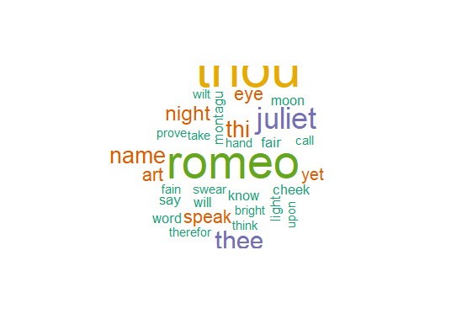

Slide 7
HW5.2 Calculate the histogram of words
plot = ggplot(subset(wf, freq>1), aes(word, freq))
plot = plot + geom_bar(stat="identity")
plot = plot + theme(axis.text.x=element_text(angle=45, hjust=1))
plot

Slide 8
