Slide 1
To click or not to click?
A predictive model based on Bayesian and logistic regression theory to investigate the attributes customers who would click on more of the advertisements placed.
Group 11
12-03-2022

Slide 2
BUSINESS PROBLEM -what and how

Slide 3
Business Problem Definition
How to achieve precise control of advertising costs？
Know your customers
What kind of customers(with what attributes) would tend to click on the advertisement?
HOW?
A predictive model is used to train a model on sample data of user behavior after ad placement to predict and summarize the profile of users who are more inclined to click on ads in the specified scenario of the sample data
Notes:
Nls 帮忙改一下看看视觉怎么修改🙏

Slide 4
Data Preprocessing

Slide 5
Dataset Preparation
Dataset Understanding
Data Preprocessing
Training & Test Data
Data size: 110,000
Data source: Taobao
Data structure:
ad_feature.csv：a description of the advertiser who placed the ad
raw_sample.csv：statistics on the basic information of the ad placement
user_profile.csv：a description of the user profile
Data linkage: By linking user_id and adgroup_id, we merge raw_sample, ad_feature and user_profile into one dataset
Randomly selected 20,000 of 110,000 pieces of data
Missing value: Removing missing values and undefined attributes
Split data set into training and test data (7:3)
Attributes Stratification
Age level
Price
Time
Build a logistic regression and a Bayesian classification model classification model respectively

Slide 6
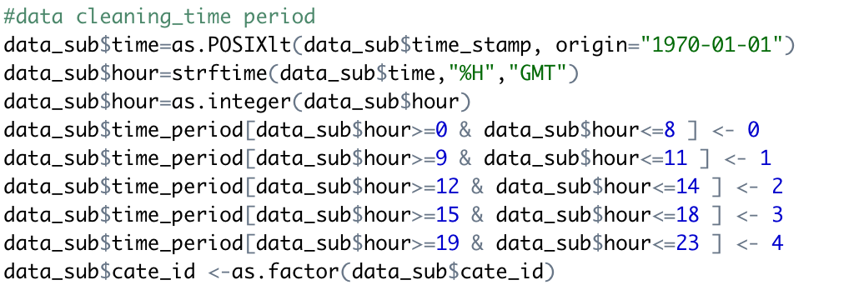
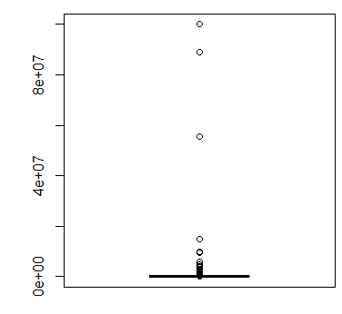
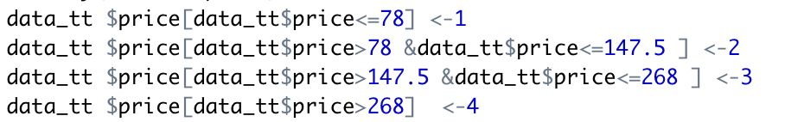
Attributes Stratification
Time
Age Level
Stratify 24 hours into 5 levels based on the daily rhythm of a person's life during the day
Original Data | Process Decision
0:0-18 | Remove.
Group1(18-24) & Group2(25-34) | Maintain still.
Group3(35-44) & Group 4(45-54) | Merge into Group 3(35-54)
Group5(55-64) & Group6:65+ | Merge into Group 4: 55+
Period | Time Level
0-8 | 0
9-11 | 1
12-14 | 2
15-18 | 3
19-23 | 4
Price
According to the boxplot, we deleted the values above the 3rd quartile, which are defined as extreme values, and to classify the prices, we defined four classes according to the quantile as (0,78], (78,147.5], (147.5,268] and the last level is price higher than 268

Slide 7
Attribute Appendix
Variable Name | Interpretation
Gender | Gender. 1 for male , 2 for female
Shopping level | Shopping depth. 1: shallow user, 2: moderate user, 3: depth user
Occupation | Is the college student? 1 for yes, 0 for no
Time period | Time period of 24 hours. 0 for 0-8 a.m.; 1 for 9-11 a.m.; 2 for 12-14 p.m.; 3 for 15-18 p.m.;4 for 19-23 p.m.
New user class level | City level based on shopping behavior in 22 days. 1 for 1st tier cities; 2 for 2nd tier cities; 3 for 3rd tier cities; 4 for other cities
Age | Age. 1 for age 18-24; 2 for age 25-34; 3 for age 35-54; 4 for age 55+
P-value | Consumption grade, 1: low, 2: mid, 3: high
Price | Purchased product price. 1 for (0,78]; 2 for (78,147.5]; 3 for (147.5,268]; 4 for price higher than 268

Slide 8
Logistic Regression

Slide 9
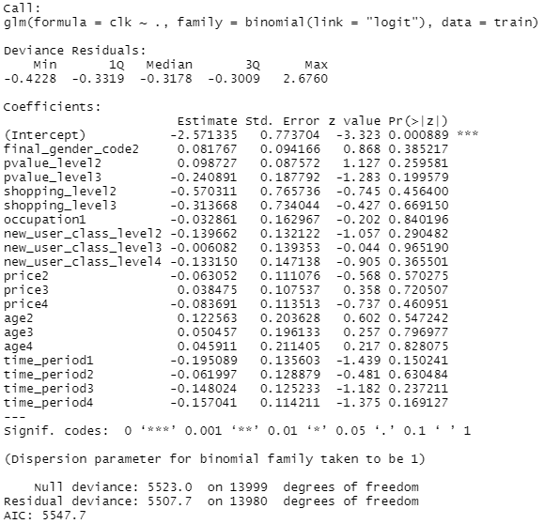
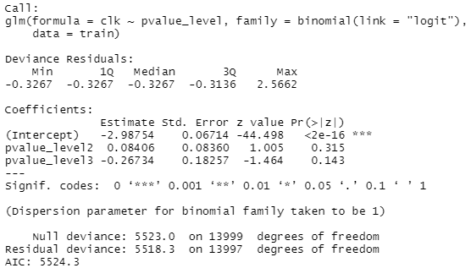
Model Building
Regression with all variables
STEPWISE
Regression after selection
Result: only pvalue_level is left
Basic Idea:
Add or subtract each variable from the set of explanatory variables based on AIC
Criteria: Least AIC

Slide 10

Evaluation
Test_dataset Confusion Matrix
Possible Reason
Actual
 | 1 | 0
1 | 0 | 0
0 | 266 | 5734
* 0 – not click 1 - click
Predicted
Click
Not click
Problem
Model can only predict “0”, which means it can not distinguish click customers
Significant volume difference
between “click "and "not click “, making model more likely to predict “not click" then “click”
Notes:
Model result应该有改动，记得看看cm是不是有变化

Slide 11
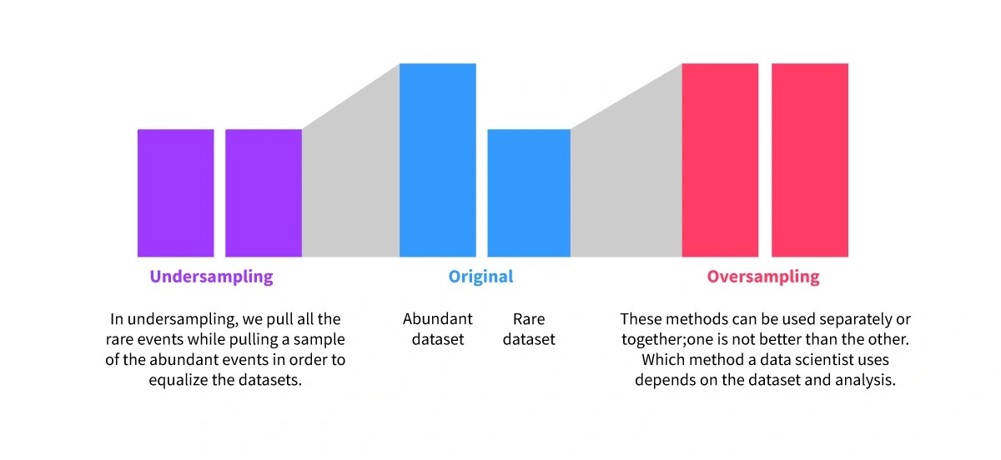
Improvement: handling imbalanced data problem
After Addition
Actual
1 | 0
11694 | 11694
* 0 – not click 1 - click
Method: Oversampling
Basic Idea: randomly duplicates minority data points in order to increase its count

Slide 12

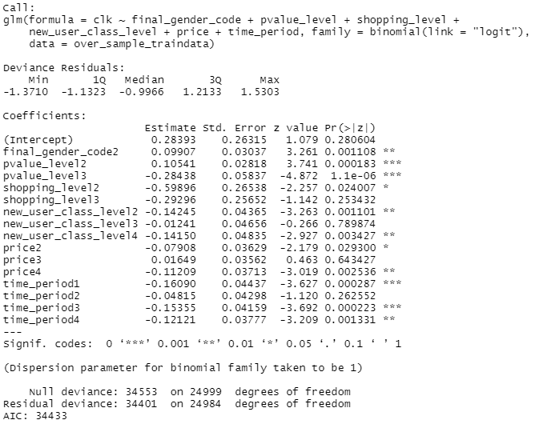
Model Result
Test_dataset Confusion Matrix
Actual
 | 1 | 0
1 | 36 | 987
0 | 230 | 4747
* 0 – not click 1 - click
Predicted
Accuracy | 0.797
Specificity | 0. 828
Sensitivity | 0.135
Balanced Accuracy | 0.482

Slide 13
Naive Bayes Classifier
Notes:
给我自己：如果贝叶斯的assumption都满足，预测结果将更准确且可利用

Slide 14
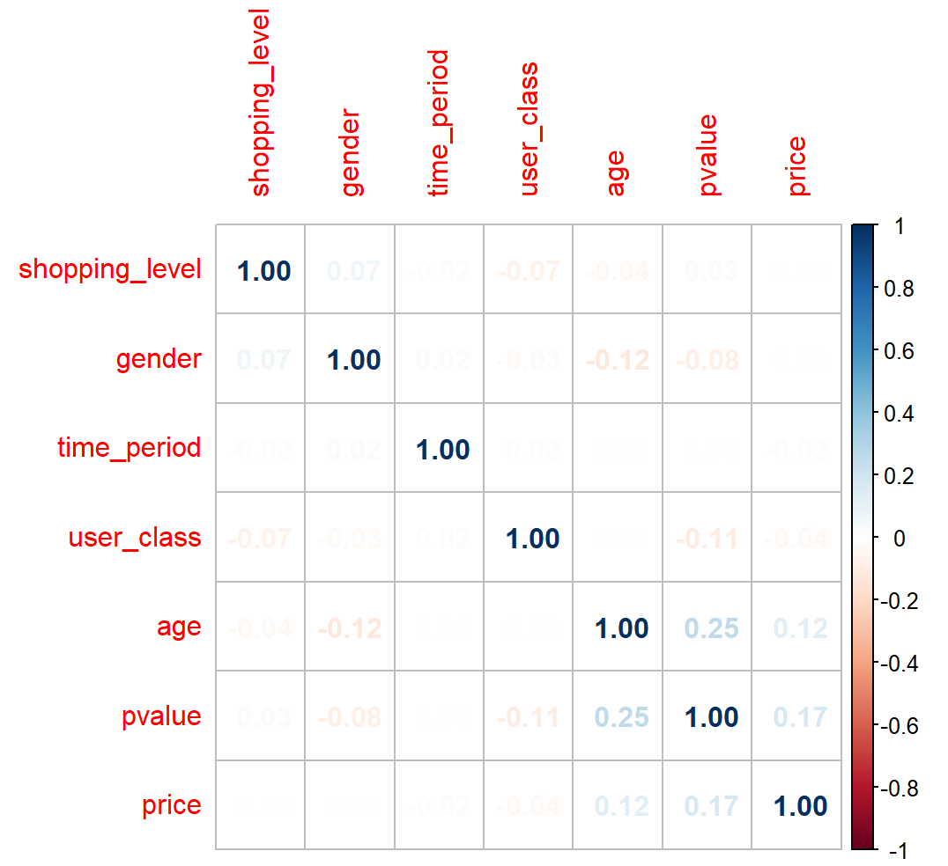
Naive Bayes Classifier Steps
Assumption Fulfillment
Model Building
1
2
Predictor: click or not
Attribute selection:
The attributes are conditionally independent
Correlation analysis
Gender
Shopping level
Time_period
User_class
Age
Pvalue
Price
Notes:
attribute conditional independence assumption

Slide 15
Naive Bayes Classifier Steps
Model Modification
Conclusion
3
4
Actual
Actual
 | 1 | 0
1 | 187 | 612
0 | 108 | 5093
* 0 – not click 1 - click
 | 1 | 0
1 | 1 | 10
0 | 294 | 5695
* 0 – not click 1 - click
barely predict “click”
Predicted
Predicted
Solution: oversampling
Accuracy | 0.949
Specificity | 0.998
Sensitivity | 0.003
Balanced Accuracy | 0.500
Accuracy | 0.880
Specificity | 0.893
Sensitivity | 0.634
Balanced Accuracy | 0.763

Slide 16
Model Comparison

Slide 17
Model Comparison
Logistic regression
Bayes classifier
Actual
Actual
 | 1 | 0
1 | 36 | 987
0 | 230 | 4747
* 0 – not click 1 - click
 | 1 | 0
1 | 187 | 612
0 | 108 | 5093
* 0 – not click 1 - click
Predicted
Predicted
Accuracy | 0.797
Specificity | 0. 828
Sensitivity | 0.135
Balanced Accuracy | 0.482
Accuracy | 0.880
Specificity | 0.893
Sensitivity | 0.634
Balanced Accuracy | 0.763
Notes:
newuserclasslevel: City level This data set covers the shopping behavior in 22 days of all users in
pvaluelevel: Consumption grade, 1: low, 2: mid, 3: high

Slide 18
Business Insight
Notes:
nls我们建议business insight就作为conclusion，不然分不出来区别，感觉意义不大。
我们会分三个part：1. user profile 2. profile的application 3. 未来的展望；这部分请参考report，我也会发群里
感谢nls

Slide 19


Predictor Profile
Age
User Class
Time Period
Purchase Value Level
Predict to click
Predict not to click
Notes:
newuserclasslevel: City level This data set covers the shopping behavior in 22 days of all users in
pvaluelevel: Consumption grade, 1: low, 2: mid, 3: high
我把user profile放在这里，这个应该算是bayes的model result之一？

Slide 20
Profile Application & Outlook
Attributes
Detailed Information
Application & Outlook
Gender
Female Purchase Power
Female MKT
Age
Main labor force age distribution
Online shopping willingness
Digital Natives
Z-generation power
User Class
2^{nd &} 3rd-tier city show great potential
Improve product penetration
High-end products
Purchase-value Level
Mid-level shows great potential
Enrich shopping experience
Sharing Economy
Notes:
newuserclasslevel: City level This data set covers the shopping behavior in 22 days of all users in
pvaluelevel: Consumption grade, 1: low, 2: mid, 3: high
我把user profile放在这里，这个应该算是bayes的model result之一？

Slide 21
Improvement
Suggested Solution
Next Step
Clarify undefined features
What kind of people are potential to interest or convert after click
Need to collect: purchase behavior after click
Category ID: introducing category feature may increase prediction accuracy
User_class: clearly-defined user class can help draw more specific conclusions
Consider more new features
Enlarging time period: find a certain weekly/monthly pattern
Notes:
Further study：加上

Slide 22
Summary

Slide 23
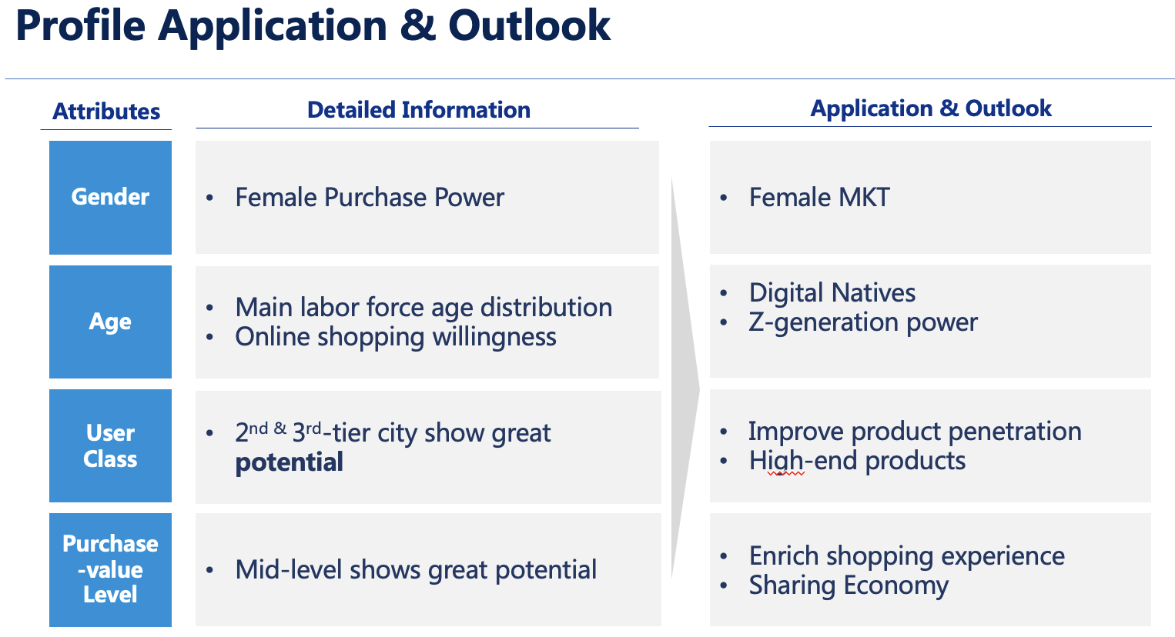
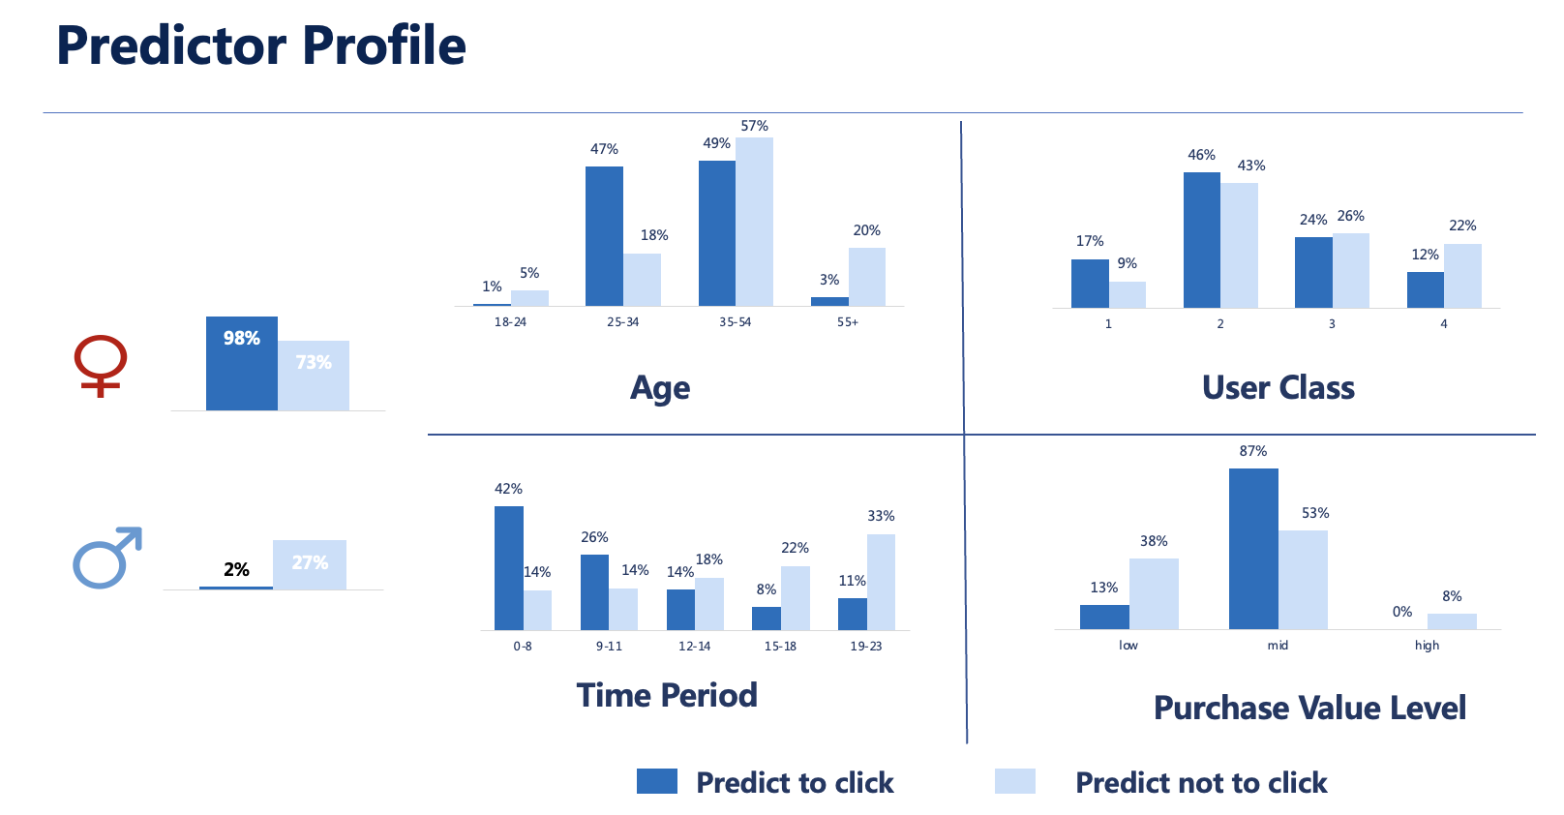
Summary
1
Data set from Taobao
2
Data cleaning & processing for model building
Logistic Model & Naïve Bayes Classifier
3
Notes:
Further study：加上

Slide 25
Appendix
Group Member List
CAO, Zhiyin | 1155182648
CHEN, Yiwei | 1155179982
CHEN, Yunshan | 1155180732
CHUN, Nok Him Anthony | 1155184967
GENG, Zongnan | 1155182692
NI, Zhengfei | 1155182761
WANG, Qi | 1155180744
YANG, Linsong | 1155182726
Notes:
newuserclasslevel: City level This data set covers the shopping behavior in 22 days of all users in
pvaluelevel: Consumption grade, 1: low, 2: mid, 3: high

