Slide 1
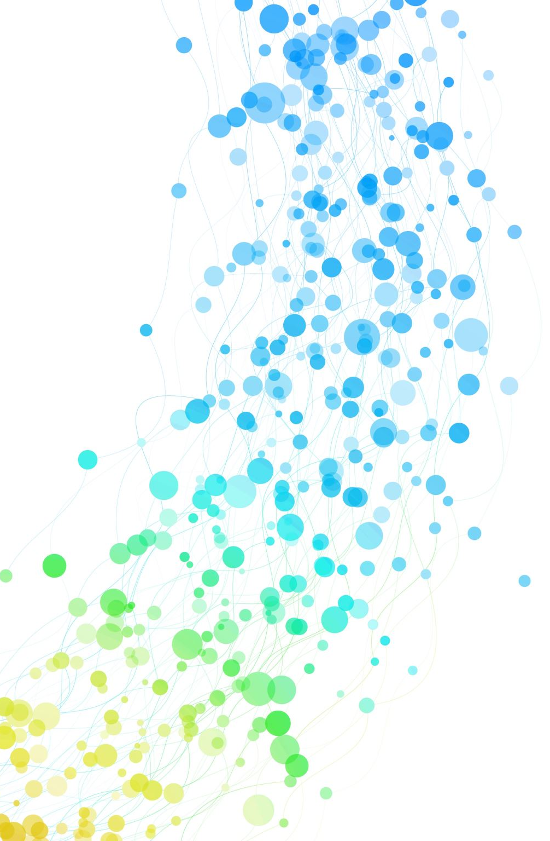
The Algebraic One-More MISIS Problem and Applications to Threshold Signatures
Chenzhi Zhu, Stefano Tessaro
University of Washington

Slide 2





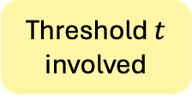








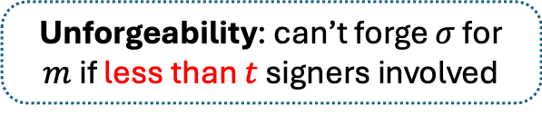
Threshold signatures [DF90]
$$\left(sk_{1},…,sk_{n},pk\right)←DisKeyGen(1^{λ})$$
Signer 1: $sk_{1}$
Avoid single point attack
$$m$$
Wallets
NIST
Threshold $t$ involved
$$σ$$
Signer $n$: $sk_{n}$
$$⋯$$
$$0/1←Verify(pk, m,σ)$$
Unforgeability: can’t forge $σ$ for $m$ if less than $t$ signers involved
Signer 2: $sk_{2}$
Notes:
The main contribution of this work in efficient lattice-based threshold signatures.
So let's start from what is threshold signatures? In this setting, initially, n signers run a DKG protocol to generates n signing key shares and one public key, so that each signer holds its signing key share by the end.
To sign a message m, it requires at least a threshold t of signers to be involved to issue a signature.
The basic security guarantees that no one can forge a signature for m if less than t signers are involved.
The main motivation of developing threshold signatures is to avoid single point attack. They have attracted significant interest in industry, for example, in crypto wallets. In addition, there is an ongoing standardization effort by NIST.

Slide 3
Lattice-based TS
Threshold FHE [BGGK17, BGG+18, ASY22]: 1-round
Not practical
Threshold linear HE [GKS23]: 2-round
NIZKs, homomorphic trapdoor commitments
W/o heavy tools: T-Raccoon [DKM+24], [CATZ24], [EKT24], Ringtail [BKW+24], [DN25]
Stronger guarantees: Robust [ENP24], Adaptive-secure [KRT24],
Identifiable-abort [DKN+25, DENP25]
Notes:
Now, let’s take a look at the existing construction of lattice-based threshold signatures.
The early constructions are based on threshold FHE, which are round optimal, but not practical due to the use of FHE.
Follow-up work proposed a more efficient scheme using only linear homomorphic encryption, but it still relies on heavy tools such as NIZKs and homomorphic trapdoor commitments.
More recently, since the work by del Pino et al. , there has been a boom in practical constructions that avoid heavy tools. We will see a detailed table of them in a minute.
Before that, I would like to mention that there are also other schemes targeting stronger security notions, but they are not the focus of this talk.

Slide 4
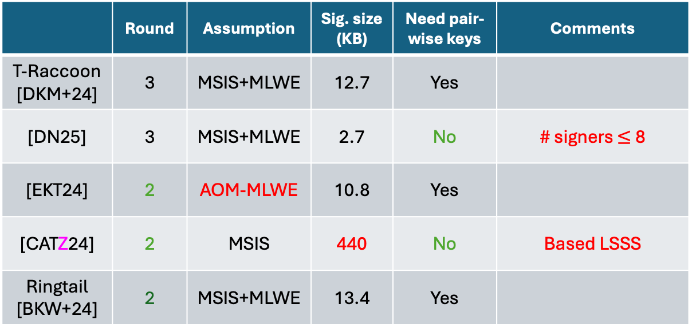

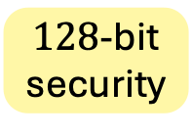
Efficient lattice-based TS
$128$-bit security
Assume ROM
 | Round | Assumption | Sig. size (KB) | Need pair-wise keys | Comments
T-Raccoon [DKM+24] | 3 | MSIS+MLWE | 12.7 | Yes
[DN25] | 3 | MSIS+MLWE | 2.7 | No | # signers $≤$ 8
[EKT24] | 2 | AOM-MLWE | 10.8 | Yes
[CATZ24] | 2 | MSIS | 440 | No | Based LSSS
Ringtail [BKW+24] | 2 | MSIS+MLWE | 13.4 | Yes
Based on cryptanalysis
This work: AOM-MLWE implied by MSIS + MLWE
[EKT24] MSIS+MLWE: 30.9 KB
[CATZ24] MSIS+MLWE: 144 KB
# hash evaluations
$≤$ 2^60
Notes:
Now, let’s take a closer look at the existing efficient schemes. They all rely on the ROM.
The first construction, Threshold Raccoon, requires 3 rounds based on standard lattice assumptions, with a signature size of about 10 KB. We consider 128-bit security. Also, it requires setting up a private key between each pair of signers.
A recent three-round scheme greatly improves the signature size and avoids the setup of pairwise keys, but only works for small signing sets.
Other schemes aim for fewer rounds. Espitau et al. gave a 2-round scheme but based on a non-standard assumption proposed in their paper. Here, the concrete efficiency is estimated based on their cryptanalysis of the new assumption.
In our prior work, we proposed a 2-round scheme under standard assumptions, and it also avoids pairwise keys, but its signature size is extremely large due to the use of a special linear secret sharing scheme.
A follow-up scheme, Ringtail, seems to achieve the best of both worlds. However, the caveat here is that their efficiency is computed assuming the # of hash evaluation is bounded by 2^60. Typically, this bound should be 2 to the security parameters. If we plug in that, their signature size would be much worse.
We can see, all existing two-round schemes have some caveats. So the key question here is: can we obtain a 2-round scheme under standard assumptions, with comparable signature size without any heuristics? We give an affirmative answer in this work.
Our key result shows that surprisingly, the AOM-MLWE assumption is implied by the standard assumptions. This implies the EKT scheme is secure under the standard assumptions. Based on our security reduction, the estimated signature size is about 30 KB. It is worse than the cryptanalysis-based parameters, but still in the same ballpark.
Based on our techniques, we also provide a tighter security analysis for our prior scheme and result in much better efficiency. We note that the advantage of the CATZ scheme here is that it has a simpler setup.

Slide 5
Overview
[CATZ24]
Tighter
[EKT24]
MSIS
AOM-MLWE
AOM-MISIS (This work)
(This work)
MSIS + MLWE
Notes:
An overview of this work are as follows.
First, we propose a modification of the AOM-MLWE problem, called AOM-MISIS. It is no harder than the original problem, meaning that the hardness of our problem implies the hardness of theirs.
Then, we show that the hardness of our problem is implied by standard lattice assumptions.
Further, we give a direct reduction from EKT to AOM-MISIS, which is tighter than going through the AOM-MLWE route.
Finally, we find the security of CATZ can also be based on the hardness of AOM-MISIS, and this reduction yields better parameter settings.
For the rest of this talk, I will first tell you what is this AOM-MISIS problem and then explain the main idea of out reduction to standard assumptions.

Slide 6
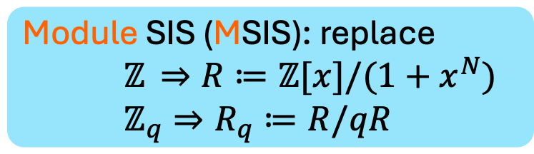
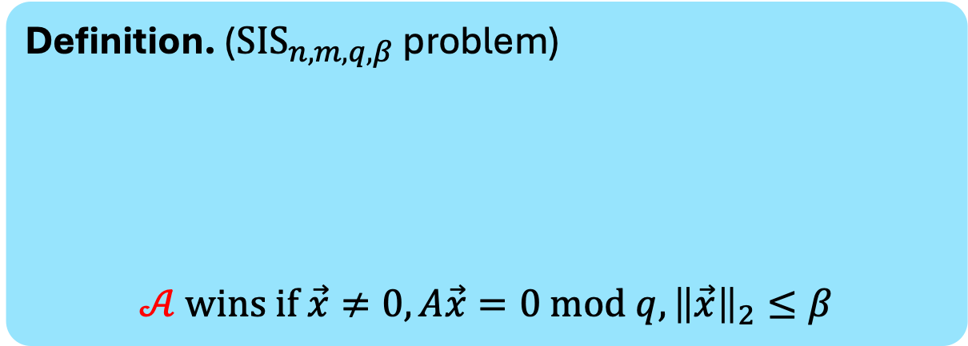
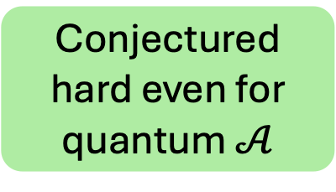

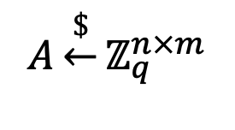

Prelims: short integer solution (SIS)
Definition. (${SIS}_{n,m,q,β}$ problem)
$$𝒜 wins if \vec{x}≠0,A\vec{x}=0 mod q,{\left\|\vec{x}\right\|}_{2}≤β$$
Stick to integer lattices in this talk
$$A\underset{←}{\$}ℤ_{q}^{n×m}$$
$$𝒜$$
$$\vec{x}∈ℤ^{m}$$
Conjectured hard even for quantum $𝒜$
Module SIS (MSIS): replace
$ℤ$ $⇒R≔ℤ[x]/(1+x^{N})$
$ℤ_{q}⇒R_{q}≔R/qR$
Notes:
Let’s first recall the Short Integer Solution (SIS) problem.
In this problem, the adversary is given a random matrix $A$, and the goal is to output a non-zero short vector $x$such that Ax = 0mod q.
This problem is conjectured to be hard for certain parameters, even against quantum algorithms. When we add an M in front, we refer to the module version of the problem, where the integer space is replaced by a polynomial ring. In practice, the module version is used for better efficiency. But, for simplicity of this talk, I will stick to the integer lattices.

Slide 7
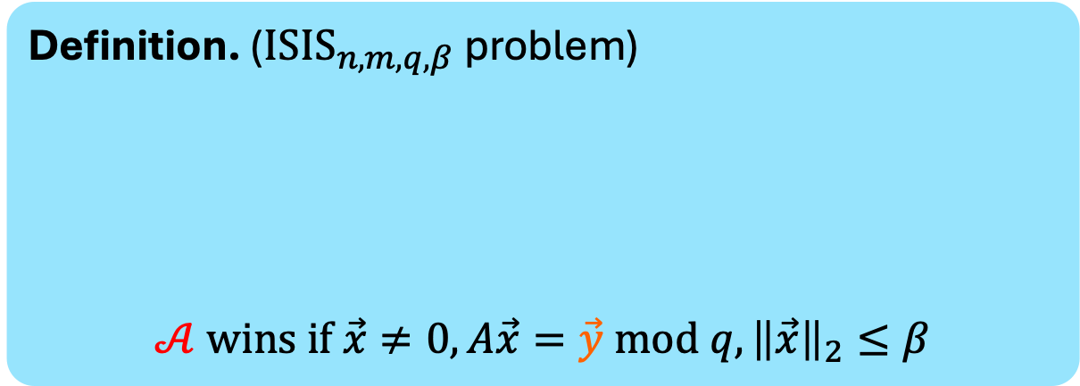
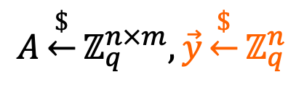
Prelims: Inhomogeneous SIS (ISIS)
Definition. ($I{SIS}_{n,m,q,β}$ problem)
$$𝒜 wins if \vec{x}≠0,A\vec{x}=\vec{y} mod q,{\left\|\vec{x}\right\|}_{2}≤β$$
$$A\underset{←}{\$}ℤ_{q}^{n×m},\vec{y}\underset{←}{\$}ℤ_{q}^{n}$$
$$𝒜$$
$$\vec{x}∈ℤ^{m}$$
Notes:
The ISIS problem refers to the inhomogeneous variant of SIS, where the goal is changed to find a short solution to a random target vector 𝑦.

Slide 8


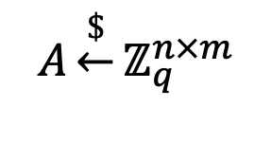
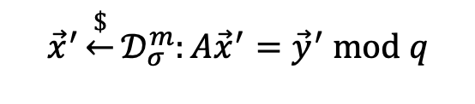
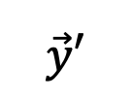



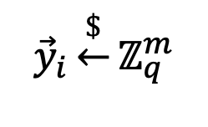
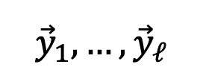
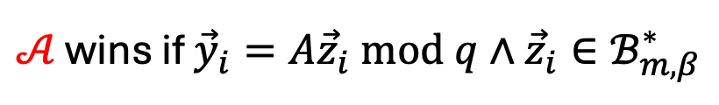
One more ISIS [AKSY21]
$$A\underset{←}{\$}ℤ_{q}^{n×m}$$
$${\vec{y}}_{i}\underset{←}{\$}ℤ_{q}^{m}$$
$$𝒜$$
$${\vec{y}}_{1},…,{\vec{y}}_{ℓ}$$
$$\vec{y}′$$
$${\vec{x}}^{′}\underset{←}{\$}𝒟_{σ}^{m}:A{\vec{x}}^{′}={\vec{y}}^{′} mod q$$
Preimage
$$\vec{x}′$$
One more: # of PI queries $<ℓ$
$𝒜$ wins if ${\vec{y}}_{i}=A{\vec{z}}_{i} mod q∧{\vec{z}}_{i}∈ℬ_{m,β}^{∗}$
$${\vec{z}}_{1},…,{\vec{z}}_{ℓ}$$
$$ℬ_{m,β}^{∗}≔\{\vec{a}∈ℤ_{p}^{m}:\vec{a}≠0∧{\left\|\vec{a}\right\|}_{2}≤β\}$$
Notes:
Let’s first see which is the one-more ISIS problem.
Here, the adversary is given ℓ ISIS challenges, and the goal is to output a short solution 𝑧_𝑖 for each challenge. We use the notation 𝐵^∗to denote the set of non-zero short vectors.
In addition, the adversary has access to a preimage oracle, which takes any target 𝑦as input and returns a short solution sampled from the conditioned discrete Gaussian distribution. To make the problem non-trivial, we require the number of PI queries to be strictly less than the number of challenges. In other words, the adversary needs to solve at least one more challenges than the number of PI queries.

Slide 9

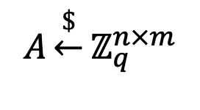
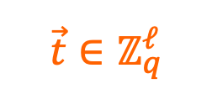

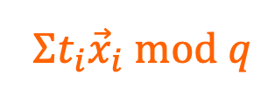

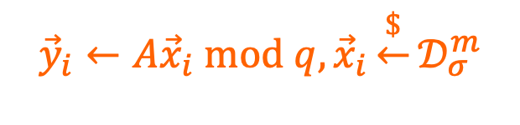
Algebraic one more ISIS (AOM-ISIS)?
$$A\underset{←}{\$}ℤ_{q}^{n×m}$$
$${\vec{y}}_{i}←A{\vec{x}}_{i} mod q, {\vec{x}}_{i}\underset{←}{\$}𝒟_{σ}^{m}$$
$$𝒜$$
$${\vec{y}}_{1},…,{\vec{y}}_{ℓ}$$
Algebraic
Preimage of $Σt_{i}{\vec{y}}_{i}$
$$\vec{t}∈ℤ_{q}^{ℓ}$$
PI
$$Σt_{i}{\vec{x}}_{i} mod q$$
One more: # of PI queries $<ℓ$
$𝒜$ wins if ${\vec{y}}_{i}=A{\vec{z}}_{i} mod q∧{\vec{z}}_{i}∈ℬ_{m,β}^{∗}$
$${\vec{z}}_{1},…,{\vec{z}}_{ℓ}$$
$$ℬ_{m,β}^{∗}≔\{\vec{a}∈ℤ_{p}^{m}:\vec{a}≠0∧{\left\|\vec{a}\right\|}_{2}≤β\}$$
[EKT24]: Solvable even if # of PI $<ℓ$
Notes:
Finally, let's see how the algebraic one-more game is defined.
Here the adversary still tries to solve \ell challenges, but now each challenge is sampled with a small preimage.
Concretely, the challenger first samples short vector x_i from discrete Gaussian distribution and computes y_i as Ax_i mod q.
standard deviation simga here can be different for each x_i, but for simplicity, let's assume they are all the same.
Moreover, the PI oracle becomes weaker in the sense that the adversary may only ask for a preimage of a linear combination of the challenges. Hence the name algebraic.
More precisely, the oracle takes as input a vector t of coefficients, and outputs the sum of t_i times x_i. which is a preimage of the sum of t_i times y_i.
Similarly, to make the problem non-trivial, the number of PI queries must be less than the number of challenges.
However, the prior work pointed out that even given this condition the problem is still easy to solvable.

Slide 10
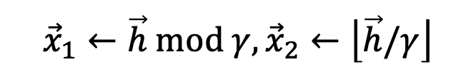




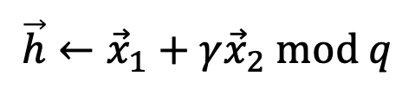
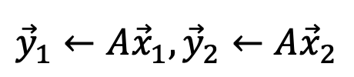
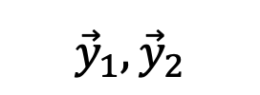

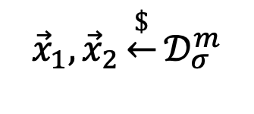
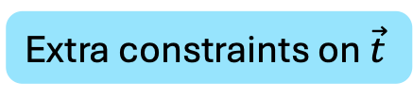
[EKT24]: Solvable even if # of PI $<ℓ$
$$A$$
$$𝒜$$
$${\vec{y}}_{1},{\vec{y}}_{2}$$
$${{\vec{x}}_{1}, \vec{x}}_{2}\underset{←}{\$}𝒟_{σ}^{m}$$
$${\vec{y}}_{1}←A{\vec{x}}_{1},{\vec{y}}_{2}←A{\vec{x}}_{2}$$
$γ>σ\sqrt{m},$ $q≫γ$
$$\vec{t}=(1,γ)$$
PI
$$\vec{h}←{\vec{x}}_{1}+γ{\vec{x}}_{2} mod q$$
$${{\vec{x}}_{1}←\vec{h} mod γ, \vec{x}}_{2}←\left\lfloor \vec{h}/γ\right\rfloor$$
Extra constraints on $\vec{t}$
Notes:
The attack is quite simple. Suppose there two challenges. The adversary make one PI query (1,\gamma), with \gamma larger than the norm of x_2, and receives x_1 + \gamma x_2.
Since with high probability, gamma is larger than the norm of x_1. the adversary can extract both x_1 and x_2 from the response.
This means we need additional constraints on the PI query.

Slide 11
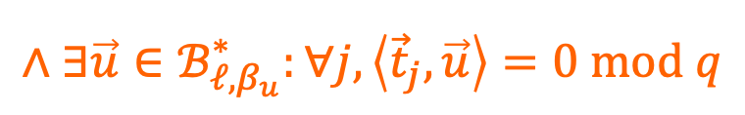
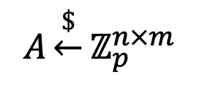

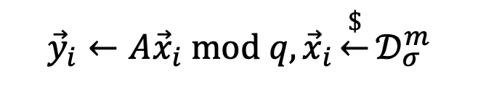
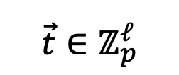


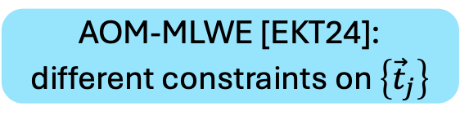
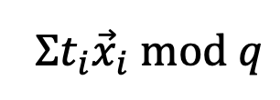

AOM-ISIS (This work)
$$ℬ_{m,β}^{∗}≔\{\vec{a}∈ℤ_{p}^{m}:\vec{a}≠0∧{\left\|\vec{a}\right\|}_{2}≤β\}$$
$$A\underset{←}{\$}ℤ_{p}^{n×m}$$
$${\vec{y}}_{i}←A{\vec{x}}_{i} mod q, {\vec{x}}_{i}\underset{←}{\$}𝒟_{σ}^{m}$$
$$𝒜$$
$${\vec{y}}_{1},…,{\vec{y}}_{ℓ}$$
$$\vec{t}∈ℤ_{p}^{ℓ}$$
PI
$$Σt_{i}{\vec{x}}_{i} mod q$$
One more: # of PI queries $<ℓ$
$${\vec{z}}_{1},…,{\vec{z}}_{ℓ}$$
$𝒜$ wins if ${\vec{y}}_{i}=A{\vec{z}}_{i} mod q∧{\vec{z}}_{i}∈ℬ_{m,β}^{∗}$
$$∧∃\vec{u}∈ℬ_{ℓ,β_{u}}^{∗}:∀j,\left\langle {\vec{t}}_{j},\vec{u}\right\rangle =0 mod q$$
AOM-MLWE [EKT24]:
different constraints on $\left\{{\vec{t}}_{j}\right\}$
${\vec{t}}_{j}$: $j$-th PI query
Notes:
In our work, the constraint is defined as follows. We require there exists a short vector u such that u is orthogonal to all the queries. here t_j denotes the j-th query.
I would also like to mention that the AOM-MLWE problem proposed in the prior work is essentially the same problem, and it only differs in the constraints placed on the queries.
We call it AOM-ISIS problem just because we think it is closer to ISIS problem, while they think it is closer to LWE problem.

Slide 12
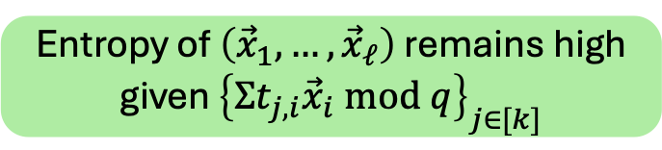



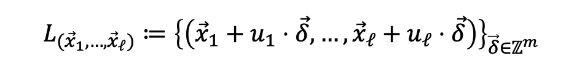
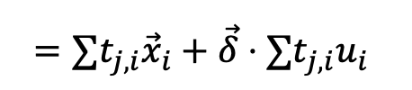

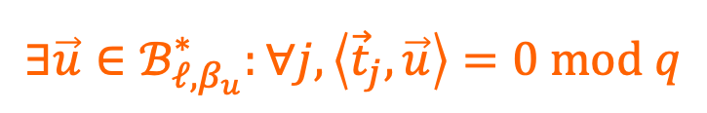



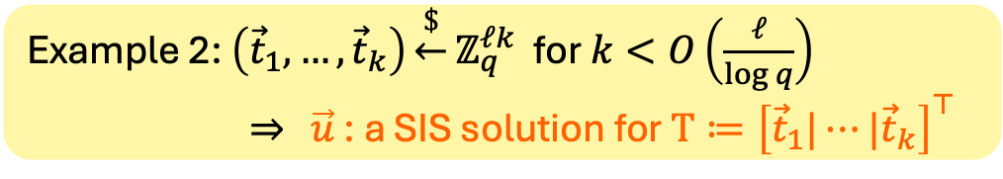
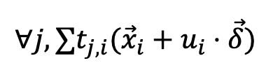


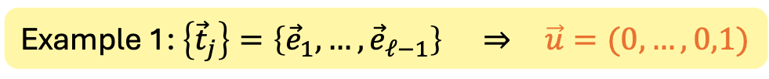
Why this constraint?
$$ℬ_{m,β}^{∗}≔\{\vec{a}∈ℤ_{p}^{m}:\vec{a}≠0∧{\left\|\vec{a}\right\|}_{2}≤β\}$$
$${\vec{t}}_{1}∈ℤ_{q}^{ℓ}$$
$$∃\vec{u}∈ℬ_{ℓ,β_{u}}^{∗}:∀j,\left\langle {\vec{t}}_{j},\vec{u}\right\rangle =0 mod q$$
$$𝒜$$
PI
$$Σt_{1,i}{\vec{x}}_{i} mod q$$
$$⇒$$
$$⋮$$
$${\vec{t}}_{k}∈ℤ_{q}^{ℓ}$$
Entropy of $\left({\vec{x}}_{1},…, {\vec{x}}_{ℓ}\right)$ remains high given ${\left\{Σt_{j,i}{\vec{x}}_{i} mod q\right\}}_{j∈[k]}$
PI
$$Σt_{k,i}{\vec{x}}_{i} mod q$$
$$L_{({\vec{x}}_{1},…, {\vec{x}}_{ℓ})}≔{\left\{\left({\vec{x}}_{1}+u_{1}⋅\vec{δ},…,{\vec{x}}_{ℓ}+u_{ℓ}⋅\vec{δ}\right)\right\}}_{\vec{δ}∈ℤ^{m}}$$
result in same PI responses
$$∀j,{∑t_{j,i}(\vec{x}}_{i}+u_{i}⋅\vec{δ})$$
$$={∑t_{j,i}\vec{x}}_{i}+\vec{δ}⋅∑t_{j,i}u_{i}$$
$$={∑t_{j,i}\vec{x}}_{i} mod q$$
$$\left\langle {\vec{t}}_{j},\vec{u}\right\rangle =0 mod q$$
Example 1: $\left\{{\vec{t}}_{j}\right\}=\left\{{\vec{e}}_{1},…,{\vec{e}}_{ℓ−1}\right\}$ $⇒$ $\vec{u}=(0,…,0,1)$
Example 2: $\left({\vec{t}}_{1},…,{\vec{t}}_{k}\right)\underset{←}{\$}ℤ_{q}^{ℓk}$ for $k<O\left(\frac{ℓ}{\log{q}}\right)$
$⇒$ $\vec{u}$ : a SIS solution for $T≔{\left[{\vec{t}}_{1}|⋯|{\vec{t}}_{k}\right]}^{⊤}$
Notes:
Now, let's take a closer look at our constraint.
One way to understand it is that it ensures that the entropy of the xi's remains high even after seeing all responses from the PI oracle.
In particular, suppose u exists. Let's consider the following lattice defined for certain x_i’s. We can show that all the points in this lattice give the same PI response. If u is short, then the lattice is dense, and thus has high entropy.
For any j, the j-th response given one point in the lattice is as follows. Expand it we get these two terms. Note that the second term vanishes due to the fact that the inner product of t_j with u is 0 mod q. Therefore the LHS is equal to the j-th PI response given the original x_i’s.
Let’s see some example of valid queries. In the first example, the queries are \ell -1 the unit vectors. Then, u is just the last unit vector. It is clear that it is short and orthogonal to each query.
In another example, the queries are just random vectors, here if k is sufficiently small, we can show there exists a short vector u which is SIS solution to the matrix defined by the queries.

Slide 13
Overview
[CATZ24]
Tighter
[EKT24]
MSIS
AOM-MLWE
AOM-MISIS (This work)
(This work)
MSIS + MLWE
Notes:
I will now focus on our reduction from the standard assumptions.

Slide 14
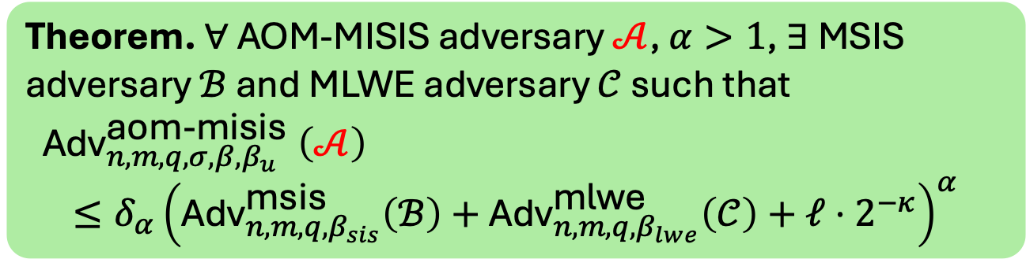


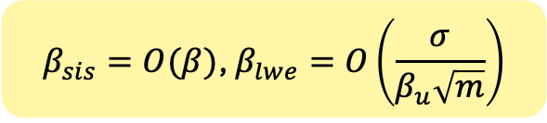
Our main result
Theorem. $∀$ AOM-MISIS adversary $𝒜$, $α>1$, $∃$ MSIS adversary $ℬ$ and MLWE adversary $𝒞$ such that
$${\text{Adv}}_{n,m,q,σ,β,β_{u}}^{\text{aom}\text{−}\text{misis}} \left(𝒜\right)$$
$$≤δ_{α}{\left({\text{Adv}}_{n,m,q,β_{sis}}^{\text{msis}}\left(ℬ\right)+{\text{Adv}}_{n,m,q,β_{lwe}}^{\text{m}\text{lwe}}\left(𝒞\right)+ℓ⋅2^{−κ}\right)}^{α}$$
$∃\vec{u}∈$ $ℬ_{ℓ,β_{u}}^{∗}$: $∀\vec{t},\left\langle \vec{t},\vec{u}\right\rangle =0$
Constant
$$β_{sis}=O(β)\text{, }β_{lwe}=O\left(\frac{σ}{β_{u}\sqrt{m}}\right)$$
smaller $β_{u}$ $→$ harder the game
Notes:
First, I want to give a rough picture of the theorem we prove here.
Recall that 𝛽is the norm bound on the solution, and 𝛽_𝑢is the norm bound on the vector 𝑢. ℓ denote the number of challenges. 𝛿_𝛼 is a constant depending on 𝛼. The SIS and LWE errors are roughly as follows. please refer to our paper for the exact theorem if you are interested.
One point I want to highlight is that the hardness of AOM-MISIS depends on 𝛽_𝑢. In particular, smaller 𝛽_𝑢 result in larger the LWE error and the problem becomes harder.

Slide 15

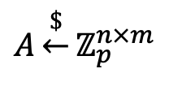



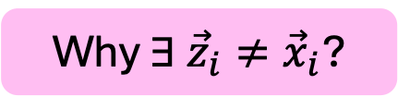










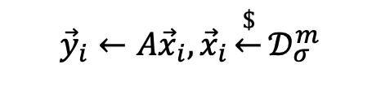
SIS $⇒$ AOM-ISIS
Proof idea from [TZ23] in the DL setting
Assume $𝒜$ always wins
$$A\underset{←}{\$}ℤ_{p}^{n×m}$$
$$A$$
$$ℬ$$
$${\vec{y}}_{1},…,{\vec{y}}_{ℓ}$$
$${\vec{y}}_{i}←A{\vec{x}}_{i}, {\vec{x}}_{i}\underset{←}{\$}𝒟_{σ}^{m}$$
$$𝒜$$
$$A\left({\vec{z}}_{i}−{\vec{x}}_{i}\right)=0 mod q$$
$$\vec{t}$$
PI
${\left\|{\vec{z}}_{i}−{\vec{x}}_{i}\right\|}_{2}$ is small
$$Σt_{i}{\vec{x}}_{i}$$
Why $∃ {\vec{z}}_{i}≠{\vec{x}}_{i}$?
$${\vec{z}}_{1},…,{\vec{z}}_{ℓ}$$
Find ${\vec{z}}_{i}≠{\vec{x}}_{i}$
$$A{\vec{z}}_{i}={\vec{y}}_{i}=A{\vec{x}}_{i} mod q$$
$${\vec{z}}_{i}−{\vec{x}}_{i}$$
Notes:
Now I will explain the reduction from SIS to the OM problem.
The reduction idea is actually from our prior work in the DL setting, where we show some one-more type assumption can be reduced the DL assumption.
For simplicity, let’s assume A always wins.
The reduction turns out to be quite simple. Here B is an adversary for the SIS problem, and A is an adverary for the one-more problem. Initially, B receives a random matrix and runs A with the matrix and challenges sampled by B itself. Then since B samples x_i's by itself, B answers the PI queries from A honestly. After A returns, B finds a z_i that is different from x_i, and outputs z_i - x_i.
It is not hard to see that it is an SIS solution. Since A wins, we know ... ,there for ..., also, it is clear ...
So this only thing that is left to show here is why such z_i exists.
The intuition is that the view of the adverary A received, the challenges and the PI responses, does not contain enough information to recover all the x_i's.

Slide 16


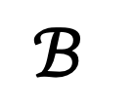


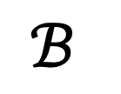






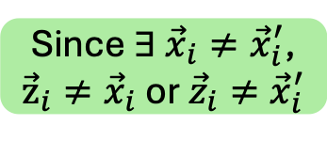

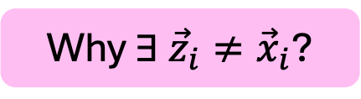





Why $∃ {\vec{z}}_{i}≠{\vec{x}}_{i}$?
Consider $\left({\vec{x}}_{1},…,{\vec{x}}_{ℓ}\right)≠\left({\vec{x}}_{1}^{′},…,{\vec{x}}_{ℓ}^{′}\right)$
$$A$$
$$A$$
$$A$$
$$ℬ$$
$$A$$
$$ℬ$$
$$𝒜$$
$$A{\vec{x}}_{i}$$
1. $A{\vec{x}}_{i}=A{\vec{x}}_{i}^{′}$
$$𝒜$$
$$A{\vec{x}}_{i}^{′}$$
$$Σt_{i}{\vec{x}}_{i}$$
$$2. Σt_{i}{\vec{x}}_{i}=Σt_{i}{\vec{x}}_{i}^{′}$$
$$Σt_{i}{\vec{x}}_{i}^{′}$$
$${\vec{z}}_{1},…,{\vec{z}}_{ℓ}$$
Since $∃ {\vec{x}}_{i}≠{\vec{x}}_{i}^{′}$,
${\vec{z}}_{i}≠{\vec{x}}_{i}$ or ${\vec{z}}_{i}≠{\vec{x}}_{i}^{′}$
$${\vec{z}}_{1},…,{\vec{z}}_{ℓ}$$
$$⇒$$
In at least one world, $ℬ$ wins
Notes:
To this more concrete, let's consider two distinct randomness and two executions, where the first one uses x_i's and the second one uses x_i' 's. Suppose they result in the same challenges and the same PI responses. Without loss of generalality, A is deterministic. Then, A have the same outputs in both executions Since ...

Slide 17












Why exists $\left({\vec{x}}_{1}^{′},…,{\vec{x}}_{ℓ}^{′}\right)≠$ $\left({\vec{x}}_{1},…,{\vec{x}}_{ℓ}\right)$ that
1. $A{\vec{x}}_{i}=A{\vec{x}}_{i}^{′} mod q, ∀ i∈[q]$
2. $Σt_{i}{\vec{x}}_{i}=Σt_{i}{\vec{x}}_{i}^{′} \text{mod} \text{q},∀ \vec{t}$
$\vec{t}$: PI query from $𝒜$
$$∃ \vec{δ}∈ℬ_{m,β}^{∗}:A\vec{δ}=0 mod q$$
$$⇒$$
$$A{\vec{x}}_{i}=A\left({\vec{x}}_{i}+k⋅\vec{δ}\right) mod q,∀k∈ℤ$$
Use LWE to embed a shorter $\vec{δ}$
Since $𝒜$ wins, $∃\vec{u}∈$ $ℬ_{ℓ,β}^{∗}$: $∀\vec{t},\left\langle \vec{t},\vec{u}\right\rangle =0 mod q$
$$⇒$$
$$∑t_{i}{\vec{x}}_{i}=∑t_{i}({\vec{x}}_{i}+u_{i}⋅\vec{v}) mod q,∀\vec{v}∈ℤ^{m}$$
$$\left({\vec{x}}_{1}^{′},…,{\vec{x}}_{ℓ}^{′}\right)≔({\vec{x}}_{1}+u_{1}⋅\vec{δ},…,x_{ℓ}+u_{ℓ}⋅\vec{δ})$$
Notes:
Then, the question boils down to why there exists such x_i' 's such that they result in the same challenges and the same PI responses.
For the first condition, the reason we can find such x_i' is that there exists a short vector \delta such that A\delta = 0. Therefore, x_i plus \delta gives the same challenge as x_i.
For the second condition, as we previously discussed, due to the existance of a short vector u in the winning condition, x_i plus u_i times a vector gives the same PI responses.
Combining them, we find the following x_i' 's, which satisfies both condition.
The last thing I want to mention is that LWE is used here to embed a short solution in A to improve the tightness of this reduction.

Slide 18












$$ℬ_{m,β}^{∗}≔\{\vec{a}∈ℤ_{p}^{m}:\vec{a}≠0∧{\left\|\vec{a}\right\|}_{2}≤β\}$$
$$\left({\vec{x}}_{1}^{′},…,{\vec{x}}_{ℓ}^{′}\right)≔({\vec{x}}_{1}+u_{1}⋅\vec{δ},…,x_{ℓ}+u_{ℓ}⋅\vec{δ})$$
$$∃ \vec{δ}∈ℬ_{m,β}^{∗}:A\vec{δ}=0$$
1. $A{\vec{x}}_{i}=A{\vec{x}}_{i}^{′}, ∀ i∈[q]$
$∃\vec{u}∈$ $ℬ_{ℓ,β_{u}}^{∗}$: $∀\vec{t},\left\langle \vec{t},\vec{u}\right\rangle =0$
$$A{\vec{x}}_{i}^{′}=A\left({\vec{x}}_{i}+u_{i}⋅\vec{δ}\right)$$
$$=A{\vec{x}}_{i}+u_{i}⋅A\vec{δ}$$
$$=A{\vec{x}}_{i}$$
2. $Σt_{i}{\vec{x}}_{i}=Σt_{i}{\vec{x}}_{i}^{′},∀ \vec{t}$
$$Σt_{i}{\vec{x}}_{i}^{′}=Σt_{i}\left({\vec{x}}_{i}+u_{i}⋅\vec{δ}\right)$$
$$=Σt_{i}{\vec{x}}_{i}+\left\langle \vec{t},\vec{u}\right\rangle ⋅\vec{δ}$$
$$=Σt_{i}{\vec{x}}_{i}$$
Notes:
Let's verify this now.
For the first condition,

Slide 19










How to show $∃ {\vec{z}}_{i}≠{\vec{x}}_{i}$ ?
$$ℬ_{m,β}^{∗}≔\{\vec{a}∈ℤ_{p}^{m}:\vec{a}≠0∧{\left\|\vec{a}\right\|}_{2}≤β\}$$
$$∃ \vec{δ}∈ℬ_{m,β}^{∗}:A\vec{δ}=0$$
$$Φ:\left({\vec{x}}_{1},…,{\vec{x}}_{ℓ}\right)↦({\vec{x}}_{1}+u_{1}⋅\vec{δ},…,{\vec{x}}_{ℓ}+u_{ℓ}⋅\vec{δ})$$
$∃\vec{u}∈$ $ℬ_{ℓ,β_{u}}^{∗}$: $∀\vec{t},\left\langle \vec{t},\vec{u}\right\rangle =0$
$$\left({\vec{x}}_{1},…,{\vec{x}}_{ℓ}\right)∼𝒟_{σ}^{mℓ}$$
Distribution of $Φ(\vec{x})$ for $\vec{x}∼$ $𝒟_{σ}^{mℓ}$
Fact 1. $𝒟_{σ}^{mℓ}≈Φ(𝒟_{σ}^{mℓ})$ $⇒$ W.h.p $∃ {\vec{z}}_{i}≠{\vec{x}}_{i}$ ($ℬ$ wins)
Small by winning condition
Fact 2. $𝒟_{σ}^{mℓ}≈Φ(𝒟_{σ}^{mℓ})$ given ${\left\|\vec{u}\right\|}_{2}$ and ${\left\|\vec{δ}\right\|}_{2}$ are small
Use LWE to embed a short $\vec{δ}$
Notes:
Now, let's denote the map as Phi.
Given this map it is still not trivial to show there exists z_i \neq x_i.
I will not go into much details here, but just outline the two main steps of our proof.
Note that x_i's are sampled from a discrete Gaussian distribution.
The first step is that we show as long as the phi map does not disturb the distribution too much, then w.h.p there exists a z_i not equal to x_i, which means B wins.
In the second step, we show indeed this phi map does not disturb the distribution too much as long as the vectors u and delta are short.
The vector u is small due to the winning condition.
To make sure there exists a small \delta, we use LWE to embed a short solution to the matrix A

Slide 20

Conclusion & open problems
MSIS + MLWE
AOM-MISIS
[CATZ24]
[EKT24]
Extend to other distribution of ${\vec{x}}_{i}$ instead of $𝒟_{σ}^{mℓ}$?
Gaps between cryptanalysis and reduction?
Thank you!
https://eprint.iacr.org/2025/436
Notes:
To conclude, we define a new one-more type problem. We show its hardness can be based on the standard assumption, and the hardness of this problem can be used to show the security of two lattice-based threshold signature schemes.
For the open problems, it is interesting to see whether we can extend our results to other distribution of x_i’s. For example, if the x_i is sampled from a bounded uniform distribution, whether we can get a similar reduction.
Also, as I mentioned, there is a gap between cryptanalysis and our reduction, Can we close the gap there?

