Slide 1

On the (Im)possibility of Game-Theoretically Fair Leader Election Protocols
Ohad Klein, Ilan Komargodski, Chenzhi Zhu

Slide 2



Leader election
* Broadcast channels
Bob
Agree on a leader
Alice
Eve
* Malicious majority
Unbiased output against colluded bad parties
Coin tossing
Hard: impossible in IT [Saks89,BN00],
high round-complexity [Cleve86]
Game-theoretic fairness [Blum83, CGK+18,CCWS20,KMSW22, …]
Notes:
Let’s say Alice, Bob, and Eve had a paper accepted at TCC and they all want to present the result at the conference. So they need to run a protocol to decide who will present the paper. Here we assume the existence of broadcast channels so there is no agreement issues. Ideally, we want the outcome to be uniformly distributed among them even when a coalition of parties can collude and deviate from the protocool . In particular, we are interested in the case where the size of coalition is more than 1/2.
In the two party case, this is basically the coin tossing problem. However, the bad new is that it is hard to do unbiased coin tossing in the presence of a malicious majority. It is entirely impossible in the information theoretical setting and even with crypto, the famous Cleve’s lower bound shows that the protocols require high round complexity to achieve strong unbiased guarantees.
To overcome Cleve’s lower bound, the good new is that we don’t need such a strong fairness notion for the Alice-Bob-Eve problem. As observed by Blum in early 80s, a weaker notion, called game theoretic fairness, is enough, and a recent line of works has shown it is possible to design efficient multi-party leader election protocols satisfying this notion.

Slide 3

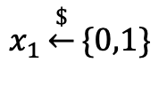







Game-theoretic fairness [CGK+18]
A coalition of malicious parties:
- can’t harm honest parties’ utility (Maximin-fair)
- can’t increase their utility (CSP-fair)
Coin-tossing [Blum83]: perfectly game-theoretically fair
$$x_{0}\underset{←}{\$}\{0,1\}$$
$$Com(x_{0})$$
$$x_{1}\underset{←}{\$}\{0,1\}$$
$$Com(x_{1})$$
Open $x_{0}$
Open $x_{1}$
Win with at least 1/2
$$\{$$
$x_{0}⊕x_{1}$, if no abort
Leader is
$1⊕i$, if $i$ aborts
Notes:
The notion was first formalized for multi-party protocols by Chung et al. in 2018. It guarantees that a coalition of malicious parties can’t ..., where the utility refers to their probability of being selected. We call the former maximin fairness and the later CSP fairness.
To see why this notion is much easier to achieve, a simple example is Blum’s coin-tossing protocol, which is perfectly game-theoretically fair. For two parties, Alice and Bob, in the first round, each party selects a random bit and commits to the bit. Then, in the second round, each party opens their bit. If no party aborts, then the leader is decided by the XOR of the two bits. If one of the parties aborts, the other party becomes the leader.
To see that the protocol is perfectly fair, suppose Bob is malicious here. First of all, Bob should never abort since there is no benefit of doing it. If Bob does not abort, since he can only see Alice’s bit after he decided his own bit, Alice will win with at least a probability of 1/2, which means the protocol is perfectly fair. However, we can see that the protocol does not satisfy the strong unbiased notion, since Bob can always abort, making the outcome be 0 all the time.

Slide 4

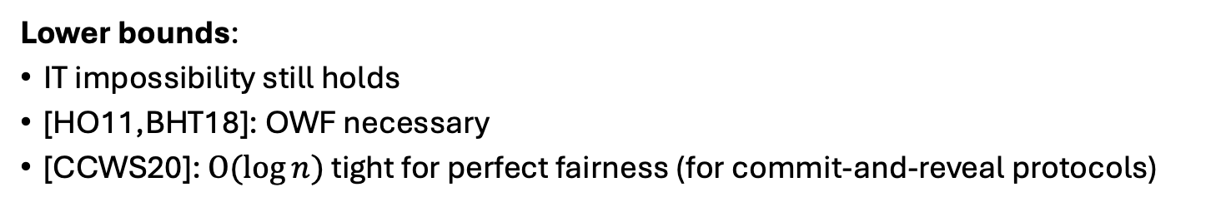


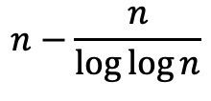

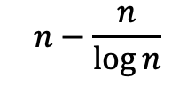


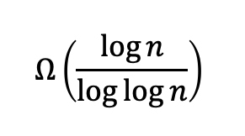




Prior upper/lower bounds
$n$: # of parties
# of rounds
$$O(\log{n)}$$
Tournament tree
[CCWS20]
[KMSW22]
$$Ω\left(\frac{\log{n}}{\log{\log{n}}}\right)$$
$$O(log{\log{n})}$$
$$O(\log^{∗}{n)}$$
This work
$$Ω(1)$$
coalition
size
$$n−\frac{n}{\log{\log{n}}}$$
$$n−\frac{n}{\log{n}}$$
$$n−n^{ε}$$
$$n−1$$
$$n/2$$
$$βn$$
Any $ε<1$
Lower bounds:
IT impossibility still holds
[HO11,BHT18]: OWF necessary
[CCWS20]: $O(\log{n})$ tight for perfect fairness (for commit-and-reveal protocols)
Question: Lower bounds for less than n-1 coalition and not perfect fairness?
Notes:
So what do we know so far about the game-theoretically fair leader election protocols?
Let’s see the following diagram, where the x-axis is the coalition size and y-axis is round complexity, and n denotes the number of parties.
For maximum coalition size, n-1, we can extend the Blum’s 2-parties protocol to n-parties setting, which is the forklore tournament tree protocol. It achieves perfect fairness and requires log n rounds.
For slightly smaller coalition, Chung et al gives a loglog n-round protocol that achieves approximate fairness against coalitions of size n - n/log n, and they show a further tradeoff when the coalition size is less tha n - n ^\epsilon.
Moreover, Komgodski et al gives a log*n round protocol when only a constant fraction of parties collude, and they show a further tradeoff upto coalitions of size ….
In terms of lower bounds: We know it is still impossible in the information-theoretical setting, and OWF functions are necessary. The only other lower bound is given by Chung et al., where they consider a special class of protocols referred to as commit-and-reveal protocols, which I will explain later, and they show that log n rounds are necessary for perfect fairness against n−1 coalitions.
So, we know nothing in terms of lower bounds when the coalition size is less than n-1 or when we do not require perfect fairness.
In this work, we also consider commit-and-reveal protocols. In particular, we show that log n/loglog n rounds are necessary for approximate fairness against coalitions of size at n – n^epsilon and we show further tradeoff when the coalition size is larger than n – n /log n.

Slide 5
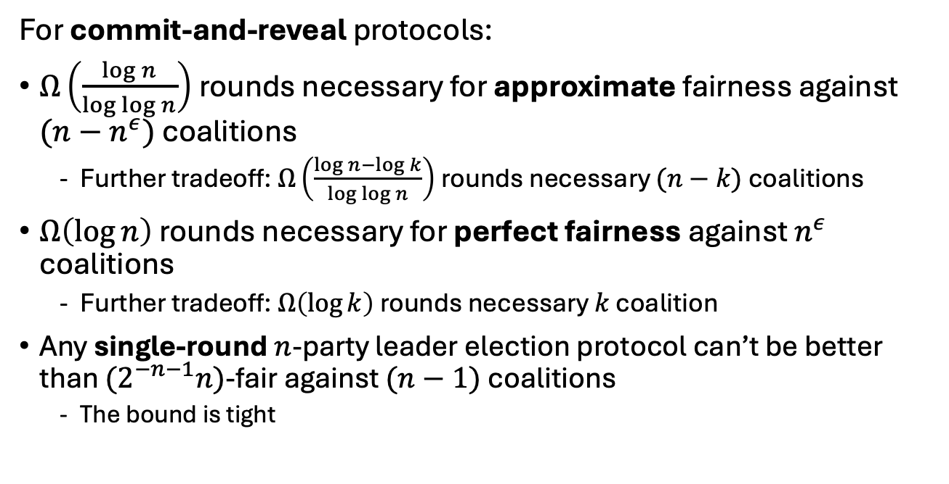
Our results
For commit-and-reveal protocols:
$Ω\left(\frac{\log{n}}{\log{\log{n}}}\right)$rounds necessary for approximate fairness against $(n−n^{ε})$ coalitions
Further tradeoff: $Ω\left(\frac{\log{n}−\log{k}}{\log{\log{n}}}\right)$rounds necessary $(n−k)$ coalitions
$Ω\left(\log{n}\right)$ rounds necessary for perfect fairness against $n^{ε}$ coalitions
Further tradeoff: $Ω\left(\log{k}\right)$rounds necessary $k$ coalition
Any single-round $n$-party leader election protocol can’t be better than $(2^{−n−1}n)$-fair against $(n−1)$ coalitions
The bound is tight
Notes:
Concretely the tradeoff is as follows.
Furthermore, for perfect fairness, we show. … , and there is further tradeoff.
We also highlight that for single round protocols, we give a concrete bound on how fair they can be. Moreover, we show the lower bound is tight.
For the result of talk, I will focus our results on approximate fairness and explain our proof ideas.

Slide 6



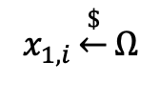
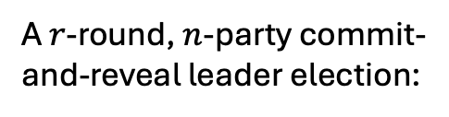

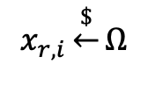





Commit-and-reveal protocols [CCWS20]
$$x_{1,i}\underset{←}{\$}Ω$$
$$Com(x_{1,i})$$
Open $x_{1,i}$
$$…$$
$$…$$
Party $i$
$$Com(x_{r,i})$$
Other parties
$$x_{r,i}\underset{←}{\$}Ω$$
Open $x_{r,i}$
A $r$-round, $n$-party commit-and-reveal leader election:
$$Π\left({\left\{x_{j,i}\right\}}_{j∈\left[r\right],i∈[n]}\right)→\left[n\right]$$
$x_{j,i}←⊥$ if Party i aborts at round j
Examples [Blum86], [KMSW22]
Notes:
Before that, let me first explain what are commit-and-reveal protocols. These protocols follow a specific structure where each round consists of two phases, a commit phase, where each party I samples a random input from a domain Omega, and broadcasts the commitment of the input, and a open phase, where parties open their inputs.
If party I aborts in round j, we set x_{j,I} to abort. And an r-round n-party protocol can be described by a function Pi, which takes the inputs from all parties across all rounds and outputs an index indicating the selected leader.
Several schemes are belong to this class.

Slide 7
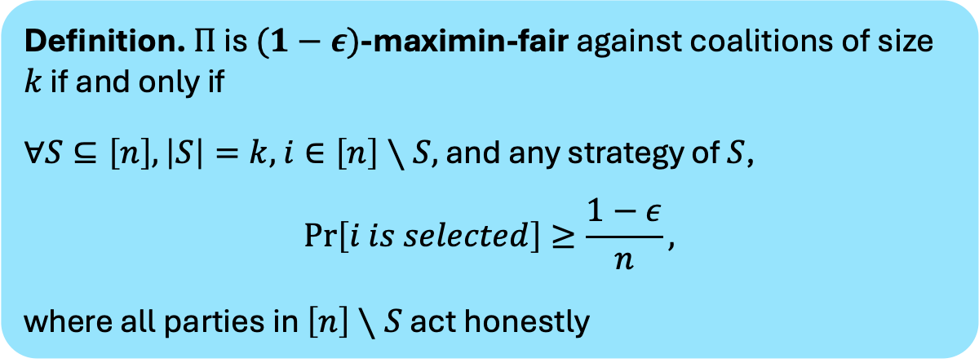
Maximin fairness
Definition. $Π$ is $(1−ε)$-maximin-fair against coalitions of size $k$ if and only if
$∀S⊆\left[n\right],\left|S\right|=k,$ $i∈\left[n\right]∖S,$ and any strategy of $S$,
$$\operatorname{Pr}\left[i is selected\right]≥\frac{1−ε}{n},$$
where all parties in $\left[n\right]∖S$ act honestly
Any honest party wins with at least $α$ $⇔$ $αn$-maximin-fair
Notes:
For approximate fairness, I only give the formal definition for maximin fairness here, since it will be the main focus of this talk.
a protocol guarantees that any honest party wins with at least probability alpha is equivalent to say the protocol is alpha n-maximin-fair.

Slide 8



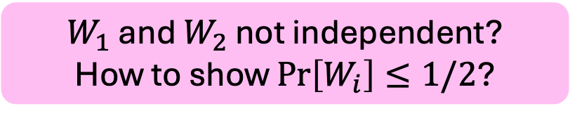

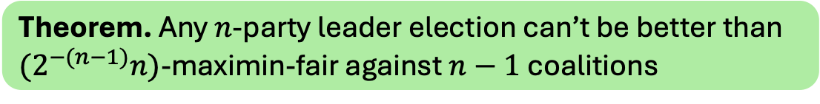

Single-round
Theorem. Any $n$-party leader election can’t be better than $(2^{−(n−1)}n)$-maximin-fair against $n−1$ coalitions
1
$W_{i}$: party 3 is selected if $i$ aborts
1
$$\operatorname{Pr}\left[W_{2}\right]≤1/2$$
2
3
$$\begin{aligned}\operatorname{Pr}\left[3 is selected\right]≤\operatorname{Pr}\left[W_{1}∩W_{2}\right]\end{aligned}$$
2
$$≤\operatorname{Pr}\left[W_{1}\right]⋅\operatorname{Pr}\left[W_{2}\right]≤\frac{1}{4}$$
$$\operatorname{Pr}\left[W_{1}\right]≤1/2$$
$W_{1}$ and $W_{2}$ not independent?
How to show $Pr\left[W_{i}\right]≤1/2$?
Notes:
For single round protocols, we show any n party protocol can’t be better than …
For simplicity, we only consider maximum corruptions in this talk. To show the statement, let's consider the 3-party case. Suppose party 1 and 2 are corrupted. Our goal is to design a strategy that reduces the probability of party 3 being selected.
Due to the commit-and-reveal framework, the bad parties can’t decide their input based on the honest party’s input, but they can still choose whether to abort after party 3 open its input. The strategy is to let one of the bad parties abort if it will make party 3 not be selected
Denote W_i as the event that party 3 is selected if party i aborts. Intuitively, given party 2 aborts, there should be a fair competition between party 1 and party 3, meaning the probability of W_2 should be at most 1/2. Similarly, the probability of W_1​ should also be at most 1/2.
Then, under this strategy, party 3 is selected only if both W1 and W2 occurs. Therefore, if the two event are independent, we can show the probability that 3 is selected is at most ¼.
However, this argument is not rigorous. For example, there is no guarantee that W1 and W2 are independent. Due to the time limit, we refer to our paper for the full proof.

Slide 9


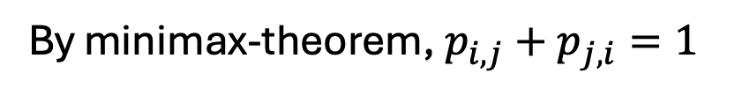




Idea: $W_{1}$ and $W_{2}$ are independent given input of party 3
1
Suppose $∃S_{1}:∀x_{3},\underset{x_{1}∼S_{1}}{Pr}\left[Π\left(x_{1},⊥,x_{3}\right)=3\right]≤p_{1,3}$
$$x_{1}∼S_{1}$$
$$∃S_{2}:∀x_{3},\underset{x_{2}∼S_{2}}{Pr}\left[Π\left(⊥,x_{2},x_{3}\right)=3\right]≤p_{2,3}$$
$$x_{2}∼S_{2}$$
2
3
$$\operatorname{Pr}{[3 is selected]}≤p_{1,3}p_{2,3}$$
$$x_{3}$$
Denote $p_{i,j}≔\min_{S_{i}}{\max_{x_{j}}{\underset{x_{i}∼S_{i}}{Pr}\left[Π\left(x_{i},x_{j},⊥\right)=j\right]}}$
By minimax-theorem, $p_{i,j}+p_{j,i}=1$
$$⇒ p_{i,j}⋅p_{j,i}≤1/4$$
$$p_{1,2}p_{2,1}p_{1,3}p_{3,1}p_{2,3}p_{3,2}≤2^{−6}$$
$p_{2,3}p_{1,3}≤1/4$ or $p_{2,1}p_{3,1}≤1/4$ or $p_{1,2}p_{3,2}≤1/4$
Notes:
To solve the dependency issue, the observation is that if the input of party 3 is fixed, then the two events are actually independent given the inputs of party 1 and party 2 are sampled independently.
Suppose there exists a strategy of sampling x1, such that for any party 3’s input, the probability that 3 is selected given party 2 abort is bounded by some constant p{1,3}, and there exists a trategy of sampling x2, such that the probability that 3 is selected given party 2 abort is bounded by some constant p{2,3}.
Suppose party 1 and 2 samples their inputs using S1 and S2 respectively. The probability that party 3 is selected would be at most p13 times p23
It is left to bound this product.
The idea is to consider all coalition pairs and choose one that does the best job.
We first extend p1,3 and p2,3 to all pairs of parties. Pi,j can be represented using the following max and min equation. Then, the maximin theorem shows pi,j + pj,I is 1,which implies pi,j times pji is at most ¼.
Therefore, the product of all pairs pi,j is at most 2^{-6}, which implies at least one of the following pairs is bounded ¼. Therefore, there is at least a pair party that makes the third party be selected with at most ¼ probability.

Slide 10
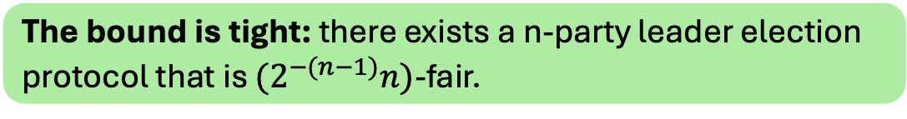
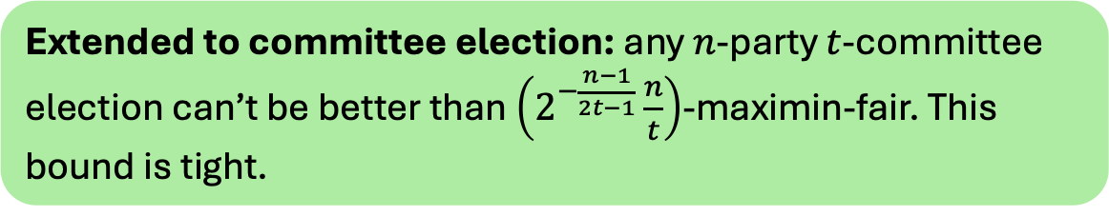

Other results
The bound is tight: there exists a n-party leader election protocol that is $(2^{−(n−1)}n)$-fair.
1
[Blum83]
A party winning all matches is selected Otherwise, an arbitrary party is selected
Any honest party wins with at least $1/4$
2
3
Extended to committee election: any $n$-party $t$-committee election can’t be better than $\left(2^{−\frac{n−1}{2t−1}}\frac{n}{t}\right)$-maximin-fair. This bound is tight.
Notes:
We also give concrete protocols that match the lower bounds. the idea is to let each pair of parties run Blum’s 2-party protocol, and the party is selected if it wins all the 2-party matches. If no such a party exists, an arbitrary party is picked.
For each honest party, since the probability that it wins one match is at least 1/2, it is selected with probability at least 2^{-(n-1)}.
We also extend our results to committee election, where the goal is to output a set of parties of a specified size.

Slide 11








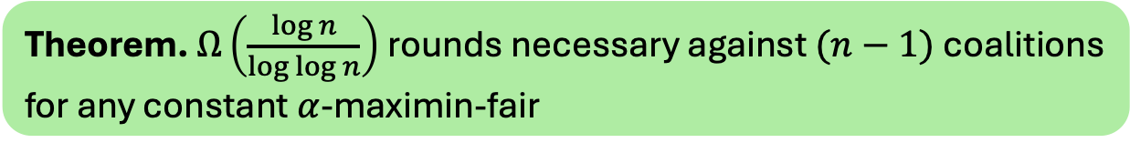
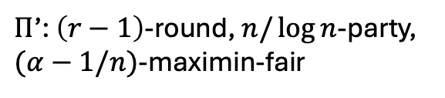

Multi-round
Theorem. $Ω\left(\frac{\log{n}}{\log{\log{n}}}\right)$rounds necessary against $(n−1)$ coalitions for any constant $α$-maximin-fair
1
2
$$…$$
n
$Π$: $r$-round, $n$-party, $α$-maximin-fair
After the first round,
$i$ is eliminated if $\operatorname{Pr}\left[i wins\right]≤α/n−1/n^{2}$
1
2
$$…$$
n
Lemma. #(remaining) $>n/\log{n}$
$$⇒$$
$$…$$
$Π$’: $\left(r−1\right)$-round, $n/\log{n}$-party, $(α−1/n)$-maximin-fair
$$⇒$$
1
2
$$…$$
n
$$r≥Ω(\log{n/\log{\log{n}}})$$
$$r≥Ω(\log{n}/\log{\log{n}})$$
Notes:
Finally, I would like to a proof sketch of our multi-round results.
Let Pi be an r-round, n-party, alpha-maximin-fair protocol. After the first commit-and-reveal round, we say a party is eliminated if the probability of it being selected is slightly decreased. Suppose we can show there exists a first round input x, such that the number of remining party is at least n/log n.
Then, we can show that this gives us a r-1-round protocol for n/log n –party with relatively the same fairness guarantee.
Intuitively, in each round, the number of parties might shrink, but it decreases by at most a factor log n. Therefore, it must take at least log⁡n\\log \log n rounds for the number of parties to reduce to one.

Slide 12

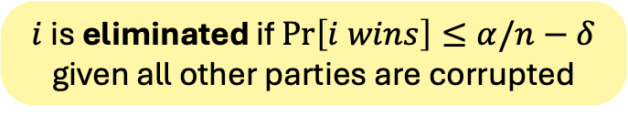




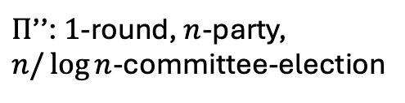

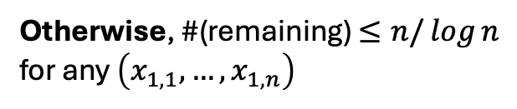

Lemma. $∃\left(x_{1,1},…,x_{1,n}\right):$ #(remaining given $x_{1,1},…,x_{1,n}$) $>n/\log{n}$
$$x_{1,1}$$
$$x_{1,2}$$
$$x_{1,n}$$
Otherwise, #(remaining) $≤n/\log{n}$ for any $\left(x_{1,1},…,x_{1,n}\right)$
1
2
$$…$$
n
$$⇒$$
$Π$’’: $1$-round, $n$-party, $n/\log{n}$-committee-election
1
2
$$…$$
n
Claim. $Π′′$ is $1/n$-maximin-fair
$$⇒$$
$$…$$
Contradicts the single-round lower bounds
$i$ is eliminated if $\operatorname{Pr}\left[i wins\right]≤α/n−δ$ given all other parties are corrupted
Notes:
Lastly, to prove the lemma, suppose the number of remaining parties is at most n/log n for any first-round input.
In this case, we can view the first round of Pi as a single-round committee election protocol, where the remaining parties are the selected committee. We can show that this protocol is \delta n-maximin fair, which contradicts our lower bounds for single-round protocols.

Slide 13
Open problems
Lower bounds for general protocols, similar to Cleve’s
Round complexity given smaller coalition size, especially, constant-ratio
Whether our lower bounds are tight
Thank you!
Notes:
I will end my talk with a few open problems. First, can we extend our lower bounds to more general protocols? Second, our lower bounds on approximate fairness only cover the case where the coalition size is nearly nnn. Can we prove something for smaller coalition sizes?
Also, it would be interesting to see whether our lower bounds are tight

