Slide 1
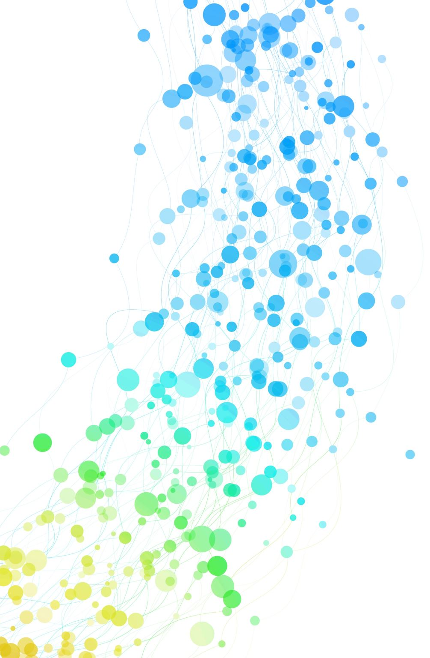
Oblivious issuance of proofs
Michele Orrú, Stefano Tessaro, Greg Zaverucha, Chenzhi Zhu
Notes:
Thanks for the introduction!
My talk today is about a new primitive we proposed in this work, which we refer to as oblivious issuance of proofs.
I will start by explaining what it is and why it is useful.

Slide 2




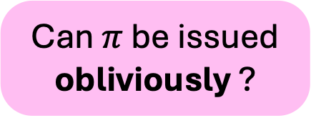
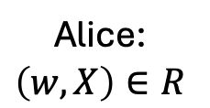



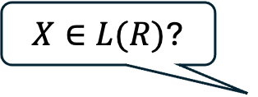
Non-interactive proofs
$$R≔\left\{\left(w,X\right)\right\}$$
Poly-time recognizable
$$L\left(R\right)≔\{X:∃w,\left(w,X\right)∈R\}$$
NP language
$X∈L(R)$?
Alice:
$$\left(w,X\right)∈R$$
Bob
Can $π$ be issued obliviously ?
$$π$$
Accept/Reject
Completeness: accept $π$ if $\left(w,X\right)∈R$
Other properties: zero-knowledge, knowledge soudness, WI, succinct, …
Soundness: reject $π$ if $X∉L(R)$
Notes:
Let's first recall the concept of non-interactive proofs.
Consider a relation R, and let L(R) denote its corresponding NP language.
Suppose Alice holds a witness w for some statement X in the language, and Bob wants to know whether X is indeed in the language.
Alice tries to convince Bob by sending a single message pi computed from the witness w, and Bob decides to whether accepts or rejects.
We say pi is a non-interactive proof if
Bob will accept if X is in the language and Alice holds a correct witness and
Bob will always reject pi if X is not in the language.
For example, the proof can simply be the witness itself.
so, to make the problem non-trivial, we usually require additional properties, such as zero knowledge,
And in this work, we consider an orthogonal problem, i.e. whether the proof can be issued obliviously

Slide 3
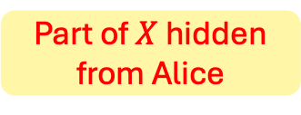



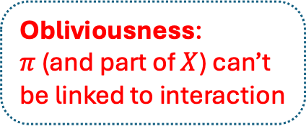


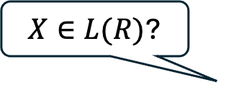
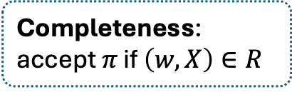
Oblivious issuance
$$R≔\left\{\left(w,X\right)\right\}$$
Part of $X$ hidden from Alice
$$L\left(R\right)≔\{X:∃w,\left(w,X\right)∈R\}$$
Obliviousness:
$π$ (and part of $X$) can’t be linked to interaction
Alice: $w$
$X∈L(R)$?
Bob: $X$
Oblivious
One-more unforgeability:
can’t forge more proofs than # of interactions
Completeness: accept $π$ if $\left(w,X\right)∈R$
$$π$$
Verify$\left(X,π\right)→1/0$
Why care?
Soundness: reject $π$ if $X∉L(R)$
Other properties …
Notes:
More precisely, the goal is to construct an interactive protocol that allows Bob to obtain a non-interactive proof, which can be verified by anyone, while keeping the proof itself hidden from Alice. Moreover, part of the statement X can remain hidden from Alice. We refer to the property as Obliviousness, which guarantees that pi and the idden part of X are unlinkable to the interaction that issues the proof.
The proof retains the same security guarantees, including completeness, soundness, and possibly other properties.
Furthermore, we require the protocol to be one-more unforgeable, meaning that Bob cannot forge more proofs than the number of completed issuance interactions without the witness.
Why do we want to obliviously issue proofs?
The main motivation is that this primitive is particularly useful for constructing blind signatures and anonymous credentials. I will now explain each of these one by one

Slide 4








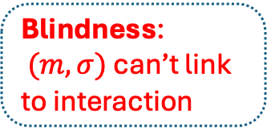
Motivations: blind signatures [Cha82]
Many applications:
E-cash [Cha82]
One’s VPN
Private click measure
Privacy Pass
…
Alice: $sk$
Bob: $pk,m$
Oblivious
$$σ$$
Blindness:
$(m,σ)$ can’t link to interaction
$$Ver\left(pk,m,σ\right)→0/1$$
Proof
One-more unforgeability:
can’t forge more signatures than # of interactions
Notes:
A blind signature protocol allows Bob to obtain a signature for a public key and a message m from Alice, who hods the corresponding secret key, while keeping the signature and message hidden from Alice. The protocol satisfies two key properties: blindness, which guarantees that m and the signature cannot be linked to the issuance interaction, and one-more unforgeable, which guarantees Bob cannot forge more signatures than # of issuance interactions.
Blind signatures have many applications. They were originally proposed for constructing anonymous e-cash systems and are now widely used in network services to achieve anonymity and protect user privacy. (Examples include Google One’s VPN services, Apple’s private click measurement, and Cloudflare’s Privacy Pass, which is currently undergoing the IETF standardization.)
We can see that the syntax of blind signatures closely resembles that of oblivious issuance of proofs. If the signature can be viewed as a proof, then the blind signatures protocol gives us an oblivious issuance protocol for certain proofs.

Slide 5
Connections with blind signatures
Blind signatures and extensions
Blind Schnorr signatures [CP93]
Partially blind signatures [AO00]
Blind signatures w/ arttributes [BL12]
U-Prove/Brands’ credential [Bra00,PZ11]
Obliviously issue PoK of DLog
Certain proofs
New constructions
Oblivious issuance of proofs
Notes:
In fact, a variety of blind signatures and their extensions have this property. For example, Blind Schnorr signatures can be interpreted as an oblivious issuance protocol for Proof of knowledge of discrete logarithms.
In turn, constructing oblivious issuance protocol for more general proofs opens the door to new constructions of blind signatures.

Slide 6









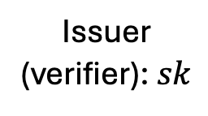

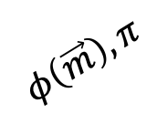


Motivations: anonymous credentials [Cha85]
Multi-show
Keyed-verification [CMZ14]
$$\vec{m}$$
Cred
$$\vec{m}$$
Issuer: $sk$
Cred
$$, π_{\text{p}}$$
Can we support unlinkable public verification?
Partial information
User: $pk,\vec{m}$
$$φ\left(\vec{m}\right),π$$
Issuer
(verifier): $sk$
$$φ\left(\vec{m}\right),π$$
User: $pk,\vec{m}$
Cred
Cred
Yes, with oblivious issuance of proofs!
Unlinkable multi-show
Pairing free
Better efficiency
Verifier: $pk$
All practical schemes [CL04, ASM06, BCC+09] require pairings
No unlinkable public verification
Notes:
Another use case is in anonymous credentials
In this scenario, a user wishes to obtain a credential from an authority for a set of attributes. For example, the credential could be a driver's license with attributes such as name, date of birth, and address. The user can later present the credential and the associated attributes to the verifier in an anonymous way, meaning that the credential presentation cannot be linked to the issuance, and even if the user presents the same credential multiple times, the transcripts of each showing cannot be linked.
Additionally, the user can reveal only partial information about the attributes, such as whether their age is over 18, while the rest of the attributes remains hidden.
This concept is known as multi-show anonymous credentials. However, a limitation of existing constructions is that all practically efficient schemes rely on pairing-friendly curves, which makes them undesirable for many applications due to the lack of standard library support.
A simpler scenario arises when the user only needs to present their credentials to the issuer. we note here that In this case, the issuer additionally needs to sends a proof that the credential is generated correctly. This referred to as keyed-verification anonymous credentials, which was first proposed by Chase et al. in 2014. They also proposed constructions based on pairing-free groups, which offer better efficiency and are used in the Signal encrypted message application.
However, th d rawback of this approach is the lack of support for unlinkable public verification. One open question is whether we can add unlinkable public verfication here. We show that we can support a single unlinkable public show through the oblivious issuance of proofs.

Slide 7

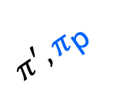

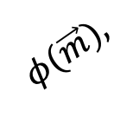




Adding public verifiability
Single-show AC [BL12,KL23]
$$\vec{m}$$
Oblivious
Preserve keyed-verification
Issuer: $sk$
$$φ\left(\vec{m}\right),π$$
User: $pk,\vec{m}$
Cred
$$, π_{\text{p}}$$
Same as before
Cred
Minor changes to issuance only
$$φ(\vec{m}),$$
Unlinkable to issuance
$π^{′},π_{\text{p}}$
Unlinkable single-show
Verifier: $pk$
Notes:
The idea is to replace the original issuance with an oblivious issuance protocol such that both credential and the proof are now unlinkable to the issuance. Therefore, to do unlinkable public showing, the user simply sends the credential and the proof to the verifier together with an additional proof pi’ which is a proof of knowledge of the hidden attributes. However, here the user can only do unlinkable showing once since if they do it twice, the two showing can be linked. Such feature is referred to as single show anonymous credentials. The nice thing about our construction is that we do not disturb the keyed verification functionality. The showing of credentials to the issuer remains the same as before. Also, the changes to the original protocol are minor and only to the issuance protocol.

Slide 8



Related works
Unlinkable to $π$ due to ZK
Meta proofs [DSY90]
$Reduce\left(X,π\right)→\tilde{π}$ : ZKP of “$∃π,Verify\left(crs,X,π\right)=1$”
Randomizable proofs [BCC+09]
Based on Groth-Sahai proofs [GS08]
Blind Schnorr signatures [CP93]
obliviously issue PoK of Dlog
Not OMUF in concurrent setting (ROS attack [BLL+21])
Fixes [Abe01, FPS20, KLR21, CAH+22, KLRX22, TZ22, FW24]
High cost
Can we issue proofs obliviously for more general relations based on pairing-free groups?
$$π$$
Rd
$$\tilde{π}$$
Relies on pairings
Pairing-free groups
Specific relations
Notes:
I will now review the related works. One way to obliviously issue a proof is via the idea of meta-proofs, where the user can generate a zero-knowledge proof that there exists a proof that makes the verification algorithm accept. Due to the zero-knowledge property, the new proof is unlinkable to the original one. However, this method is not efficient due to either the large proof size or the high computational cost.
Another way is to use randomizable proofs, allowing the user to randomize the proof to create an unlinkable version. One drawback here is that the existing construction is based on Groth-Sahai proofs which relies on pairing.
Also, as mentioned earlier, Blind Schnorr signatures can be interpreted as the oblivious issuance of proofs of knowledge of discrete logarithms. The scheme is quite efficient and is based on pairing-free groups. However, a recent attack shows that the scheme is not OMUF if we allow arbitrary concurrency. there are ongoing efforts to avoid the attack. Nonetheless, they only considered proofs for specific relations.
Thus, the main problem we address here is whether it is possible to issue proofs obliviously for more general relations based on pairing-free groups.

Slide 9
Contributions
Syntax & security of oblivious issuance of proofs
Pairing-free constructions for algebraic relations
Relies on AGM+ROM
New constructions:
- Partially unique blind sigs
- U-Prove with OMUF
Adding unlinkable public verifiability:
- 2HashDH OPRF
- Keyed-verification AC
Notes:
Our contributions can be summarized as follows. First, we give formal syntax and security definitions for the primitive. Next, we give pairing-free constructions for a class of linear relations, which we refer to as algebraic relations. One note here is that our security analysis relies on both algebraic group model and random oracle model. The applications of our construction are twofold.
First, they give us several new constructions of blind signatures and anonymous credentials. Second, they can be used to add unlinkable public verification to several existing systems.
The first one is adding unlikable public verification to 2HashDH OPRF. This gives us a new construction of anonymous tokens with fast private verifications, and also a new blind signature scheme with part of the signature is unique and unforgeable.
The second one is adding public verification to algebraic MACs, which is the key primitive underlying the keyed-verification anonymous credential. As mentioned earlier, it adds the ublic single-show feature to the original keyed-verification anonymous credential. The resulting system is based on pairing-free groups and only require minor changes to the issuance protocol only.
Finally, we give a variant of U-Prove credentials which achieves one-more unforgeable in concurrent settings. The original protocol was affected by the ROS attack.

Slide 10
Rest of talk
Syntax & security
Algebraic relations
Our constructions
Notes:
For the rest of the talk, I will first go through the syntex, security definitions, then introduce algebraic relations, and finally give an overview of our constructions.

Slide 11
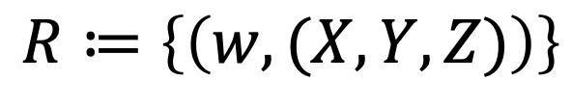

Syntax
Public
Chosen by user freely
$$R≔\left\{\left(w,(X,Y,Z)\right)\right\}$$
Hidden from issuer
Depending on ($w,Y)$
Statement
Notes:
First of all, we consider the following relation, where the statement is divided into three components (X,Y,Z).
We divide the statement into three conponents because we want part of the statement to be hidden from the issuer and part of the statement to be chosen by the user freely
The X part of statement is public, while the Y and Z part are hidden from the issuer. The Y part can be chosen freely by user independent of the witness, and the remaining part Z can depends on both the witness and the statement Y.

Slide 12

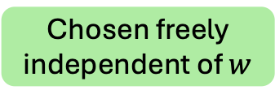




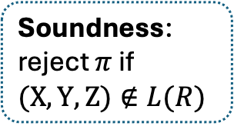


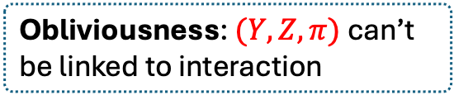



Syntax
Security
Free Mode
Restricted Mode
Hidden from issuer
$$R≔\left\{\left(w,(X,Y,Z)\right)\right\}$$
Chosen freely
independent of $w$
$$L\left(R\right)≔\{(X,Y,Z):∃w,\left(w,(X,Y,Z)\right)∈R\}$$
Issuer:$w, X$
User: $X,$
$\text{inf}$o
$$Y$$
info
Soundness:
reject $π$ if $(X,Y,Z)∉L(R)$
Oblivious
$$Y,$$
$$Z,π$$
$$\left(X,Y,Z\right)∈L(R)$$
Obliviousness: $(Y,Z,π)$ can’t be linked to interaction
Randomly sampled depending on info
Notes:
Hope things will become clearer after we go through the syntax of issuance.
We consider two modes of issuance. The first is called the "free mode," where the user can freely choose the Y part. After running the interaction with the issuer, the user obtains the Z part along with a proof showing that (X,Y,Z) is in the language.
The second mode is called the "restricted mode." The difference here is that the user cannot freely choose Y; instead, the user can only choose some public information that determines the distribution of Y.
Regarding security, in both modes, soundness ensures that no one can forge a valid proof for (X,Y,Z) that is not in the language. Obliviousness ensures that (Y,Z,π) cannot be linked to the issuance interaction, even if the issuer is malicious.

Slide 13


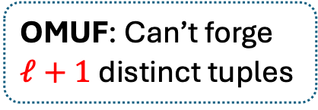
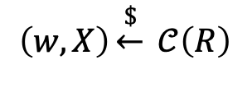






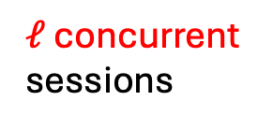
One-more unforgeability (OMUF)
Concurrent example
I
U
$$R≔\left\{\left(w,(X,Y,Z)\right)\right\}$$
$$\left(w,X\right)\underset{←}{\$} 𝒞\left(R\right)$$
Set of possible $\left(w,X\right)$
OMUF
Issuer:$w, X$
Adversary:$X$
$$≠$$
$ℓ$ concurrent sessions
Soundness: Can’t forge valid $π$ for $\left(X,Y,Z\right)∉L(R)$
$$⋮$$
OMUF: Can’t forge $ℓ+1$ distinct tuples
$$\left(Y_{1},Z_{1},π_{1}\right),…,(Y_{ℓ+1},Z_{ℓ+1},π_{ℓ+1})$$
$π_{i}$ valid for $\left(X,Y_{i},Z_{i}\right)∈L(R)$
Notes:
In addition, we want to achieve one-more unforgeability, which is defined through the following game.
Initially, a (w,X) pair is sampled. The adversary acting as a malicious user with input X can engage in \ell concurrent signing sessions with the issuer, where concurrent means the interaction of different sessions can be arbitrary interleaved. The adversary wins if it can output ell + 1 distinict tuples of Y,Z and proof, where each proof I is a valid proof that (X,Yi,Zi) is in the language. We also note here that OMUF is different from Soundness which guarantees that the adversary cannot forge a proof for a statement that is not in the language.

Slide 14

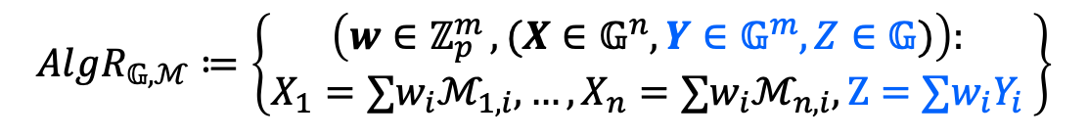
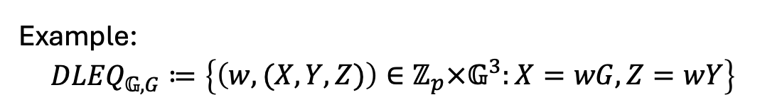
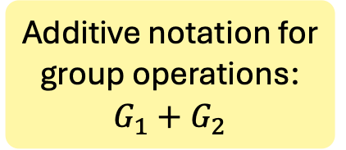

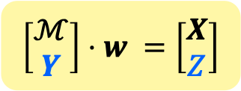

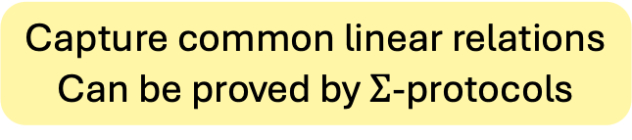
Algebraic Relations
Additive notation for group operations:
$$G_{1}+G_{2}$$
$$𝔾=\left\langle G\right\rangle ,p=\left|𝔾\right|$$
$$ℳ∈𝔾^{n×m}$$
$$AlgR_{𝔾,ℳ}≔\left\{\begin{aligned}\left(w∈ℤ_{p}^{m }, (X∈𝔾^{n}, Y∈𝔾^{m}, Z∈𝔾)\right): \\ X_{1}=∑w_{i}ℳ_{1,i},…,X_{n}=∑w_{i}ℳ_{n,i},Z=∑w_{i}Y_{i} \end{aligned}\right\}$$
$$\left[\begin{aligned}ℳ \\ Y\end{aligned}\right]⋅w =\left[\begin{aligned}X \\ Z\end{aligned}\right]$$
Capture common linear relations
Can be proved by $Σ$-protocols
Example:
$${DLEQ}_{𝔾,G}≔\left\{\begin{aligned}\left(w,(X,Y,Z)\right)∈ℤ_{p}×𝔾^{3}:X=wG,Z=wY\end{aligned}\right\}$$
$$=AlgR_{𝔾,ℳ=[G]}$$
Notes:
I will now introduce the algebraic relations.
Given a prime order cyclic group G, and a n by m matrix in G. The algebraic relation parametrized by G and M is defined as follows.
For simplicity, we use additive notation to denote group operations.
The witness is a scalar vector in Zp, and X is a vector in G such that Xi is equal to the linear combination of the i-th row matrix M with coefficient w.
Y part of the statement is a vectors in G, and Z is a single group element that equals to the sum of wi Yi. These relations can be expressed compactly as a matrix equation.
Algebraic relations encompass many common linear relations and can be proved using sigma-protocols. One example is the DLEQ relation where the witness is a scalar in Zp and X,Y,Z are three group elements, satisfying X = wG for some group generator G and Z = wY. This is a specific case of an algebraic relation where M is a one by one matrix.

Slide 15
Our constructions
Notes:
I will now give an overview of our constructions.

Slide 16

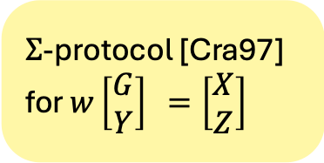
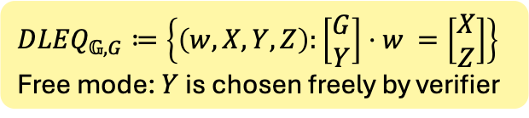

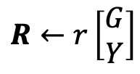

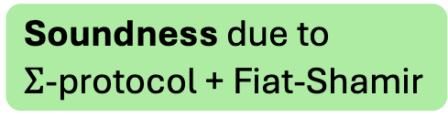






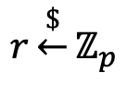


Starting: w/o obliviousness
$${DLEQ}_{𝔾,G}≔\left\{\begin{aligned}\left(w,X,Y,Z\right):\left[\begin{aligned}G \\ Y\end{aligned}\right]⋅w =\left[\begin{aligned}X \\ Z\end{aligned}\right]\end{aligned}\right\}$$
Free mode: $Y$ is chosen freely by verifier
$$\left(𝔾, p,G\right): 𝔾=\left\langle G\right\rangle ,p=\left|𝔾\right|$$
Issuer:$w, X$
User: $X,Y$
Achieve obliviousness?
$$Y$$
$$Z←w⋅Y$$
$$r\underset{←}{\$}ℤ_{p}$$
$$Z$$
$$, R$$
$$c←H(X,Y,Z,R)$$
$Σ$-protocol [Cra97] for $w\left[\begin{aligned}G \\ Y\end{aligned}\right] =\left[\begin{aligned}X \\ Z\end{aligned}\right]$
$$R←r\left[\begin{aligned}G \\ Y\end{aligned}\right]$$
$$s$$
$$s←r+c⋅w$$
$$π←(R,s)$$
Soundness due to
$Σ$-protocol + Fiat-Shamir
Notes:
Let’s start by considering the scenario where we don’t require obliviousness. For simplicity, I'll use the DLEQ (Discrete Logarithm Equality) relation as an example, and focuse on the free mode.
Without obliviousness, the user just sends Y to Issuer and issuer responses with Z equal to w times Y. Then, they run the sigma protocol for the DLEQ relation.
The proof is sound in the random-oracle model due to soundness of the sigma protocol and the fiat-shamir transformation.
Now, we try to achieve obliviousness.
The issuer first sampled a random r and sends a vector R which is equal to r times G and r times Y, then the user sends back a challenge computed from a hash function, and the issuer responds with s equal to r + c times w, the final proof consists of R and s. One can verifiy the proof by checking the following relation.

Slide 17
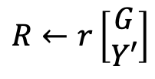



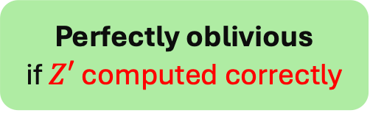
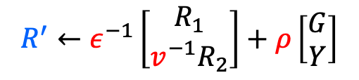






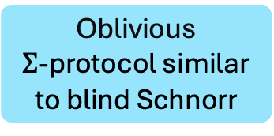
Achieving obliviousness
$${DLEQ}_{𝔾,G}≔\left\{\begin{aligned}\left(w,X,Y,Z\right):\left[\begin{aligned}G \\ Y\end{aligned}\right]⋅w =\left[\begin{aligned}X \\ Z\end{aligned}\right]\end{aligned}\right\}$$
Free mode: $Y$ is chosen freely by verifier
$$\left(𝔾, p,G\right): 𝔾=\left\langle G\right\rangle ,p=\left|𝔾\right|$$
Random masks
Hidden from issuer
Issuer:$w, X$
User: $X,Y$
$$Y′$$
$$Y^{′}←v⋅Y,Z←v^{−1}⋅Z′$$
$$Z′←w⋅Y′$$
$$R^{′}←ε^{−1}\left[\begin{aligned}R_{1} \\ {v^{−1}R}_{2}\end{aligned}\right]+ρ\left[\begin{aligned}G \\ Y\end{aligned}\right]$$
$$, R$$
$$r\underset{←}{\$}ℤ_{p}$$
$$Z′$$
$$c←H(X,Y,Z,R)$$
$$c←ε⋅H\left(X,Y,Z,R′\right)$$
$$R←r\left[\begin{aligned}G \\ Y′\end{aligned}\right]$$
Oblivious
$Σ$-protocol similar to blind Schnorr
$$s$$
$$π←(R^{′},ε^{−1}s+ρ)$$
$$s←r+c⋅w$$
Perfectly oblivious
if $Z′$ computed correctly
Obliviousness in ROM
Soundness of $π$
Notes:
First, to hide Y, the idea is to randomize it by multiplying it with a random mask, resulting in Y’ and send Y’ to the issuer. After receiving Z’, the user can compute the real Z by dividing out the mask. In the protocol, red denotes the random masks and blue denotes elements that are hidden from the issuer.
Next, we can make the sigma protocol oblivioius using an approach similar to blind Schnorr signatures. Due to time constraints, I won’t delve into the details here.
To prove obliviousness, we first show that if Z’ is always computed correctly, the protocol achieves perfect obliviousness. Then, the soundness of pi guarantees Z' is computed correctly. Since the soudness of pi relies on the random oracle, we can show the protocol is oblivious in the random oracle model.

Slide 18


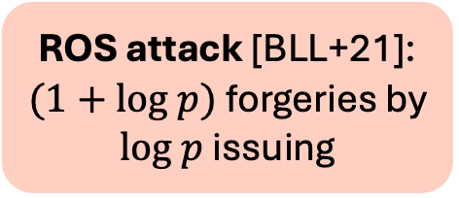




One-more unforgeability?
$${DLEQ}_{𝔾,G}≔\left\{\begin{aligned}\left(w,X,Y,Z\right):\left[\begin{aligned}G \\ Y\end{aligned}\right]⋅w =\left[\begin{aligned}X \\ Z\end{aligned}\right]\end{aligned}\right\}$$
Free mode: $Y$ is chosen freely by verifier
$$\left(𝔾, p,G\right): 𝔾=\left\langle G\right\rangle ,p=\left|𝔾\right|$$
Issuer:$w, X$
Adversary:$X$
$$Y′$$
$$Z′←w⋅Y′$$
ROS attack [BLL+21]:
$(1+log p)$ forgeries by $log p$ issuing
$$, R$$
$$r\underset{←}{\$}ℤ_{p}$$
$$Z′$$
$$R←r\left[\begin{aligned}G \\ Y′\end{aligned}\right]$$
$$c$$
$$s$$
$$s←r+c⋅w$$
Linearity:
$$s_{1}=r_{1}+c_{1}⋅w$$
$$\left(s_{1}+s_{2}\right)=(r_{1}+r_{2})+(c_{1}+c_{2})⋅w$$
$$s_{2}=r_{2}+c_{2}⋅w$$
Notes:
Now, let’s consider whether the protocol is one-more unforgeable. Unfortunately, the ROS attack applies here, which gives an adversary that can generate 1 + log p distinct forgeries by starting log p issuing sessions. A very high level reason that the attack works is due to the linearity of the protocol that allows the adversary to easily combine elements from different issuing sessions.

Slide 19




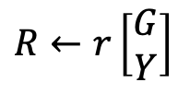



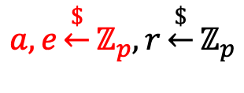







Avoid ROS attack (w/o oblivious)
$${DLEQ}_{𝔾,G}≔\left\{\begin{aligned}\left(w,X,Y,Z\right):\left[\begin{aligned}G \\ Y\end{aligned}\right]⋅w =\left[\begin{aligned}X \\ Z\end{aligned}\right]\end{aligned}\right\}$$
Free mode: $Y$ is chosen freely by verifier
$$\left(𝔾, p,G\right): 𝔾=\left\langle G\right\rangle ,p=\left|𝔾\right|$$
Issuer:$w, X$
User: $X,Y$
Idea from [TZ22]
$$Y$$
$$Z←w⋅Y$$
Commitment of $e$
$$Z$$
$$a,e\underset{←}{\$}ℤ_{p}, r\underset{←}{\$}ℤ_{p}$$
$$, R$$
$$, C←g^{a}h^{e}$$
$$c←H\left(X,Y,Z,R,C\right)$$
$$c←H\left(X,Y,Z,R\right)$$
$$R←r\left[\begin{aligned}G \\ Y\end{aligned}\right]$$
$$s$$
$$,a,e$$
Binding of $C$
$$π←(R,s)$$
$$s←r+(ce)⋅w$$
$$π←(R,s,a,e)$$
$$s←r+c⋅w$$
Break linearity
Obliviousness assuming DL
Soundness assuming DL
Notes:
To avoid the ROS attack, we leverage an idea from the prior work. For simplicity, let’s ignore obliviousness for now. The core idea is to let the issuer commit to a random value e in the first round. After receiving the challenge ccc, the issuer computes the response as before, but now multiplies c by e. Then, the issuer sends s along with the opening of the commitment, which is included in the final proof. I won’t delve into the proof details here, but at a high level, multiplying e here breaks the linearity of the protocol, which is crucial for the ROS attack.
Soundness of the proof now relies on the the binding property of the commitment, which holds under the discrete log assumption. We can also follow the same diagram showed in the previous slide to achieve obliviousness and prove it under the discrete log assumption.

Slide 20
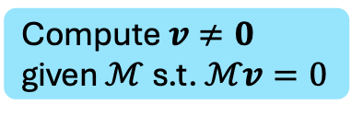
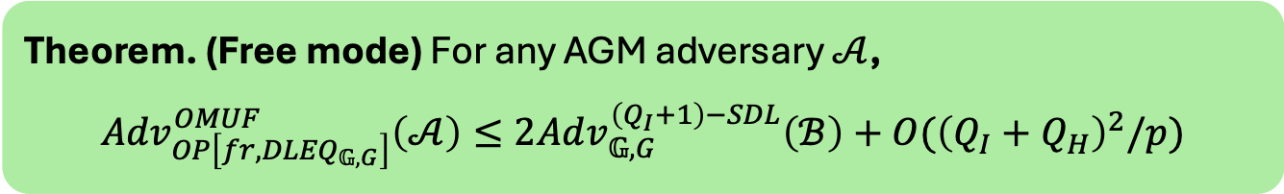
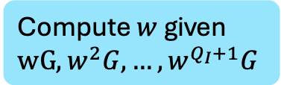


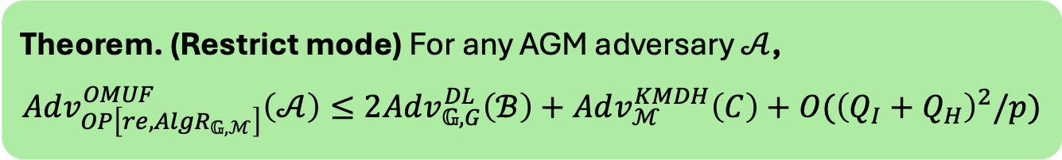



One-more unforgeability
$${DLEQ}_{𝔾,G}≔\left\{\begin{aligned}\left(w,X,Y,Z\right):\left[\begin{aligned}G \\ Y\end{aligned}\right]⋅w =\left[\begin{aligned}X \\ Z\end{aligned}\right]\end{aligned}\right\}$$
Free mode: $Y$ is chosen freely by verifier
Compute $w$ given $wG,w^{2}G,…,w^{Q_{I}+1}G$
Theorem. (Free mode) For any AGM adversary $𝒜$,
$${Adv}_{OP\left[fr,{DLEQ}_{𝔾,G}\right]}^{OMUF}\left(𝒜\right)≤2Adv_{𝔾,G}^{\left(Q_{I}+1\right)−SDL}\left(ℬ\right)+O({\left(Q_{I}+Q_{H}\right)}^{2}/p)$$
Due to: issuer sends $wY$ in each issuing
$Q_{I}$: # of issuing, $Q_{H}:$ # of $H$ queries
$$AlgR_{𝔾,ℳ}≔\left\{\begin{aligned}\left(w,X,Y,Z\right):\left[\begin{aligned}ℳ \\ Y\end{aligned}\right]⋅w =\left[\begin{aligned}X \\ Z\end{aligned}\right]\end{aligned}\right\}$$
Restrict mode: $Y$ sampled according Info
Compute $v≠0$ given $ℳ$ s.t. $ℳv=0$
Theorem. (Restrict mode) For any AGM adversary $𝒜$,
$${Adv}_{OP\left[re,{AlgR}_{𝔾,ℳ}\right]}^{OMUF}\left(𝒜\right)≤2Adv_{𝔾,G}^{DL}\left(ℬ\right)+Adv_{ℳ}^{KMDH}\left(C\right)+O({\left(Q_{I}+Q_{H}\right)}^{2}/p)$$
Implied by DL for common $ℳ$
Notes:
For one-more unforgeability in the free mode, we prove the following theorem for the dleq relation, where QI denotes the number of issuing sessions and QH denotes the number of random oracle queries. OMUF of the scheme relies on the (QI+1)-strong discrete log assumption, which assumes that it is hard to compute w given wG, w^2G, and so on until w^{QI+1} G. The assumption is necessary since the issuer sends wY in each issuing session for any Y chosen by the adversary, which means the adversary can learn all the values given by the strong discrete log assumption.
Also, for the restricted mode, we show OMUF for any algebraic relations relies on the discrete log assumption and that the Kernel matrix DH problem is hard for M, which means it is hard to a non-zero vector such that M times v is 0 vector. For typical matrices M, such as a random matrix, this assumption is implied by the discrete log assumption.

Slide 21
Conclusion & open problems
Blind signatures
Oblivious issuance of proofs for algebraic relations
New constructions:
- Partially unique blind sigs
- U-Prove with OMUF
Adding unlinkable public verification:
- 2HashDH OPRF
- Keyed-verification AC
More relations?
Other proofs, SNARKs?
Other applications?
Our paper: https://ia.cr/2023/1635
Notes:
To conclude, we propose the oblivious issuance of proofs, which can be seen as a generalization of blind signatures. We present efficient, pairing-free constructions for algebraic relations and show several applications.
For future work, it would be valuable to explore whether our constructions can be extended to a broader range of relations and if we can do oblivious issuance for other proof systems, such as SNARKs, it is interesting to investigate further applications for this primitive.

Slide 22
Thank you!

