Slide 1

Snowblind: A Threshold Blind Signature in Pairing-Free Groups
Elizabeth Crites, Chelsea Komlo, Mary Maller,
Stefano Tessaro, Chenzhi Zhu
Aug. 23, 2023

Slide 2







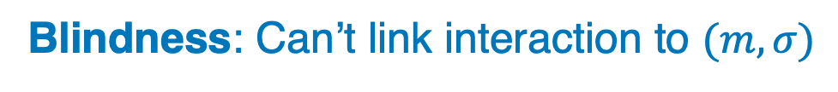

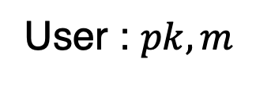
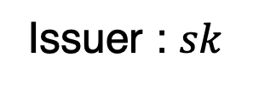
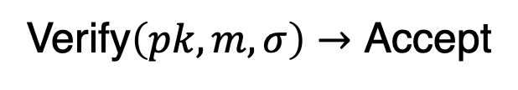
Blind signatures [Cha82]
Our Concern: Risk of Compromise
Many applications:
Anonymous e-cash [Cha82]
Privacy Pass
PCM
Google One’s VPN
…
Issuer : $sk$
User : $pk,m$
Blindness: Can’t link interaction to $(m,σ)$
$$σ$$
Verify$\left(pk,m,σ\right)→$ Accept
Solution: Thresholdizing!
Notes:
Let’s start by recalling what blind signatures are. A blind signature scheme is a protocol between an issuer and a user. The issuer holds the secret key, and the user can interact with the issuer to obtain a signature for their message, which can be efficiently verified given the corresponding public key.
In addition, we require that the issuer does not know the message during the interaction, and moreover, even given the message and the signature later, the signer cannot link them back to which interaction that issues them. We call this property blindness.
Blind signatures have many applications. For example, they were first proposed to build anonymous e-cash system. They are now used in several systems in industry, such as Privacy Pass, Apple’s private click measurements and in google one’s VPN services.
However, our concern here is the risk of secret-key compromise., one natural way to mitigate this risk is to thresholdize the protocol.

Slide 3







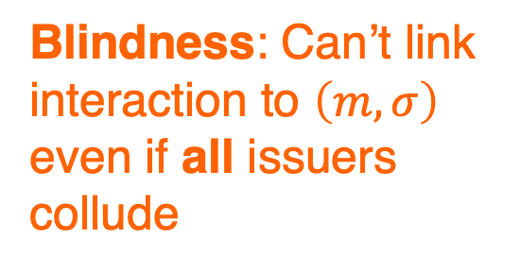

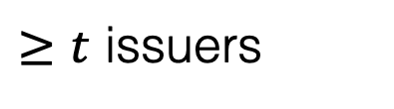


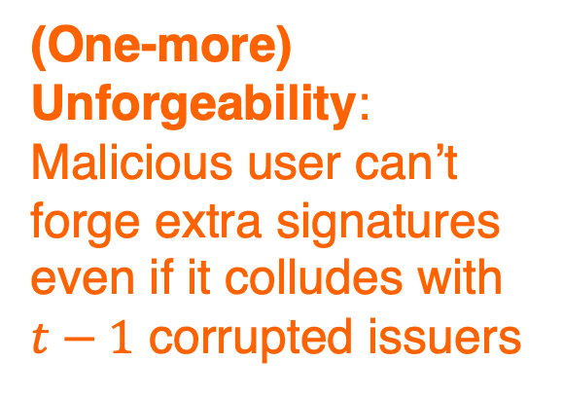
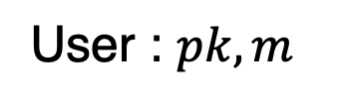

Threshold blind signatures
$≥t$ issuers
E.g. 2-out-of-3
$$sk$$
User : $pk,m$
(One-more) Unforgeability: Malicious user can’t forge extra signatures even if it colludes with $t−1$ corrupted issuers
$$sk_{1}$$
$$σ$$
$$sk_{2}$$
Blindness: Can’t link interaction to $\left(m,σ\right)$ even if all issuers collude
$$sk_{3}$$
Notes:
Therefore, in this work we study a threshold version of blind signatures. In this scenario, the secret key is secret-shared among a group of issuers. To get a signature, the user needs to interact with at least a threshold t of issuers. For threshold blind signatures, blindness guarantees that even if all issuers collude, they cannot link the interaction to the message-signature pair. In terms of unforgettability, roughly, they guarantee that a malicious user, after a number of signing interactions, cannot forge extra signatures even if it colludes with t-1 corrupted issuers. We will see a more formal definition later.

Slide 4
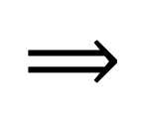
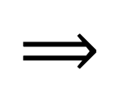
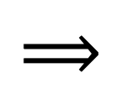
Practically efficient schemes
Blind Signature Schemes
Threshold-Blind
Pairing-based:
Blind BLS [BLS01]
Okamoto [Oka06]
Lack of library support
$$⟹$$
Threshold-blind BLS [VZK03]
Threshold Okamoto [KM14]
RSA-based:
Blind RSA [AF96,CJT01]
$$⟹$$
Threshold-blind RSA [CJT03]
Large sig size
Pairing-free groups: Blind Schnorr [CP93], Okamoto-Schnorr [PS96], [Abe01], [FPS20], [TZ22]
$$⟹$$
No good construction yet!
Good library support & Smaller sig size
Notes:
For blind signatures, there are solutions based on pairings, on RSA and on pairing-free groups. Both pairing-based and RSA-based schemes have thresholdized versions. But for schemes in pairing free groups, there is no good construction yet. The existing constructions don’t have the desired security guarantees we want to achieve. We will discuss that in a minute.
Therefore, the focus of this work is on schemes in pairing-free groups. They also have advantages that they are supported by standard libraries, which is not the case for pairing-based schemes, and they have smaller signature sizes compared to RSA-based schemes for achieving the same security level.

Slide 5
Can we construct efficient threshold blind signatures in pairing-free groups?
Yes!
Notes:
In short, we are addressing the following problem: Can we create efficient threshold blind signatures in pairing-free groups? And we provide a positive answer in this work.
Ideally, we would like to start from an existing blind signature scheme in a pairing free group, and provide a threshold version of this scheme.

Slide 6
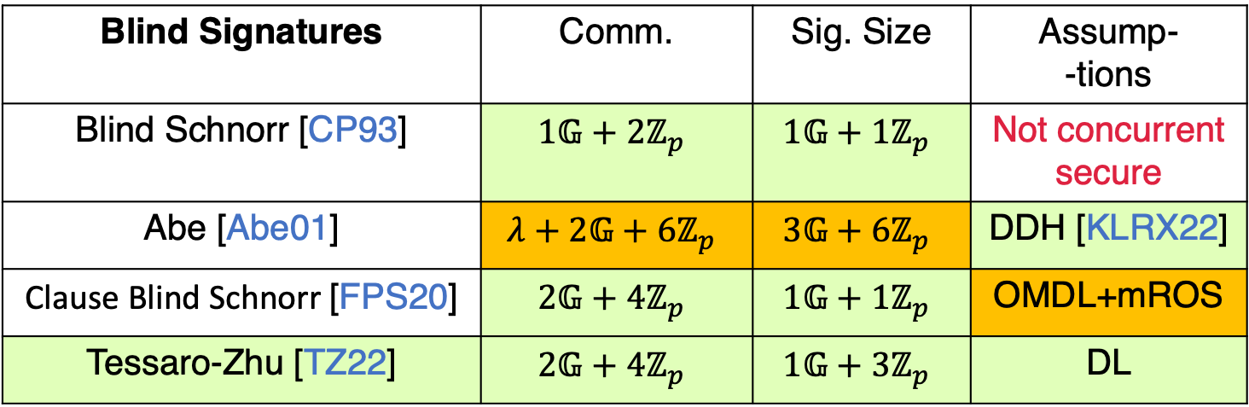
Prior blind signatures in pairing-free groups
Assume ROM+AGM
Blind Signatures | Comm. | Sig. Size | Assump- -tions
Blind Schnorr [CP93] | $$1𝔾+2ℤ_{p}$$ | $$1𝔾+1ℤ_{p}$$ | Not concurrent secure
Abe [Abe01] | $$λ+2𝔾+6ℤ_{p}$$ | $$3𝔾+6ℤ_{p}$$ | DDH [KLRX22]
Clause Blind Schnorr [FPS20] | $$2𝔾+4ℤ_{p}$$ | $$1𝔾+1ℤ_{p}$$ | OMDL+mROS
Tessaro-Zhu [TZ22] | $$2𝔾+4ℤ_{p}$$ | $$1𝔾+3ℤ_{p}$$ | DL
ROS attack [BLL+21]
Threshold-Blind Okamoto-Schnorr [LJY99, KKL01]: not concurrent secure
Thresholdize [TZ22]?
Notes:
Ideally, we would like to start from an existing blind signature scheme in a pairing free group, and provide a threshold version of this scheme. So, I’d like to give an overview of what is available. It’s worth noting here that all past constructions and also our results are proven secure in the random-oracle model and algebraic group model. Removing any of these ideal models without heavy crypto is a challenging open problem. In the early 1990s, Blind Schnorr signatures were introduced. They are very simple and efficient. Unfortunately, recent ROS attack by Benhamouda et shows that they are not concurrently secure, which is a fatal drawback for practical use. Therefore, efforts have been made to develop efficient schemes that are concurrently secure.
The current state of art is my previous work with Tessaro which is almost as simple as Blind Schnorr and concurrently secure under the Discrete log assumption. Other schemes are either less efficient or rely on non-standard assumptions.
Regarding threshold blind signatures, there were only some efforts to thresholdize a variant of Blind Schnorr, called Okamoto-Schnorr. But these protocols inherit the same problem as Blind Schnorr, i.e. they don't offer concurrent security.
Given the past literature, we are trying to thresholdize Tessaro-Zhu’s scheme in the work.

Slide 7
Our results
Improved blind signatures upon [TZ22]
Reduce sig. size by 1 scalar
Alternative construction with simpler proof
Snowblind: first threshold blind signatures in pairing-free groups
Notes:
Our contributions are as follows. First, we show that Tessaro-Zhu’s Scheme can actually be improved without compromising security. More precisely, we can reduce the signature size by 1 scalar. Additionally, we give an alternative construction with a simpler security proof. Then, we give threshold versions of the improved schemes. These are the first threshold blind signatures in pairing-free groups with concurrent security.
For the rest of the talk, I will try to show you our constructions and convey the main ideas without going into the proof details.

Slide 8


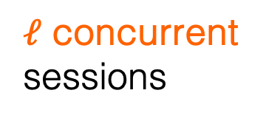
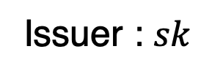

One-more unforgeability (OMUF)
of Blind Signatures
Issuer : $sk$
Adversary : $pk$
Concurrent
Example
I
U
$$⋮$$
$ℓ$ concurrent sessions
$$\left(m_{1},σ_{1}\right),…,\left(m_{ℓ+1},σ_{ℓ+1}\right)$$
OMUF: Can’t forge $ℓ+1$ distinct msg-sig pairs
Notes:
First, let’s take a closer look at unforgeability of blind and threshold-blind signatures. Unlike in a normal signature scheme, where unforgeability is defined as the adversary cannot forge a signature that has not been issued by the issuer, for blind signatures, it is unclear which signatures are issued. Therefore, we need to use another notion called one-more unforgeability. the security game is defined as follows. The adversary plays the role of a malicious user. It can interact with an honest issuer for ell concurrent sessions and the goal is to output ell + 1 valid distinct message and signature pairs. Here “concurrent” means the user doesn’t need to wait until the previous session is finished before starting a new session.

Slide 9






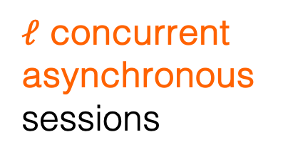

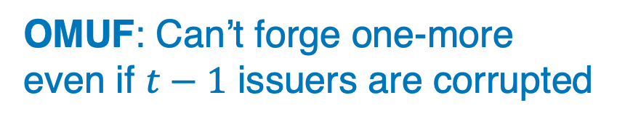

OMUF of threshold blind signatures
E.g. 2-out-of-3
Adversary : $pk$
$$, sk_{2}$$
$$⋮$$
$$sk_{1}$$
$ℓ$ concurrent
asynchronous sessions
$$⋮$$
$$\left(m_{1},σ_{1}\right),…,\left(m_{ℓ+1},σ_{ℓ+1}\right)$$
$$sk_{2}$$
OMUF: Can’t forge one-more even if $t−1$ issuers are corrupted
$$sk_{3}$$
Notes:
To extend OMUF to threshold blind signatures, the first difference is that the adversary can corrupt t-1 issuers, for example, here the adversary can corrupt the second issuer and learn her secrete key share. Also, the adversary can interact with multiple honest issuers during a single signing session. Similar to blind signatures, the adversary can engage in ell signing sessions and its goal is to output ell+1 message-signature pairs. It’s worth noting that all the interactions can be arbitrarily concurrent and asynchronous which means the adversary does not need to wait for all issuers to respond in one round before sending out messages for the next round.

Slide 10
Overview
Improved blind signatures upon [TZ22]
Reduce sig. size by 1 scalar
Alternative construction with simpler proof
Snowblind: first threshold blind signatures in pairing-free groups
Notes:
For the first part of our results, I will briefly go through the previous constructions and then see how we make improvements.

Slide 11

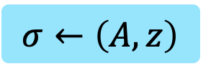
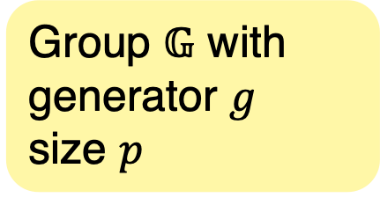
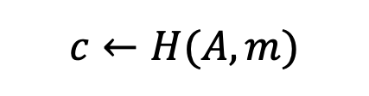
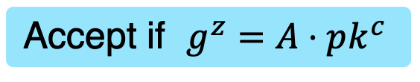
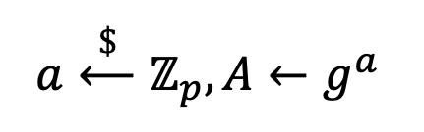
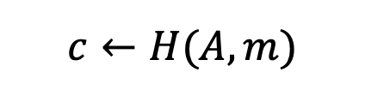
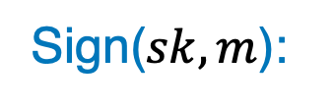
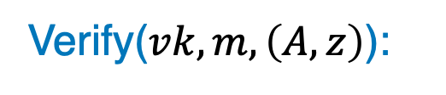
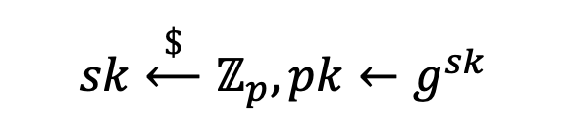
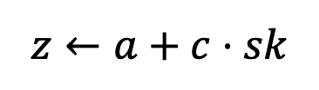
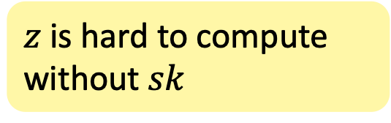
Schnorr’s signatures [Sch91]
$$sk\overset{\$}{⟵}ℤ_{p}, pk←g^{sk}$$
KeyGen:
Group $𝔾$ with
generator $g$
size $p$
$$a\overset{\$}{⟵}ℤ_{p},A←g^{a}$$
Sign($sk,m$):
$$c←H(A,m)$$
$$z←a+c⋅sk$$
$$H:\{0,1\}^{∗}→ℤ_{p}$$
$$σ←\left(A,z\right)$$
$z$ is hard to compute without $sk$
Verify($vk,m,\left(A,z\right)$):
$$c←H(A,m)$$
Accept if $g^{z}=A⋅pk^{c}$
Notes:
The starting point is Schnorr's Signature scheme proposed in the early 90s. The scheme is fairly simple. The secret key is a random scalar and the public key is g to the secret key.
To sign a message, we sample a random scalar a, and compute a nonce big A as g to the power of little a. Then, we compute a challenge c as the hash of the nonce and the message and compute z as a + c times sk. The final signature is the nonce and z.
To verify a signature, we compute the challenge from the nonce and the message and check whether g to z is equal to A times pk to c. Intuitively, it is hard to forge a signature since it is hard to compute such z without knowing the secret key.

Slide 12

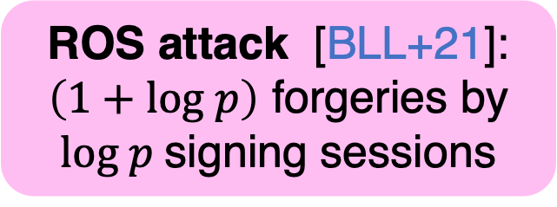

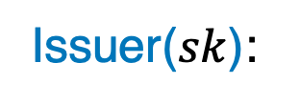








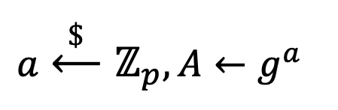



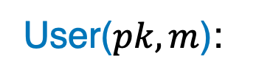
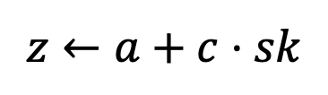
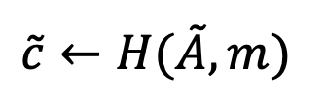
Blind Schnorr [CP93]
Issuer($sk$):
User($pk,m$):
Randomized Procedure
$$a\overset{\$}{⟵}ℤ_{p},A←g^{a}$$
$$A$$
$$A$$
$$\tilde{A}$$
R
$$\tilde{c}←H(\tilde{A},m)$$
$$c$$
$$c$$
$$\tilde{c}$$
$$z←a+c⋅sk$$
$$z$$
Perfect Blindness
$$z$$
$$\tilde{z}$$
$$σ←\left(\tilde{A},\tilde{z}\right)$$
Due to linearity
$$z_{1}=a_{1}+c_{1}⋅sk$$
$$z_{2}=a_{2}+c_{2}⋅sk$$
ROS attack [BLL+21]: $\left(1+log p\right)$ forgeries by $log p$signing sessions
$$\left(z_{1}+z_{2}\right)=(a_{1}+a_{2})+(c_{1}+c_{2})⋅sk$$
Notes:
The Blind Schnorr signature scheme bascially runs the signing of Schnorr signatures interactively. In addition, there is a randomized procedure run by the user to blind the resulting signature.
I will not give the details of this randomization, but the key property that it ensures is that the signature is independent of the transcript, which implies that the scheme is perfectly blind.
Surprisingly, recent work by Benhamouda et al gives an attack – the so-called ROS attack – which breaks the OMUF of blind Schnorr signatures in polynomial time. More precisely, the attack executes log p signing sessions in a clever way that allows the adversary to forge 1 + log p signatures. Very roughly speaking, the attack crucially leverages the linearity of the protocol ,namely, it attempts to linearly combine two sessions with a1,z1,c1, and a2,z2,c2,to get a valid session for z1+z2 and a1+a2 with challenge c1+c2. This of course generally is not going to give a valid signature, but the ROS attack cleverly leverages the concurrency to ensure that this is the case.

Slide 13


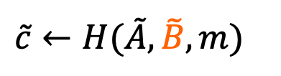






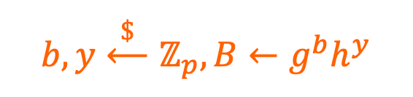
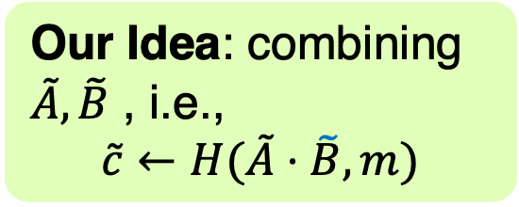



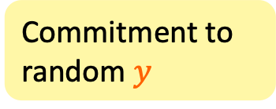
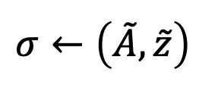

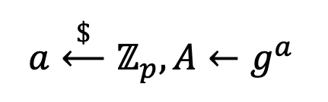
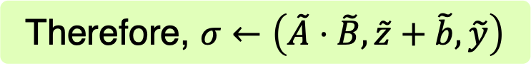


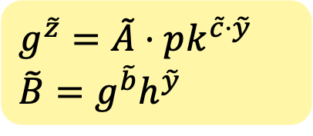
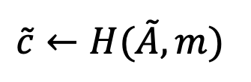
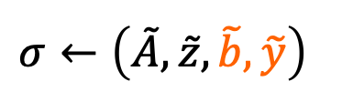
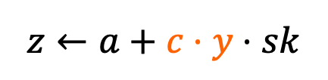



Tessaro-Zhu [TZ22]
How to improve signature size?
Issuer($sk$):
User($pk,m$):
Our Idea: combining $\tilde{A},\tilde{B}$ , i.e.,
$$\tilde{c}←H(\tilde{A}⋅\tilde{B},m)$$
$$a\overset{\$}{⟵}ℤ_{p},A←g^{a}$$
$$b,y\overset{\$}{⟵}ℤ_{p},B←g^{b}h^{y}$$
$$A$$
$$A,B$$
$$\tilde{A},\tilde{B}$$
$$A,B$$
$$\tilde{A}$$
$$A$$
R
$$c$$
$$\tilde{c}←H(\tilde{A},m)$$
Commitment to random $y$
$$c$$
$$\tilde{c}$$
$$\tilde{c}←H(\tilde{A},\tilde{B},m)$$
$$z,b,y$$
$$z$$
$$z,b,y$$
$$z$$
$$\tilde{z},\tilde{b},\tilde{y}$$
$$\tilde{z}$$
$$z←a+c⋅y⋅sk$$
$$σ←\left(\tilde{A},\tilde{z}\right)$$
$$σ←\left(\tilde{A},\tilde{z},\tilde{b},\tilde{y}\right)$$
$$g^{\tilde{z}}=\tilde{A}⋅pk^{\tilde{c}⋅\tilde{y}}$$
$$\tilde{B}=g^{\tilde{b}}h^{\tilde{y}}$$
Break linearity
$$g^{\tilde{z}+\tilde{b}}h^{\tilde{y}}=\tilde{A}⋅\tilde{B}⋅pk^{\tilde{c}⋅\tilde{y}}$$
$$⟹$$
OMUF in ROM+AGM based on DL
Therefore, $σ←\left(\tilde{A}⋅\tilde{B},\tilde{z}+\tilde{b},\tilde{y}\right)$
Notes:
The Tessaro-Zhu scheme bypasses this issue by introducing a new random value y that randomizes the challenge when computing z. This value is sampled already in the first round, and the issuer initially creates a commitment B to this random value y, which is sent to the user. The challenge is computed by hashing also the commitment. In the third round, the opening of the commitment is sent to the user and the blinded opening is added to the signature. The signature satisfies the two equations. First, g^z should be equal to …, second, b and y should be a valid opening of the commitment
-After receiving A,B, the user randomizes them and computes the challenge by hashing both A tilde and B tilde. On the way, the user randomizes the interaction to ensure blindness. Then, the issuer sends z together with b and y to the user. Finally, the user computes z y and b corresponding to the randomized A and B, which satisfies the following equations. The resulting signature is A z b y. The highlighted parts outline the differences from Blind Schnorr.
Due to the c times y term, we cannot linearly combine the two sessions anymore, and the scheme is proved OMUF in ROM+AGM based on DL.
Our first contribution of this work is showing that we can improve the signature size without compromising security. Our main observation is that we can combine the nonce and the commitment and compute the challenge as the hash of the nonce times commitment and the message. Then, during verification, instead of verifying the two equations, we can verify a single combined equation. So the signature size is reduced by one scalar.

Slide 14





$$z←a+c⋅y⋅sk$$
$$z←a+f(c,y)⋅sk$$
Two instantiations:
$f_{1}\left(c,y\right)≔c⋅y$
$f_{2}\left(c,y\right)≔c+y^{q}$
$$gcd\left(q,p−1\right)=1$$
$q=5$ works for most elliptic curves
Notes:
Another contribution is that we ask ourselves whether the only way to randomize the challenge is by multiliciaton, or whether we can find different ways to do so via some other function of c and a committed random value y. It turns out that we can instantiation f in another way , which is c+y^q for q that is coprime to p-1. and for most elliptic curves, we can set q = 5.

Slide 15













Our blind signatures
Issuer($sk$):
User($pk,m$):
$$a\overset{\$}{⟵}ℤ_{p},A←g^{a}$$
$$b,y\overset{\$}{⟵}ℤ_{p},B←g^{b}h^{y}$$
$$A,B$$
$$A,B$$
$$R$$
R
$$c$$
$$\tilde{c}←H(R,m)$$
$$c$$
$$\tilde{c}$$
$$z,b,y$$
$$z,b,y$$
$$\tilde{z}, \tilde{y}$$
$$z←a+f(c,y)⋅sk$$
$$σ←\left(R,\tilde{z}, \tilde{y}\right)$$
Two instantiations:
$f_{1}\left(c,y\right)≔c⋅y$
$f_{2}\left(c,y\right)≔c+y^{q}$
Different for different $f$
Notes:
Our optimized protocol therefore looks as follows. Here the randomization is different for different f.

Slide 16



Security
Two instantiations: $f_{1}\left(c,y\right)≔c⋅y$, $f_{2}\left(c,y\right)≔c+y^{q}$
Theorem. (Blindness) Both instantiations are perfectly blind.
Theorem. (OMUF) For any AGM adversary $𝒜$,
$${\text{Adv}}_{BS[𝔾,f_{1}]}^{\text{omuf}}\left(𝒜\right)≤2{\text{Adv}}_{𝔾}^{\text{dl}}\left(ℬ\right)+{\left(Q_{S}+Q_{H}\right)}^{2}/p$$
$${\text{Adv}}_{BS[𝔾,f_{2}]}^{\text{omuf}}\left(𝒜\right)≤(Q_{S}+2){\text{Adv}}_{𝔾}^{\text{dl}}\left(ℬ\right)+{Q_{S}Q}_{H}^{2}/p$$
Same bound as [TZ22]
$Q_{S}$: # of signing sessions
Simpler proof:
reduced to 1-D ROS (IT-hard)
$Q_{H}$: # of $H$ queries
Notes:
In terms of security, we show that both instantiations are perfectly blind, and both instantiation are OMUF under DL assumption in ROM and AGM. In particular, for the first instantiation, we do a similar reduction as the prior work and get the same security bound. For the second instantiation, we give a simpler security proof than the prior one, where we reduce OMUF to 1-D ROS which is known to be information theoretically hard.

Slide 17
Overview
Improved blind signatures upon [TZ22]
Reduce sig. size by 1 scalar
Alternative construction with simpler proof
Snowblind: first threshold blind signatures in pairing-free groups
Notes:
For the final part, I will now show how to thresholdize our blind signatures.

Slide 18





























Thresholdize: strawman scheme
$$sk_{1},…,sk_{n}\overset{\$}{⟵}{ShamirSS}_{(n,t)}(sk)$$
Issuer-$i$($sk_{i}$):
User($pk,m$):
$$a_{i}\overset{\$}{⟵}ℤ_{p},A_{i}←g^{a_{i}}$$
Combine
Perfect Blindness
$$∏A_{j}$$
$$∏B_{j}$$
$$b_{i},y_{i}\overset{\$}{⟵}ℤ_{p},B_{i}←g^{b_{i}}h^{y_{i}}$$
$$A_{i},B_{i}$$
$$←$$
$$←$$
$$A,B$$
${\text{User}}_{BS[𝔾,f]}$
$$∑y_{j}$$
$$c$$
$$←$$
$$c$$
$$z_{i}←a_{i}+f(c,y)⋅λ_{i}⋅sk_{i}$$
$$y_{i}$$
Need to know $y$
$$y$$
$$y←∑y_{j}$$
$$z_{i},b_{i}$$
$$z,b,y$$
$$←$$
$$←$$
$$∑z_{j}$$
$$∑b_{j}$$
$$σ←\left(\tilde{R},\tilde{z}, \tilde{y}\right)$$
Lagrange Coefficient
Notes:
Let’s start with a strawman scheme. First, secret key shares are t-out-of-n shamir secret shares. During a signing session, each issuer i generates its own nonces A_i and the commitments B_i to the random values y_i. After receiving all A_i, B_i, the user computes A and B as the products of all A_i and B_i respectively. Then, the user runs the user protocol for the underlying blind signatures to compute the challenge c.
After receiving c, a natural way to compute z_i is as ????, where y is the sum of all y_i and lambda is the Lagrange coefficient. However, the problem is that each issuer cannot compute y. Therefore, a straightforward solution is to let each issuer sends their own y_i to the user. The user sends the sum y of the yi’s back to each issuer. In the final round, each issuer sends z_i and b_i to the user. After receiving all z_i and b_i, the user computes z and b as the sum of z_i and b_i respectively, and computes the signature using the user protocol of the underlying blind signatures.
One can show that the perfect blindness of the strawman scheme is implied by the perfect blindness of the underlying blind signatures.
Unfortunatey, we cannot prove this scheme one-more unforgeable. I will try to explain the main issues and show how we fix them.

Slide 19














Is the strawman scheme OMUF?
Our goal: reducing to OMUF of underlying blind signatures
$𝒜$ for $StrawTS[𝔾,f]$
$ℬ$ for $BS[𝔾,f]$
$$ℬ$$
$$A_{i},B_{i}$$
$$A′,B′$$
$$𝒜$$
$${\text{Issuer}}_{BS[𝔾,f]}$$
$$c$$
$$c′$$
$$y_{i}$$
$$z′,b′,y′$$
$$z_{i}←a_{i}+f(c,y)⋅λ_{i}⋅sk_{i}$$
$$y$$
$$z_{i},b_{i}$$
Issue: If $𝒜$ sends $y≠∑y_{j}$, then $ℬ$ can’t compute $z_{i}$
Notes:
Unfortunatey, we cannot prove this scheme one-more unforgeable. Here, I will try to give some high level intuition about the challenges without going into any proof details, and then illustrate the actual protocol that we can prove secure.
Our approacch here is to reduce the OMUF of the threshold blind scheme to the OMUF of the underlying blind signatures. I.e. for any OMUF adversary for the strawman scheme, we want to construct an adversary B for the underlying blind signature. The key step in the reduction is the adversary B needs to simulate each signing session with A using its own issuer oracle. Very very roughly, the main issue here is that A can send y that is not equal to the sum of all y_i and then B cannot compute z_i with the issuer oracle.

Slide 20








Issue: we need to make sure $y=∑y_{j}$
$$sk_{1},…,sk_{n}\overset{\$}{⟵}{ShamirSS}_{(n,t)}(sk)$$
Idea: let each issuer computes $y$ itself and use the commitment to ensure correctness
Issuer-$i$($sk_{i}$):
User($pk,m$):
$$a_{i}\overset{\$}{⟵}ℤ_{p},A_{i}←g^{a_{i}}$$
$$∏A_{j}$$
$$∏B_{j}$$
$$b_{i},y_{i}\overset{\$}{⟵}ℤ_{p},B_{i}←g^{b_{i}}h^{y_{i}}$$
$$A_{i},B_{i}$$
$$←$$
$$←$$
$$A,B$$
${\text{User}}_{BS[𝔾,f]}$
$$c,\{B_{j}\}$$
$$c$$
$$c$$
Check $∀j, B_{j}=g^{b_{j}}h^{y_{j}}$
$$b_{i},y_{i}$$
$$y_{i}$$
$$y$$
$$y←∑y_{j}$$
$$\{b_{j},y_{j}\}$$
$$z_{i}←a_{i}+f(c,y)⋅λ_{i}⋅sk_{i}$$
$$z_{i},b_{i}$$
$$z,b,y$$
$$←$$
$$←$$
$$∑z_{j}$$
$$∑b_{j}$$
$$σ←\left(\tilde{R},\tilde{z}, \tilde{y}\right)$$
Notes:
The first issue is that we need to make sure the value y sent by the user is equal to the sum of all y_j in order to do the security reduction. However, there is no guarantee that this is the case in the strawman scheme. A malicious user can send arbitrary y to issuers.
The idea to fix it is to let each issuer computes y itself and use the commitments B to ensure y is correct. Concretely, we make the following changes. In the second move, the user needs to send all {B_j} to each issuer. Then, each issuer sends the opening of their B_i to the user. After receiving all the openings the user simply echoes them back to each issuer. Now, each issuer can verify the correctness of each y_i and compute y by itself

Slide 21


Another issue: need to extract $y_{j}$ for corrupted $j$
$$sk_{1},…,sk_{n}\overset{\$}{⟵}{ShamirSS}_{(n,t)}(sk)$$
Idea: include an online extractable commitment
Issuer-$i$($sk_{i}$):
User($pk,m$):
$$a_{i}\overset{\$}{⟵}ℤ_{p},A_{i}←g^{a_{i}}$$
$$∏A_{j}$$
$$∏B_{j}$$
$$b_{i},y_{i}\overset{\$}{⟵}ℤ_{p},B_{i}←g^{b_{i}}h^{y_{i}}$$
$$A_{i},B_{i}$$
$$←$$
$$←$$
$$A,B$$
${\text{User}}_{BS[𝔾,f]}$
$$c,\{B_{j}\}$$
$$c$$
Check $∀j, B_{j}=g^{b_{j}}h^{y_{j}}$
$$b_{i},y_{i}$$
$$y←∑y_{j}$$
$$\{b_{j},y_{j}\}$$
$$z_{i}←a_{i}+f(c,y)⋅λ_{i}⋅sk_{i}$$
$$z_{i},b_{i}$$
$$z,b,y$$
$$←$$
$$←$$
$$∑z_{j}$$
$$∑b_{j}$$
$$σ←\left(\tilde{R},\tilde{z}, \tilde{y}\right)$$
Notes:
Then, when we try to prove the security of this scheme, we yet find another issue, i.e., in the second more, we need to extract y_j from B_j for corrupted issuer j. The solution is just to use an online extractable commitment here.

Slide 22















To ensure correctness of $y$
Idea: let each issuer computes $y$ itself and use commitment to ensure correctness
Issuer-$i$($sk_{i}$):
Sample $a_{i},A_{i}←g^{a_{i}}$
Sample $b_{i},y_{i},B_{i}←g^{b_{i}}h^{y_{i}}$
$$A_{i},B_{i}$$
$$c,\{B_{j}\}$$
User
$$b_{i},y_{i}$$
Issue: need to extract $y_{j}$ for corrupted $j$
Check $∀j, B_{j}=g^{b_{j}}h^{y_{j}}$
$$\{b_{j},y_{j}\}$$
$$z_{i}←a_{i}+f(c,y)⋅λ_{i}⋅sk_{i}$$
$$z_{i}$$
$$←$$
Use an online extractable commitment
$$∑y_{j}$$
Notes:
To make sure that y sent by the malicious user is correct, we let each issuer compute y by themselves and use commitment to ensure that y is computed correctly. In the second round, the user needs to send all {B_j} to each issuer. Then, each issuer sends the opening of their B_i to the user. After receiving all the openings the user simply echoes them back to each issuer. Now, each issuer can verify the correctness of each y_i and compute y as the sum of all y_i’s.
However, when we try to prove its security of this scheme, we find another issue, i.e., we need to extract y_j when receiving B_j from the user for corrupted issuer j. The solution is just to use an online extractable commitment here.

Slide 23





























Final scheme: SnowBlind
Use $H′(y_{i})$ as an online extractable commitment to $y_{i}$
Issuer-$i$($sk_{i}$):
User($pk,m$):
Sample $a_{i},A_{i}←g^{a_{i}}$
$$∏A_{j}$$
$$∏B_{j}$$
Sample $b_{i},y_{i},B_{i}←g^{b_{i}}h^{y_{i}}$
$$A_{i},B_{i},$$
$$cm_{i}$$
$$←$$
$$←$$
$$A,B$$
${\text{User}}_{BS[𝔾,f]}$
$${cm}_{i}←H′(y_{i})$$
$$\left\{cm_{j}\right\}$$
$$c,$$
$$c$$
$$y_{i}$$
Check $∀j, {cm}_{j}=H^{′}\left(y_{j}\right)$
$$\{y_{j}\}$$
$$∑y_{j}$$
$$←$$
$$z_{i}←a_{i}+f(c,y)⋅λ_{i}⋅sk_{i}$$
$$z_{i},b_{i}$$
$$z,b,y$$
$$←$$
$$←$$
$$←$$
$$∑z_{j}$$
$$∑b_{j}$$
$$σ←\left(\tilde{R},\tilde{z}, \tilde{y}\right)$$
$$∑y_{j}$$
Notes:
Then, we get our final scheme Snowblind. Since we are assuming the random oracle model, we can simply use the hash function as an online extractable commitment.

Slide 24



Security of SnowBlind
Theorem. (Blindness) SnowBlind is perfectly blind.
Theorem. (OMUF) For any AGM adversary $𝒜$,
$${\text{Adv}}_{SonwBlind[𝔾,{f_{1}/f}_{2}]}^{\text{omuf}}\left(𝒜\right)≤ (Q_{S}+2){\text{Adv}}_{𝔾}^{\text{dl}}\left(ℬ\right)+{Q_{S}\left(Q_{S}+Q_{H}\right)}^{2}/p$$
$Q_{S}$: # of signing sessions
$Q_{H}$: # of $H$ queries
Notes:
Regarding security, we show Snowblind is perfect blind and OMUF under the DL assumption in the random oracle model and algebraic group model.

Slide 25
Open problems
More efficient schemes
Better round complexity
Removing extra commitments
Adaptive security
Notes:
Finally, I’d like to mention a few open problems. First, it is interesting to see whether we can construct a more efficient protocol. For example, improving round complexity of snowBlind or removing the extra commitments in the signing protocol.
Also, we only prove the static security of our scheme. It would be interesting to know whether we can extend our results to the realm of adaptive security.

Slide 26
Thank you!
Our paper: https://eprint.iacr.org/2023/1228.pdf

