Slide 1
Operational Problem
Understanding factors affecting plant throughput
Why is throughput changing?
Internal Data
Pressure Temperature Flow Rate
Weather API
Temperature Humidity Conditions
Database
Maintenance Equipment History
Business Question
Does weather influence throughput?

Slide 2
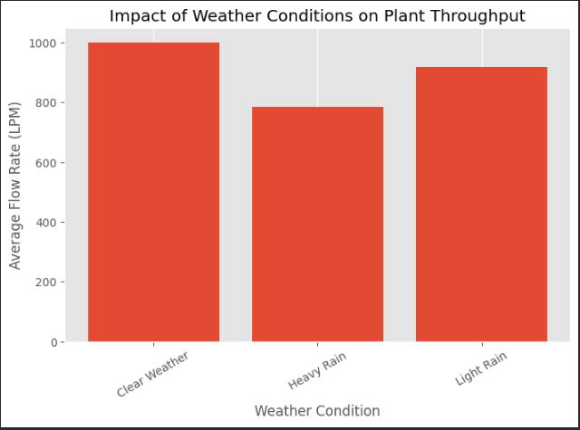
Observations & Insights
Integrated analysis from multiple data sources
CSV
Internal
API
Weather
SQL
Maintenance
Master Dataset
Unified operational view
Key Finding
Weather-linked throughput patterns identified
Impact
External data improved visibility and schedule predictability

Slide 3
Recommendations
Using integrated data for proactive decisions
Weather Planning
Include forecasts in operations scheduling
Operations
Adjust during disruptions
Monitoring
Build live KPI dashboards to monitor the parameters from various data sources.
Integration
Continue combining data from multiple sources to better operational forecasting and scheduling.
Better Data → Better Decisions

