Slide 1






Introduction to NGS
BecA-ILRI, Nairobi
May 2018
Introduction to NGS data analysis pipelines and file formats

Slide 2
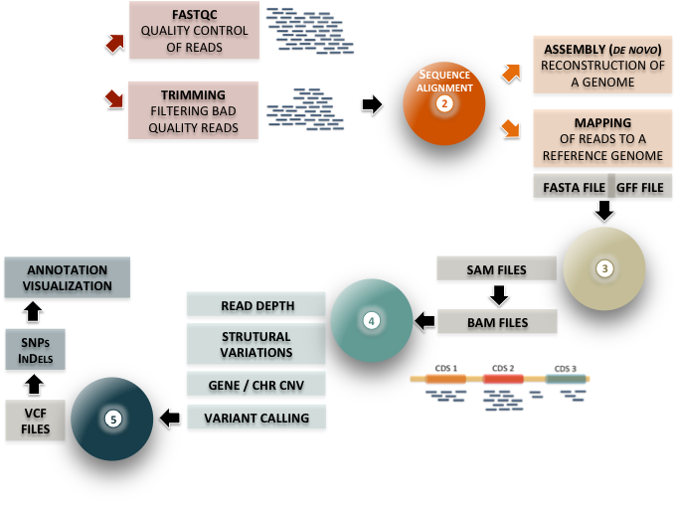
Fastq
files
1

Slide 3
Introduction to NGS
ILRI, Nairobi
May 2018
Part I: Quality Control

Slide 4
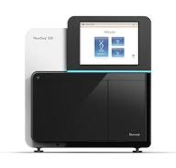
FastQ files
FASTQ FILE FORMAT
read file format
What is a FastQ file?
FASTQ= FASTA + Quality
FastQ format is a text-based format for storing both a biological sequence and the corresponding per base quality scores
-> Most common output provided by sequencing platforms
Raw sequence data: FastQ files
PART
1
A

Slide 5
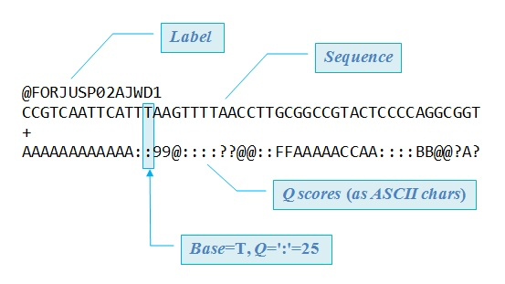
FASTQ File Format
FASTQ FILE FORMAT
read file format
- A FASTA file uses at least 2 lines per sequence:
Line 1 begins with a ‘>’ and is followed by a sequence identifier
Line 2 is the sequence letters
- A FASTQ file uses four lines per sequence:
Line 1 begins with a '@' and is followed by a sequence identifier
Line 2 is the sequence letters
Line 3 begins with a '+' and is rarely followed by the sequence identifier
Line 4 encodes the quality values for the sequence in Line 2, and must contain the same number of symbols as letters in the sequence
PART
1
A

Slide 6
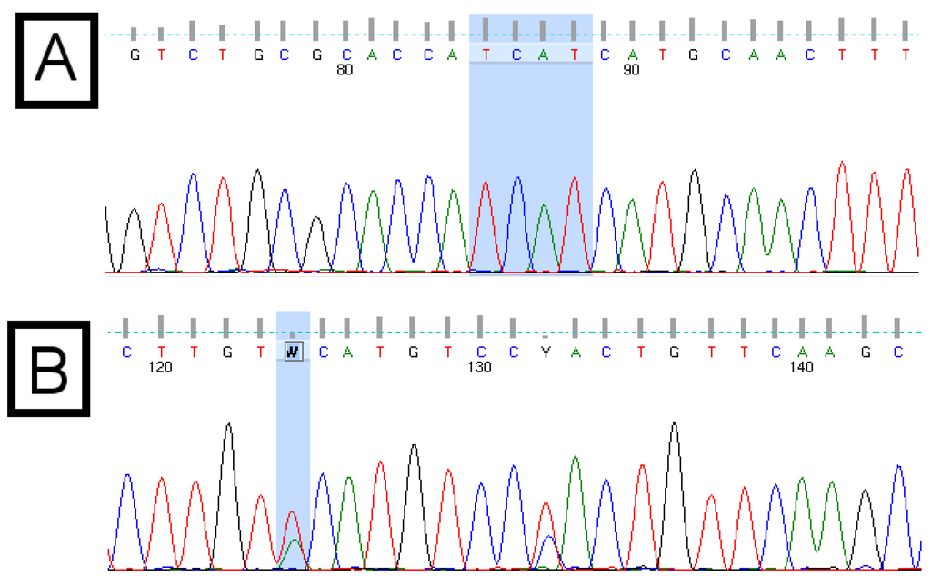
FASTQ FILE FORMAT
read file format
a FASTQ file is a file containing :
reads sequences
a quality score associated to each read position
-> Just as Sanger!
Reminder: Sanger Sequencing
Sequence
Quality
PART
1
A

Slide 7
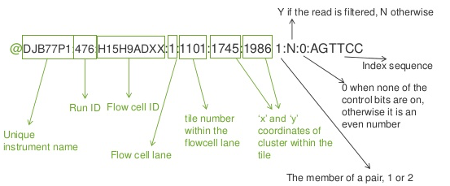
FASTQ FILE FORMAT
read file format
a FASTQ file is a file containing :
reads sequences
a quality score associated to each read position
standard read headers (very often)
PART
1
https://image.slidesharecdn.com/,data-management-for-quantitative-biology-data-sources-next-generation-technologies-apr-30-2015-dr-stefan-czemmel-27-638.jpg
A
Notes:
Believe it or not, your microbiome

Slide 8
FASTQ FILE FORMAT
Phred quality score
- The quality score of a base is called the Phred score (or Q score)
It is an integer value defined as a property that is logarithmically related to the base calling error probabilities (P)
- Phred or Q scores are often represented as ASCII characters
Starting in Illumina 1.8, the quality scores have basically returned to the use of the Sanger format (Phred+33)
PART
1
https://en.wikipedia.org/wiki/FASTQ_format#Quality
B

Slide 9
FASTQ FILE FORMAT
Phred quality score
SSSSSSSSSSSSSSSSSSSSSSSSSSSSSSSSSSSSSSSSS..................................................... ..........................XXXXXXXXXXXXXXXXXXXXXXXXXXXXXXXXXXXXXXXXXXXXXX...................... ...............................IIIIIIIIIIIIIIIIIIIIIIIIIIIIIIIIIIIIIIIII...................... .................................JJJJJJJJJJJJJJJJJJJJJJJJJJJJJJJJJJJJJJJ...................... LLLLLLLLLLLLLLLLLLLLLLLLLLLLLLLLLLLLLLLLL..................................................... !"#$%&'()*+,-./0123456789:;<=>?@ABCDEFGHIJKLMNOPQRSTUVWXYZ[\]^_`abcdefghijklmnopqrstuvwxyz{|}~ | | | | | | 33 59 64 73 104 126
0.2......................26...31........41
Sanger
Solexa
Illumina 1.3+
Illumina 1.5+
Illumina 1.8+
ASCII code
Phred score

Slide 10
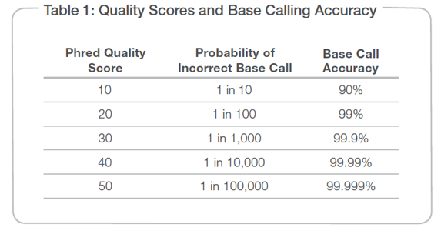
FASTQ FILE FORMAT
Phred quality score
Note: Phred version is independent from the sequencing technology version
LLLLLLLLLLLLLLLLLLLLLLLLLLLLLLLLLLLLLLLLL..................................................... !"#$%&'()*+,-./0123456789:;<=>?@ABCDEFGHIJKLMNOPQRSTUVWXYZ[\]^_`abcdefghijklmnopqrstuvwxyz{|}~ | | | | | | 0.........................26...31.......41
Illumina 1.8+
Phred score
Position Quality Score:
30–40: ✔️ Good
<20: 🗑 Discard
20 – 30: depends on overall quality
PART
1
B
http://www.illumina.com

Slide 11
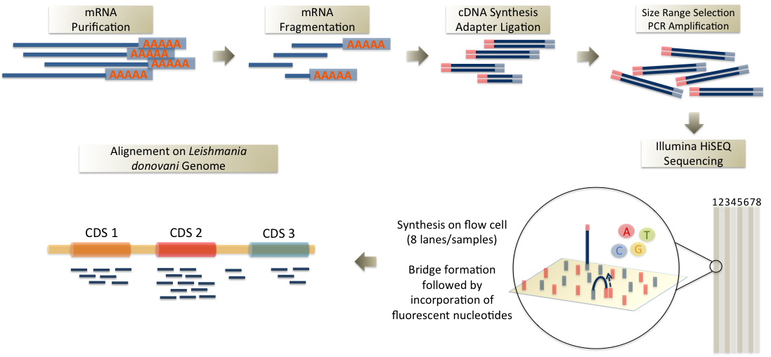
FASTQC
QUALITY CONTROL OF READS
Fastq
files
1

Slide 12
READS QUALITY CHECK
FastQC
FastQC: Quality Control for FastQ files
GUI, Command line, Available on Galaxy
Graphic reports
http://www.bioinformatics.babraham.ac.uk/projects/fastqc/
http://dnacore.missouri.edu/PDF/FastQC_Manual.pdf
PART
2

Slide 13
READS QUALITY CHECK
FastQC
- Quality control checks on raw sequence data
Input: FastQ files (or BAM/SAM)
Output: Summary graphs allowing quick data assessment
- FastQC can be run in 2 modes:
Stand alone interactive application ← small number of samples
Non-interactive mode ← large number
FastQC can be integrated in ANALYSIS PIPELINES
PART
2

Slide 14
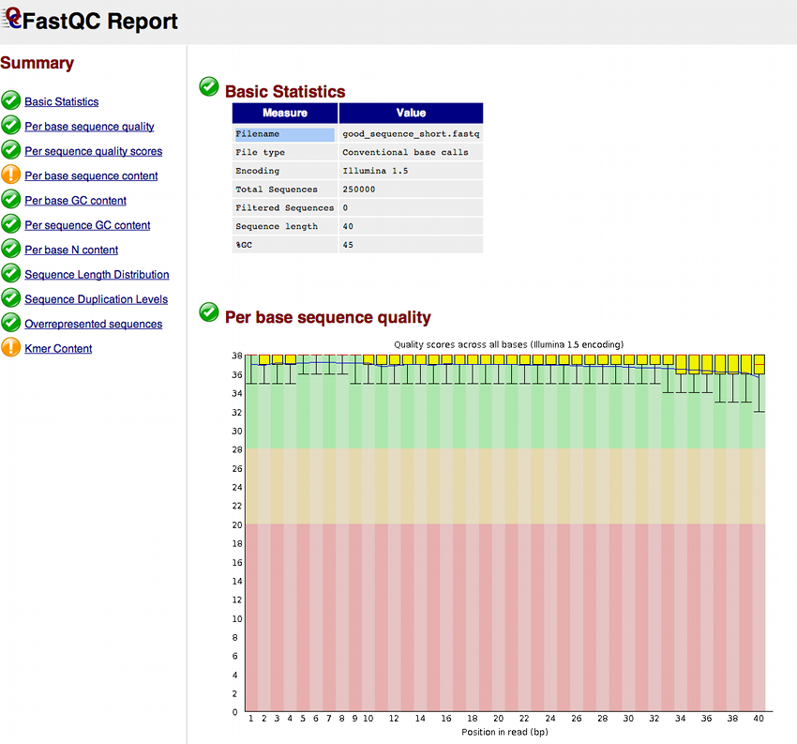
READS QUALITY CHECK
FastQC
A summary of the modules which were run, and a quick evaluation of whether the results seem entirely normal, slightly abnormal or very unusual.
Normal
Reasonable
Unexpected
Good Quality
Poor Quality
PART
2

Slide 15
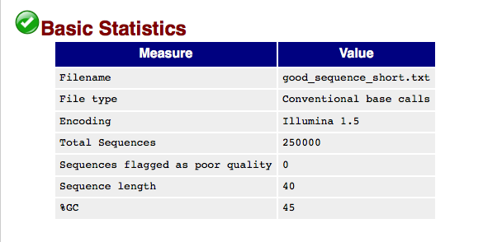
READS QUALITY CHECK
FastQC
Basic Statistics
ASCII quality encoding format (Phred format)
Number of reads, Read length, …
PART
2

Slide 16
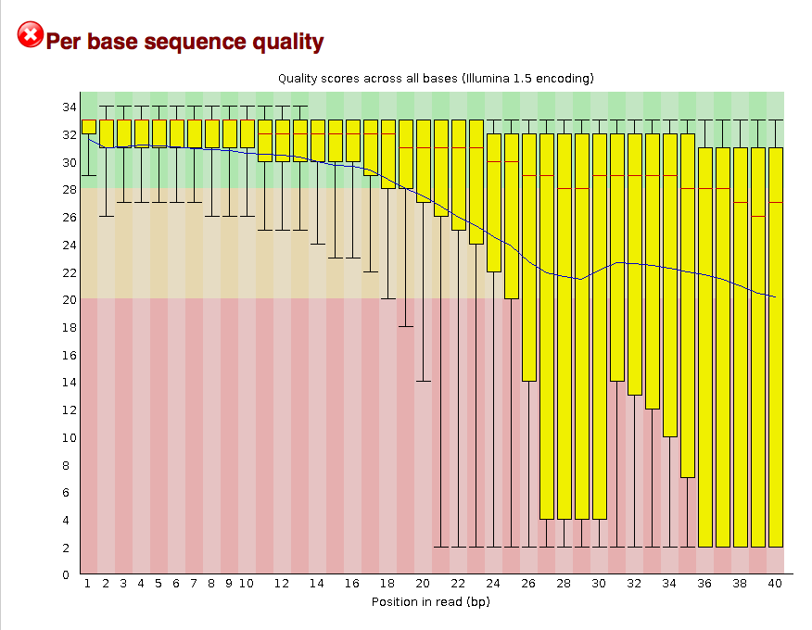
READS QUALITY CHECK
FastQC
Per base sequence quality
Overview of the range of quality values (Phred scores) across all bases from all reads
Upper and Lower whiskers:
10% and 90% points
Red line: median value
Phred Q Score
Blue line: mean quality
Yellow box: inter-quartile range
(25-75%)
Position in read (bp)
In most platforms, the quality is lower at the beginning/end of reads
-> This is common ! Short loss of quality early in the run and quality degrades as the run progresses
PART
2

Slide 17
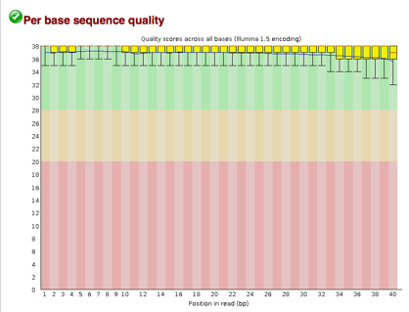
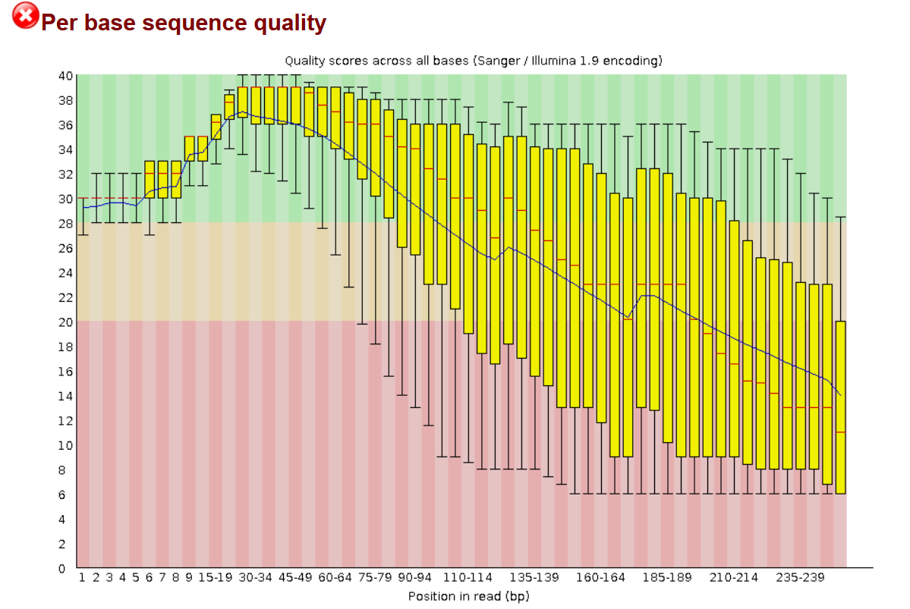
READS QUALITY CHECK
FastQC
Per base sequence quality
Phred Q Score
GOOD
B A D
Position in read (bp)
PART
2

Slide 18
READS QUALITY CHECK
FastQC
Per base sequence quality
• High proportion of bad quality bases
• High variability
• High decrease in terms of quality towards the end of the read
→ Important to remove bad quality data
PART
2
https://insidedna.me/tool_page_assets/tutorials/tutorial17/10.png
Notes:
Believe it or not, your microbiome

Slide 19
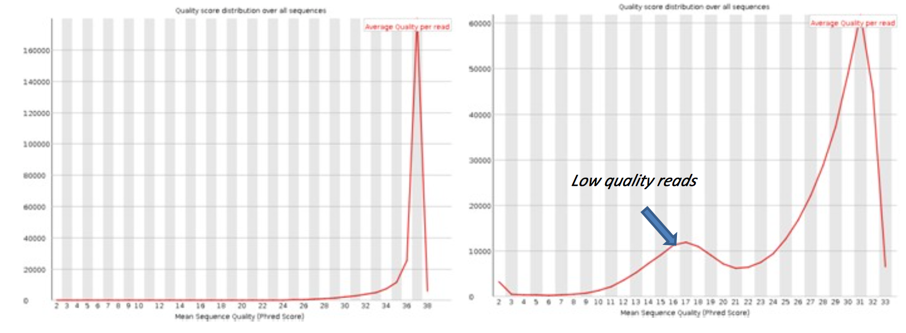
READS QUALITY CHECK
FastQC
Per Sequence Quality
PART
2
(http://slideplayer.com/slide/5422676/)
Notes:
I would suggest you to remove the highly ambiguous reads based on the N's% (>=50)in them, then go for error correction with tools such as Musket (the only one I have used). http://musket.sourceforge.net/homepage.htm#latest
Keep in mind that the quality values do not change after musket, so the quality filter is nor more necessary.
So, Remove ambiguity and then Error-correction.
After doing all this, you will not have to worry about trimming your ends or quality filter again.

Slide 20
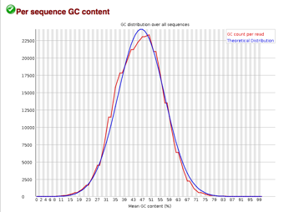

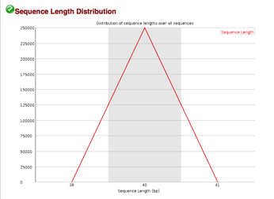
READS QUALITY CHECK
FastQC
Per Sequence GC Content
Sequence Length Distribution
PART
2

Slide 21

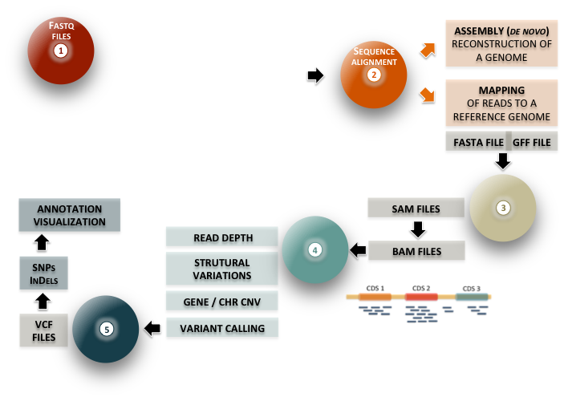
FASTQC
QUALITY CONTROL OF READS
TRIMMING
FILTERING BAD QUALITY READS

Slide 22
READ PRE-PROCESSING
Trimming low quality bases
Trimming low Quality Bases:
- Remove low quality bases, identified by the probability that they are called incorrectly.
- Widely but heterogeneously applied
- Keep in mind! Trimming might impact downstream analyses
Trimming is more important for denovo assembly, check this study
PART
3
A
(Williams et al., 2016)
Notes:
I would suggest you to remove the highly ambiguous reads based on the N's% (>=50)in them, then go for error correction with tools such as Musket (the only one I have used). http://musket.sourceforge.net/homepage.htm#latest
Keep in mind that the quality values do not change after musket, so the quality filter is nor more necessary.
So, Remove ambiguity and then Error-correction.
After doing all this, you will not have to worry about trimming your ends or quality filter again.

Slide 23
Raw Data
READ PRE-PROCESSING
Trimming low quality bases
Raw reads sequences
PART
3
A

Slide 24
Raw Data
Raw Data
READ PRE-PROCESSING
Trimming low quality bases
Raw reads sequences
Good Reads
PART
3
A

Slide 25
Raw Data
Raw Data
READ PRE-PROCESSING
Trimming low quality bases
Raw reads sequences
Good Reads
Not So Good
Reads
PART
3
A

Slide 26
Raw Data
READ PRE-PROCESSING
Trimming low quality bases
Our example sample analysed using FastQC:
reads of 51bp
average quality = 26
=> Poor quality in the ends of reads can be removed using reads filtering or reads trimming tools
PART
3
A

Slide 27
Reads pre-processing
Raw Data
READ PRE-PROCESSING
Trimming low quality bases
READS FILTERING
READS TRIMMING
ADAPTIVE TRIMMING
ADAPTIVE TRIMMING FOLLOWED BY READ FILTERING
PART
3
A

Slide 28
Method 1: Reads Filtering
Raw Data
READ PRE-PROCESSING
Trimming low quality bases
Reads with poor quality ends can be discarded using FILTERING tools
Good Reads
Not So Good
Reads
PART
3
A

Slide 29
Method 1: Reads Filtering
Method 1: Reads Filtering
Raw Data
READ PRE-PROCESSING
Trimming low quality bases
Reads with poor quality ends can be discarded using FILTERING tools
Good Reads
AFTER FILTERING:
Sample Overall Quality ↑
Number of Reads ↓
PART
3
A

Slide 30
Method 1: Reads Filtering
Method 1: Reads Filtering
Raw Data
READ PRE-PROCESSING
Trimming low quality bases
FastQC graph
2
1
Reads with poor quality ends are removed from the dataset ( 1 )
But some good quality positions are lost ( 2 )
PART
3
A

Slide 31
Reads pre-processing
READ PRE-PROCESSING
Trimming low quality bases
READS FILTERING
READS TRIMMING
ADAPTIVE TRIMMING
ADAPTIVE TRIMMING FOLLOWED BY READ FILTERING
PART
3
A

Slide 32
Method 2: Reads Trimming
READ PRE-PROCESSING
Trimming low quality bases
Poor quality ends of reads can be cut using TRIMMING tools
Good Reads
Rather Good
Reads
✄
PART
3
Length cut-off threshold
A

Slide 33
Method 2: Reads Trimming
Method 2: Reads Trimming
READ PRE-PROCESSING
Trimming low quality bases
Poor quality ends of reads can be cut using TRIMMING tools
Good Reads
Rather Good
Reads
Trimmed reads are of better quality than raw reads but they are shorter!
PART
3
A

Slide 34
Method 2: Reads Trimming
Method 2: Reads Trimming
READ PRE-PROCESSING
Trimming low quality bases
FastQC graph
Cut-off threshold Length = 30 bp
Reads are now of different lengths
Number of raw reads = number of raw reads
34
PART
3
A

Slide 35
Reads pre-processing
READ PRE-PROCESSING
Trimming low quality bases
READS FILTERING
READS TRIMMING
ADAPTIVE TRIMMING
ADAPTIVE TRIMMING FOLLOWED BY READ FILTERING
PART
3
A

Slide 36
Method 3: ADAPTIVE Trimming
READ PRE-PROCESSING
Trimming low quality bases
A more precise TRIMMING approach
Good Reads
25
✁
25
✁
25
✁
Rather Good
Reads
✁
25
25
✁
PART
3
A

Slide 37
Method 3: ADAPTIVE Trimming
Method 3: ADAPTIVE Trimming
READ PRE-PROCESSING
Trimming low quality bases
A more precise TRIMMING approach
Good Reads
Rather Good
Reads
Trimmed reads are of better quality than raw reads but they are of variable lengths.
Some reads can be extremely short!
PART
3
A

Slide 38
Method 3: ADAPTIVE Trimming
READ PRE-PROCESSING
Trimming low quality bases
FastQC graph
Poor quality ends are removed from the dataset
But the good quality positions are kept (yeah!)
PART
3
A

Slide 39
Reads pre-processing
READ PRE-PROCESSING
Trimming low quality bases
READS FILTERING
READS TRIMMING
ADAPTIVE TRIMMING
ADAPTIVE TRIMMING FOLLOWED BY READ FILTERING
PART
3
A

Slide 40
Method 4: ADAPTIVE Trimming + filtering
READ PRE-PROCESSING
Trimming low quality bases
Poor quality in the end can be cut using TRIMMING AND FILTERING tools
Good Reads
✁
✁
✁
Rather Good
Reads
✁
✁
✁
✄
PART
3
Length cut-off threshold
A

Slide 41
Method 3: ADAPTIVE Trimming
READ PRE-PROCESSING
Trimming low quality bases
FastQC graph
Poor quality ends are removed from the dataset
But the good quality positions are kept (yeah!)
PART
3
A

Slide 42
READ PRE-PROCESSING
Trimming low quality bases
Trimming low Quality Bases
Low quality base reads from the sequencer can cause an otherwise mappable sequence not to align. There are a number of open source tools that can trim off 3' bases and produce a FASTQ file of the trimmed reads to use as input to the alignment program.
Manipulating tools
FASTX-Toolkit provides a set of command line tools for manipulating fasta and fastq files. The available modules include a fastx_trimmer utility for trimming fastq sequences (and quality score strings) before alignment.
gunzip -c Sample.fastq.gz | fastx_trimmer -l 50 -Q 33 > Sample_trimmed.fq
Trim down to 50 bases (last base is 50)
option that specifies how base qualities on the 4th line of each fastq entry are encoded
PART
3
https://wikis.utexas.edu/display/bioiteam/Evaluating+your+raw+sequencing+data#Evaluatingyourrawsequencingdata-Trimminglowqualitybases
A
Notes:
Believe it or not, your microbiome

Slide 43
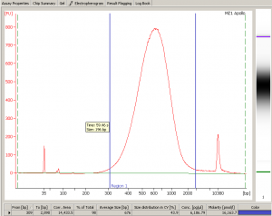
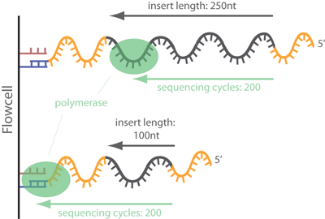
Clipping
READ PRE-PROCESSING
Trimming adapters
Trimming sequencing adapters/primers (clipping)
Adapter
Sequencing primer
Library size distribution (Agilent Bioanalyzer)
Clipping is necessary when
Read Length > Insert Size
PART
3
www.ecseq.com
B

Slide 44
READ PRE-PROCESSING
Trimming adapters
Adapters Trimming
A 3' adapter contamination can cause the insert sequence not to align (adapter sequence ≠ bases at the 3' end of the reference genome sequence).
Unlike general fixed-length trimming, adapter trimming removes differing numbers of 3' bases depending on where the adapter sequence is found.
Manipulating tools
Cutadapt program is an excellent tool for removing adapter contamination.
Ex cutadapt on on a single-end read sample:
cutadapt -m 22 -O 33 -a AGATCGGAAGAGCACACGTCTGAACTCCAGTCAC
discard any sequence that is smaller than 22 bases after trimming
No trimming of 3' adapter sequences unless at least the first 10 bases of the adapter are seen at the 3' end of the read
PART
3
https://wikis.utexas.edu/display/bioiteam/Evaluating+your+raw+sequencing+data#Evaluatingyourrawsequencingdata-Trimminglowqualitybases
B
Notes:
Believe it or not, your microbiome

Slide 45
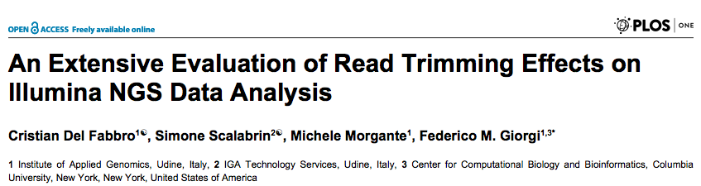
Reads Pre-Processing
READ PRE-PROCESSING
Tools
Trimming sequencing adapters/primers (clipping) and poor quality ends and filter short reads
Dozens of tools available!
AlienTrimmer, Cutadapt, ConDeTri, FastX, Sickle, SolexaQA, Trimmomatic…
They use different methods and algorithms and offer at lot of options
If PE reads: Filter unpaired reads
PART
3
C

Slide 46

Reads Pre-Processing
Reads Pre-Processing
READ PRE-PROCESSING
Tools
Trimming Poor Quality Ends
A few examples from Del Fabbro et. Al.
- RNA-Seq (Homo sapiens)
“SolexaQA achieves the highest quality while keeping the highest amount of reads”
- Assembly (Prunus persica)
“Read trimming affects only partially genome assembly results”
“Stringent trimming tends to heavily remove data and decrease overall assembly quality”
- SNP Identification (Prunus persica and Saccharomyces cerevisiae)
“All trimmers drastically reduce the percentage of alternative allele nucleotides (…) bringing this false positive call indicator from 30% to 10%”
There is no golden method / tool
→ DEPENDS ON THE APPLICATION
PART
3
C

