Slide 1






Introduction to NGS
BecA-ILRI, Nairobi
May 2018
File formats
Understanding your mapping

Slide 2
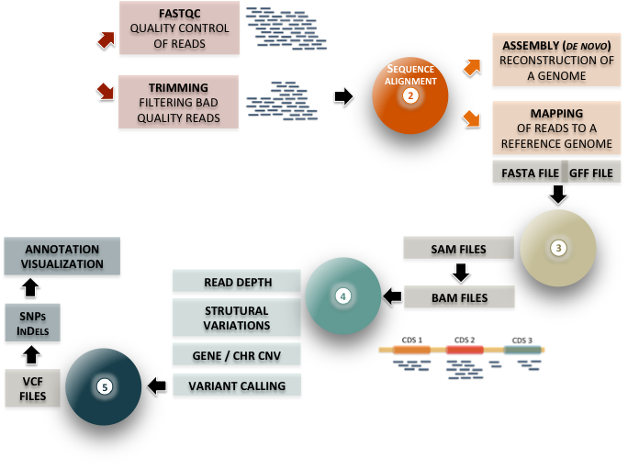
Fastq
files
1

Slide 3
Introduction to NGS
ILRI, Nairobi
May 2018
Part I: File formats

Slide 4


Overview of analysis workflow
FASTQC
QUALITY CONTROL OF READS
ASSEMBLY (de novo)
RECONSTRUCTION OF A GENOME
Fastq
files
1
TRIMMING
FILTERING BAD QUALITY READS
2
MAPPING
OF READS TO A REFERENCE GENOME
FASTA FILE
GFF FILE
ANNOTATION
VISUALIZATION
SAM FILES
3
READ DEPTH
4
BAM FILES
SNPs
InDels
STRUTURAL VARIATIONS
GENE / CHR CNV
VCF FILES
5
VARIANT CALLING

Slide 5

FastQ files
FASTQ FILE FORMAT
read file format
What is a FastQ file?
FASTQ= FASTA + Quality
FastQ format is a text-based format for storing both a biological sequence and the corresponding per base quality scores
-> Most common output provided by sequencing platforms
Raw sequence data: FastQ files
PART
1
A

Slide 6
FastQ files
FASTQ FILE FORMAT
read file format
What is a FastQ file?
FASTQ= FASTA + Quality
FastQ format is a text-based format for storing both a biological sequence and its corresponding quality scores
Raw sequence data: FastQ files

Slide 7
SAM and BAM formats

Slide 8
SAM, BAM formats
SAM/BAM files
After mapping the FASTQ file to the reference genome you will end up with a SAM or BAM alignment file
SAM stands for Sequence Alignment/Map format
A single SAM file can store mapped, unmapped, and even QC-failed reads from a sequencing run, and indexed to allow rapid access. This means that the raw sequencing data can be fully recapitulated from the SAM/BAM file.
Raw sequence data: Fastq files
Mapping (Bowtie, BWA or others)
BAM/SAM files

Slide 9
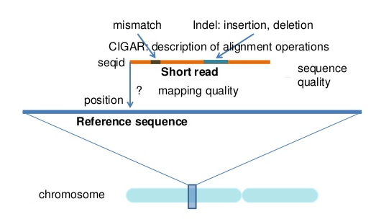
SAM Format
SAM/BAM files
Li Shen, 2014

Slide 10
SAM, BAM formats
SAM/BAM files
SAM is rarely helpful and really takes up too much space which is why we use only the BAM in principle
A BAM file (.bam) is the binary version of a SAM file (saving storage and faster manipulation)
Raw sequence data: Fastq files
Mapping (Bowtie, BWA or others)
BAM/SAM files
Notes:
A BAM file is just a SAM file but stored in binary; you should always convert your SAM files into BAM to save storage space and BAM files are faster to manipulate.

Slide 11
SAM, BAM formats
SAM/BAM files
A SAM file (.sam) is a tab-delimited text file that contains sequence alignment data
SAM files can be opened using a text editor or viewed using the UNIX "more" command
Most alignment programs will supply:
- a header: describing the format version, sorting order of the reads, genomic sequences to which the reads were mapped
- an alignment section: contains the information for each sequence about where/how it aligns to the reference genome
Raw sequence data: Fastq files
Mapping (Bowtie, BWA or others)
BAM/SAM files

Slide 12
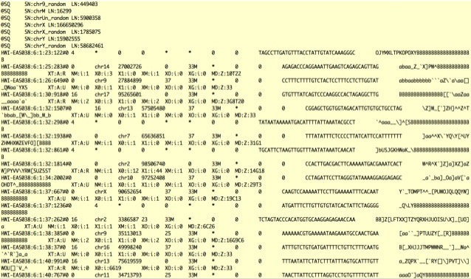
SAM, BAM formats
SAM files
Alignment section
11 columns (tab-separated)
Header:
Notes:
Each header line begins with the character `
@
' followed by one of the two-letter header record type codes
de ned in this section.

Slide 13
SAM Format
SAM files
CIGAR
PNEXT
TLEN
RNEXT
QNAME
FLAG
RNAME
POS
MAPQ
SEQ
QUAL
http://samtools.sourceforge.net/SAM1.pdf
http://genome.sph.umich.edu/wiki/SAM

Slide 14
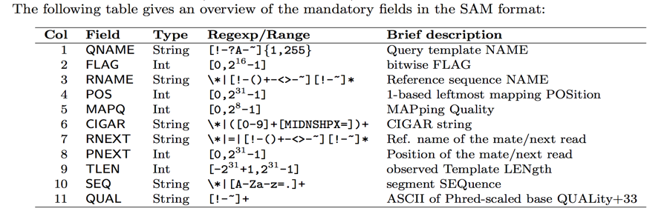
SAM fomat
SAM files
(http://samtools.github.io/hts-specs/SAMv1.pdf)
QNAME: Query template NAME. Reads/segments having identical QNAME are regarded to come from the same template. A QNAME ‘*’ indicates the information is unavailable.
Used to group/identify alignments that are together, like paired alignments or a read that appears in multiple alignments.
Notes:
In the SAM format, each alignment line typically represents the linear alignment of a segment. Each line
has 11 mandatory elds. These elds always appear in the same order and must be present, but their values
can be `0' or `*' (depending on the eld) if the corresponding information is unavailable. The following table
gives an overview of the mandatory elds in the SAM format

Slide 15
SAM fomat (2)
SAM files
(http://samtools.github.io/hts-specs/SAMv1.pdf)
FLAG: FLAG: bitwise FLAG (ideal for compression).
11 boolean flags all stotred in a singe column

Slide 16
SAM flag: example
SAM files
SAM file
read mapped to position 7:
FLAG 163 (=1 + 2 + 32 + 128):
Read is the second read in the pair (128)
Read is properly paired (1 + 2)
its mate is mapped to 37 on the reverse strand (32)

Slide 17
Decoding SAM flags
SAM files
Explain flag tool:
https://broadinstitute.github.io/picard/explain-flags.html

Slide 18
SAM fomat (3)
SAM files
(http://samtools.github.io/hts-specs/SAMv1.pdf)
It equals −10 log10 Pr{mapping position is wrong}, rounded to the nearest integer.
The MAPQ value can be used to figure out how unique an alignment is in the genome.
Large number, >10 indicates it's likely the alignment is unique.
255 indicates that the mapping quality is not available

Slide 19
SAM fomat: CIGAR string
SAM files
The CIGAR string is a sequence of numbers and letters representing the associated information on bases alignment used to indicate things like which bases align (either a match/mismatch) with the reference, are deleted from the reference, and if there are insertions that are not in the reference
More information about these formats available here: http://samtools.sourceforge.net
https://samtools.github.io/hts-specs/SAMv1.pdf

Slide 20

SAM fomat: CIGAR string
SAM files
Mapped and unmapped reads are imported into SAM/BAM format
The standard CIGAR description of pairwise alignment defines three operations:
‘M’ for alignment match, ‘I’ for insertion compared with the reference and ‘D’ for deletion.
(NB: The POS indicates that the read aligns starting at position 5 on the reference)
The CIGAR :
3M = 3 bases in the read sequence align with the reference.
1I = The next base in the read does not exist in the reference.
1D = The reference base does not exist in the read sequence
POS: 5
CIGAR: 3M1I3M1D2M
http://genome.sph.umich.edu/wiki/SAM

Slide 21
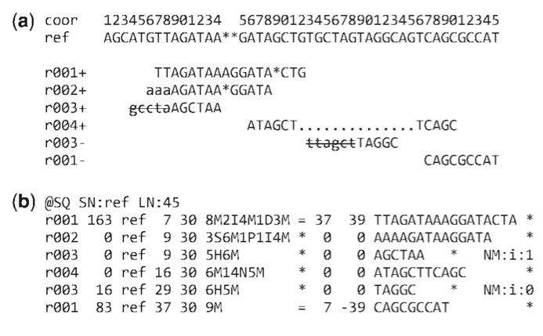
SAM fomat: CIGAR string
SAM files
Examples of CIGAR strings for different types of alignments
Alignments
SAM file
(Li et al., 2009)

Slide 22
SAM fomat (5)
SAM files
SAM format (5)
(http://samtools.github.io/hts-specs/SAMv1.pdf)
Name of mate (mate pair information for paired-end sequencing)
Position of mate (mate pair information)
Obviously, the chromosome and position are important. The CIGAR string is also important to know where insertions (i.e. introns) might exist in your read.

Slide 23
Introduction to NGS
ILRI, Nairobi
May 2018
Part II: Visualizing mapping results

Slide 24
IGV: Integrated Genome Viewer

Slide 25
IGV
Notes:
IGV requires that
both SAM and BAM files be sorted by position and indexed
the index files follow a specific naming convention by adding a .sai or .bai to the file

Slide 26
Introduction to NGS
ILRI, Nairobi
May 2018
Part III: Exploring SAM/BAM files with Samtools

Slide 27
SAMtools
samtools
A free software package for manipulating SAM/BAM files
SAMtools provides the utilities for:
Viewing and formatting
Extracting statistics
Indexing
Manipulating SAM/BAM files
Editing
Usage: samtools <command> [options]
27

Slide 28
SAMtools
samtools
Different samtools options available:
http://www.htslib.org/doc/samtools.html
28

Slide 29
Converting SAM <--> BAM
samtools
One of the most used tools since BAM files are often the input files needed for many different analysis programs
samtools view
#from SAM to BAM
samtools view -b test.sam > test.bam
#from BAM to SAM
samtools view test.bam > test.sam
Use options –h and –H to deal with the header
Notes:
-S Ignored for compatibility with previous samtools versions. Previously this option was required if input was in SAM format, but now the correct format is automatically detected by examining the first few characters of input.

Slide 30
Sorting files with samtools
samtools
Always sort your BAM files; many downstream programs only take sorted BAM files.
samtools sort
#sorting a bam file
samtools sort test.bam –o test.bam
#converting SAM directly to a sorted BAM file
samtools view test.sam |samtools sort –o test.bam

Slide 31
Indexes
samtools
Some programs require that for faster access we need a companion file (often called index) for the different formats
FASTA (.fa & .fai) (samtools faidx )
BAM and BAI formats (suffixes .bam & .bai) (samtools index)
VCF (.vcf & .vcf.idx)
Notes:
Like an index for a book creating an index for a computer database allows quick access to any "record" given a short "key". In the case of mapping programs, creating an index for a reference sequence allows it to more rapidly place a read on that sequence at a location where it knows at least a piece of the read matches perfectly or with only a few mismatches. By jumping right to these spots in the genome, rather than trying to fully align the read to every place in the genome, it saves a ton of time.

Slide 32
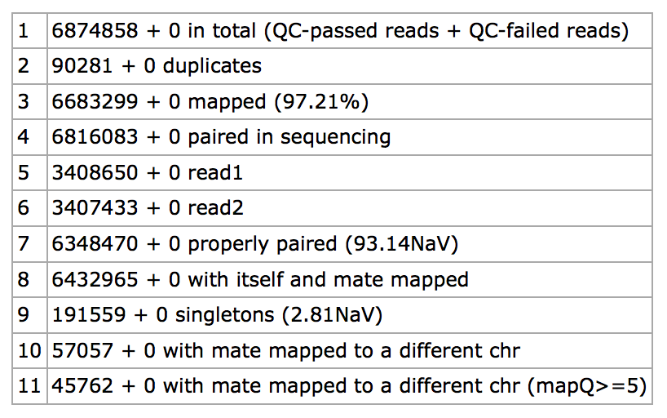
Getting simple statistics using SAMtools
samtools
samtools flagstat file.bam
Does a full pass through the input file to calculate and print statistics such as:
% reads mapped
% unmapped reads
% reads properly paired
Other information

Slide 33
Indexes
samtools
Some programs require that for faster access we need a companion file (often called index) for the different formats
FASTA (.fa & .fai)
BAM and BAI formats (suffixes .bam & .bai)
VCF (.vcf & .vcf.idx)

Slide 34
Creating a BAM index
samtools
Many tools require a BAM Index file to more efficiently access reads in a BAM file.
To create a BAM index:
You must first sort the BAM file to create a sorted.bam
Run samtools index with the sorted.bam as input
This will create a file named sorted.bam.bai which contains the index
Example:
samtools view file.sam >file.bam
samtools sort file.bam -o file_sorted.bam
samtools index file_sorted.bam file_sorted.bai
34

Slide 35
Extracting some information from the BAM
samtools
Filtering out unmapped reads from BAM files
samtools view -h -F 4 file.bam > file_only_mapped.sam
# output back to BAM
samtools view -h -F 4 –b file.bam > file_only_mapped.bam
Extracting SAM entries mapping to a specific region
#index the bam file first
samtools index file.bam
samtools view file.bam chr1:200000-500000
#all reads mapping on chr1 as another bam
samtools view –b file.bam chr1 > file_chr1.bam

Slide 36
Computing the depth
samtools
Samtools allows computing the depth at each position
Samtools depth
#syntax
samtools depth options file.bam
# –a allows to output all positions (including those with zero depth)
samtools depth –a test.bam
#–q INT only count reads with base quality greater than INT
samtools depth –q int test.bam

Slide 37
Computing the coverage per region
samtools
Samtools allows computing the read depth per genomic region, as specified in the supplied BED file
Samtools bedcov
#syntax
samtools bedcov options region.bed file.bam

Slide 38
Introduction to NGS
ILRI, Nairobi
May 2018
Exercises:
https://github.com/bixcop18/module_3_intro_NGS/blob/master/exploremappingresults.md

Slide 39
GFF and BED formats

Slide 40
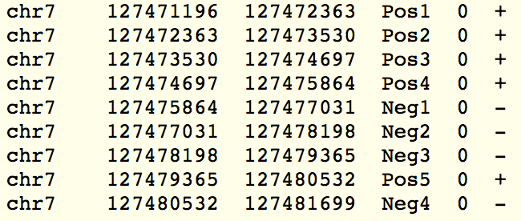
BED Format
BED files
BED = (Browser Extensible Data)
(http://genome.ucsc.edu/FAQ/FAQformat)
BED starts are zero-based and BED ends are one-based
► Tab-delimited files
► 3 first fields required, others optional
File format (BEDPE): describes disjoint genome features, such as structural variations or paired-end sequence alignments.
SCORE*
FEATURE NAME
STRAND
START-END
CHR
7. thickStart - The starting position at which the feature is drawn thickly.
8. thickEnd - The ending position at which the feature is drawn thickly.
9. itemRgb - An RGB value of the form R,G,B (e.g. 255,0,0).
10. blockCount - The number of blocks (exons) in the BED line.
11. blockSizes - A comma-separated list of the block sizes.
12. blockStarts - A comma-separated list of block starts.
* Any string could be used (p-value, enrichment score…)

Slide 41
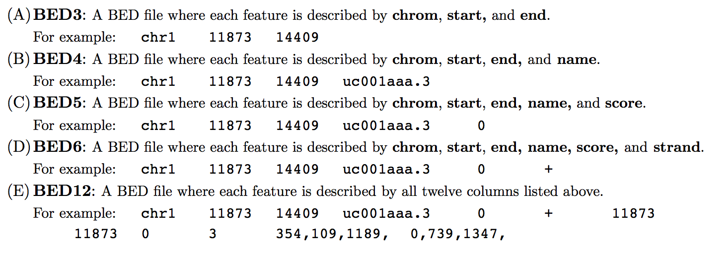
Different BED Formats
BED files

Slide 42
BED Format
BED files
► BEDTools support a wide range of operations for interrogating and manipulating genomic features.
intersectBed
Returns overlapping features between two BED/GFF/VCF files.
genomeCoverageBed
Histogram or a “per base” report of genome coverage.
…
► Coverage
The number of times each nucleotide is « read »
Fold Coverage (numberX )

Slide 43
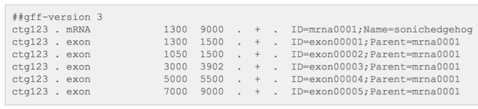
GFF3 Format
GFF files
GFF3
The two most widely used formats for representing genome features are the BED and GFF formats.
GFF (Generic Feature Format) is a standard file format for storing genomic features in a text file.
Careful : GFF has several versions, the most recent is GFF3.
GFF start at a 1-based position and ends at a 1-based position.
► 1 line for 1 feature
► tab-delimited file (tab-separated columns)
► 9 columns + optional additional information
STRAND
PHASE
SCORE
SEQ-ID
SOURCE
TYPE
START-END
ATTRIBUTES
http://gmod.org/wiki/GFF3
http://www.ensembl.org/

Slide 44
VCF format

Slide 45
Variant calling and VCF format
VCF files
Many tools for variants detection: GATK, Samtools (mpileup), FreeBayes, PICARD, etc.

Slide 46
VCF Format
VCF files
VCF file (.vcf) = “Variant Calling format”
Tab-delimited text file format that can store information about variants: the differences between your sample and the reference genome.
All this information can be easily queried (VCFtools).
Format validation.
SNV annotation.
VCF comparison.
Statistics.
…

Slide 47
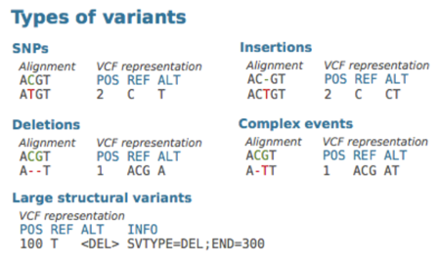
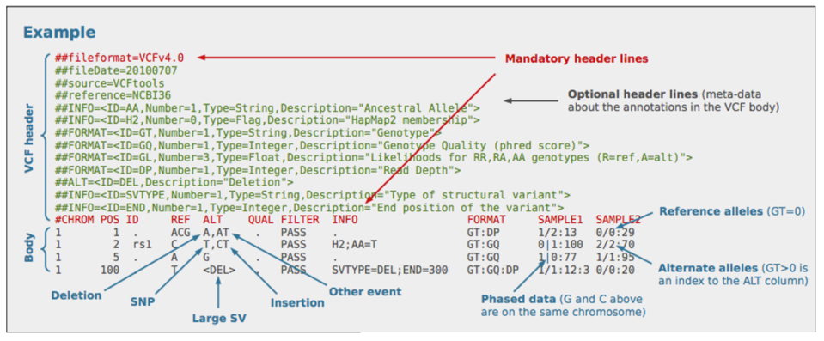
Variant calling and VCF format
VCF files
VCF Format coordinates are 1-based
http://wiki.bits.vib.be/index.php/NGS-formats
Notes:
The sample-level information contained in the VCF (also called "genotype fields") may look a bit complicated at first glance, but they're actually not that hard to interpret once you understand that they're just sets of tags and values.
https://software.broadinstitute.org/gatk/documentation/tooldocs/current/org_broadinstitute_gatk_tools_walkers_variantutils_VariantsToTable.php

Slide 48
Extracting info from VCF files
VCF files
No need to write your own parser, you can use GATK Variants to table
https://software.broadinstitute.org/gatk/documentation/tooldocs/current/org_broadinstitute_gatk_tools_walkers_variantutils_VariantsToTable.php
http://wiki.bits.vib.be/index.php/NGS-formats
Notes:
The sample-level information contained in the VCF (also called "genotype fields") may look a bit complicated at first glance, but they're actually not that hard to interpret once you understand that they're just sets of tags and values.

Slide 49
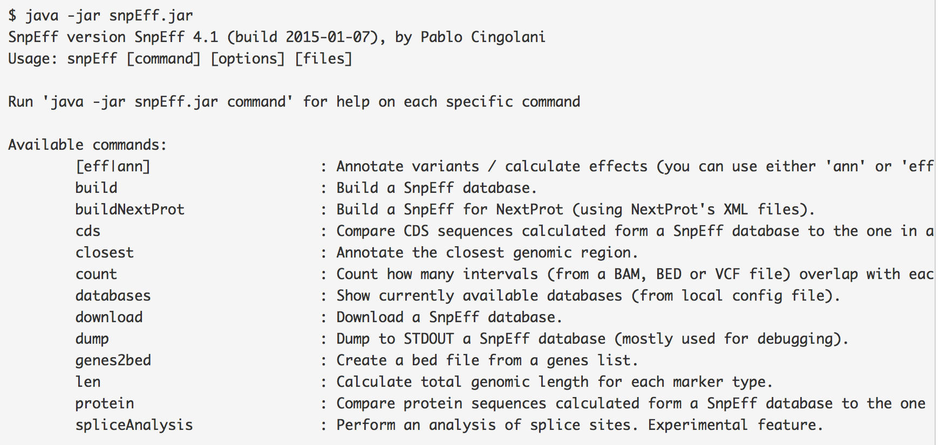
VARIANT CALLING FILTERING
Variants annotation
Variant annotation programs: SnpEff
A variant annotation and effect prediction tool.
Annotates and predicts the effects of variants on genes: Are they in a gene? In an exon? Do they change protein coding? Do they cause premature stop codons?
http://wiki.bits.vib.be/index.php/NGS-formats

Slide 50
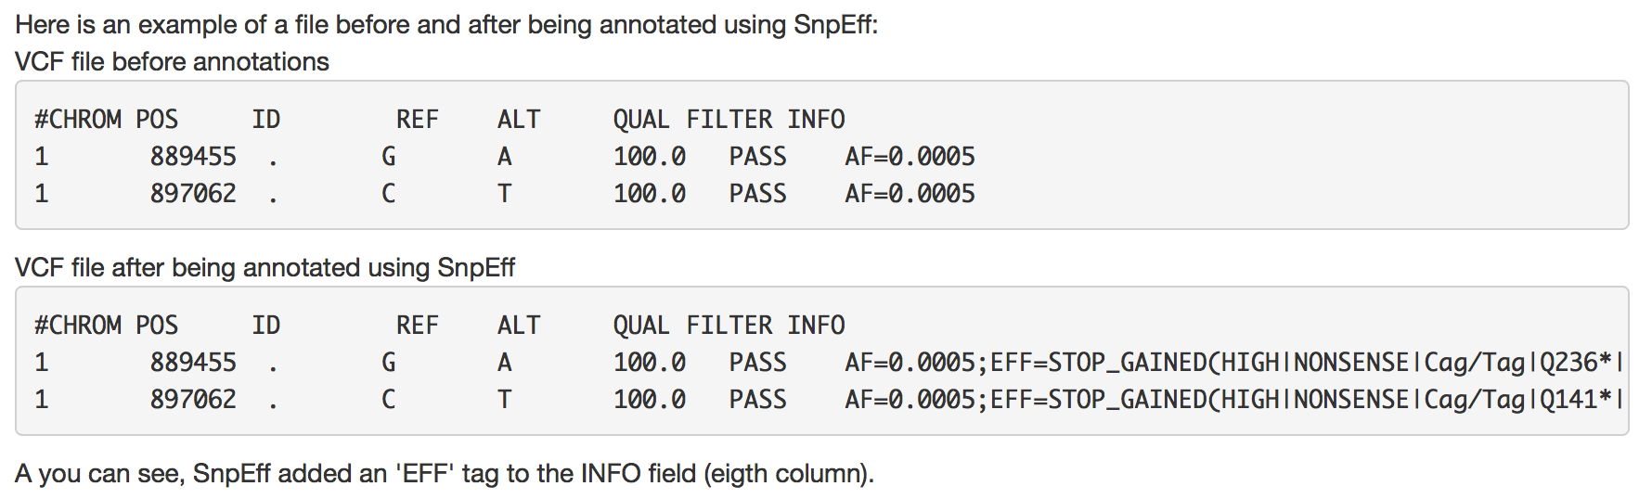
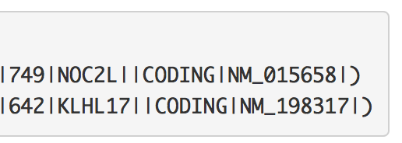
VARIANT CALLING FILTERING
Variants annotation
http://wiki.bits.vib.be/index.php/NGS-formats

