Slide 1

Loan Default Prediction Model
Project Title:

Slide 2
Outline of the Presentation
Project Title
Business Understanding
Overview of the Project
Problem statement
Objectives of the project
Business challenge and proposed solution
Data Understanding
Data Preparation- Setting up, Importing Libraries and Utility Functions and Loading, data Cleaning
Data Exploration
Building a Loan Default Prediction Model
Comparison Analysis
Recommendations and Conclusion
Next Steps

Slide 3
Problem Statement:
Kenya’s financial sector is grappling with rising loan default rates, which undermine the profitability and stability of lending institutions. Despite government efforts like the Hustler Fund to improve credit access, default rates remain high—nearly 29% of its portfolio was at risk by August 2023. This underscores the need for better risk assessment tools to identify high-risk borrowers and reduce financial losses.
Borrowers face limited access to affordable credit due to high interest rates and strict qualification criteria, especially among marginalized groups. To address these challenges, there is a need for a machine learning-based loan default prediction model that leverages historical and behavioral data to support data-driven lending decisions, improve credit profiling, and promote financial inclusion.

Slide 4
Stakeholder Understanding
The Key Stakeholders interest in this Loan Default Prediction Model project include
Banks and Financial Institutions
Interest: Minimize loan defaults and improve profitability.
Expectation: A reliable model that enhances credit risk assessment, reduces bad debts, and supports better lending decisions.
Credit Risk Analysts
Interest: Need accurate tools to assess borrower risk levels.
Expectation: Access to a data-driven model with high predictive power to support portfolio analysis and risk mitigation strategies.
Fintech Companies
Interest: Develop innovative and efficient lending solutions.
Expectation: Integration-ready predictive models to personalize loan products and expand access to credit while managing risk.
Regulatory Bodies (e.g., Central Bank of Kenya)
Interest: Ensure financial sector stability and responsible lending.
Expectation: Insights from the model to guide policy-making, monitor systemic risks, and enforce prudent lending standards.
Borrowers (especially underserved populations)
Interest: Fair access to credit and reduced rejection rates.
Expectation: Transparent and inclusive loan evaluation processes that consider diverse credit histories and support financial inclusion.

Slide 5
Data Understanding: Data Insights
The CRB dataset used in building this Loan Default Prediction Model was sourced from a Credit Reference Bureau Licensed by Central bank of Kenya being data collected over a period of +12years from various banking financial institutions in Kenya
The CRB Dataset was Zipped Dataset has Four files:
Application data- 9492 entries;
Contract data- 9374 entries;
ContractSnapshot data- 274371 entries;
CRB data – 6750 entries;
Current and Savings Account Data – 857677 entries .
All the four files were merged into one dataset and after cleaning we resulted into a dataset of 584110 entries using a random sample size of 5%

Slide 6
Data Preparation:
A threshold of 50% and median was used to handle Missing Values in numerical columns while “unknown” was used to fill null values for categorical columns except for gender column which was replaced with “other”
All date columns were converted into right date format
All Duplicate Values were subsequently dropped.
The dataset has four data types (integer, float, object and datetime64)
There are xx Numeric Columns:
There are xx Categorical Columns:

Slide 7
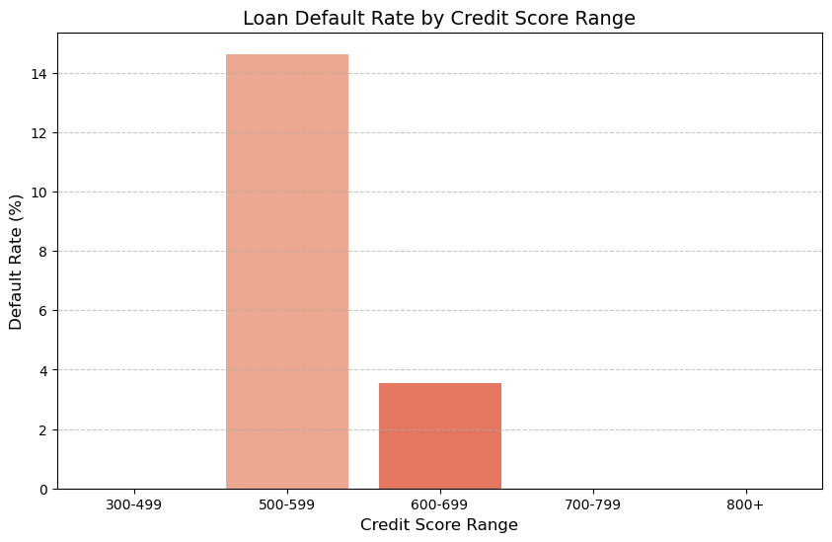
Data Visualization: Loan Default Rate by Credit Score Range
Key Observations:
Borrowers with credit scores between 500-599 have the highest default rates.
Default rates decrease as credit scores increase, with 700+ scores showing the lowest risk.
There is a clear inverse relationship between credit score and loan default.
Interpretation:
A lower credit score strongly correlates with a higher probability of default.
Borrowers with poor credit history (300-499) are the riskiest.
Borrowers with scores above 700 are financially responsible and less likely to default.
Recommendations:
Implement stricter lending policies for borrowers with scores below 600.
Offer credit-building programs to borrowers in the 500-600 range.
Consider rewarding high-score borrowers with lower interest rates or better loan terms.

Slide 8
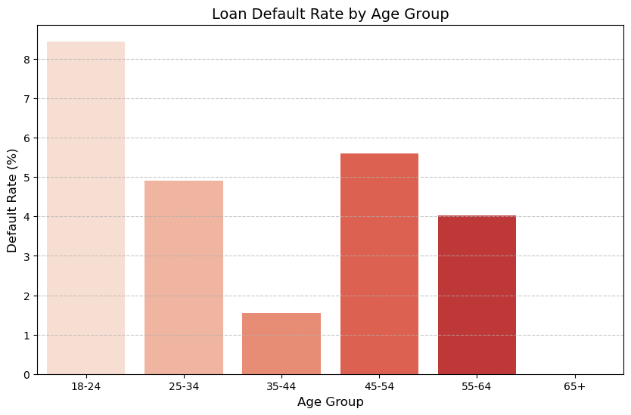
Data Visualization: Loan Default Rate by Age Group
Key Observations:
Young borrowers (18-24) have the highest default rates.
Default rates decrease for middle-aged groups (35-54), indicating more financial stability.
Borrowers aged 55+ show a slight increase in default rates, possibly due to reduced income after retirement.
Interpretation:
Young borrowers may struggle with financial management or job instability.
Middle-aged borrowers (35-54) have lower default rates, likely due to career stability.
Older borrowers (55+) may face financial constraints due to retirement.
Recommendations:
Offer financial education and budgeting tools for young borrowers.
Consider alternative repayment plans for older borrowers nearing retirement.
Implement targeted risk assessment based on borrower age and financial history

Slide 9
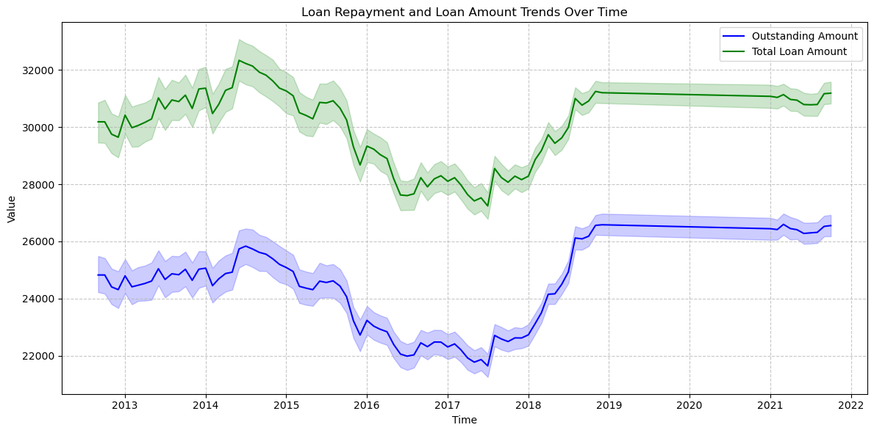
Loan Repayment and Loan Amount Trends Over Time
Key Observations: Trend Movement (2012–2022):
Both Outstanding Amount (blue) and Total Loan Amount (green) follow a broadly similar trend, indicating a correlation between loan issuance and repayment levels.
A noticeable dip occurs around 2015–2017, followed by a steady increase post-2018.
The gap between the Total Loan Amount and Outstanding Amount has narrowed slightly over time, which could signal improved repayment behavior.
Interpretation:
The drop between 2015–2017 may reflect economic distress, stricter lending criteria, or changes in borrower behavior (e.g., increased defaults or reduced credit access).
The rebound and stabilization after 2018 likely reflect economic recovery, better credit management, or strategic Bank interventions (e.g., credit scoring or borrower vetting).
Recommendations:
Preserve the current trajectory by maintaining strong loan appraisal standards, borrower education, and post-disbursement monitoring.
Invest in Predictive Analytics : Use historical trends to predict borrower behavior, anticipate default cycles, and optimize loan product design.
Improve Data Reporting & Segmentation: Break down the data further by loan types, borrower profiles, or sectors to uncover hidden patterns and target high-performing segments.
Policy Review : If policy changes (internal or regulatory) occurred around 2017–2018, evaluate their impact and consider reinforcing or replicating them.

Slide 10
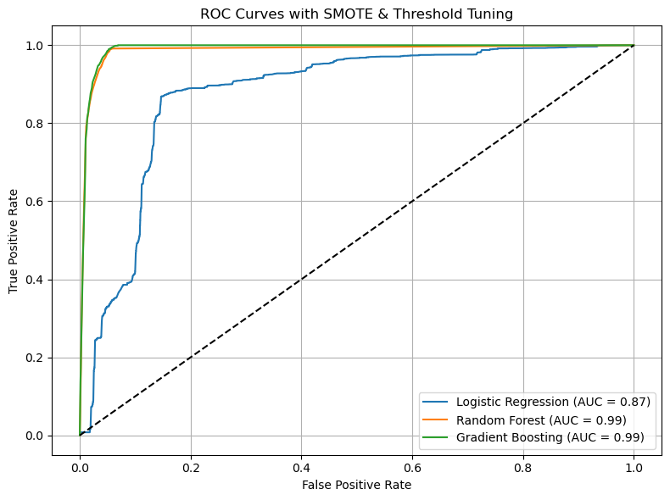
ROC Curves with SMOTE & Threshold Tuning
Insights and Observations:
ROC curve illustrates each model's ability to distinguish between defaulters and non-defaulters.
Gradient Boosting and Random Forest models show excellent discrimination capability achieving the highest AUC of 0.99, while Logistic Regression closely follows at 0.87.
Random Forest & Gradient Boosting are likely to perform better because they can handle non-linearity.

Slide 11
Modelling:
The following models were selected for this problem:-
Logistic Regression Model – This was used to build a Baseline model which further Tuned to generate using scaling method to generate Best model
Random Forest Model with SMOTE – ( This was selected as preferred model)
Gradient Boosting Model –
XGBoost

Slide 12

Model Evaluation

Slide 13
Model Evaluation: Interpretation
Baseline Logistic Regression Model Performance:
Reported overall accuracy of 99%.
Logistic Regression achieved the highest recall (0.99) but with the lowest precision (0.41), F-1 Score (.58) indicating a high false positive rate.
Interpretation: This model catches nearly all defaulters (high recall) but also generates many false positives (low precision), leading to a lower F1-score. It's highly cautious
Random Forest Model:
Overall Model Accuracy: 99%
Random Forest showed the best balance between recall (0.96) and precision (0.51), yielding the highest F1-score (0.67).
Interpretation: Performs similarly to Logistic Regression in recall, but slightly better in F1-score. It is aggressive in identifying defaulters but also lets more false positives through compared to Random Forest.
Gradient Boosting Model:-
Overall Accuracy: 99%
Gradient Boosting also achieved high recall (0.99) with moderate precision (0.45), placing it between the other two in overall performance.
Interpretation: Performs similarly to Logistic Regression in recall, but slightly better in F1-score. It is aggressive in identifying defaulters but also lets more false positives through compared to Random Forest.

Slide 14
Recommendation :
Primary Model Recommendation: Random Forest Model
Deploy Random Forest as the primary model for predicting loan defaults:
It offers the best balance (F1-score = 0.67) and very high recall (0.96) — critical for catching actual defaulters.
Precision (0.51) is acceptable in credit risk where missing a defaulter is more costly than flagging a few good applicants.
Secondary/Use-Case Based Models:
Use Gradient Boosting if slight increases in precision are preferred and interpretability is not critical.
Use Logistic Regression where transparency is paramount (e.g., compliance with regulatory requirements), but expect more false positives

Slide 15
Deployment :

Slide 16
Next Steps:
The organization can further improve the model performance by including hyperparameter tuning for both Random Forest and Gradient Boosting to further optimize performance.

Slide 17

Thank You

