Slide 1

DUAL MODE VISION-GUIDED ROBOTIC ARM
A Project report submitted in partial fulfilment of the requirement for the degree of the
BACHELOR OF TECHNOLOGY
IN
ELECTRONICS AND COMMUNICATION ENGINEERING
SUBMITTED BY
CHADARAM MAANAS
Reg No: 321106512004
BORA ABHINAV
Reg No: 321106512005
CHEPURI NATRAJ
Reg No: 321106512006
MANNAVA SREE PARDHEEV KUMAR
Reg No: 321106512028
UNDER THE ESTEEMED GUIDANCE OF
Prof. P. RAJESH KUMAR M.E., Ph.D.
Professor
DEPARTMENT OF ELECTRONICS AND COMMUNICATION ENGINEERING
ANDHRA UNIVERSITY COLLEGE OF ENGINEERING
VISAKHAPATNAM – 530003
2022–2026

Slide 2
Abstract
🎯 OBJECTIVE
🏗️ ARCHITECTURE
This project develops a 6-DOF robotic arm capable of autonomous object sorting via computer vision and human-in-the-loop gesture control, switching seamlessly between modes without physical intervention.
Hardware: 6× MG996R servos on a metal arm kit, ESP8266 microcontroller, MPU6050 IMU. Software: ROS2 Jazzy, Gazebo Harmonic for physics simulation, RViz for visualisation, YOLOv8 for hand/object detection.
📊 PROGRESS
🔬 SIGNIFICANCE
Milestones complete: (1) hardware procured; (2) custom URDF developed after iterative adaptation; (3) arm simulated in Gazebo & RViz; (4) initial ESP8266 servo control written; (5) YOLO hand detection tested — pipeline integration ongoing.
Dual-track development (hardware + software simulation) validates each track independently, reducing integration risk and ensuring a testable prototype at every phase of the project lifecycle.
Abstract | 2/10

Slide 3
System Architecture & Tools
Two parallel development tracks converging into one unified system
Hardware Track
Software Track
• 6-DOF Metal Servo Arm Kit
• ROS2 Jazzy Jalisco
• 6× MG996R Servo Motors
• Gazebo Harmonic (Simulation)
• ESP8266 Microcontroller
• RViz (Visualisation)
• IMU Sensor (MPU6050)
• YOLOv8 (Hand Detection)
• 5V / 10A Dedicated PSU
• OpenCV + MediaPipe
IMU / Camera Feed → ESP8266 / ROS2 → Servo Motor Commands → Arm Motion
System Architecture & Tools | 3/10

Slide 4
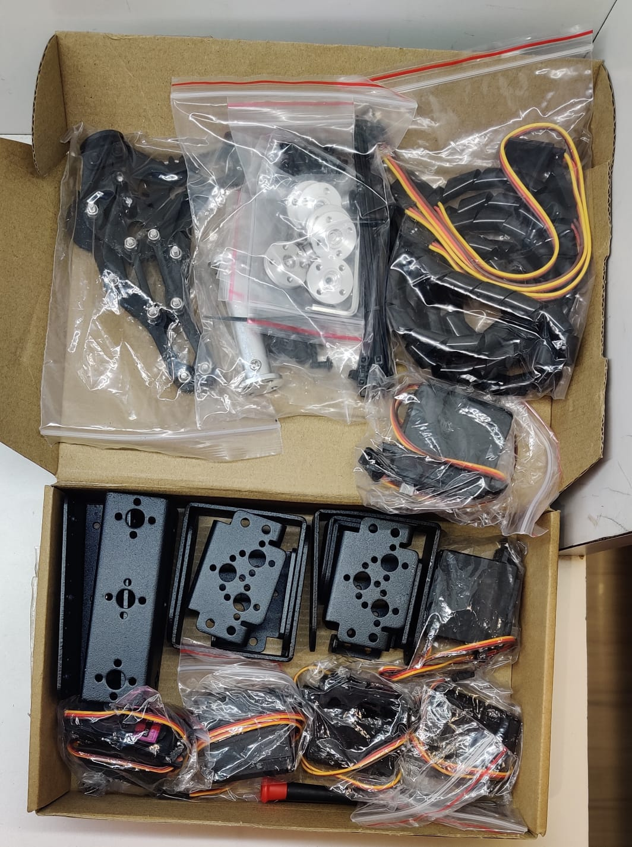
Phase 1 — Hardware Procurement
✅ Completed
OVERVIEW
01
Component Selection
All primary hardware components were ordered and received. Component selection was finalised based on torque, availability, and ESP8266 compatibility.
Six MG996R servos (9–11 kg·cm), ESP8266 NodeMCU for Wi-Fi PWM control, MPU6050 IMU for 6-axis feedback. Initial plan called for 4 servos; upgraded to 6 for full DOF.
02
Procurement & Delivery
Components sourced and ordered. Arm kit, servos, ESP8266, IMU, and 5V/10A PSU all received and inspected.
OUTCOME
All hardware is on hand and ready for wiring and firmware integration.
03
Inventory Verified
6× MG996R, 1× ESP8266 NodeMCU, 1× MPU6050, 1× 6-DOF frame + claw gripper, 1× 5V/10A PSU — confirmed complete.
Phase 1 — Hardware Procurement | 4/13

Slide 5
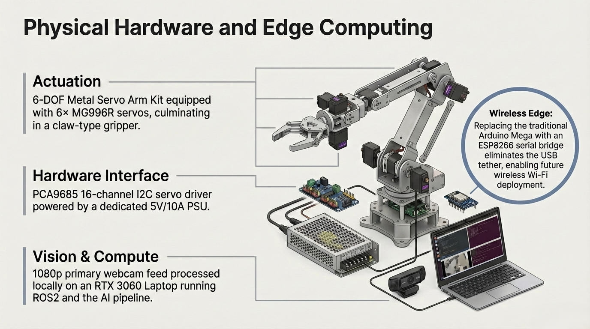

Slide 6
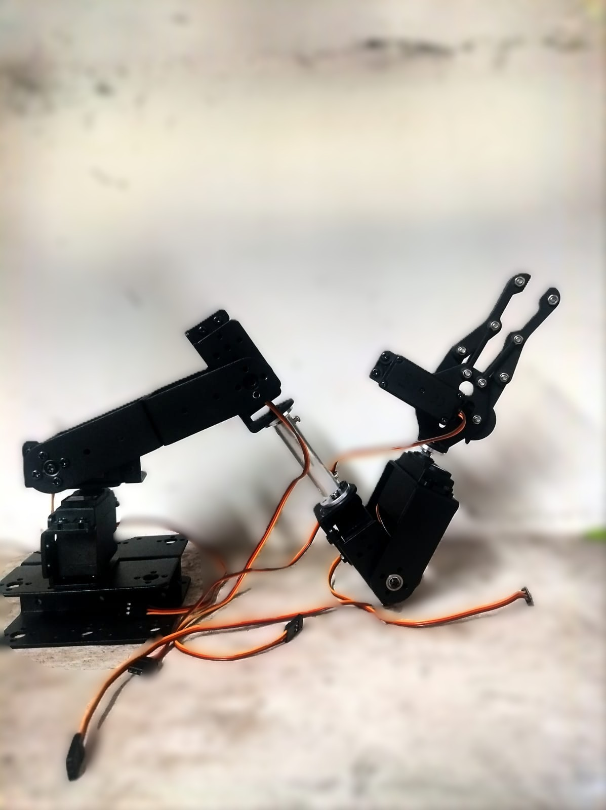

Slide 7
Phase 2 — 3D Model & URDF Development
✅ Completed (Multiple Iterations)
OVERVIEW
01
Challenge: No Matching URDF
A URDF is mandatory for Gazebo simulation. No pre-existing URDF matched our hardware, so one was created from an adapted open-source reference.
The purchased 6-DOF metal arm kit has no freely available 3D model or URDF online. Without a URDF, simulation and motion planning are impossible.
02
Reference Model Located
ferasboulala/five-dof-robot-arm on GitHub was used as a base. Mesh proportions and joint placements were studied against the physical hardware.
OUTCOME
Working Xacro URDF produced and integrated into the ROS2 workspace package my_arm_description.
03
Iterative Adaptation
Multiple attempts: adjusting link lengths, correcting joint axes, converting to ROS2 Xacro format, adding the 6th joint and gripper, fixing mesh collision/inertia errors.
04
Working Model Achieved
Stable Xacro URDF produced with 6 correctly defined joints, link inertias, and collision geometry — sufficient for simulation and motion planning.
Phase 2 — 3D Model & URDF Development | 7/13

Slide 8
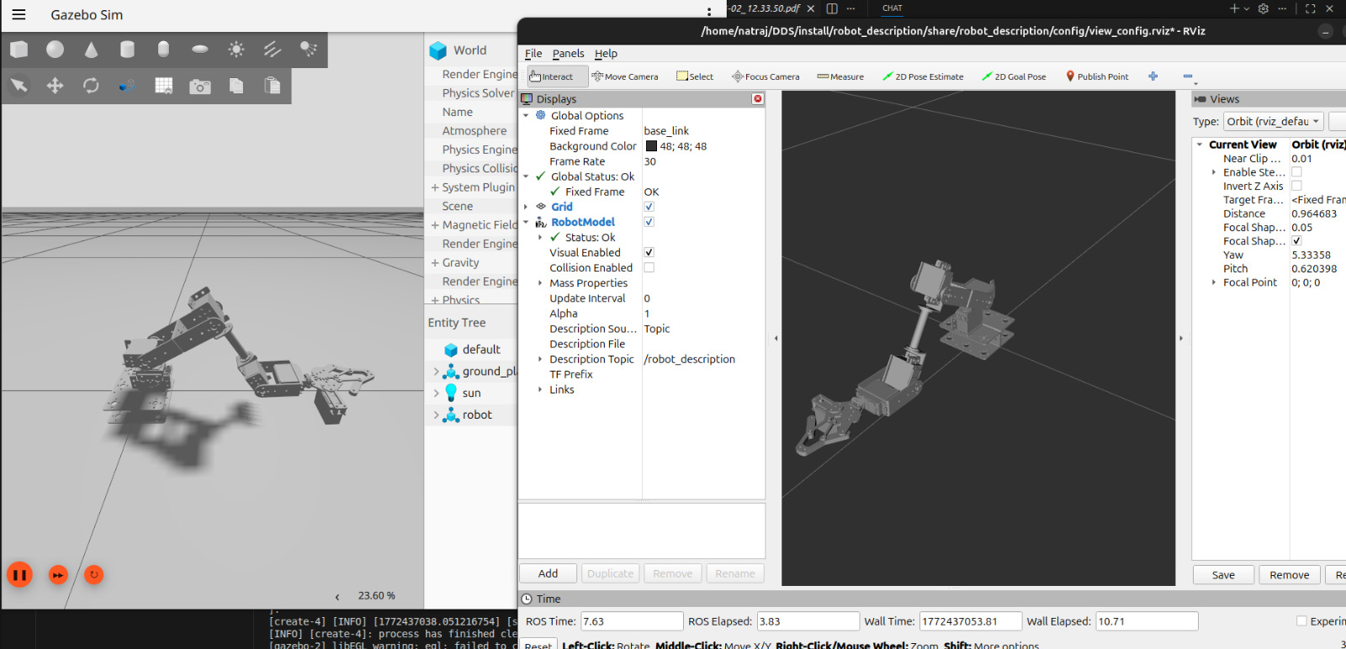
Phase 3 — Simulation in Gazebo & RViz
✅ Completed
OVERVIEW
01
RViz Visualisation
With the URDF ready, the arm was loaded into Gazebo Harmonic (physics sim) and RViz (kinematic visualisation) as the primary testbed before hardware deployment.
Loaded via display.launch.py. joint_state_publisher_gui sliders confirmed all 6 joints move correctly. Link transforms verified.
02
Gazebo Harmonic Launch
Arm spawned via gazebo.launch.py. gz-ros2-bridge configured to relay joint states. JointTrajectoryController from ros2_control activated.
OUTCOME
Arm simulates correctly in Gazebo with physics-accurate joint motion. Trajectory commands execute reliably via ROS2 topics.
03
Controller Verification
ros2 control list_controllers confirmed joint_trajectory_controller and joint_state_broadcaster active.
04
Motion Testing
Test trajectory commands published via ros2 topic pub. Pick-place sequences and joint-level position commands prototyped in simulation.
Phase 3 — Simulation in Gazebo & RViz | 8/13

Slide 9
Phase 4 — Servo Motor Control (ESP8266)
🔄 In Progress
OVERVIEW
01
ESP8266 PWM Control
Initial development of servo motor control firmware on the ESP8266 began in parallel with simulation. This is the hardware counterpart to the simulated JointTrajectoryController.
ESP8266 NodeMCU selected for built-in Wi-Fi and PWM output. Will receive joint angle commands and translate them to PWM signals for all 6 MG996R servos.
02
Signal Generation
MG996R servos need 50 Hz PWM, 500–2500 µs pulse width for full motion range. Initial firmware maps angle → pulse width and generates signals on digital IO pins.
OUTCOME
Individual servo control functional. Multi-servo coordination and ROS2–ESP8266 bridge are the next steps.
03
Initial Tests
Preliminary tests on individual servo motors complete. Smooth angle transitions with configurable speed implemented to prevent jerky motion.
Phase 4 — Servo Motor Control (ESP8266) | 9/13

Slide 10
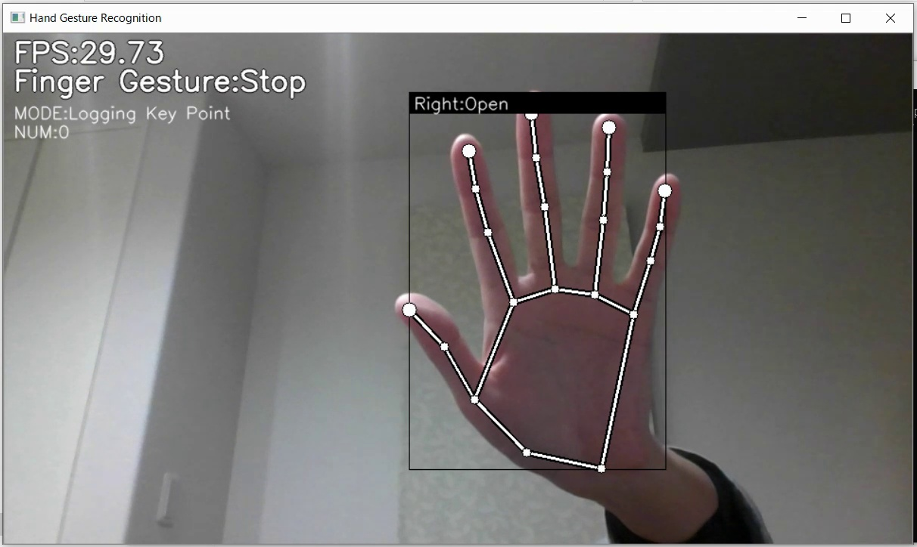
Phase 5 — Computer Vision Integration (YOLO)
🔄 Under Development
OVERVIEW
01
YOLOv8 Model Setup
A YOLOv8-based pipeline was developed to detect a human hand and convert that detection into servo movement commands. This is the core intelligence of gesture control mode.
YOLOv8 (Ultralytics) configured on NVIDIA RTX 3060 with CUDA 12.1 for accelerated inference. Targeting real-time >30 FPS performance.
02
Detection → Command Pipeline
Intended: camera → YOLOv8 bounding box → centroid → IK → 6 joint angles → ESP8266 servo commands. Partially implemented.
OUTCOME
Hand detection functional in isolation. Full pipeline integration into ROS2 + servo chain is the current blocker under active debugging.
03
Integration Issues Found
Latency spikes in detection-to-command loop, coordinate mapping calibration errors, and serialization issues passing YOLO output into ROS2 topics.
04
Current Status
YOLO detects hands reliably in isolation. End-to-end integration from detection to servo command under active debugging and expected to resolve in next cycle.
Phase 5 — Computer Vision Integration (YOLO) | 10/13

Slide 11
Challenges & Current Status
Dual-track development: each track validated independently, converging at integration
Hardware Track
Software Track
COMPLETED
COMPLETED
✅ All components procured
✅ URDF created after iterative adaptation
✅ Specs verified
✅ Arm visualised in RViz
✅ ESP8266 PWM firmware written
✅ Gazebo simulation running
✅ Individual servo response tested
✅ ros2_control JTC active
PENDING
✅ YOLOv8 detection working in isolation
⏳ Full arm assembly & wiring
PENDING
⏳ Multi-servo coordinated control
⏳ YOLO → ROS2 command pipeline
⏳ ROS2 ↔ ESP8266 serial bridge
⏳ Camera-to-workspace calibration
⏳ IMU integration
⏳ MoveIt2 motion planning
⏳ Autonomous mode logic
Key Challenge: The most significant obstacle was the absence of a ready-made URDF for the purchased arm kit, requiring multiple iterative reconstruction attempts before a working simulation model was produced.
Challenges & Current Status | 11/12

Slide 12
Next Steps & Roadmap
Structured development path — testable artefact at every phase
P1
P2
P3
P4
Hardware Assembly
ROS2 ↔ Hardware Bridge
Vision Pipeline Fix
Full System Integration
→ Wire all 6 servos
→ ESP8266 serial bridge node
→ Debug YOLO → ROS2 pipeline
→ Autonomous sorting mode
→ Connect IMU
→ ROS2 JointTrajectory → servo
→ Camera calibration
→ Gesture control (local)
→ PSU integration
→ Real HW controller test
→ Coordinate mapping
→ Mode switching logic
→ Bench test all joints
→ ros2_control HW interface
→ Latency test
→ 50-cycle stress test
Each phase produces a standalone demonstrable prototype — ensuring progress is always presentable regardless of final timeline.
Next Steps & Roadmap | 12/12

