Slide 1
TheDailyDive
What you should know to start your day

Slide 2
Visiting multiple websites and traversing ad-ridden content is exhausting. I just want a convenient click to give me what I need to start the day.

Slide 3
Concept
Location based information portal
Visiting multiple websites and traversing ad-ridden content is exhausting. I just want a single click to give me what I need to start the day.
As a user I want to visit a single page and view content that’s relevant and interesting.

Slide 4
Process
Technologies used
CSS, Bootstrap frontend
Navigator geolocation
Openweather
Moment JS
Big Data Cloud
Regional location data for local news
Multiple New York Times APIs
Technology and global news
Write once, use many functionality to render news articles
Breakdown of tasks and roles
Challenges
Successes

Slide 5
Process
Roles
Zeke – frontend styling
Zach – frontend styling, weather presentation javascript
Sam – News card generation javascript
Jon – News card generation javascript
Challenges
Github code pushes continuously broke presentation
Breaking up tasks to keep team working on functionality
Successes
Great teamwork
Everyone played a role
Hard work

Slide 6
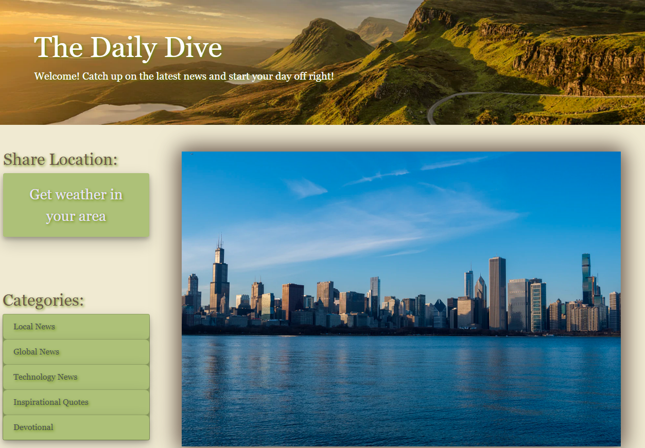
Demo

Slide 7
Directions for Future Development
Ability to clone to personal repo and add content to users preference
Potential for further customization of news selections
Potential for customization of frontend styling for users preference
Further work on responsive layout

Slide 8
Links
https://github.com/Chequelito/theDailyDive
https://chequelito.github.io/theDailyDive/

