Slide 1
Co-Splicing Indices
Concept and algorithm

Slide 2
Contents
Introduction and Our definition of co-splicing
Our dataset and objective
Pairwise to multi-way models
Co-splicing Indices (CSI): RA diff. & confidence score
Algorithmic implementation of CSI
Calculating CSI by hand for understanding purposes

Slide 3
Endogenous splicing
1
2
3
4
Endogenous splicing
1
2
3
4

Slide 4
SSO-induced exon skipping
1
2
3
4
+ SSO
1
3
4
Exon 2 excised

Slide 5
Data
Experiments and data preprocessing by Muhammad Ikhsan Bin Muzakar
Control cells & cells treated with SSO
GeneScan measures of relative abundance (RA) of each detectable isoform
Exons in isoform is deduced
Genes: BAG6, BCL2L12/13, BCLAF1, BID, BIN1, BIRC6, BNIP1, NAIP, SHMT, with 1-8 SSOs used per gene

Slide 6
Hypothesis | SSO induces co-splicing
1
2
3
4
+ SSO
3
4
and/or
1
4
and/or
1
3
1 & 2 excised
2 & 3 excised
2 & 4 excised

Slide 7
Objective
Identify SSO-induced co-splicing events in dataset
for wet lab validation

Slide 8
Model & Possible co-splicing types
Simplified reality:
We only look at two exons at a time: ExonA-ExonB
Exon present = 1, exon absent = 0
Co-exclusion: 1-1 → 0-0
Co-inclusion: 0-0 → 1-1
Exchange: 1-0 → 0-1, or the other way

Slide 9
Multi-way model
Isoform A
Isoform B
…
…
Co-exclusion/ Co-inclusion
Pairwise relations can be built into multi-way model
Grey: Exon present
White: Exon absent
‘…’: More exons in the isoform not represented in diagram
Co-exclusion/ Co-inclusion
Exchange
Exchange
Co-exclusion/ Co-inclusion
Exchange
Isoform C
Isoform D
…
…

Slide 10
Co-Splicing Indices (CSI): RA difference
Isoform A
Isoform B
Based on the data, we can calculate the difference in relative abundance (RA) for each “connection”.
Example: Isoform A → Isoform B co-exclusion
1-1 → 0-0
Algorithm:
if isoform A (1-1) exist in control:
then RA diff = sum of treatment (0-0) –
sum of control (0-0)
if RA diff < 0:
discard entry
Note: directionality matters because they look at different exon pairs
…
…
Co-exclusion = +0.2
Co-inclusion = +0.1
Isoform C
Isoform D
…
…

Slide 11
Co-Splicing Indices (CSI): RA difference
1. Why “sum of” in the algorithm?
Algorithm:
if isoform A (1-1) exist in control:
then RA diff = sum of treatment (0-0) –
sum of control (0-0)
Because in pairwise model, we only look at two exons (in this example, 0-0), but many isoforms can possess the same exon states.
2. Why if RA diff < 0: discard entry?
A co-spliced isoform always increase in relative abundance after treatment.
Thus, if an entry has treatment – control < 0, we discard the entry from further analysis.
Isoform B
…
is the sum of
Isoform B1
…
+
Isoform B2
…
+
…

Slide 12
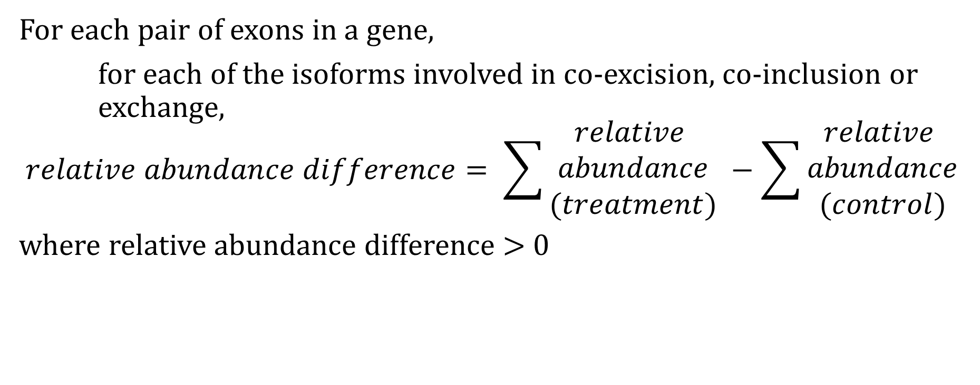
Co-Splicing Indices (CSI): Assumptions
For each pair of exons in a gene,
for each of the isoforms involved in co-excision, co-inclusion or exchange,
$$relative abundance difference= \sum{\begin{aligned}relative \\ abundance \\ (treatment)\end{aligned} −\sum{\begin{aligned}relative \\ abundance \\ (control)\end{aligned} }}$$
where relative abundance difference > 0
Assumptions:
1. True positive co-splicing is indicated by high RA difference
2. Isoform A → C & B → C is true (but maybe only A → C is true)

Slide 13
Co-Splicing Indices (CSI): Confidence score
We are more confident of RA difference if assumptions are true.
Assumption 1: True positive co-splicing is indicated by high RA difference
More likely false positive if the difference is not statistically significant
With >2 replicates, we can calculate significance
Assumption 2: Isoform A → C, isoform B → C is true and so on
If there is only one control non-spliced isoform (e.g. 1-1), and one treatment co-spliced isoform (e.g. 0-0),
then we only observe A → C, thus assumption is true
Notes:
# Assumptions of CSI model:
# 1. Isoform A --> B, E --> B is true (but perhaps only A --> B is occurring)
# 2. Increase in relative_abundance (RA) --> Increase in absolute quantity
# contributing_isoforms: Number of isoforms in control contributing to
# the RA_diff.
# e.g. if A --> B, E --> B: contributing_isoforms = 2
# The lower the number, the more confident we are
# about assumption 1.
# total_isoforms: Total number of NONZERO RA isoforms present in control.
# The fewer the number, the more confident we are about
# assumption 2. For example, if in control there is only
# only one isoform, any increase in co-spliced isoforms' RA
# in treatment must have been derived from the only isoform
# in control.
# RA_cont_spliced_isoform: Relative abundance of the co-spliced isoform in
# control. The lower the number, the more confident
# we are about assumption 2.
# This is the weakest factor because treatment
# can result in increase in absolute quantity of
# co-spliced isoform but still it is not reflected
# in relative abundance.

Slide 14

Co-Splicing Indices (CSI): Confidence score
We can convert our level of confidence into a score
Let A be number of isoforms that can contribute to co-spliced form in control
Let B be the number of co-spliced isoforms in treatment
$$confidence score =−log\left(P\right) ∗10+\left(\frac{1}{A}+\frac{1}{B}\right)∗25$$
where 0 < confidence score < 100 as –log(p-value) is capped at 5
Notes:
# Assumptions of CSI model:
# 1. Isoform A --> B, E --> B is true (but perhaps only A --> B is occurring)
# 2. Increase in relative_abundance (RA) --> Increase in absolute quantity
# contributing_isoforms: Number of isoforms in control contributing to
# the RA_diff.
# e.g. if A --> B, E --> B: contributing_isoforms = 2
# The lower the number, the more confident we are
# about assumption 1.
# total_isoforms: Total number of NONZERO RA isoforms present in control.
# The fewer the number, the more confident we are about
# assumption 2. For example, if in control there is only
# only one isoform, any increase in co-spliced isoforms' RA
# in treatment must have been derived from the only isoform
# in control.
# RA_cont_spliced_isoform: Relative abundance of the co-spliced isoform in
# control. The lower the number, the more confident
# we are about assumption 2.
# This is the weakest factor because treatment
# can result in increase in absolute quantity of
# co-spliced isoform but still it is not reflected
# in relative abundance.

Slide 15
Co-Splicing Indices (CSI): Magnitude
Consider the following:
Control Treatment
Exon A | Exon B | Relative abundance
1 | 1 | 0.1
1 | 0 | 0.9
0 | 0 | 0.0
Exon A | Exon B | Relative abundance
1 | 1 | 0.0
1 | 0 | 0.1
0 | 0 | 0.9
Difference in relative abundance = treatment(0-0) – control (0-0)
= 0.9 – 0.0 = 0.9 (very high!)

Slide 16
Co-Splicing Indices (CSI): Magnitude
Control Treatment
Exon A | Exon B | Relative abundance
1 | 1 | 0.1
1 | 0 | 0.9
0 | 0 | 0.0
Exon A | Exon B | Relative abundance
1 | 1 | 0.0
1 | 0 | 0.1
0 | 0 | 0.9
But on a closer look, co-splicing is unlikely because
(1-0) in control is spliced, not co-spliced, to give (0-0)

Slide 17
Co-Splicing Indices (CSI): Magnitude
Control Treatment
Exon A | Exon B | Relative abundance
1 | 1 | 0.1
1 | 0 | 0.9
0 | 0 | 0.0
Exon A | Exon B | Relative abundance
1 | 1 | 0.0
1 | 0 | 0.1
0 | 0 | 0.9
Thus, for co-splicing of (1-1) → (0-0), we should look at the “intermediate” isoforms where single splicing occurred: (1-0) and (0-1).
Co-splicing is more likely to occur when the smallest difference between (0-0) and (1-0)/ (0-1) is large. The extent of difference is called magnitude.

Slide 18
Graphically, when magnitude is small, distance between co-spliced isoform (0-0) is close to the intermediates
0-1
1-1
1-0
0-0
But if magnitude is large, co-spliced isoform (0-0) is far from the intermediates, therefore we are more confident that (0-0) is derived from (1-1) than (0-1)/(1-0)
0-1
1-1
1-0
0-0

Slide 19
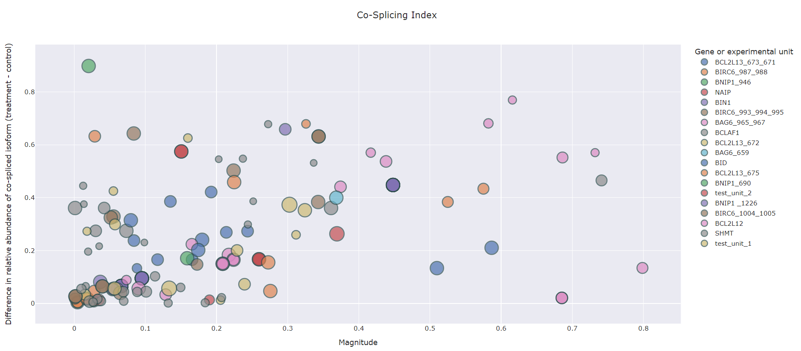
Co-Splicing Indices
Input: CSV datasheet
Output: Table with CSI and corresponding interactive scatterplot
Notes:
# Assumptions of CSI model:
# 1. Isoform A --> B, E --> B is true (but perhaps only A --> B is occurring)
# 2. Increase in relative_abundance (RA) --> Increase in absolute quantity
# contributing_isoforms: Number of isoforms in control contributing to
# the RA_diff.
# e.g. if A --> B, E --> B: contributing_isoforms = 2
# The lower the number, the more confident we are
# about assumption 1.
# total_isoforms: Total number of NONZERO RA isoforms present in control.
# The fewer the number, the more confident we are about
# assumption 2. For example, if in control there is only
# only one isoform, any increase in co-spliced isoforms' RA
# in treatment must have been derived from the only isoform
# in control.
# RA_cont_spliced_isoform: Relative abundance of the co-spliced isoform in
# control. The lower the number, the more confident
# we are about assumption 2.
# This is the weakest factor because treatment
# can result in increase in absolute quantity of
# co-spliced isoform but still it is not reflected
# in relative abundance.

Slide 20
Co-Splicing Indices | Interactive HTML plot
Different gene/ SSO has different colour
Higher relative abundance means effect size of co-splicing is large!
Size determined by confidence score
Higher confidence means [1] model assumptions are met and, if there are replicates, [2] significant difference between treatment and control
Higher magnitude means as likely to be co-splicing as single splicing

Slide 21
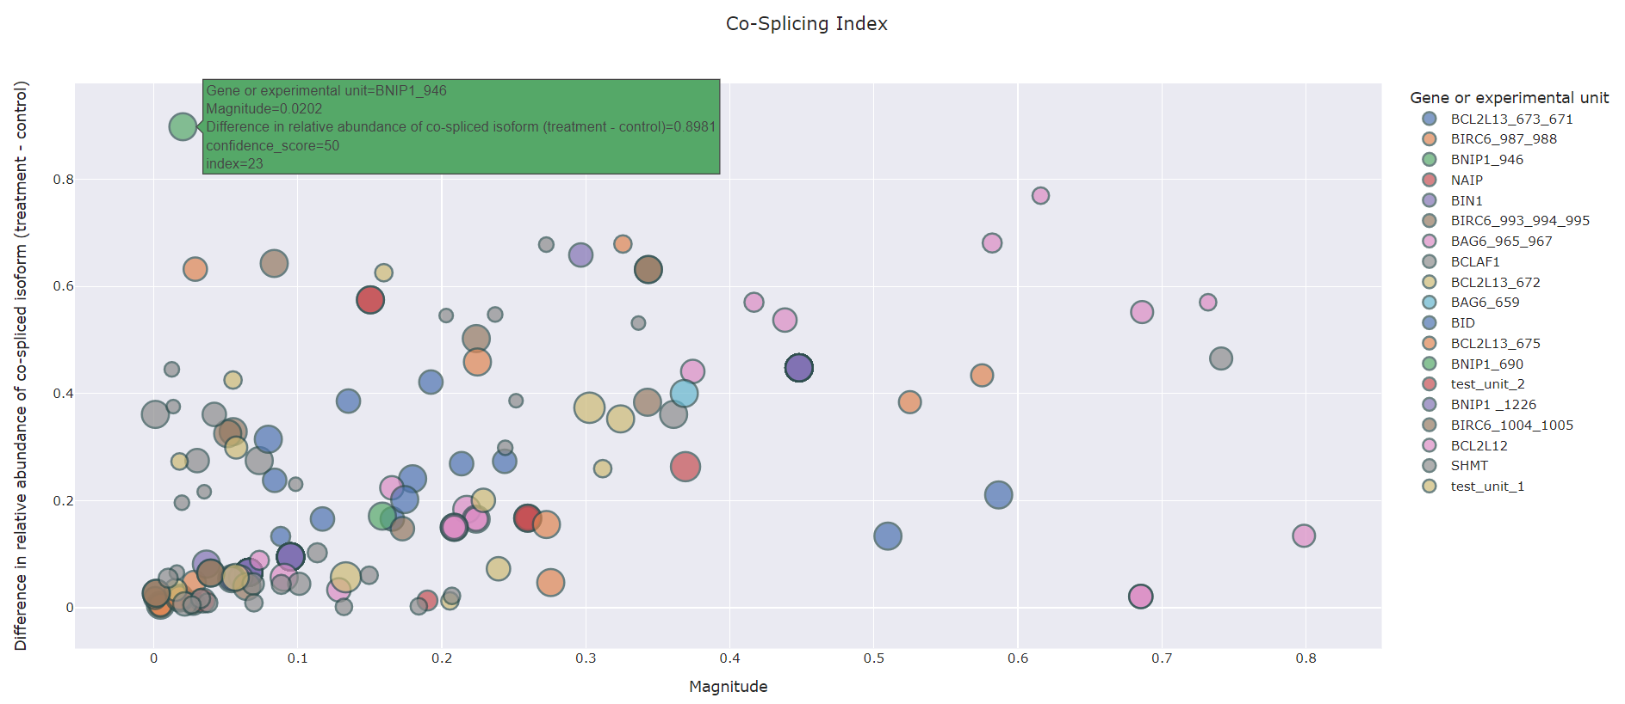
CSI interactive HTML plot
Index for reference to corresponding output datasheet

Slide 22
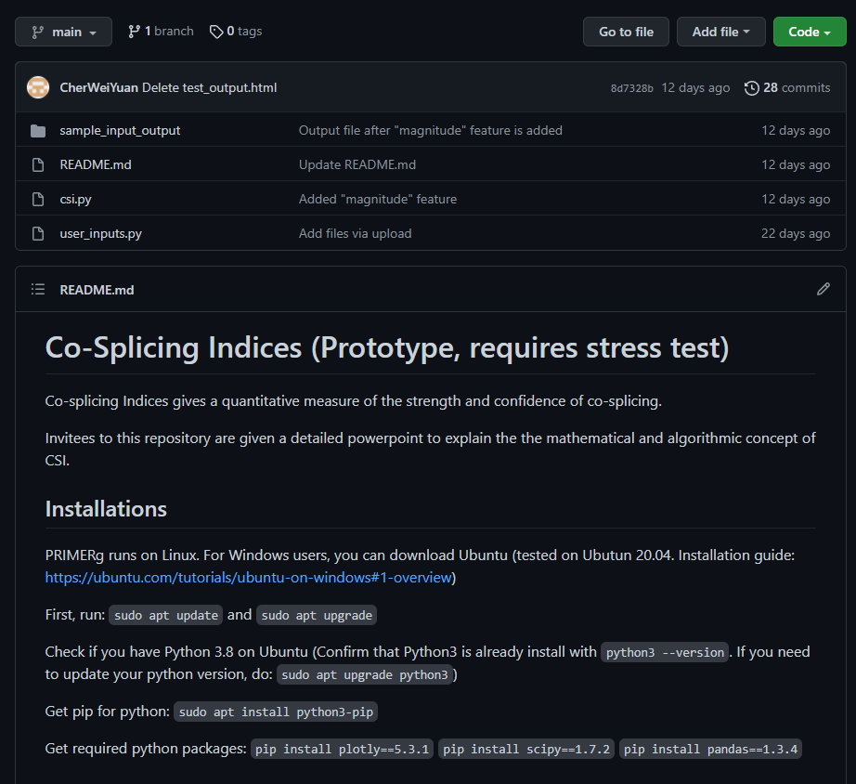
GitHub
Source code
Quick-start guide
Sample input and output (artificial data, our data is safe)
Private repository (email me at e0031403@u.nus.edu to get access)

Slide 23
Co-Splicing Indices
Calculation by hand for clarification

Slide 24
CSI by hand
(1 expt_unit, 3 replicates)

Slide 25
CSI by hand
(Let’s look at exon 28 and 30)
Note: Column “E1”-“E10” is not labelled with the real exon ID because this table needs to accommodate different genes with different exon IDs (i.e. CSI.py can calculate for CSI for different genes together and plot the results on one graph)

Slide 26
CSI by hand
Suppose we want to calculate for co-inclusion (0-0 → 1-1) for exon 28 and 30 (marked as E1 and E3)
We first check if 0-0 exists and is non-zero (yes, it is). Now we no longer look at 0-0 and focus on 1-1 instead.
Then we extract relative abundance for treatment (0.4129, 0.5, 0.3) and control (0.798, 0.6, 0.5).
RA diff = mean for treatment – mean for control = 0.4043-0.6326 = -0.228
# contributing isoform in control = 1 since there is only one (1-1) isoform
# co-spliced isoform in treatment = 1 since there is only one (0-0) isoform
Since biological replicate = 3, we use non-parametric pairwise test (Mann-Whitney U), which gives us p-value of 2.11.
Therefore, confidence score = (1/1 + 1/1) * 25 + (-log(2.11)) * 10 = 71.1

Slide 27
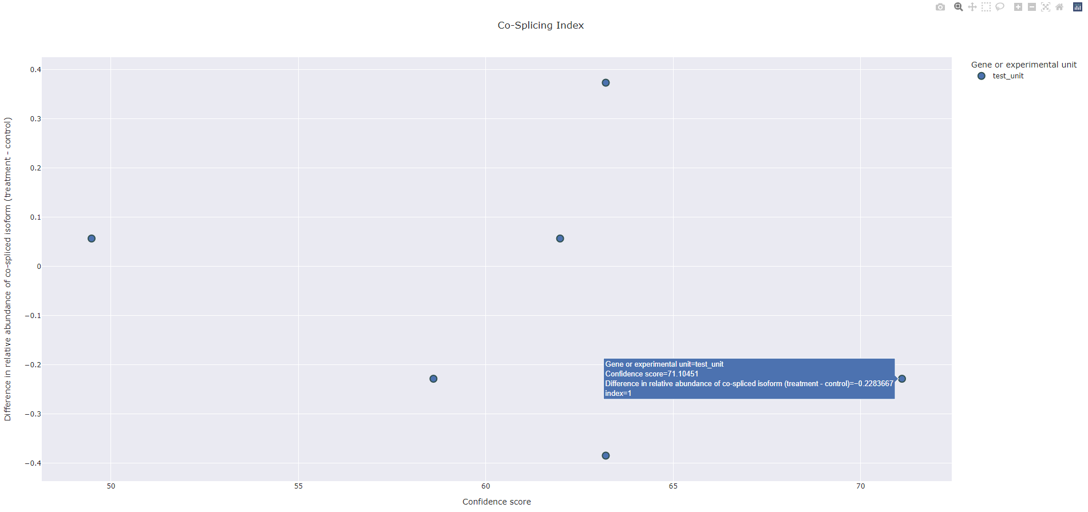
CSI by hand
The result in output datasheet and html plot
If difference in relative abundance is negative, like in this case, it is discarded.
Biologically speaking, it does not make sense for a “co-spliced” isoform to decrease in relative abundance after treatment.

