Slide 1
MUSIC PLAYER
Introduction
Cheralathan.P
09-09-2024

Slide 2
Playback songs/ Audio Files
Manipulating Audio Files
Aim of Project
Simple and intuitive text-based interface
User-friendly error messages and prompts

Slide 3
Business Problem
Premium version
Contains Ads
Monthly Subscriptions

Slide 4
Pause song
Unpause song
Functionalities
Rewind Song
Set Position
Pygame Library
Stop song
Mixer and Music
Set Volume

Slide 5
User Input Validation
Handling Invalid Inputs
Error Handling
Try
Except
ValueError

Slide 6
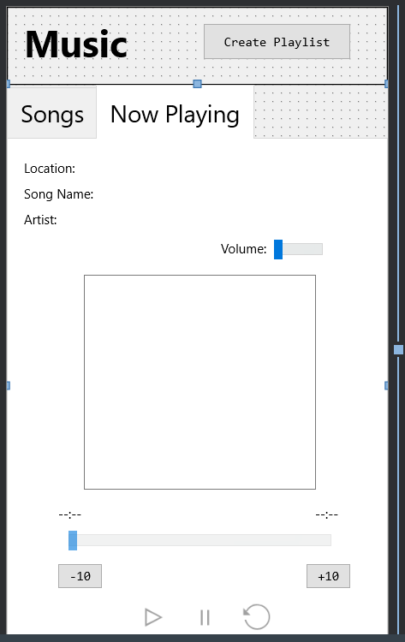
Graphical User Interface
Playback Timer
Shuffle Songs
Conclusion
Thank You

