Slide 1

SAMSUNG PRISM
Generative AI
Hackathon
3rd Edition 2026 – 27
Theme ID - 05 · Interruptible Real-Time Agents
Team Name - Stack Overlords
College Name - Vellore Institute of Technology (VIT)
Member Name & Email 1- Pranav Kumar, pranav.kumar2023@vitstudent.ac.in
Member Name & Email 2- Cheralathan M, cheralathan.m2023@vitstudent.ac.in
Member Name & Email 3- Machum Roy Choudhury, machumroy.choudhury2023@vitstudent.ac.in
Member Name & Email 4- Vansh Garg, vansh.garg2023@vitstudent.ac.in
Submission Github link - https://github.com/CheralathanM/Prism
Notes:
Opening slide for the 3rd edition of the PRISM Generative AI Hackathon. Replace the SAMSUNG PRISM pill with the official PRISM logo image if you have the asset. Confirm the academic year label (2026-27) before circulating.

Slide 2
Theme
Theme 05: Interruptible Real-Time Agents. A voice agent that keeps listening while it thinks, speaks and calls tools, and stays correct when the user interrupts or changes their mind.
Benchmark: Full-Duplex-Bench v3 (FDB-v3). Real spoken, disfluent requests (false starts, self-corrections, hesitations); a request passes only if the right tool calls are made.
What we built: fdagent, a LiveKit voice agent built on a deterministic session kernel, plus an in-car extension and a browser demo UI.
Constraints we set ourselves: zero API cost, and no benchmark knowledge in code, prompts or tests (enforced by an automated integrity test).

Slide 3
Existing Solutions & Gaps
Cascaded pipelines
End-to-end speech models
Gaps we target
• STT → LLM → tools → TTS, one turn at a time
• Barge-in usually just stops the audio
• Tool calls fire on the first version of the request
• Natural turn-taking
• Tool use is hard to audit or reproduce
• No guarantee a booking or order happens exactly once
• Late results applied after the user changed their mind
• Duplicate side effects on retries
• No single owner of conversation state; no replay
Our answer: keep the models asynchronous, but let exactly one deterministic component decide what is executed and what is said, and journal every decision so any session can be replayed.

Slide 4
Our Solutions & Architecture Diagram
Mic
LiveKit room
Silero VAD
speech on/off
Whisper STT
separate process
Ordered inbox
events, in order
Async intelligence, deterministic state. STT, planner, tools and TTS run asynchronously and only propose.
The kernel alone changes state, dispatches and cancels tools, admits results and decides what is spoken. Results come back as events through the same inbox, so every race is resolved in one place.
SESSION KERNEL
single writer · pure step(event) → actions
no I/O, no clock, no randomness
Journal (JSONL)
every decision · identical replay
Planner worker
Gemini (free tier): JSON plan only,
never executes tools
Tool executor
idempotency keys, timeouts,
advisory cancel
Speech channel
ordered; stops on barge-in;
drops stale speech
Piper TTS → LiveKit
local voice, streamed

Slide 5
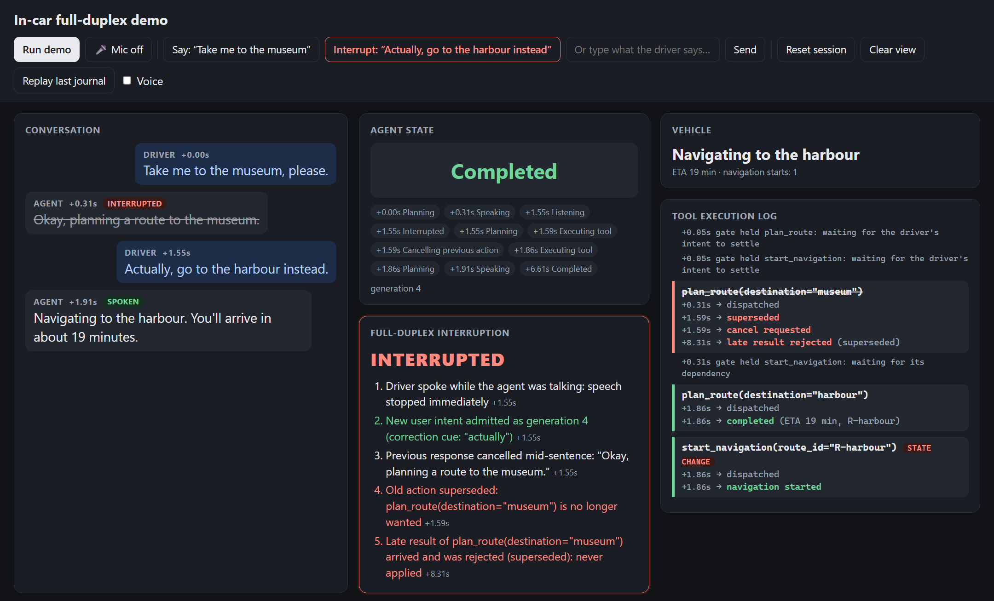
Demo & Product Walkthrough
1. Ask: “Take me to the museum.” The agent plans the route and starts to answer.
2. Interrupt: “Actually, go to the harbour instead,” while it is still talking.
3. See it: speech stops, INTERRUPTED; the museum route is superseded and its late result rejected.
4. Result: the harbour route is planned and navigation starts exactly once, with the new ETA.
5. Replay: re-execute the journal; decisions and actions are identical.
Run: python -m fdagent.extensions.incar.ui
Video: https://youtu.be/sMvY18ipvdg
Demo UI after a run. Every item on screen comes from the real kernel journal.

Slide 6
Tools and tech stack used
Role | Tool | Runs where / cost
Real-time transport | LiveKit Agents 1.8.3 + LiveKit Cloud | Cloud, free Build plan
Voice activity detection | Silero VAD (LiveKit plugin) | Local CPU, free
Speech-to-text | Whisper base.en (Hugging Face transformers), in its own process | Local CPU, free
Planner (LLM) | Gemini 3.5 flash-lite via OpenAI-compatible endpoint | Google AI Studio free tier
Text-to-speech | Piper en_US-lessac-medium | Local CPU, free
Agent core | Python 3.12 asyncio; deterministic kernel; JSONL journal and replay | Local
Demo UI | aiohttp + Server-Sent Events + plain HTML/JS | Local, no build step
Evaluation | pytest (176 tests); official FDB-v3 harness, unmodified | Local
No paid API is required. An optional OpenAI stack exists but is not the default.

Slide 7
Impact & Use case
Use case: in-car assistant
Also: service and booking agents
• Driver asks for a destination, then changes it mid-sentence
• The agent stops talking, drops the old route and starts navigation exactly once, to the new destination
• Built on the unchanged kernel: 2 tool specs + mock car backend
• Shopping, banking, housing and travel requests (the FDB-v3 domains)
• Callers correct themselves (“Friday, no, Saturday”) and interrupt
• Only the corrected intent is executed
Safety
Trust
Cost
Portability
no stale state-changing action after the user changes their mind
every decision is journaled and can be replayed and audited
runs on local models and free tiers
a new domain is new tool specs, not a new agent

Slide 8
Innovation highlights, results and limitations
Innovation
Results (local, unofficial)
Limitations
• Generations: every speech onset or transcript makes older plans stale
• Reconcile gate: keep, supersede, revive or retry; dispatch only on settled intent
• Result admission: late results of superseded calls are rejected
• Completion guard and deterministic replay
• 176 automated tests pass (2 skipped)
• 6-case validation: pipeline 6/6, exact match 4/6 (2 STT errors)
• Partial FDB-v3 run, 34 of 100 recordings: 17/30 scored pass, exact match, not the gpt-4o judge
• 4 infrastructure failures reported separately
• 0 duplicate calls · self-correction 3/3 · 15 barge-ins handled
• CPU Whisper base.en: mishears IDs and rare names; 2.5–8 s per turn
• Free-tier planner: some wrong or extra tool choices; 7–19 s spikes
• Median perceived latency 7.5 s (p90 21.5 s) on CPU
• Benchmark run incomplete and not officially judged

Slide 9
What’s next
Faster, more accurate speech recognition: GPU or streaming STT, plus ID-aware post-processing for order numbers and names.
Lower latency: speculative execution of read-only tools while the user is still speaking, committed only if the intent holds.
Complete evaluation: the full 100-recording FDB-v3 run with the official judge.
Richer in-car domain: add stops, reroute on traffic and confirm state-changing actions, all on the same kernel.
Production hardening: multi-session load tests and journal-based regression suites built from real sessions.

Slide 10
Brownie points slide( differentiation)
Deterministic and replayable
Honest evaluation
No benchmark leakage
The kernel has no I/O, clock or randomness; every session journal replays with identical decisions.
Partial results labelled as partial; infrastructure failures separated from agent failures.
An integrity test fails the build if benchmark IDs or answers appear in code, prompts or tests.
Zero-cost stack
Real-time safety
Transparent demo
Local Whisper and Piper, free-tier Gemini, LiveKit free plan: no billing anywhere.
STT runs in its own process so it cannot stall the audio loop; dispatch waits for pending transcripts.
The UI renders the real kernel journal: no scripted animations, and replay proves it.

Slide 11
Checklist- Updated on Public GitHub
Working prototype code — public or shared GitHub repo (Y/N) Y · https://github.com/CheralathanM/Prism
README with reproducible setup instructions (Y/N) Y · README.md + scripts/reproduce.sh
Demo video, max 5 minutes (YouTube or Drive link) Y · https://youtu.be/sMvY18ipvdg
Presentation file (PPT or PDF) (Y/N) Y · this deck

Slide 12
Thank you
Organised by the Language AI Team and the PRISM Team, Samsung R&D Institute India
Notes:
Closing slide. Add the Google Form URL and a contact email before sharing. Edition 2 organising team for reference: Language AI - Sourabh Tiwari, Gaurav, Sanjeeth Pothireddy, Gorang Maniar; PRISM - Binny Lakra, Prakhar Chandrakar, Vishu Kumar; Kick-off and mentors - Giridhar Jakki, Deepraj Prabhakar Patkar (Language AI), Srimanu Prasad Nagaraju, Ashish Kumar (Tech Strategy).

