Slide 1
Building an Intelligent Aerial Surveillance System through Deep-learning Based Object Detection and Recognition
Team members:
Ch.Prasanna Chandrika
B.Seetharam
A.Geethika
Ch.Mohan
GUIDE DETAILS:
Dr.B.Janakiramaiah
Designation:Professor

Slide 2
CONTENTS
Problem Statement and Objectives
Literature Survey
Proposed Solution
Requirement Analysis and Feasibility Study
Methodologies

Slide 3
Problem Statement and Objectives

Slide 4
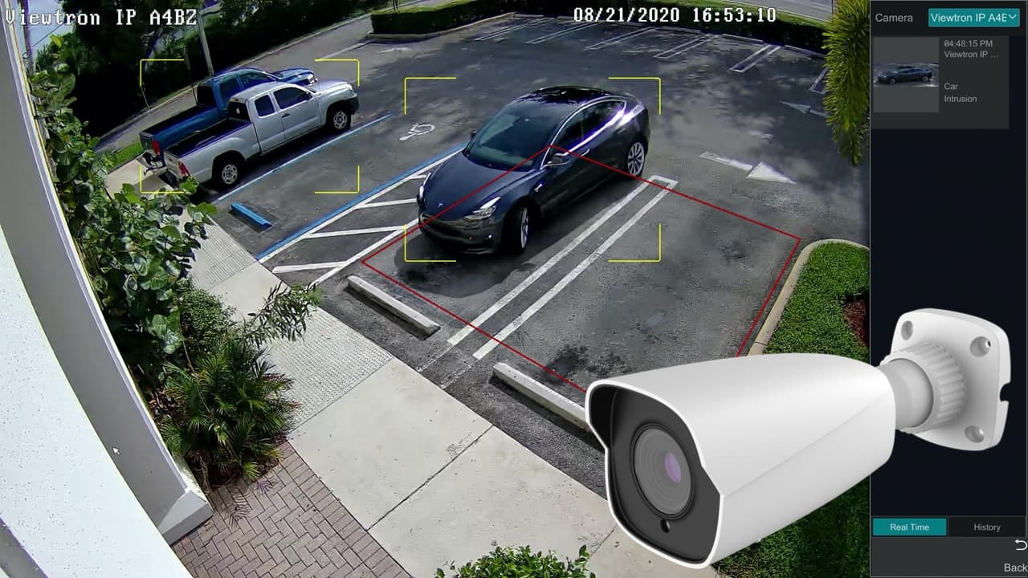
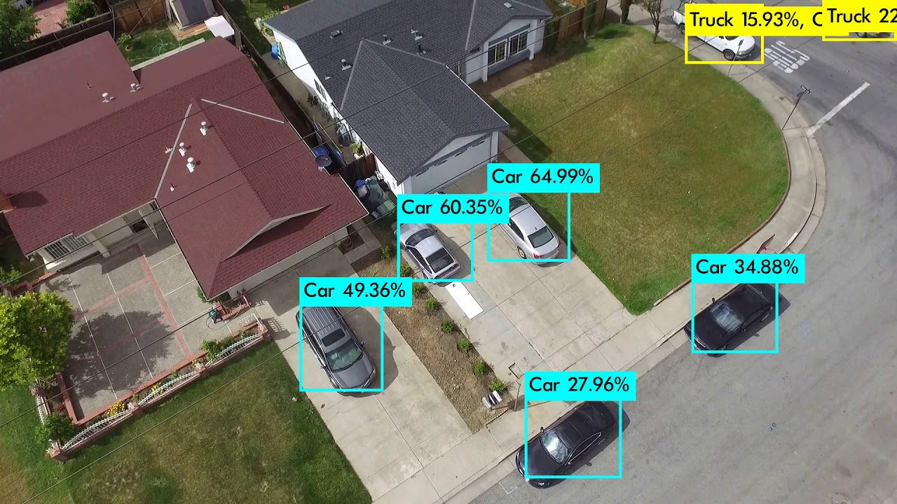
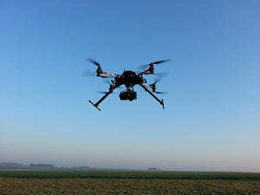
PROBLEM STATEMENT
The first generation of video surveillance systems was based in closed-circuit television (CCTV) networks, being limited by the stationary nature of cameras. More recently, unmanned aerial vehicles (UAVs) have been regarded as a
solution to overcome such limitations: UAVs provide a fast and cheap way for data collection, and can easily assess confined spaces, producing minimal noise while reducing the staff demands and cost.
The object detection and Recognition is very important in Aerial Surveillance application. Aerial Surveillance through unmanned aerial vehicles allow us to detect and recognize the objects. However, most of the approaches allow us to track the objects and recognize them that rely on deletion of background to provide accurate detection's[1].

Slide 5
OBJECTIVES
Bounding Box
and Head Poses
Short term
re-identification
Unique ID’s
Long term
re-identification
Elimination of Degradation Factors

Slide 6
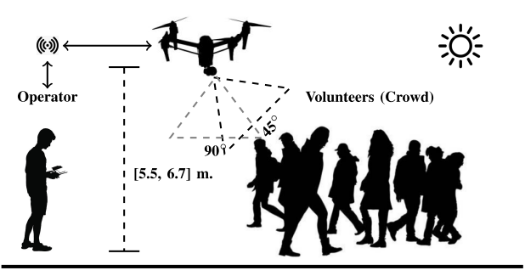
Degradation Factors
Poor resolution/blur
Motion blur
Partial occlusions
Pose and Lighting/shadows
UAV elevation angle

Slide 7
Literature Survey

Slide 8
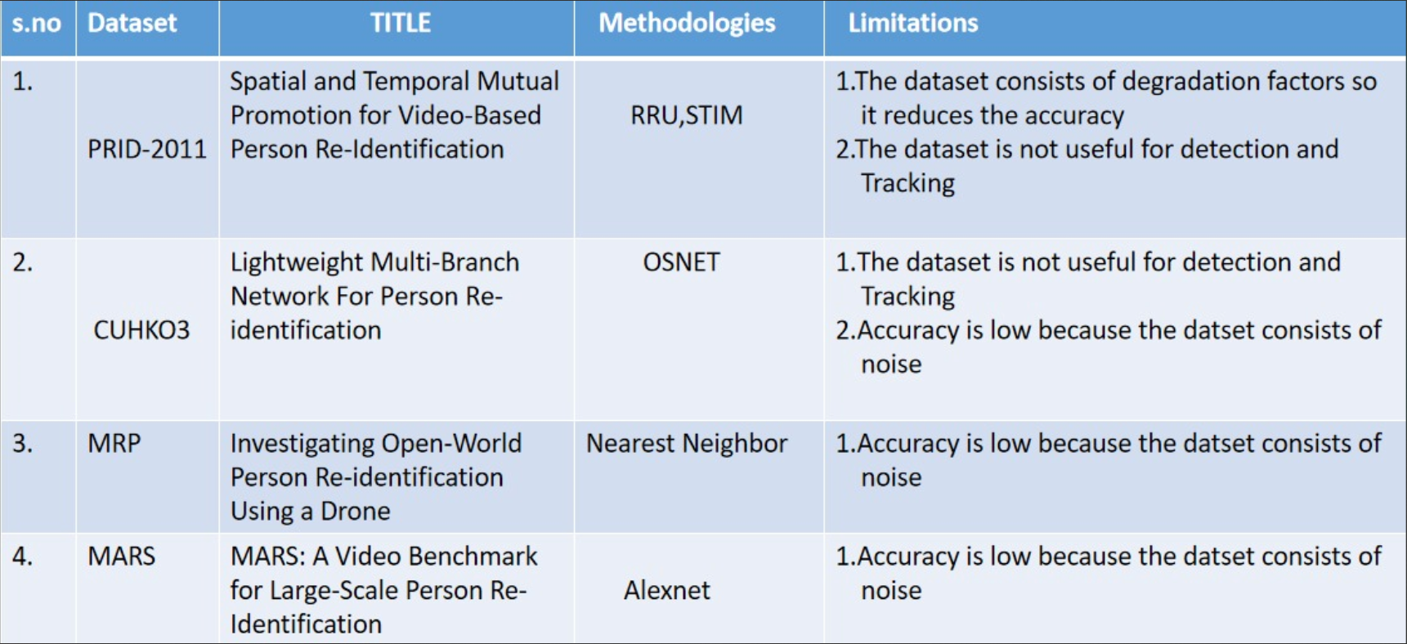
Literature Survey

Slide 9
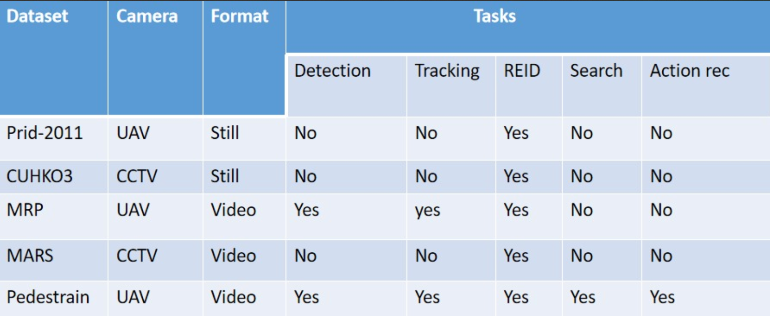
Literature Survey
Gaps Identified
When compared to other datasets the PDESTRE dataset contain low degradation factors
When we perform Object detection,Tracking,Re-Identification the PDESTRE dataset yeilds better results

Slide 10
Proposed Solution

Slide 11
PROPOSED SOLUTION
3
Pedestrian Tracking
2
Pedestrian Detection
For the tracking task, the TracktorCV is selected to represent the state-of-the-art.
5
Re-identification
1
Dataset
The RetinaNet is considered to represent the state-of-the-art in P-DESTRE
4
3D Depth map generation
The GLTR is well known re identification algorithms to represent the state-of-the-art and assessed their performance.
The 3D depth maps of scenes are generated using a pair of orthogonal aerial images. The parallax displacement of each pixel demonstrates the height of that point in the real-world coordinate system.[4]
The dataset is freely available at
http://pdestre.di.ubi.pt/.

Slide 12
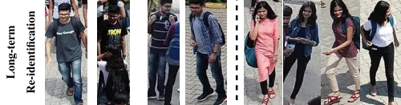

Re-Identification
Short term re-identification
Short-term re-identification problem was the main motivation for the development of the P-DESTRE dataset.The Short term re-identification is mainly focused on the clothing appearance of the subjects.
Long term re-identification
long-term re-identification problem was the main motivation for the development of the P-DESTRE dataset. Here, there is not any guarantee about the clothing appearance of subjects, nor about the time elapsed between consecutive observations of one ID. In such circumstances, the analysis of alternative features should be considered (e.g., face, soft-biometrics
based).

Slide 13
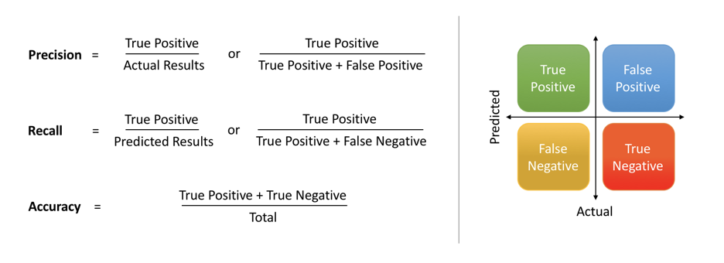
EVALUATION PARAMETERS
RECALL
PRECISION
ACCURACY
Instead of looking at the number of false positives the model predicted, recall looks at the number of false negatives that were thrown into the prediction mix.
Precision is the ratio of true positives to the total of the true positives and false positives.
Accuracy is defined as the proportion of correct predictions in all predictions made.

Slide 14
Model Fine tuning
Training Batches
Training batches play an important role in fine tuning of network models. We therefore did not limit our training iterations to small numbers.
1
3
Regenerated Anchor Boxes
Instead of using existing anchor boxes from our base network Retinanet, we increased anchor boxes and regenerated 12 using K Means.These regenerated anchor boxes were then used at four detection levels for training our model and it improved the accuracy.
2
4
Transfer Learning
Learning Rate
In transfer learning, the knowledge of an already trained machine learning model is applied to a different but related problem..
Learning rate is one of the crucial parameters while training the network model. Instead of using a steep constant learning rate, we used a step by step learning rate of 0.0001.

Slide 15
Requirement Analysis and Feasibility Study

Slide 16
Requirements Analysis
The main purpose of this project is to build an intelligent aerial surveilance system that can detect objects. Object detection can be applied to a wide range of applications,we have two primary goals:
1. we want to be able to detect pedestrain .
2. we want to recognize whether a person is present.
Software requiremets:
1.Dataset
2.Python 3.7.0
3.Tensorflow 2.1.0
4.Keras 2.9.0

Slide 17
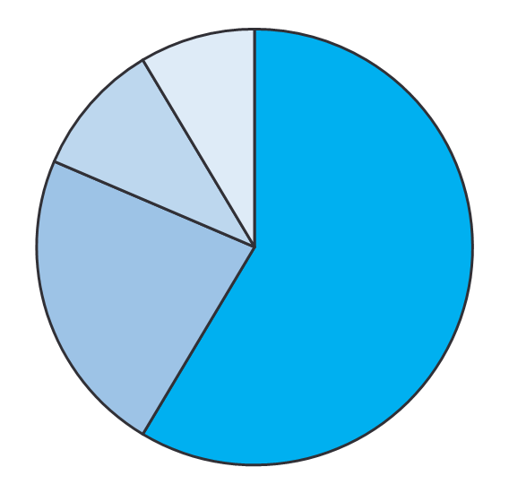
Feasibilty Study
Information Feasibility:
The gathered information is completely reliable, meaningful and correct. So, the model is feasible in this context.
Technical Feasibility:
The project deals with the re-identification of pedestrains. It uses PyCharm IDE for Python programming, libraries such as numpy, tensorflow, etc. So, the project is technically feasible within the limits of current technology.
Economic Feasibility:
The proposed system does not require any additional expenditure for its development. So, it is economically feasible.
Operational Feasibility:
The proposed system is very much efficient in solving the problems that are addressed by the existing system. The proposed system is expected to provide the end users with timely, pertinent, accurate and useful formatted information. Hence, the system is operationally feasible.
Legal and Ethical Feasibility:
The proposed plan conforms to legal and ethical requirements.

Slide 18
Methodologies

Slide 19
Water flow model
Planing
Construction
stage where the cost and time constraints are estimated.
code is generated.
Planing
Constructing
Communication
Modeling
Testing
requirements are gathered.
design based on the requirements
is done after code completion.

Slide 20
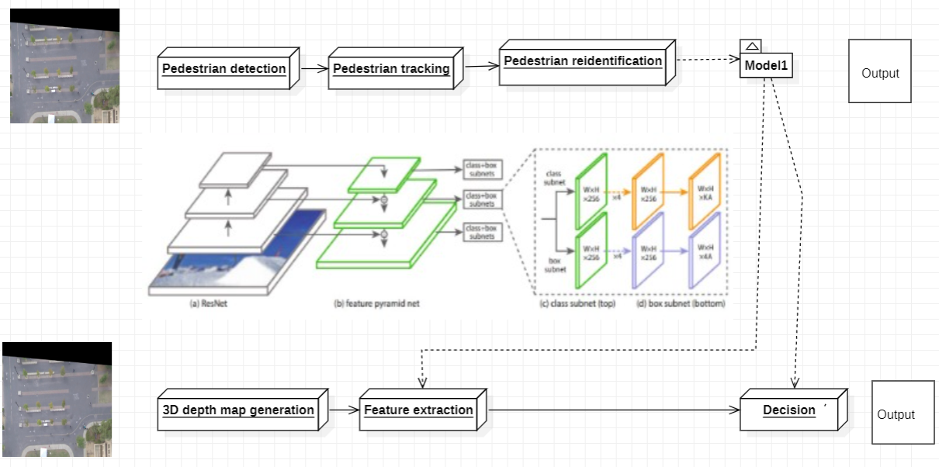
Architecture

Slide 21
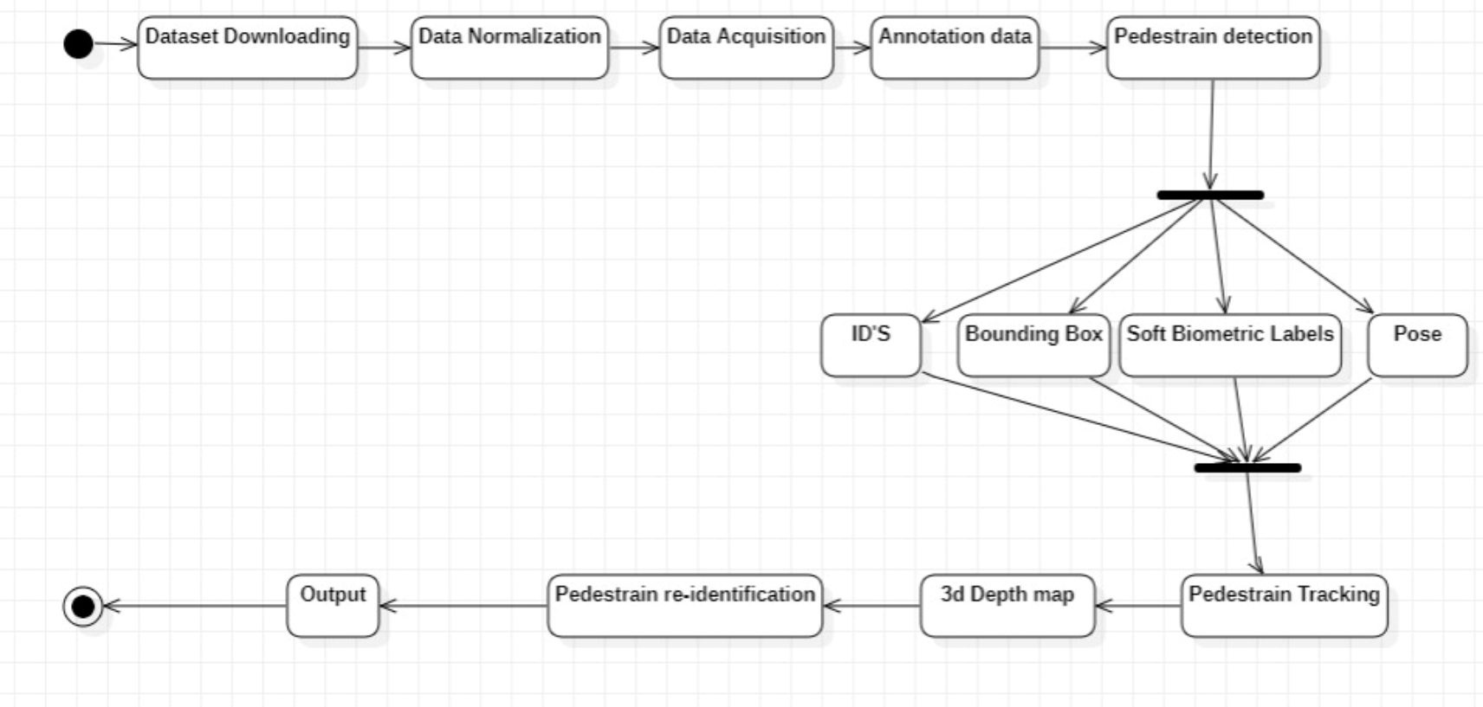
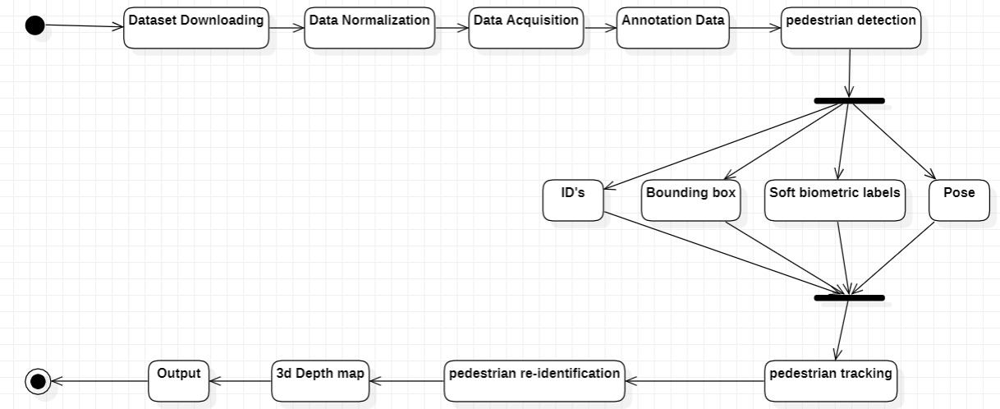
Activity Diagram
Activity Diagram
An activity diagram visually presents a series of actions or flow of control in a system similar to a flowchart or a data flow diagram. It provides a view of the behavior of a system by describing the sequence of actions in a process.

Slide 22
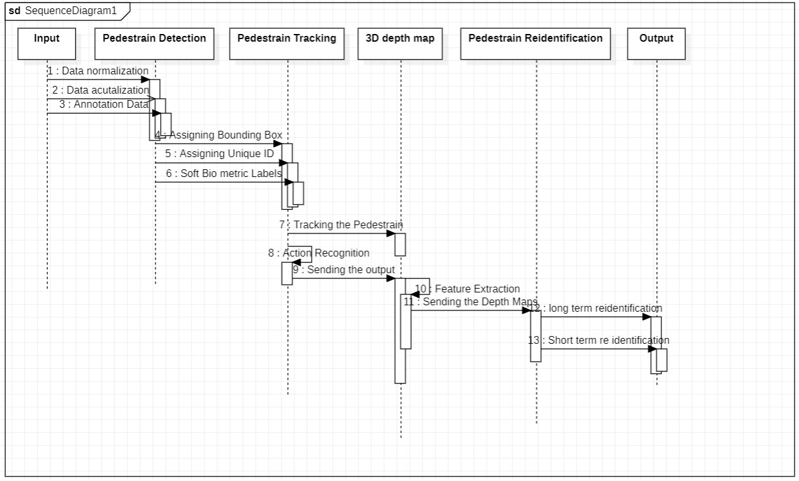
Sequence Diagram
Sequence Diagram
The Sequence diagram shows the message flow from one object to another object.It describes how and in what order the objects in a system function.

Slide 23
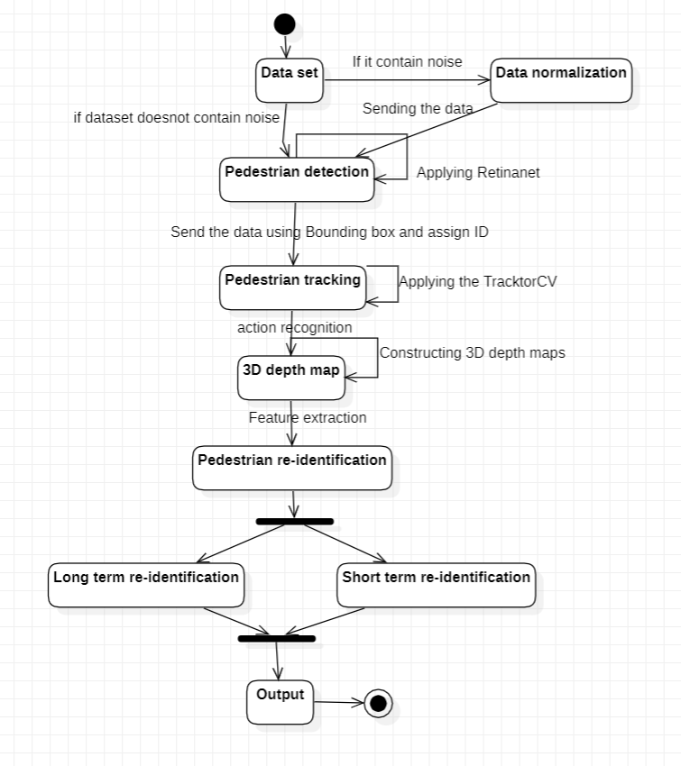
State Chart Diagram
State Chart Diagram
A state diagram is used to represent the condition of the system or part of the system at finite instances of time. It is a behavioral diagram and it represents the behavior using finite state transitions.

Slide 24
References

Slide 25
References
1.S. V. Aruna Kumar, Ehsan Yaghoubi,“The P-DESTRE: A Fully Annotated Dataset for Pedestrian Detection, Tracking, and Short/Long-Term Re-Identification from Aerial Devices”
DATASETS:
PRID:Yiheng Liu,1 Zhenxun Yuan,2 Wengang Zhou,1 Houqiang Li,“ Spatial and Temporal Mutual Promotion for Video-Based Person Re-Identification”
CUHKO3: Fabian Herzog, Xunbo Ji, Torben Teepe Stefan Hormann Johannes Gilg Gerhard Rigoll,“LIGHTWEIGHT MULTI-BRANCH NETWORK FOR PERSON RE-IDENTIFICATION”
MARS:Liang Zheng, Zhi Bie, Yifan Sun, Jingdong Wang,Chi Su, Shengjin Wang, and Qi Tian“A Video Benchmark for Large-Scale Person Re-Identification”
MRP: Ryan Layne, Timothy M. Hospedales, and Shaogang Gong, “Investigating Open-World Person Re-identification Using a Drone”
4.SALEH JAVADI,“Vehicle Detection in Aerial Images Based on 3D Depth Maps and Deep Neural Networks”
5.Felix Kuhnke, Jorn Ostermann,“Deep Head Pose Estimation Using Synthetic Images and Partial Adversarial Domain Adaption for Continuous Label Spaces”
6.Chandan G, Ayush Jain, Harsh Jain, Mohana “Real Time Object Detection and Tracking Using Deep Learning and OpenCV”

Slide 26
THANK YOU

