Slide 1
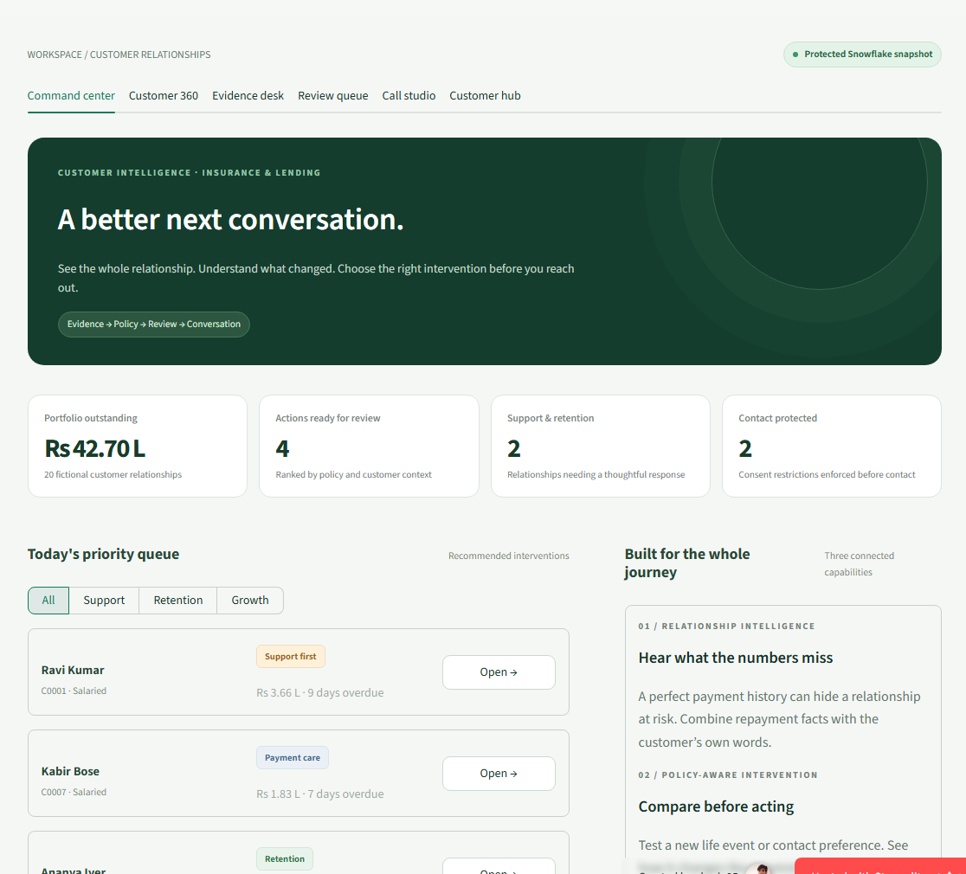
CUSTOMER 360 AND NEXT BEST ACTION ENGINE
Samvaad360
A better next
conversation.
Borrower context → evidence → reviewable intervention
Verified prototype · 6 October 2026
Lending demonstration · Fictional customer data
Samvaad360 · Customer 360 + Next Best Action · Synthetic lending prototype
01
Notes:
Samvaad360 demonstrates the Lending side of the Customer 360 and Next Best Action Engine track. Public URL uses a restricted read-only Snowflake snapshot. All borrower records and public review/conversation outcomes are fictional. This is an implemented prototype, not a production lending approval service.
[Sources]
https://samvaad360.streamlit.app/ — actual hosted screenshot, 6 October 2026
Local verification artifact: output/cloud/public-browser/hosted/result.json
https://github.com/Cherie05/samvaad360/blob/main/docs/production-readiness.md
[/Sources]

Slide 2
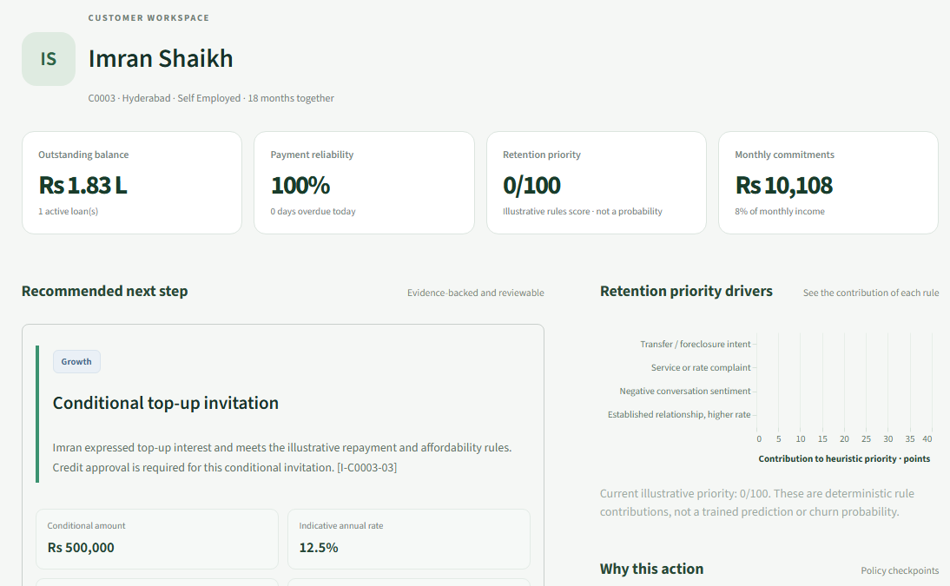
SAMVAAD360 / LENDING
The borrower’s context gets lost.
Repayment history is only part of the relationship.
01
Structured facts
Loans, payments and affordability.
02
Unstructured context
Calls, email and the borrower’s words.
03
Contact preferences
Permission, DND and human follow-up.
Samvaad360 · Customer 360 + Next Best Action · Synthetic lending prototype
02
Notes:
The problem is an incomplete relationship view across structured lending facts and unstructured interactions. The screen is the actual public Customer 360. Scores and indicative terms in the application are illustrative rules, not predictions or final credit approvals. No measured business uplift is claimed.
[Sources]
https://github.com/Cherie05/samvaad360/blob/main/samvaad/engine.py
https://samvaad360.streamlit.app/ — Customer 360 screenshot
[/Sources]

Slide 3
SAMVAAD360 / LENDING
One path through the whole relationship.
Each stage carries its source, permission and review state forward.
01
02
03
04
05
Intake
Reconcile
Understand
Review
Follow up
Capture customer
and consent.
Join source IDs
and record versions.
Read facts with
conversation evidence.
Check policy and
approval authority.
Record outcome
and update context.
Public changes stay in one visit. Staff onboarding, source sync and cases persist locally.
Samvaad360 · Customer 360 + Next Best Action · Synthetic lending prototype
03
Notes:
Public customer onboarding, source import, source mappings, cases and contact requests are isolated to the visitor session and do not alter the shared Snowflake demo. The authenticated local staff portal uses persistent SQLite and a scoped borrower capability link. Customer intake does not create a loan or complete KYC.
[Sources]
https://github.com/Cherie05/samvaad360/blob/main/public_app/ui/relationship.py
https://github.com/Cherie05/samvaad360/blob/main/samvaad/relationship.py
[/Sources]

Slide 4
SAMVAAD360 / LENDING
The live demo has explicit data boundaries.
LIVE PUBLIC DEMO
Browser
Streamlit UI
Snapshot
Snowflake
Six guided workspaces
Python · fixed queries
Hourly reuse + limits
20 fictional customers
PERSISTENT STAFF + BORROWER PORTAL
Staff portal
API + SQLite
Publisher
Private data
Applicant intake links
Reviewed intake + sync
Activation pending
Snowflake · pending
Public visitors cannot write shared customer data or place telephone calls.
Samvaad360 · Customer 360 + Next Best Action · Synthetic lending prototype
04
Notes:
Technology stack is Python Streamlit frontend, protected fixed Snowflake snapshot reader, FastAPI operational backend and SQLite local persistence. Private Snowflake publisher and export outbox are implemented but private writer activation is pending. Production would also require managed operational storage, authentication, observability and verified provider deployment.
[Sources]
https://github.com/Cherie05/samvaad360/blob/main/public_app/repository.py
https://github.com/Cherie05/samvaad360/blob/main/webhook/main.py
https://github.com/Cherie05/samvaad360/blob/main/samvaad/relationship.py
[/Sources]

Slide 5
SAMVAAD360 / LENDING
Three capabilities compose the demo.
01
02
03
Relationship
intelligence
Policy-aware
intervention
Guarded
automation
Reconcile customer, loan, repayment and conversation records.
Cite evidence, test new context and route the right review.
Require recorded approval and preserve a replay-safe audit trail.
CoCo skill definitions included: evidence · generate · approved runner.
Samvaad360 · Customer 360 + Next Best Action · Synthetic lending prototype
05
Notes:
Implemented modular application capabilities are demonstrated in the hosted and local browser checks. Repository contains .cortex/skills/samvaad-evidence, samvaad-generate and samvaad-approved-runner. The evidence skill reads grounded local customer facts; generate creates a policy-checked recommendation; the approved runner executes only an explicitly approved local synthetic action. Presence of these definitions is not proof of an authenticated end-to-end CoCo CLI run. That proof remains pending at deck generation.
[Sources]
https://github.com/Cherie05/samvaad360/blob/main/.cortex/skills/samvaad-evidence/SKILL.md
https://github.com/Cherie05/samvaad360/blob/main/.cortex/skills/samvaad-generate/SKILL.md
https://github.com/Cherie05/samvaad360/blob/main/.cortex/skills/samvaad-approved-runner/SKILL.md
[/Sources]

Slide 6
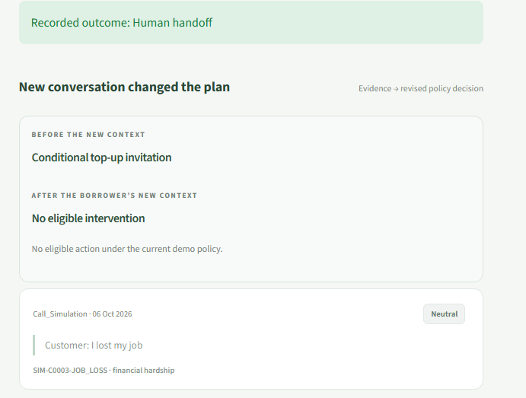
SAMVAAD360 / LENDING
New context changes the recommendation.
BEFORE
Eligible for a conditional
top-up invitation.
Borrower reply: “I lost my job.”
Growth closes.
Supportive human handoff.
Actual hosted browser rehearsal · no telephone call or loan executed
Samvaad360 · Customer 360 + Next Best Action · Synthetic lending prototype
06
Notes:
Hosted browser test entered a fictional borrower hardship reply in the conversation rehearsal. The engine reevaluated actual new visit evidence, removed growth eligibility and recorded human handoff. Browser speech controls are present, but audio audibility was not verified by the automation. Twilio provider adapter exists but is disabled and no real telephone call was placed.
[Sources]
Local verification artifact: output/cloud/public-browser/hosted/result.json — checks 8 and 9
https://github.com/Cherie05/samvaad360/blob/main/samvaad/engine.py
https://samvaad360.streamlit.app/ — call-outcome screenshot
[/Sources]

Slide 7
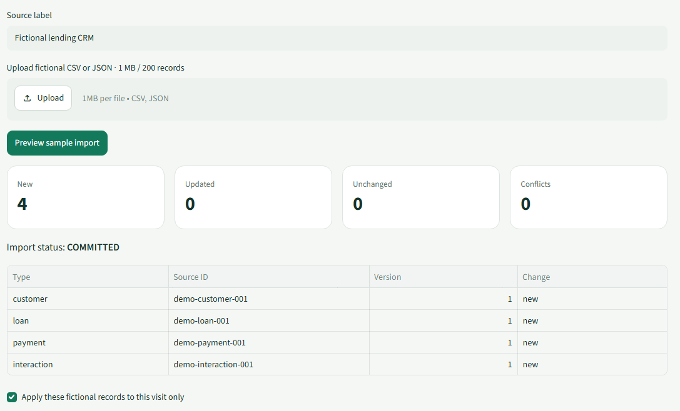
SAMVAAD360 / LENDING
Customer data enters through a reviewed flow.
Capture → Preview → Review → Customer 360
Customer, loan, payment and conversation records join through source IDs and versions.
A clean import is applied explicitly. Conflicts block the batch; a replay does not duplicate it.
Samvaad360 · Customer 360 + Next Best Action · Synthetic lending prototype
07
Notes:
Source uploads are capped at 1 MB and 200 records. JSON full-relationship example includes linked customer, loan, payment and interaction records. Preview validates types, references, versions and conflicts. Local commit is atomic and revalidated. Reviewed onboarding can be linked to source customer IDs; names alone never merge people. The public screenshot shows four fictional records applied only to this visit, not shared Snowflake.
[Sources]
https://github.com/Cherie05/samvaad360/blob/main/samvaad/relationship.py
https://github.com/Cherie05/samvaad360/blob/main/public_app/ui/relationship.py
Local verification artifact: output/cloud/public-browser/hosted/result.json — source import checks
[/Sources]

Slide 8
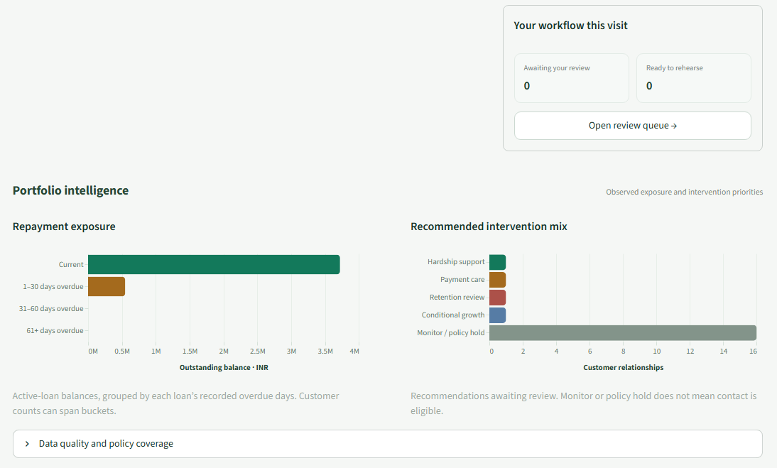
ENTERPRISE CONTROLS / IMPLEMENTED PROTOTYPE
Useful actions need enforceable limits.
01
Protect compute
Shared snapshot, fixed SQL and query reservations.
02
Protect the relationship
Consent, DND, hardship and approval gates.
03
Protect execution
Scoped portal links, idempotency and audit records.
Samvaad360 · Customer 360 + Next Best Action · Synthetic lending prototype
08
Notes:
Implemented controls include read-only dedicated Snowflake user/fixed queries, shared hourly snapshot reuse, application query reservations, hosted usage guard, consent and DND gates, hardship suppression, approval fingerprints and idempotency. Operational API adds scoped portal capabilities, rate admission and signed provider callbacks. Public Streamlit is not behind the prepared per-IP gateway; do not claim per-IP host enforcement or total Snowflake account credit cap. Telephony is disabled until provider, identity, policy and deployment configuration are completed.
[Sources]
https://github.com/Cherie05/samvaad360/blob/main/public_app/security.py
https://github.com/Cherie05/samvaad360/blob/main/samvaad/telephony.py
https://github.com/Cherie05/samvaad360/blob/main/webhook/main.py
https://samvaad360.streamlit.app/ — usage-protection screenshot
[/Sources]

Slide 9
SAMVAAD360 / LENDING
Verified workflows. Clear remaining gates.
557
20
6
Automated tests
Hosted browser checks
Private portal checks
LIVE TODAY
BEFORE PRODUCTION
Public Snowflake demo, six workspaces, visit isolation and persistent local CRM.
Private cloud writer · managed operational database + SSO · carrier call proof · CoCo CLI recording
Samvaad360 · Customer 360 + Next Best Action · Synthetic lending prototype
09
Notes:
GitHub CI run 37483107870 passed 557 tests. Anonymous hosted browser evidence passed 20 checks at 2026-10-06T15:00:27 UTC with Snowflake backend verified. Private staff/borrower browser report passed 6 checks. These are functional prototype checks, not penetration testing, audited lending compliance or real carrier call validation. Private cloud writer activation, managed operational storage/SSO, operational provider deployment and authenticated CoCo end-to-end recording remain gates.
[Sources]
https://github.com/Cherie05/samvaad360/actions/runs/37483107870
Local verification artifact: output/cloud/public-browser/hosted/result.json
Local verification artifact: output/cloud/relationship-browser/result.json
[/Sources]

Slide 10
SAMVAAD360 / PUBLIC PROTOTYPE
Try the journey. Inspect the evidence.
LIVE WEBSITE
samvaad360.streamlit.app
PUBLIC SOURCE + IMPLEMENTATION
github.com/Cherie05/samvaad360
Track: Customer 360 and Next Best Action Engine
Fictional lending data · Public reviews and conversations are visit-local simulations
Samvaad360 · Customer 360 + Next Best Action · Synthetic lending prototype
10
Notes:
Public reviewer links are clickable. Website reads a restricted live Snowflake synthetic snapshot. The public demonstration never writes customer data to shared Snowflake, executes a financial action, sends an invitation or dials a telephone. For judging, pair this deck with an actual end-to-end workflow recording. Organizer template was not available at generation; see external template_mapping.txt for provisional custom-deck mapping.
[Sources]
https://samvaad360.streamlit.app/
https://github.com/Cherie05/samvaad360
[/Sources]

