Slide 1
Lab 3: Studies on Heterogeneity and City Policy Impacts (AIE1901)

Slide 2
Course Overview:
Explore two extensions of the Schelling model — one adds altruistic agents, the other introduces a city planner.
Altruistic model: even a few altruists can catalyze a shift from overcrowded segregation to a balanced, half-filled state.
Planner model: policy investment can reshape neighborhood attractiveness, sometimes leading to stronger centralization or segregation.

Slide 3
Before starting
Please connect to the CUHKSZ Wi-Fi while on campus,
Please use the school VPN when off campus
For more details: https://itso.cuhk.edu.cn/node/169

Slide 4
Step 1: Get lab files
In your browser, go to Blackboard.
Locate Lab 3 and download the Schelling-simulation-Lab3-Altruists.zip and the Schelling-simulation-Lab3-Investment.zip
Unzip this two files in your PC ( keep the original filenames and file structure ).

Slide 5
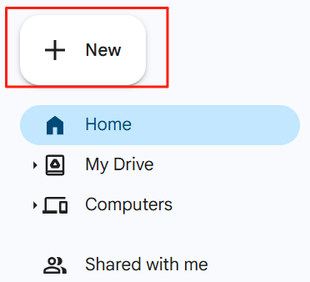

Step 2: Upload Lab files to Google Drive
In your browser, go to: https://drive.google.com/
Click ‘+ New’ in the upper left corner.
Click ‘Folder upload’
Upload the two folders one by one you just unzipped.

Slide 6
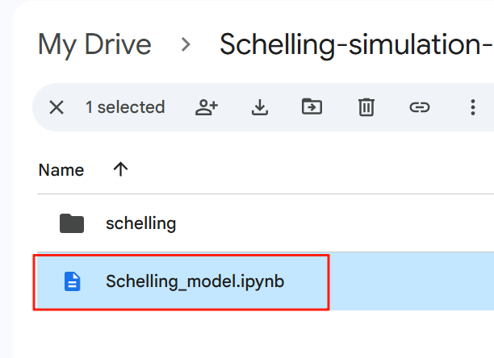
Step 3: Open the ipynb in Google Colab.
Double-click the ipynb files.
It will automatically open in Google Colab.
💡 Tip: Using Google Chrome may provide the smoothest experience when accessing Google services.

Slide 7
Part 1
Giant Catalytic Effect of Altruists

Slide 8
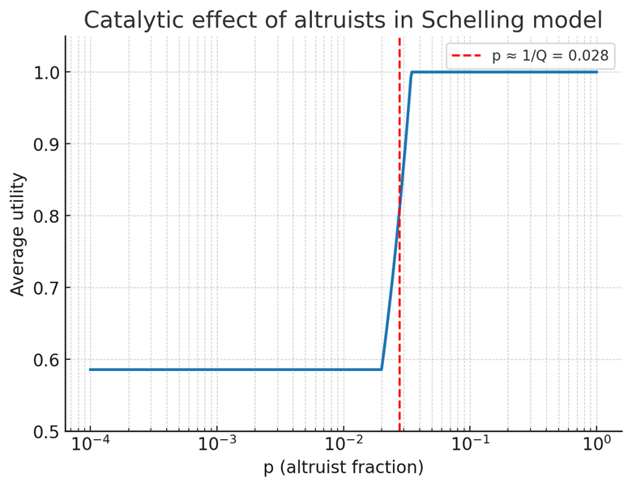
1. Background and Research Question
Classic Schelling Model
Agents are egoists, moving only to maximize personal satisfaction.
Leads to excessive segregation, even when everyone prefers mixed neighborhoods.
Extension in This Study
Introduces a tiny fraction of altruistic agents who move to improve collective utility rather than individual gain.
Core Research Question
What happens to collective outcomes when a small fraction of altruists is introduced into a population of egoists?
Can this small group trigger a “catalytic effect”—a sudden transition of the entire system toward a socially optimal state?

Slide 9
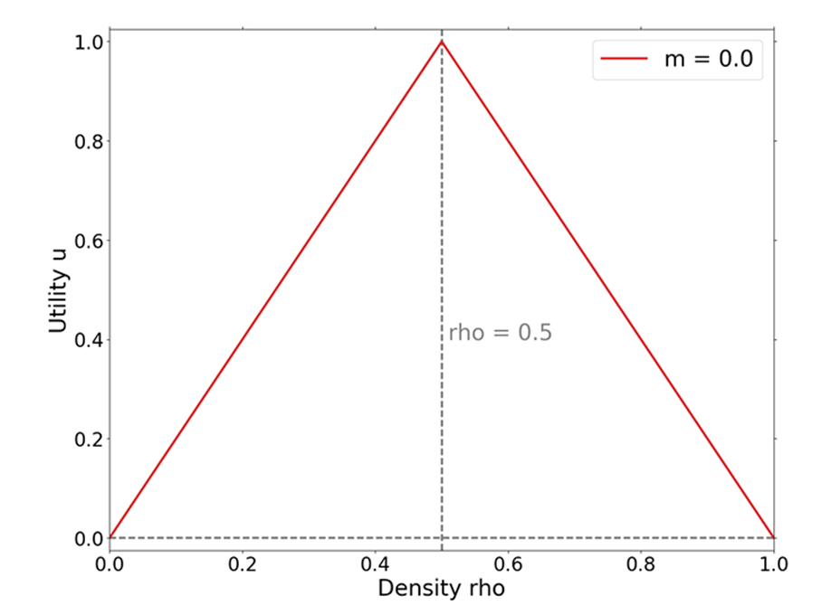

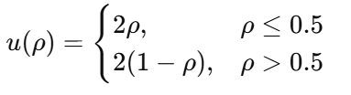

2. Model Structure and Key Assumptions
1. City and Agents
The city is divided into Q blocks (neighborhoods), each with a capacity of H agents.
The overall density is ρ₀, representing the initial fraction of occupied sites.
Each block’s density is
2. Utility Function
Agents are happiest when their neighborhood is half full — neither too empty nor too crowded.
3. Behavior Rules
Egoists: Move only if their own utility increases (Δu > 0).
Altruists: Move only if the total system utility increases (ΔU > 0), where

Slide 10
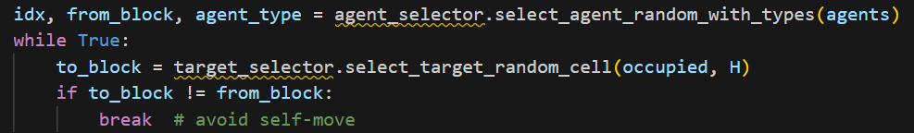
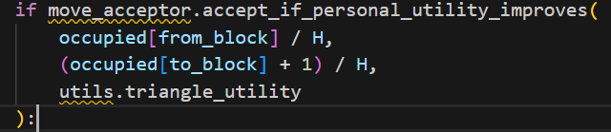
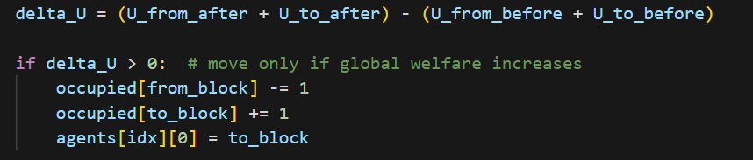
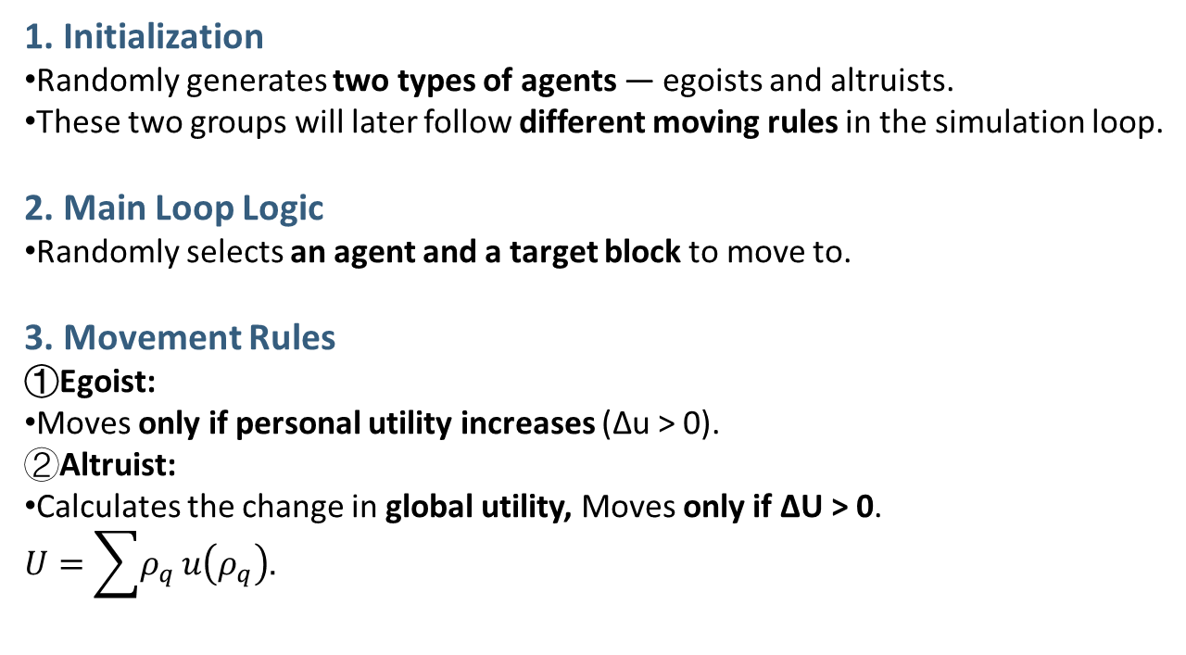
3. Code Structure Overview
1. Initialization
Randomly generates two types of agents — egoists and altruists.
These two groups will later follow different moving rules in the simulation loop.
2. Main Loop Logic
Randomly selects an agent and a target block to move to.
3. Movement Rules
①Egoist:
Moves only if personal utility increases (Δu > 0). ②Altruist:
Calculates the change in global utility, Moves only if ΔU > 0. $U=\sum{ρ_{q}}u\left(ρ_{q}\right)$.
Updates both the occupancy and agent position after each move. The simulation stops after a fixed number of steps.

Slide 11
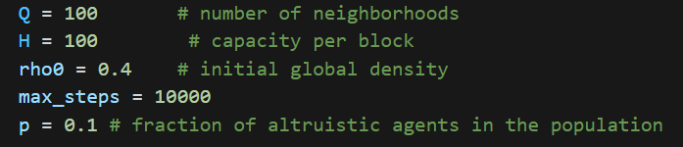
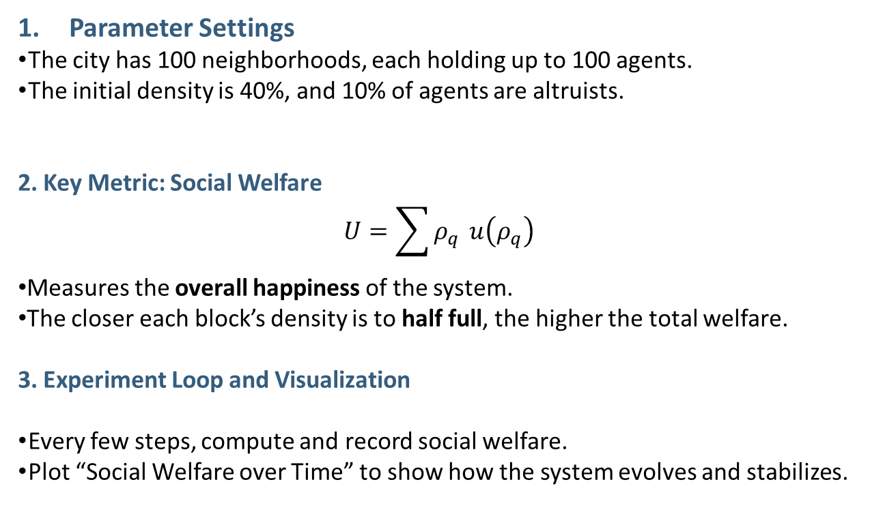
4. Simulation and Results Analysis
Parameter Settings
The city has 100 neighborhoods, each holding up to 100 agents.
The initial density is 40%, and 10% of agents are altruists.
2. Key Metric: Social Welfare
$$U=\sum{ρ_{q}} u\left(ρ_{q}\right)$$
Measures the overall happiness of the system.
The closer each block’s density is to half full, the higher the total welfare.
3. Experiment Loop and Visualization
Every few steps, compute and record social welfare.
Plot “Social Welfare over Time” to show how the system evolves and stabilizes.

Slide 12
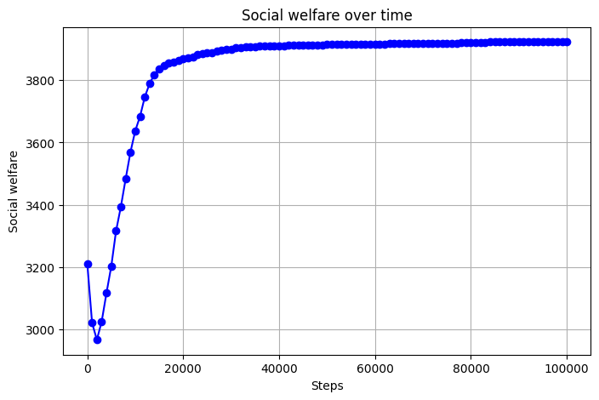
5. Experimental Findings
Main Results
Even with a small fraction of altruists (low p), the system shifts from the overcrowded state created by egoists to the optimal configuration.
The response is nonlinear:
the improvement in utility is nonlinear, but happens through a phase transition — a sudden jump in social welfare.
Mechanism: Altruists act as catalysts — their movements open new migration paths, guiding egoists to redistribute themselves and reach a better collective outcome.

Slide 13
Part 2
What if city planners could invest in certain blocks?

Slide 14
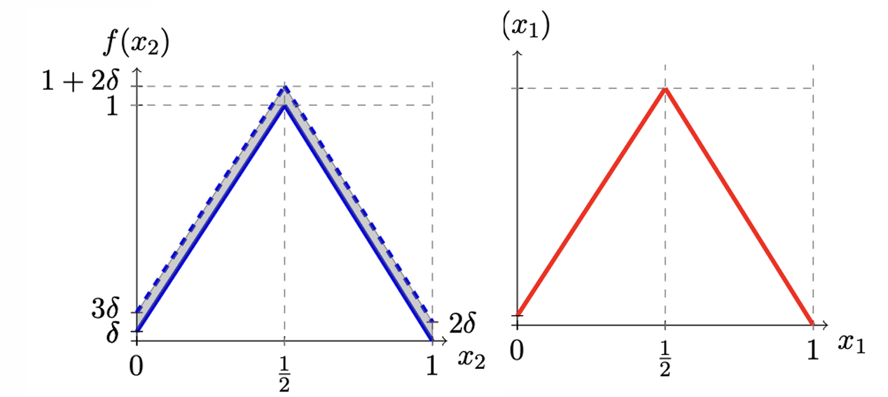
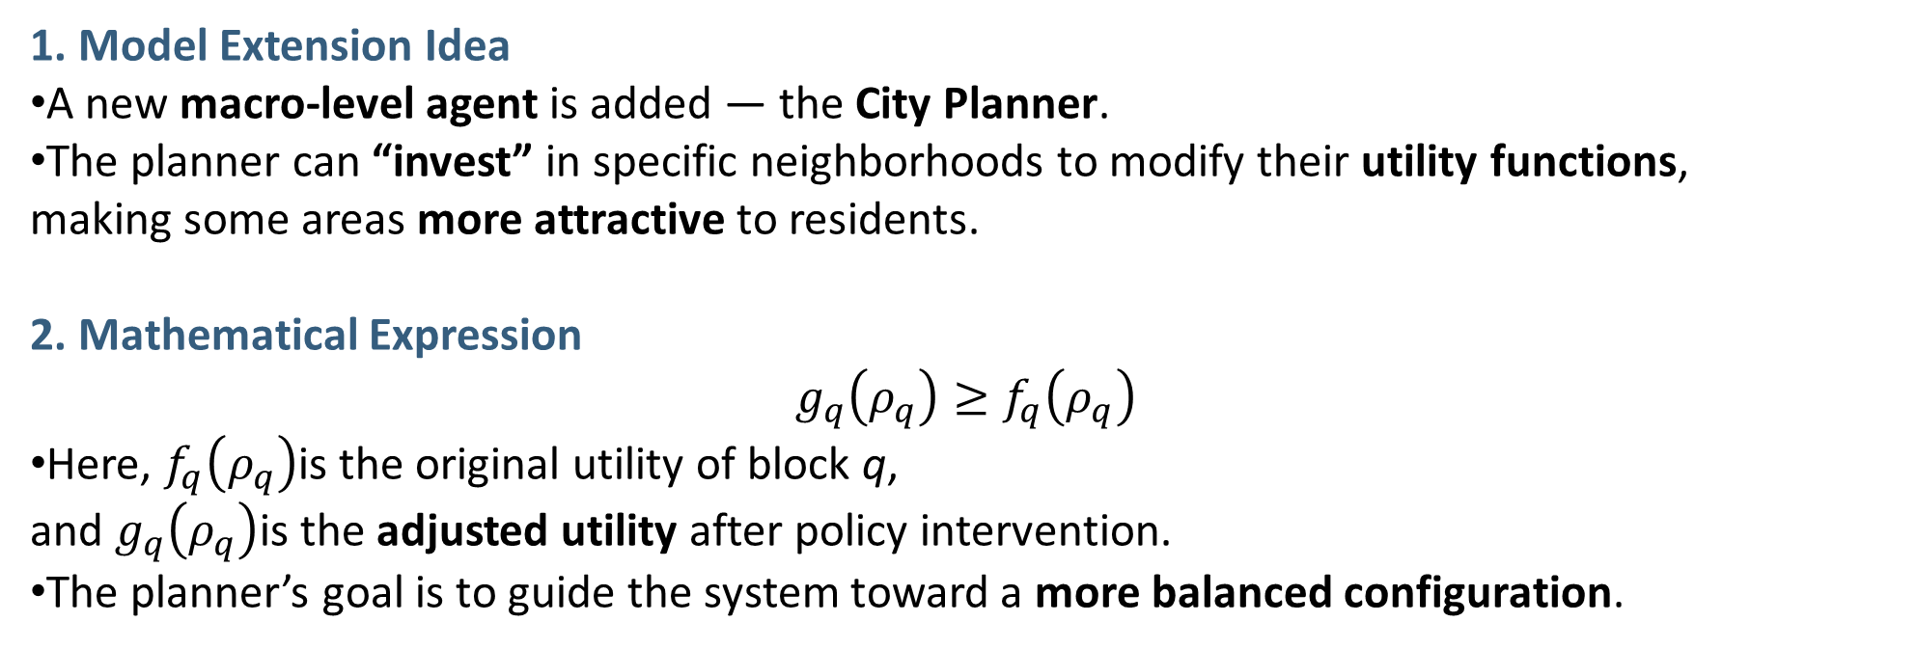
Introducing a City Planner (Policy Intervention)
1. Model Extension Idea
A new macro-level agent is added — the City Planner.
The planner can “invest” in specific neighborhoods to modify their utility functions, making some areas more attractive to residents.
2. Mathematical Expression
$$g_{q}\left(ρ_{q}\right)≥f_{q}\left(ρ_{q}\right)$$
Here, $f_{q}\left(ρ_{q}\right)$is the original utility of block q, and $g_{q}\left(ρ_{q}\right)$is the adjusted utility after policy intervention.
The planner’s goal is to guide the system toward a more balanced configuration.

Slide 15
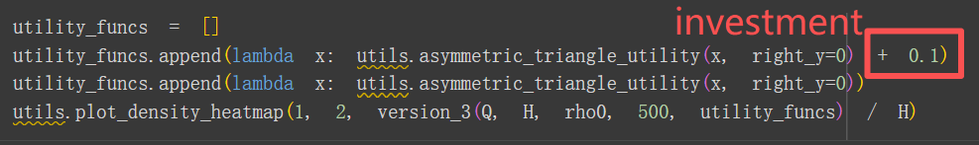
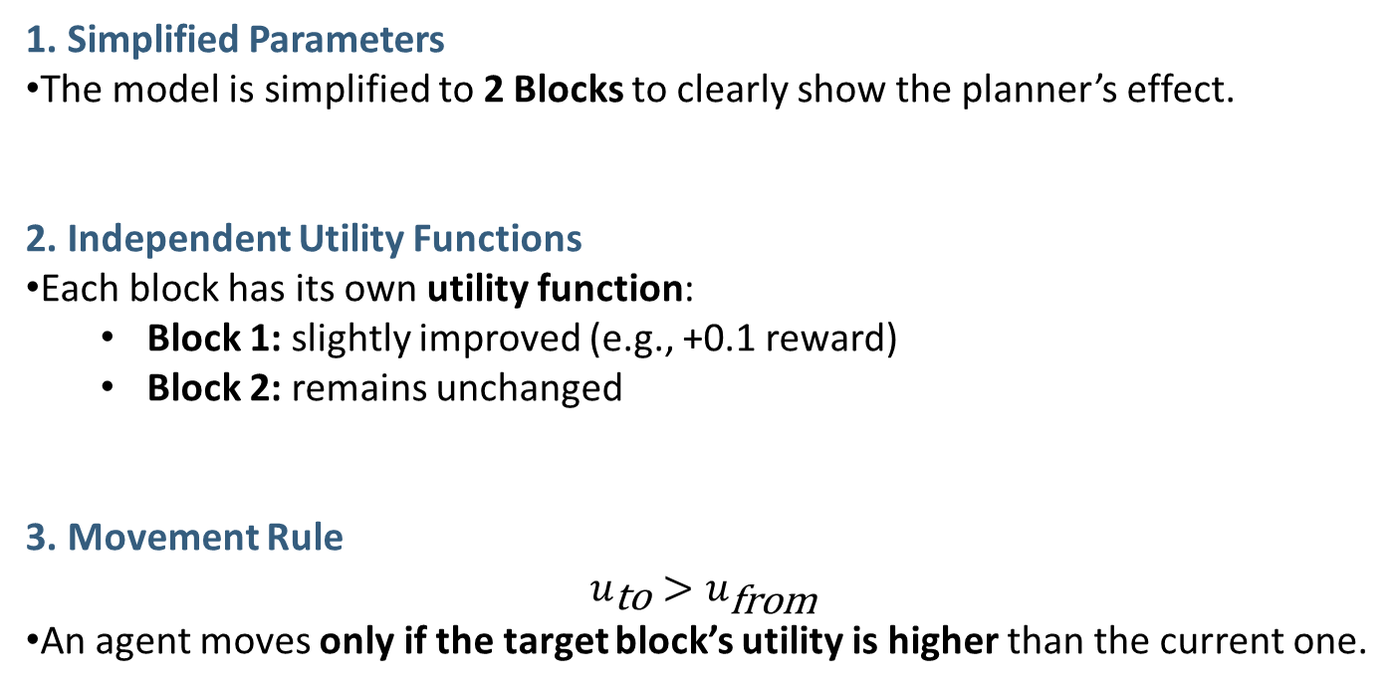
Code Structure for the Planner Version
1. Simplified Parameters
The model is simplified to 2 Blocks to clearly show the planner’s effect.
2. Independent Utility Functions
Each block has its own utility function:
Block 1: slightly improved (e.g., +0.1 reward)
Block 2: remains unchanged
3. Movement Rule
$$u_{\text{to}}>u_{\text{from}}$$
An agent moves only if the target block’s utility is higher than the current one.

Slide 16

Simulation Result
Observation
After running the simulation, the planner’s investment makes Block 1 much more attractive.
As a result, most agents move toward Block 1 — forming a single dominant center.
Instead of reducing segregation, the policy actually intensifies it — the city becomes even more unevenly segregated.
Block 1 Block2

Slide 17
Try it yourself!
Set different parameters
to observe changes in the plot.

Slide 18
Thank You!
Thank you for your attention and participation.
📬 Contact Information:
zhanzhanzhao@cuhk.edu.cn (Dr. Zhao Zhanzhan)
225080011@link.cuhk.edu.cn (Jia Xiao )

