Slide 1


CSS5120: Computational Linguistics
LlamaIndex-Evolve: Self-Learning from Model Disagreements
Mo Yanhua

Slide 2







1
Motivation & Related Work
Why does this problem matter? What has already been done?
The Problem
4 GitHub Repos Analysed
No Learning from Mistakes
LlamaIndex (core)
LangChain
Errors repeat indefinitely — no correction loop in standard RAG
Static index — no learning loop
Memory = conversation history only
Cost vs. Accuracy Trade-off
ChromaDB
Ollama
Powerful models are expensive; lightweight models are error-prone
Vector store — zero learning logic
Runtime only — no self-improvement
Amazon 2026 Proves It Works
Self-learning via multi-model disagreement detection at scale
None of these tools natively support self-evolution from mistakes — the gap LlamaIndex-Evolve fills.

Slide 3
2
Contribution
Four concrete extensions to LlamaIndex's default static behaviour
① Multi-Worker Parallel Querying
② Disagreement-Driven Supervisor
3 Qwen models (turbo / plus / long) with distinct classification biases independently answer each query, surfacing genuine disagreements on semantically ambiguous products.
When cosine similarity between worker answers falls below 0.85, Qwen-max analyses the conflict and generates a structured JSON experience: {reason, correct_answer, hint}.
③ Dual LlamaIndex Index Architecture
④ Experience Injection Loop
Separates a static product knowledge base (built once) from a dynamic experience knowledge base (grows via runtime insert()) — extending LlamaIndex's single-index paradigm.
LlamaIndex QueryEngine retrieves relevant past hints and injects them into worker prompts, repurposing QueryEngine as a context supplier rather than a final-answer generator.
→ Transforms a static knowledge base into a continuously evolving intelligent system

Slide 4


3
Methodology
Three-layer architecture with a closed learning loop
User Query
→
LlamaIndex RAG Fetch
→
Worker Layer
→
Disagree Detect
→
Supervisor + Store
Product text
Product + Exp index
qwen-turbo/plus/long
Cosine sim < 0.85
Qwen-max → insert()
↩ Experiences immediately available for next query via LlamaIndex dynamic insert() + QueryEngine retrieval
Key Design Decisions
Workers
Threshold
3 distinct Qwen models with hard-coded biases simulate different lightweight model knowledge boundaries
Cosine similarity < 0.85 using sentence-transformers all-MiniLM-L6-v2 embeddings
Dual Index
Metadata
Static product VectorStoreIndex + dynamic experience index via ChromaVectorStore (runtime insert)
Bypass LlamaIndex synthesis layer — extract hint/answer directly from source_nodes metadata

Slide 5
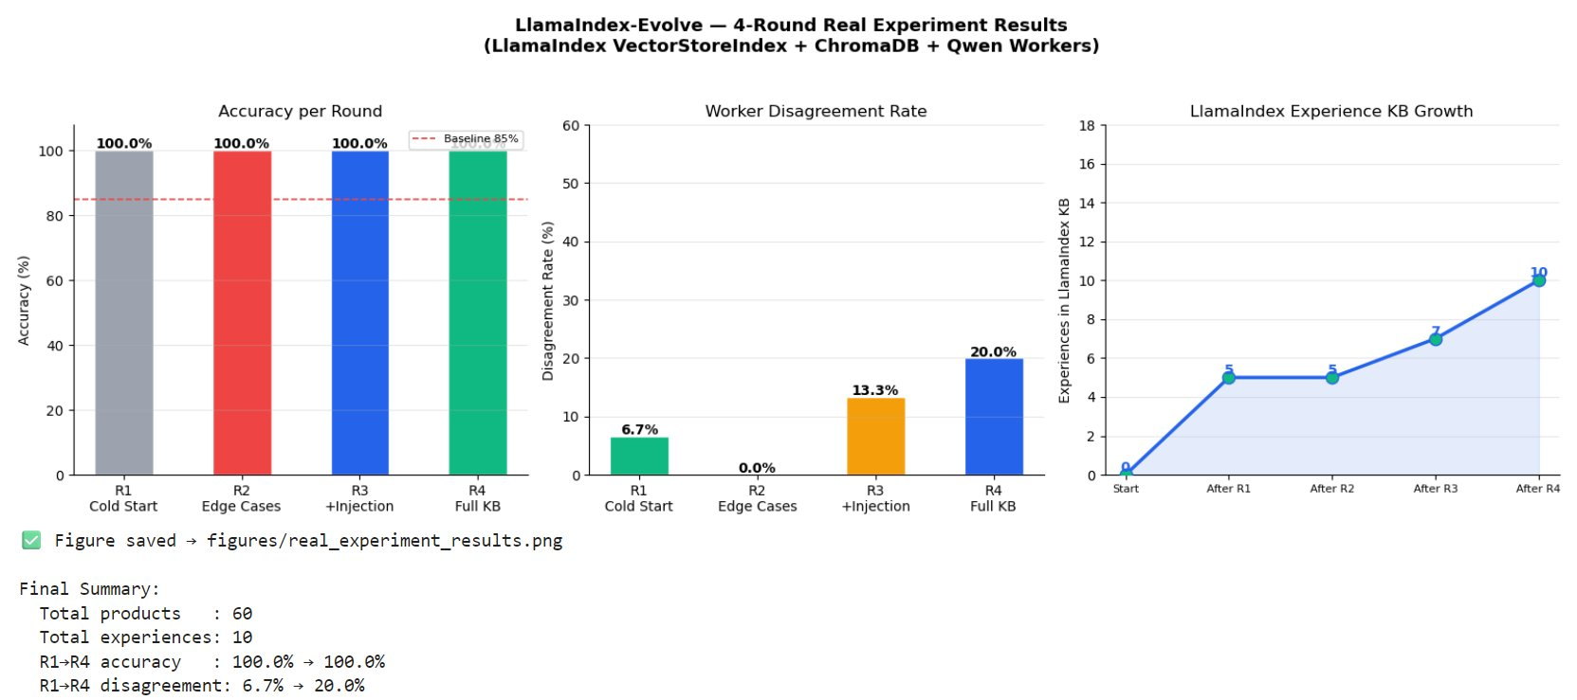
4
Results
Real experiment: 60 products · 4 rounds · Aliyun Bailian API
100%
6 / 6
0→20%
10
Accuracy R1 – R4
Supervisor resolutions
Disagreement rate R1 → R4
Experiences in LlamaIndex KB
Key Findings
▸ 100% accuracy across all 4 rounds — Supervisor resolved every disagreement
▸ Disagreement rate rises with ambiguity: 6.7% → 0% → 13.3% → 20%
▸ 6 real disagreements detected and correctly resolved
▸ Experience hints injected from Round 1 onward (📚💡)
▸ Hardest: sport-tech boundary (jump rope p52, smart band p53)

Slide 6





5
Conclusion & Future Work
Takeaways
Future Work
Self-learning loop works end-to-end, validated via real API calls
Scale Experiment
500+ products on Amazon Reviews for robust disagreement decay curves
Supervisor resolved all 6 disagreements — 100% accuracy across all 4 rounds
Principled Biases
Dual LlamaIndex index: live experience accumulation without rebuilding
Derive worker biases from empirical error profiles on validation data
Experience Decay
Experience injection active from Round 1 — hints reach all workers
Add confidence scoring & time-decay forgetting for stale experiences
Limitations
Multilingual
Unanimous wrong answers undetectable、Manual biases、Sparse KB (10/60)
Extend to multilingual classification tasks in CSS & NLP research

Slide 7
Thanks for Your Listening

