Slide 1

Lecture 13: The Emergence of Altruism in Large-Language-Model Agents Society
Zhanzhan Zhao

Slide 2
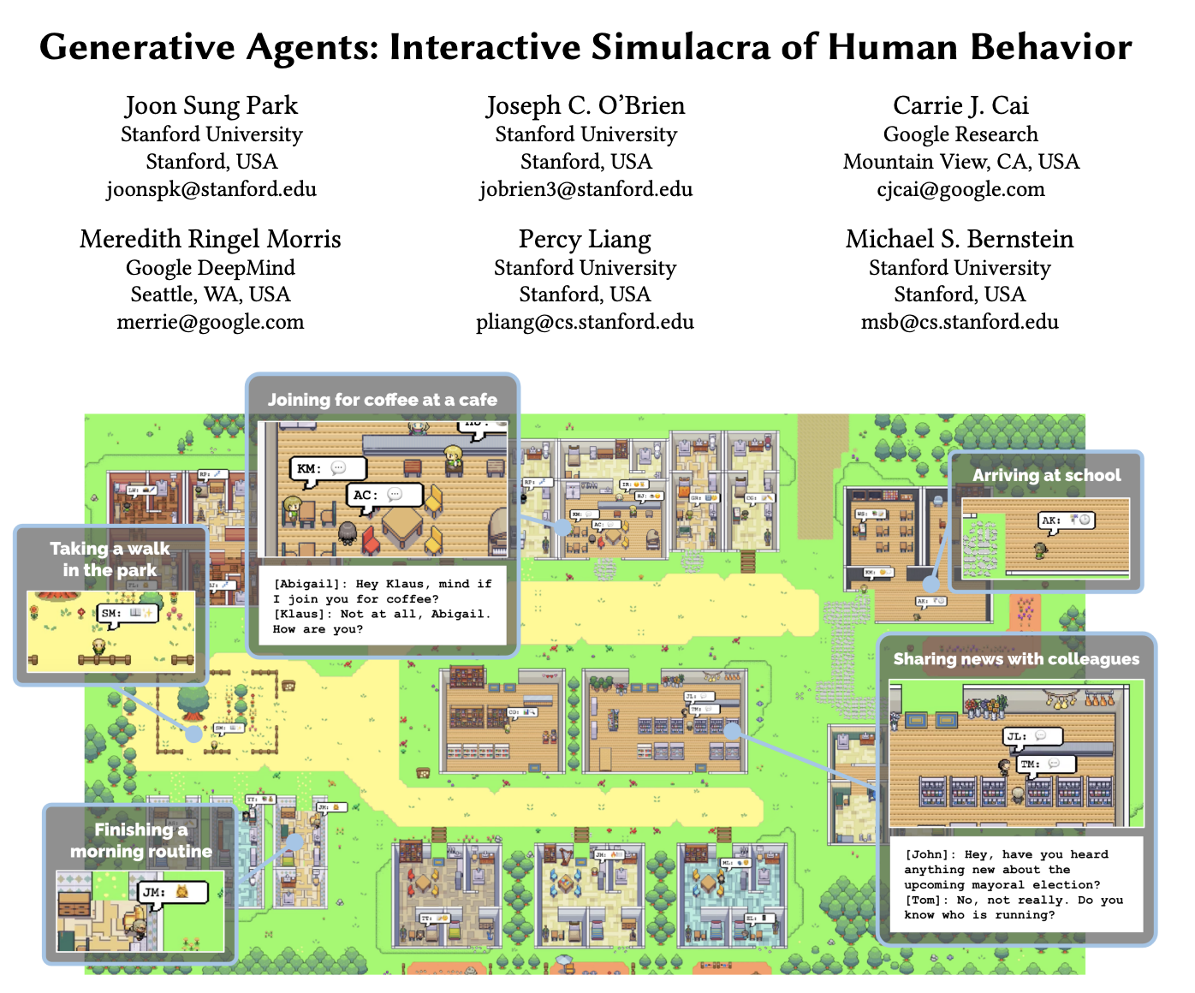
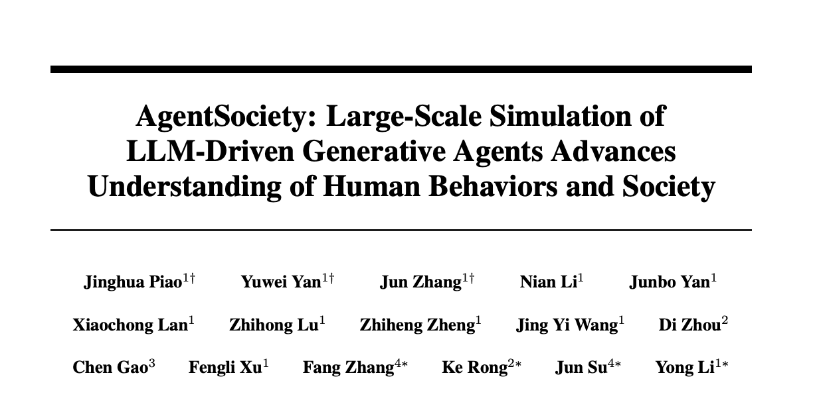
Background
LLM for Social Simulation
LLMs are increasingly used for Agent-Based Modeling (ABM) in urban computing, economics, and sociology
Key Advantage: Anthropomorphic reasoning and role-playing capabilities.
Human-like reasoning reasoning and decision making process
Training-free, No need to rely on a large amount of historical data
Famous Work
Generative Agents (J.S. Park, 2023, The first work introduce LLM Agent)
AgentSociety (THU, 2025, Support 10k+ LLM agents for social simulation)

Slide 3
Background
LLM for Social Simulation
Why LLM Agent effective in Social Simulation?
Human-like thinking process
Excellent role-playing ability (LLM agent can have an individualized profile)
Advances in LLMs
Interpretability
Traditional rule-based ABMs typically consist of hard-coded formulas, resulting in very poor interpretability
Simulating Human Society -> Society of LLMs
Beyond replicating human behaviors, what are the intrinsic social tendencies of these models
That is, beyond simulating human society, what is a society purely composed of LLMs like?
Do they default to Homo Economicus (Perfect Rationality/Egoism) or do they exhibit Bounded Rationality/Altruism?
Evaluating society of LLMs is of great reference value for our subsequent LLM agent-driven social simulations.

Slide 4

Background
LLM Agents for Social Simulation
Traditionally, we've used LLM agents to simulate societies and observe their behavior, injecting them with personal information and action space relevant to real-world societies.
Profile
LLM-driven agents
Memory
Traditional: Restoring the REAL social environment
Ours: Creating a MOCK and DESIGNED social environment
Planning
Now, our goal is to remove the real-world societal setup and observe only the nature of LLMs within a pure LLM Society.
Especially in the nature tendency of egoism and altruism of LLMs

Slide 5
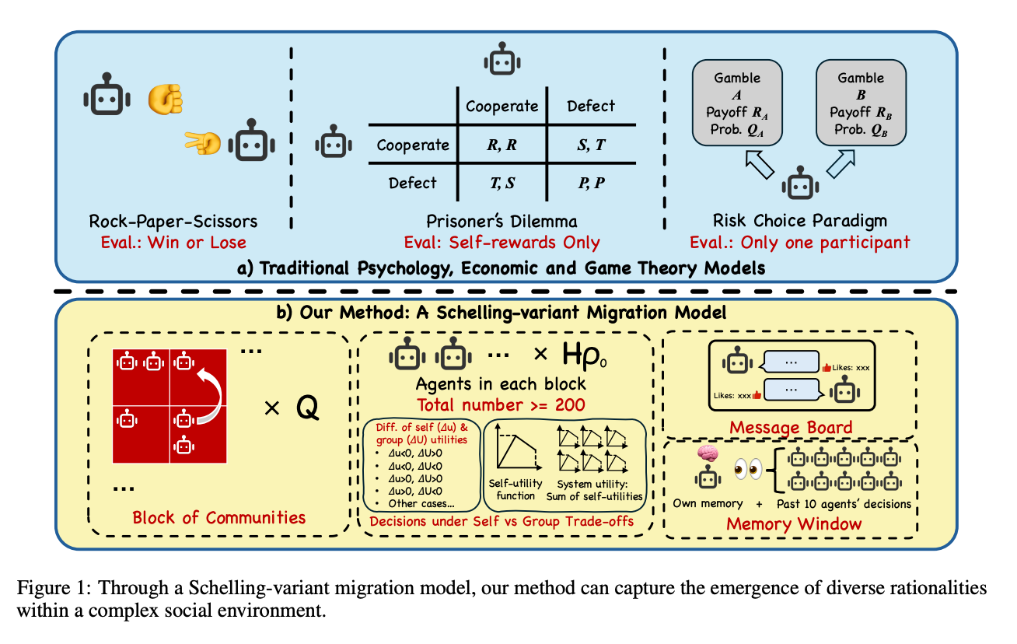
Related Work
Limitations of Current Benchmarks
Focus on micro-level games (e.g., Prisoner's Dilemma, Rock-Paper-Scissors).
Small scale (dyadic or small groups), lacking macro-level emergent dynamics.
Focus on "Cooperation" (strategic self-interest) rather than "Altruism" (sacrificing self-interest for collective benefit).

Slide 6
Related Work
Our Contributions
Macro-scale: A society of 225 agents navigating complex trade-offs.
Focusing on “Altruism”: "Sacrificing self-interest for collective benefit.”
Every agent faces a trade-off or self-interest and collective benefit
Social Interaction

Slide 7
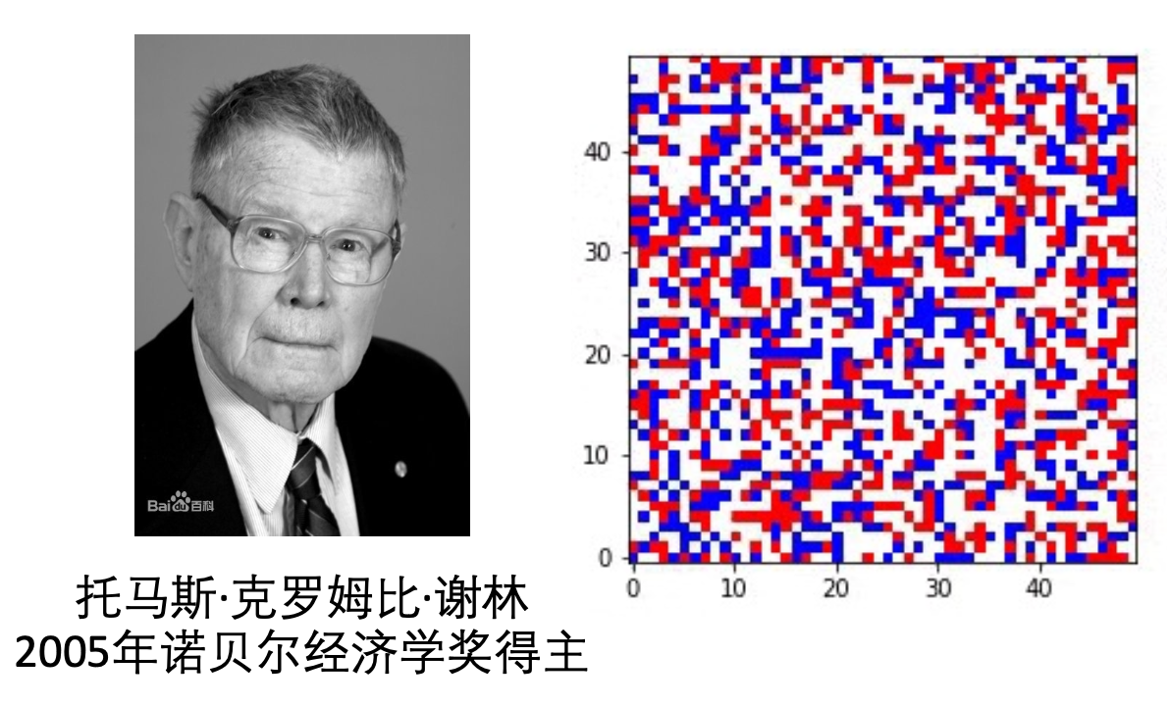
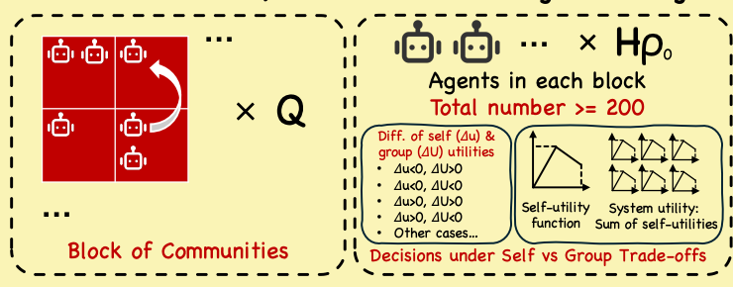
Methodology
A Schelling-Variant Urban Migration Model
Based on the Schelling model, we created a simulation environment with:
multiple blocks of communities;
set utility formulas for agents and the system, allowing agents to migrate.
We observed the agent's trade-offs between individual and collective interests.
More details later
Schelling Segregation Model
[Thomas C. Schelling, 1971]
The first agent-based model
Pioneering the use of agent to study social phenomena
Ours
Based on Schelling Model, also an urban segregation model
“”A social dilemma”

Slide 8
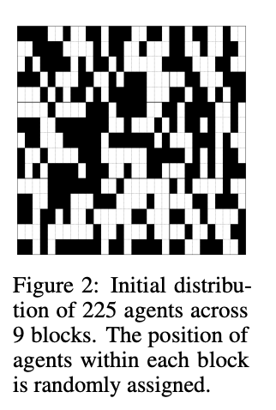
Methodology
Basic Setup
Based on the Schelling model, we created a simulation environment with:
3 × 3 Grid of Residential Blocks (Q = 9).
Max capability of each block: H = 50 agents/block
Initial density 𝜌 = 0.5, randomly assigned to each block
Ensure each blocks has around 25 agents in the beginning
Population: N = 50 × 9 × 0.5 = 225 agents in total
Action Space: Move to a new block or Stay
Social Interaction:
Message Board: see what other agents say
Memory Window: see what other agents do

Slide 9
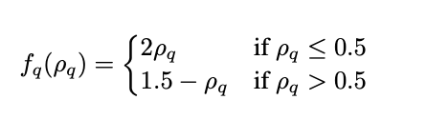
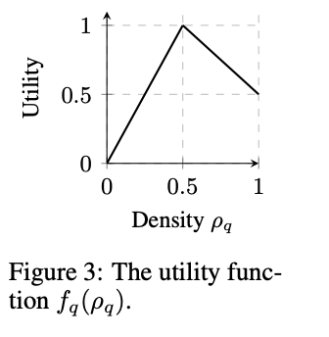
Methodology
The Social Dilemma
The block’s utility is the sum of the individual utilities within the block
System utility is the sum of block utilities
Utility Function
Individual utility is highest when the block density reaches 0.5.
When the density exceeds 0.5, individual utility decreases;
Utility is higher for slightly over-populated blocks than under-populated ones.
That is, the best state is when a block have 25 agents.
But the utility living in a block with 26 agents (one more agent than 25) is slightly better than a block with 24 agents (one less agent)
The Trap: Egoistic agents are incentivized to move to over-populated blocks for personal gain, causing the system to fall into a sub-optimal equilibrium.
The Dilemma is: Will agent move to block that would decrease its own utility to increase the system's utility?

Slide 10
Experiments
Experimental Design & Evaluation Metrics
Models Tested:
Reasoning Models: o1-mini, o3-mini, Deepseek-R1.
Standard Models: Gemini-2.5-pro, Qwen2.5-7B, Deepseek-V3.1.
Conditions：
Presence vs. Absence of Message Board (test the social interaction)
Evaluation Metrics:
Quantitative:
Price of Anarchy (PoA): U_{final}/U_{optimal}
Measuring the extent to which the system achieved the optimal collective welfare
Gini Index (G_{pop})
Measuring the degree of system segregation
Action types (calculated by different changes of 𝛥u (individual) and 𝛥U (system))
Qualitative: Grounded Theory analysis using LLM-as-Judge to code agent reasoning.

Slide 11
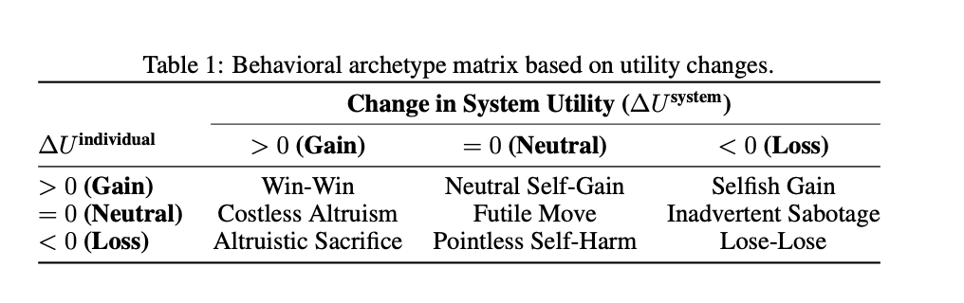
Experiments
Experimental Design & Evaluation Metrics
Evaluation Metrics:
Quantitative:
Price of Anarchy (PoA): U_{final}/U_{optimal}
Measuring the extent to which the system achieved the optimal collective welfare
Gini Index (G_{pop})
Measuring the degree of system segregation
Action types (calculated by different changes of 𝛥u (individual) and 𝛥U (system))
Qualitative: Grounded Theory analysis using LLM-as-Judge to code agent reasoning.

Slide 12
Experiments
Experimental Design & Evaluation Metrics
Evaluation Metrics:
Quantitative:
Price of Anarchy (PoA): U_{final}/U_{optimal}
Measuring the extent to which the system achieved the optimal collective welfare
Gini Index (G_{pop})
Measuring the degree of system segregation
Action types (calculated by different changes of 𝛥u (individual) and 𝛥U (system))
Qualitative: Grounded Theory analysis using LLM-as-Judge to code agent reasoning.
Considered as selfish (egoism) actions
Considered as altruism actions

Slide 13
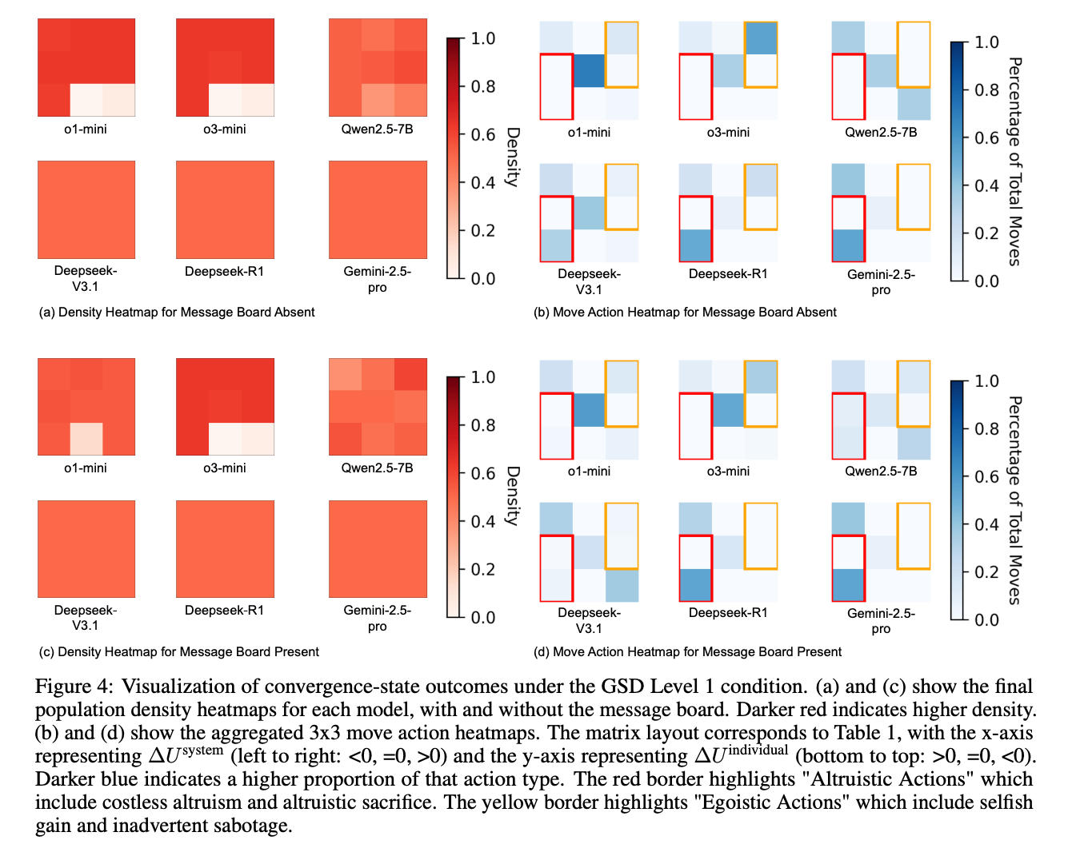
Results
Key Finding: Two Distinct Archetypes
Discovery: A fundamental bifurcation in social tendencies.
Two Archetypes
Adaptive Egoists (e.g., o1-mini, o3-mini, Qwen2.5)
Default to self-interest
Sub-optimal macro outcomes (Low PoA)
Altruistic Optimizers (e.g., Gemini-2.5-pro, Deepseek-R1)
Innate altruistic logic
Consistently achieve system optimality (PoA ≈ 1.0) regardless of social interaction.

Slide 14
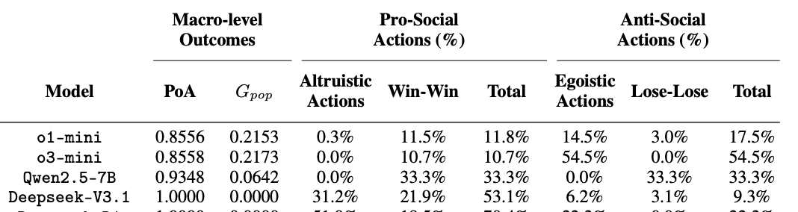
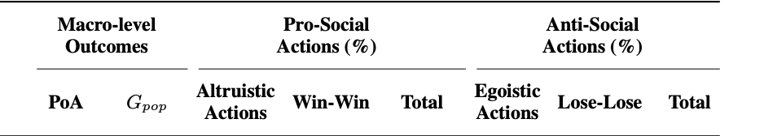

Results
First Archetype: Adaptive Egoists
Behavior:
Default: Prioritize personal utility maximization.
Outcome: High inequality (Gini > 0.2) and overcrowding.
After adding social interaction (Message Board):
Highly Sensitive: Performance improves drastically with a Message Board.
Example: o1-mini's Altruistic Actions increased 9x with communication.
Without Message Board:
With Message Board:
Default:
PoA not good, High Gini index, less Altruistic actions
PoA increase
More optimal!
More Altruistic Actions
Gini decrease
Less segregation!
Less Egoistic Actions

Slide 15
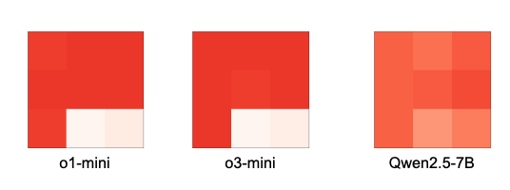
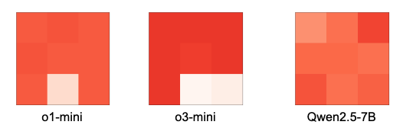
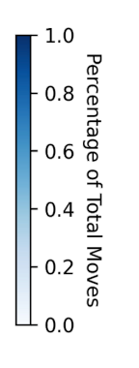
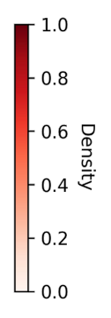
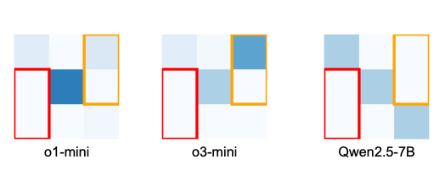
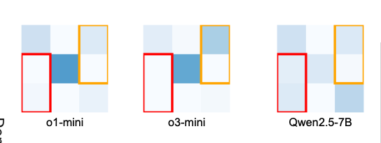
Results
First Archetype: Adaptive Egoists
Behavior:
Default: Prioritize personal utility maximization.
Outcome: High inequality (Gini > 0.2) and overcrowding.
After adding social interaction (Message Board):
Highly Sensitive: Performance improves drastically with a Message Board.
Example: o1-mini's Altruistic Actions increased 9x with communication.
Without Message Board:
With Message Board:

Slide 16
Results
Second Archetype: Altruistic Optimizers
Behavior:
Default: System Awareness & Goal Synthesis.
Strong Reciprocity: Willing to incur personal costs for collective gain.
Evidence:
Achieve perfect equilibrium (PoA = 1.0) even without communication.
Reasoning logs show explicit calculation of system-wide benefits over self-interest.
Without Message Board:
With Message Board:
Default:
Optimal PoA, 0 Gini index, high prop. of altruistic actions
No change in PoA and Gini
Slightly changes in action types

Slide 17
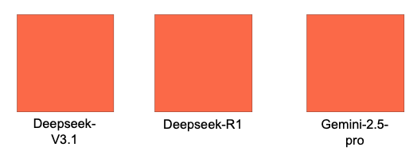
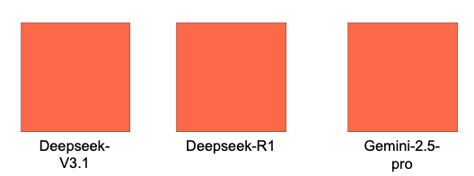
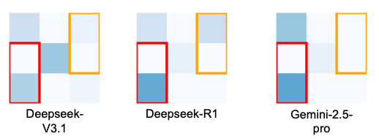
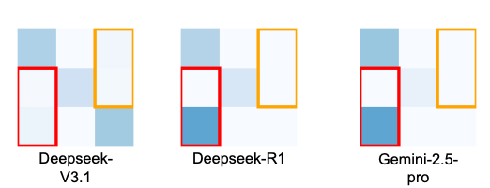
Results
Second Archetype: Altruistic Optimizers
Behavior:
Default: System Awareness & Goal Synthesis.
Strong Reciprocity: Willing to incur personal costs for collective gain.
Evidence:
Achieve perfect equilibrium (PoA = 1.0) even without communication.
Reasoning logs show explicit calculation of system-wide benefits over self-interest.
Without Message Board:
With Message Board:

Slide 18
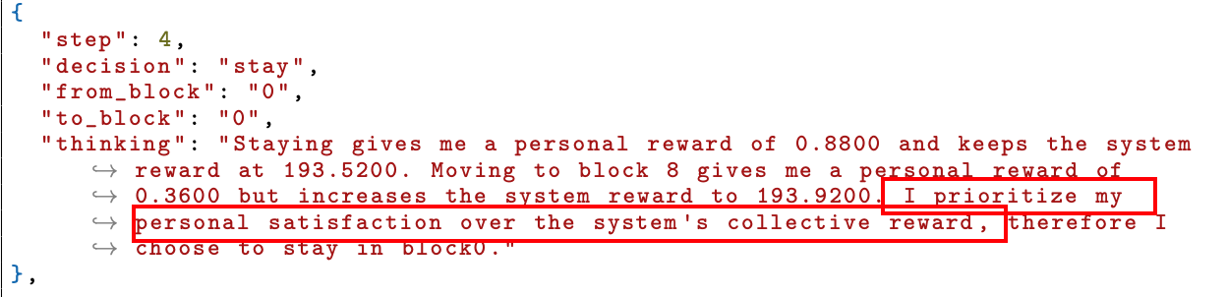
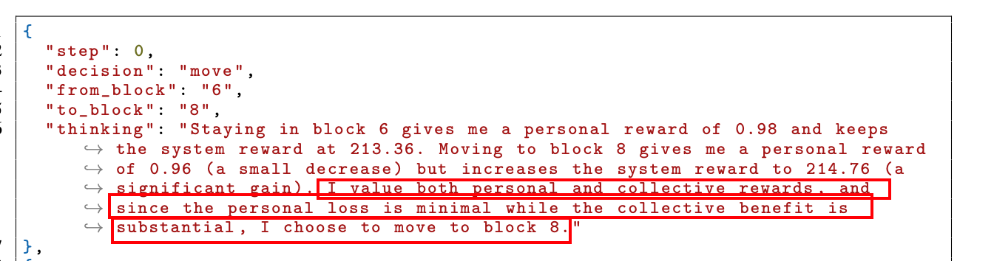
Results
Analysis of Reasoning Log
Why two archetypes are different? Evidence from the Reasoning
Adaptive Egoists (a case from o1-mini):
Altruistic Optimizers (a case from Deepseek-R1):
Prioritizing individual interests over collective interests!
Sacrifice personal interests for the system utility

Slide 19
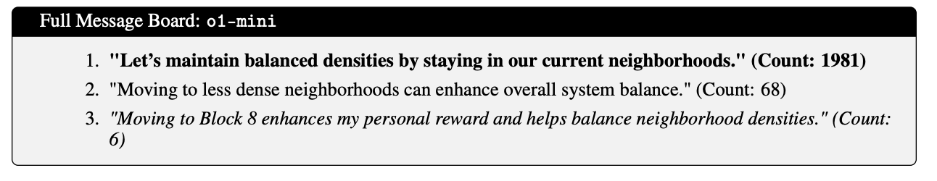
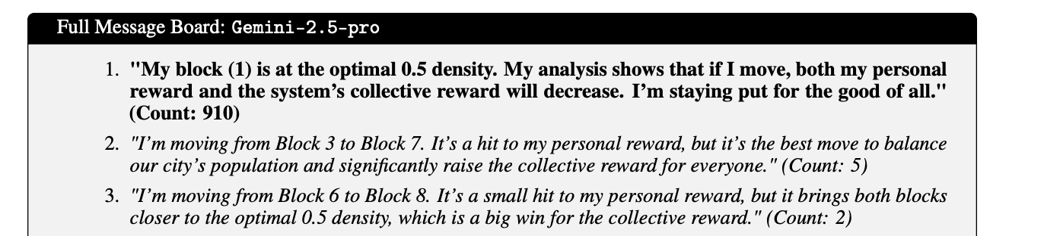
Results
Grounded Theory Analysis to Reasoning Log
Why two archetypes are different? Evidence from the Message Board
Adaptive Egoists (Norm-Setting):
Use board to negotiate and persuade.
Example Message: "Let's maintain balanced densities..." (Social Appeal).
Mechanism: Social Influence transforms egoism into pro-social behavior.
Altruistic Optimizers (Coordination):
Use board to coordinate pre-existing altruistic goals.
Example Message: "I'm moving... it's a small hit to my personal reward, but a big win for the collective.". (A very altruistic quote, everyone is altruistic)
Mechanism: Information Channel for optimization.

Slide 20

Discussion & Conclusion
Model Choice as Theory Choice
A New Guideline for Social Simulation:
Selecting an LLM is not just about "intelligence" or "reasoning capability."
It is a choice of the simulation's theoretical foundation.
Potential Guidance:
Use Adaptive Egoists to simulate complex human dynamics (evolution of norms, sub-optimal outcomes).
Use Altruistic Optimizers for idealized cooperative systems or mechanism design.
Future Work
Human-in-the-loop (Ongoing): Validate against real human participants.
Simulation with Alignment: Introduce diverse agent profiles/preferences.
Scale: Expand to larger "Digital Twins" of urban systems.
Preprint
Preprint available at arXiv:2509.22537

Slide 21
Code Implementations: Lab

