Slide 1
Docker
By Sacha Barber

Slide 2
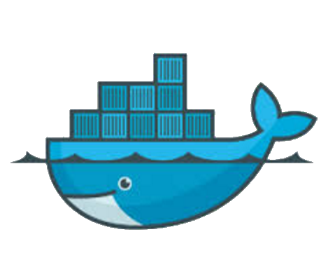
Docker
Fundamentals
Images
Basic building block of how Docker works (very important)
Repositories
Docker keep track of all images/containers you have created
Command Line Tools
Rich set of command line tools
Community Images (DockerHub)
On line portal of community based images, some excellent base images here

Slide 3
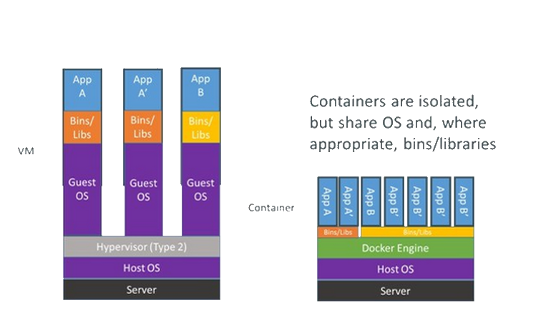
Docker
Compared To Vms

Slide 4
Docker
Images
Images Store
Making your own Images
Publishing An Images

Slide 5
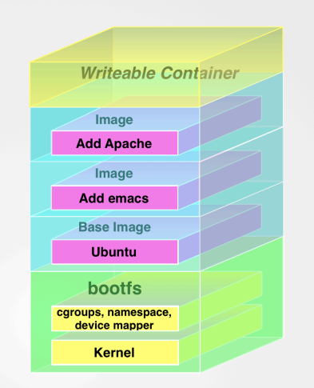
Docker
Images / Layers
Base images from DockerHub
Add our own stuff via Docker file
Use base / custom images via docker.compose

Slide 6
Docker
Custom Layers / Images
Typically done via custom dockerfile
Can chose what to add to our OWN layer in docker file
Could publish this layer as base image for others (but meh we are selfish)

Slide 7
Docker
Communication To Container / Ports / Names
Typically done via custom dockerfile/docker compose
Can pick what is added to the layer
Can expose ports
Can pick entry point
++ much more

Slide 8
Docker
Taking It Further Docker Compose
What about complex setups, which are not just one Jar/Dll
Docker compose (another file format) allow us to chain services (web, DB, etc etc) together as discrete units of interdependent software
Nicely expressed in easy to use DSL (i.e. Docker compose file)
Very rich DSL, ports, networking, dependencies, env-vars etc

Slide 9
Docker
Taking It Further Docker Compose
Docker Swarm / Cubernates (google)
Not covered in this presentation, but if you wanted to use Docker for PROD would have to use either of these

