Slide 1
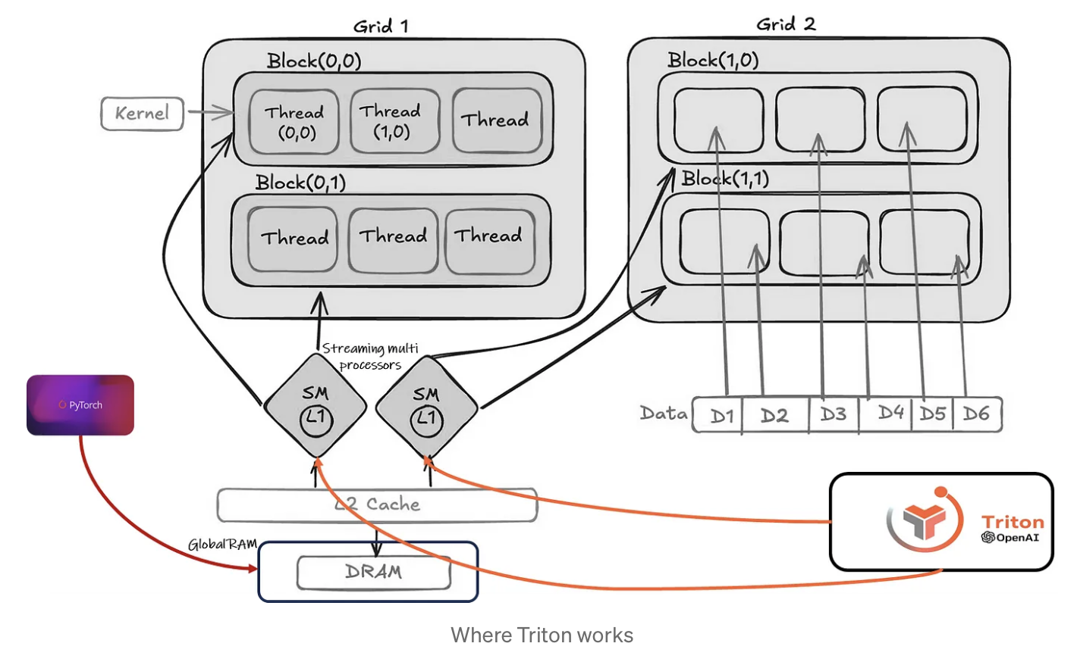
Pytorch
Triton
General purpose kernels
Custom kernels
Separate ops
Fused ops
Inefficient memory management
Fine-grained control
cuDNN
Python overhead
GPU compiled
Sources:
1) https://medium.com/@fellyralte/supercharging-gpu-performance-with-triton-writing-custom-kernels-made-easy-ac80f4d13885

