Slide 1
中北大学 文学系学术答辩 PPT
Zhongbei University
Academic defense ppt of Literature Department of Zhongbei University
author / Meimei Han

Slide 2
01.
Text here
Copy paste fonts. Choose the only o ption to retain text……
02.
Text here
Copy paste fonts. Choose the only o ption to retain text……
Contents
03.
Text here
Copy paste fonts. Choose the only o ption to retain text……
04.
Text here
Copy paste fonts. Choose the only o ption to retain text……

Slide 3
1
Edit Master text styles
Theme color makes PPT more convenient to change.
Adjust the spacing to adapt to Chinese typesetting, use the reference line in PPT……

Slide 4
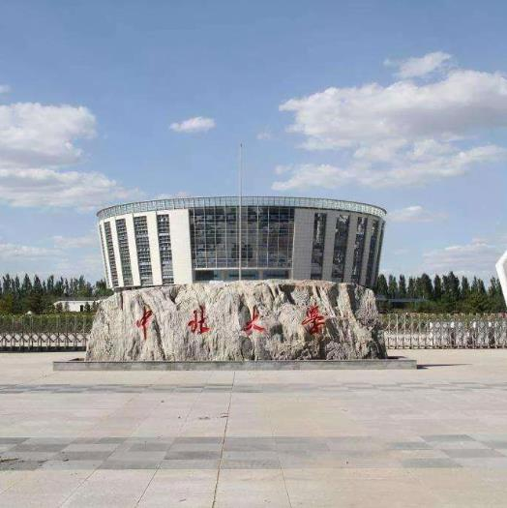
Text here /
Unified fonts make reading more fluen t.
Theme color makes PPT more convenient to change. Adjust the spacing to adapt to C hinese typesetting, use the reference line in PPT.
516 46K
9646 1K
467 46K
Text here
Text he re
Text here

Slide 5
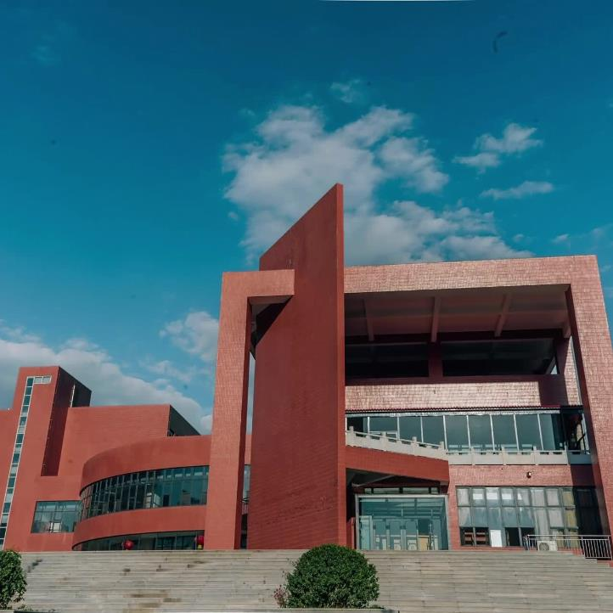
Text here /
Unified fonts make
read ing more fluent.
Theme color makes PPT more convenient to change.
Adjust the spacing to adapt to Chinese typesetting, use the reference line in PPT.

Slide 6
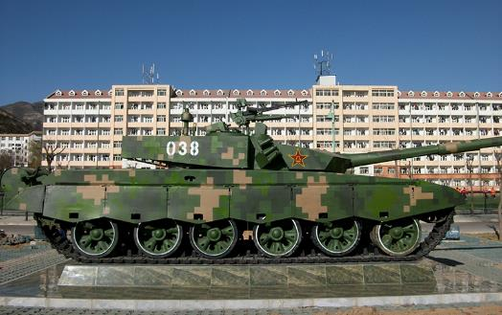
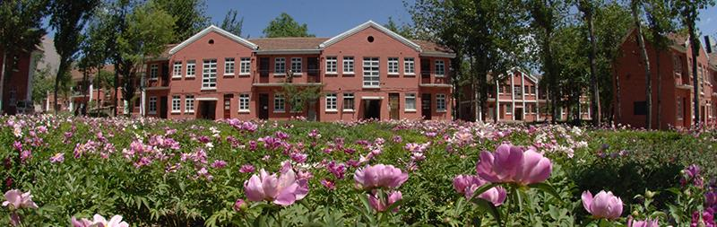
Text here /
P PT
Unified fonts make reading
more fluent.
Text here
Copy paste fonts. Choose the only optio n
to retain text……
Text here
Theme color makes PPT more convenient to change.
Adjust the spacing to adapt to Chinese ty pesetting, use the reference line in PPT……
Copy paste fonts. Choose the o nly option
to retain text……
6 5%

Slide 7
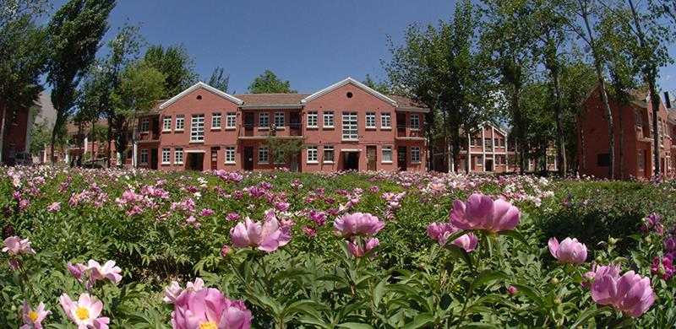
Text here /
S upporting text here.
U nified Fonts Make Reading More Fluent.
T ext here
Co py paste fonts. Choose the only option to retain text.
… …

Slide 8
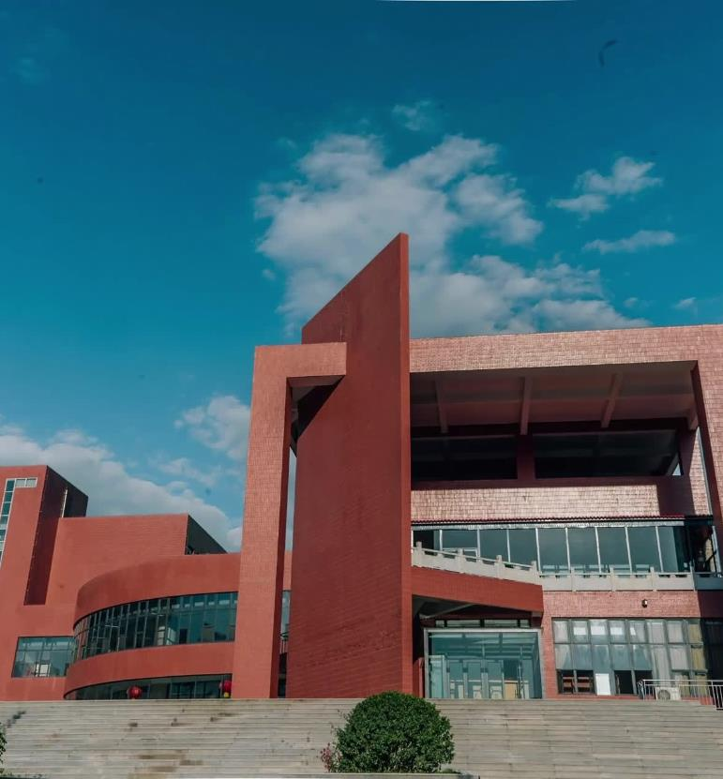
Text here /
Unified fonts make reading more fluent.
Theme color makes PPT more convenient to change.Adjust the spacing to adapt to Chinese typesetting, use the reference line in PPT.
… ….
Text here
Copy paste fonts. Choose the only option to retain text.
… …
Text here
Copy paste fonts. Choose the only option to retain text.
… …
Text here
Copy paste fonts. Choose the only option to retain text.
… …

Slide 9
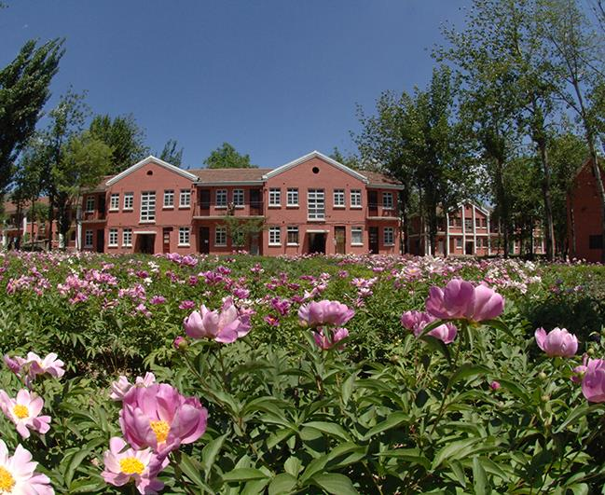
Text here /
Text here
Sup porting text here Sup porting text here Sup porting text here Sup text here Sup porting text here Sup Sup porting text here Sup porting text here Sup porting text here Sup text here Sup porting text here Sup Sup porting text here Sup porting text here Sup porting text here text here Sup porting text here Sup
Text here
Sup porting text here Sup porting text here Sup porting text here Sup text here Sup porting text here Sup Sup porting text here Sup porting text here Sup porting text here Sup text here Sup porting text here Sup Sup porting text here Sup porting text here Sup porting text here text here Sup porting text here Sup

Slide 10
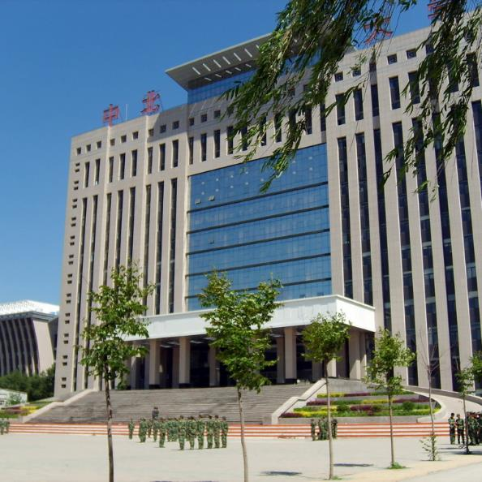
Text here /
T ext here
Copy pas te fonts. Choose the only option to retain text.
T ext here
Copy pas te fonts. Choose the only option to retain text.
T ext here
Copy pas te fonts. Choose the only option to retain text.
T ext here
Copy pas te fonts. Choose the only option to retain text.

Slide 11
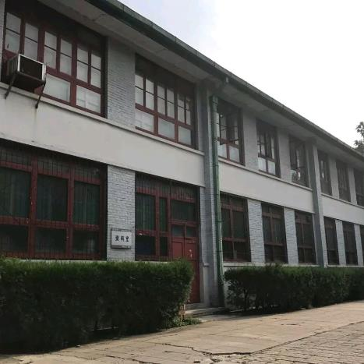
Text here /
Unified fonts make reading more fl uent.
Theme color makes PPT more convenient to change.Adjust the spacing to adapt to Chinese typesetting, use the reference line in PPT.
… ….
Text here
Text here
Text here
Supporting text he re.
… …
Supporting text he re.
… …
Supporting text he re.
… …

Slide 12


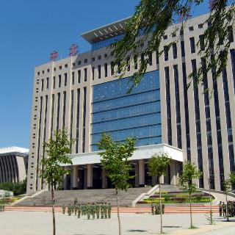
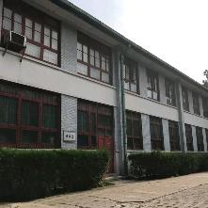
Unified fonts
make r eading more fluent.
Supporting text here.
You can use the icon library in iSlide (www.islid e.cc) to filter and replace existing icon elements with one click.

Slide 13






Unified fonts make reading more f luent.
T ext here
S upporting text here.
T ext here
Text he re
S upporting text here.
Supporting text h ere.
T ext here
T ext here
Text he re
S upporting text here.
S upporting text here.
Supporting text h ere.

Slide 14

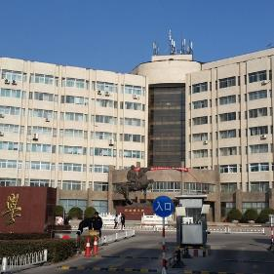

Text here /
Supporting text here Supporting text here Supporting text here Sup text here Sup porting text here Sup Sup
Supporting text here Supporting text here Sup porting text here Sup text here Sup porting text here Sup Sup
porting text here Sup porting text here Sup porting text here Sup text here Sup porting text here Sup Sup porting text here Sup porting text here Sup porting text here text here Sup porting text here Sup porting text here Sup porting text here Sup porting text here text here Sup porting text here Sup
Sup porting text here
Text here

Slide 15
Text here /
Unified fonts make read ing more fluent.
Theme color makes PPT more convenient to change.
Adjust the spacing to adapt to Chinese typesetting, use the reference line in PPT……
Text H ere 〉

Slide 16

20%
T ext here
Copy paste fonts. Choose the only option to retain text.
36%
Text he re
Copy paste fonts. Choose the only option to retai n text.
68%
Text he re
Copy paste fonts. Choose the only option to retai n text.
89%
Te xt here
Copy paste font s. Choose the only option to retain text.

Slide 17


Text here /
01.Text here
Copy paste fonts. Choose the only option to ret ain text.
……
Unified fonts make reading more fluent.
Theme color makes PPT more convenient to change.
Adjust the spacing to adapt to Chinese typesetting, use the reference line in PPT.
02.Text here
Copy paste fonts. Choose the only opti on to retain text.
……

Slide 18
Text here /
Text here
Supporting text here
……
Text here
Text here
Supporting text here
……
Supporting text here
……
Text here
Text here
Supporting text here
……
Supporting text here
……

Slide 19
Unified font s make
reading more fluent.
Theme color makes PPT more convenient t o change.
Adjust the spacing to adapt to Chinese typesetting, use the reference line in PPT.
01.Te xt here
Copy paste fonts. Choose t he only option to retain text.
02.T ext here
Copy paste fonts. Choose t he only option to retain text.
67%
Category
54%
03.T ext here
Category
81%
Copy paste fonts. Choose the only option to retain text.
Text here
04.T ext here
Copy paste fonts. Choose the only option to retain text……
Copy paste fonts. Choose the only option to retain text.

Slide 20
Text here /
Te xt here
Te xt here
Te xt here
Te xt here
Te xt here
Suppo rting text here.
… …
Suppo rting text here.
… …
Suppo rting text here.
… …
Suppo rting text here.
… …
Suppo rting text here.
… …

Slide 21
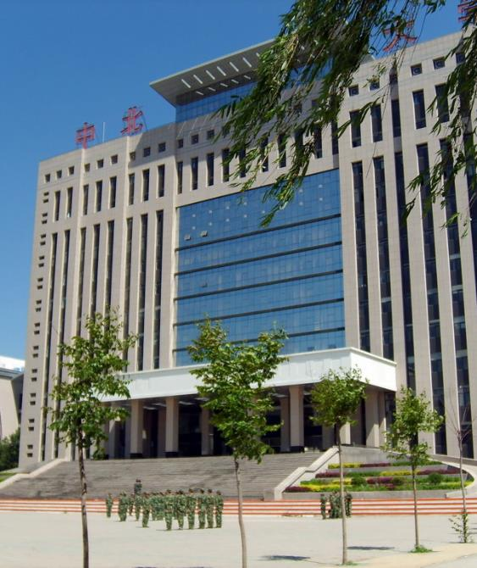
Text here /
Unified f onts make
reading more fluent.
Theme color makes PPT more con venient to change.
Adjust the spacing to adapt to Chinese typesetting, use the reference line in PPT.
Text here
Text here
Text here
Copy paste fonts. Choose the only option to retain text……
Copy paste fonts. Choose the only option to retain text……
Copy paste fonts. Choose the only option to retain text……

Slide 22
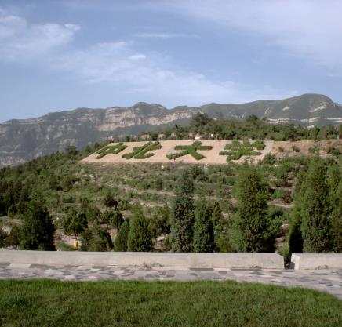
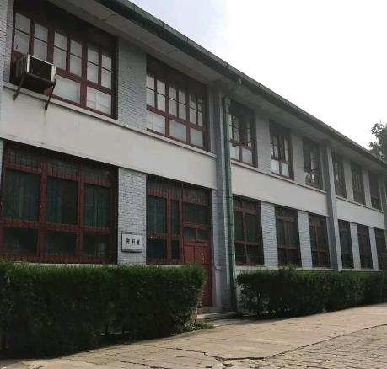
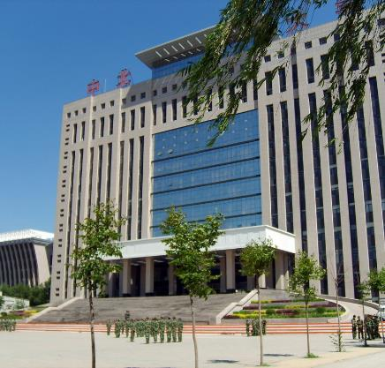
Text here /
…text
…text
…text
Supporting text here.
……
Supporting text here.
……
Supporting text here.
……

Slide 23

Text here /
Unified fonts make
reading more fluent.
Theme color makes PPT more convenient to change.
Adjust the spacing to adapt to Chinese typesetting, use the reference line in PPT.
Text here
Text here
Copy paste fonts. Choose the only option to retain text.
……
Copypaste fonts. Choose the only option to retain text.
……

Slide 24

Unified fonts make
reading more fluen t.
Theme color makes PPT more convenient to change.Adjust the spacing to adapt to Chinese typesetting, use the r eference line in PPT.
……
Supporting text her e.
……

Slide 25


Text here /
Unified fonts make reading more f luent.
Te xt
Copy paste fonts. Choose the only option to retai n text……
Copy paste fonts. Choose the only option to retai n text……
Copy paste fonts. Choose the only option to retai n text……
Copy paste fonts. Choose the only option to retai n text……
Copy paste fonts. Choose the only option to retai n text……
Copy paste fonts. Choose the only option to retai n text……

Slide 26
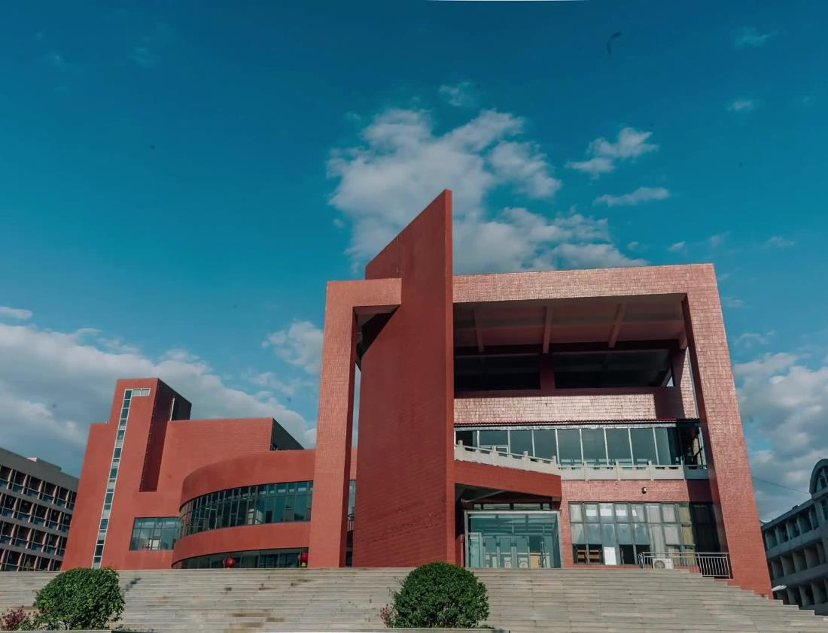
Text here /
Unified fonts ma ke reading more fluent.
Theme color makes PPT more convenient to change.
Adjust the spacing to adapt to Chinese typesetting, use the reference line in PPT.
Text here
Copy paste fonts. Choose the only option to retain text……
Text here
Copy paste fonts. Choose the only option to retain text……

Slide 27

Text here /
Tex t here
Tex t here
Copy paste fonts. Choos e the only option to retain text.
Copy paste fonts. Choos e the only option to retain text.
Copy paste fonts. Choos e the only option to retain text.
Copy paste fonts. Choos e the only option to retain text.
Copy paste fonts. Choos e the only option to retain text.
Copy paste fonts. Choos e the only option to retain text.

Slide 28

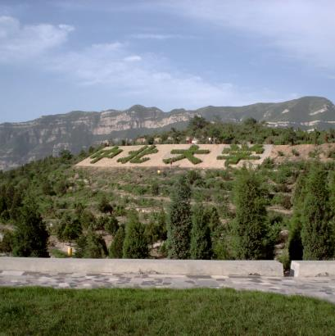
Text here /
Text here
Supporting text here.
When you copy & past e, choose "keep text only" option.
Text he re
Text he re
Copy paste fonts. Choose the onl y option to retain text.
……
Copy paste fonts. Choose the only option to retain te xt.
……

Slide 29
THANKS
Theme color makes PPT more convenient to change.
Adjust the spacing to adapt to Chinese typesetting, use the reference line in PPT……

