Slide 1
中国石油大学（华东） 文学系学术答辩 PPT
China University of Petroleum
(East China)
author / Meimei Han
Time / 2024.05
Notes:
51PPT模板网，幻灯片演示模板及素材免费下载！
51PPT模板网 唯一访问网址：www.51pptmoban.com

Slide 2
Text h ere
Text h ere
01
02
Sup porting text here Sup porting text here Sup porting text here
Sup porting text here Sup porting text here Sup porting text here
Contents
目录
Sup porting text here
……
Text h ere
Text h ere
03
04
Sup porting text here Sup porting text here Sup porting text here
Sup porting text here Sup porting text here Sup porting text here

Slide 3
01
Edit Master text styles
Theme color make s PPT more convenient to change.
Adjust the spacing to adapt to Chinese typesetting, use the reference line in PPT.

Slide 4
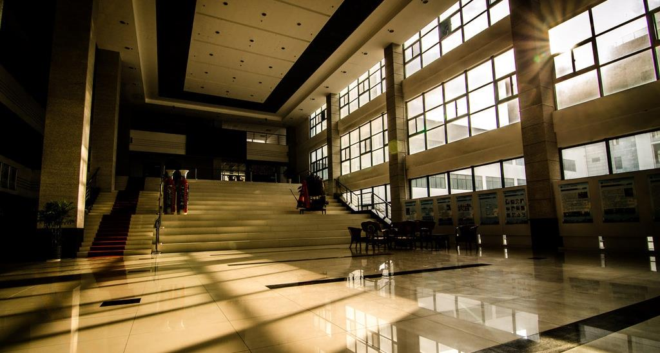
S upporting text here.
U nified fonts make reading more fluent.
T heme color makes PPT more convenient to change.
Adjust the spacing to adapt to Chinese typesetting, use the reference line in PPT.
……

Slide 5

Supporting text her e.
Text he re
Unified Fonts Make
Reading More Fluen t.
Copy paste fonts. Choose the only option to retain tex t.
Text he re
Unified fonts make reading more fluent.
Theme color makes PPT more convenient to change.Adjust the spacing to adapt to Chinese typesetting, use the reference line in PPT.
Supporting text here.
You can use the icon library in iSlide (www.islide.cc) to filter and replace existing icon elements with one click.
Copy paste fonts. Choose the only option to retain tex t.
Text he re
Copy paste fonts. Choose the only option to retain tex t.

Slide 6


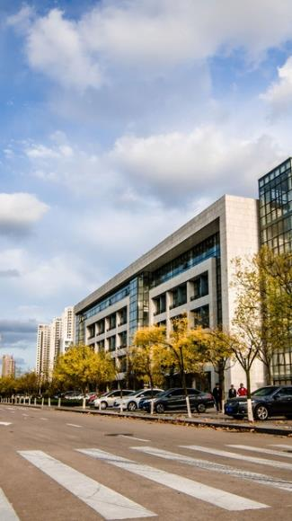

Text here
Supporting text here.
……
Text…
Text here
Sup porting text here
……

Slide 7

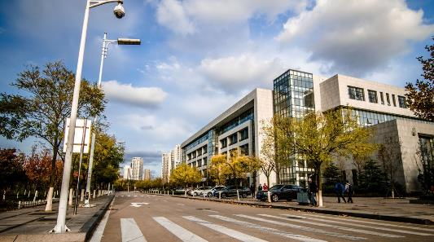
Unified Fonts Make Reading More F luent.
Unified Fonts Make Reading More F luent.
Text he re
Text he re
Copy paste fonts. Choose the only option to retain text.
……
Copy paste fonts. Choose the only option to retain text.
……

Slide 8
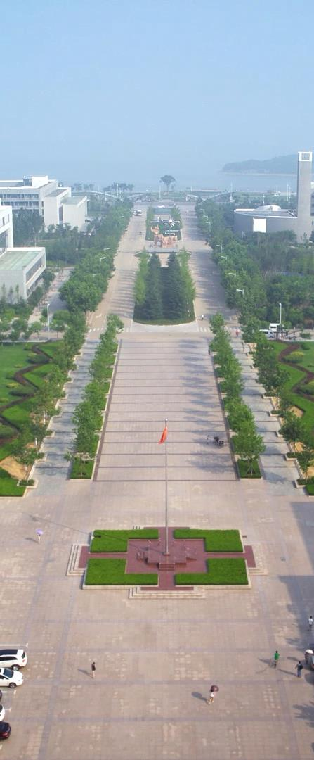
Text here
Supporting text here……
Unified
Fonts Make
Reading More Fluent.
Text here
Supporting text here……
Text here
Supporting text here……

Slide 9
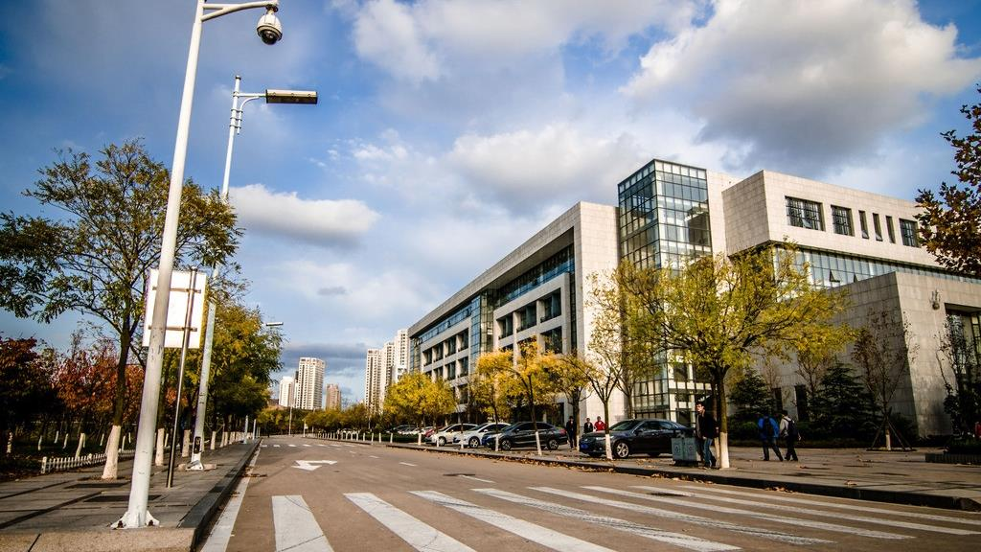
Text here
0 1
Copy paste fonts. Choose t he only option to retain text……
Unified Fonts Make
Reading More Fluent.
Text here
0 2
Copy paste fonts. Choose the only option to re tain text……
Text here
0 3
Copy paste fonts. Choose the only option to re tain text……

Slide 10

Unified fonts make reading more fluent.
Theme color makes PPT more convenient to change.Adjust the spacing to adapt to Chinese typesetting, use the reference line in PPT.

Slide 11
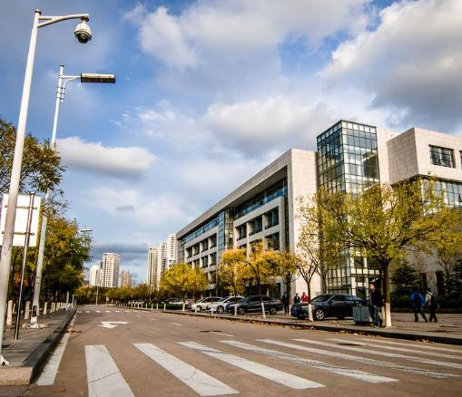

Unified fonts make reading more fluent.
Supporting text here.
Adjust the spacing to adapt to Chinese typesetting, use the reference line in PPT.
Tex t here

Slide 12
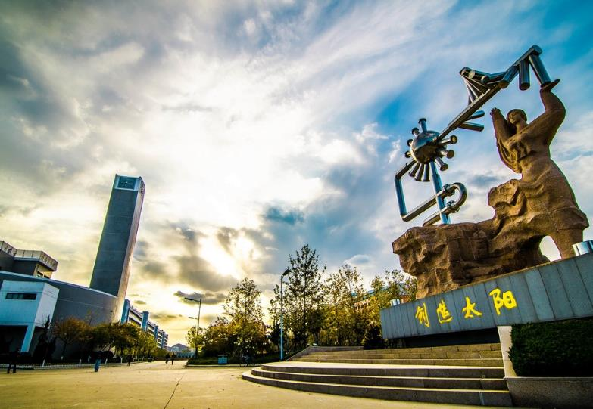
01.T ext here
Copy paste fonts. Cho ose the only option to retain text.
……
02.Tex t here
Theme color makes PPT more convenient to change.
Adjust the spacing to adapt to Chinese typesetting, use the reference line in PPT.
……
…t ext

Slide 13

Texthere
Texthere
Copy paste fonts. Choose the only option to retain text.
……
Copy paste fonts. Choose the only option to retain text.
……
Unified fonts make
reading more fluent.
Theme color makes PPT more convenient to change.
Adjust the spacing to adapt to Chinese typesetting, use the reference line in PPT.
Copy paste fonts. Choose the only option to retain text.
……
Copy paste fonts. Choose the only option to retain text.
……

Slide 14
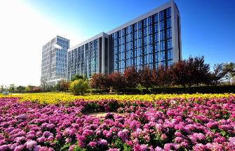

Sup porting text here.
Unifie d fonts make reading more fluent.
Theme color makes PP T more convenient to change.
Adjust the spacing to adapt to Chinese typesetting, use the reference line in PPT.
……
Te xt here
Te xt here
Copy past e fonts. Choose the only option to retain text.
……
Copy past e fonts. Choose the only option to retain text.
……

Slide 15
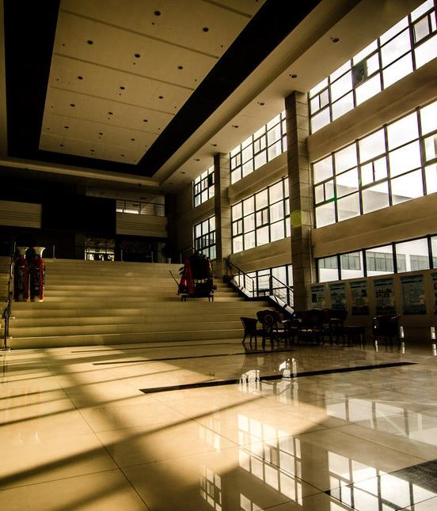
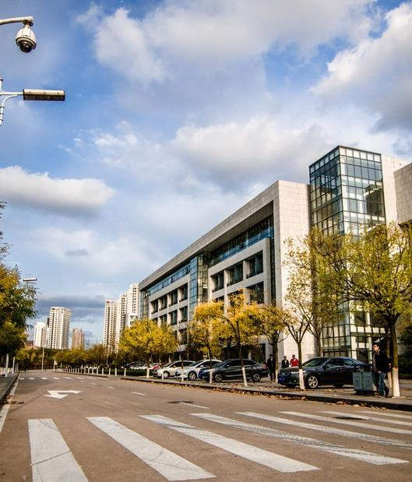
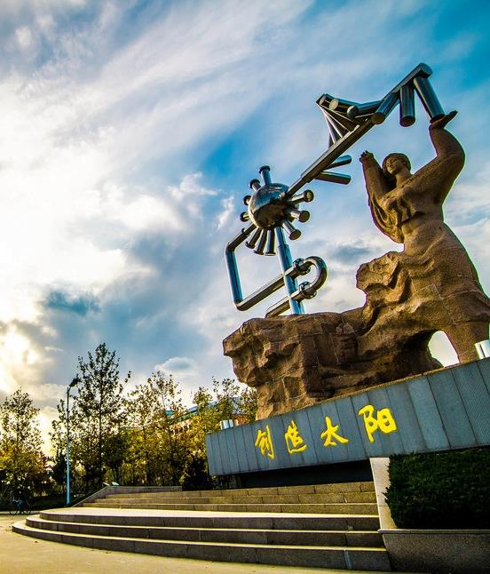
Unified fo nts make reading more fluent.
Theme color makes PPT more conve nient to change.Adjust the spacing to adapt to Chinese typesetting, use the reference line in PPT.
1
2
3
Te xt here
T ext here
T ext here
Copy paste fonts . Choose the only option to retain text.
……
……
Copy p aste fonts. Choose the only option to retain text.
……
……
Copy p aste fonts. Choose the only option to retain text.
……
……

Slide 16
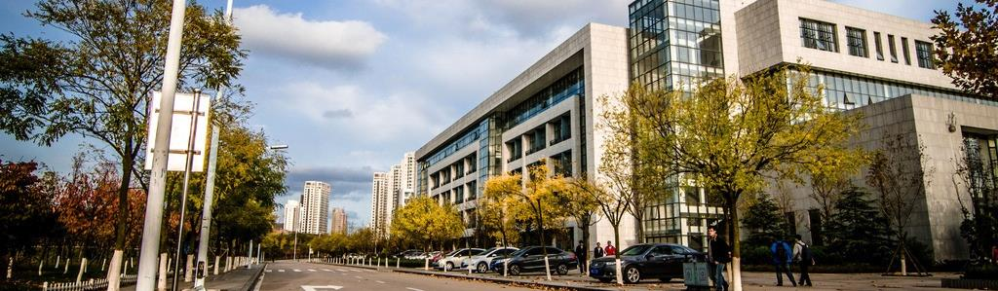
Unified
Font s Make
Reading More Fluent.
Tex t here
Tex t here
Te xt here
Support ing text here.
Support ing text here.
Sup porting text here.
… … ……
… … ……
… … ……
… … ……
… … ……
… … ……

Slide 17

Unified Fonts Make R eading More Fluent.
Theme color makes PPT more convenient to change. Adjust the spacing to adapt to Chinese typesetting, use the reference line in PPT.
Text Here
Text Here
Text Here
Text Here
Copy paste fonts. Choose the o nly option to retain text.
……
Copy paste fonts. Choose the only option to retain text.
……
Copy paste fonts. Choose the only option to retain text.
……
Copy paste fonts. Choose the only option to retain text.
……

Slide 18
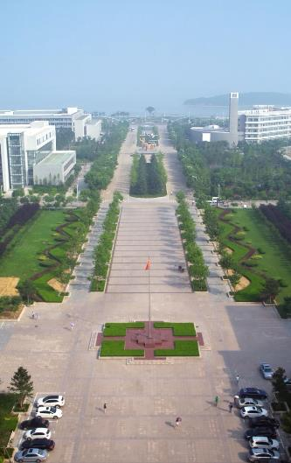


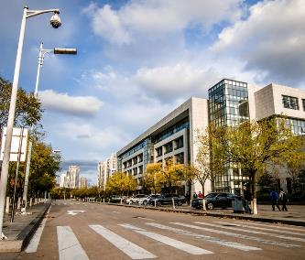

Te xt here
Theme color makes PPT more convenient to change.Adjust the spacing to adapt to Chinese typesetting, use the reference l ine in PPT.
01.Tex t here
02.Tex t here
03.Text he re
04.Text he re
05.Text he re
Supporting te xt here.
……
Supporting te xt here.
……
Supporting te xt here.
……
Supporting text here.
……
Supporting text here.
……

Slide 19

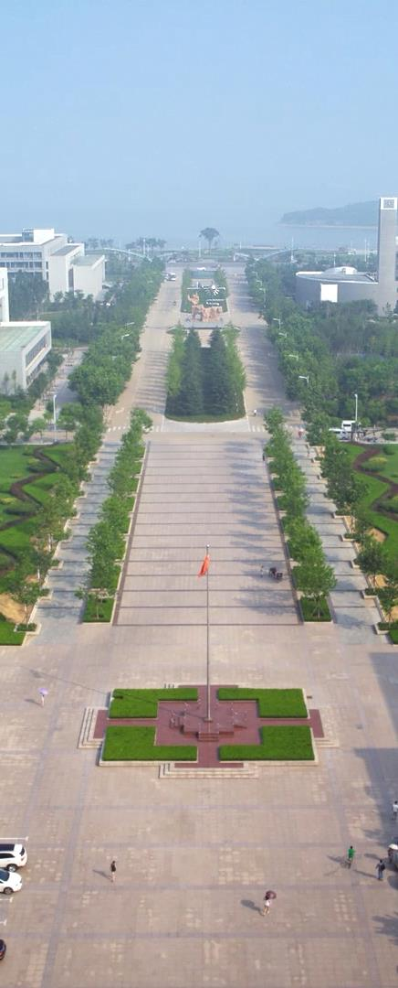
Text here
Unified fonts make reading more fluent.
Theme color makes PPT more convenient to change.Adjust the spacing to adapt to Chinese typesetting, use the reference line in PPT.
……
909 ,606K

Slide 20
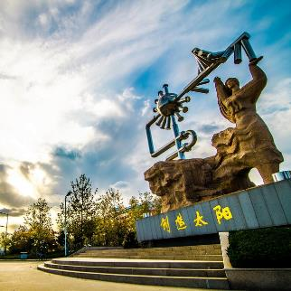
C EO
T ext here
S upporting text here.
U nified Fonts Make Reading More Fluent.
Unified fonts make reading more fluent.
Theme color makes PPT more convenient to change.Adjust the spacing to adapt to Chinese typesetting, use the reference line in PPT.
Supporting text here.
You can use the icon library in iSlide (www.islide.cc) to filter and replace existing icon elements with one click.
……

Slide 21


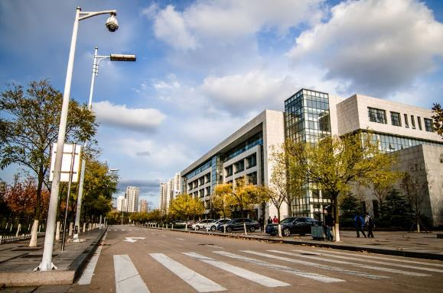
0 1
0 2
0 3
T ext here
T ext here
Text here
Copy p aste fonts. Choose the only option to retain text.
Copy p aste fonts. Choose the only option to retain text.
Copy paste fonts. Choose t he only option to retain text.

Slide 22
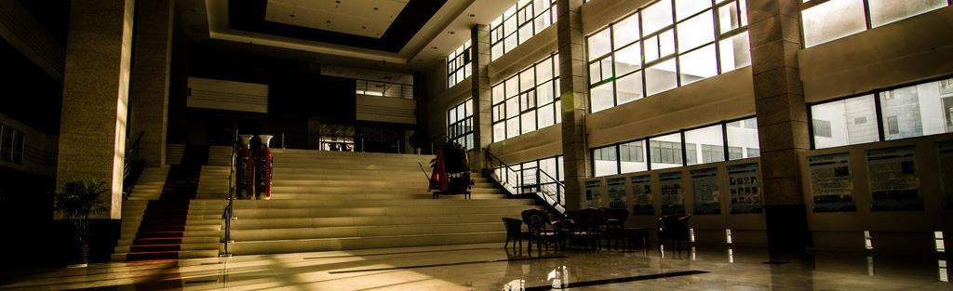
T ext here
T ext here
Copy past e fonts. Choose the only option to retain text.
……
Copy past e fonts. Choose the only option to retain text.
……

Slide 23
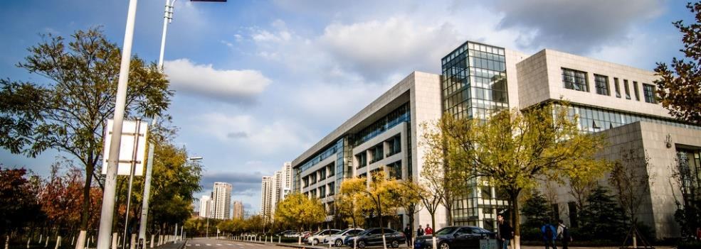
Unified fonts make
reading more flu ent.
Theme color makes PPT more convenient to change.
Adjust the spacing to adapt to Chinese typesetting, use the reference li ne in PPT.
Text here
Copy paste fonts. Choose the only option to retain text……
Text here
Copy paste fonts. Choose the only option to retain text……

Slide 24

80%
Text here
Copy paste fonts. Choose the only option to retain text.
… …

Slide 25
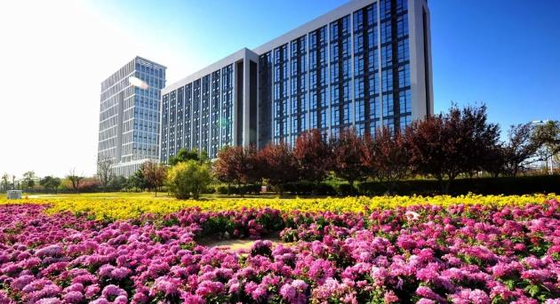
Text here
T ext here
Uni fied fonts make
reading more
fluent.
Copy pas te fonts. Choose the only option to retain text.
……
Copy paste fonts. Choose the only option to retain text.
……
Copy pas te fonts. Choose the only option to retain text.
……
Copy paste fonts. Choose the only option to retain text.
……
Theme col or makes PPT more convenient to change.
Adjust the spacing to adapt to Chinese typesetting, use the reference line in PPT.

Slide 26
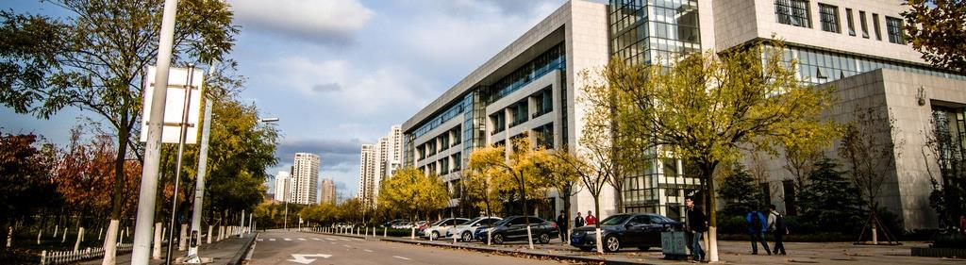
Supporting text here.
Unified Fonts Make Reading More Fluent.
Copy paste fonts. Choose the only option to retain text……
Copy paste fonts. Choose the only option to retain text……

Slide 27

Supporting text here.
Unified
Fonts Make
Reading More Fluent.
Text here
Supporting text here.
Theme color makes PPT more convenient to change.
Adjust the spacing to adapt to Chinese typesetting, use the reference line in PPT.
……
Text here
Supporting text here.
Text Here
Text here
Copy paste fonts. Choose the only option to retain text.
……
Supporting text here.
Text Here
Copy paste fonts. Choose the only option to retain text.
……

Slide 28
Text here
Text here
Text he re
Text he re
Text he re
Theme color make s PPT more convenient to change.
Adjust the spacing to adapt to Chinese typesetting, use the reference line in PPT.
Theme color make s PPT more convenient to change.
Adjust the spacing to adapt to Chinese typesetting, use the reference line in PPT.
Theme color make s PPT more convenient to change.
Adjust the spacing to adapt to Chinese typesetting, use the reference line in PPT.
Theme color make s PPT more convenient to change.
Adjust the spacing to adapt to Chinese typesetting, use the reference line in PPT.
Theme color make s PPT more convenient to change.
Adjust the spacing to adapt to Chinese typesetting, use the reference line in PPT.

Slide 29
THANKS
Unified fonts make reading more fluent.
Notes:
51PPT模板网，幻灯片演示模板及素材免费下载！
51PPT模板网 唯一访问网址：www.51pptmoban.com

