Slide 1
九江职业技术学院 文学系学术答辩 PPT
Jiujiang Vocational andTechnical College
Jiujiang Vocational and Technical College
author / Meimei Han | Time / 2024.05

Slide 2
Contents
01
02
03
04
T ext
T ext
T ext
T ext
Copy p aste fonts. Choose the only option to retain text.
……
Copy p aste fonts. Choose the only option to retain text.
……
Copy p aste fonts. Choose the only option to retain text.
……
Copy p aste fonts. Choose the only option to retain text.
……

Slide 3
01
Edit Master text styles
Theme color make s PPT more convenient to change.
Adjust the spacing to adapt to Chinese typesetting, use the reference line in PPT.

Slide 4
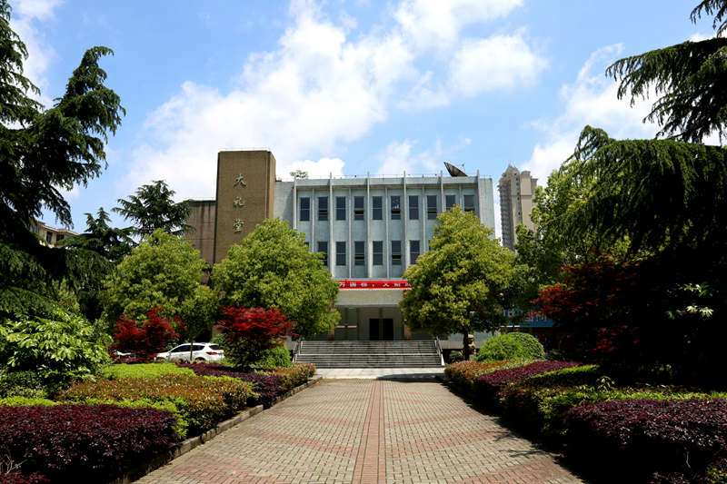
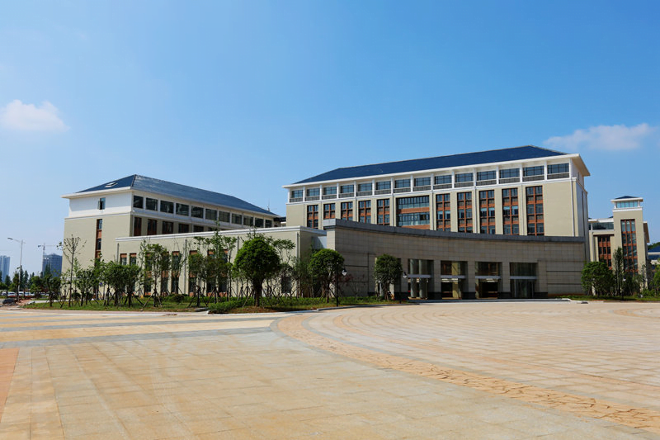
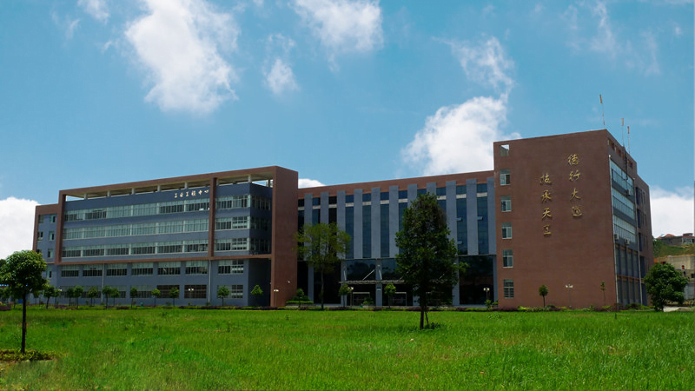
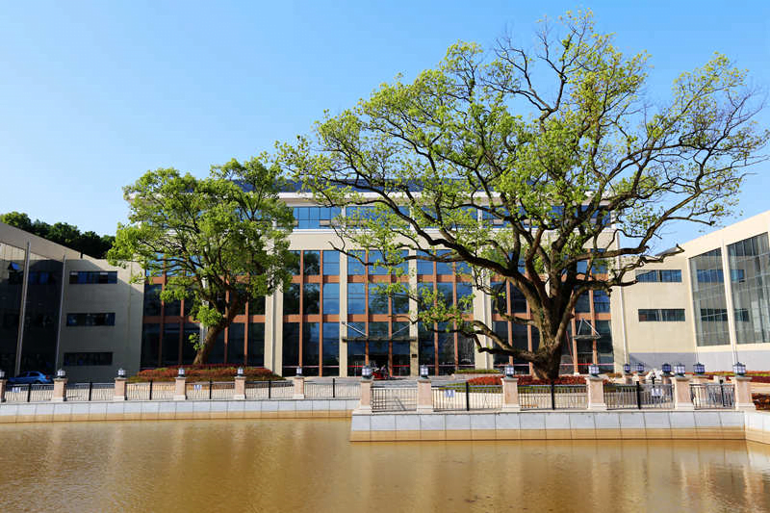
Text he re
0 1
Copy paste fonts. Choose the only option to retain te xt……
Text here
Text he re
02
Copy paste fonts. Choose the only option to retain te xt……
Text he re
03
Copy paste fonts. Choose the only option to retain te xt……
Text he re
04
Copy paste fonts. Choose the only option to retain te xt……

Slide 5
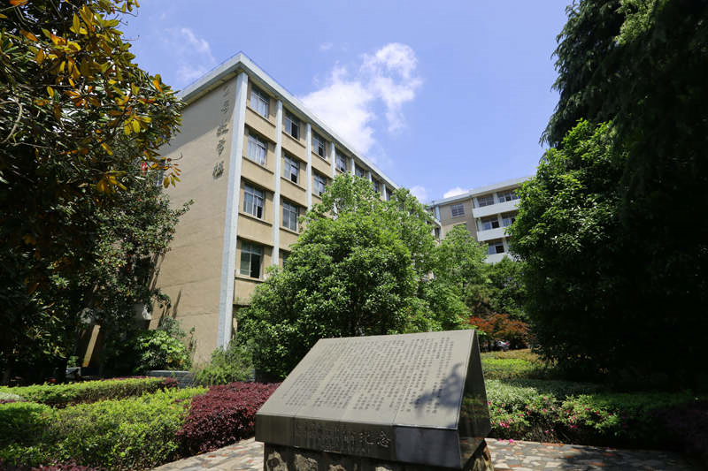
Text here
Unified fonts make readi ng more fluent.
Theme color makes PPT more convenient to change.
Adjust the spacing to adapt to Chi nesetypesetting, use the reference line in PPT.
Text here
Text here
Text here

Slide 6
Text here
Unified fonts make read ing more fluent.
Theme color makes PPT more convenient to change.
Adjust the spacing to adapt to Chinese typesetting, use the reference line in PPT.
0 1
0 3
0 5
Text here
Text he re
Text he re
Supporting text here.
… …
Text he re
Supporting text here.
… …
Text he re
Supporting text here.
… …
Supporting text here.
… …
Supporting text here.
… …
0 2
0 4

Slide 7
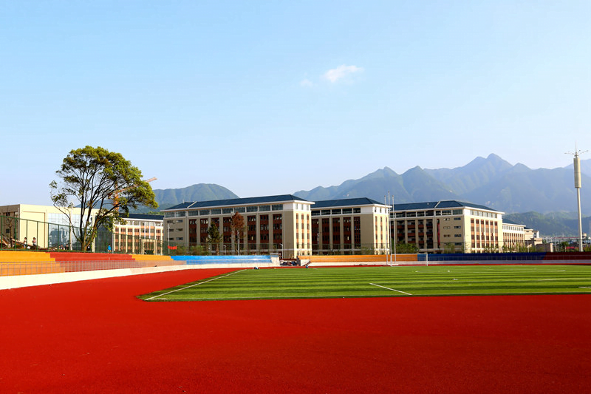
Un ified fonts
make reading more fluent.
Theme color makes PPT more convenient to change. A djust the spacing to adapt to Chinese typesetting, use the reference line in PPT.
Text here
Text here
Text here
Text here

Slide 8
Text here
1
2
3
4
Te xt here
Text here
Te xt here
Text here
Copy paste font s. Choose the only option to retain text.
……
Copy paste fonts. Choose the only op tion to retain text.
……
Copy paste font s. Choose the only option to retain text.
……
Copy paste fonts. Choose the only op tion to retain text.
……

Slide 9
Text here
Unified font s make
reading more fluent.
Theme color makes PPT more convenient to c hange.Adjust
the spacing to adapt to Chinese typesetting, use the reference
line in PPT.
Text here
Text here
Text here
Notes:
51PPT模板网，幻灯片演示模板及素材免费下载！
51PPT模板网 唯一访问网址：www.51pptmoban.com

Slide 10
Text here
Text here
Text here
Text here
Text here
Text here
Text here
Text here
Text here
Copy paste fonts. Choose the only option to retaintext.
……
Copy paste fonts. Choose the only option to retaintext.
……
Copy paste fonts. Choose the only option to retaintext.
……

Slide 11
Text here
Suppo rting text here.
Theme color makes PPT more c onvenient to change.
Adjust the spacing to adapt t o Chinese typesetting, use the reference line in PPT.
Text here
Text here
Suppo rting text here
……
Suppo rting text here
……
Suppo rting text here
……
Supporting te xt here
……

Slide 12
Text here
Unified Fonts Make Reading More Fluent.
Theme color makes PPT more convenient to change. Adjust the spacing to adapt to Chinese typesetting, use the reference line in PPT.
.……
Supp orting text here.
……
Supp orting text here.
……
Supp orting text here.
……

Slide 13
Text here
Unified fonts make
reading more fluen t.
Text he re
Copy paste fonts. Choose the only option to retain text.
……
Tex t here
Unified fonts make
reading more fluent.
Copy paste fonts. Cho ose the only option to retain text.
……

Slide 14
Text here
Te xt here
Copy paste fo nts. Choose the only option to retain text.
……
Te xt here
Te xt here
Copy paste fo nts. Choose the only option to retain text.
……
Copy paste fo nts. Choose the only option to retain text.
……

Slide 15
Text here
Unifi ed fonts make reading
more fluent.
Theme color make s PPT more convenient to change.
Adjust the spacing to adapt to Chinese typesetting, use the reference line in PPT……
Theme color make s PPT more convenient to change.
Adjust the spacing to adapt to Chinese typesetting, use the reference line in PPT……

Slide 16
Text here
Unified fonts make
reading more fluen t.
Theme color makes PPT more convenient to change. Adjust the spacing to adapt to Chinese typesetting, use the reference line in PPT.
… …
Text he re
Text here
Text here
Supporting text here.
… …
Supporting text here.
… …
Supporting text here.
… …

Slide 17
Unif ied fonts make
reading more fluent.
Theme color m akes PPT more convenient to change. Adjust the spacing to adapt to Chinese typesetting, use the reference line in PPT.
Theme color m akes PPT more convenient to change. Adjust the spacing to adapt to Chinese typesetting, use the reference line in PPT.
Text he re
Text here
Text here
Supporting text here.
… …
Supporting text here.
… …
Supporting text here.
… …

Slide 18
Text here
Unified fonts make reading more flue nt.
Theme color makes PPT more convenient to change.
Adjust the spacing to adapt to Chinesetypesetting, use the reference line in PPT.
Text here ›

Slide 19
Text here
Support ing text here.
U nified fonts make reading more fluent.
01.T ext here
02.T ext here
03.T ext here
Theme color makes PPT more convenient to change.
Adjust the spacing to adapt to Chinese typesetting, use the reference line in PPT.
……
Copy paste fonts. Choo se the only option to retain text.
……
Copy paste fonts. Choo se the only option to retain text.
……
Copy paste fonts. Choo se the only option to retain text.
……

Slide 20
Text here
Copy paste fonts. Choose the only option to retain text.
… …
Copy paste fonts. Choose the only option to retain text.
… …
...Text
...Text
...Text
...Text
Copy paste fonts. Choose the only option to retain text.
… …
Copy pas te fonts. Choose the only option to retain text.
… …

Slide 21
Text here
Unifie d fonts make reading more fluent.
Theme color makes PP T more convenient to change.
Adjust the spacing to adapt to Chinese typesetting, use the reference line in PPT.
… …
Te xt Here
Copy past e fonts. Choose the only option to retain text.
……
Te xt Here
Copy past e fonts. Choose the only option to retain text.
……

Slide 22
Text here
Unified fonts make reading more fl uent.
Theme color makes PPT more convenient to change. Adjust the spacing to adapt to Chinese typesetting, use the reference line in PPT.
5 1646K
9646 1K
4 6746K
T ext here
Text he re
T ext here

Slide 23
P PT
U nified fonts
make reading more fluent.
Th eme color makes PPT more convenient to change.
Adjust the spacing to adapt to Chinese typesetting, use the reference line in PPT……

Slide 24
Text here
Unified fonts make
reading more fluent.
Text here
Text here
Theme color makes PPT more convenient to change.
Adjust the spacing to adapt to Chinese typ esetting, use the reference line in PPT.
Copy paste fonts. Choose the only option to retain text.
……
Copy paste fonts. Choose the only optionto retain text.
……
Copy paste fonts. Choose the only option to retain text.
……
Copy paste fonts. Choose the only optionto retain text.
……

Slide 25
Text here
Text here
Text here
Supporting text here.
… …
Supporting text here.
… …
Text here
Text here
Supporting text here.
… …
Supporting text here.
… …
Notes:
51PPT模板网，幻灯片演示模板及素材免费下载！
51PPT模板网 唯一访问网址：www.51pptmoban.com

Slide 26
Text here
Unified fonts make read ing more fluent.
Theme color makes PPT more convenient to change.
Adjust the spacing to adapt to Chinese typesetting, use the reference line in PPT……
Theme color makes PPT more convenient to change.
Adjust the spacing to adapt to Chinese typesetting, use the reference line in PPT……

Slide 27
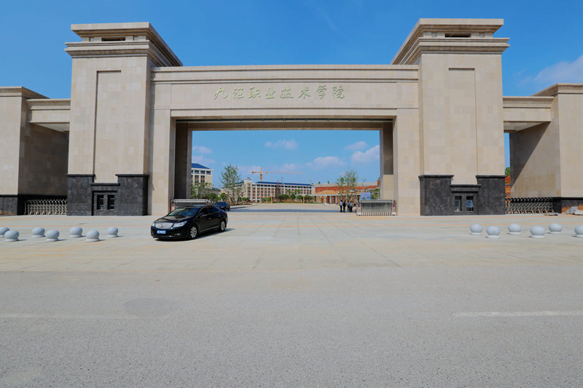
Tex t here
Tex t here
Tex t here
Tex t here
Tex t here
Te xt here
Supporti ng text here.
……
Supporti ng text here.
……
Supporti ng text here.
……
Supporti ng text here.
……
Supporti ng text here.
……
Supp orting text here.
……

Slide 28
THANKS
Theme color makes PPT more convenient to change.
Adjust the spacing to adapt to Chinese typesetting, use the reference line in PPT……

