Slide 1
华中农业大学 文学系学术答辩 PPT
Jiangxi University of Finance and Economics
author / Meimei Han
Notes:
51PPT模板网，幻灯片演示模板及素材免费下载！
51PPT模板网 唯一访问网址：www.51pptmoban.com

Slide 2
Contents
01
T ext here
Copy paste fonts. Choose the only option to ret ain text.
02
T ext here
Copy paste fonts. Choose the only option to ret ain text.
03
T ext here
Copy paste fonts. Choose the only option to ret ain text.

Slide 3
01
Edit Master text styles
Theme color make s PPT more convenient to change.
Adjust the spacing to adapt to Chinese typesetting, use the reference line in PPT.

Slide 4
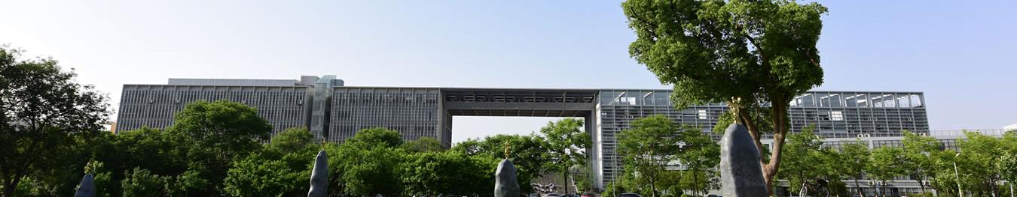
U nified fonts
make reading more fluent.
Unified fonts make reading more fluent. The me color makes PPT more convenient to change.
Adjust the spacing to adapt to Chinese typesetting, use the reference line in PPT.
……
Notes:
51PPT模板网，幻灯片演示模板及素材免费下载！
51PPT模板网 唯一访问网址：www.51pptmoban.com

Slide 5

Supportin g text here.
Unified Fonts Ma ke
Reading More Fluent.
Unified fonts make reading more fluent.
Theme color makes PPT more conv enient to change.
Adjust the spacing to adapt to Chinese typesetting, use the reference line in PPT.
……
01
02
03
04
40%
23%
72%
57%
text here
text here
text here
text here

Slide 6
5 0%
Te xt
8 52,256
Copy pa ste fonts. Choose the only option to retain text……
8 0%
T ext here
Copy pa ste fonts. Choose the only option to retain text……
8 0%
5 0%
6 5%
9 62,256
Copy pa ste fonts. Choose the only option to retain text……
T ext

Slide 7
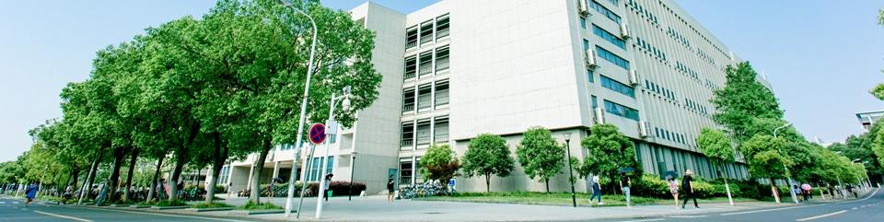
Text here
Unified fonts make reading more fluent. Theme color makes PPT more convenient to change. Adjust the spacing to adapt to Chinese typesetting, use the reference line in PPT ……
Text here
Text here
Text here
Copy paste fonts. Choosethe only option to retain text.
Copy paste fonts. Choose the only option toretain text.
Copy paste fonts. Choosethe only option to retain text.

Slide 8



U nified fonts
make reading more fluent.
Them e color makes PPT more convenient to change.
Adjust the spacing to adapt to Chinese typesetting, use the reference line in PPT.
Te xt here
Te xt here
T ext here
Copy paste fonts. Choose the only option to retain text.
……
Copy paste fonts. Choose the only option to retain text.
……
Co py paste fonts. Choose the only option to retain text.
……
T ext here ›

Slide 9

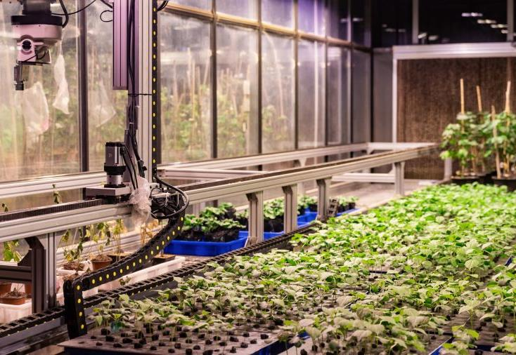
Text here
Copy paste fonts.Choose the only option to retain text
0 1
0 2
Support ing text here.
……
Supporting text here.
……

Slide 10
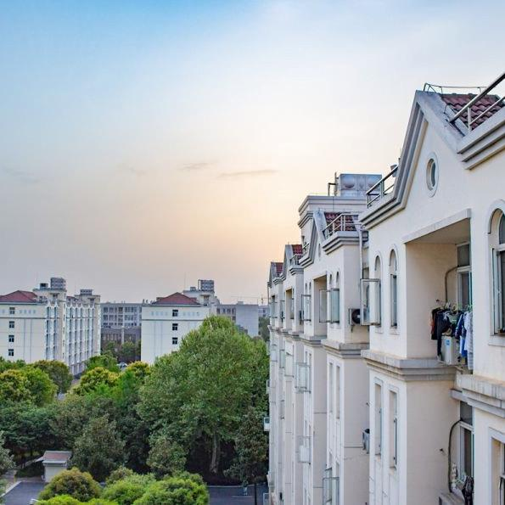
Supporting text here.
Unified Fonts Make Reading More Fluent.
Text here
Copy paste fonts. Choose the only option to retain text……
Text here
Copy paste fonts. Choose the only option to retain text……
Text here
Copy paste fonts. Choose the only option to retain text……

Slide 11
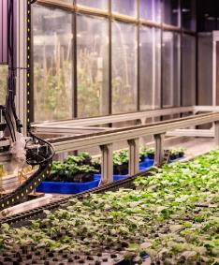



Text here
Copy paste fonts.Choose the only option to retain text.
……
Text here
Text here
Copy paste fonts.Choose the only option to retain text.
……
Copy paste fonts. Choose the only option to retain text.
……
Text here
Copy paste fonts. Choose the only option to retain text.
……

Slide 12
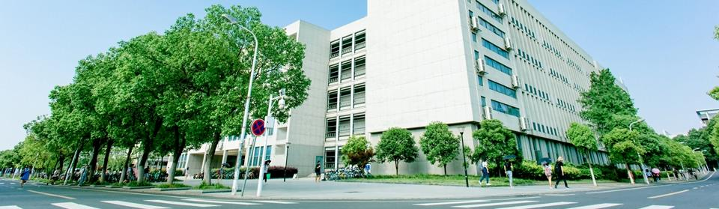
Text h ere
Text h ere
Text h ere
Text here
Text here
Supporting text her e.
……
Supporting text her e.
……
Supporting text her e.
……
Supporting text here.
……
Supporting text here.
……

Slide 13
Text here
Text here
Copy paste fonts. Choose the only option to retain text.
Copy paste fonts. Choose the only option to retain text.
Text
Text here
Text here
Copy paste fonts. Choose the only option to retain text.
Copy paste fonts. Choose the only option to retain text.
Text
Text here
Text here
Copy paste fonts. Choose the only option to retain text.
Copy paste fonts. Choose the only option to retain text.

Slide 14
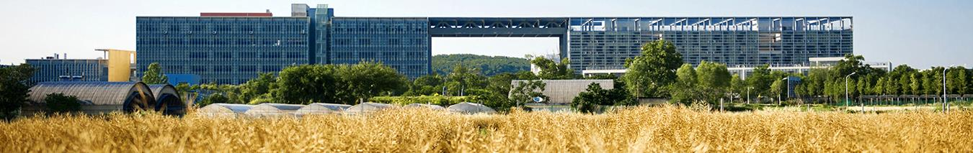
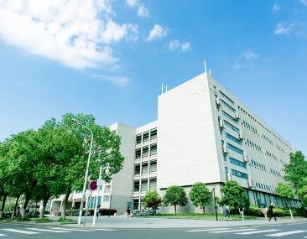
Text
here
Text here
Text here
Supporting text here.
……
Supporting text here.
Supporting text here.
……
Supporting text here.
Supporting text here.
……
Text here
Supporting text here.
……

Slide 15



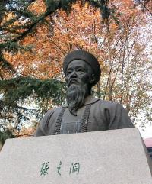

Texthere
Text here
Text here
Text here
Supporting text here.
……
Supporting text here.
……
Texthere
Supporting text here.
……
Supporting text here.
……
Supporting text here.
……

Slide 16
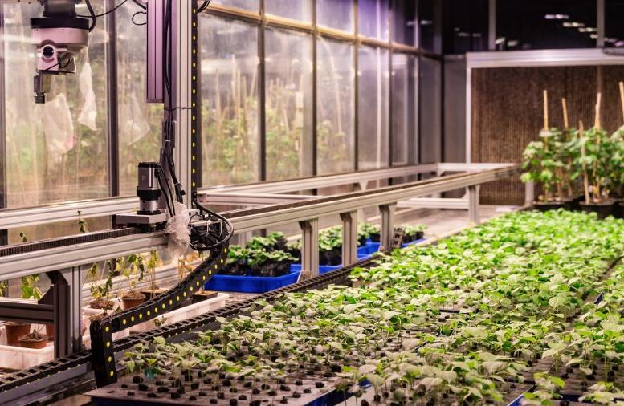
Text here
Supporti ng text here.
……
23%
Text here
Tex t here
Supporti ng text here.
……
23%
Text here
Tex t here
Supporti ng text here.
……

Slide 17

Text here
Copy paste fonts. Choose the only option to retain text.
… …
Unified fonts make
reading more fluent.
Text here
Theme color makes PPT more convenient to change.
Adjust the spacing to adapt to Chinese typesetting, use the reference line in PPT.
Copy paste fonts. Choose the only option to retain text.
… …
Text here
Copy paste fonts. Choose the only option to retain text.
… …

Slide 18
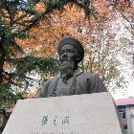



Texthere
Texthere
Copy paste fonts. Choose the only option to retain text.
… …
Copy paste fonts. Choose the only option to retain text.
… …
Text here
Text here
Copy paste fonts. Choose the only option to retain text.
… …
Copy paste fonts. Choose the only option to retain text.
… …

Slide 19

Unified Fonts Make Reading More Fluent. Theme color makes PPT more convenient to change. Adjust the spacing to adapt to Chinese typesetting, use the reference line in PPT..……
..t ext
Unified Fonts Make Reading More Fluent. Theme color makes PPT more convenient to change. Adjust the spacing to adapt to Chinese typesetting, use the reference line in PPT..……
Unified Fonts Make Reading More Fluent. Theme color makes PPT more convenient to change. Adjust the spacing to adapt to Chinese typesetting, use the reference line in PPT..……

Slide 20
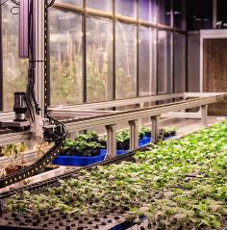


Text here
Text here
Copy paste fonts. Choose the only opt ion to retain text.
……
Copy paste fonts. Choose the only opt ion to retain text.
……
Text here
Text here
Copy paste fonts. Choose the only opt ion to retain text.
……
Copy paste fonts. Choose the only opt ion to retain text.
……

Slide 21

Supportin g text here.
Unified Fonts Ma ke
Reading More Fluent.
Unified fonts make reading more fluent.
Theme color makes PPT more conv enient to change.
Adjust the spacing to adapt to Chinese typesetting, use the reference line in PPT.
……
Text here
52%
Supporting text here
31%
27%
77%

Slide 22



Text here
Supporting text here.
……
…text
Text here
Text here
Supporting text here.
Supporting text here.
Supporting text here.
……
Supporting text here.
……
Text here
Supporting text here.
……

Slide 23


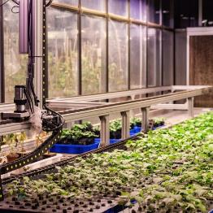

Unified fonts make
reading more fluent.
Theme color makes PPT more convenient to change.
Adjust the spacing to adapt to Chinese typesetting, use the reference line in PPT.
Texthere ›

Slide 24
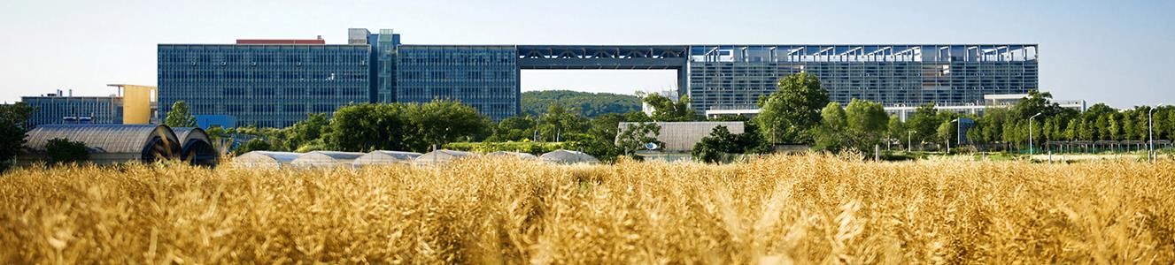
Unified fonts make
reading more fl uent.
Theme color makes PPT more convenient to change. Adjust the spacing to adapt to Chinese typesetting, use the referen ce line in PPT.
Theme color makes PPT more convenient to change.
Adjust the spacing to adapt to Chinese typesetting, use the referenc e line in PPT……
6 5%
3 5%
1 5%
T ext here
T ext here
Text he re

Slide 25

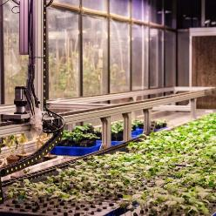

Unified Fonts Make Reading More Fluent.
Text here
Text here
Text here
Supporting text here.
… …
Supporting text here.
… …
Supporting text here.
… …

Slide 26




Unified fonts make reading more fluent.
Text here
Copy paste fonts. Choose th e only option to retain text.
Text h ere
Copy paste fonts. Choose th e only option to retain text.
Text h ere
Copy paste fonts. Choose the only option to ret ain text.

Slide 27
“
Supporting text he re
Supporting text here
Supporting text he re
…
Text Here
2 0%
Supporting text here Sup porting text here
50%
Text He re
30%
Supporting text here Supporting text h ere
Text He re
Supporting text here Supporting text h ere

Slide 28




Unified fonts make
r eading more fluent.
Theme color makes PPT more convenient to change.
Adjust the spacing to adapt to Chinese typesetting, use the reference line in PPT.
Text here ›

Slide 29
THANKS
Theme color makes PPT more convenient to change.
Adjust the spacing to adapt to Chinese typesetting, use the reference line in PPT……

