Slide 1



START
Notes:
1. Change title screen later with better design
2. Change font maybe later

Slide 2
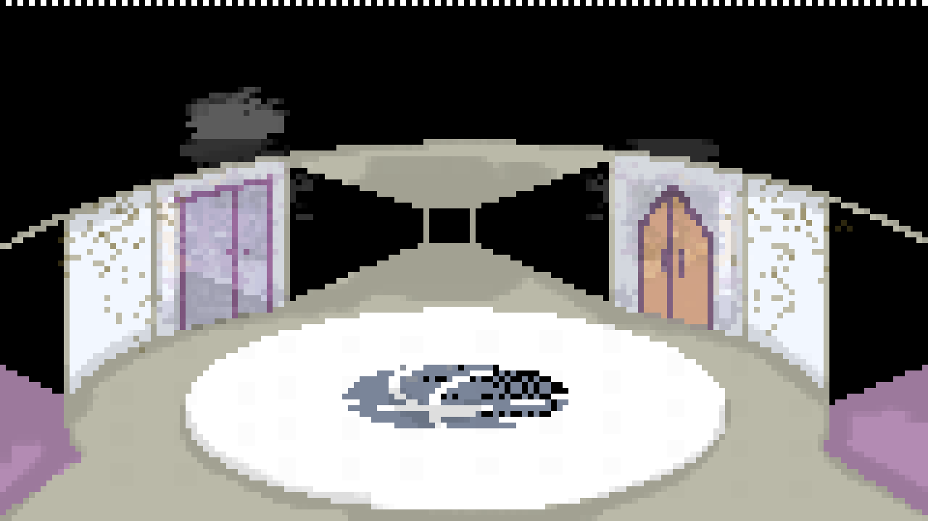

Welcome to the Atrium.
A murder has occurred.
Your job: Investigate.
Good luck.
OKAY
Notes:
1. Change title screen later with better design
2. Change font maybe later

Slide 3
Start with the crime scene.
OKAY
Notes:
1. Change title screen later with better design
2. Change font maybe later

Slide 4


Body found around:
4:00 – 5:00 PM.
Body shows signs of struggle – bruises on neck and wrist.
Victim is Victoria.
17, Female, 5’5.
Popular at school,
Chance of haters.
Notes:
1. Change title screen later with better design
2. Change font maybe later

Slide 5

x
Body found around:
4:00 – 5:00 PM.
Body shows signs of struggle – bruises on neck and wrist.
Victim is Victoria.
17, Female, 5’5.
Popular at school,
Chance of haters.
Notes:
1. Change title screen later with better design
2. Change font maybe later

Slide 6
That’s weird.
Yeah
Notes:
1. Change title screen later with better design
2. Change font maybe later

Slide 7

Bzz! Bzz! The walkie talkie is buzzing.
Notes:
1. Change title screen later with better design
2. Change font maybe later

Slide 8
We got information on the victim. Victim lives with her roommate, Layla. They appear to be close, though Layla does not seem fazed.
Noted
Notes:
1. Change title screen later with better design
2. Change font maybe later

Slide 9
She also has an ex-boyfriend, Brian.
They reportedly had an intense messy breakup.
Noted
Notes:
1. Change title screen later with better design
2. Change font maybe later

Slide 10
Victim also has a close older brother, Charlie.
He seemed troubled and agitated when asked.
Noted
Notes:
1. Change title screen later with better design
2. Change font maybe later

Slide 11
Try checking out the purple room on the first floor.
Okay
Notes:
1. Change title screen later with better design
2. Change font maybe later

Slide 12
Wait! A camera is necessary; did you bring it?
No.
Notes:
1. Change title screen later with better design
2. Change font maybe later

Slide 13
Sigh. Find one.
Now go.
Okay
Notes:
1. Change title screen later with better design
2. Change font maybe later

Slide 14
The second floor is out of bounds.
Notes:
1. Change title screen later with better design
2. Change font maybe later

Slide 15







The VIP Lounge
x
What a weird place… Everything looks normal.
What am I supposed to look for again?
Notes:
1. Change title screen later with better design
2. Change font maybe later

Slide 16
The VIP Lounge
Ever since she got popular, I was constantly shoved aside like some unwanted trash.
This is infuriating, I can’t let her keep taking my spotlight.
Notes:
1. Change title screen later with better design
2. Change font maybe later

Slide 17

The VIP Lounge
Ever since she got popular, I was constantly shoved aside like some unwanted trash.
This is infuriating, I can’t let her keep taking my spotlight.
Notes:
1. Change title screen later with better design
2. Change font maybe later

Slide 18
The VIP Lounge
A fingerprint! I wonder if this will relate.
Keep Searching
Leave, no return
Ever since she got popular, I was constantly shoved aside like some unwanted trash.
This is infuriating, I can’t let her keep taking my spotlight.
Notes:
1. Change title screen later with better design
2. Change font maybe later

Slide 19
The VIP Lounge
Ever since she got popular, I was constantly shoved aside like some unwanted trash.
This is infuriating, I can’t let her keep taking my spotlight.
Notes:
1. Change title screen later with better design
2. Change font maybe later

Slide 20
The VIP Lounge
x
Time of crime – 4:00 – 5:00PM. How is it still 5PM?
Maybe the clock is broken.
Ever since she got popular, I was constantly shoved aside like some unwanted trash.
This is infuriating, I can’t let her keep taking my spotlight.
Notes:
1. Change title screen later with better design
2. Change font maybe later

Slide 21

The VIP Lounge
Ever since she got popular, I was constantly shoved aside like some unwanted trash.
This is infuriating, I can’t let her keep taking my spotlight.
Notes:
1. Change title screen later with better design
2. Change font maybe later

Slide 22
The VIP Lounge
x
Ever since she got popular, I was constantly shoved aside like some unwanted trash.
This is infuriating, I can’t let her keep taking my spotlight.
Notes:
1. Change title screen later with better design
2. Change font maybe later

Slide 23
The second floor is out of bounds.
Notes:
1. Change title screen later with better design
2. Change font maybe later

Slide 24

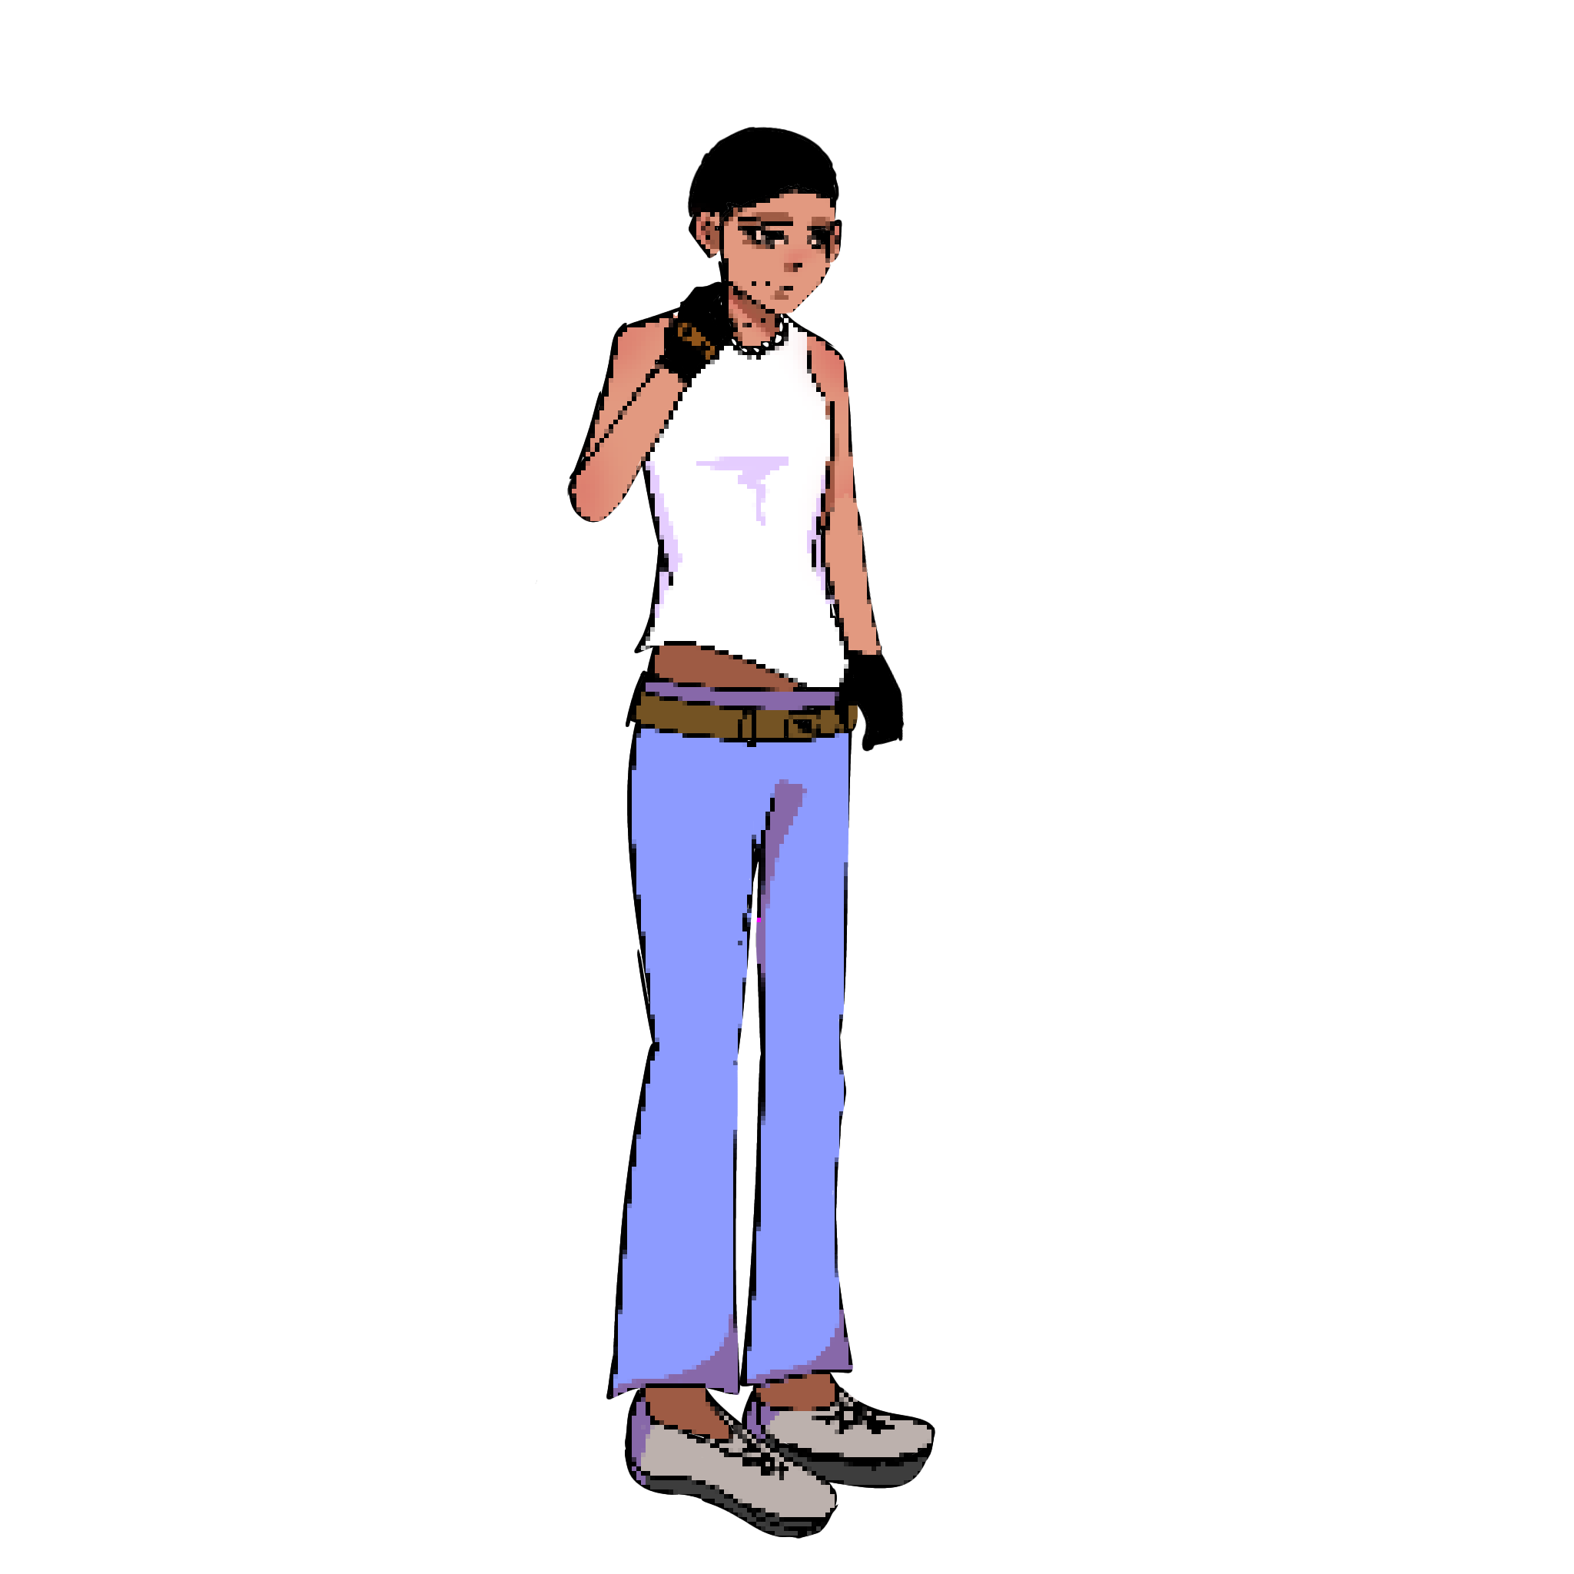




Old Unrented Room
x
Hmm. Dirty, old room. Must be untouched for long.
What kind of Atrium is this? So rusted out.
Notes:
1. Change title screen later with better design
2. Change font maybe later

Slide 25
Old Unrented Room
Notes:
1. Change title screen later with better design
2. Change font maybe later

Slide 26
Old Unrented Room
Notes:
1. Change title screen later with better design
2. Change font maybe later

Slide 27
Old Unrented Room
Notes:
1. Change title screen later with better design
2. Change font maybe later

Slide 28
Old Unrented Room
Notes:
1. Change title screen later with better design
2. Change font maybe later

Slide 29

Old Unrented Room
x
Why are you here?
Notes:
1. Change title screen later with better design
2. Change font maybe later

Slide 30
Old Unrented Room
x
I’m a detective investigating the Victoria case. May I have your name, sir? And have you seen anything? Any screaming or struggle?
Notes:
1. Change title screen later with better design
2. Change font maybe later

Slide 31

Old Unrented Room
x
Ah she’s my ex, serves her good.
And no I didn’t see anything, I’m also innocent.
Notes:
1. Change title screen later with better design
2. Change font maybe later

Slide 32
Old Unrented Room
x
Ah, Brian. Why are you sitting here blankly then?
Notes:
1. Change title screen later with better design
2. Change font maybe later

Slide 33
Old Unrented Room
x
Recently rented this room, need some work. Now if you excuse me-
Notes:
1. Change title screen later with better design
2. Change font maybe later

Slide 34
Old Unrented Room
x
Sir, I’m sure you’re busy. But may we have you stay in the suspect room for a while? All of Victoria’s close contacts will join you shortly after.
Notes:
1. Change title screen later with better design
2. Change font maybe later

Slide 35
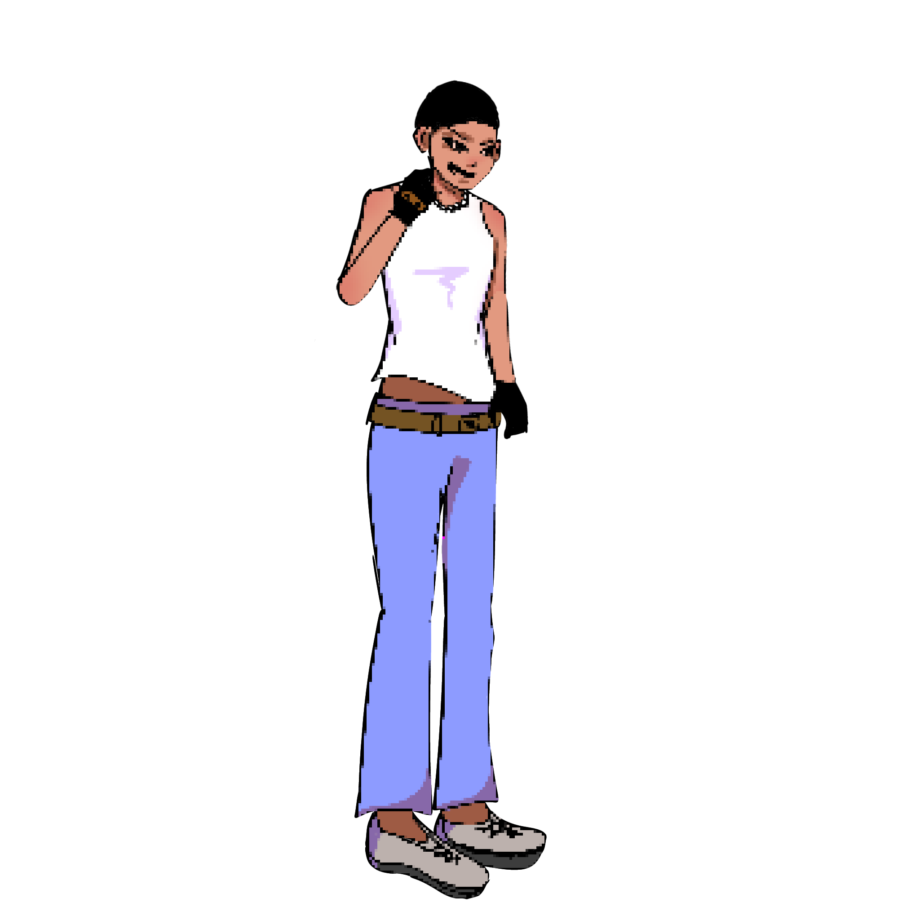
Old Unrented Room
x
Suspect?! I told you I have nothing to do with that kid. Look, I’m just trying to make a living. Victoria is not my business!
Notes:
1. Change title screen later with better design
2. Change font maybe later

Slide 36
Old Unrented Room
x
This is just standard procedure. Please follow me.
Notes:
1. Change title screen later with better design
2. Change font maybe later

Slide 37
Old Unrented Room
x
UGH!
Notes:
1. Change title screen later with better design
2. Change font maybe later

Slide 38
Old Unrented Room
<-
Notes:
1. Change title screen later with better design
2. Change font maybe later

Slide 39
The second floor is out of bounds.
Yay! You found the first suspect. Let’s search the corridors.
Maybe pick up a camera along the way.
Okay
Notes:
1. Change title screen later with better design
2. Change font maybe later

Slide 40
The second floor is out of bounds.
Notes:
1. Change title screen later with better design
2. Change font maybe later

Slide 41
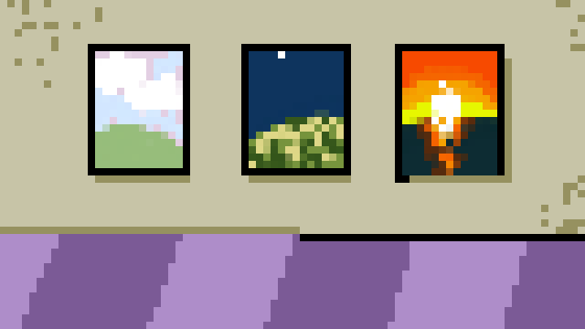
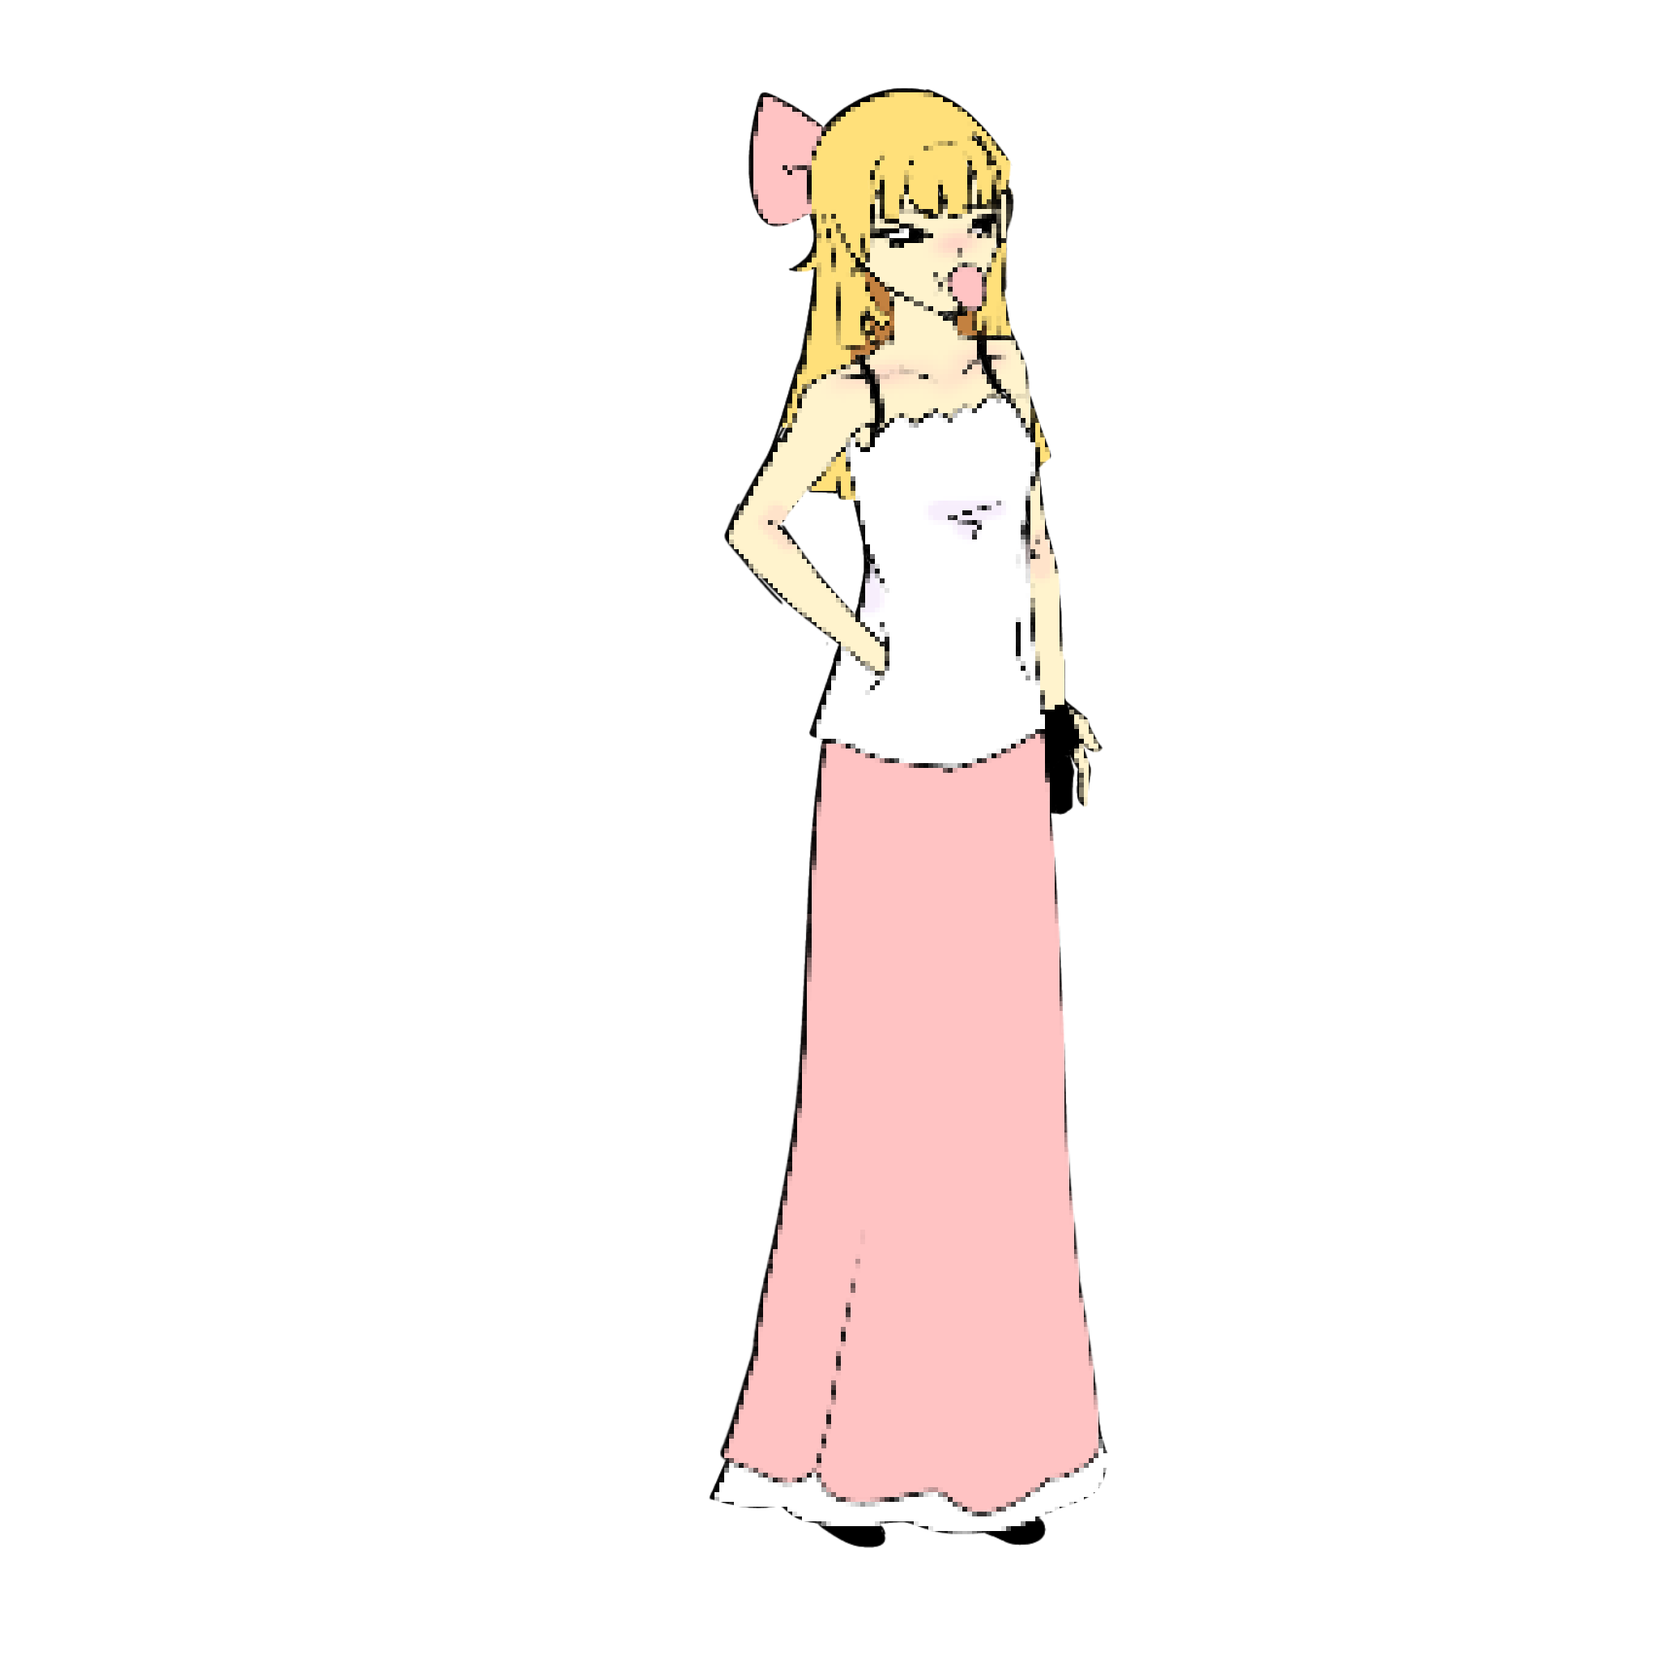

Slide 42

x
Ew, who are you?

Slide 43
x
Detective investigating the Victoria case. Are you Layla?

Slide 44

x
I heard, but I didn’t do anything. Hell, haven’t even seen her the entire day!

Slide 45
x
You’re her roommate, aren’t you? Did you see anything at time of crime?

Slide 46
x
I was in the 2nd floor bathroom I suppose, but I did hear screaming and something like a fight.

Slide 47
x
Interesting. May I escort you to the suspect room? It’s standard procedure.

Slide 48
x
Ugh, fine! Make it quick.

Slide 49
x
Great ma’am. Oh and, can I borrow that camera you’re holding?

Slide 50

Seriously? Whatever.

Slide 51
Good job. You found a camera! Use it to record evidence.
Okay

Slide 52
The second floor is out of bounds.
Notes:
1. Change title screen later with better design
2. Change font maybe later

Slide 53
The second floor is out of bounds.
Bzzz-
Huh?
Notes:
1. Change title screen later with better design
2. Change font maybe later

Slide 54
The second floor is not out of bounds.
x
That’s… weird. Why do I suddenly feel light-headed?
Notes:
1. Change title screen later with better design
2. Change font maybe later

Slide 55
Huh?

Slide 56
Welcome to the Atrium.
A murder has occurred.
Good luck.
OKAY
Notes:
1. Change title screen later with better design
2. Change font maybe later

Slide 57
Start with the crime scene.
OKAY
Notes:
1. Change title screen later with better design
2. Change font maybe later

Slide 58
Body found around:
4:00 – 5:00 PM.
Body shows no signs of struggle.
Victim is Victoria.
17, Female, 5’5
Everyone’s favorite.
Notes:
1. Change title screen later with better design
2. Change font maybe later

Slide 59
x
Body found around:
4:00 – 5:00 PM.
Body shows no signs of struggle.
Victim is Victoria.
17, Female, 5’5
Everyone’s favorite.
Notes:
1. Change title screen later with better design
2. Change font maybe later

Slide 60
x
What? Was everything not real?
Notes:
1. Change title screen later with better design
2. Change font maybe later

Slide 61
Bzz! Bzz! The walkie talkie is buzzing.
Notes:
1. Change title screen later with better design
2. Change font maybe later

Slide 62
We need information and a decision ASAP. Family is demanding. The mall is momentarily locked; there should be no one inside.
Wait.
Notes:
1. Change title screen later with better design
2. Change font maybe later

Slide 63
Copy?
Noted
Notes:
1. Change title screen later with better design
2. Change font maybe later

Slide 64
Try checking out the purple room on the first floor.
Okay
Notes:
1. Change title screen later with better design
2. Change font maybe later

Slide 65
The second floor is out of bounds.
Notes:
1. Change title screen later with better design
2. Change font maybe later

Slide 66

The VIP Lounge
x
This again?
Notes:
Change title screen later with better design
2. Change font maybe later
3. remove the out of bound hyperlink

Slide 67
The VIP Lounge
Ever since she got popular, I was constantly shoved aside like some unwanted trash.
This is infuriating, I can’t let her keep taking my spotlight.
Notes:
1. Change title screen later with better design
2. Change font maybe later

Slide 68

The VIP Lounge
Ever since she got popular, I was constantly shoved aside like some unwanted trash.
This is infuriating, I can’t let her keep taking my spotlight.
Notes:
1. Change title screen later with better design
2. Change font maybe later

Slide 69
The VIP Lounge
A laptop!
Enter
Ever since she got popular, I was constantly shoved aside like some unwanted trash.
This is infuriating, I can’t let her keep taking my spotlight.
Notes:
1. Change title screen later with better design
2. Change font maybe later

Slide 70


Slide 71

Shut down? (No return)

Slide 72


Slide 73


Slide 74

Found a note that seemed to be from a diary talking about how they are only known as Victoria’s second at school.
Owner seems to be in 12th grade.
Found during 4:00-4:30 patrol.

Slide 75

x
Is it this drawer?

Slide 77

I’m so sick of Vic. The teachers love her; all my friends prefer her over me.
This is so unfair!
I wanted to confront her after math class today but my teacher held me back for homework.
When will she just stay out of my life forever?!

Slide 78
x
I’m so sick of Vic. The teachers love her; all my friends prefer her over me.
This is so unfair!
I wanted to confront her after math class today but my teacher held me back for homework.
When will she just stay out of my life forever?!

Slide 79
The VIP Lounge
x
I- Is that water red? It was clear last time.
Ever since she got popular, I was constantly shoved aside like some unwanted trash.
This is infuriating, I can’t let her keep taking my spotlight.
Notes:
1. Change title screen later with better design
2. Change font maybe later

Slide 80
The VIP Lounge
x
Hmm… Someone must’ve messed with the clock.
Ever since she got popular, I was constantly shoved aside like some unwanted trash.
This is infuriating, I can’t let her keep taking my spotlight.
Notes:
1. Change title screen later with better design
2. Change font maybe later

Slide 81

The VIP Lounge
Ever since she got popular, I was constantly shoved aside like some unwanted trash.
This is infuriating, I can’t let her keep taking my spotlight.
Notes:
1. Change title screen later with better design
2. Change font maybe later

Slide 82
The VIP Lounge
x
An ID? Charlie Beck… Victoria’s Brother.
Ever since she got popular, I was constantly shoved aside like some unwanted trash.
This is infuriating, I can’t let her keep taking my spotlight.
Notes:
1. Change title screen later with better design
2. Change font maybe later

Slide 83
The VIP Lounge
x
Victoria this,
Victoria that.
Always her, never me!
Notes:
1. Change title screen later with better design
2. Change font maybe later

Slide 84

The second floor is out of bounds.
Notes:
1. Change title screen later with better design
2. Change font maybe later

Slide 85
The second floor is out of bounds.
x
This was Layla’s camera and polaroid!
Notes:
1. Change title screen later with better design
2. Change font maybe later

Slide 86
Notes:
1. Change title screen later with better design
2. Change font maybe later

Slide 87

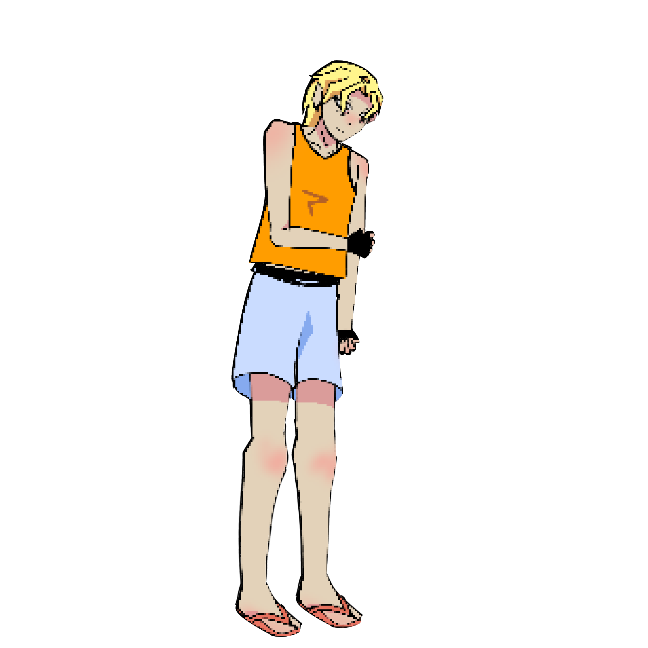

Slide 88
x
Excuse me sir, are you Charlie?

Slide 89


x
Oh! Y-Yes I am. Who are you?

Slide 90
x
I am a detective investigating your sister’s case. Mind if I escort you into the holding room?

Slide 91
x
Right. I’m totally innocent! I wasn’t even here to save her…
What a bad brother I am!

Slide 93
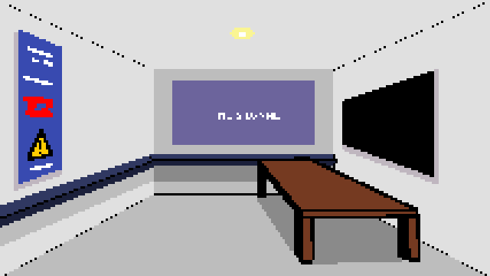
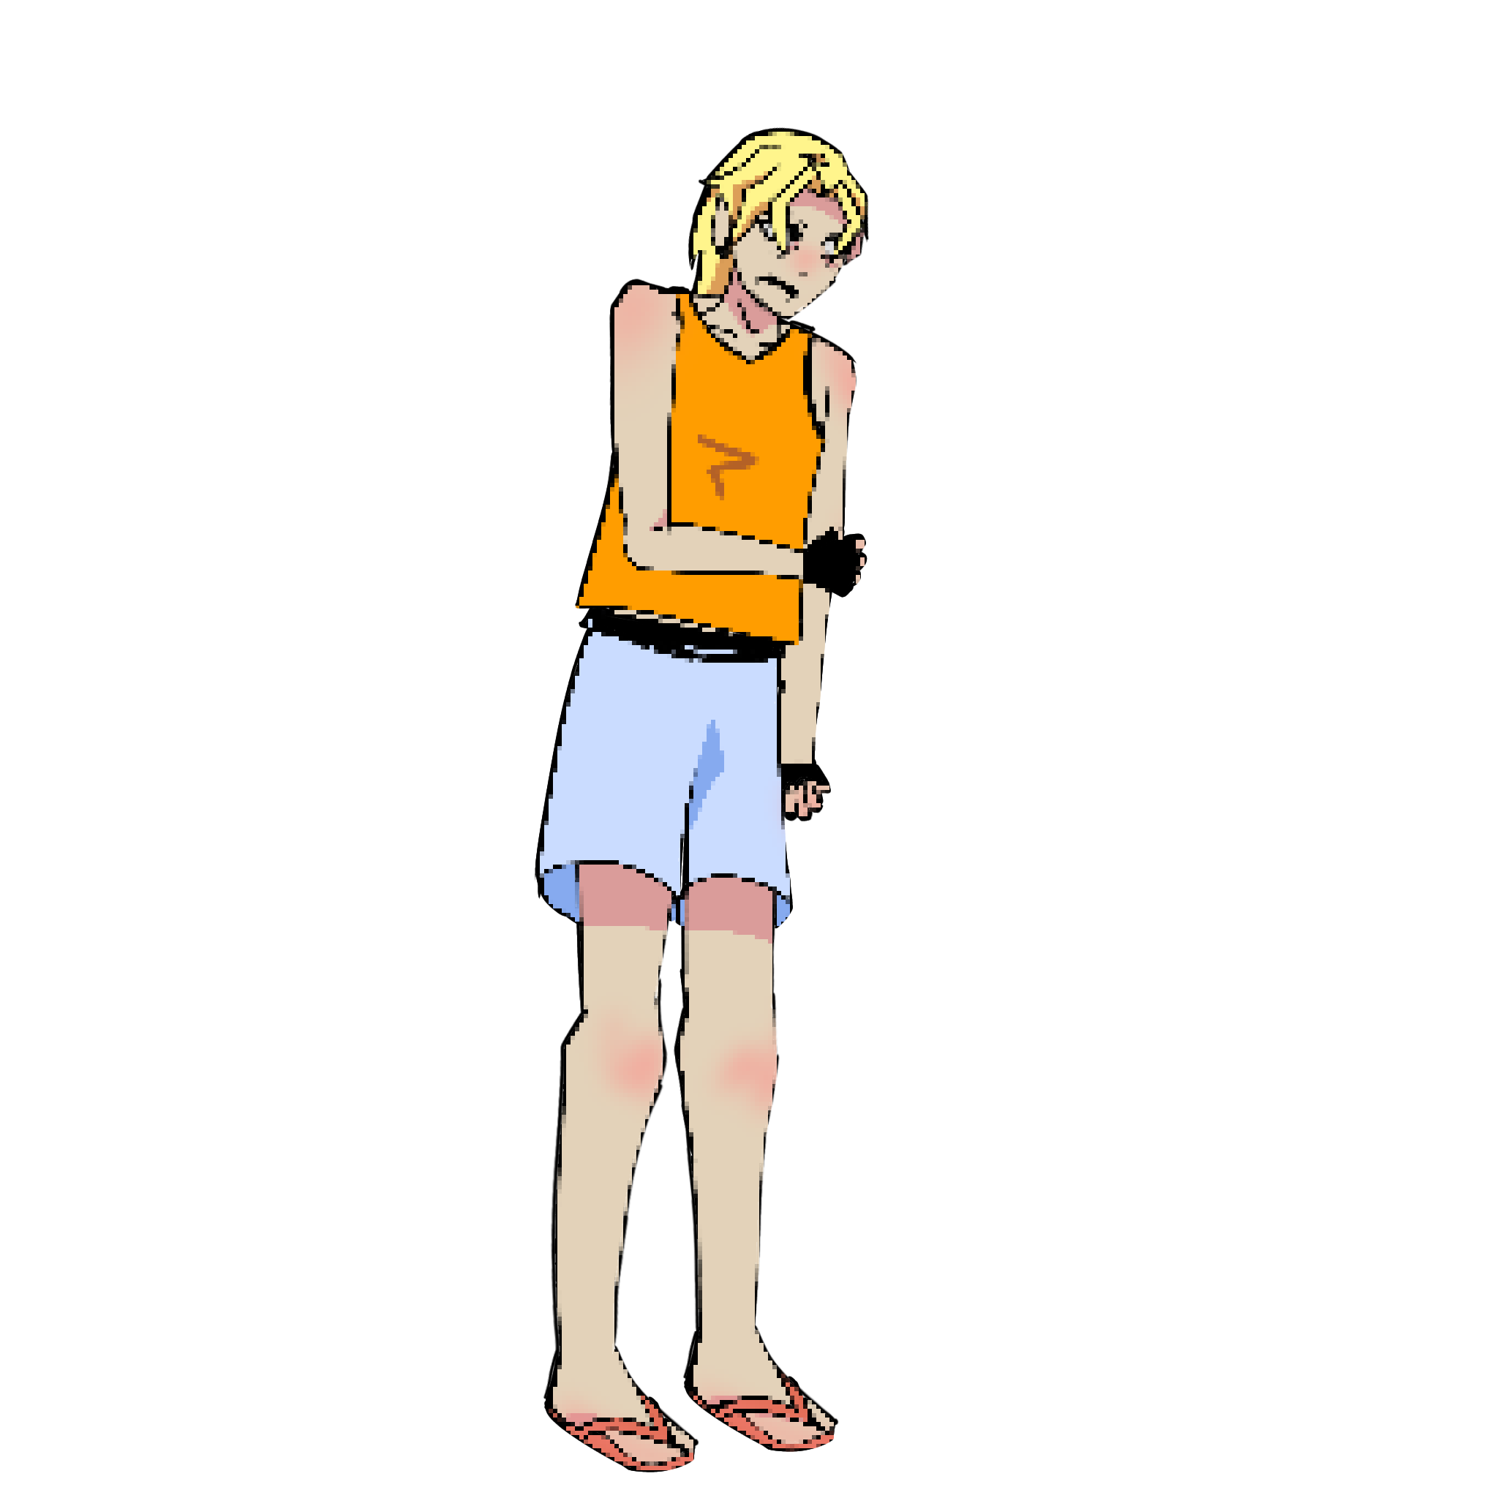

Notes:
Them fighting

Slide 94
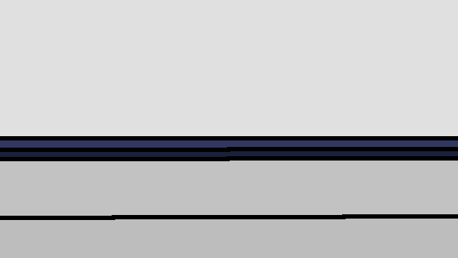


Slide 95
x
That’s enough of you three! Why are you fighting?

Slide 96
x
He insulted my sister!

Slide 97
x
Insulted? Oh please. It was the truth, Charlie. Your sister lied to me; to the whole school!

Slide 98
x
You still don’t deserve to talk about her like that!

Slide 99
x
x
Oh my god, Brian. I know how much of a jerk you are. She wasn’t lying! If she was I’d know!

Slide 100
x
You’d know? You make me laugh-

Slide 101
x
ENOUGH!

Slide 102
x
…

Slide 103
Detective, we have reviewed the evidence you submitted. It isn’t sufficient.
Noted.

Slide 104
x
I’ll be back. You guys behave yourselves.

Slide 105
Maybe you missed a corridor?
Okay

Slide 106
Notes:
1. Change title screen later with better design
2. Change font maybe later

Slide 107


Notes:
1. Change title screen later with better design
2. Change font maybe later

Slide 108
A USB stick!
Wait there’s more…
Okay
Notes:
1. Change title screen later with better design
2. Change font maybe later

Slide 109

Blood? Quick, be sure to take a picture!
Notes:
1. Change title screen later with better design
2. Change font maybe later

Slide 110

Notes:
1. Change title screen later with better design
2. Change font maybe later

Slide 111
Where can I load this USB?
Okay
Notes:
1. Change title screen later with better design
2. Change font maybe later

Slide 112

Notes:
1. Change title screen later with better design
2. Change font maybe later

Slide 113
Notes:
1. Change title screen later with better design
2. Change font maybe later

Slide 114

Notes:
1. Change title screen later with better design
2. Change font maybe later

Slide 115
Notes:
1. Change title screen later with better design
2. Change font maybe later

Slide 116
The VIP Lounge
x
… Why do I feel so agitated?
Notes:
Change title screen later with better design
2. Change font maybe later
3. remove the out of bound hyperlink

Slide 117
The VIP Lounge
Ever since she got popular, I was constantly shoved aside like some unwanted trash.
This is infuriating, I can’t let her keep taking my spotlight.
Notes:
1. Change title screen later with better design
2. Change font maybe later

Slide 118
The VIP Lounge
Ever since she got popular, I was constantly shoved aside like some unwanted trash.
This is infuriating, I can’t let her keep taking my spotlight.
Notes:
1. Change title screen later with better design
2. Change font maybe later

Slide 119
The VIP Lounge
Ever since she got popular, I was constantly shoved aside like some unwanted trash.
This is infuriating, I can’t let her keep taking my spotlight.
Notes:
1. Change title screen later with better design
2. Change font maybe later

Slide 120
The VIP Lounge
Quick!
Enter
Notes:
1. Change title screen later with better design
2. Change font maybe later

Slide 124
kSlide 122

Slide 125
I don’t know what’s happening but I’ve been doing things out of my will-------
My vision is noisy and I feel like someone is following me.

Slide 127


Slide 128

x
Is that blonde hair? The second figure is Victoria, the victim. But the perpetrator is unclear.

Slide 130
Notes:
1. Change title screen later with better design
2. Change font maybe later

Slide 134
Notes:
Them fighting

Slide 136
x
I got evidence but footage was unclear, I need to hear everyone’s alibis. Starting with you, Charlie.

Slide 137
x
R-right. I was at home around 4pm and I was watching TV. I suddenly received a phone call about Victoria and I rushed over here.

Slide 138
x
Layla?

Slide 139
x
Like I said, I was in the bathroom. I was there for a while because uhm, I ate something wrong.

Slide 140
x
And out of nowhere I heard a scream or something. That’s all I can offer ya.

Slide 141
x
Brian?

Slide 142
x
I was talking to the property manager on the paperwork of the room I rented.

Slide 143
x
Hmm… I wonder who is the culprit.

Slide 144
Question more?
  Question
Decide

Slide 145
Who to question?
  Charlie
  Layla
  Brian
Decide

Slide 146
x
Charlie, I found your ID card in the purple room. Why is that?

Slide 147
x
You did? I must’ve left it there last sunday after my group project.

Slide 148
x
The school term has already ended, Charlie. What school project do you have?

Slide 149
x
It’s not for school, you see. Me and my friends were working on a business. We booked the room to discuss.

Slide 150
x
I see.

Slide 151
x
Layla, I found your polaroid on the floor. It seems that the picture was taken just a while ago. The timestamp showed 4:30, around time of crime.

Slide 152
x
x
Does it now?

Slide 153
x
Yes, answer me this, you said you were in the bathroom around that time.

Slide 154
x
x
Yeah, and?

Slide 155
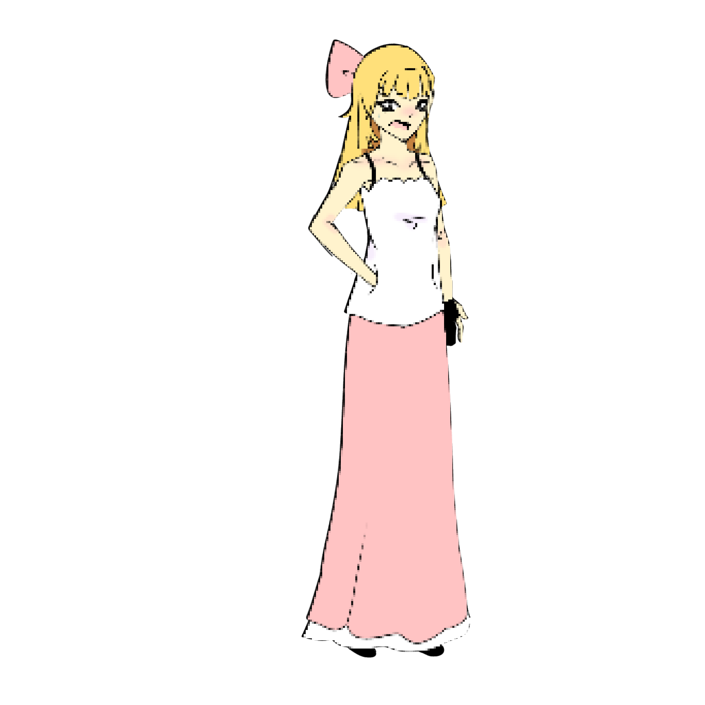
x
Let me speak!

Slide 156
x
…

Slide 157
x
How did you take the picture then?

Slide 158
x
x
I don’t recall taking that picture.

Slide 159
x
I see.

Slide 160
x
Brian, Let me ask you: when was the last time you see Victoria?

Slide 161
x
Not ever since I saw that lying kid humiliate me in front of the whole school.

Slide 162
x
We found a fingerprint we ran tests on in the purple room. It was yours.

Slide 163
x
I was in there because I left my watch on accident. I was in that room with Victoria privately the day before.

Slide 166
x
I see.

Slide 167
x
I have made my decision.

Slide 168
Who is the murderer?
  Charlie
  Layla
  Brian

Slide 169
x
Charlie, follow me.

Slide 170
x
Layla, follow me.

Slide 171
x
Brian, follow me.

Slide 172
Uh oh!
?

Slide 173
It found you.
?

Slide 174
Good luck.
?

Slide 175
Oh, Layla.
?

Slide 176
x
x
WAIT- PLEASE BELIEVE ME! I DON’T HAVE ANY MEMORY EVEN SEEING HER TODAY!

Slide 177
x
I’m sorry, but it’s up to court now.

Slide 178
x
x
PLLLLLLLLLLLLLLLLLLLLLLLEASE!

Slide 179

Oo, it’s the key to leave!

Slide 180
You think it’s that easy?
Think again.

Slide 181
Whoops! It won’t let you go that easily.

Slide 182
Well, good job, detective! You caught the c̸̛͎u̴̬̚l̵̠̆p̶̱̓r̶̹͌į̴̄t̸̙̏
Shouldn’t you go home?

Slide 183
Fine, here’s the key.
Good luck escaping it though.

Slide 184
Fine, here’s the key.
Good luck escaping it though.

