Slide 1

Toward a battery digital twin
Phase 1: reliable cyclic voltammetry evidence
Cheritha Kaiwar · Prajwal S · Karan Koder
Under the guidance of Dr. Manjunatha C.
RV College of Engineering, Bengaluru
SiNK 2026 · RESEARCH PRESENTATION
01
Notes:
Title and authors supplied by the project team. Scope: implemented CV quality layer, with future battery-health validation planned.
Logo source: https://d2lk14jtvqry1q.cloudfront.net/media/large_89_9b01402b5b_926235f86d.png

Slide 2
Problem statement
Industry needs battery diagnostics grounded in reliable measurements.
A CV trace can have missing units or acquisition details.
A scan boundary can cut off a peak and make its potential unknowable.
A health model trained on generated labels cannot establish physical-cell accuracy.
Engineering need: check the evidence before reporting features or health estimates.
SiNK 2026 · RESEARCH PRESENTATION
02
Notes:
Industrial context: NREL Battery Lifespan research, https://www.nrel.gov/transportation/battery-lifespan.html. CV and model limitations are findings from this repository.
Logo source: https://d2lk14jtvqry1q.cloudfront.net/media/large_89_9b01402b5b_926235f86d.png

Slide 3
Existing solutions and our contribution
Battery management | Uses operating voltage, current and temperature to estimate state.
Potentiostat software | Plots CV scans and provides peak and baseline analysis.
Health prediction research | Trains models on features paired with measured capacity.
This Phase 1 prototype | Keeps CV acquisition order, checks support for features, and shows why a value is withheld.
SiNK 2026 · RESEARCH PRESENTATION
03
Notes:
Sources: NREL https://www.nrel.gov/transportation/battery-lifespan.html ; Gamry Echem Analyst manual https://www.gamry.com/assets/Uploads/EchemAnalystSoftwareManual.pdf ; battery SoH ML on labeled cells https://arxiv.org/abs/2102.00837 . No claim of unique invention or superiority over existing CV tools.
Logo source: https://d2lk14jtvqry1q.cloudfront.net/media/large_89_9b01402b5b_926235f86d.png

Slide 4
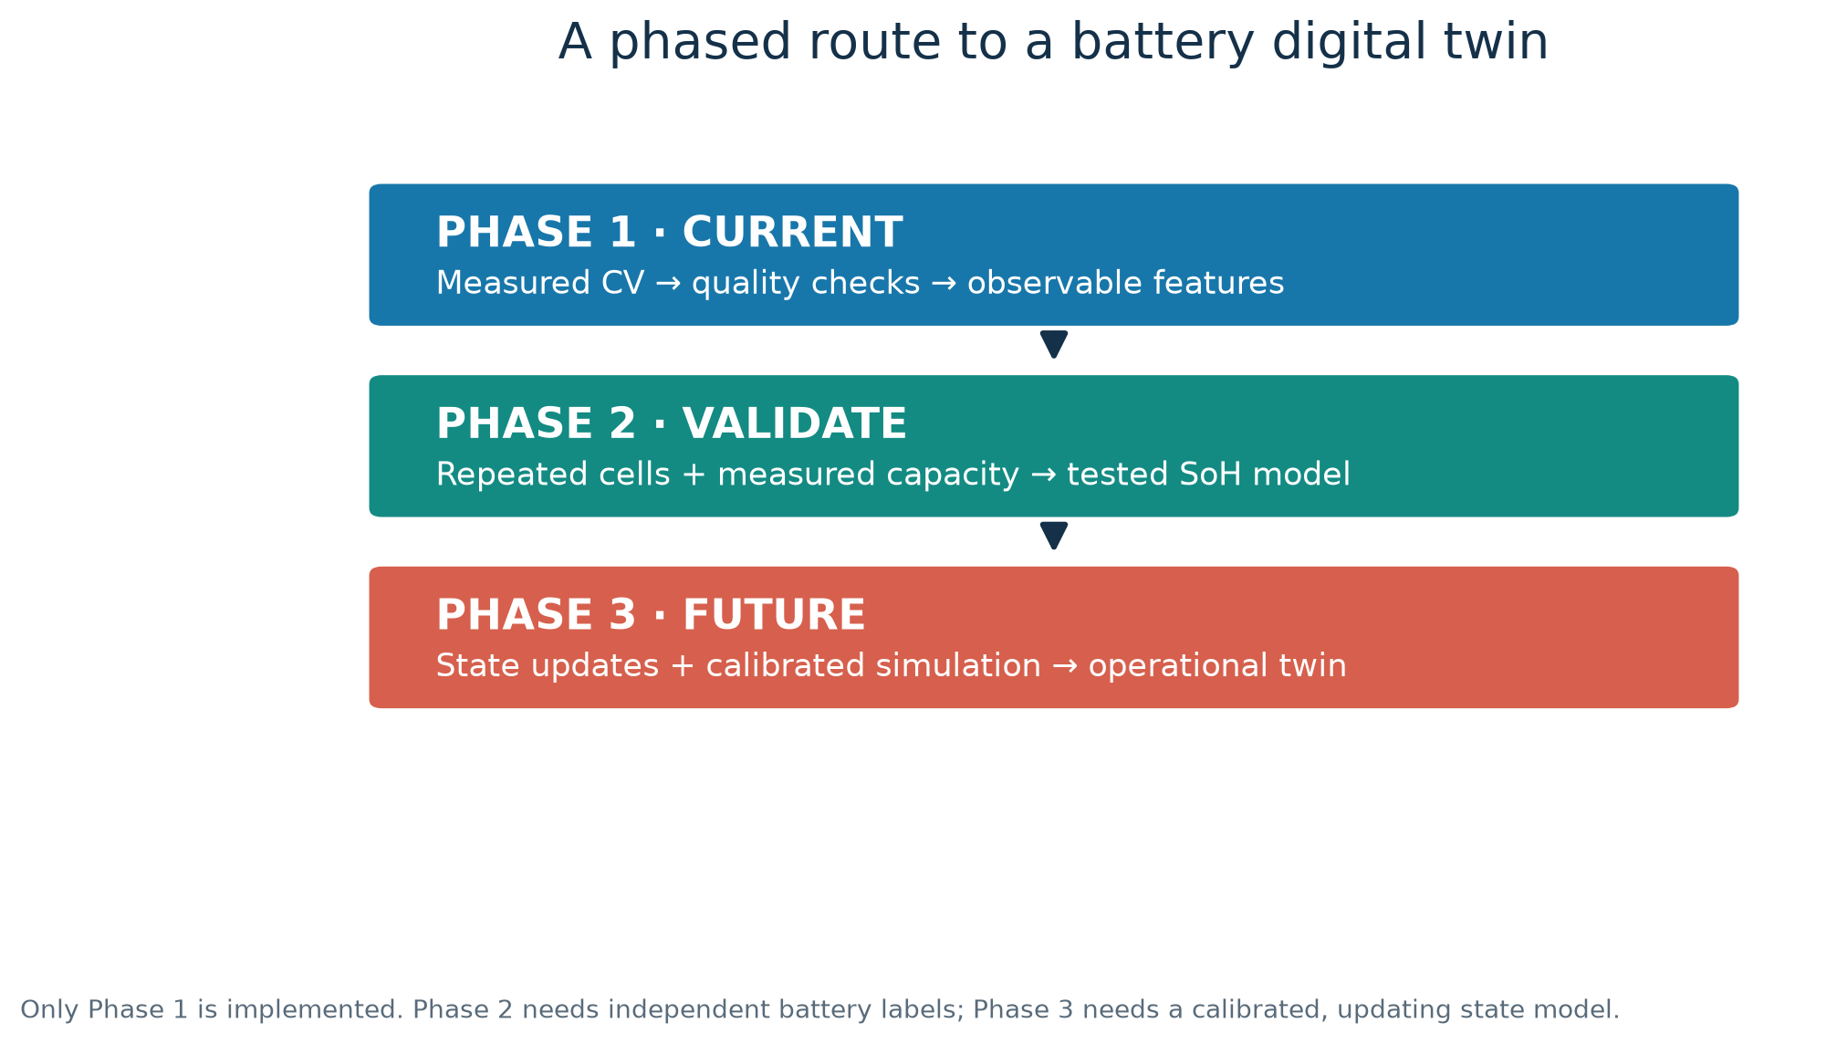
Research question and scope
Detect when a CV scan does not support a reported feature
SiNK 2026 · RESEARCH PRESENTATION
04
Notes:
Phase 1 is implemented in the repo. Phase 2 requires repeated measurements and independent capacity labels. Phase 3 requires a calibrated model that updates for an identified physical battery. Figure is generated from research/generate_conference_figures.py. SINk 2026 organiser theme context: https://www.linkedin.com/posts/dr-vishal-chaudhary_schedule-activity-7508161441263304704-ga_Y . The fit is electrochemical sensing linked to interpretable decisions, with an energy application.
Logo source: https://d2lk14jtvqry1q.cloudfront.net/media/large_89_9b01402b5b_926235f86d.png

Slide 5
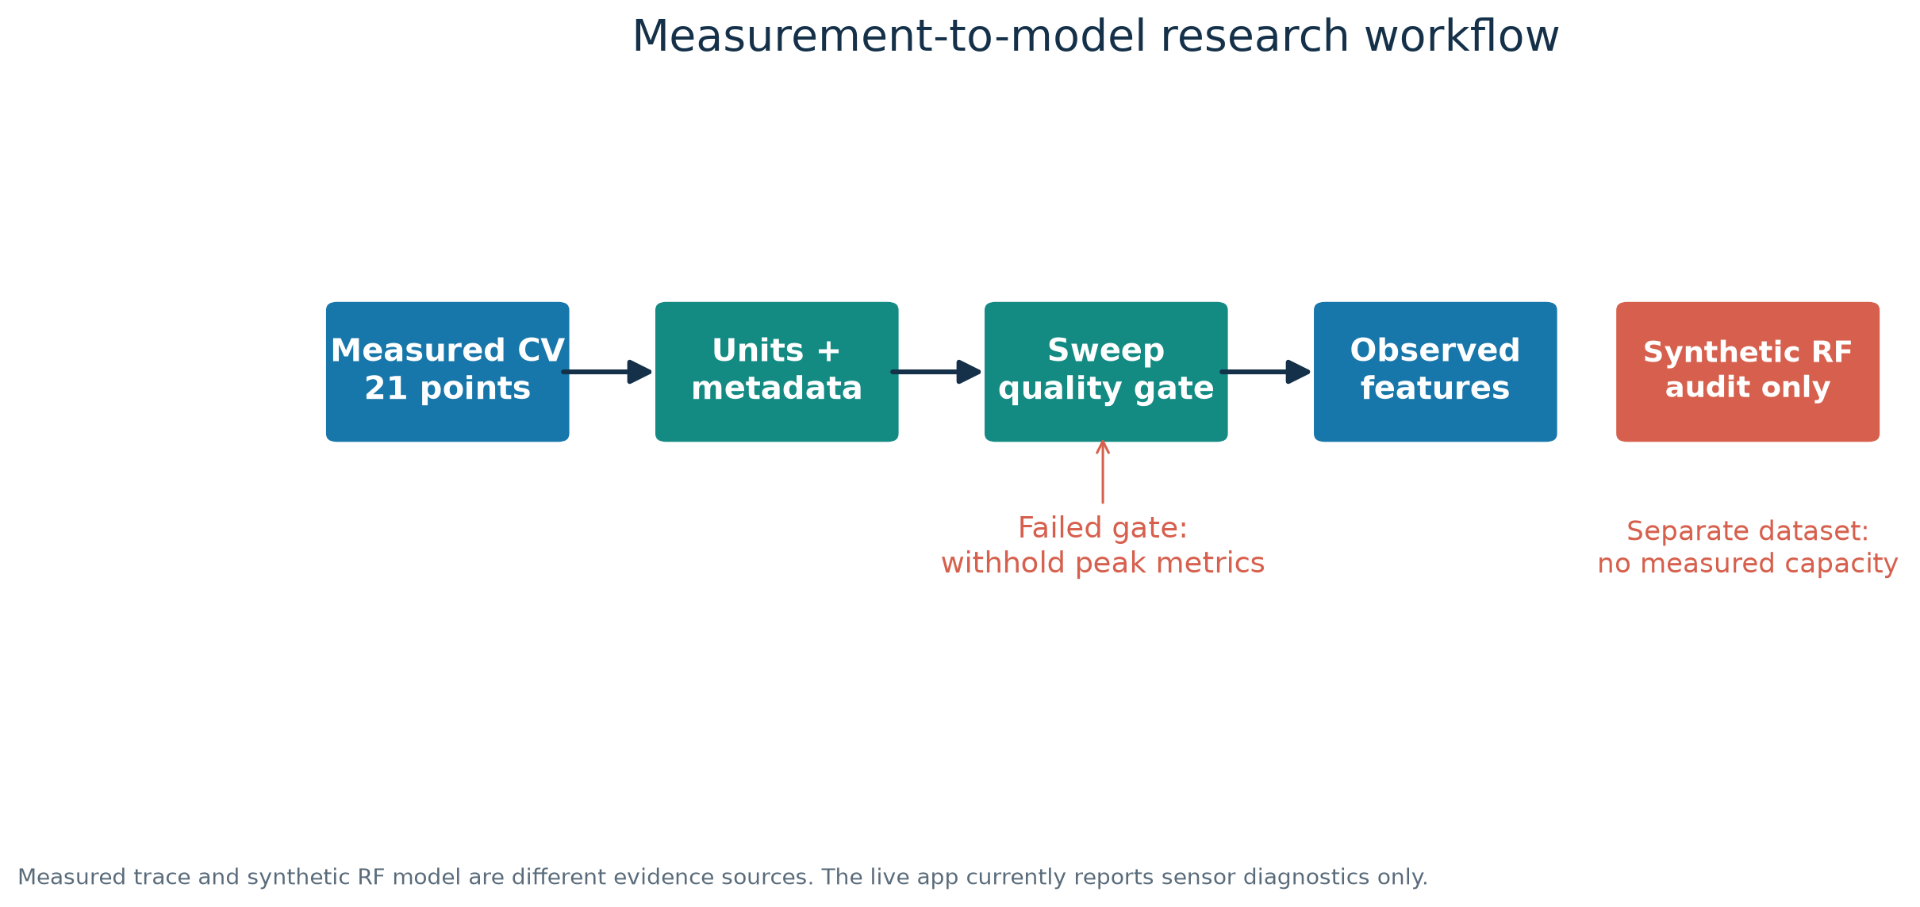
Methodology: CV quality gate
SiNK 2026 · RESEARCH PRESENTATION
05
Notes:
Data flow: preserve ordered CSV; require explicit units in the live API; check forward and return branch, closure and interior extrema; report only supported descriptors. The synthetic RF model is a separate dataset and not connected to the measured trace. Figure generated from repository source.
Logo source: https://d2lk14jtvqry1q.cloudfront.net/media/large_89_9b01402b5b_926235f86d.png

Slide 6
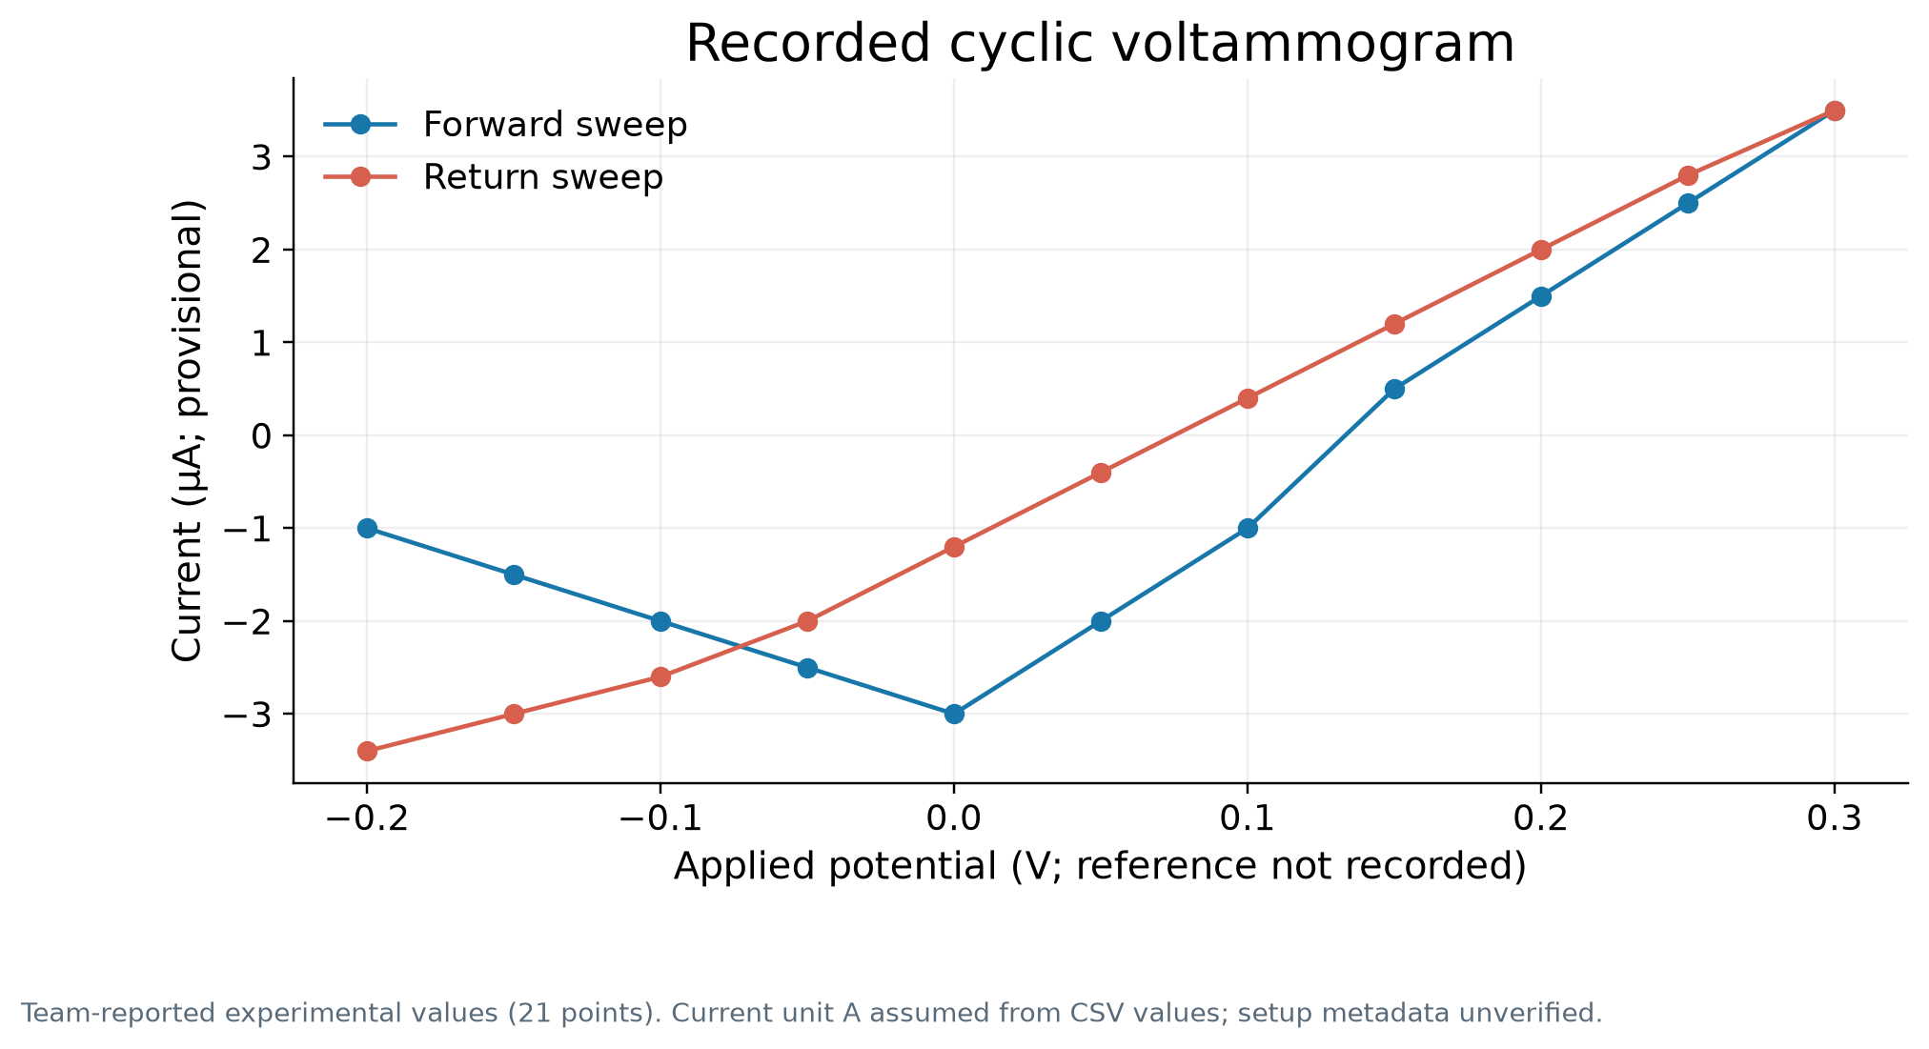
Experimental input: one reported CV sweep
21 measured values
Team reports a real CV setup.
Approximately room temperature.
Electrodes reported: graphite, platinum and Ag/AgCl. Roles not documented.
Scan rate and current unit not recorded in the CSV.
SiNK 2026 · RESEARCH PRESENTATION
06
Notes:
Source: attached_assets/14,12csv_1765724360390.csv and research/experimental_metadata.json. Current is plotted in µA only under a provisional assumption that the source numbers are amperes. Team reports experimental origin, but original instrument export is unavailable.
Logo source: https://d2lk14jtvqry1q.cloudfront.net/media/large_89_9b01402b5b_926235f86d.png

Slide 7
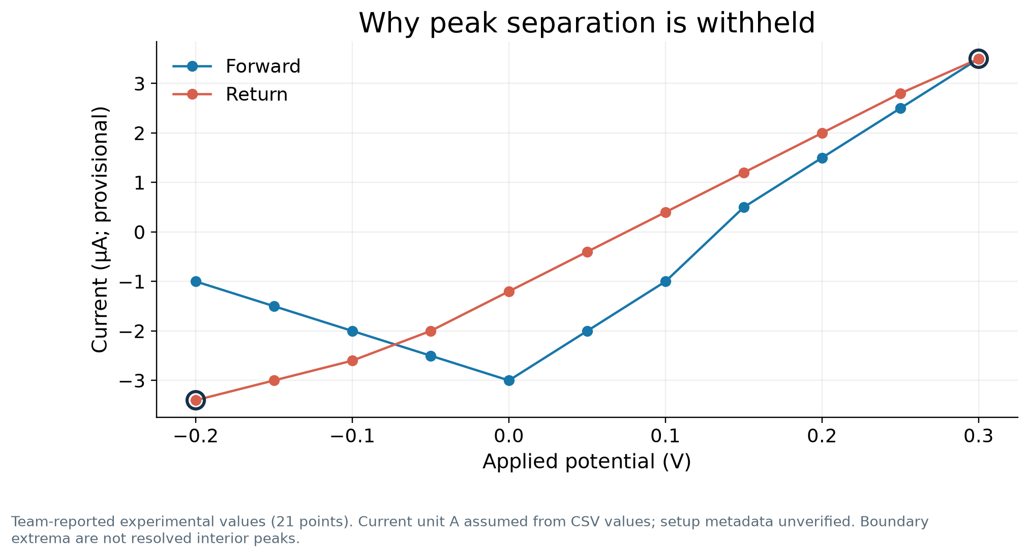
Measured result: peak separation withheld
Quality: limited
Apparent extrema sit at the scan limits.
The true peak positions may lie beyond the voltage window.
The system leaves ΔEp blank and gives the reason.
SiNK 2026 · RESEARCH PRESENTATION
07
Notes:
Source: supplied 21-point CSV, analyzed by research/cv_sensor_study.py and the live API. The signed path integral is approximately -1.75e-7 A·V under the provisional ampere assumption; it is not charge, energy or capacity.
Logo source: https://d2lk14jtvqry1q.cloudfront.net/media/large_89_9b01402b5b_926235f86d.png

Slide 8
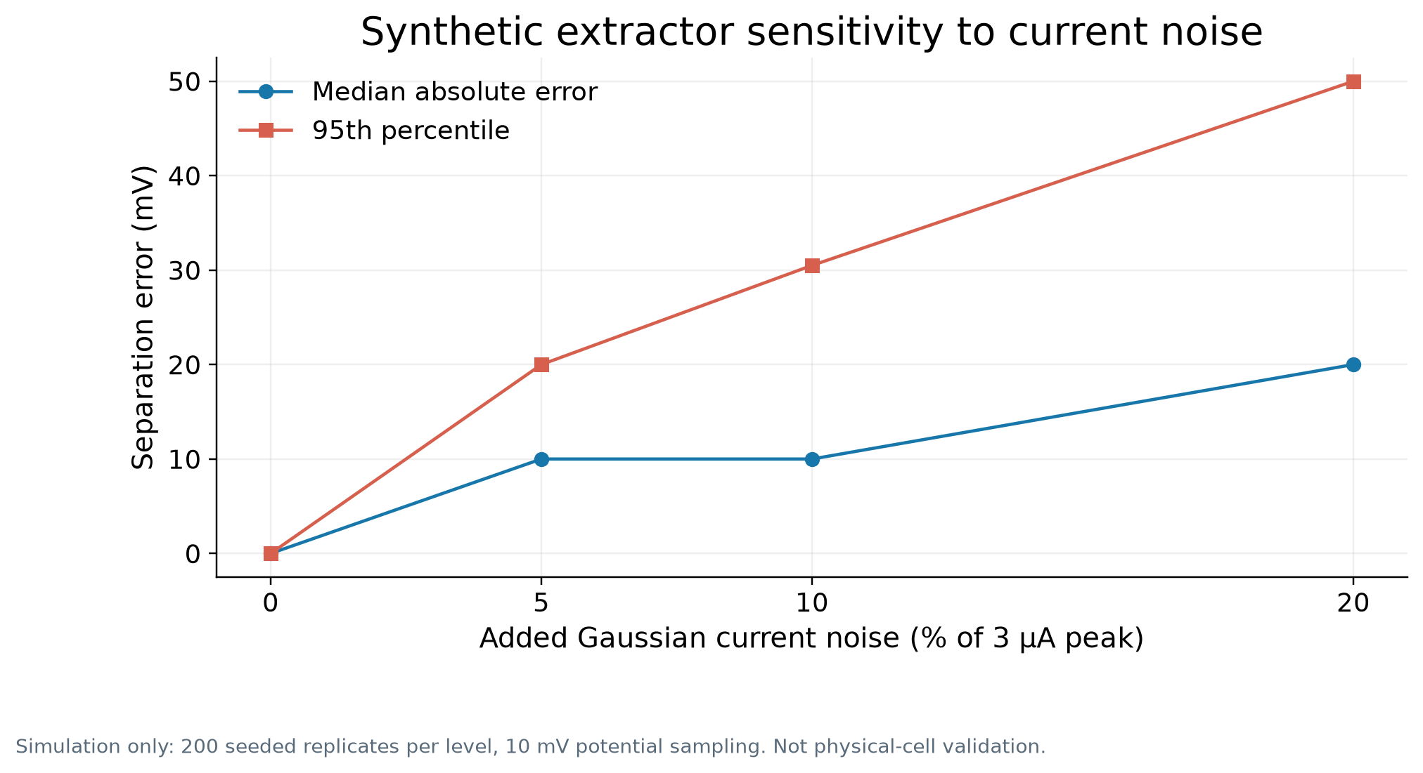
Controlled test: sensitivity to current noise
At 10% noise
10 mV
median absolute error
30.5 mV
95th percentile error
Simulation only; 200 replicates per level
SiNK 2026 · RESEARCH PRESENTATION
08
Notes:
Source: research/results/sensor_report.json, seed 20260926. Gaussian peak simulation: +/-0.10 V peaks, 3 microamp amplitude, 10 mV sampling. Independent Gaussian current noise. At 10% current noise: median absolute separation error 10 mV, empirical 95th percentile 30.5 mV across 200 seeded replicates. This measures software extractor sensitivity under one signal model. It is not an instrument error specification or physical battery accuracy. The single experimental scan has 50 mV potential increments and no reference peak or repeats, so physical sensing accuracy is unknown.
Logo source: https://d2lk14jtvqry1q.cloudfront.net/media/large_89_9b01402b5b_926235f86d.png

Slide 9
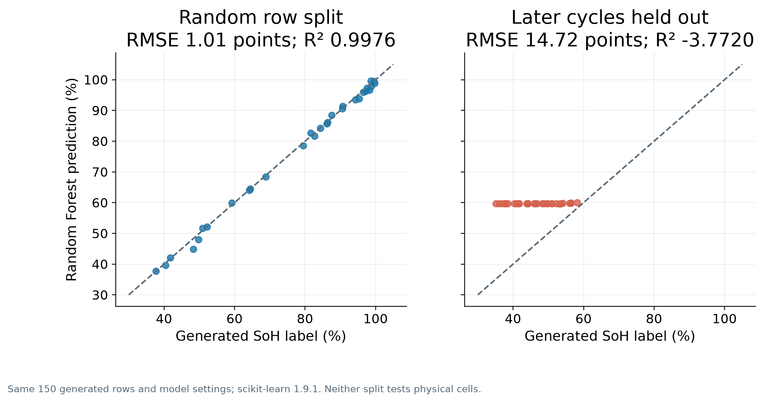
Random Forest regression metrics
Generated-data random split: R² 0.9976, RMSE 1.01 points, MAE 0.75 points
SiNK 2026 · RESEARCH PRESENTATION
09
Notes:
Source: ml/training_data.csv and research/conference_figures/figure_metrics.json. Features were generated from the synthetic SoH trajectory. Random row split: RMSE 1.0072 SoH points, MAE 0.7460 points, R2 0.997608. Last 30 cycles held out: RMSE 14.7183 points, MAE 13.1128 points, R2 -3.771964. R2 is a regression fit measure, not classification accuracy. Neither test validates a physical cell. The live API does not run this model.
Logo source: https://d2lk14jtvqry1q.cloudfront.net/media/large_89_9b01402b5b_926235f86d.png

Slide 10
Conclusion
Phase 1 provides a working CV evidence layer.
The prototype preserves the reported experimental trace and checks sweep quality.
It correctly withholds peak separation for boundary-limited data.
The simulation tests extraction sensitivity; the synthetic model audit does not validate SoH.
SiNK 2026 · RESEARCH PRESENTATION
10
Notes:
Conclusion limited to implemented software behavior and one team-reported experimental trace. The project has no independently measured capacity labels, so it cannot claim health prediction accuracy or a complete digital twin.
Logo source: https://d2lk14jtvqry1q.cloudfront.net/media/large_89_9b01402b5b_926235f86d.png

Slide 11
Future scope
Phase 2: physical validation
Recover instrument exports, electrode roles, material identity, units and scan rate.
Repeat CV on identified cells and pair each sweep with measured discharge capacity.
Test repeatability and any SoH model on entire cells held out from training.
Phase 3: operational twin
Calibrate a battery-specific state model, update it from new data, and verify it over time.
SiNK 2026 · RESEARCH PRESENTATION
11
Notes:
Future work proposal, not achieved results. The original 21-point CSV has no capacity target or complete acquisition metadata. Proposed physical validation follows the principles of separated cells and independently measured outcomes.
Logo source: https://d2lk14jtvqry1q.cloudfront.net/media/large_89_9b01402b5b_926235f86d.png

Slide 12
References
Project data and methods. Battery-digital-twin repository: experimental CSV, metadata record, sensor study, and synthetic audit (2026).
NREL. Battery Lifespan: diagnostics and model-based battery health research. nrel.gov/transportation/battery-lifespan.html
Elgrishi et al. A Practical Beginner’s Guide to Cyclic Voltammetry. Journal of Chemical Education 95 (2018). DOI: 10.1021/acs.jchemed.7b00361
Gamry Instruments. Echem Analyst software manual: cyclic voltammetry analysis. gamry.com/assets/Uploads/EchemAnalystSoftwareManual.pdf
"Battery digital twins: Perspectives on the fusion of models, data and artificial intelligence." Energy and AI 1 (2020). DOI: 10.1016/j.egyai.2020.100016
"Machine learning pipeline for battery state of health estimation" (2021). arXiv:2102.00837
SiNK 2026 · RESEARCH PRESENTATION
12
Notes:
Full URLs: https://www.nrel.gov/transportation/battery-lifespan.html ; https://pubs.acs.org/doi/10.1021/acs.jchemed.7b00361 ; https://www.gamry.com/assets/Uploads/EchemAnalystSoftwareManual.pdf ; https://doi.org/10.1016/j.egyai.2020.100016 ; https://arxiv.org/abs/2102.00837 .
Logo source: https://d2lk14jtvqry1q.cloudfront.net/media/large_89_9b01402b5b_926235f86d.png

Slide 13
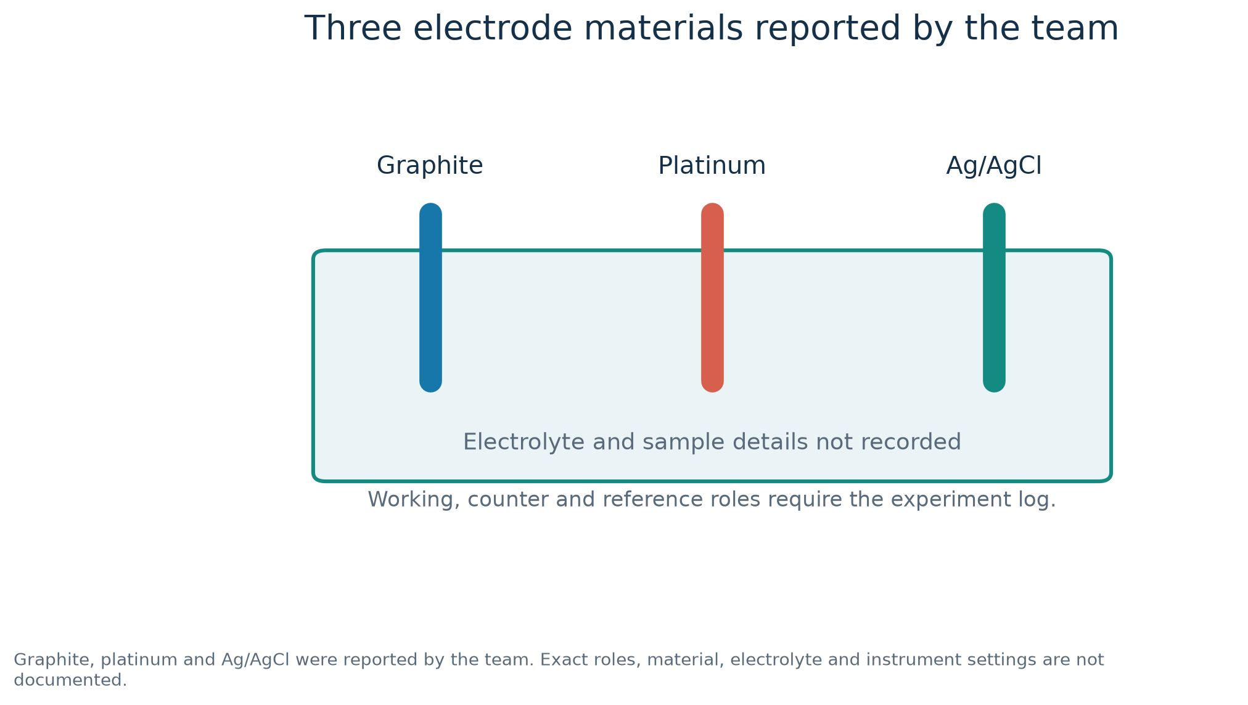
Electrode materials reported by the team
SiNK 2026 · FIGURE APPENDIX
13
Notes:
The team reported graphite, platinum and Ag/AgCl. Exact roles, material and electrolyte are not documented. Figure generated by research/generate_conference_figures.py from repository data.
Logo source: https://d2lk14jtvqry1q.cloudfront.net/media/large_89_9b01402b5b_926235f86d.png

Slide 14
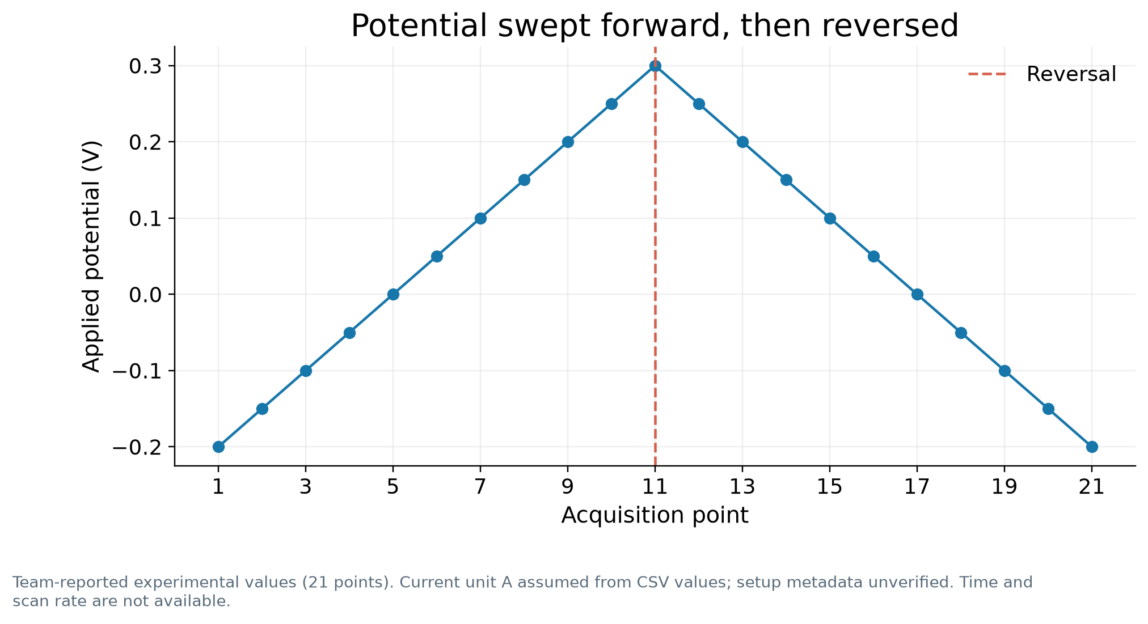
Potential sequence
SiNK 2026 · FIGURE APPENDIX
14
Notes:
Same team-reported 21-point experimental trace. Time and scan rate unavailable. Figure generated by research/generate_conference_figures.py from repository data.
Logo source: https://d2lk14jtvqry1q.cloudfront.net/media/large_89_9b01402b5b_926235f86d.png

Slide 15
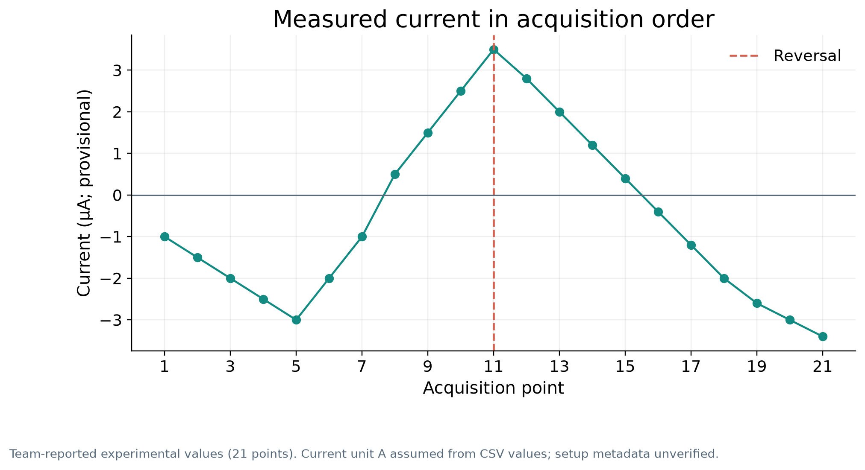
Current sequence
SiNK 2026 · FIGURE APPENDIX
15
Notes:
Same team-reported experimental trace; current unit provisional. Figure generated by research/generate_conference_figures.py from repository data.
Logo source: https://d2lk14jtvqry1q.cloudfront.net/media/large_89_9b01402b5b_926235f86d.png

Slide 16
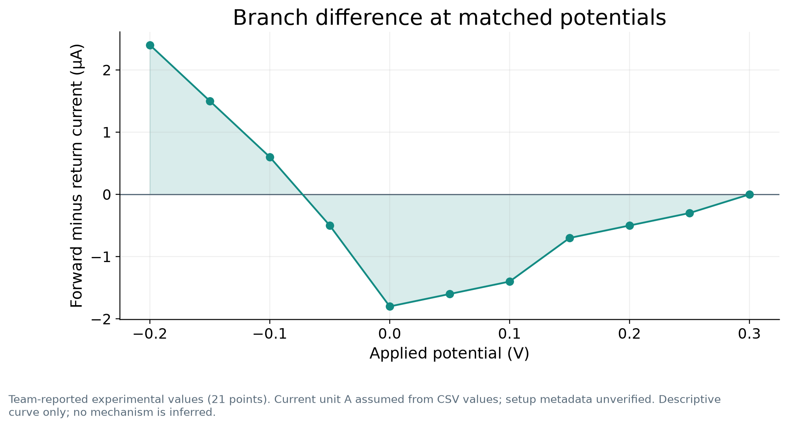
Forward and return current difference
SiNK 2026 · FIGURE APPENDIX
16
Notes:
Derived from the same 21 points. Descriptive curve, no mechanism attribution. Figure generated by research/generate_conference_figures.py from repository data.
Logo source: https://d2lk14jtvqry1q.cloudfront.net/media/large_89_9b01402b5b_926235f86d.png

Slide 17
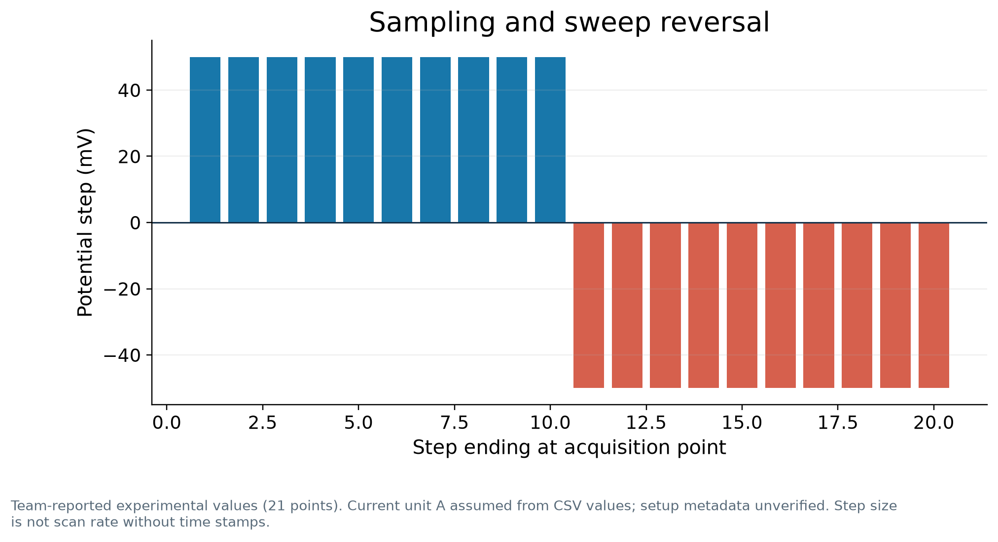
Potential sampling steps
SiNK 2026 · FIGURE APPENDIX
17
Notes:
Step size cannot determine scan rate without timestamps. Figure generated by research/generate_conference_figures.py from repository data.
Logo source: https://d2lk14jtvqry1q.cloudfront.net/media/large_89_9b01402b5b_926235f86d.png

Slide 18
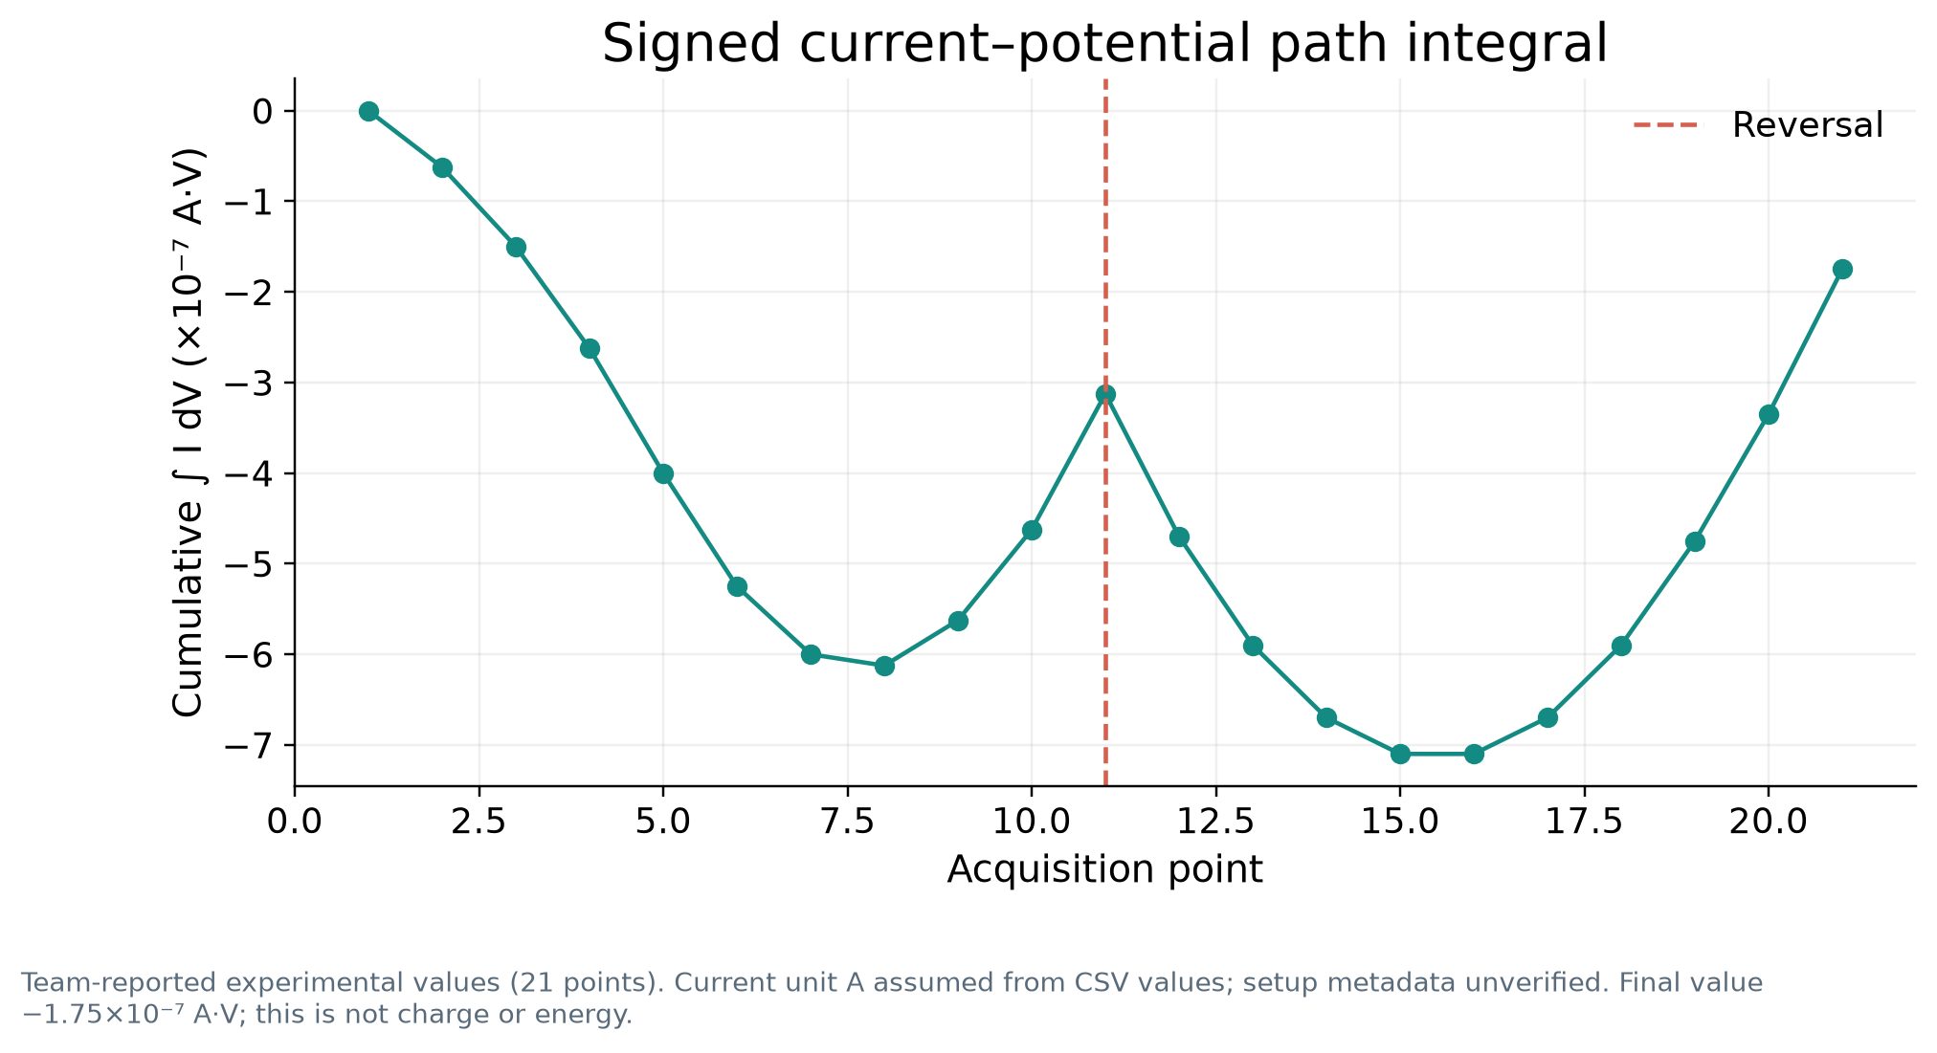
Signed path integral
SiNK 2026 · FIGURE APPENDIX
18
Notes:
A·V under the provisional ampere interpretation. This is not charge or energy. Figure generated by research/generate_conference_figures.py from repository data.
Logo source: https://d2lk14jtvqry1q.cloudfront.net/media/large_89_9b01402b5b_926235f86d.png

Slide 19
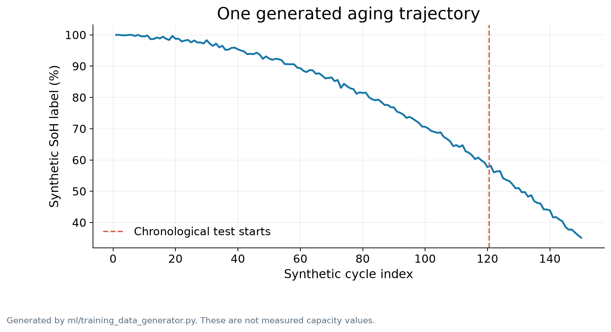
Generated SoH trajectory
SiNK 2026 · FIGURE APPENDIX
19
Notes:
From ml/training_data.csv; no measured capacity values. Figure generated by research/generate_conference_figures.py from repository data.
Logo source: https://d2lk14jtvqry1q.cloudfront.net/media/large_89_9b01402b5b_926235f86d.png

Slide 20
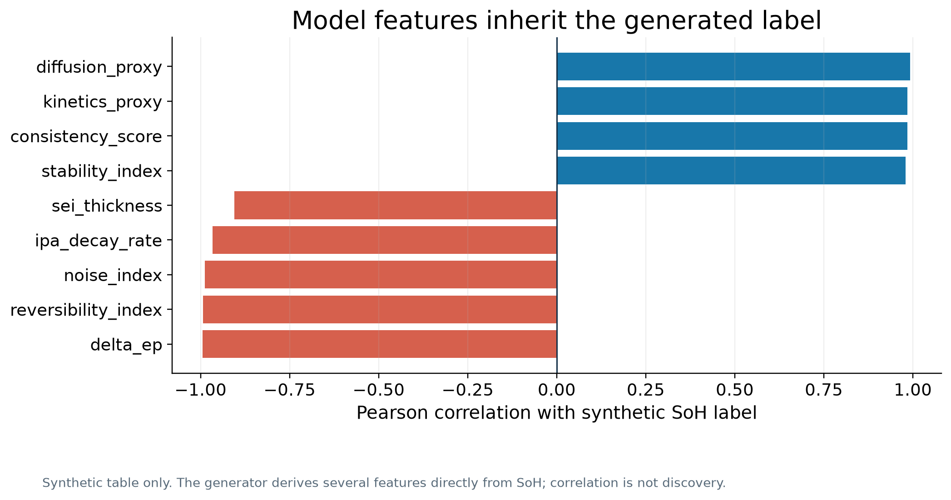
Synthetic feature correlations
SiNK 2026 · FIGURE APPENDIX
20
Notes:
Features derive from generated SoH labels; correlations are not physical discovery. Figure generated by research/generate_conference_figures.py from repository data.
Logo source: https://d2lk14jtvqry1q.cloudfront.net/media/large_89_9b01402b5b_926235f86d.png

