Slide 1
A solution for image blur caused by atmospheric turbulence in astrophotography
Minimum viable product
by Pedro Agundez Fernandez

Slide 2
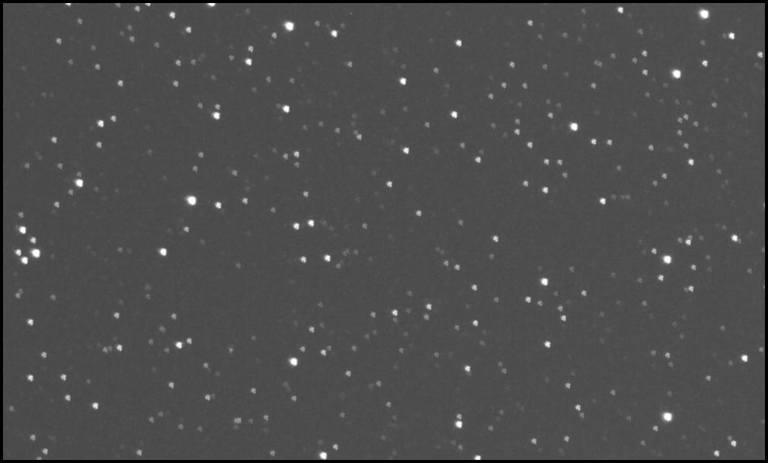
One of the problems that are normally faced when taking astronomical images is the atmospheric turbulence, it refracts the light that passes through it in a way that is hard to predict. This phenomenon makes it hard to take long exposure pictures without blur.
The image above is an example of how a long exposure picture can appear blurred.

Slide 3
There are solutions to this problem such as the use of a Shack Hartmann wavefront sensor, to measure how the incoming light is refracted.
However, the approach taken here is simpler, since it doesn't require more equipment than the telescope and CCD already needed to capture astronomical images.
To do it, a series of short exposure pictures are taken and then combined to form the final image.
The gif above shows an exaggerated example of how each short exposure picture would be shifted in a random manner

Slide 4
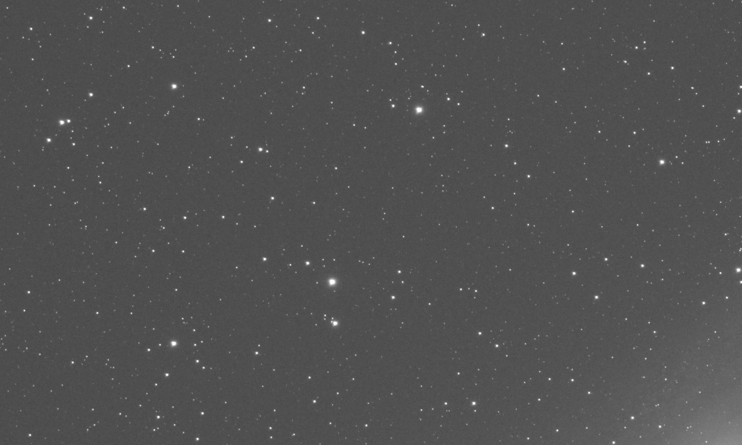
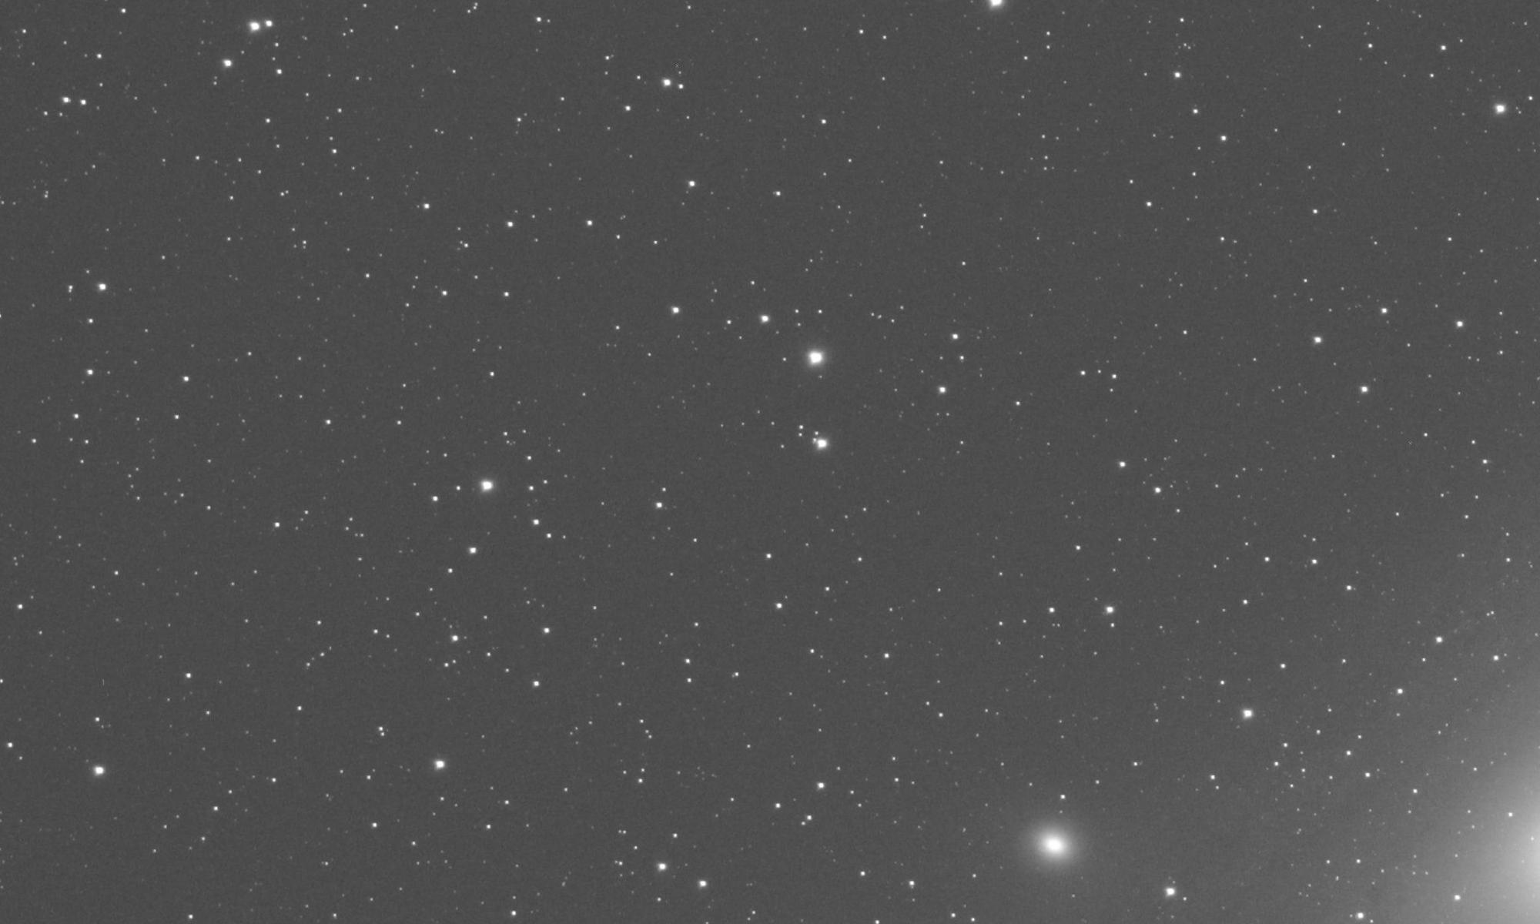
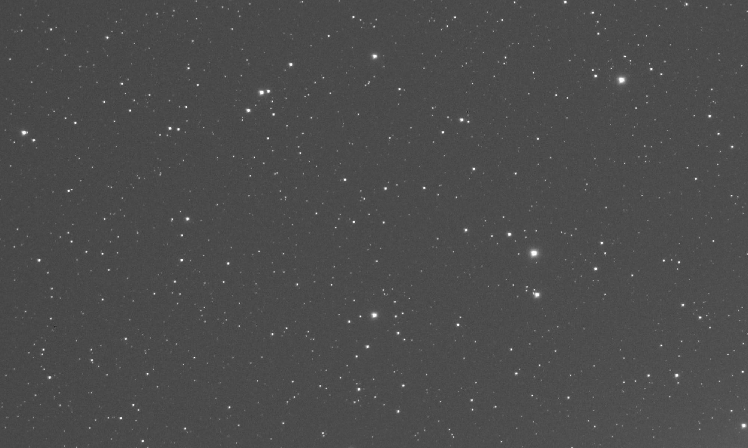
The program takes in images of the same size that are shifted randomly by the atmospheric turbulence
The user can pass as an argument which of the images will serve as the pivot to calculate the shift of the rest

Slide 5
1
2
The program then calculates the shift of each image (using Fast Fourier Transform algorithm, FFT) with respect to the pivot...

Slide 6
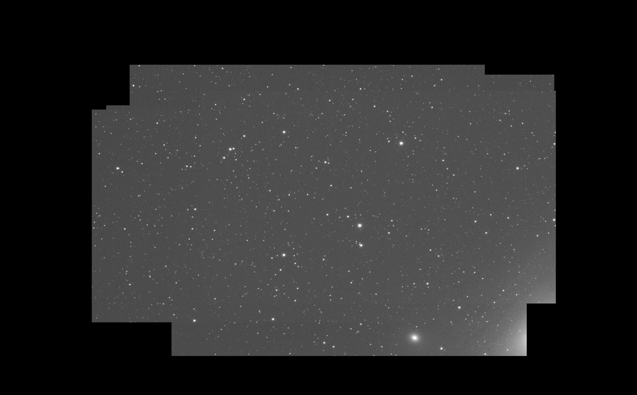
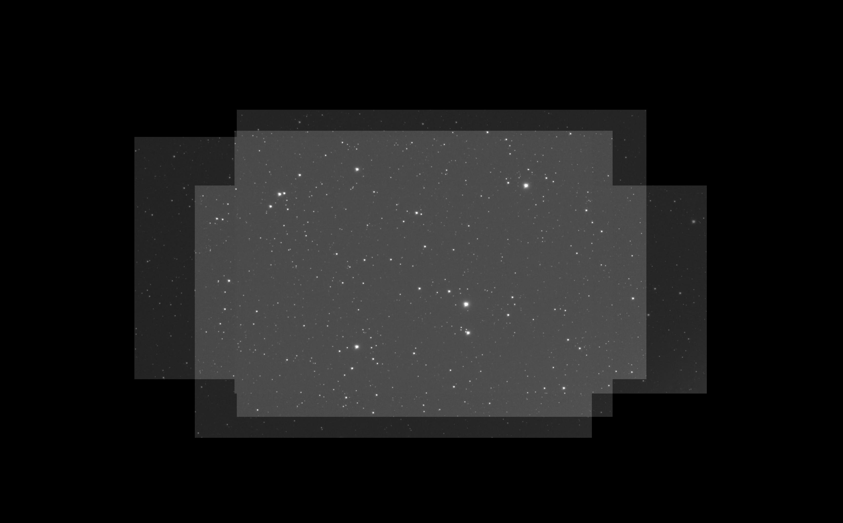
Max value combining
Median combining
And stacks the images to form a complete image. On the left image max value combining is shown, that means the pixel chosen from each image is the max value, this approach is better for information integrity, but it also carries the noise from all the images. Median combining, on the other hand, reduces the noise but some information at the edges might be lost.

