Slide 1
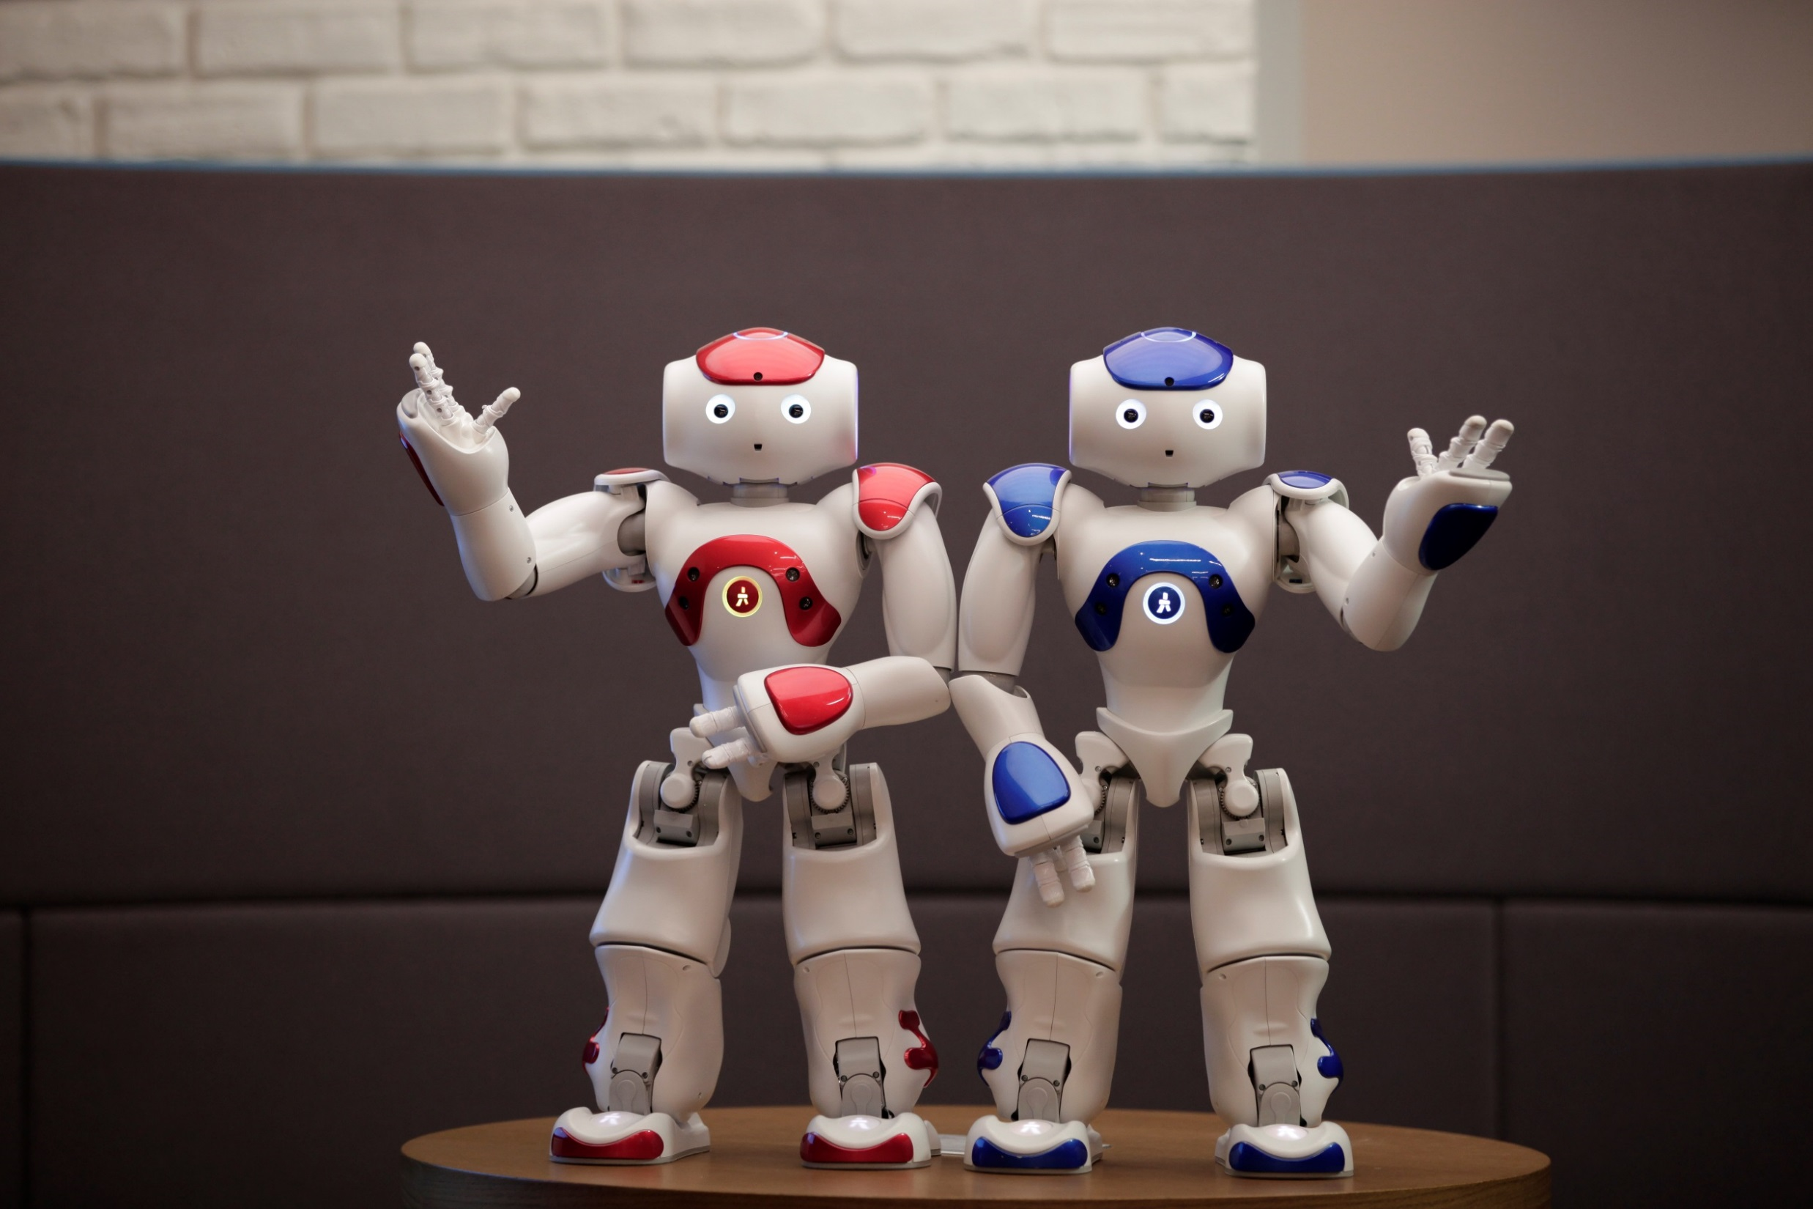

LET’S PROGRAM OUR HUMANOID FRIEND NAO
(with or without robot)

Slide 2
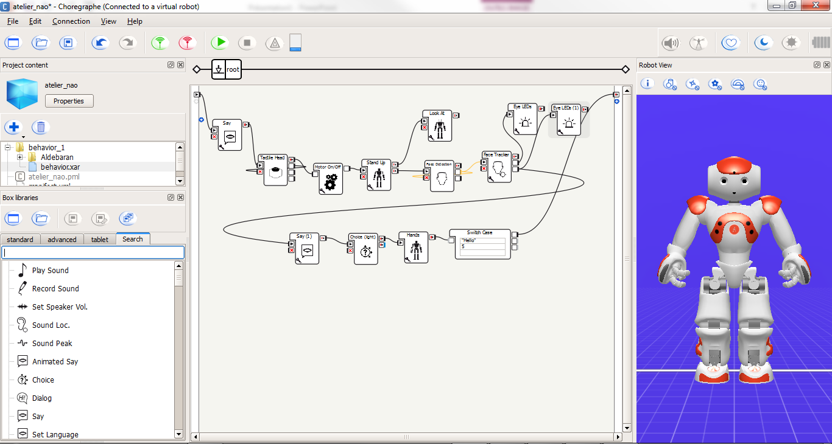
Choregraphe
It is the graphical interface to program NAO
Main Plane
Search
Boxes
Simulator

Slide 3
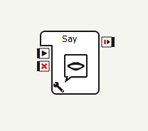
Boxes
Input
Execute a specific action
Python mainly
Boxes can be connected to each other
Output
Stop box
Parameters
Double-click to edit

Slide 4
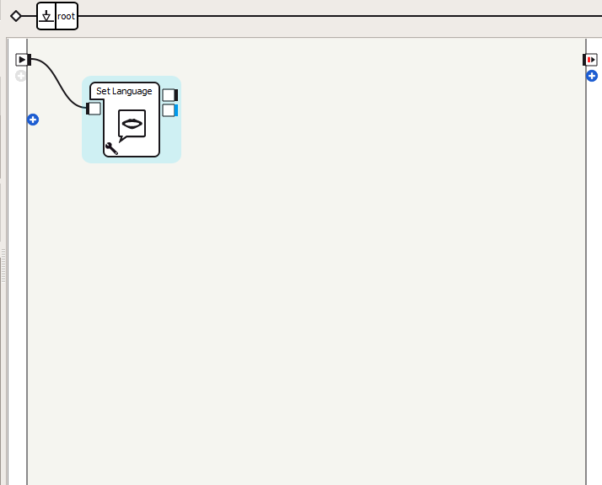
1 – Set up language
I use Set language box
I select ‘English’ in the parameters
Parameters
I connect my box to the beginning
SAVE YOUR PROJECT

Slide 5
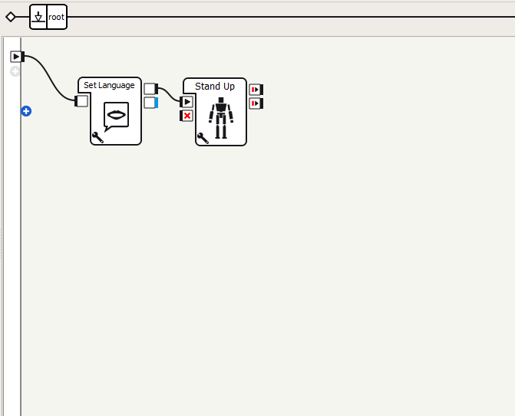
2 – Stand up NAO !
I use Stand Up box
I connect this box to the previous one
SAVE YOUR PROJECT

Slide 6
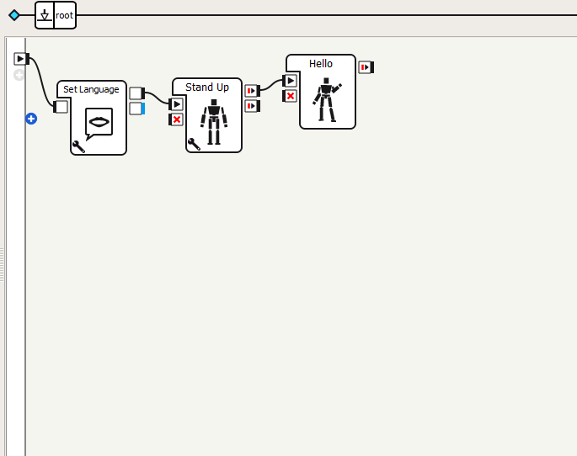
3 – Hello !
I use Hello box
I connect this box to the previous one
SAVE YOUR PROJECT

Slide 7
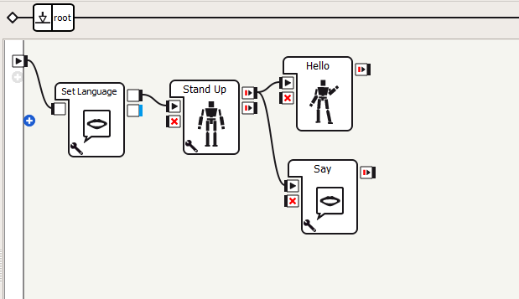
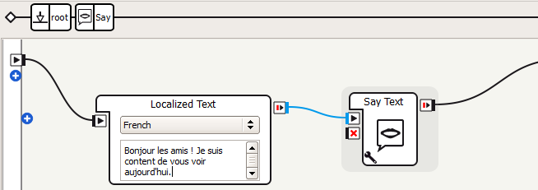
3 – NAO introduces himself
I use Say box
I connect it to the same output than the Stand Up box
I select English and write:
« Hey guys,
I am happy to see you today! »
To go back to the main plane, I click on
Root

Slide 8
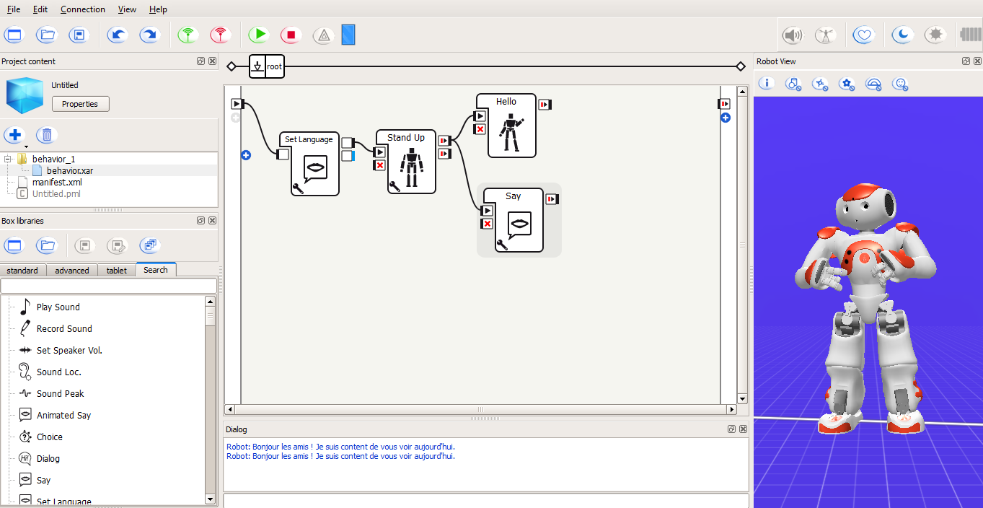
4 – Let’s test
To test, I press Play
The result is displayed in the simulator
Conversation will appear in the dialog window

Slide 9
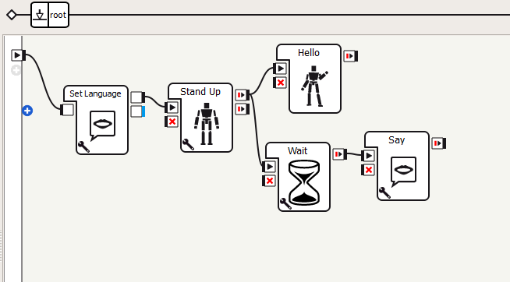
5 – Let’s improve this !
To get NAO to wait, I use the Wait box
I put the new box in between the
Stand Up and Say boxes.
I select 1,0 seconde in the parameters
SAVE YOUR PROJECT

Slide 10
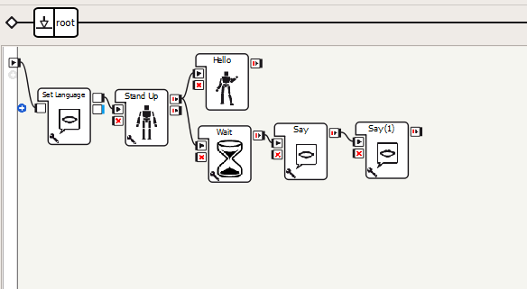
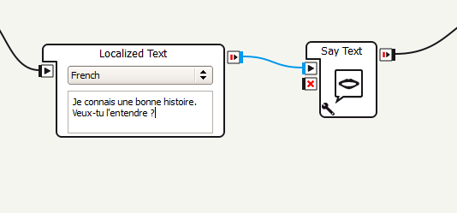
6 – Asking a question
To ask a question, I use the Say box
I select English and write:
« I know a good story.
Do you want to listen to it ? »

Slide 11
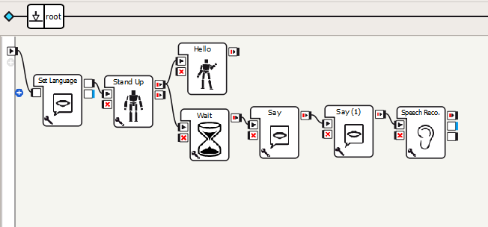
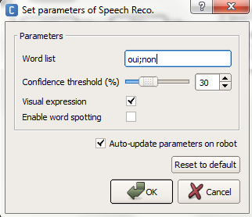
7 – Listening to the answer
I use the Speech Reco box so that NAO
can understand my answer.
I connect my box to the Say box
I go into the parameters
In Word List I enter: yes;no

Slide 12
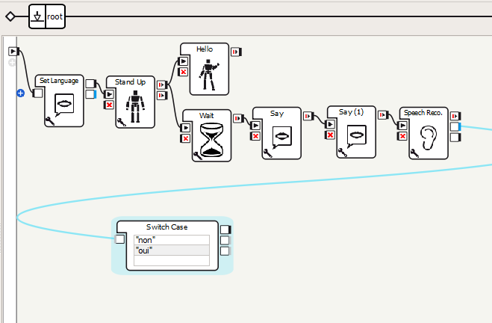
8 – Analyzing the answer
I use the Switch Case box in order to get NAO to analyze my answer
On the first line, I type « no »
On the second line, I type « yes »
SAVE YOUR PROJECT

Slide 13
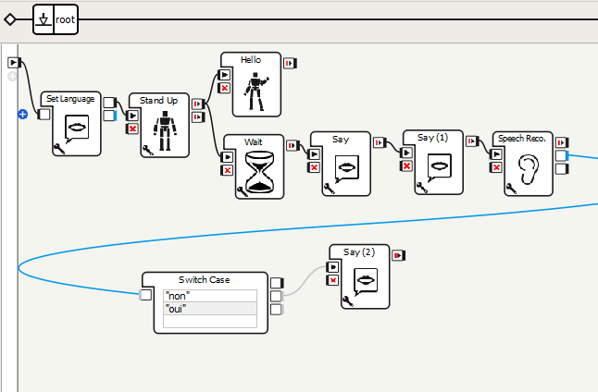
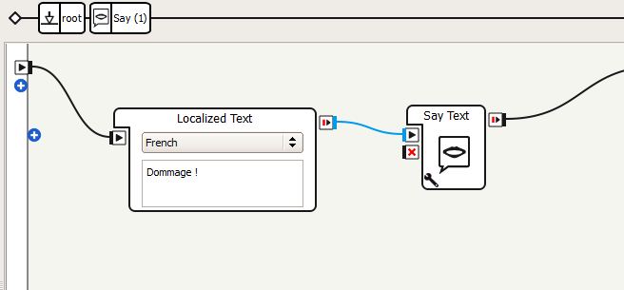
9 – The answer is NO
Let’s use the Say box
I connect this box to the « no » output of the Switch Case box
I select English and type:
« Too bad! »

Slide 14
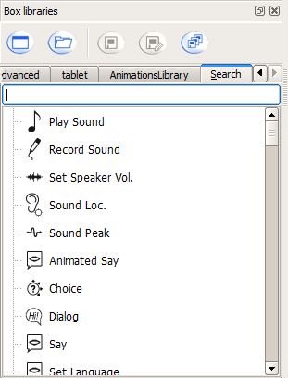
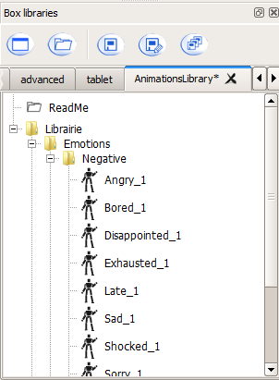
10 – NAO is sad
In the animation library, I am going to use the
Sad box
I connect it to the Say box and to the final exit
SAVE YOUR PROJECT

Slide 15
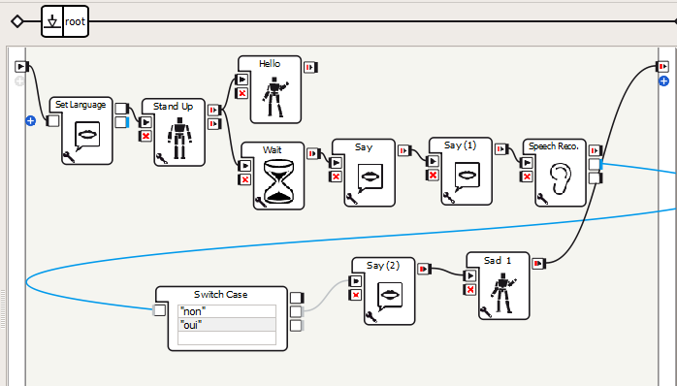
11 – NAO is sad
I connect it to the Say box and to the final exit
I test by pressing Play
SAVE YOUR PROJECT

Slide 16
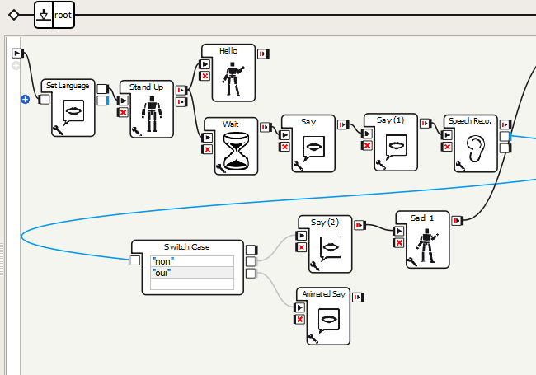
12 – The answer is YES
This time I am going to use the
Animated Say box
I connect this box to the « yes » output
of the Switch Case box
SAVE YOUR PROJECT

Slide 17
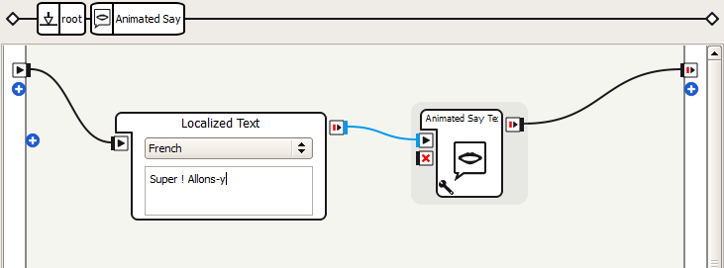
13 – NAO is happy
I open the Animated Say box
I select English and write:
« Great! Let’s go !»
I go back to the main plane by clicking root
And I test by clicking Play
SAVE YOUR PROJECT

Slide 18
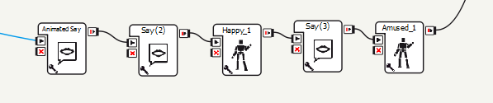
14 – Write the story
Use Say boxes to tell your own story
Add reactions and emotions using the animation library
In the end, it should looks like this:
SAVE YOUR PROJECT

