Slide 1
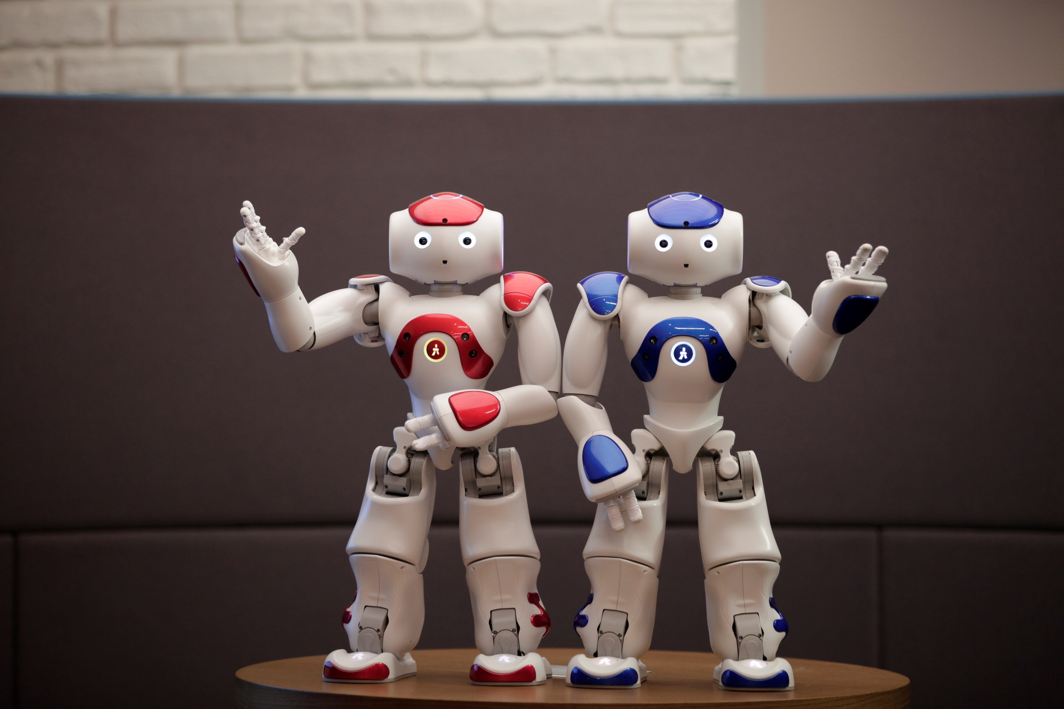

PROGRAMMING NAO THE HUMANOID ROBOT
(with or without robot)

Slide 2
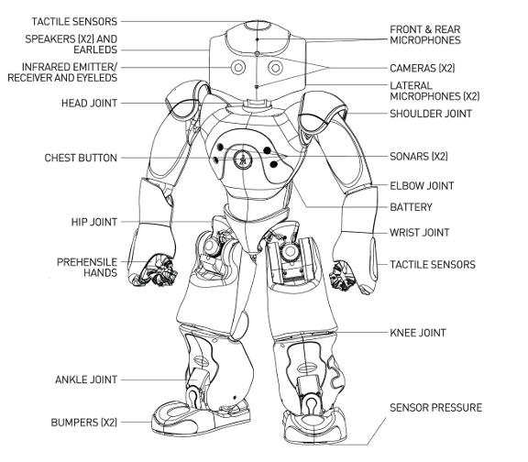
NAO, HUMANOID ROBOT
Robots are electronic machines programmed to do things autonomously.
Humanoid robots are robots with their overall appearances based on that of the human body.

Slide 3
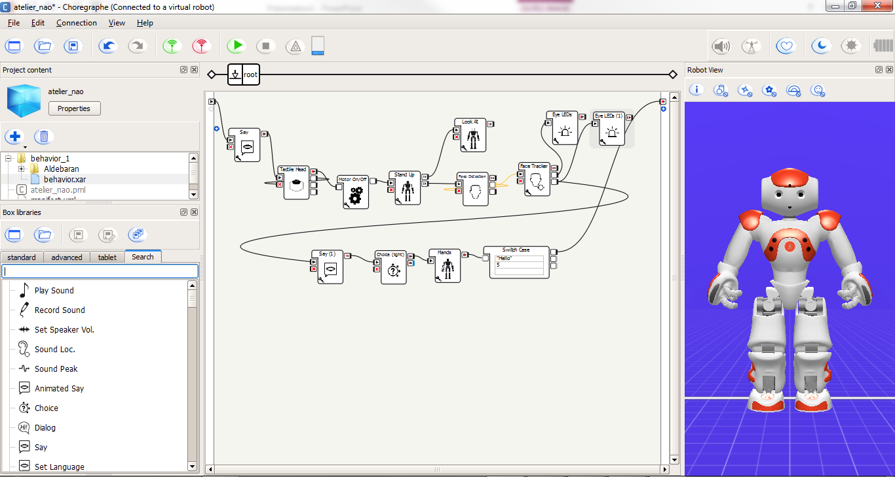
COMMUNICATE WITH NAO
Main Plan
Virtual robot
Boxes library
Choregraphe is a graphical programming software

Slide 4
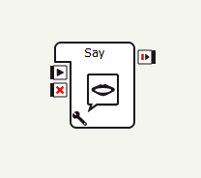
BOXES
A box execute a specific action
Inputs
Output(s)
Boxes can be connected to each other thanks to their inputs and outputs
They are written in Python language
Settings
Notes:
Transition: Les exercices.

Slide 5
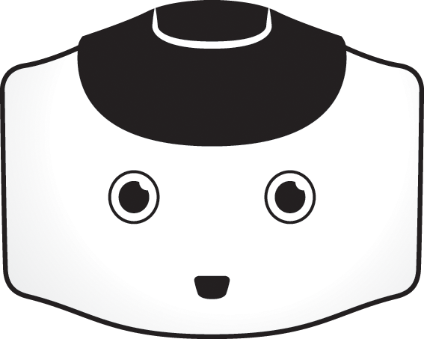
TODAY’S MISSIONS
Exercise 2 :
Program NAO to make him move and speak
Exercise 1 :
Configure and wake up NAO
Exercise 3 :
Teach NAO dialog and action rules
Improve your application and test it on NAO
Notes:
Transition: Nous allons commencer par Paramétrer et réveiller NAO. Pour cela, nous allons utiliser des boîtes qui vont réaliser trois actions différentes : Définir la langue, utiliser le capteur tactile de la tête pour que lorsque quelqu’un le touche, NAO se lève. A votre avis, comment vont s’appeler ces trois boîtes ?

Slide 6
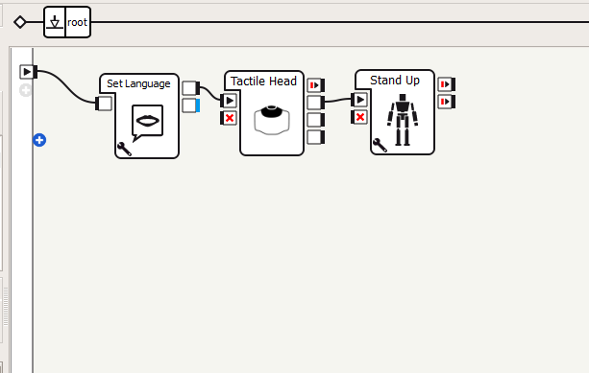
CONFIGURE & WAKE UP NAO
Place and configure the following boxes:
Set language (to configure in your language)
Tactile Head
Stand Up
Connect the boxes to each others
Notes:
Transition : Faire Parler NAO

Slide 7
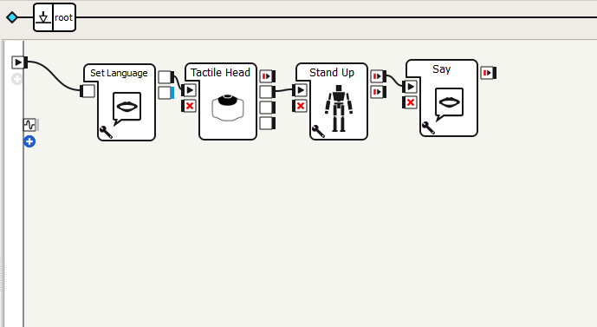
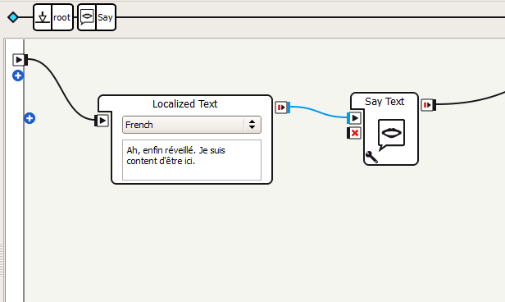
MAKE NAO SPEAKS
Drag and connect the Say box
Double-click at the center of the box to edit it and choose the appropriate language
Write down:
« Ah, finally I wake up. Happy to be here! »
Click on root to come back to the main plan
Notes:
Transition: Maintenant que nous avons fait parler NAO, nous allons aussi lui donner vie en lui créant des mouvements. Nous allons donc lui imaginer un mouvement où il regarde de droite à gauche.

Slide 8
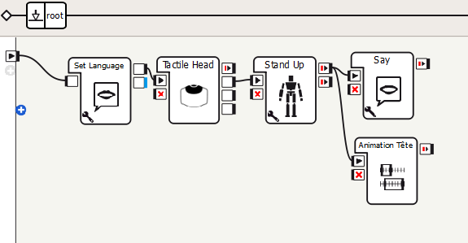
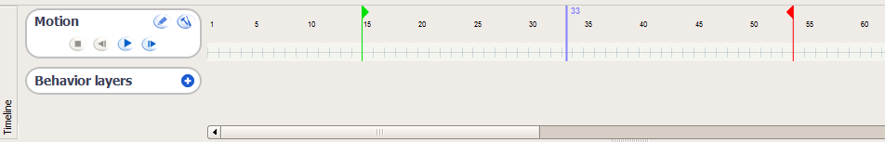
ANIMATE NAO
By right clicking on the main plan, create a new Timeline box that you name Head Animation
Double-click at the center of the box to enter the animation mode
We are going to create key frames on the Timeline and for each, define a position for NAO’s head
Notes:
Une boîte Timeline est une boîte qui contient une chronologie. Le temps y est représenté sous forme de frames ou repères qui correspondent chacun à une position des moteurs du robot.
Les chiffres eux, représentent le nombre de repères. 25 repères correspondent à une seconde.
Le curseur vert représente le point de départ de mon animation, le rouge le point final. Le curseur bleu, m’indique où je suis.
La flèche Play, va me permettre de jouer mon animation pour observer le résultat.

Slide 9
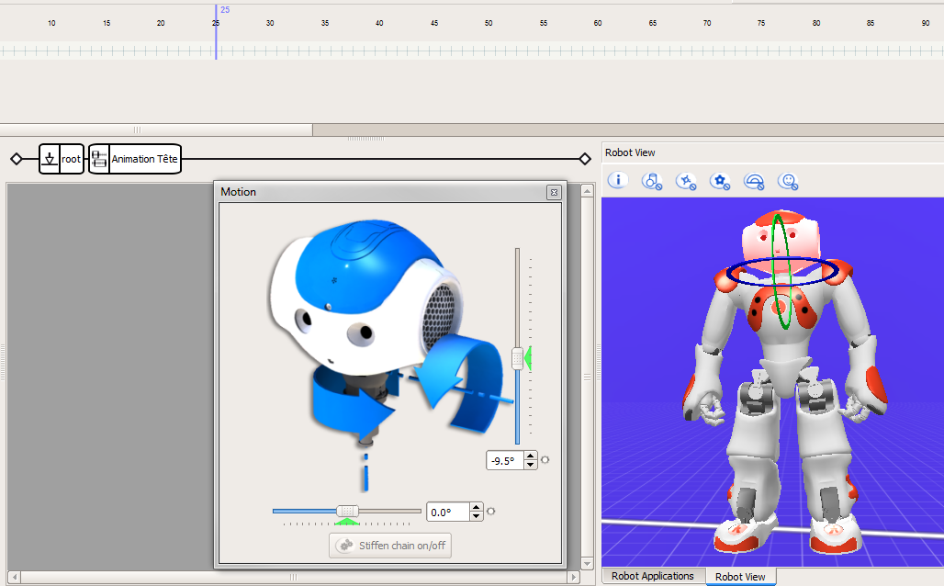
ANIMATE NAO (2)
Position your cursor on frame 25 and click on NAO’s head in the simulator
Adjust the head motor angle
To save the position, right click on the Timeline and choose Store joints in Key frame
Repeat the operation every 25 frames to create the whole animation

Slide 10
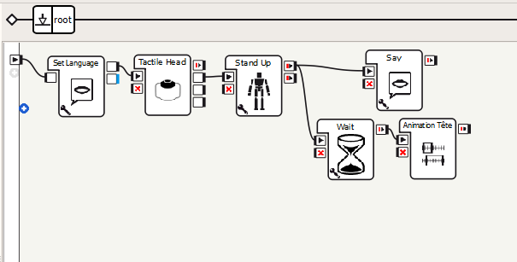
ANIMATE NAO (3)
Click on Play to test
Add a Wait box between Stand Up and Head Animation boxes
Save your project on the desktop

Slide 11
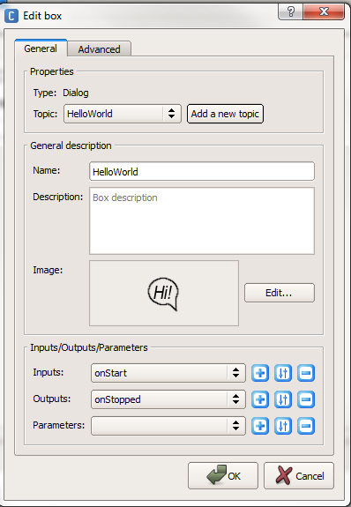
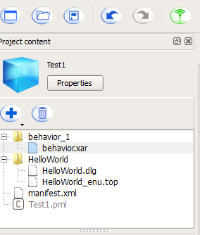
PROGRAM DIALOG RULES
Create a new Dialog Box and click on Add a new topic.
Select the language and name it HelloWorld (no space allowed)
A new folder appears in your project. The first file is your box that you can drag on the main plan.
Notes:
Transition: Pour l’instant, notre boîte de dialogue est vide. Nous allons donc la remplir et cela se fait dans mon deuxième fichier, celui dont le nom fini en .top

Slide 12
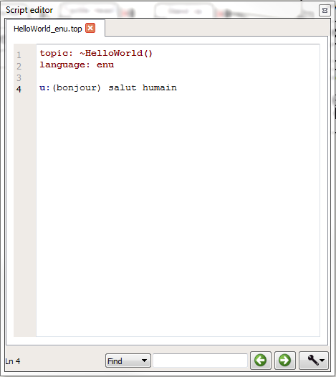
PROGRAM DIALOG RULES
Double-click on HelloWorld_enu.top. You will be able to write there user rules that NAO will have to follow.
User rules have the following structure:
Humain input
Robot Output
Example: u: (hello) hi human
The rule (:u) states that when NAO hears « hello » (input) he answers « hi human » (output).
Notes:
Transition: Nous avons écris notre premier règle. Mais lorsque nous parlons, nous avons plusieurs façons de dire bonjour par exemple. Comme je ne peux pas être sur de ce que la personne qui parlera avec NAO va dire, je vais devoir prévoir les autres possibilités.

Slide 13
RULES STRUCTURE
To optimize the dialog, we can improve the rules structure. Here are some examples:
Example 1: u: (hello robot) hi human
There is 1 input and 1 output
Example 2: u: ([hello greetings howdy]) hi human
There are different possible inputs and one output
Example 3: u: (["hello robot" greetings howdy]) [hi hey hello]
There are different possible inputs and some are made of several words and also different outputs
Example 4: u: ([hello greetings howdy]) [hi hey "hello human"]
There are different possible inputs and also different outputs with some made of several words

Slide 14
EXERCISE
Use the examples to write user rules allowing NAO to introduce himself when asked
Example 1: u: (hello robot) hi human
There is 1 input and 1 output
Example 2: u: ([hello greetings howdy]) hi human
There are different possible inputs and one output
Example 3: u: (["hello robot" greetings howdy]) [hi hey hello]
There are different possible inputs and some are made of several words and also different outputs
Example 4: u: ([hello greetings howdy]) [hi hey "hello human"]
There are different possible inputs and also different outputs with some made of several words

Slide 15
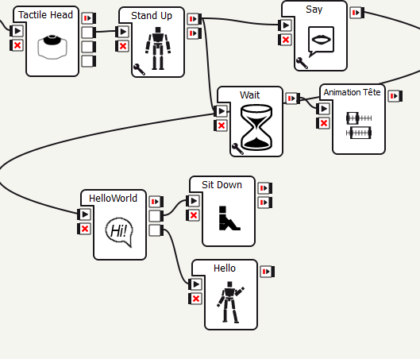
GOING FURTHER
Dialog rules can be linked to animations.
To do so, we have to create events.
Add the following rules:
u: (Please sit down) ok I sit down $sit=1
u: ([" Wave at me" “Greet people“]) Okay I greet $hello=1
Create two new outputs to the dialog box:
« sit » and « hello » and connect them to the matching boxes
Right click and choose « add output » in the menu to create a new output

