Slide 1
MACHINE LEARNING PROJECT
Bitcoin Market
State Prediction
2010–2023
Predicting bull, sideways, and bear regimes with on-chain indicators
3-class
176 → 40
10 models
80 / 20
Daily on-chain data
27 raw → 176 engineered → top 40
Supervised + LSTM + DQN + Ensemble
Time-ordered split
Cherrili/bitcoin-market-prediction
01

Slide 2
CONTENTS
Contents
01
Data & Problem
Dataset, label scheme, data split principle.
02
Analysis Methods
Train/test split, cross-validation, key challenges.
03
Feature Engineering
Feature construction, selection, preprocessing.
04
ML Models
10 models: supervised, sequential, RL, ensemble.
05
Results & Robustness
Macro-F1 primary metric, why 0.4124 matters, binary robustness, feature importance, Q&A.
Cherrili/bitcoin-market-prediction
02

Slide 3
DATA & PROBLEM
Dataset D splits into D_tr and D_te; labels derived from 30-day forward return.
Two daily CSV sources merged: blockchain metrics + on-chain indicators. Date range 2010–2023, ~4,700 observations. Class distribution is moderately imbalanced → class_weight=‘balanced’ applied across all models.
30-day Forward Return Label
BULL > +15%
Label = 1
SIDEWAYS ±15%
Label = 0
Key Principle: D_te is held out completely — no fitting, no tuning, no inspection until final evaluation. All splits are strictly chronological; no random shuffling is ever applied to a time-series dataset.
BEAR < -15%
Label = -1
Cherrili/bitcoin-market-prediction
03

Slide 4
ANALYSIS METHODS
Time-series constraints require special handling at every step.
01
02
03
04
05
06
Split
CV
Leakage
Imbalance
Stability
Baseline
Strict 80/20 chronological split — no shuffling, no look-ahead
GridSearchCV + TimeSeriesSplit(n=5) — only training folds used for tuning
Scaler and feature selector fitted on D_tr only; D_te never touched
class_weight=‘balanced’ or sample weights applied; macro F1 used as tuning metric
Distribution shift checked between train and test windows
Always-Up (majority) and Random Guess included as sanity baselines
Key principle: D_te is untouched during all training, tuning, and feature selection.
Cherrili/bitcoin-market-prediction
04

Slide 5
FEATURE ENGINEERING
27 raw columns (2 CSVs) → 19 base features → 176 engineered → top 40 selected by RF importance.
27
176
Top 40
5
Raw columns (2 CSVs merged)
After rolling means, lags & momentum
Selected by RF importance
Feature groups
Network activity
transaction rate, active addresses, mempool size
Mining security
hash rate, difficulty, miner revenue, fees
Market valuation
price, market cap, realised cap, NUPL, MVRV
Temporal memory
Rolling 7/14/30d means, lag 1/3/7/14/30d, momentum
Cherrili/bitcoin-market-prediction
05

Slide 6
ML MODELS
10 models tested: classical supervised, sequence, reinforcement learning, and ensemble methods.
01
02
03
04
05
06
Logistic Regression
KNN + SVM
Random Forest
XGBoost / LightGBM
Bi-LSTM
DQN + Ensembles
Linear baseline, class_weight=balanced
Distance-based; SVM with linear/RBF kernel
Bagged trees; also used for feature selection
Boosted trees; best ROC AUC
Sequence model, window=30, hidden=128, 2 layers
RL agent; Voting + Stacking ensemble
All models tuned via GridSearchCV + TimeSeriesSplit(n=5). Hyperparameters calibrated per model.
Cherrili/bitcoin-market-prediction
06

Slide 7
WHY F1=0.4124 MATTERS
Three compounding reasons why Stacking macro-F1=0.4124 is a meaningful result.
01
02
03
04
05
06
Temporal split
Distribution shift
3-class harder
vs Random
vs Always-Sideways
Ensemble wins
Train ends Jan 2020; test covers the 2020-2023 crash cycle. No leakage of any kind.
2022 crypto crash created a structurally different regime — models trained pre-crash face genuine novelty.
Binary F1 reaches 0.57 (SVM); 3-class benchmark is inherently more demanding.
+23.8% above random-guess macro-F1 of 0.333 — statistically meaningful separation.
+71.1% above majority-class-only baseline — ensemble correctly identifies non-sideways regimes.
Stacking F1=0.4124 beats RF (0.3105), LSTM (0.3452), and LightGBM (0.3384) individually.
F1=0.4124 reflects a real signal from on-chain data extracted under strict temporal constraints.
Cherrili/bitcoin-market-prediction
07

Slide 8
RESULTS — MACRO-F1 AS PRIMARY METRIC
Macro-F1 chosen over accuracy: all 3 classes matter equally; accuracy is misleading on imbalanced data.
Model Performance
Stacking (RF+KNN+LGB+XGB)
Acc 0.4283
F1 0.4124 | AUC 0.5796
Best Macro F1
Voting Ensemble
Acc 0.4198
F1 0.3903 | AUC 0.5926
0.4124
Random Forest ★
Acc 0.5781
F1 0.3105 | AUC 0.5217
Stacking Ensemble
KNN
Acc 0.5770
F1 0.3119 | AUC 0.4974
LSTM (Bi, window=30)
Acc 0.5675
F1 0.3452 | AUC 0.5831
LightGBM
Acc 0.3369
F1 0.3384 | AUC 0.6158 ★
Cherrili/bitcoin-market-prediction
08

Slide 9
BINARY ROBUSTNESS CHECK
Collapsing to Bull vs. Bear confirms the pipeline works — difficulty lies in 3-class separation.
Binary Classification Results (Bull vs. Bear)
SVM (linear)
Acc 0.5587
F1 0.5452 | AUC 0.6509 ★
Best Binary AUC
XGBoost
Acc 0.5720
F1 0.5720 | AUC 0.6369
0.6509
Logistic Regression
Acc 0.5320
F1 0.5256 | AUC 0.6461
SVM (linear kernel)
Random Forest
Acc 0.5427
F1 0.4900 | AUC 0.6436
KNN
Acc 0.5493
F1 0.4593 | AUC 0.5619
Always-Up (majority)
Acc 0.5213
F1 0.3427 | AUC N/A
Cherrili/bitcoin-market-prediction
09

Slide 10
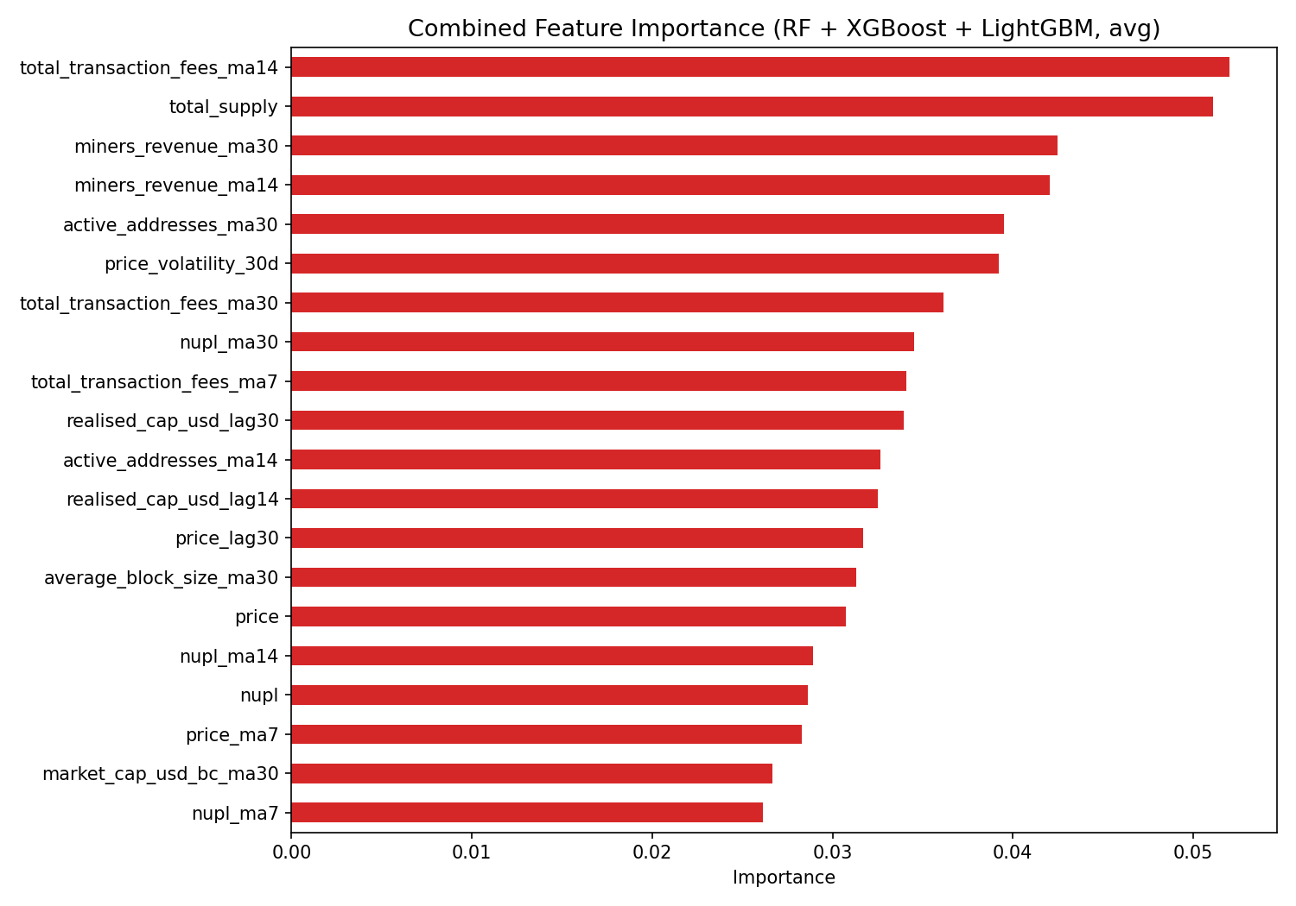
RESULTS — INTERPRETATION
Feature importance reveals which indicators most influence market state predictions.
Top Features (RF)
MVRV ratio, market cap, realised cap, price momentum (7/14/30d) — valuation cluster dominates
Top Features (LightGBM)
exchange_volume lags, hash_rate_ma30, coin_days_destroyed — network activity cluster
Interpretation
Bear class is hardest to predict — models tend to over-predict Bull/Sideways. Ensemble methods improve balance.
Cherrili/bitcoin-market-prediction
10

Slide 11
CONCLUSION
Rigorous temporal evaluation reveals that Bitcoin prediction is limited more by distribution shift than by model complexity.
Limitations
30-day / ±15% label choice is sensitive. On-chain features miss macro shocks. Single train/test split cannot prove cycle stability.
Key finding
Ensemble (F1=0.4124) beats single models, but binary robustness (AUC up to 0.65) proves the pipeline is valid. The ceiling is data quality, not algorithm choice.
Future work
Walk-forward validation, probability calibration, external signals (macro, derivatives, sentiment), class-specific thresholds.
Q & A
Cherrili/bitcoin-market-prediction
11

