Slide 1
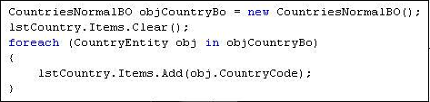
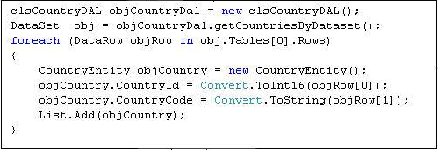
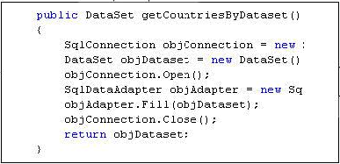
Client Code
Business Layer
Data access layer
Database

Slide 2
Dataset to Business Objects
Transform
UI
BO
DAL
SQL Server
Data access layer
User Interface
Business Object
ADO.net object, Dataset. Datareader

Slide 3
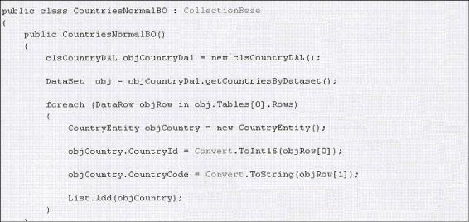
Get Data from DAL
Loop through all rows
Set data from Dataset to the BO
Add to the collection

Slide 4
Data Model transformed to the Object Model
1 as to many
relationship
Name
name
address1
address2
1
Address
0
0
Transformation complication multiplies

Slide 5
Ent 4.1
Matter goes worst
DAL
Ent 4.0
Enterprise Application Blocks
Ent 3.1
Custom Data Access Layer
Ent 1.1
Third Party DAL Component
Ent 2.0
Ent 3.0

Slide 6
Crud multiplies complication
Complex code for object transformation
Need to write business logic mapping code
non-uniform mechanism
Querying and sorting Business object
Inconsistent DAL component

Slide 7
Two Problems
Inconsistent Data Structure
Generalized query mechanism

Slide 8
Data
Field
Value

Slide 9
we all understand field and value
I understand field and value
I understand field and value
I understand field and value
UI
BO
DAL

Slide 10
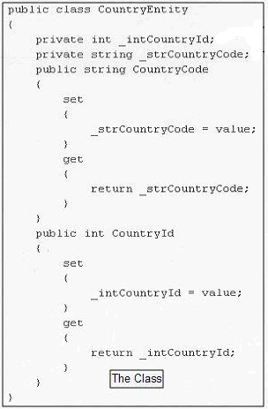
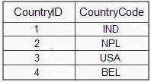
The Table
The Class

Slide 11
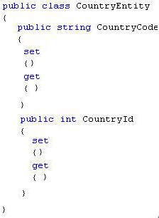
We all understand entity
UI
BO
DAL

Slide 12
Custom Collection Objects
Business Object Model
Generalized query mechanism
ADO.net Objects
Transformation and filling data in the object model
XML
Something custom

Slide 13
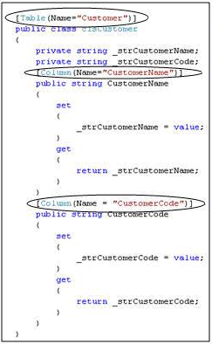

Step 1: - Customer table attribute
Step 2: - attribute all fields with column names

Slide 14
EntityObjects
DataContext
SQL Server

Slide 15
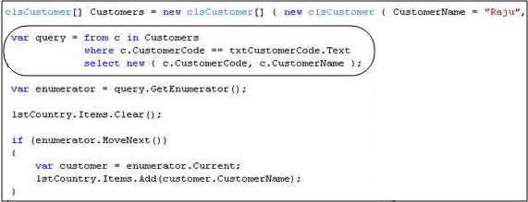
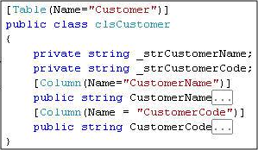
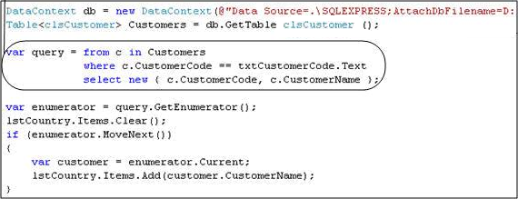
Common Shared Entity
Common Query Language

Slide 16
IEnumerable<CountryEntity>
Table<CountryEntity>
UI
BO
DAL
CountryEntity object consistent

Slide 17
LINQ says: - I can help you query and transform DAL to Business object models
BO
DAL
LINQ says: - I can help you ease query and filter Business object collection
LINQ says: - I can be used DAL replacement

Slide 18
UI
BO
DAL
CountryEntity
IEnumerable<CountryEntity>
Table<CountryEntity>
Pure Entity object
Entity objects has a Business object context here
Entity objects has a Datacontext here

Slide 19
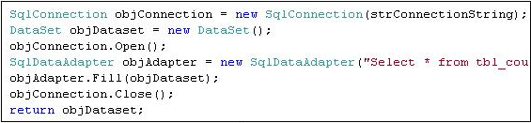

7 lines of codes reduced to 3 lines of codes

Slide 20
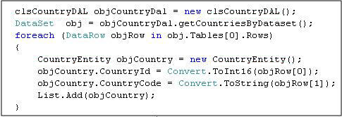

7 lines of codes reduced to 2 lines of codes

