Slide 1

Slide 1
Data Bootcamp Final Project
2019 NYU Stern Spring Semester
The Changes in the Real Estate Investment in China over the Last 15 Years
Principal Investigators:
Ruijie (Cherry) Cai, Wei Wang

Slide 2
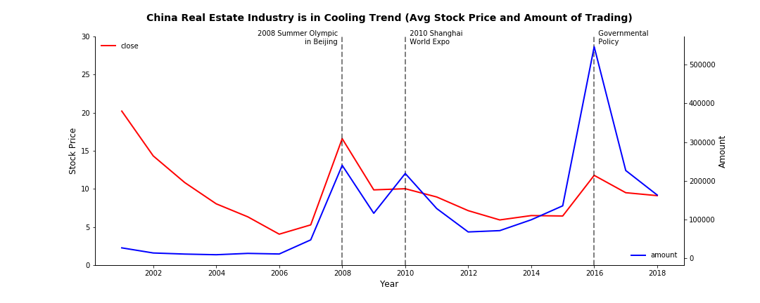
Slide 2
2

Slide 3
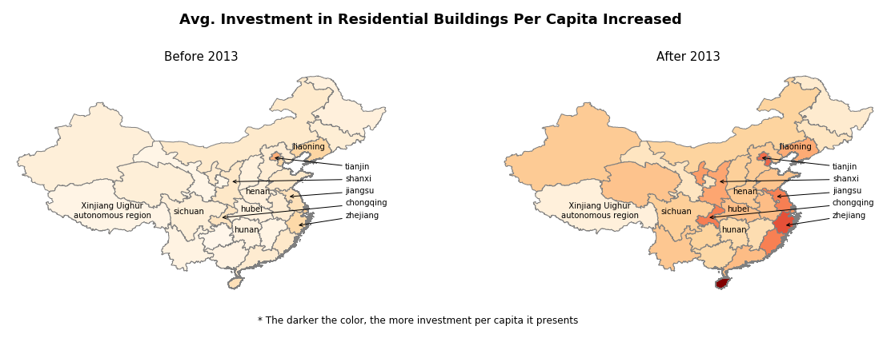
Slide 3
3

Slide 4
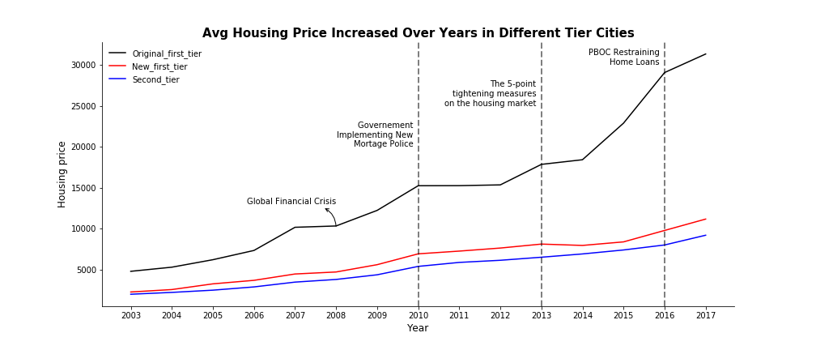
Slide 4
4

Slide 5

Slide 11
A SPECIAL THANKS TO
Professor Michael Waugh

