Slide 1
Modeling with R and the Tidyverse
Matt McDonald
University of Connecticut
FNCE 5352

Slide 2
Materials
Materials are available on github
LINK: https://github.com/mattmcd71/fnce5352_spring2020

Slide 3
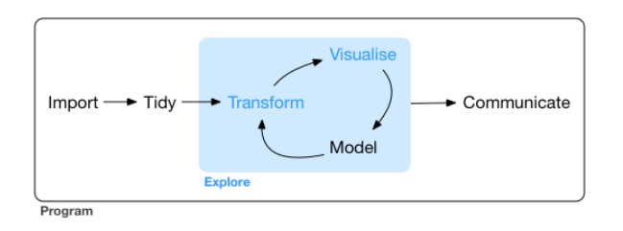
Modeling Workflow

Slide 4
Focus of this course
Model Workflow
Tools available to support modeling workflow
Getting things done!

Slide 5
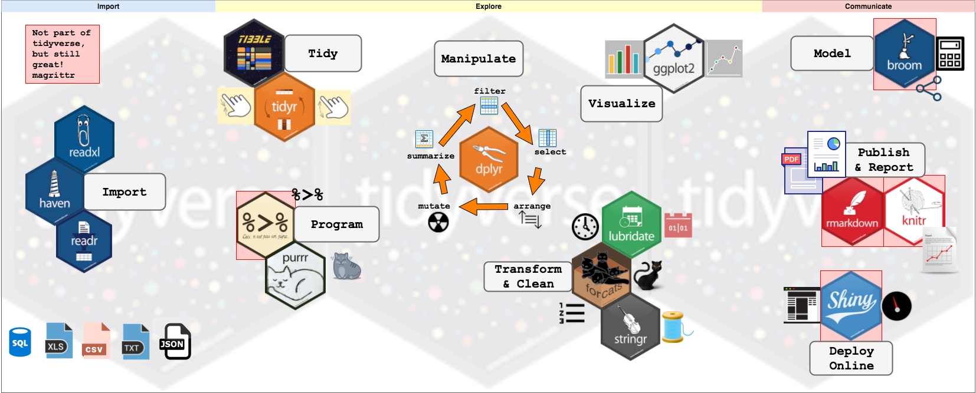
Tidyverse

Slide 6
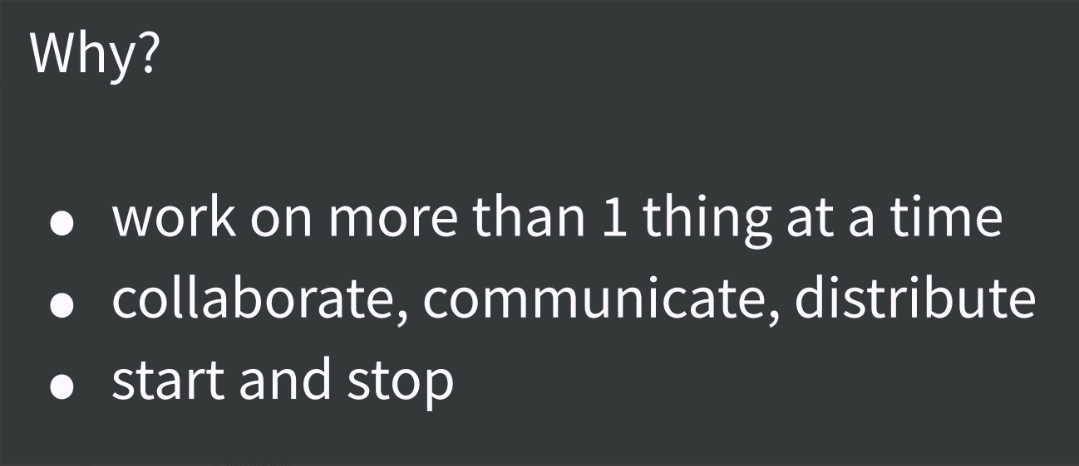
Project-Based Workflow

Slide 7
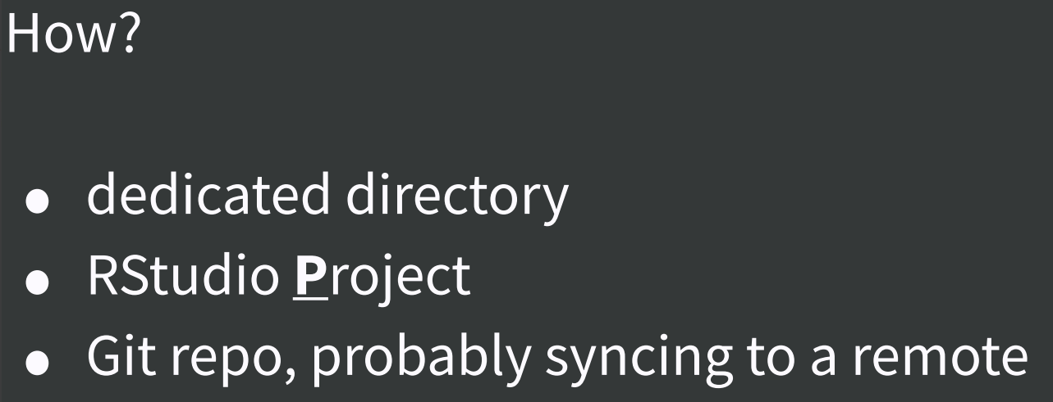
Project-Based Workflow

Slide 8
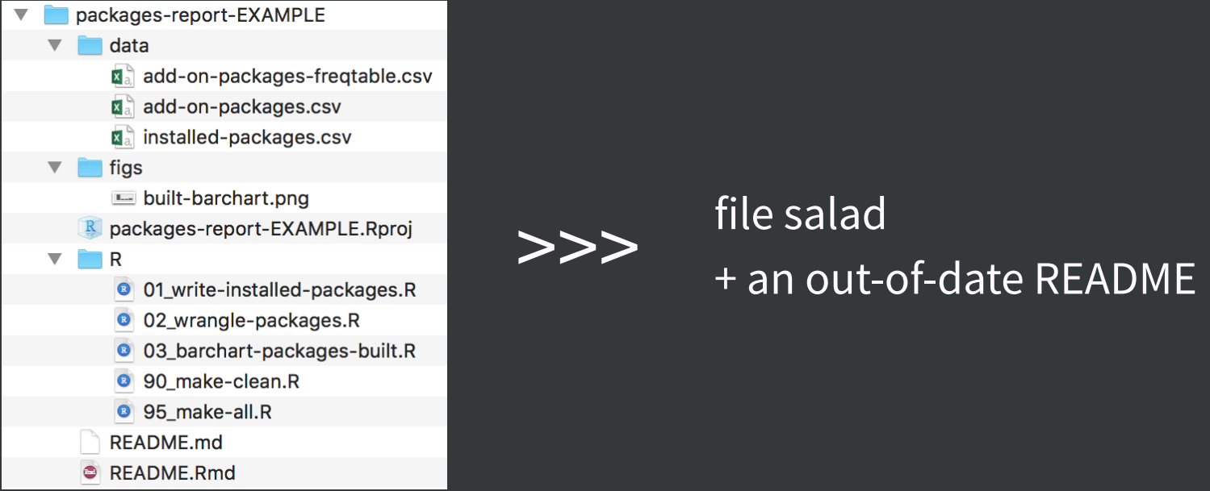
Project-Based Workflow

Slide 9
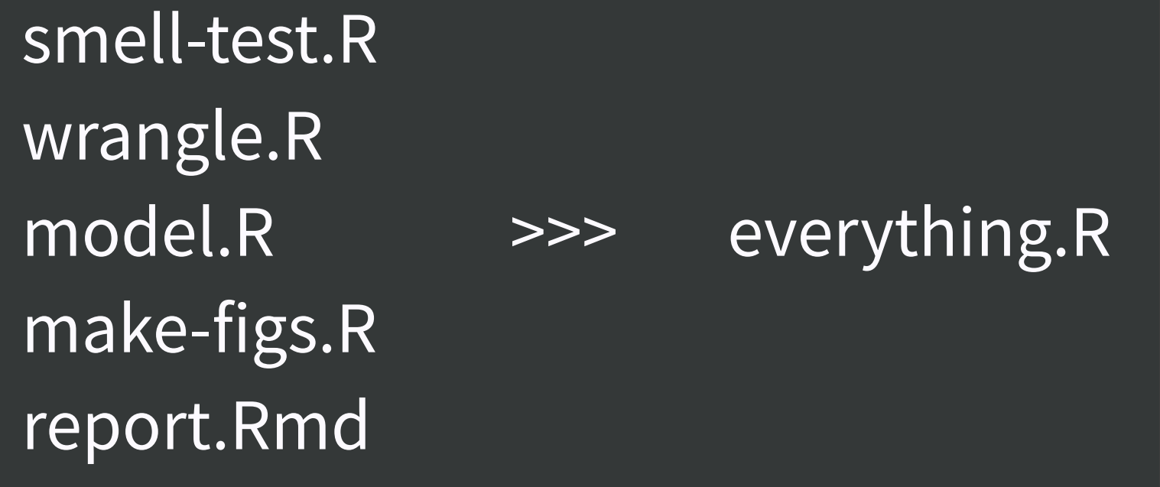
Project-Based Workflow

Slide 10
Help on the Tidyverse
Rstudio Cheat Sheets!
https://www.rstudio.com/resources/cheatsheets/
R for Data Science
http://r4ds.had.co.nz/
Feature Engineering and Selection
https://bookdown.org/max/FES/

