Slide 1
Low Cost Apparatus for Testing Biophotovoltaics
By Amir Shukri

Slide 2
Introduction: Biophotovoltaics
Devices that convert light energy into electrical energy using microorganisms that can undergo photosynthesis.
There are multiple categories such as cellular and subcellular living biophotovoltaics and photo-microbial fuel cells

Slide 3
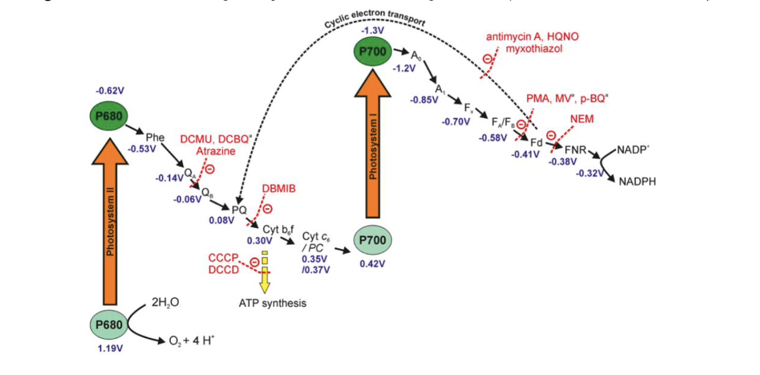
Mechanism

Slide 4
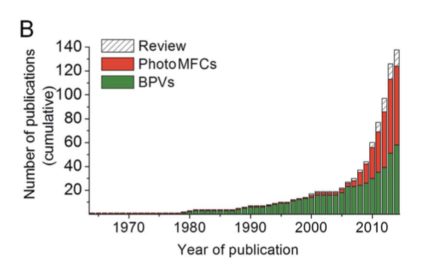
Why biophotovoltaics?
Environmentally sustainable in disposability and manufacture
Potentially more efficient than conventional photovoltaics that are limited by the Shockley Quesser thermodynamic limit.
However, current power output and efficiency very low in comparison to conventional PVs and suitable for niche applications only.

Slide 5
Problem
Current research in biophotovoltaics use non-standardised measurements of light.
Results between studies are difficult to compare
One main issue is cost of commercial solar simulators being overly expensive.

Slide 6
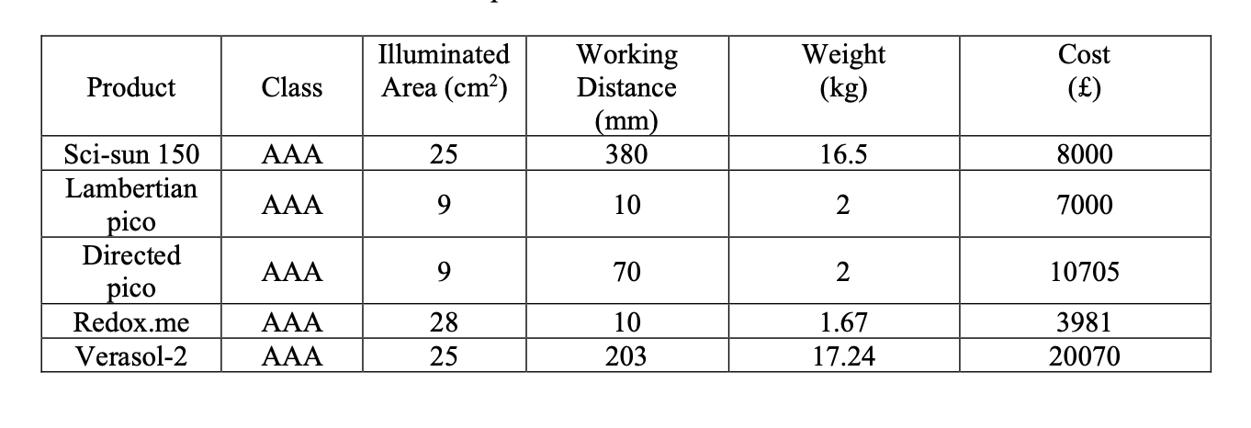
Solar Simulator Prices from different companies

Slide 7
Research objective
Understand and describe examples of biophotovoltaics systems and select appropriate dimension for designed solar simulator.
Review existing solar simulators to analyse its functional capabilities suitable to be implemented for biophotovoltaics testing according to relevant standards.
Analyse current suitability of solar simulators used to test biophotovoltaic system.
Design a low-cost solar simulator system that is appropriate for biophotovoltaics testing.

Slide 8
Design Specifications
Total cost must be below £500
Illuminated area would be 3cm x 3cm, assumed BPV device area is below these dimensions
Lift mechanism being able to accommodate for differing light working distance as well as varying BPV setup height.
Wavelength AM1.5G conditions between 400nm-1100nm as photosynthesis does not require UV or NIR wavelength.
Ideally Class AAA solar simulator
6 holes with diameter of 8mm.
Enclosed area whilst minimising ingress of light from openings.

Slide 9
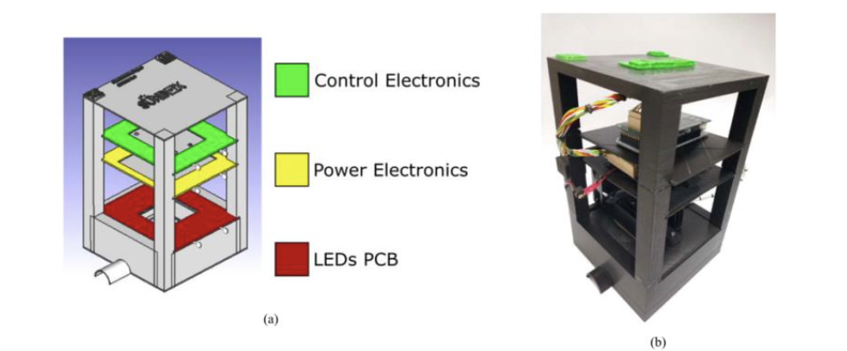
Main inspiration for design (López-Fraguas et al, 2019)

Slide 10
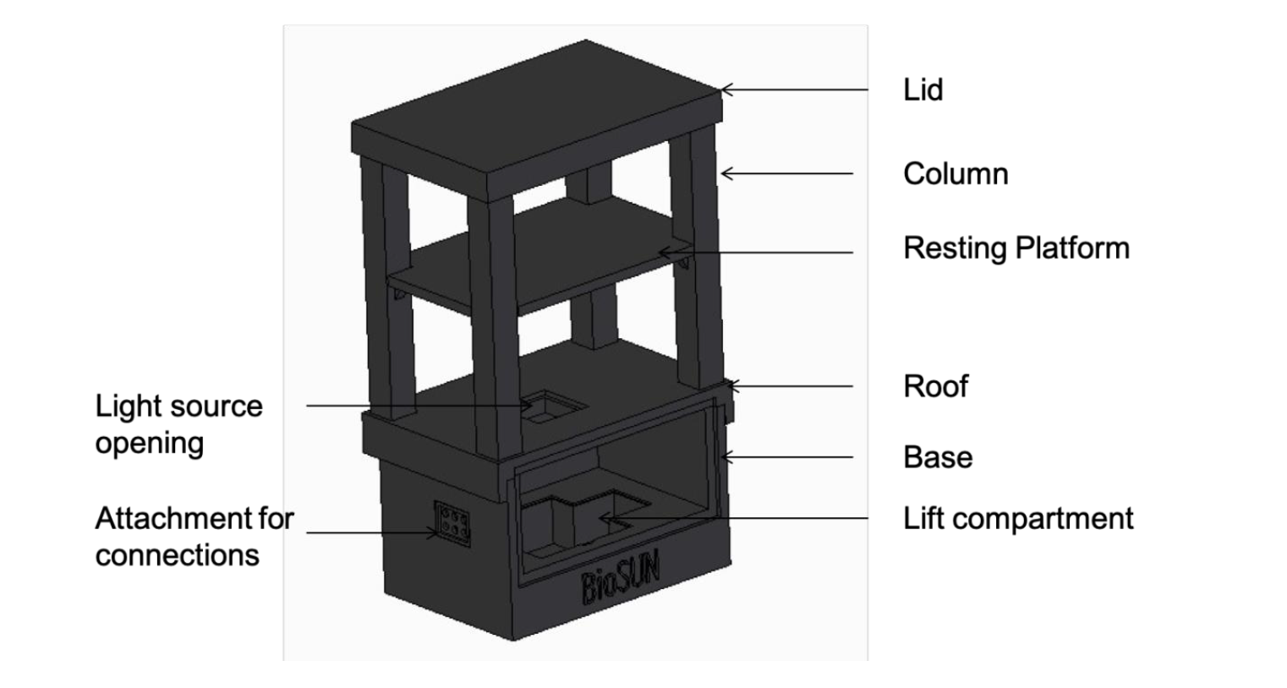
Final Design BioSUN

Slide 11
Design considerations
Material Selection
Lift Mechanism
Opening
Manufacturability
Mechanical Feasibility

Slide 12
Optics, power and control electronics
After literature research, Lopez-Fraguas et al study showed most promise in terms of cost reduction.
Using Arduino Uno to control electronics and cheap off the shelf LEDs for optics to create light simulation that follow the standards from specification

Slide 13
Force analysis: Hypothesis vs FEA
Assumption of the weight on each surface of design of 2kg on the platform for power and control electronics
1kg on the roof for optics
0.5kg on the base for the lift mechanism
Force approximated as even distribution.

Slide 14
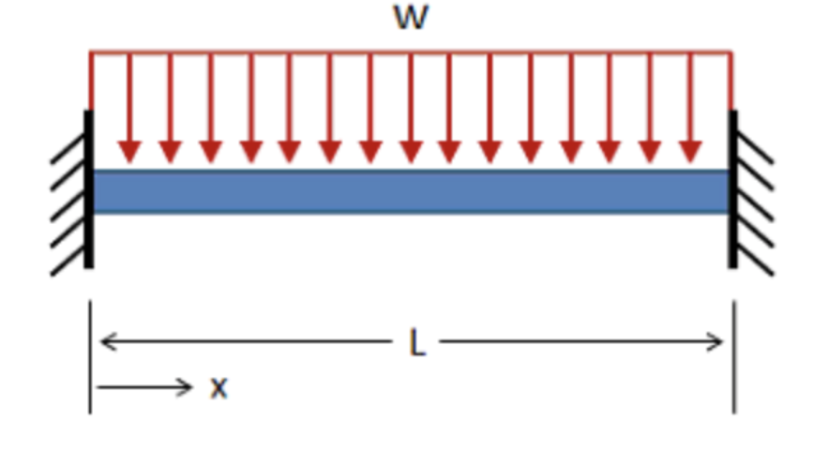
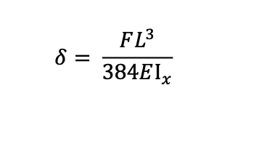
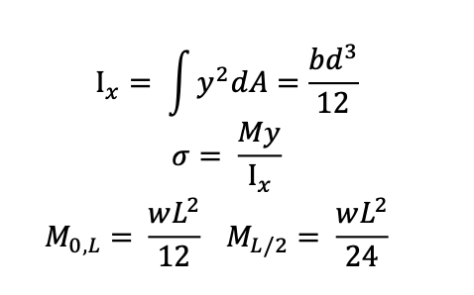
Force calculations: Simplified beam model for platform

Slide 15
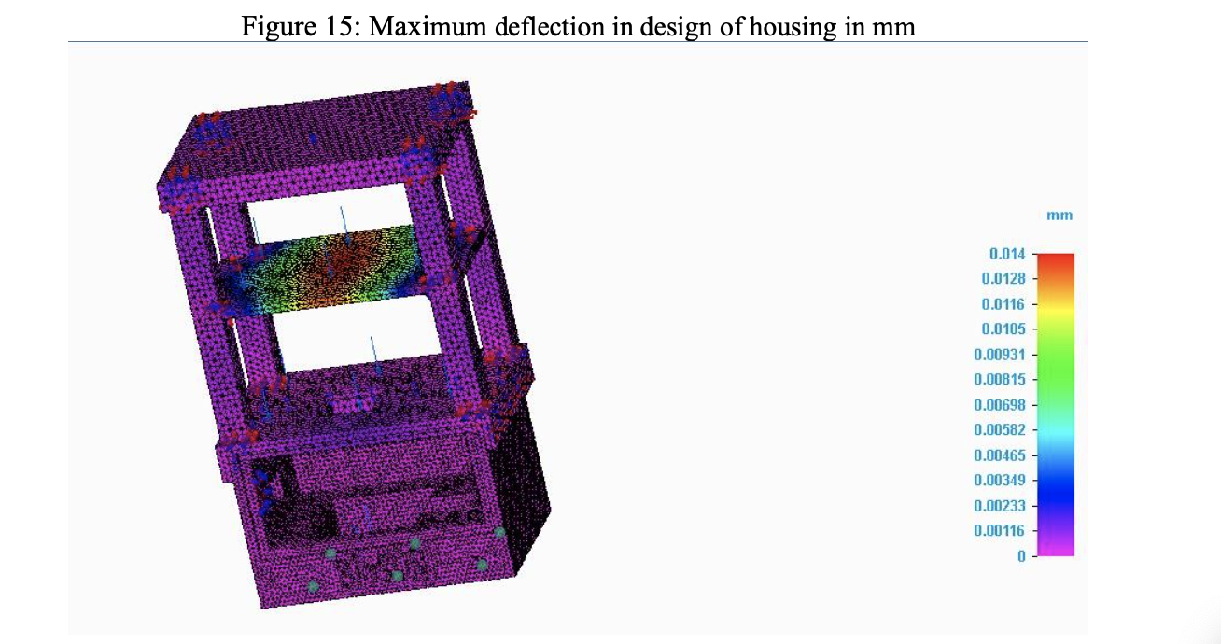
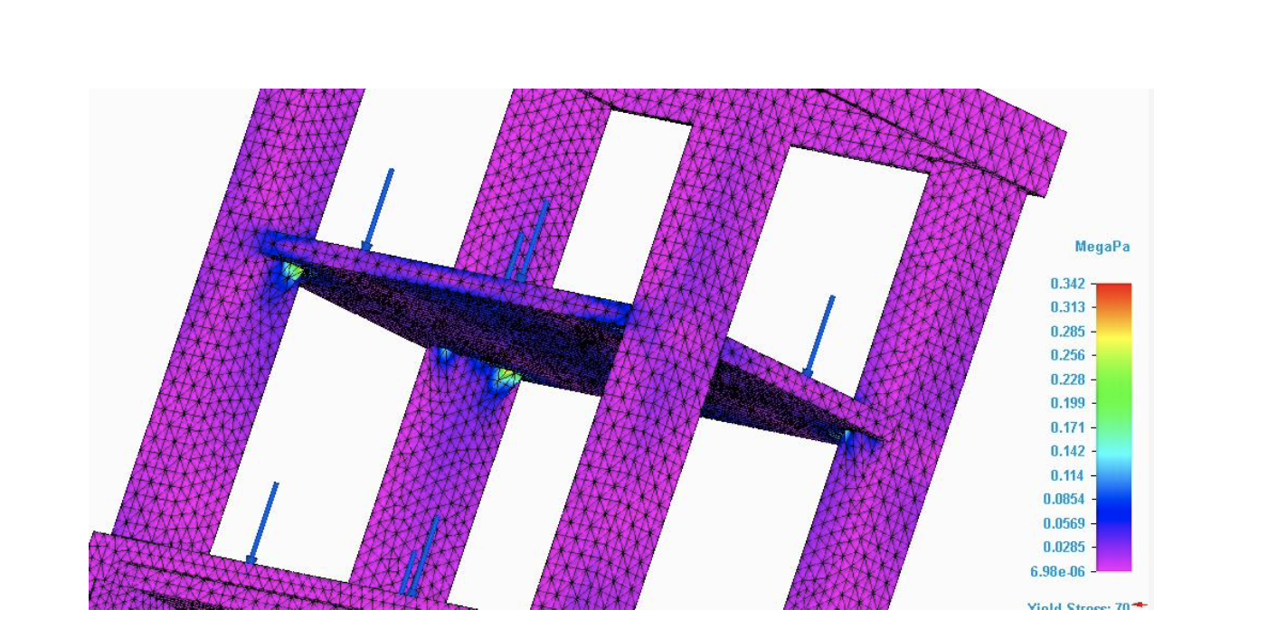
FEA analysis: Deflection and maximum stress

Slide 16
Results
Force calculations results, maximum deflection = 0.0276 mm and maximum stress = 0.119MPa
FEA analysis, maximum deflection = 0.014mm , maximum stress = 0.342
Both were below PLA yield stress at 70 MPa, therefore will not fail.

Slide 17
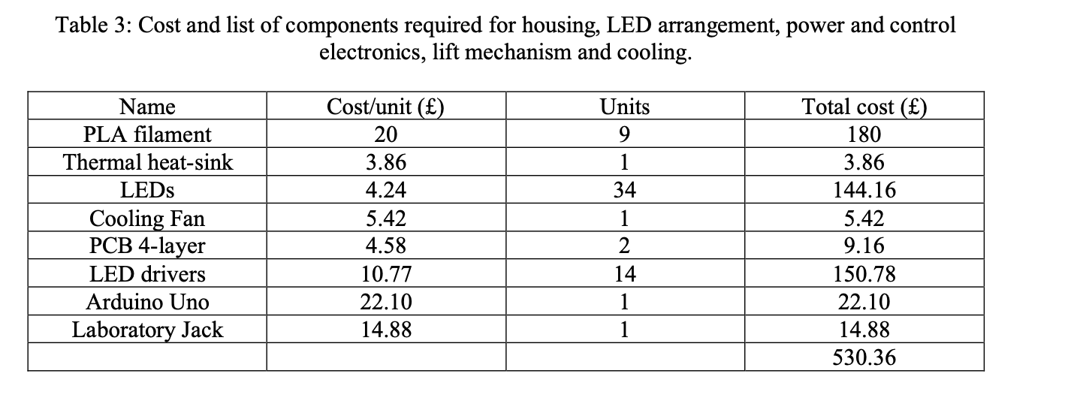
Cost analysis

Slide 18
Conclusion
Cost was 6% higher than initial estimate. Perhaps an overdesign, can reduce the material used in thickness of walls.
Bigger illumination area could be accommodated in the future as LED technology improves
Force calculations and FEA analysis differ due to model approximating 2D forces and does not account 3D interaction of forces
Manufacturability and ease of use prioritised, however in retrospect dimensions can only be made using specific 3D printers.

