Slide 1
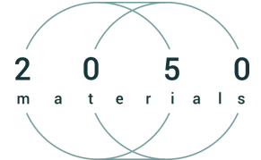

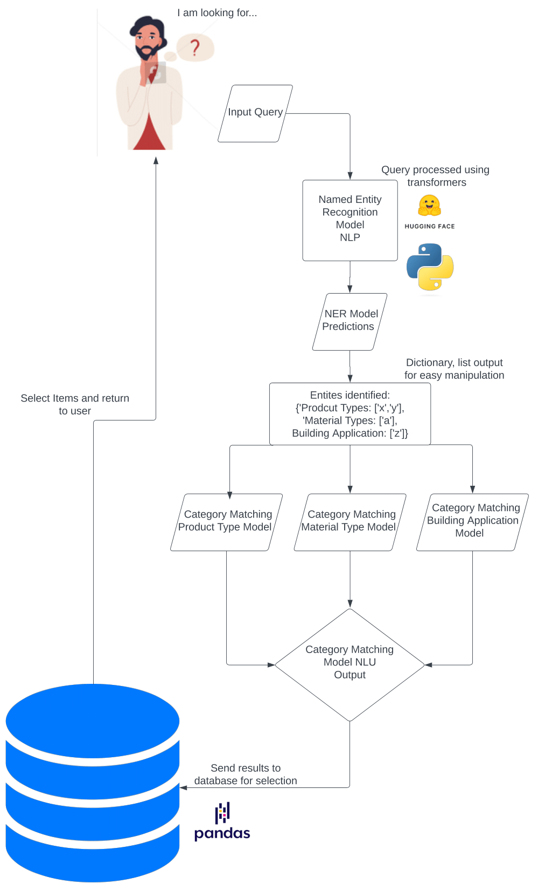
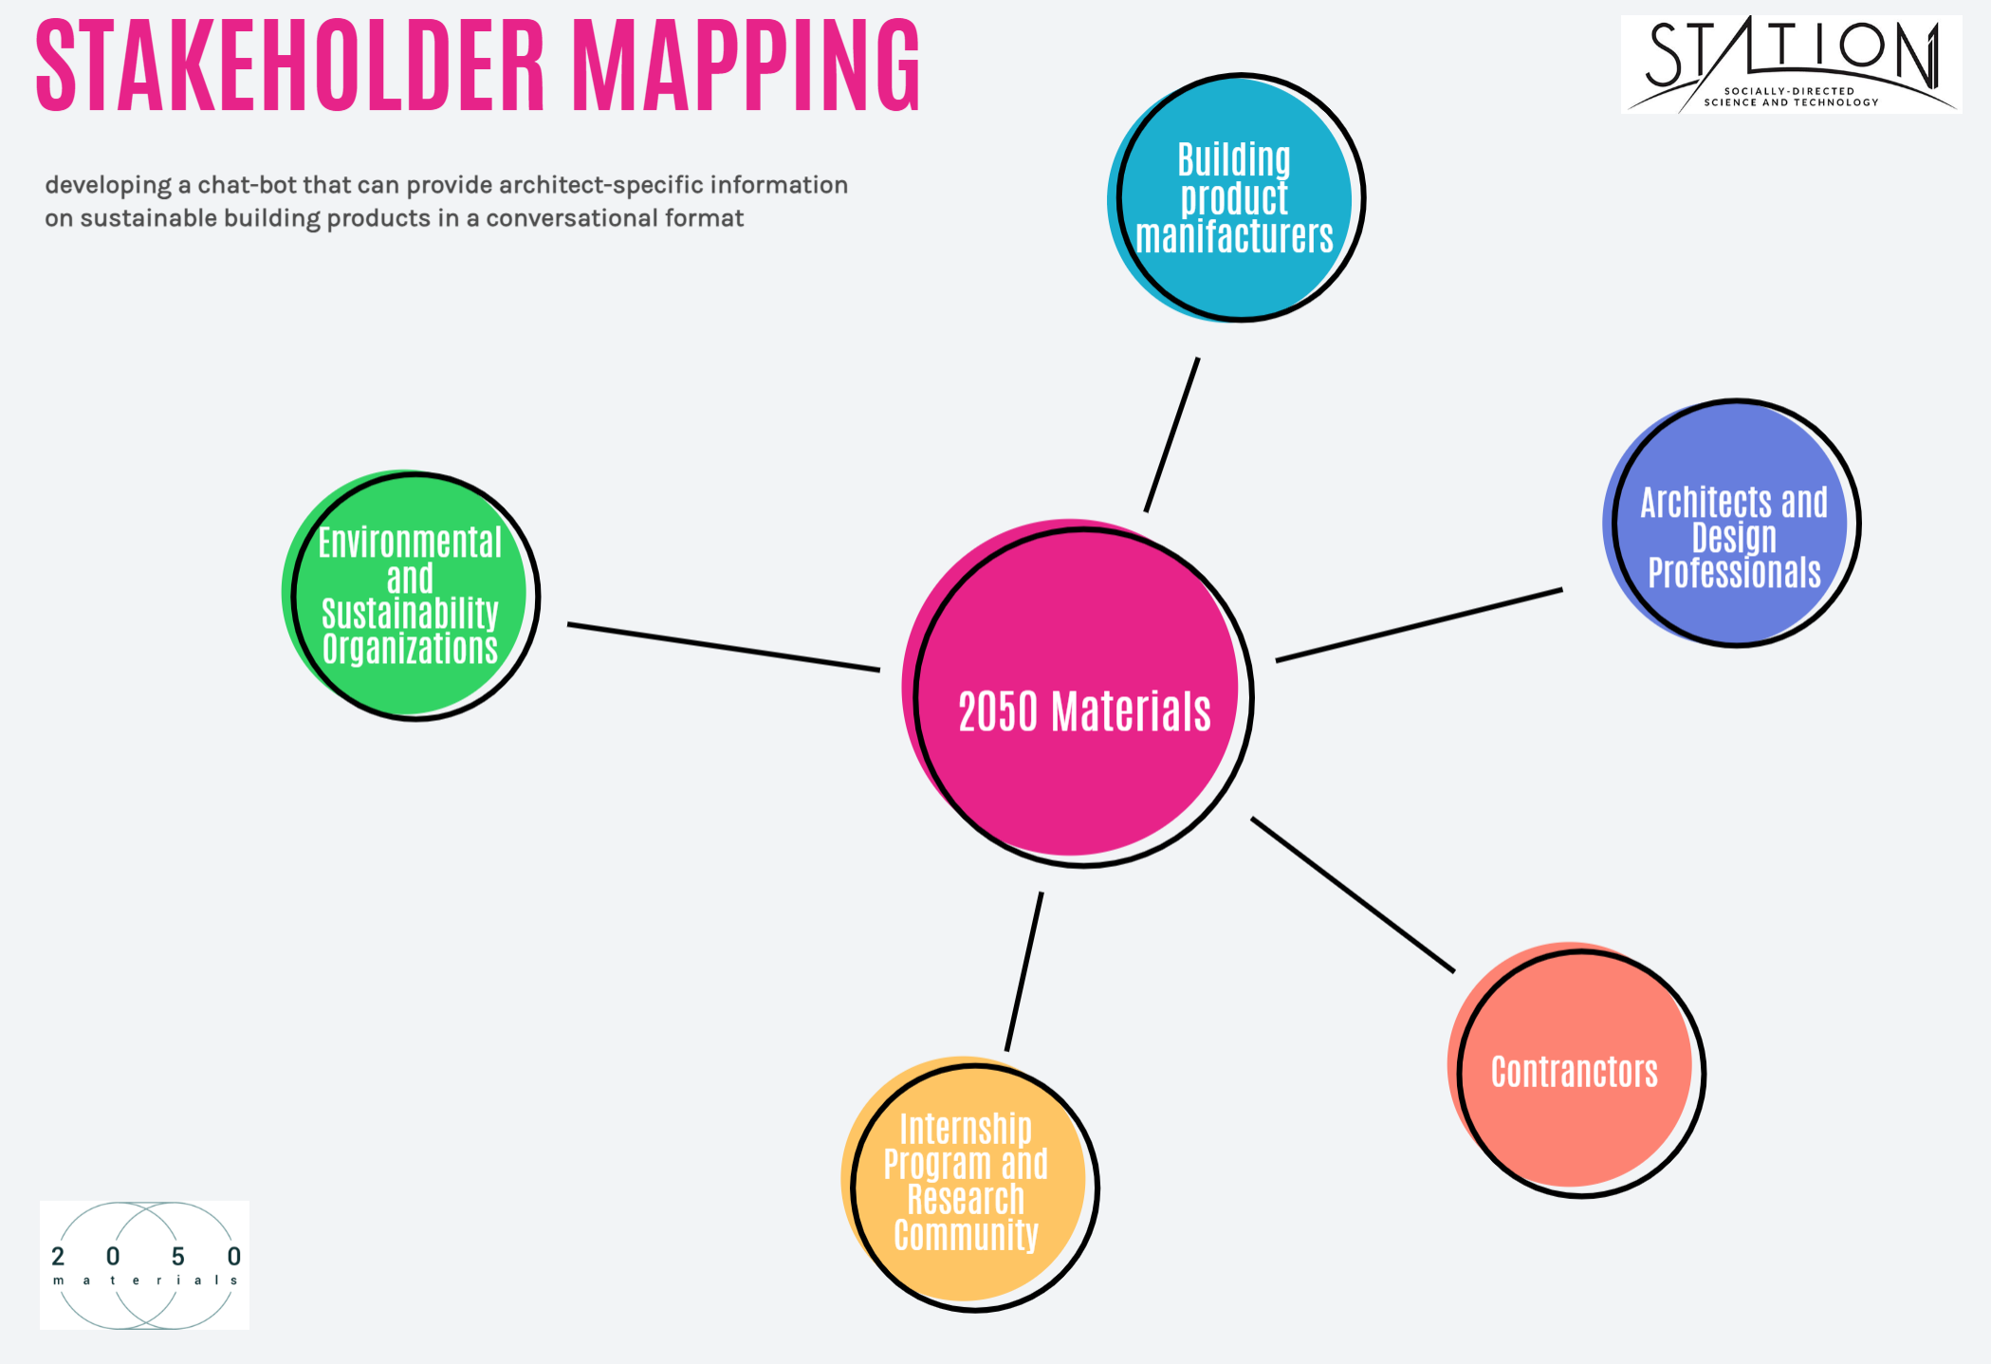
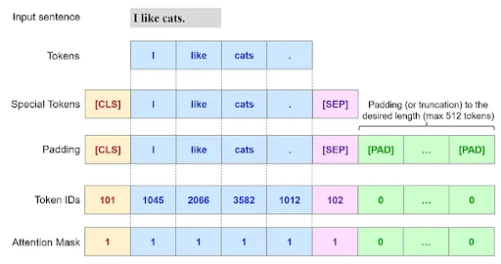
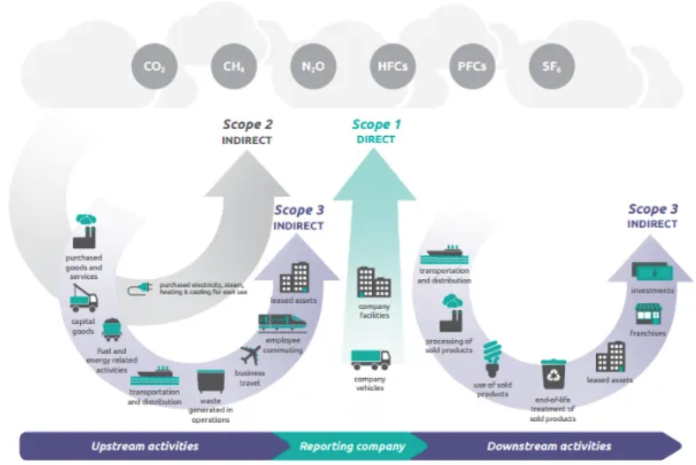
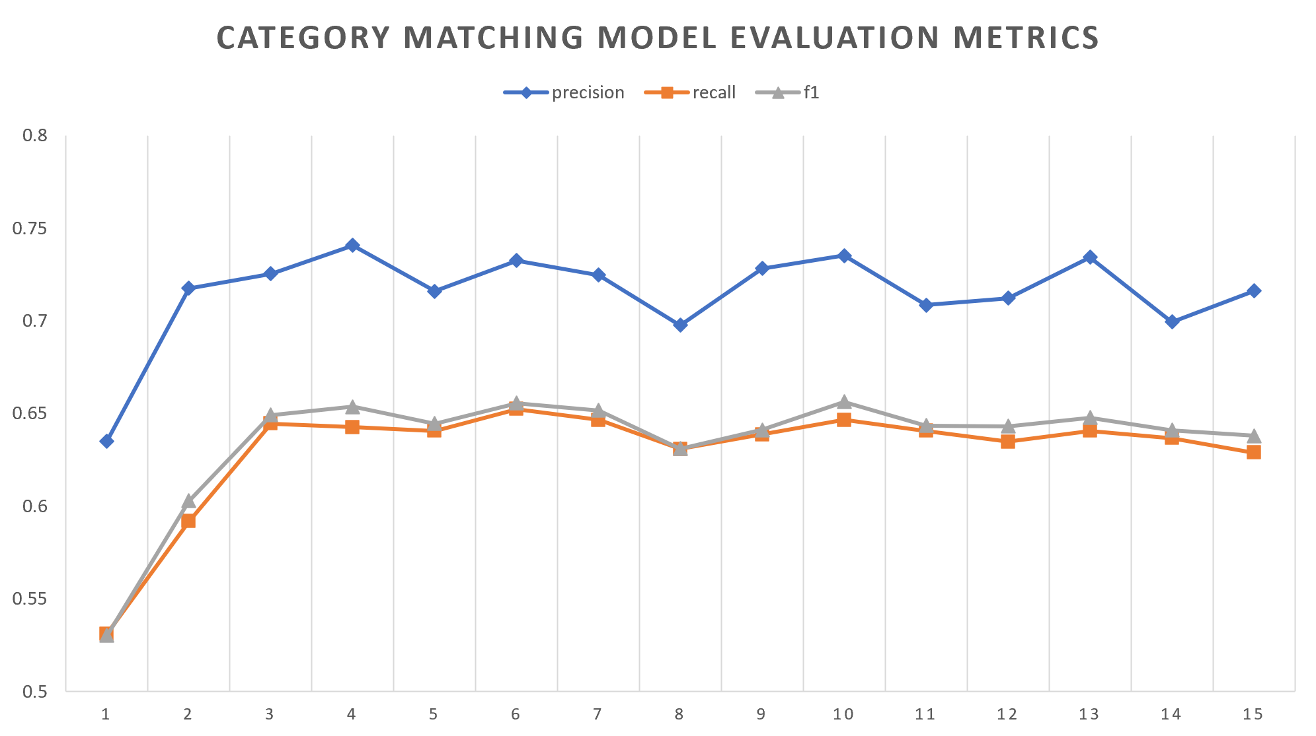
Sustainable Construction through NLP: Advanced Multiparameter Search Optimization Endrit Berberi^{1,2,3}, Cherubel Kefyalew^{1,2,4}, Nicodemos Varanava²
(1) Station1 (Lawrence, MA), (2) 2050 Materials (London, UK), (3) University of Florida (Gainesville, Florida), (4) George Mason University (Fairfax, Virginia)
Background & Objectives
This research project primarily focuses on enhancing the digitization of sustainability data of 2050 Materials, a tech company providing a digital library of eco-friendly building materials. The project aims to leverage Artificial Intelligence (AI) and Natural Language Processing (NLP) to enhance the search capabilities on the platform using nature language. Specifically, natural language processing will enable multiparameter filtering giving architects a powerful tool. This would facilitate the transition to a more sustainable and responsible building industry.
Literature Review:
A comprehensive literature review reveals the significance of AI and machine learning across different sectors, including the construction industry. AI tools, specifically those employing Natural Language Processing (NLP), demonstrate potential in enhancing the search capabilities on platforms, improving user engagement, and delivering critical information. This is particularly relevant in the context of sustainable construction data, providing a sophisticated tool for industry professionals. Transformer models such as BERT and RoBERTa have seen wide usage in natural language understanding tasks. However, their potential for improving multiparameter search functionality in our specific project context requires further exploration (Devlin et al., 2018).
Results & Discussion
Social Impact Discussion
Ethical Implications:
Sustainability and environmental benefits are evident, as the tool promotes eco-friendly practices. Yet, the energy consumption of large-scale AI computations requires attention. This tool’s social impact could be substantial, fostering sustainable building practices and influencing industry standards. However, unintended consequences may arise, such as job displacement if AI tools reduce the need for certain roles (Gkinko et al., 2022).
Future Work
Moving forward, continual model training is essential due to the dynamic nature of the products provided by 2050 Materials, necessitating regular updates and improvements to the training datasets over time. Another aim should be to alleviate the computational demands and potential biases within the AI models, while ensuring responsible and ethical data use. It is also vital to exert efforts to enhance accessibility and inclusivity, to ensure a broad and diverse user base can benefit from the developed solutions.
Integrative Conclusions
This project underscores the potential of AI, and specific components like NLP, in enhancing search capabilities and digitizing sustainability data for the construction industry. Early findings show promising results with respect to data accuracy. However, future work needs to address computational demands, potential AI bias, and ethical data usage. A careful balance between technological advancement and social and environmental impact must be struck, with a commitment to maintain accessibility and inclusivity in the implementation.
Acknowledgements
We would like to thank the team at 2050 Materials, namely Phanos Hadjikyriakou, Chandra Challagonda, and especially Dr. Nicodemos Varnava for his close and continuing mentorship and guidance throughout this project. Additionally, we extend a special thanks to the esteemed instructional team of Station1.
References
Abioye, S. O., Oyedele, L. O., Akanbi, L., Ajayi, A., Delgado, J. M. D., Bilal, M., ... & Ahmed, A. (2021). Artificial intelligence in the construction industry: A review of present status, opportunities and future challenges. Journal of Building Engineering, 44, 103299.
Devlin, J., Chang, M. W., Lee, K., & Toutanova, K. (2018). Bert: Pre-training of deep bidirectional transformers for language understanding. arXiv preprint arXiv:1810.04805.
Sanh, V., Debut, L., Chaumond, J., & Wolf, T. (2020, March 1). Distilbert, a distilled version of Bert: Smaller, faster, cheaper and lighter. arXiv.org. https://arxiv.org/abs/1910.01108
Rajaraman, V. (2023). From ELIZA to ChatGPT: History of Human-Computer Conversation. Resonance, 28(6), 889-905.
Kaplan, A., & Haenlein, M. (2020). Rulers of the world, unite! The challenges and opportunities of artificial intelligence. Business Horizons, 63(1), 37-50.
Gkinko, L., & Elbanna, A. (2022). AI Chatbots sociotechnical research: An overview and Future Directions. Proceedings http://ceur-ws. org ISSN, 1613, 0073
3. Miller, T. (2019). Explanation in artificial intelligence: Insights from the social sciences. Artificial intelligence, 267, 1-38.
5. Nowak, A., Lukowicz, P., & Horodecki, P. (2018). Assessing artificial intelligence for humanity: Will AI be the our biggest ever advance? Or the biggest threat [Opinion]. IEEE Technology and Society Magazine, 37(4), 26-34.
6. Konya-Baumbach, E., Biller, M., & von Janda, S. (2023). Someone out there? A study on the social presence of anthropomorphized chatbots. Computers in Human Behavior, 139, 107513.
8. Pearce, K., Alghowinem, S., & Breazeal, C. (2022). Build-a-Bot: Teaching Conversational AI Using a Transformer-Based Intent Recognition and Question Answering Architecture. arXiv preprint arXiv:2212.07542.
12. Rothman, D., & Gulli, A. (2022). Transformers for Natural Language Processing: Build, train, and fine-tune deep neural network architectures for NLP with Python, PyTorch, TensorFlow, BERT, and GPT-3. Packt Publishing Ltd.
13. Nadkarni, P. M., Ohno-Machado, L., & Chapman, W. W. (2011). Natural language processing: an introduction. Journal of the American Medical Informatics Association, 18(5), 544-551.
Named Entity Recognition & Category Matching Multi-filtering process
As the user inputs their query into the 2050 Materials’ website. It is then pushed into the Named Entity Recognition Model. This query is then tokenized into using DistilBERT. As said in the previous section, DistilBERT is selected due to runs 60% faster while preserving over 95% of BERT’s performances. Tokenization is a process that takes each word in the query and separates it, each word is then given an integer value that is fed into the NER Model. This model, having been fine-tuned on the library of products, will then determine what each word in the query represents, product types, material types, and building applications. Separating results into a dictionary of lists, depending on the query. This development of a multi-parameter search optimizer allows for better comprehension and understanding of user requests. Classified results are loaded into a Category Model, custom, fine-tuned models were developed to process each type of search parameter. Each parameter is then tokenized and
Figure 5: Stakeholder Map
Figure 3: Flowchart by Cherubel Kefyalew
fed into the corresponding model. Calculating the similarity to items in the database. The items with the highest probability are then selected from the database, outputting results to the user. This multi-filtering approach allows us to enhance the search capabilities for architects.
Category Matching Model performance
Figure 1: Fine-tuning bert for text classification (Albanese, N. C. 2022, May 16)
Figure 2: Corporate emission scopes. Image by Greenhouse Gas Protocol
Research Questions:
How can NLP enhance search capabilities for sustainable construction data, facilitating detailed filtering for industry professionals?
What are the potential benefits of this AI-enhanced search for the construction industry, and how might it contribute to a more sustainable future?
Methods and Analysis:
These AI models have been developed using PyTorch, a machine learning framework. For this project we utilized this framework for advanced Natural Language Processing (NLP) & Natural Language Understanding (NLU) tasks. Designed to convert natural language search queries into Django-compatible structured query sets. Built using Hugging Face Transformers library. Specifically, utilizing pre-trained models, notably BERT for its high accuracy, although given BERT's substantial computational demand, the more efficient DistilBERT was chosen, considering its near-equivalent performance. The model operates in two primary stages: Named Entity Recognition (NER) and Category Matching. The initial stage employs NER, an NLP task adept at locating and categorizing named entities into defined groups, like product types, material types, and building applications, among others. For initial testing, we used a categorically organized temporary dataset, including parameters like product type and material type, extracted from the 2050 Materials' digital library. To mimic potential user inputs, template queries, for which corresponding labels were created through a custom Python script, aiding in training our NER model. The second stage, Category Matching, involves NLU to match identified entities from the NER stage to a predefined list of categories, accomplished by training on these categories and fine-tuning it to understand and mimic the search behavior of users. The fusion of NER & Category Matching creates a multifiltering system capable of handling complex queries, making it versatile and efficient.
Figures 4: Predicting label categories. DistilBERT model performance and accuracy metrics.
Based on the results represented on Figure 4, it appears that the DistilBERT model's performance at predicting the label categories improved over the 15 epochs of training. This is evident from the increasing trend in precision, recall, and F1 scores. However, it's clear that after the ninth epoch, the precision, recall, and F1 score show small fluctuations. After a certain number of epochs, the model reaches a plateau, and additional training doesn't necessarily improve performance. In terms of metrics, precision started from 0.256 in the first epoch and reached a maximum of 0.772 by the ninth epoch. It signifies the proportion of true positive predictions (correctly predicted labels) among all positive predictions made. The upward trend implies that the model is getting better at making accurate predictions over time.
The recall increased from 0.218 in the first epoch to a peak of 0.682 in the ninth epoch. This metric represents the proportion of true positives in all actual positive instances. The increase over epochs shows that the model is getting better at identifying positive instances. The F1 score, which is the harmonic mean of precision and recall, also demonstrated an increasing trend, starting from 0.192 and reaching a maximum of 0.693 in the ninth epoch. This shows that the model's overall predictive accuracy, considering both precision and recall, improved during training.

