Slide 1
Ames Iowa: Alternative to the Boston Housing Data Set
Predicting the house price is a well-known problem in the field of machine learning. The most famous dataset used for this task is the Boston Housing Data Set. In this project, an alternative database was selected. This database has been created for educational purpose only and it was presented in the Journal of Statistics Education in 2011.
Objective: Predict the house prices using different parameters
Database
2930 observations
80 features
46 categorical parameters
34 discrete/continuous parameters

Slide 2
Hypotheses
If the intrinsic value of a property is defined by different parameters such as the number of rooms or the total surface for example, then it must possible to have an algorithm which can predict with good accuracy the price of a property.
→ use the 80 parameters
If some parameters are more meaningful than others to explain the price of a house, then by taking into account only these parameters the price of a house should be still predictable.
→ use only the most relevant parameters

Slide 3
Relevant Parameters Selection
Parameter | Pearson coefficient
Ground living area (square feet) | 0,7
Basement area | 0,635
Garage area | 0,63
1st floor living area | 0,625
Year Built | 0,56
Full Bath | 0,536
Year Remodel | 0,53
Masonry veneer area | 0,5
Fireplaces | 0,49
Total Rooms Above Grd | 0,48
Keep only the discrete/continuous parameters
Compute the Pearson correlation factor between each continuous/discrete parameters and the sale price

Slide 4



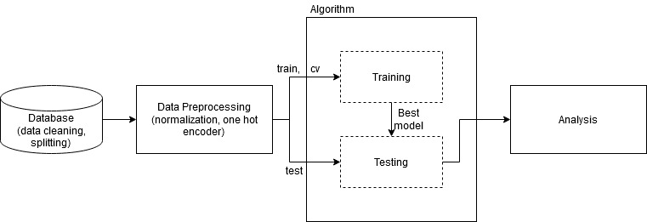
Code Structure
The whole toolchain is managed by a configuration file
Each experiment will have its own configuration file (reproducibility)
The algorithm block can be: random forest, decision tree, linear regression, …
The toolchain is generic and it can work with whatever parameters the user want to test

