Slide 1
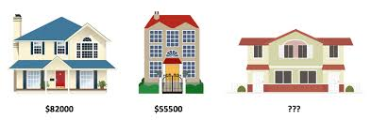
INTELLIGENT ENGINE FOR HOUSES PRICES ESTIMATION
Master in Artificial Intelligence M05 – Reproducibility and open science Mini project
Authors: Michelle Vanessa MEGUEP and Arthur CHERUBINI

Slide 2
Table of contents
About the project:
Description, goals, hypotheses defined
The database used and the work on the data
The algorithms
The project reproducibility
What has been put in place or planned?
Project status(Demo) and next steps

Slide 3


About THE PROJECT
Predicting the house price is a well-known problem in the field of machine learning. One of the best-known projects on this is the Boston House prices.
The objectives of this project:
Find the most relevant features which determine houses prices
Apply differents algorithms and find the one with the best prediction performance
Two hypothesis defined:
Between all the house features, only some are relevant in the price prediction
One algorithm between the linear regression, decision tree and random forest can predict with good accuracy the price of a property
Database
Ames Iowa: the database chosen instead of the Boston Housing Data Set.
2930 observations and 80 features which can be categorical or discrete/continuous

Slide 4



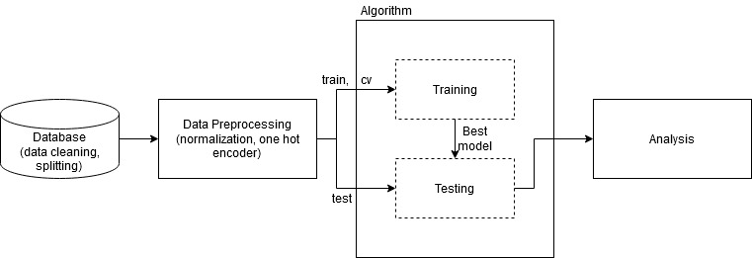

THE REPRODUCIBILITY
Code structure
Project fully documented
The whole toolchain is managed by a configuration file
Each experiment will have its own configuration file (reproducibility)
The algorithm block can be: random forest, decision tree, linear regression, …
The toolchain is generic and it can work with whatever parameters the user want to test

Slide 5

Demo and next steps

