Slide 1
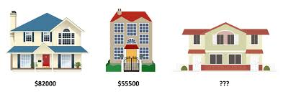
INTELLIGENT ENGINE FOR HOUSES PRICES ESTIMATION
Master in Artificial Intelligence M05 – Reproducibility and open science Mini project
Authors: Arthur CHERUBINI and Michelle Vanessa MEGUEP

Slide 2
Table of contents
About the project:
Description, goals, hypotheses defined
The database used and the work on the data
The algorithms
The project organisation
The work sharing and contribution
The collaboration between the team members
The project reproducibility
What has been put in place or planned?
Project status(Demo) and next steps

Slide 3


About THE PROJECT
Predicting the house price is a well-known problem in the field of machine learning. one of the best-known projects on this is the Boston House prices.
The objectives of this project:
Find the most relevant features which determine houses prices
Apply differents algorithms and find the one with the best prediction performance
Two hypothesis defined:
Between all the house features, only some are relevant in the price prediction
One algorithm between the linear regression, decision tree and random forest can predict with good accuracy the price of a property
Database
Ames Iowa: the database chosen instead of the Boston Housing Data Set.
2930 observations and 80 features of type categorical and discrete/continuous

Slide 4
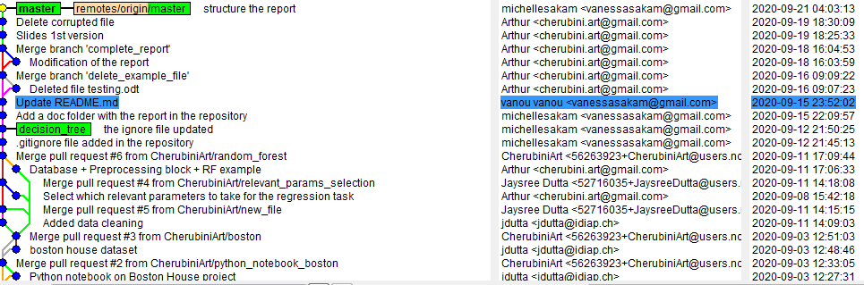


THE PROJECT Organisation
coding
Collaboration

Slide 5


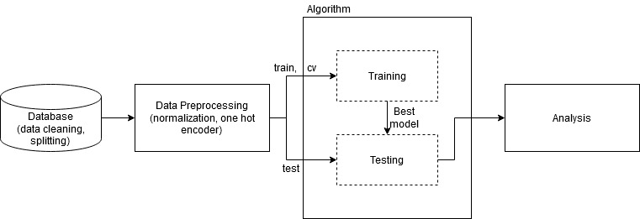


THE REPRODUCIBILITY
Code structure
Project full documented
The whole toolchain is managed by a configuration file
Each experiment will have its own configuration file (reproducibility)
The algorithm block can be: random forest, decision tree, linear regression, …
The toolchain is generic and it can work with whatever parameters the user want to test

Slide 6

Demo and next steps

Slide 7
Hypotheses
If the intrinsic value of a property is defined by different parameters such as the number of rooms or the total surface for example, then it must possible to have an algorithm which can predict with good accuracy the price of a property.
→ use the 80 parameters
If some parameters are more meaningful than others to explain the price of a house, then by taking into account only these parameters the price of a house should be still predictable.
→ use only the most relevant parameters

Slide 8
Ames Iowa: Alternative to the Boston Housing Data Set
Predicting the house price is a well-known problem in the field of machine learning. The most famous dataset used for this task is the Boston Housing Data Set. In this project, an alternative database was selected. This database has been created for educational purpose only and it was presented in the Journal of Statistics Education in 2011.
Objective: Predict the house prices using different parameters
Database
2930 observations
80 features
46 categorical parameters
34 discrete/continuous parameters

Slide 9
Relevant Parameters Selection
Parameter | Pearson coefficient
Ground living area (square feet) | 0,7
Basement area | 0,635
Garage area | 0,63
1st floor living area | 0,625
Year Built | 0,56
Full Bath | 0,536
Year Remodel | 0,53
Masonry veneer area | 0,5
Fireplaces | 0,49
Total Rooms Above Grd | 0,48
Keep only the discrete/continuous parameters
Compute the Pearson correlation factor between each continuous/discrete parameters and the sale price

