Slide 1

Basic Details of the Team and Problem Statement
Ministry/Organization Name/Student Innovation:
GOVT OF HIMACHAL PRADESH
PS Code: SIH1382
Problem Statement Title: Real-Time Vehicle Tracking System
Team Name: RAVEN CLAN
Team Leader Name: GUNTI SATHYA PRIYA
Institute Code (AISHE): C - 19607
Institute Name: CVR COLLEGE OF ENGINEERING
Theme Name: Smart Vehicles

Slide 2
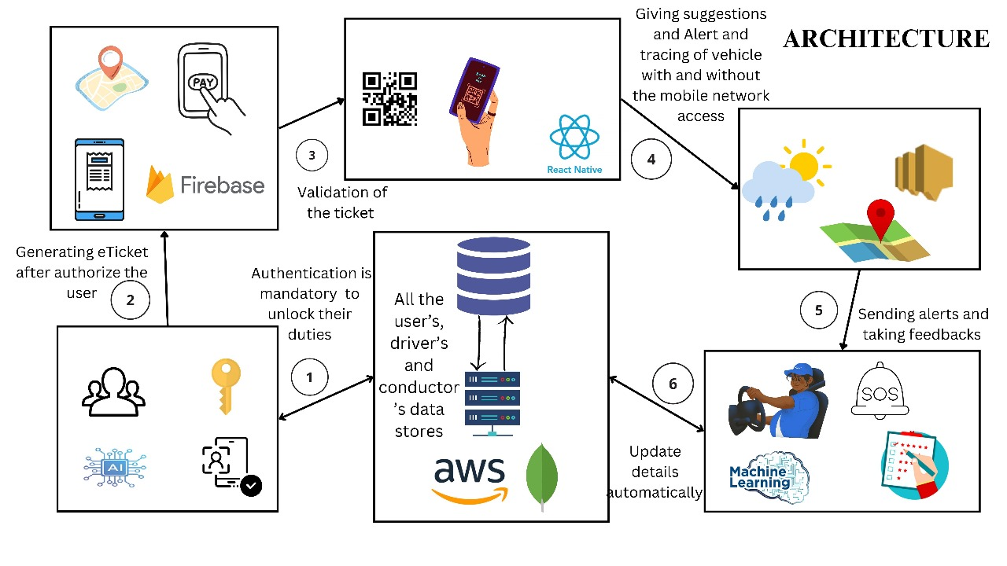






















Idea/Approach Details
An Android and web-based application which provide real-time information to the users regarding the availability of buses, their upcoming timings, seat availability, ticket pricing, desired bus location, and emission compliance.
Provides real-time bus location, number of seats available, ticket fair, bus details, arrival time, and destination times with VLT AIS-140.
AWS SNS, S3, and Route 53 are used for notifications, storage, and DNS service, respectively.
e-Ticket generation via payment gateway.
Employee attendance through facial recognition using Artificial Intelligence (AI)
Add process flow chart or simulated image of prototype or any relevant image related to your idea
Technology stack :
validating the passenger’s QR code
Provide details about driver drowsiness to the conductor using Deep learning (DL).
Warns and suggests to passengers about accident-prone areas using real-time weather data using the Weather API.
Provide a chatbot facility using Natural language processing (NLP).

Slide 3
Idea/Approach Details
Describe your Use Cases here
Describe your Dependencies / Show stopper here
Bus registration
➠ The administrator registers new buses and their details and updates the bus details.
Facial Attendance
➠ Giving the attendance of employees.
➠ Employees get access to the application after they are marked as present.
Bus Tracking
➠ A passenger tracks their desired bus and knows about related data like its arrival time, fare, fuel, consumption, route, bus number, and number of seats available.
e-Ticket generation
➠ The passenger makes payment for an e-ticket after he steps into the bus.
➠ The application generates a QR with a ticket.
Passenger Authentication
➠ Conductors and Ticket checkers scan the QR code and verify the passenger's e-ticket.
Driver drowsiness detection
➠ The application detects the driver's mood and warns the conductor if the driver feels sleepy.
Warnings
➠ The application warns passengers about routes based on the weather conditions.
Recommendations to passengers
➠ The application suggests famous places, hotels, restaurants, and tourist guides to the passengers.
Chat bot
➠ Chatbot facility is integrated in application to solve user queries.
Offline availability
➠ Vehicle tracking is done using the VLT AIS API, which doesn’t require any network connections.
➠ Our website is a Progressive Web App that can be accessed while offline.

Slide 4
Team Member Details
Team Leader Name: Gunti Sathya Priya
Branch : B.Tech Stream : IT Year : III
Team Member 1 Name: Pingili Chandra Shekar Reddy
Branch : B.Tech Stream : IT Year : III
Team Member 2 Name: Cheruku Chandana
Branch : B.Tech Stream : IT Year : III
Team Member 3 Name: Sajja Dileep
Branch : B.Tech Stream : IT Year : III
Team Member 4 Name: Meela Mani Teja
Branch : B.Tech Stream : IT Year : III
Team Member 5 Name: Kadari Bhuvanesh
Branch : B.Tech Stream : IT Year : III
Team Mentor 1 Name: SeethaRam Nagesh
Category : Academic Expertise : AI & ML Domain Experience : 22 years
Team Mentor 2 Name: B.Vikranth
Category : Academic Expertise : Linux Domain Experience : 22 years

