Slide 1



TECHNICAL SEMINAR - 1
MedAi: A Smartwatch-Based Application Framework for the Prediction of Common Diseases Using Machine Learning
Internal Guide
S. Swetha
Assistant Professor, IT Department
Technical Seminar Coordinator
Dr. Sarangam Kodati
Associate Professor, IT Department
Head of the Department
Dr. Bipin Bihari Jayasingh
Professor, IT Department
CH. CHANDANA
21B81A1207

Slide 2
ABSTRACT
Health information technology is one of today’s fastest-growing and most powerful technologies. This technology is used predominantly for predicting illness and obtaining medications quickly because visiting a doctor and performing pathological tests can be time-consuming and expensive. This has prompted many researchers to contribute by developing new disease prediction systems or improving existing ones. This paper presents a smartwatch-based prediction system named ‘MedAi’ for multiple diseases such as ischemic heart disease, hypertension, respiratory disease, hyperthyroidism, hypothyroidism, stroke, myocardial infarction, kidney failure, gallstones, diabetes, dyslipidemia using machine learning algorithms. It comprises three core modules: a prototype smartwatch ‘Sense O’Clock’ equipped with eleven sensors to collect bodily statistics, a machine learning model to analyze the data and make a prediction, and a mobile application to display the prediction result. A dataset consisting of patient bodily statistics was obtained from a local hospital according to ethical guidelines, such as obtaining the prior consent of both patients and doctors. We employ several machine learning algorithms, including Support Vector Machine (SVM), Support Vector Regression (SVR), K-Nearest Neighbor (KNN), Extreme Gradient Boosting (XGBoost), Long Short Term Memory (LSTM), and Random Forest (RF) to investigate the best performing algorithm. Experimentation using our dataset shows that the RF algorithm outperforms other machine learning algorithms such as SVM, KNN, XGBoost, etc., in predicting aforementioned diseases with an accuracy of 99.4%. The system provides full-time assistance to the user by reporting his or her body condition and suggesting requisite remedies. It is a notable addition to early disease prediction systems and can predict multiple disease vulnerabilities before they reach an irrecoverable stage. Finally, we compare our method with the related existing methods.

Slide 3
INTRODUCTION
The paper focuses on the development of a smartwatch-based prediction system named 'MedAi' for multiple diseases using machine learning algorithms.
The motivation behind this system is the need for quick and cost-effective disease prediction and medication, as visiting a doctor and performing pathological tests can be time-consuming and expensive.
System comprises three core modules: a prototype smartwatch called 'Sense O'Clock' equipped with sensors to collect bodily statistics, a machine learning model for data analysis and prediction, and a mobile application to display the prediction results.
It employs various machine learning algorithms, including Support Vector Machine (SVM), Support Vector Regression (SVR), K-Nearest Neighbor (KNN), Extreme Gradient Boosting (XGBoost), Long Short Term Memory (LSTM), and Random Forest (RF), to investigate the best performing algorithm.
'MedAi' not only predicts diseases accurately but also provides continuous assistance by monitoring body condition and suggesting remedies, aiding in early disease detection and prevention .

Slide 4
The major contributions of the proposed system are:
A complete package smartwatch "Sense O'Clock," equipped with eleven sensors for health monitoring with optimal power, is designed.
An optimum algorithm is selected from among several widely used machine learning approaches.
An integrated application framework based on mobile applications and machine learning algorithms is proposed to notify the user of his or her health status.
A machine learning model that provides noticeably higher accuracy (by at least 3-4%) compared to existing works on common disease prediction, which predict only a few common diseases, is presented.

Slide 5
LITERATURE REVIEW
SMART WEARABLES WITH VARIOUS SENSORS
Sivaraj et al. introduced "Medibot," a smartwatch medical chatbot with four sensors and Firebase-based disease prediction. However, its limited sensors and reliance on the Internet were drawbacks. "Sense O'Clock" addresses this with eleven sensors for more accurate predictions.
Lutze et al. focused on smartwatches for elderly health assistance, using branded watches to notify family members of motion changes. The high cost and excessive features were issues. "Sense O'Clock" offers a cost-effective, minimal interface dedicated to disease prediction.
DISEASE PREDICTION USING MACHINE LEARNING METHODS
Arumugam et al. developed a machine learning approach focused on heart disease in diabetic patients using decision tree, naive Bayes, and SVM. "MedAi" expands this by predicting twelve diseases using eight algorithms with higher accuracy.
Alfifian et al. created a system for diabetic patients using BLE-based sensors and machine learning to predict diabetes and blood glucose levels. "MedAi" surpasses this by predicting multiple diseases with better performance.
MOBILE APPLICATIONS FOR HEALTH CARE
Sethi et al. developed a broad symptom-based disease prediction app needing good medical knowledge, unlike "MedAi" which is user-friendly and integrates smartwatch data seamlessly.
Johari et al. proposed a self-checkup app predicting less prevalent diseases with manual user input. "MedAi" automates predictions using real-time smartwatch data.

Slide 6
PROBLEM STATEMENT
The modern healthcare landscape faces significant challenges due to the lack of routine checkups, often hindered by time constraints, financial burdens, and accessibility issues. This leads to delayed diagnosis and treatment of diseases, resulting in increased mortality. There is a pressing need for a comprehensive solution that can facilitate early disease prediction and continuous health monitoring.

Slide 7
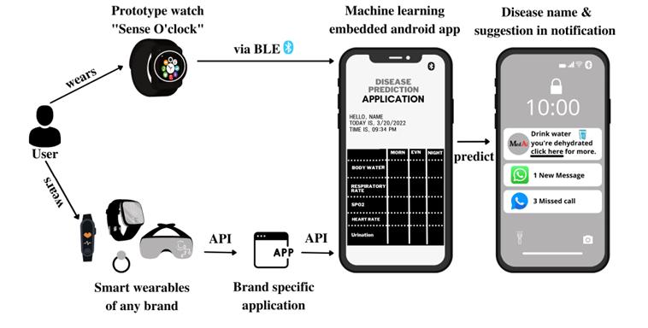
PROPOSED METHODOLOGY & IMPLEMENTATION
A. SYSTEM ARCHITECTURE
The system relies on developing a high-performing machine learning model for accurate disease prediction.
A dataset with records of twelve diseases is partitioned for 5-fold cross-validation to train and test eight algorithms, including Random Forest, SVM, and KNN.
The best model is embedded into a mobile application, which fetches smartwatch data, connects with an API for predictions, and notifies the user with results and suggestions.
This approach ensures efficient and reliable disease prediction.

Slide 8
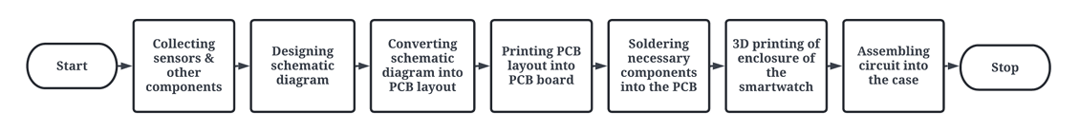
B. ‘‘SENSE O’CLOCK’’ PROTOTYPE WATCH FRAMEWORK
This includes 3 phases namely –
Hardware Implementation phase
Software Implementation phase
Communication phase
1. Hardware Implementation phase

Slide 9
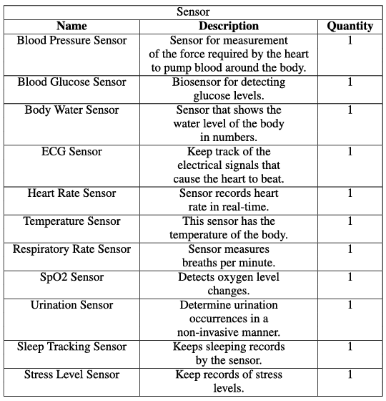
Smartwatch prototype component description (sensors)

Slide 10
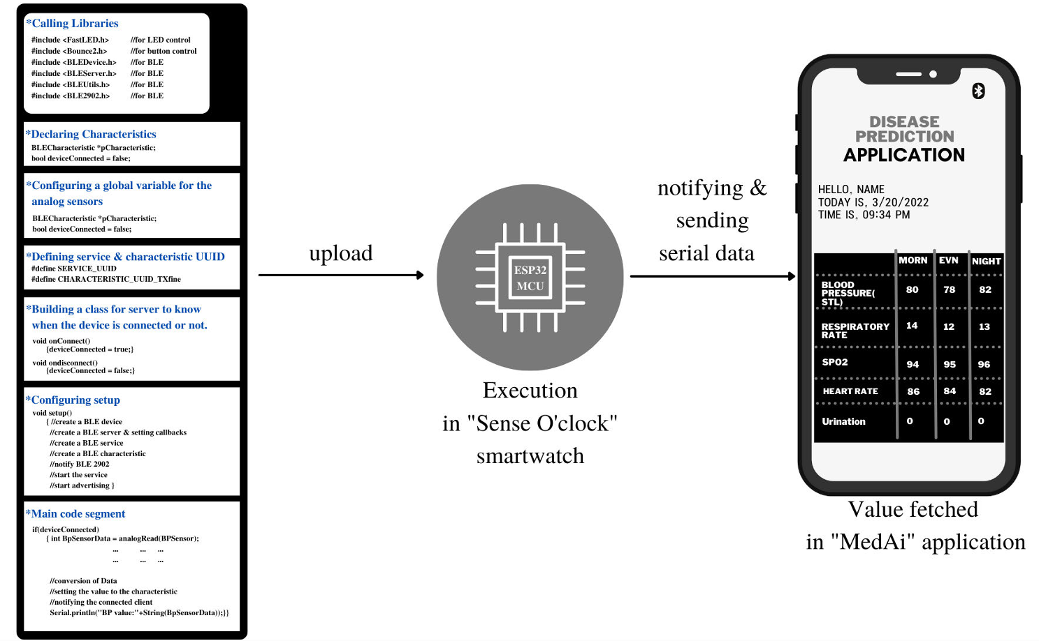
2. Software Implementation phase
The "Sense O'Clock" smartwatch, an IoT device, integrates hardware with software to collect sensor data.
Upon establishing a mobile connection, it uses the BLE component to send raw sensor data to the device.
The "MedAi" application receives this data and processes it via an API.

Slide 11
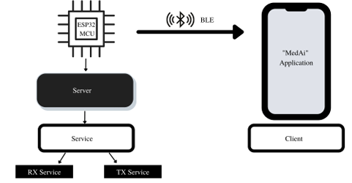
3. Communication phase
The ESP32 MCU integrates WiFi and BLE via SPI/SDIO or I2C/UART, known for robust design and power efficiency. "MedAi" opts for BLE for real-time data to the mobile app for its power efficiency, security, and availability. Unlike Bluetooth, BLE notifies on data changes, ideal for smartwatches. WiFi's cost and accessibility and third-party APIs' privacy concerns are avoided.
WiFi: WiFi is fast and efficient for data transfer but can be costly and lacks widespread availability, especially in less developed countries where internet access might be limited to homes and not public places.
Third-Party API: Free APIs from reputable companies offer data organization and storage but pose significant security risks, making them unsuitable for handling sensitive health information.
BLE: BLE allows ESP to transmit data efficiently with low power consumption, ideal for smartwatches. It uses unique identifiers (UUIDs) for server-client connections, ensuring optimized power usage, enhanced security, and wide availability.

Slide 12
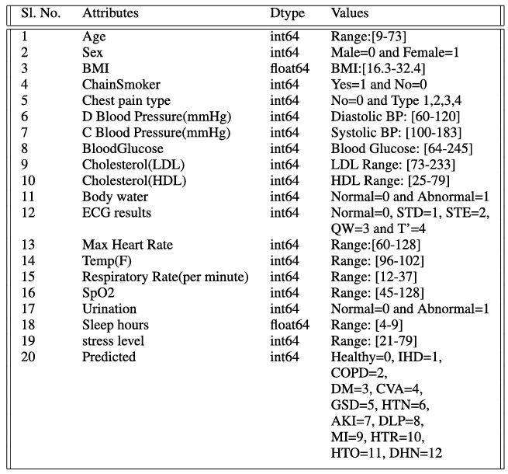
C. MACHINE LEARNING MODEL IMPLEMENTATION
Data Description Table
Data Collection
Attribute Selection
Data Preprocessing
• Data acquisition
• Library import
• Dataset import
• Missing data handling
• Data encoding
• Dataset splitting
• Feature scaling etc.

Slide 13
Implementation of Learning Algorithms
Support Vector Regression: SVR utilizes two kernel functions, namely ‘rbf' and 'linear', to predict continuous values based on a gamma parameter set at 0.1. It aims to minimize Mean Square Error (MSE) and maximize R-squared performance metrics on both training and test datasets.
Support Vector Machine: SVM employs a 'linear' kernel for classifying datasets, focusing on accuracy, precision, and recall measures. It evaluates model performance using confusion matrices, emphasizing accuracy as the primary metric for testing.
K-Nearest Neighbours: KNN involves selecting a parameter K (set at 3 in this study) to determine the number of nearest neighbors contributing to predictions. It measures performance using accuracy, precision, recall, and visualizes results with confusion matrices.
Random Forest Classifier: This classifier utilizes 100 decision trees (n_estimators) to classify data through majority voting. Performance is assessed using metrics like accuracy, precision, and recall, akin to other classification methods.

Slide 14
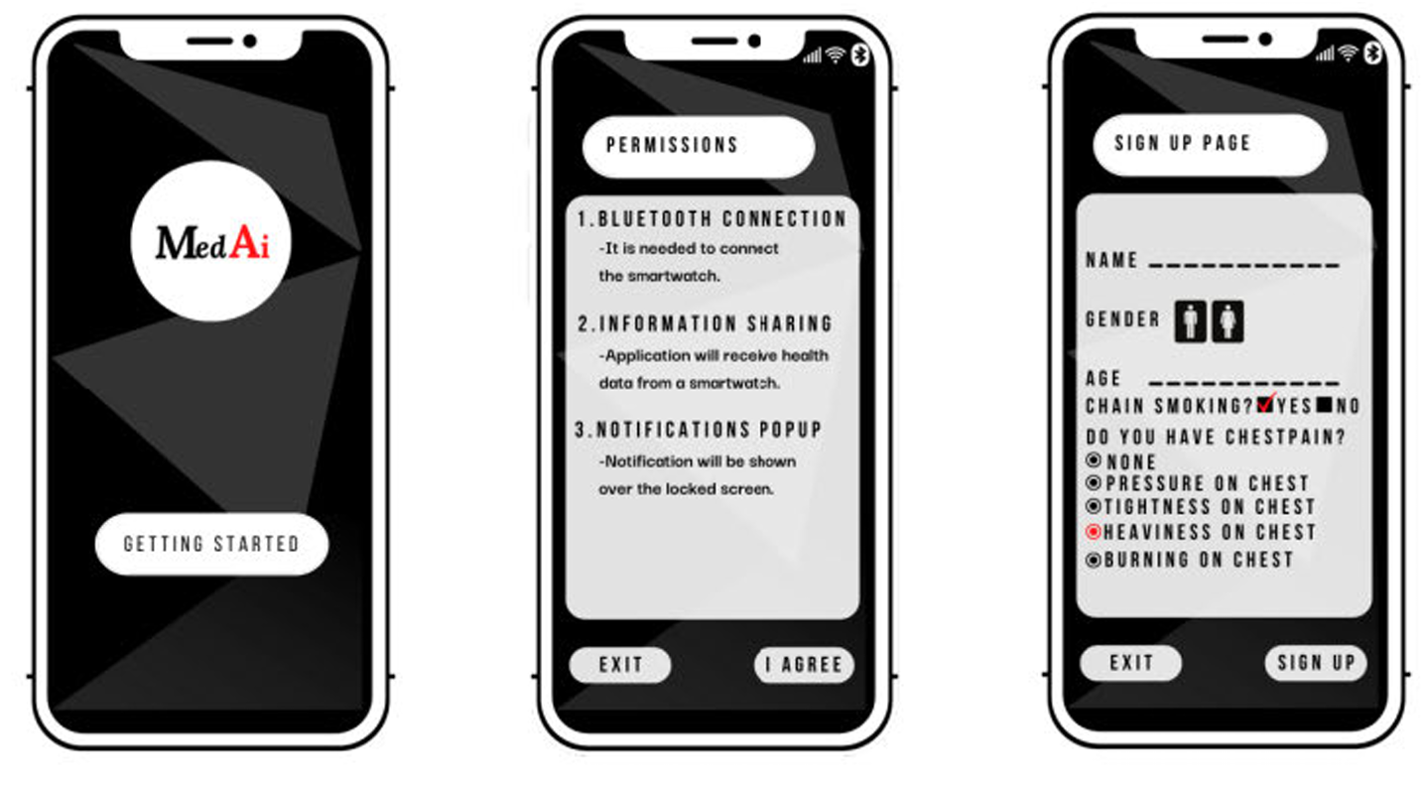
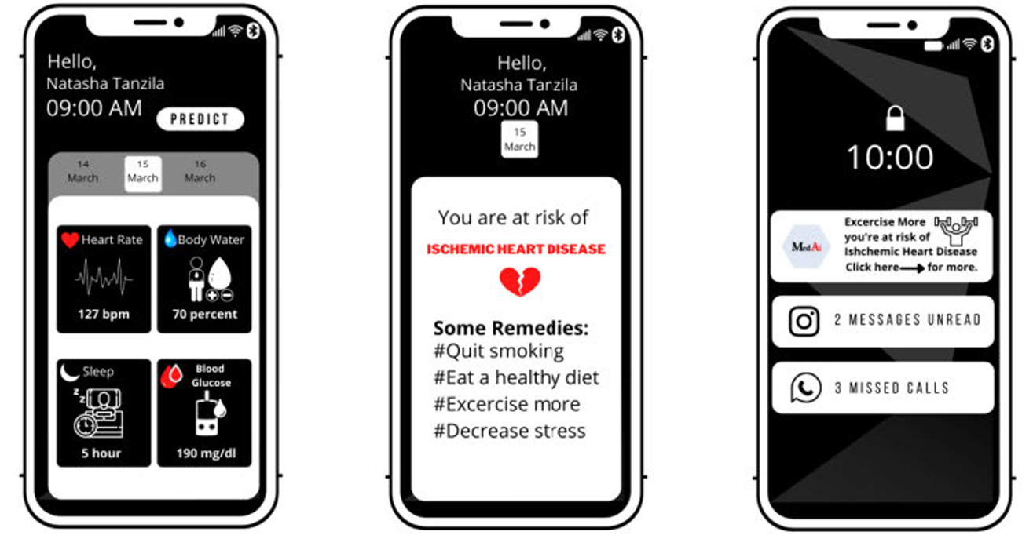
D. DEPLOYMENT OF THE MODEL INTO MOBILE APPLICATION

Slide 15
RESULTS & DISCUSSIONS
PERFORMANCE EVALUATION METRICS
Classification performance metrics used in this study are as follows:
Accuracy: The ratio of the number of correct predictions to the total number of predictions is known as accuracy. (TP+TN)
(TP+FP+FN +TN)
Accuracy =
Precision: The ratio of the number of correctly predicted positives to the total number of positive predictions. Precision is effective in lowering the number of False Positives.
(TP)
(TP+FP)
Precision =
Recall: The ratio of the number of correctly predicted positives to the total number of actual positives.
The recall is particularly useful in reducing the number of False Negatives.
(TP)
(TP+FN)
Recall =
TP = True Positive (Correctly predicted as positive)
TN = True Negative (Correctly predicted as negative)
FP = False Positive (Incorrectly predicted as positive)
FN = False Negative (Incorrectly predicted as negative)
F1-Score: It is equivalent to the harmonic mean of both precision and recall.
Precision × Recall
Precision + Recall
F1-Score = 2 ×

Slide 16
Regression analysis performance measures employed in this study are as follows:
MSE: Mean Square Error defines how close the data points are to the fitted regression line.
1
N
N
∧
2
∑
i=1
(yi – yi)
RMSE: Root Mean Square Error is simply the square root of Mean Square Error.
1
N
√
∑
i=1
∧
2
(yi – yi)
R-Squared: R-squared indicates how much variance in the output / anticipated variable is explained by the input variables.
∧
2
(yi – yi)
2
∑
R
= 1 -
-
2
(yi – yi)
∑

Slide 17
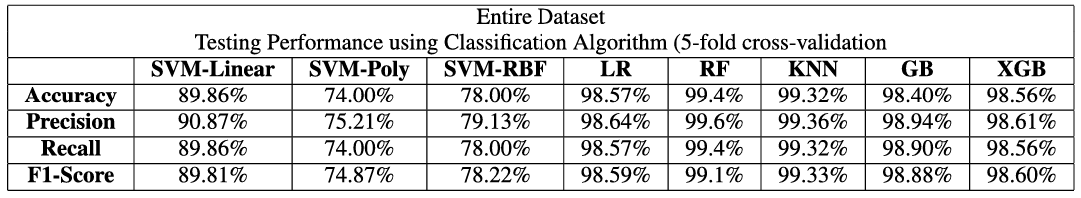
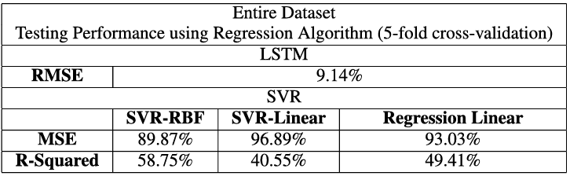
MODEL EVALUATION
Training Performance: The training process suffered no loss, as the datasets had been preprocessed to remove missing values and outliers.
Testing Performance: The outcomes of some of the dataset’s testing on the application of each method will be presented.
Performance evaluation of the entire dataset:
Classification algorithm’s performance
Regression algorithm’s performance
RF algorithm can be seen to outperform all the other algorithms providing 99.4% accuracy on test data.

Slide 18
CONCLUSION & FUTURE ENHANCEMENTS
In this study, the "MedAi" system was developed, encompassing the design of a smartwatch equipped with numerous sensors, the construction of a machine learning model evaluated across eight algorithms, and the proposal of an Android health application capable of predicting twelve different diseases. This system serves as a valuable tool for individuals of all demographics, facilitating proactive health management by identifying early symptoms indicative of serious illnesses, thereby potentially reducing rates of sudden death and undiagnosed terminal diseases. Designed to be cost-effective, energy-efficient, and user-friendly, "MedAi" enables continuous health monitoring and alerts users to significant bodily changes that may signify underlying health issues. The predictive model, leveraging the RF algorithm with an accuracy of 99.4%, validated against real-life patient health datasets, underscores its robustness and reliability.
Future endeavors for "MedAi" include expanding the dataset to enhance predictive capabilities, advancing smartwatch production with the "Sense O'Clock" design, incorporating additional seasonal diseases into its predictive repertoire, and launching the mobile application for widespread accessibility.

Slide 19
REFERENCES
G. Kessler. (2016). Are There Really 10,000 Diseases and Just 500 ‘Cures’?. Accessed: Apr. 1, 2022. [Online]. Available: https://www.washingtonpost.com/news/fact-checker/wp/2016/11/17/are there-really-10000-diseases-and-500-cures/
(2019). Global Burden of Disease (GBD 2019), Institute for Health Metrics and Evaluation. Accessed: Apr. 1, 2022. [Online]. Available: https://www.healthdata.org/gbd/2019
(2022). Health Resources—Health Spending—OECD Data. Accessed: Apr. 1, 2022. [Online]. Available: https://data.oecd.org/healthres/health spending.htm
(2022). Diseases Potentially Acquired by Travel to Southeast Asia. Accessed: Apr. 1, 2022. [Online]. Available: https://www.uptodate.com/contents/diseases-potentially-acquired-by-travel-to-southeast-asia
(2022). Global Health and Fitness app Downloads 2020 | Statista. Accessed: Apr. 1, 2022. [Online]. Available: https://www.statista.com/statistics/1127248/health-fitness-apps downloads-worldwide/
(2022) Digital Around the World—DataReportal—Global Digital Insights. DataReportal-Global Digital Insights. Accessed: Apr. 1, 2022. [Online]. Available: https://datareportal.com/global-digital-overview

Slide 20


