Slide 1
Inside a Neural Network
Six components, one learning loop
Teja Swaroop Cherukuri
AIML-501: Model Development, Indiana Wesleyan University
November 2026
Notes:
This presentation explains the six building blocks of a neural network and shows how they work together when a network learns. Teal connections stand for positive weights and orange for negative weights, the same colors used in the TensorFlow Playground.

Slide 2
How Data Flows Through a Network
Forward pass: data moves left to right
1 Inputs enter
Each feature, such as an x and y coordinate, goes into one input neuron.
2 Hidden layers transform
Each neuron combines weighted inputs and applies an activation function.
3 Output predicts
The last layer gives the answer, which the loss function compares with the truth.
Input layer
x₁, x₂
Hidden layer 1
4 neurons
Hidden layer 2
2 neurons
Output layer
prediction
Source: Google for Developers (2025); network shape from Smilkov & Carter (n.d.).
Notes:
This matches the TensorFlow Playground default network: two input features (X1 and X2), a hidden layer of 4 neurons, a hidden layer of 2 neurons, and one output. Data flows from the input layer, through the hidden layers, to the output layer. During training the error then flows backward to update the weights.

Slide 3
1. Layers
What they are
Groups of neurons that process data in stages. Every network has an input layer, one or more hidden layers, and an output layer.
Why they matter
Each layer builds on the one before it. Early layers find simple patterns; deeper layers combine them into complex ones. More layers can learn harder shapes but take longer to train.
Input
Raw features enter
Hidden
Simple patterns (edges, curves)
Hidden
Combined patterns (shapes)
Output
Final prediction
Source: Google for Developers (2025).
Notes:
Layers are the stages of a network. In the Playground, the plus and minus buttons add or remove hidden layers.

Slide 4
2. Neurons
x₁ = 1.0
w₁ = 0.8
What it is
The basic unit of a network. It takes inputs, does one small calculation, and passes the result on.
How it works
1. Multiply each input by its weight
2. Add them up with a bias
3. Pass the total through an activation function
x₂ = 0.5
Σ → f
0.7
w₂ = −0.4
bias b = 0.1
Worked example
z = (1.0)(0.8) + (0.5)(−0.4) + 0.1 = 0.7
output = ReLU(0.7) = 0.7
Source: Google for Developers (2025). Example values chosen for illustration.
Notes:
A single neuron with two inputs. The worked example uses ReLU, which keeps positive values and turns negative values into zero.

Slide 5
3. Weights
What they are
A number on every connection that controls how strongly one neuron's output affects the next neuron.
Positive vs. negative
A positive weight pushes the next neuron's value up; a negative weight pushes it down. A weight near zero means the connection barely matters.
Why they matter
Weights are what the network learns. Training is the process of adjusting thousands or millions of weights until predictions are accurate.
Teal = positive weight Orange = negative weight Thicker = stronger
Sources: Goodfellow et al. (2016); colors follow Smilkov & Carter (n.d.). Network weights are illustrative.
Notes:
The colors match the TensorFlow Playground, where blue-teal lines are positive weights and orange lines are negative weights, and line thickness shows strength. The network drawn here is illustrative; its weights are not from a trained model.

Slide 6
4. Activation Functions
max(0, x). Fast and the most common choice for hidden layers.
Squeezes any value into 0 to 1. Useful for probabilities.
Squeezes values into −1 to 1. The Playground default.
Output equals input. With only linear activations, many layers act like one.
Curves calculated from each formula. Activations add the non-linearity that lets networks learn curved boundaries. Source: Google for Developers (2025).
Notes:
Each chart is calculated from the function's formula for inputs from -3 to 3. Without a non-linear activation, stacking layers adds no extra power, because a chain of linear steps is still linear.

Slide 7
5. Loss Functions
What they are
A formula that scores how wrong a prediction is. Training tries to make this number as small as possible.
Two common types
Mean squared error (MSE): average of (prediction − truth)². Used for predicting numbers.
Cross-entropy: −ln(probability given to the correct answer). Used for classification.
Values calculated as −ln(p); loss grows fast when the model is confidently wrong. Source: Goodfellow et al. (2016).
Notes:
The bar values are calculated: -ln(0.9) = 0.105, -ln(0.6) = 0.511, and -ln(0.2) = 1.609. The TensorFlow Playground shows training loss and test loss in the top right while the model trains.

Slide 8
6. Optimization Algorithms
What they are
Methods that adjust the weights to reduce the loss, one small step at a time.
Gradient descent
Finds which direction lowers the loss and moves each weight a little that way. The step size is the learning rate.
Learning rate matters
At 0.3 the loss falls from 9.00 to 0.01 in four steps. At 1.1 each step overshoots and the loss grows to 38.70.
Common optimizers
SGD and Adam. Adam adapts the step size for each weight automatically.
Sources: Goodfellow et al. (2016); Kingma & Ba (2015). Chart values calculated, not measured.
Notes:
The chart values are calculated by hand-coded gradient descent on a one-weight loss L(w) = (w - 3)^2, starting at w = 0. With learning rate 0.3 the loss goes 9.00, 1.44, 0.23, 0.04, 0.01. With learning rate 1.1 it goes 9.00, 12.96, 18.66, 26.87, 38.70 because each step overshoots the minimum.

Slide 9
The Learning Loop
1
2
3
4
Forward pass
Inputs flow through layers. Neurons apply weights and activation functions.
Measure loss
The loss function compares the prediction with the correct answer.
Backpropagation
The error is traced backward to find how much each weight caused it.
Update weights
The optimizer nudges every weight to reduce the loss.
Repeat for every batch of data. One pass through all the training data is called an epoch.
Source: Google for Developers (2025).
Notes:
All six components work together in this loop. The Playground's Epoch counter shows how many times the loop has gone through the full training data.

Slide 10
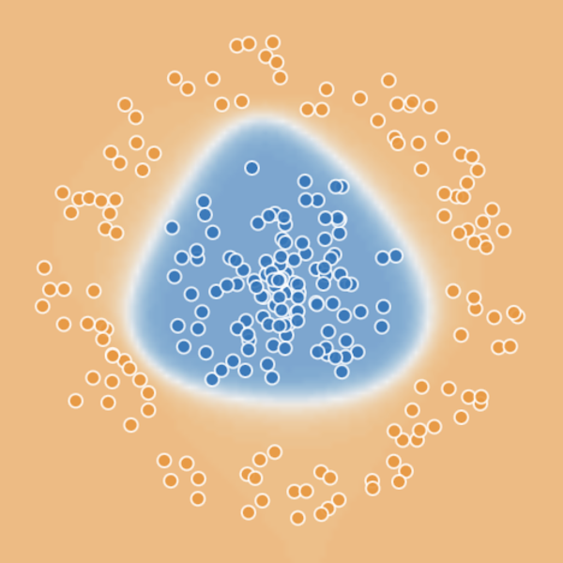
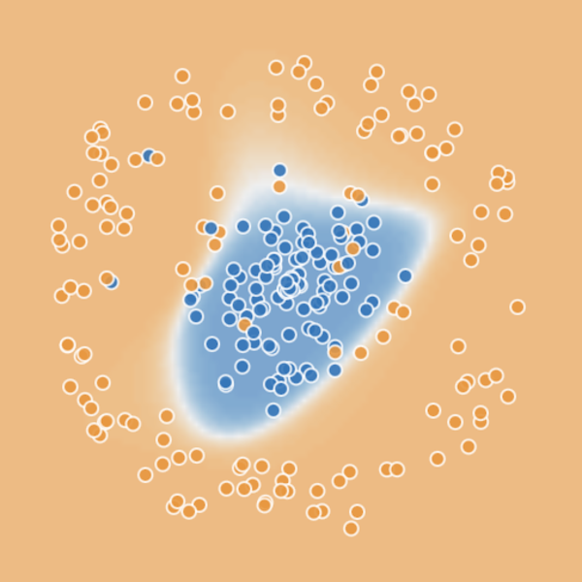
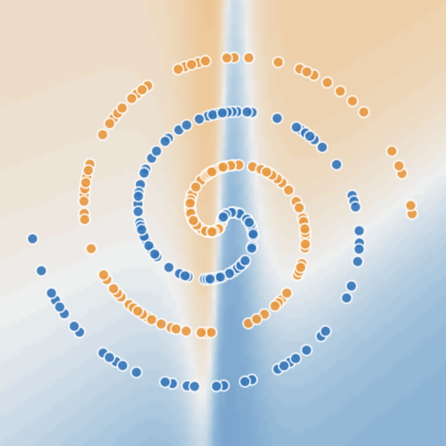
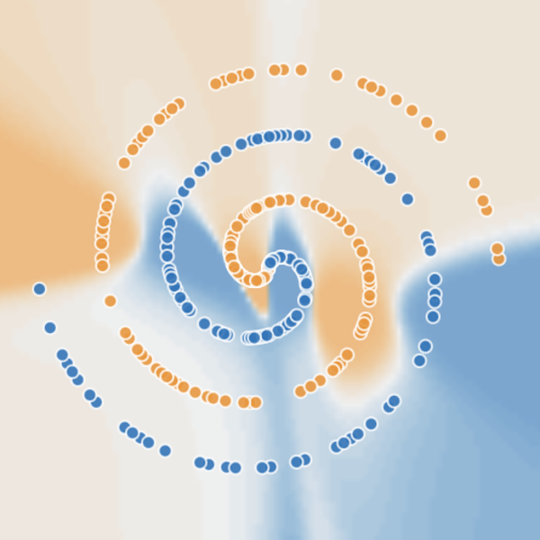
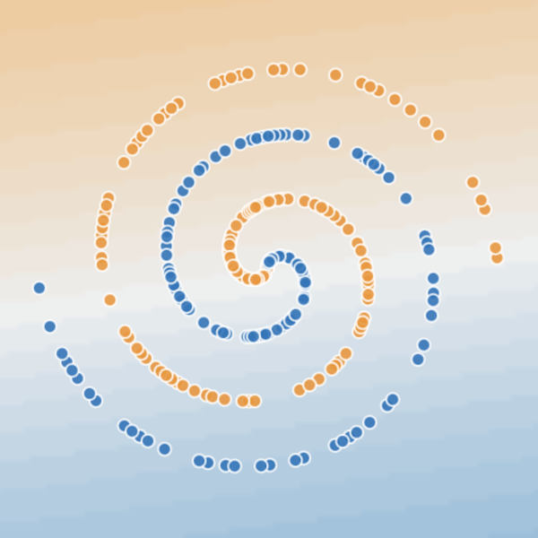
My Playground Experiments
Run | Dataset | Noise | Hidden layers | Activation | Epoch | Training loss | Test loss
1 | Circle | 0 | 4, 2 | Tanh | 311 | 0.003 | 0.004
2 | Circle | 30 | 4, 2 | Tanh | 311 | 0.089 | 0.182
3a | Spiral | 0 | 4, 2 | Tanh | 524 | 0.409 | 0.452
3b | Spiral | 0 | 6, 6, 6, 6 | Tanh | 512 | 0.275 | 0.295
4 | Spiral | 0 | 4, 2 | Linear | 327 | 0.470 | 0.474
All runs: learning rate 0.03, batch size 10, 50% training data, no regularization, inputs X₁ and X₂, classification.
Run 1
Test loss 0.004
Run 2
Test loss 0.182
Run 3a
Test loss 0.452
Run 3b
Test loss 0.295
Run 4
Test loss 0.474
Notes:
These are my own runs in the TensorFlow Playground. Each image is the Output panel from my screenshot of that run: orange and blue dots are the two classes, and the background shows what the network predicts for each point. Loss values are copied from the Test loss and Training loss readouts in each screenshot.

Slide 11
What My Experiments Showed
Noise widens the gap
Adding 30% noise raised test loss from 0.004 to 0.182, about twice its training loss (0.089). The network partly learned the noise.
Harder data needs more capacity
On the spiral, 4 layers of 6 neurons cut test loss from 0.452 to 0.295 at a similar epoch (512 vs. 524).
Activations create the curves
With Linear activation the network could only draw a straight boundary through the spiral. Test loss 0.474 was the worst of all runs.
Bigger is slower and bumpier
The 24-neuron network's loss curve became jagged late in training, so more capacity also needs more care.
Notes:
All values come from my Playground screenshots. Run 1: Circle, no noise. Run 2: Circle, 30% noise. Run 3a: Spiral with the default 4-2 network. Run 3b: Spiral with four hidden layers of 6 neurons. Run 4: Spiral with Linear activation. Each run used learning rate 0.03 and batch size 10.

Slide 12
Summary
0.004
Why visualizing networks matters
Seeing data flow, weights, and the decision boundary turns abstract math into something you can check with your own eyes.
Key insights
All six components work as one learning loop.
The right size network depends on the data.
Non-linear activations are what make curved boundaries possible.
Always compare test loss with training loss.
Test loss on the clean circle
0.452 → 0.295
Spiral test loss with a bigger network
0.474
Spiral test loss with Linear activation
Notes:
The three numbers come from my own Playground runs: run 1, runs 3a and 3b, and run 4.

Slide 13
References
Goodfellow, I., Bengio, Y., & Courville, A. (2016). Deep learning. MIT Press. https://www.deeplearningbook.org/
Google for Developers. (2025, August 25). Neural networks. Machine Learning Crash Course. https://developers.google.com/machine-learning/crash-course/neural-networks
Kingma, D. P., & Ba, J. (2015). Adam: A method for stochastic optimization. In Proceedings of the 3rd International Conference on Learning Representations. https://arxiv.org/abs/1412.6980
Smilkov, D., & Carter, S. (n.d.). A neural network playground [Online tool]. TensorFlow. Retrieved November 7, 2026, from https://playground.tensorflow.org/
Notes:
All sources are cited on the slides where they are used.

