Slide 1

U of T Computer Graphics Club: Handwriting to Text
Based on the tutorial on https://nordicapis.com/digitize-your-notes-with-microsoft-vision-api/
Slides by Cheryl Lao

Slide 2
Things you should have installed:
Python 3.6
Git (optional but will make getting the example file easier)
Notes:
Mention that you have the completed code
-Add a link to where you can download that
-

Slide 3
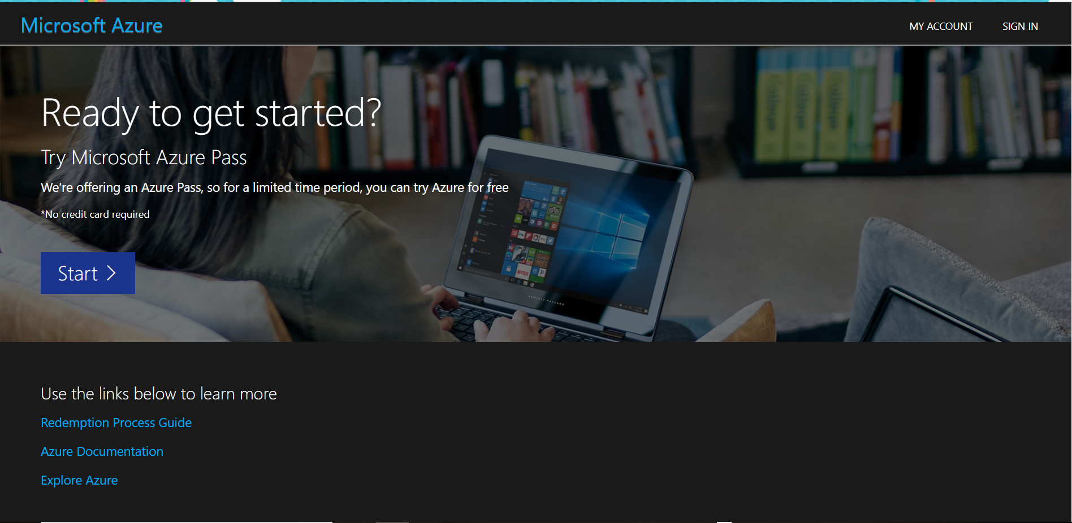
Notes:
Sign in using your email

Slide 4
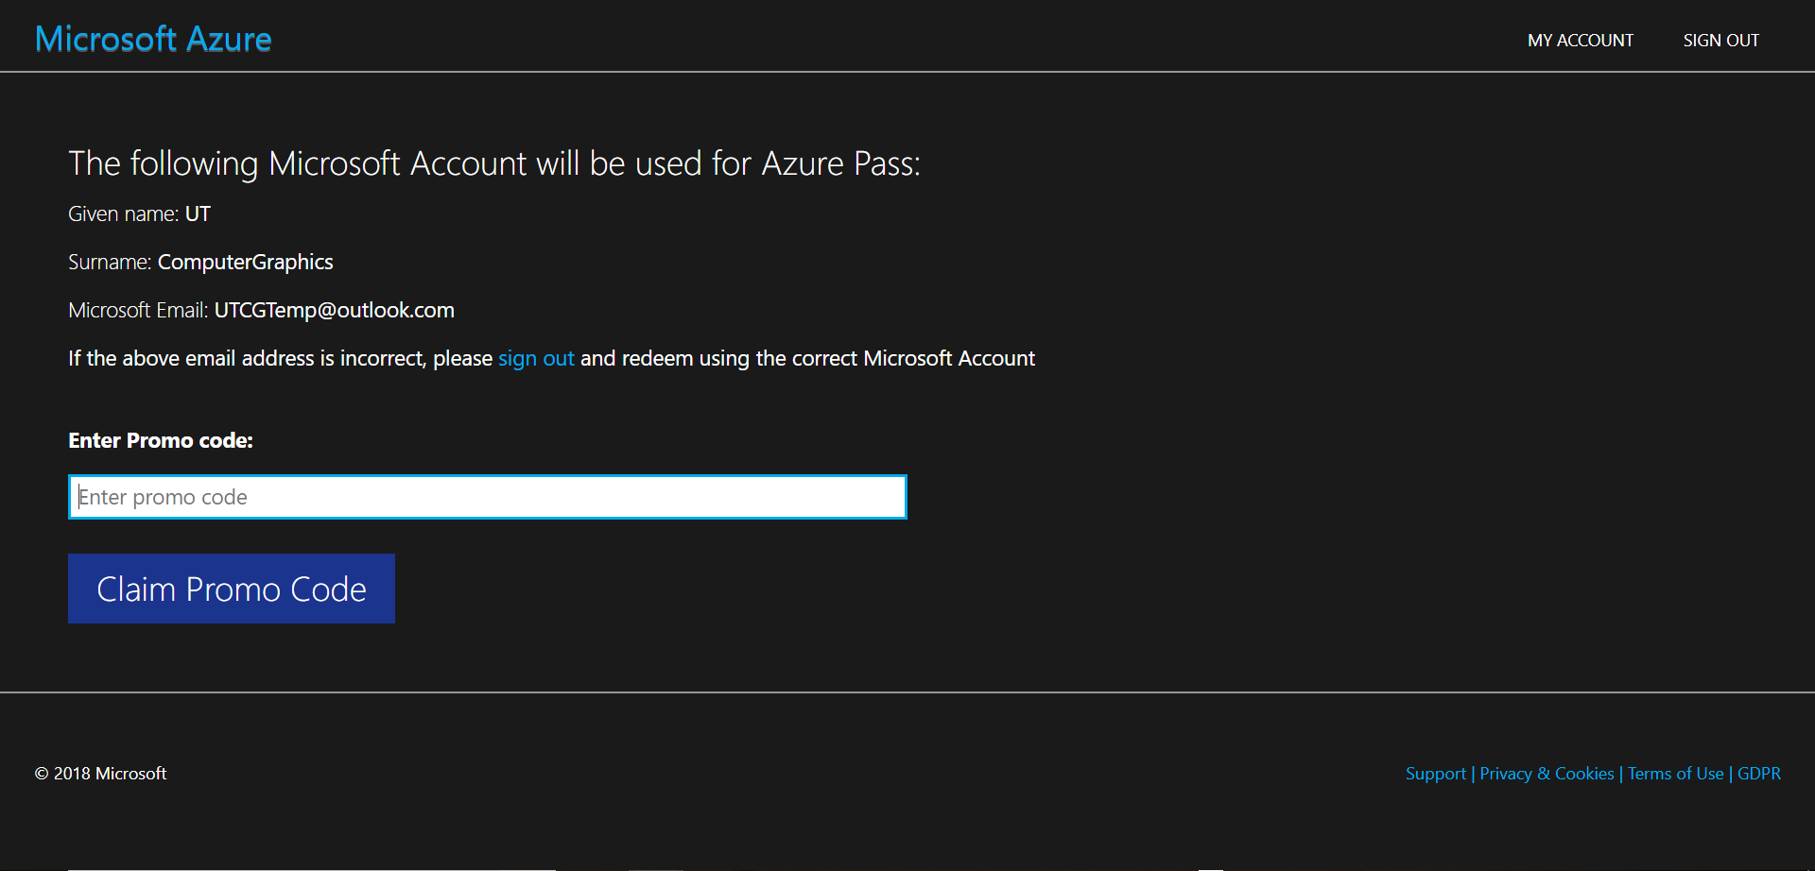

Slide 5
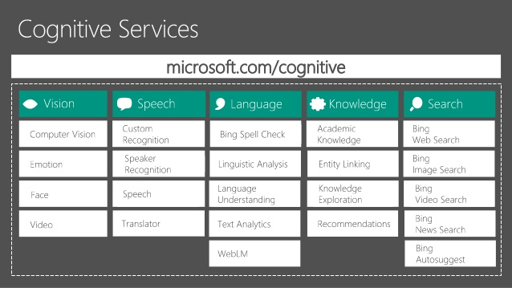
https://azure.microsoft.com/en-us/services/cognitive-services/computer-vision/
Image from Sage Franch’s presentation: https://www.slideshare.net/SageFranch/building-intelligence-with-microsoft-cognitive-services

Slide 6
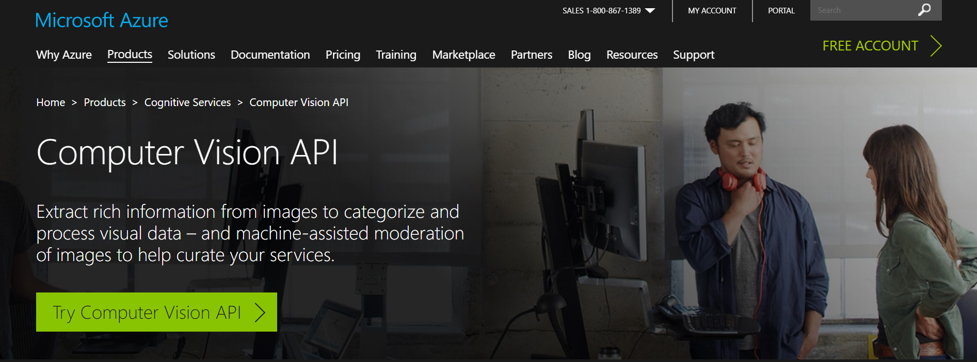
Microsoft’s Computer Vision API
https://azure.microsoft.com/en-us/services/cognitive-services/computer-vision/

Slide 7
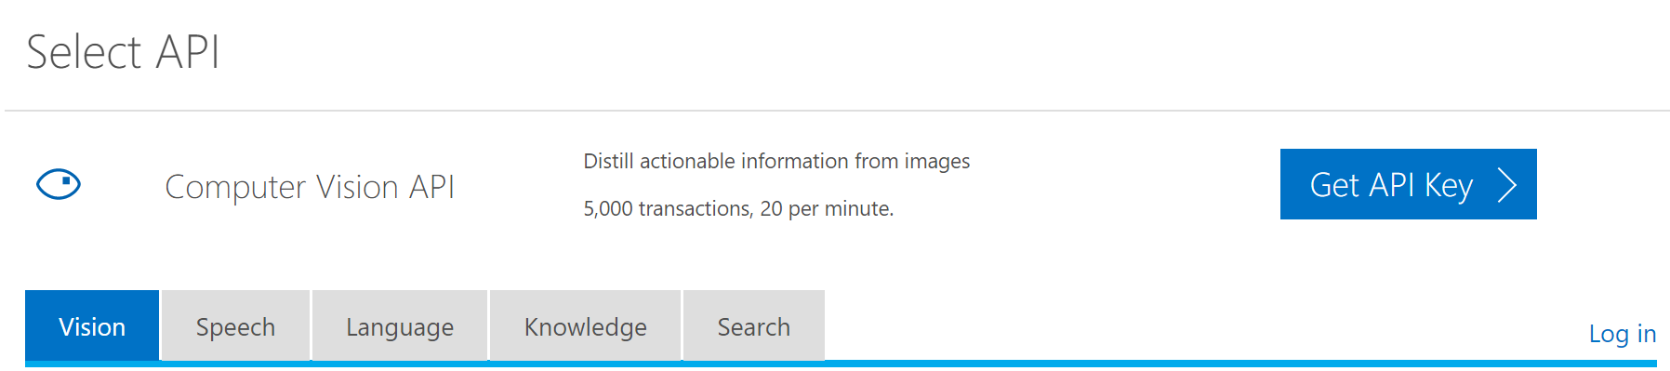
Microsoft’s Computer Vision API
https://azure.microsoft.com/en-us/services/cognitive-services/computer-vision/
Log in and write down the url and key!
Notes:
Now it’s time to redeem your Azure passes!!
Azure passes don’t work if you’ve used that email for a pass before!!
Make sure the link matches your region

Slide 8
Git repo for this project
Git repo link: https://github.com/Cheryl-Lao/HandwritingParser.git
Copy and paste the script from that location directly into a .py file on your computer OR:
Go to your command line
Go to the directory where you want to save the project (cd <subdirectory name>)
To copy the entire repository: git clone <url>
The folder that you get will have the completed project inside. Try to follow along without the completed code though!
Notes:
One version with completed code and one version with a skeleton of it

Slide 9
Importing necessary packages

Slide 10
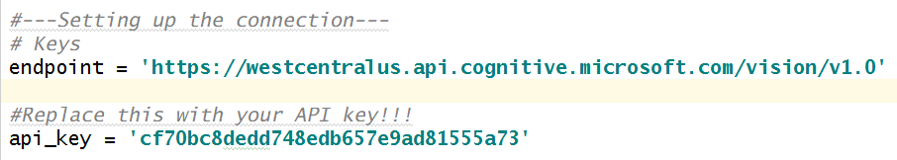
Recording the API key
Replace the api_key with the key that you get when you log in!!!

Slide 11
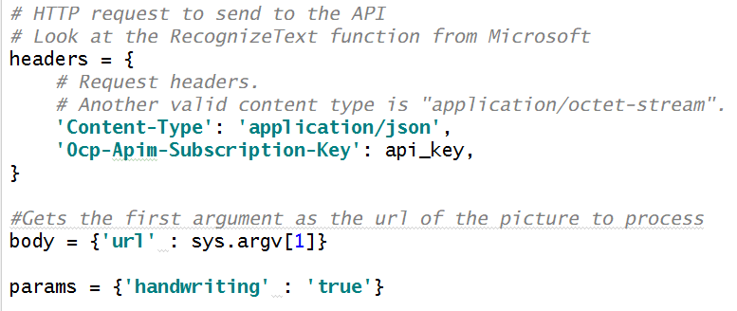
Setting up the http connection
Notes:
If you set params = false, it’ll use OCR to try to identify the text (which is NOT what we want for handwritten text)

Slide 12
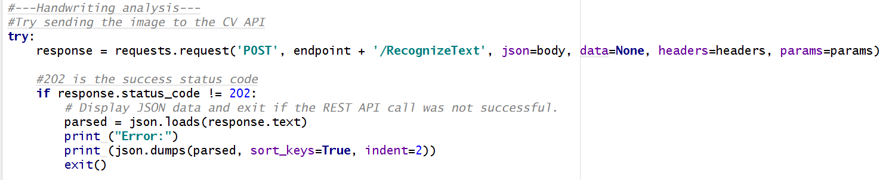
Error checking
Notes:
This error checking is a best practice
The response line is making the request to the API using the parameters that you just gave it

Slide 13
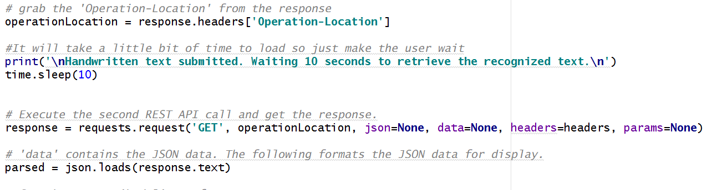
Sending the api request

Slide 14
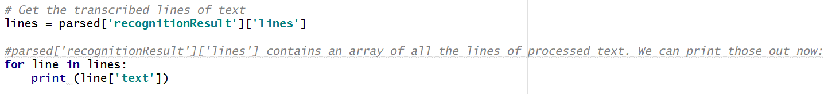
Printing the lines that you’re getting from the api (optional)

Slide 15
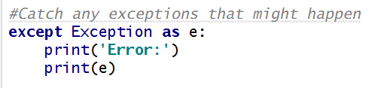
Catch any errors that may have happened

Slide 16
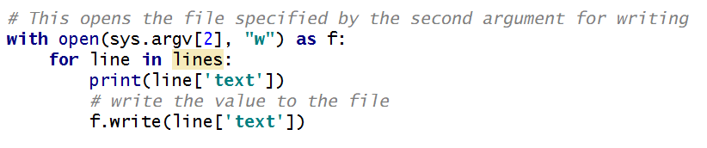
Write to a Text file

Slide 17
Running the script:
Use the command line to go to the directory where your file is stored:
(Use cd <subfolder name> to go into a subfolder)
python <script name> <image URL> <file to write to>

Slide 18
Image limitations
Supports: JPEG, PNG, BMP
Image file must be less than 4MB
Dimensions must be at least 40px X 40px, at most 3200px X 3200px
Only available in English

Slide 19

Any Questions/Concerns/ideas?

Slide 20
More resources

Slide 21



Thanks for coming!
utcomputergraphics@gmail.com
UTCG University of Toronto Computer Graphics Club (All of our updates are here!!!)
utcg.club
The original tutorial that this workshop was based on: https://nordicapis.com/digitize-your-notes-with-microsoft-vision-api/
Slides by Cheryl Lao

